Slide 1
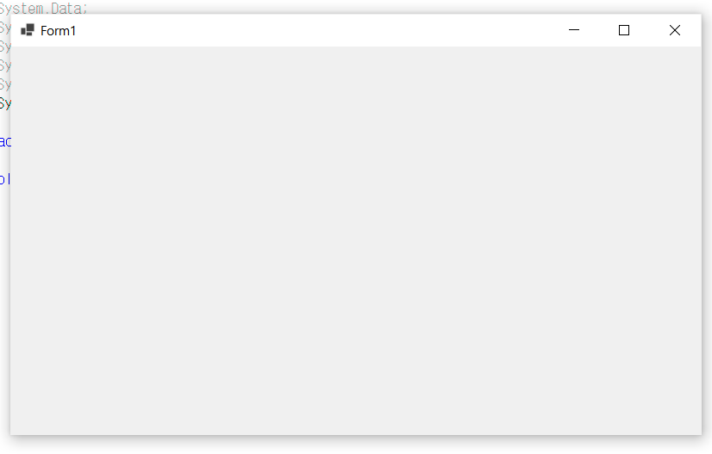
using System;
using System.Collections.Generic;
using System.Linq;
using System.Threading.Tasks;
using System.Windows.Forms;
namespace HelloForm
{
static class Program
{
/// <summary>
/// The main entry point for the application.
/// </summary>
[STAThread]
static void Main()
{
Application.SetHighDpiMode(HighDpiMode.SystemAware);
Application.EnableVisualStyles();
Application.SetCompatibleTextRenderingDefault(false);
Application.Run(new Form1());
}
}
}

Slide 2
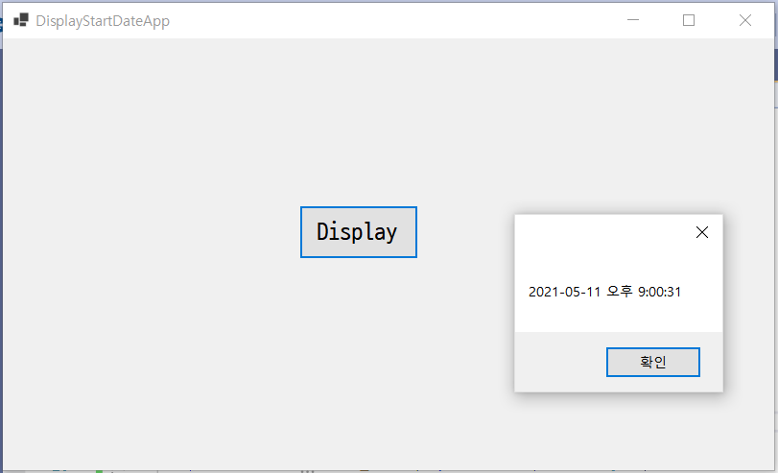
using System;
using System.Collections.Generic;
using System.ComponentModel;
using System.Data;
using System.Drawing;
using System.Linq;
using System.Text;
using System.Threading.Tasks;
using System.Windows.Forms;
namespace HelloForm
{
public partial class Form1 : Form
{
public Form1()
{
InitializeComponent();
startDateTime = DateTime.Now;
}
DateTime startDateTime;
public DateTime GetStartDateTime()
{
return startDateTime;
}
private void button1_Click(object sender, EventArgs e)
{
MessageBox.Show(GetStartDateTime().ToString());
}
}
}

Slide 3
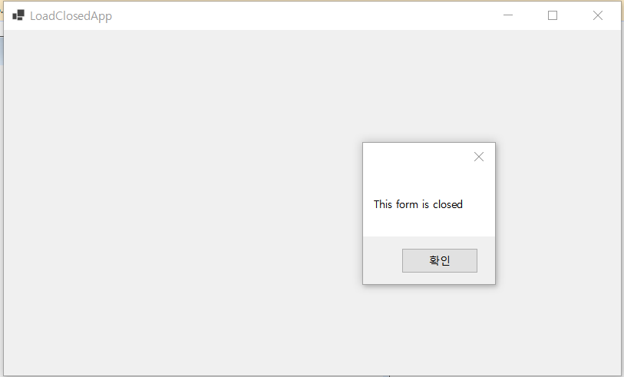
using System;
using System.Collections.Generic;
using System.ComponentModel;
using System.Data;
using System.Drawing;
using System.Linq;
using System.Text;
using System.Threading.Tasks;
using System.Windows.Forms;
namespace HelloForm
{
public partial class Form1 : Form
{
public Form1()
{
InitializeComponent();
}
private void Form1_Load(object sender, EventArgs e)
{
MessageBox.Show("This form is loaded");
}
private void Form1_FormClosed(object sender, FormClosedEventArgs e)
{
MessageBox.Show("This form is closed");
}
}
}

Slide 4
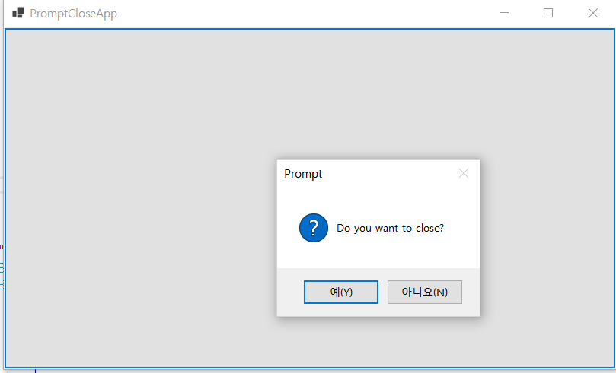
using System;
using System.Collections.Generic;
using System.ComponentModel;
using System.Data;
using System.Drawing;
using System.Linq;
using System.Text;
using System.Threading.Tasks;
using System.Windows.Forms;
namespace HelloForm
{
public partial class Form1 : Form
{
public Form1()
{
InitializeComponent();
}
private void Form1_FormClosing(object sender, FormClosingEventArgs e)
{
if (MessageBox.Show("Do you want to close?",
"Prompt",
MessageBoxButtons.YesNo,
MessageBoxIcon.Question) == DialogResult.Yes)
{
e.Cancel = false;
}
else
{
e.Cancel = true;
}
}
private void button1_Click(object sender, EventArgs e)
{
Close();
}
}
}

Slide 5
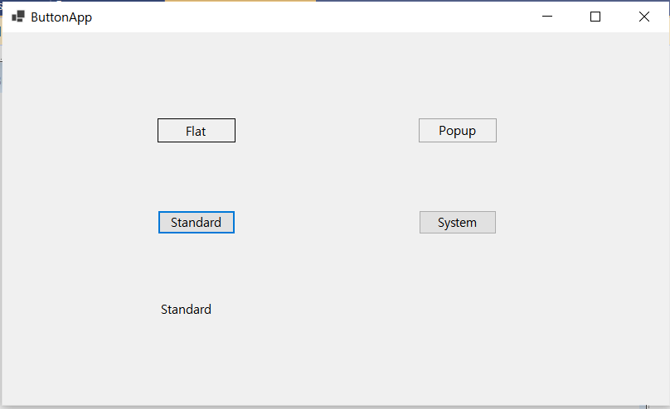
using System;
using System.Collections.Generic;
using System.ComponentModel;
using System.Data;
using System.Drawing;
using System.Linq;
using System.Text;
using System.Threading.Tasks;
using System.Windows.Forms;
namespace HelloForm
{
public partial class Form1 : Form
{
public Form1()
{
InitializeComponent();
}
private void button1_Click_1(object sender, EventArgs e)
{
label1.Text = FlatStyle.Flat.ToString();
}
private void button2_Click(object sender, EventArgs e)
{
label1.Text = FlatStyle.Popup.ToString();
}
private void button3_Click(object sender, EventArgs e)
{
label1.Text = FlatStyle.Standard.ToString();
}
private void button4_Click(object sender, EventArgs e)
{
label1.Text = FlatStyle.System.ToString();
}
}
}

Slide 6
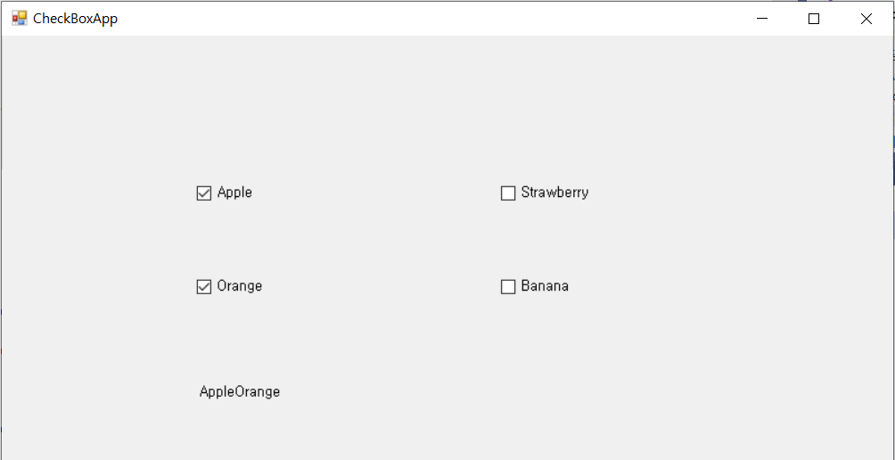
using System;
using System.Collections.Generic;
using System.ComponentModel;
using System.Data;
using System.Drawing;
using System.Linq;
using System.Text;
using System.Threading.Tasks;
using System.Windows.Forms;
namespace HelloForm
{
public partial class Form1 : Form
{
public Form1()
{
InitializeComponent();
}
private void UpdateLabel(string s, bool b)
{
if (b)
{
label1.Text += s; // label1의 Text 프로퍼티에 문자열 추가
}
else
{
string strTemp = label1.Text;
int i = strTemp.IndexOf(s);
label1.Text = strTemp.Remove(i, s.Length);
}
}
private void checkBox1_CheckedChanged(object sender, EventArgs e)
{
UpdateLabel(checkBox1.Text, checkBox1.Checked);
}
private void checkBox2_CheckedChanged(object sender, EventArgs e)
{
UpdateLabel(checkBox2.Text, checkBox2.Checked);
}
private void checkBox3_CheckedChanged(object sender, EventArgs e)
{
UpdateLabel(checkBox3.Text, checkBox3.Checked);
}
private void checkBox4_CheckedChanged(object sender, EventArgs e)
{
UpdateLabel(checkBox4.Text, checkBox4.Checked);
}
}
}

Slide 7
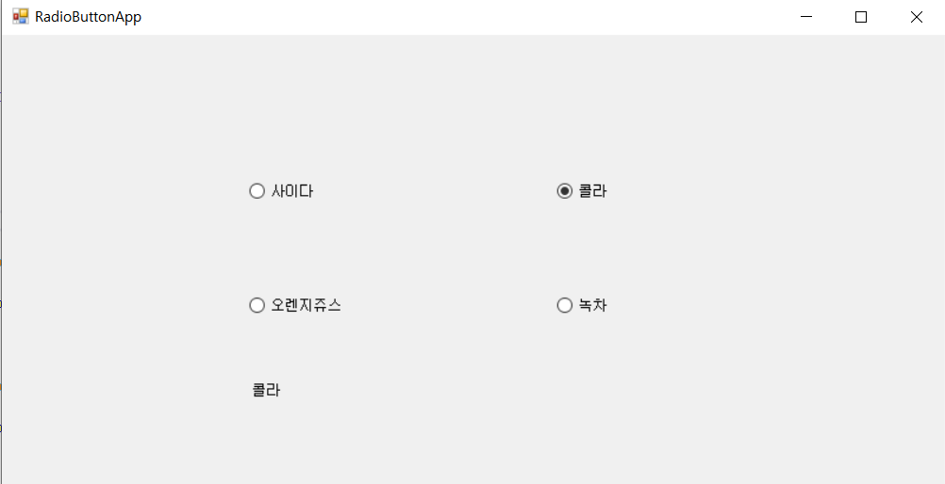
using System;
using System.Collections.Generic;
using System.ComponentModel;
using System.Data;
using System.Drawing;
using System.Linq;
using System.Text;
using System.Threading.Tasks;
using System.Windows.Forms;
namespace HelloForm
{
public partial class Form1 : Form
{
public Form1()
{
InitializeComponent();
}
private void radioButton1_CheckedChanged(object sender, EventArgs e)
{
label1.Text = radioButton1.Text;
}
private void radioButton2_CheckedChanged(object sender, EventArgs e)
{
label1.Text = radioButton2.Text;
}
private void radioButton3_CheckedChanged(object sender, EventArgs e)
{
label1.Text = radioButton3.Text;
}
private void radioButton4_CheckedChanged(object sender, EventArgs e)
{
label1.Text = radioButton4.Text;
}
}
}

Slide 8
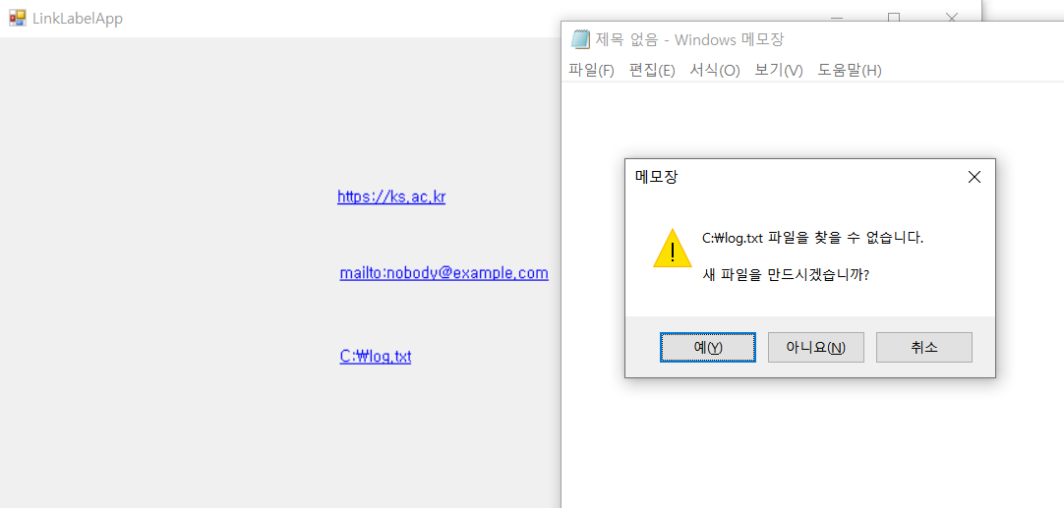
using System;
using System.Collections.Generic;
using System.ComponentModel;
using System.Data;
using System.Drawing;
using System.Linq;
using System.Text;
using System.Threading.Tasks;
using System.Windows.Forms;
using System.Diagnostics;
namespace HelloForm
{
public partial class Form1 : Form
{
public Form1()
{
InitializeComponent();
}
private void linkLabel1_LinkClicked(object sender, LinkLabelLinkClickedEventArgs e)
{
Process.Start(linkLabel1.Text);
}
private void linkLabel2_LinkClicked(object sender, LinkLabelLinkClickedEventArgs e)
{
Process.Start(linkLabel1.Text);
}
private void Form1_Load(object sender, EventArgs e)
{
Process.Start("Notepad.exe", linkLabel3.Text);
}
}
}

Slide 9
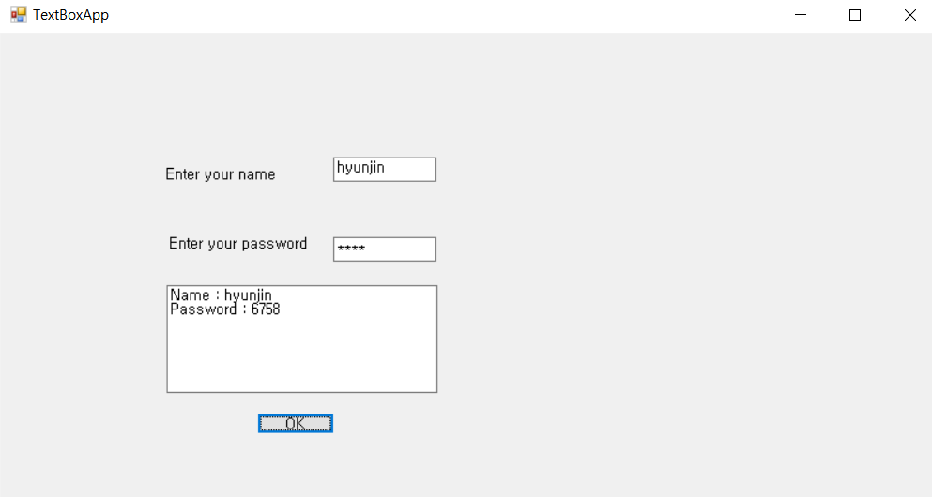
using System;
using System.Collections.Generic;
using System.ComponentModel;
using System.Data;
using System.Drawing;
using System.Linq;
using System.Text;
using System.Threading.Tasks;
using System.Windows.Forms;
using System.Diagnostics;
namespace HelloForm
{
public partial class Form1 : Form
{
public Form1()
{
InitializeComponent();
}
private void button1_Click(object sender, EventArgs e)
{
textBox3.Text = "Name : " + textBox1.Text +
"\r\nPassword : " + textBox2.Text;
}
}
}

Slide 10
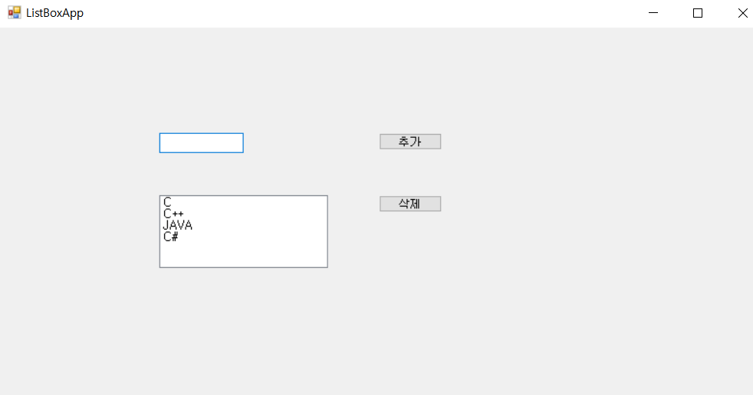
using System;
using System.Collections.Generic;
using System.ComponentModel;
using System.Data;
using System.Drawing;
using System.Linq;
using System.Text;
using System.Threading.Tasks;
using System.Windows.Forms;
using System.Diagnostics;
namespace HelloForm
{
public partial class Form1 : Form
{
public Form1()
{
InitializeComponent();
}
private void button1_Click(object sender, EventArgs e)
{
if (textBox1.Text != "")
{ //리스트 상자 추가
listBox1.Items.Add(textBox1.Text);
textBox1.Text = "";
}
}
private void button2_Click(object sender, EventArgs e)
{
if (listBox1.SelectedIndex > -1)
listBox1.Items.RemoveAt(listBox1.SelectedIndex);
//리스트 상자의 선택된 항목을 제거
}
}
}

Slide 11
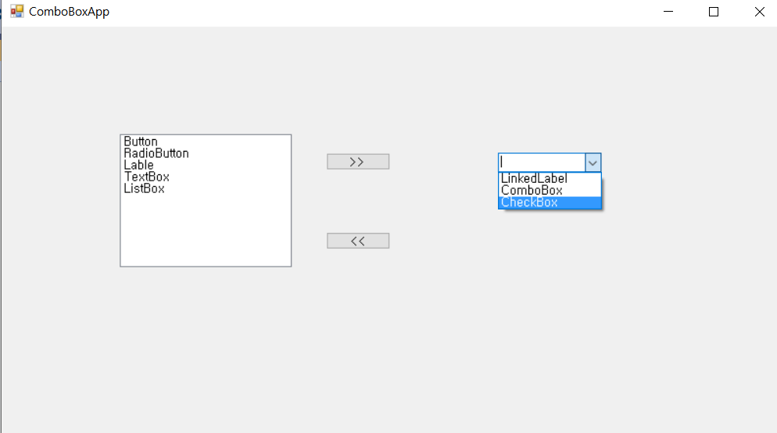
using System;
using System.Windows.Forms;
namespace HelloForm
{
public partial class Form1 : Form
{
public Form1()
{
InitializeComponent();
}
private void button1_Click(object sender, EventArgs e)
{
if (listBox1.SelectedItem != null)
{
//리스트 상자의 선택 항목을 콤보 상자에 추가
comboBox1.Items.Add(listBox1.SelectedItem);
//리스트 상자에서 선택 항목을 삭제
listBox1.Items.Remove(listBox1.SelectedItem);
}
}
private void button2_Click(object sender, EventArgs e)
{
if (comboBox1.SelectedItem != null)
{
//리스트 상자의 선택 항목을 콤보 상자에 추가
listBox1.Items.Add(comboBox1.SelectedItem);
//리스트 상자의 선택 항목을 삭제
comboBox1.Items.Remove(comboBox1.SelectedItem);
}
}
}
}

Slide 12
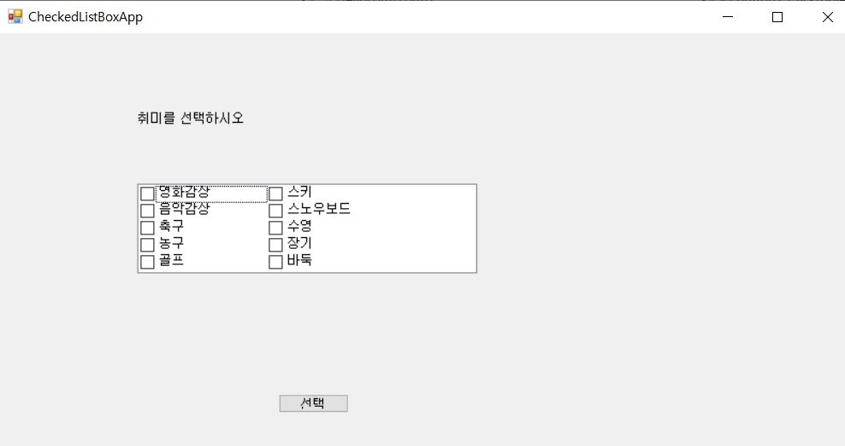
using System;
using System.Windows.Forms;
namespace HelloForm
{
public partial class Form1 : Form
{
public Form1()
{
InitializeComponent();
}
private void button1_Click(object sender, EventArgs e)
{
string strTemp = "";
foreach (object obj in checkedListBox1.CheckedItems)
{
strTemp += obj.ToString();
strTemp += " ";
}
MessageBox.Show("당신의 취미는 " + strTemp + "입니다.");
}
}
}

Slide 13
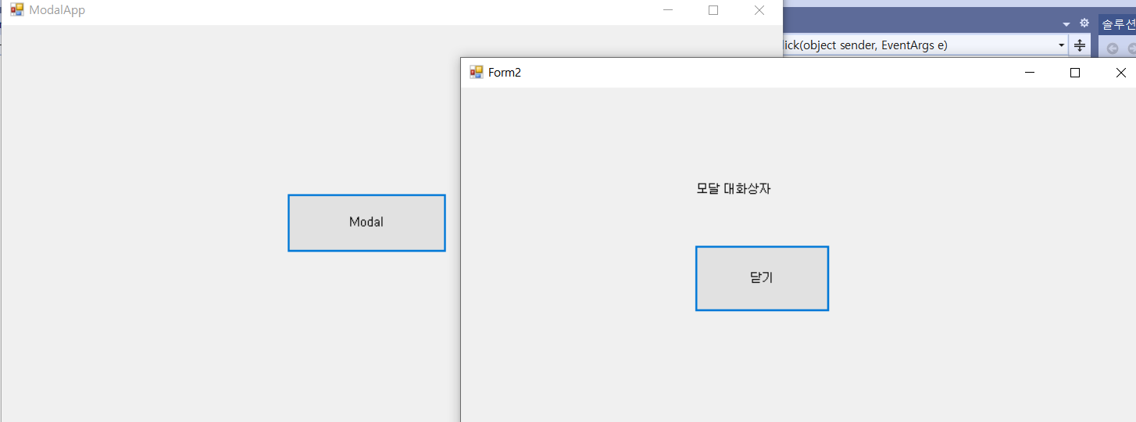
using System;
using System.Collections.Generic;
using System.ComponentModel;
using System.Data;
using System.Drawing;
using System.Linq;
using System.Text;
using System.Threading.Tasks;
using System.Windows.Forms;
namespace HelloForm
{
public partial class Form2 : Form
{
public Form2()
{
InitializeComponent();
}
private void button1_Click(object sender, EventArgs e)
{
Close();
}
}
}
using System;
using System.Windows.Forms;
namespace HelloForm
{
public partial class Form1 : Form
{
public Form1()
{
InitializeComponent();
}
private void button1_Click(object sender, EventArgs e)
{
Form2 form2 = new Form2();
form2.ShowDialog(); // form2를 모달 방식으로 띄운다.
}
}
}

Slide 14
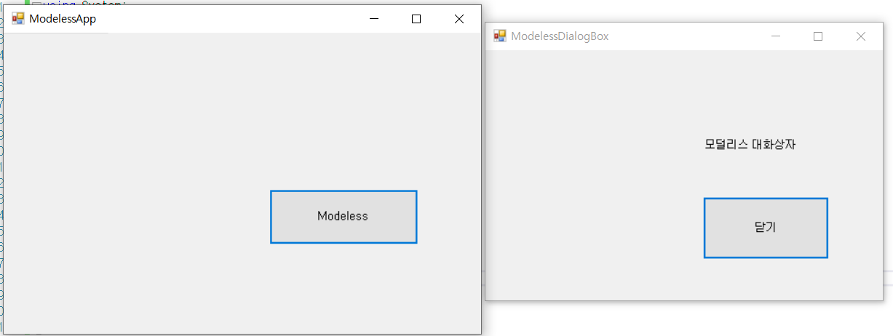
using System;
using System.Windows.Forms;
namespace HelloForm
{
public partial class Form2 : Form
{
public Form2()
{
InitializeComponent();
}
private void button1_Click(object sender, EventArgs e)
{
Close();
}
}
}
using System;
using System.Windows.Forms;
namespace HelloForm
{
public partial class Form1 : Form
{
public Form1()
{
InitializeComponent();
}
private void button1_Click(object sender, EventArgs e)
{
Form2 form2 = new Form2();
form2.Show(); // form2를 모덜리스 방식으로 띄운다.
}
}
}

Slide 15
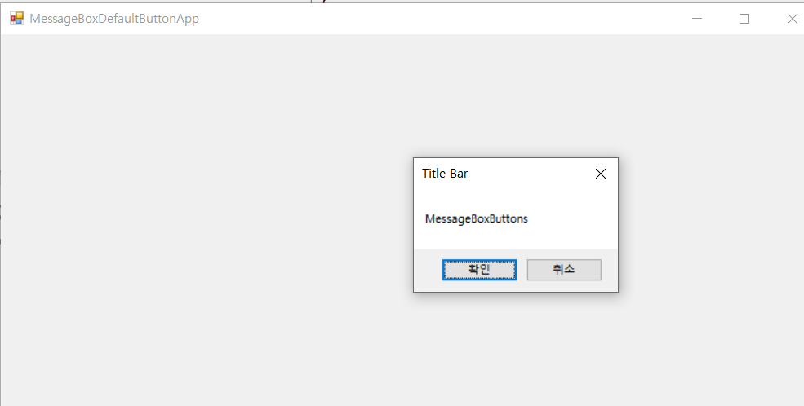
using System;
using System.Windows.Forms;
namespace HelloForm
{
public partial class Form1 : Form
{
public Form1()
{
InitializeComponent();
}
private void Form1_Load(object sender, EventArgs e)
{
}
private void Form1_Click(object sender, EventArgs e)
{
MessageBox.Show("MessageBoxButtons", "Title Bar",
MessageBoxButtons.OKCancel);
}
}
}

Slide 16
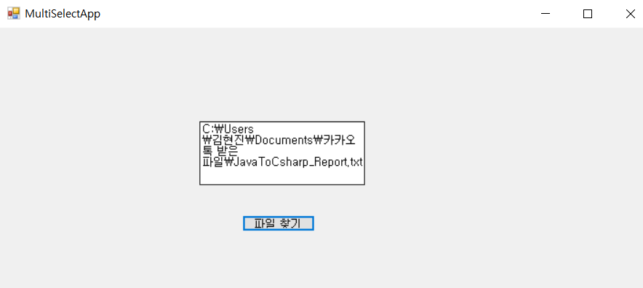
using System;
using System.Windows.Forms;
namespace HelloForm
{
public partial class Form1 : Form
{
public Form1()
{
InitializeComponent();
}
private void button1_Click(object sender, EventArgs e)
{
openFileDialog1.InitialDirectory = @"C:\";
openFileDialog1.Filter
= "텍스트 파일(*.txt)|*.txt|모든 파일(*.*)|*.*";
openFileDialog1.FilterIndex = 1; // "텍스트 파일(*.txt)|*.txt“
openFileDialog1.RestoreDirectory = true;
openFileDialog1.ShowDialog();
textBox1.Text = openFileDialog1.FileName;
}
}
}

Slide 17
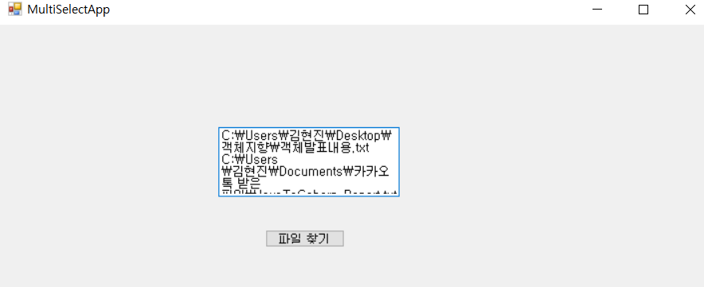
using System;
using System.Windows.Forms;
namespace HelloForm
{
public partial class Form1 : Form
{
public Form1()
{
InitializeComponent();
}
private void button1_Click(object sender, EventArgs e)
{
openFileDialog1.InitialDirectory = @"C:\";
openFileDialog1.Filter
= "텍스트 파일(*.txt)|*.txt|모든 파일(*.*)|*.*";
openFileDialog1.FilterIndex = 1;
openFileDialog1.RestoreDirectory = true;
openFileDialog1.Multiselect = true;
openFileDialog1.ShowDialog();
foreach (string strTmp in openFileDialog1.FileNames)
{
textBox1.Text += strTmp;
textBox1.Text += "\r\n";
}
}
}
}

Slide 18
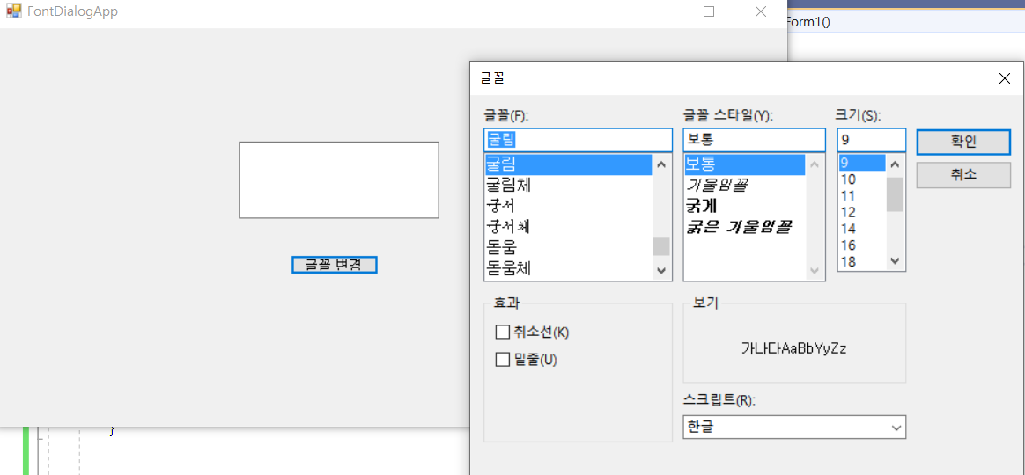
using System;
using System.Windows.Forms;
namespace HelloForm
{
public partial class Form1 : Form
{
public Form1()
{
InitializeComponent();
}
private void button1_Click(object sender, EventArgs e)
{
fontDialog1.ShowDialog();
textBox1.Font = fontDialog1.Font;
textBox1.ForeColor = fontDialog1.Color;
}
}
}

Slide 19
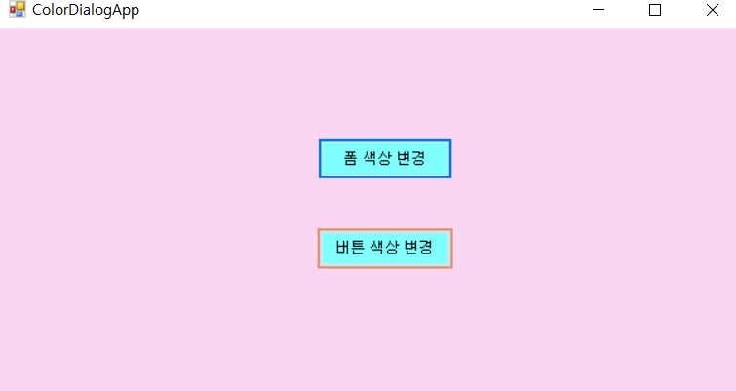
using System;
using System.Windows.Forms;
namespace HelloForm
{
public partial class Form1 : Form
{
public Form1()
{
InitializeComponent();
}
private void button1_Click(object sender, EventArgs e)
{
colorDialog1.ShowDialog();
this.BackColor = colorDialog1.Color;
}
private void button2_Click(object sender, EventArgs e)
{
colorDialog1.ShowDialog();
button1.BackColor = colorDialog1.Color;
button2.BackColor = colorDialog1.Color;
}
}
}

Slide 20
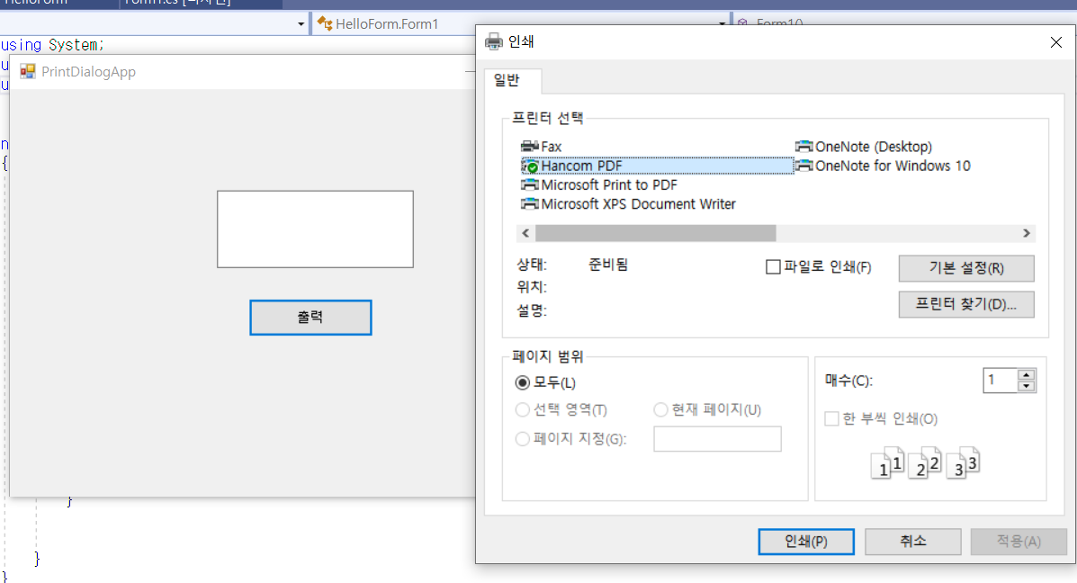
using System;
using System.Windows.Forms;
using System.Drawing.Printing;
namespace HelloForm
{
public partial class Form1 : Form
{
public Form1()
{
InitializeComponent();
}
private void button1_Click(object sender, EventArgs e)
{
PrinterSettings printer = new PrinterSettings();
PrintDocument pd = new PrintDocument();
printDialog1.PrinterSettings = printer;
printDialog1.Document = pd;
printDialog1.ShowDialog();
}
}
}

Slide 21
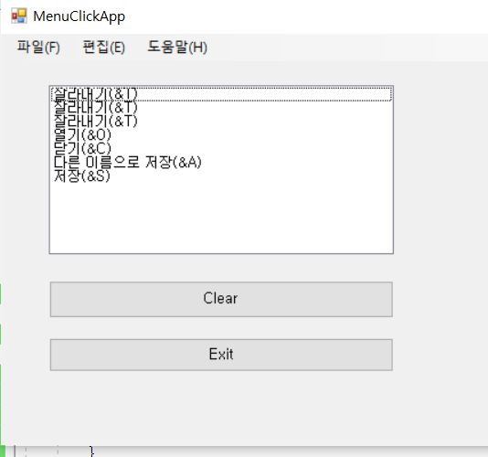
using System;
using System.Collections.Generic;
using System.ComponentModel;
using System.Data;
using System.Drawing;
using System.Linq;
using System.Text;
using System.Threading.Tasks;
using System.Windows.Forms;
namespace MenuTest
{
public partial class Form1 : Form
{
public Form1()
{
InitializeComponent();
}
private void button1_Click(object sender, EventArgs e)
{
listBox1.Items.Clear();
}
private void button2_Click(object sender, EventArgs e)
{
Application.Exit();
}
private void 새파일NToolStripMenuItem_Click(object sender, EventArgs e)
{
listBox1.Items.Add(((ToolStripMenuItem)sender).Text);
}
private void 열기OToolStripMenuItem_Click(object sender, EventArgs e)
{
listBox1.Items.Add(((ToolStripMenuItem)sender).Text);
}
private void 닫기CToolStripMenuItem_Click(object sender, EventArgs e)
{
listBox1.Items.Add(((ToolStripMenuItem)sender).Text);
}
private void 다른이름으로저장ToolStripMenuItem_Click(object sender, EventArgs e)
{
listBox1.Items.Add(((ToolStripMenuItem)sender).Text);
}
private void 인쇄PToolStripMenuItem_Click(object sender, EventArgs e)
{
listBox1.Items.Add(((ToolStripMenuItem)sender).Text);
}
private void 저장SToolStripMenuItem_Click(object sender, EventArgs e)
{
listBox1.Items.Add(((ToolStripMenuItem)sender).Text);
}
private void 미리보기ToolStripMenuItem_Click(object sender, EventArgs e)
{
listBox1.Items.Add(((ToolStripMenuItem)sender).Text);
}
private void 종료XToolStripMenuItem_Click(object sender, EventArgs e)
{
listBox1.Items.Add(((ToolStripMenuItem)sender).Text);
}
private void 잘라내기TToolStripMenuItem_Click(object sender, EventArgs e)
{
listBox1.Items.Add(((ToolStripMenuItem)sender).Text);
}
private void 복사CToolStripMenuItem_Click(object sender, EventArgs e)
{
listBox1.Items.Add(((ToolStripMenuItem)sender).Text);
}
private void 붙여넣기PToolStripMenuItem_Click(object sender, EventArgs e)
{
listBox1.Items.Add(((ToolStripMenuItem)sender).Text);
}
private void 프로그램정보AToolStripMenuItem_Click(object sender, EventArgs e)
{
listBox1.Items.Add(((ToolStripMenuItem)sender).Text);
}
}
}

Slide 22
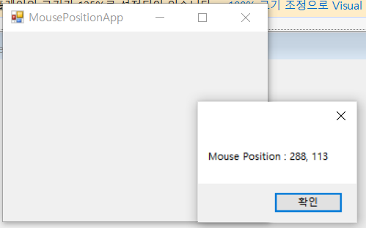
using System;
using System.Collections.Generic;
using System.ComponentModel;
using System.Data;
using System.Drawing;
using System.Linq;
using System.Text;
using System.Threading.Tasks;
using System.Windows.Forms;
namespace MouseEvent
{
public partial class Form1 : Form
{
public Form1()
{
InitializeComponent();
}
private void Form1_MouseEnter(object sender, EventArgs e)
{
Point mousePoint = PointToClient(MousePosition);
string msg = "Mouse Position : " + mousePoint.X + ", "
+ mousePoint.Y;
MessageBox.Show(msg);
}
}
}

Slide 23
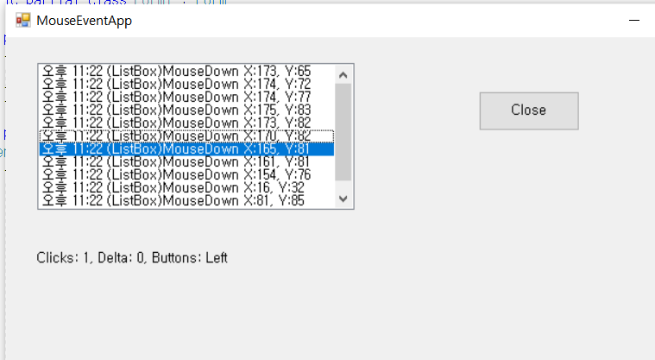
using System;
using System.Collections.Generic;
using System.ComponentModel;
using System.Data;
using System.Drawing;
using System.Linq;
using System.Text;
using System.Threading.Tasks;
using System.Windows.Forms;
namespace MouseEvent
{
public partial class Form1 : Form
{
public Form1()
{
InitializeComponent();
}
private void UpdateEventLabels(string msg, int x, int y,
MouseEventArgs e)
{
string message = string.Format("{0} X:{1}, Y:{2}", msg, x, y);
string eventMsg = DateTime.Now.ToShortTimeString();
eventMsg += " " + message;
listBox1.Items.Insert(0, eventMsg);
listBox1.TopIndex = 0;
string mouseInfo;
if (e != null)
{
mouseInfo = string.Format("Clicks: {0}, Delta: {1}, " +
"Buttons: {2}", e.Clicks, e.Delta,
e.Button.ToString());
}
else
{
mouseInfo = string.Format("Clicks: {0}", msg);
}
label1.Text = mouseInfo;
}
private void listBox1_MouseDown(object sender, MouseEventArgs e)
{
UpdateEventLabels("(ListBox)MouseDown", e.X, e.Y, e);
}
private void listBox1_DoubleClick(object sender, EventArgs e)
{
Point mousePoint = PointToClient(MousePosition);
UpdateEventLabels("(ListBox)DoubleClick",
mousePoint.X, mousePoint.Y, null);
}
private void button1_Click(object sender, EventArgs e)
{
Application.Exit();
}
}
}

Slide 24
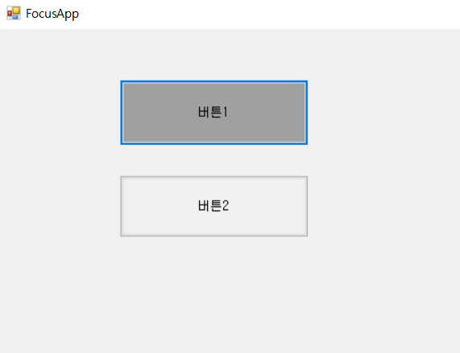
using System;
using System.Collections.Generic;
using System.ComponentModel;
using System.Data;
using System.Drawing;
using System.Linq;
using System.Text;
using System.Threading.Tasks;
using System.Windows.Forms;
namespace MouseEvent
{
public partial class Form1 : Form
{
public Form1()
{
InitializeComponent();
}
private void button1_Click(object sender, EventArgs e)
{
this.button1.BackColor = SystemColors.Control;
this.button2.Focus();
if (this.button2.Focused)
this.button2.BackColor = SystemColors.ControlDark;
}
private void button2_Click(object sender, EventArgs e)
{
this.button2.BackColor = SystemColors.Control;
this.button1.Focus();
if (this.button1.Focused)
this.button1.BackColor = SystemColors.ControlDark;
}
}
}

Slide 25
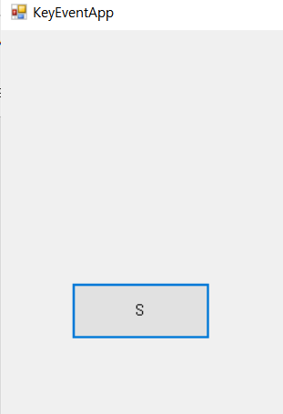
using System;
using System.Collections.Generic;
using System.ComponentModel;
using System.Data;
using System.Drawing;
using System.Linq;
using System.Text;
using System.Threading.Tasks;
using System.Windows.Forms;
namespace MouseEvent
{
public partial class Form1 : Form
{
public Form1()
{
InitializeComponent();
}
public int xPt, yPt;
public static readonly int MOVE = 10;
private void button1_KeyUp(object sender, KeyEventArgs e)
{
this.xPt = this.button1.Location.X;
this.yPt = this.button1.Location.Y;
switch (e.KeyCode)
{
case Keys.Left:
xPt -= MOVE; break;
case Keys.Right:
xPt += MOVE; break;
case Keys.Up:
yPt -= MOVE; break;
case Keys.Down:
yPt += MOVE; break;
}
this.button1.Text = e.KeyCode.ToString();
this.button1.Location = new Point(xPt, yPt);
}
}
}

Slide 26
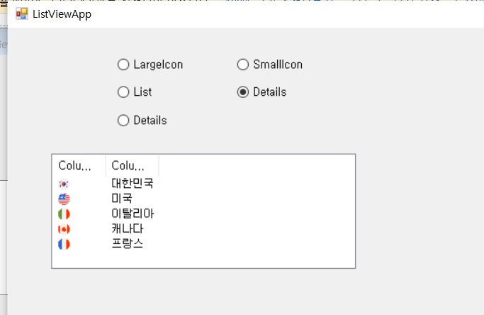
using System;
using System.Collections.Generic;
using System.ComponentModel;
using System.Data;
using System.Drawing;
using System.Linq;
using System.Text;
using System.Threading.Tasks;
using System.Windows.Forms;
namespace MouseEvent
{
public partial class Form1 : Form
{
public Form1()
{
InitializeComponent();
}
private void radioButton1_CheckedChanged(object sender, EventArgs e)
{
if (radioButton1.Checked)
// 리스트 뷰의 항목을 큰 아이콘 형태로 보여준다.
listView1.View = View.LargeIcon;
}
private void radioButton2_CheckedChanged(object sender, EventArgs e)
{
if (radioButton2.Checked)
// 리스트 뷰의 항목을 작은 아이콘 형태로 보여준다.
listView1.View = View.SmallIcon;
}
private void radioButton3_CheckedChanged(object sender, EventArgs e)
{
if (radioButton3.Checked)
// 리스트 뷰의 항목을 간단한 리스트 형태로 보여준다.
listView1.View = View.List;
}
private void radioButton4_CheckedChanged(object sender, EventArgs e)
{
if (radioButton4.Checked)
// 리스트 뷰의 항목을 자세한 리스트 형태로 보여준다.
listView1.View = View.Details;
}
private void radioButton5_CheckedChanged(object sender, EventArgs e)
{
if (radioButton5.Checked)
// 리스트 뷰의 항목을 타일 형태로 보여준다.
listView1.View = View.Tile;
}
private void listView1_Click(object sender, EventArgs e)
{
foreach (ListViewItem item in listView1.SelectedItems)
{
ListViewItem.ListViewSubItemCollection subItem = item.SubItems;
// 각 항목에 대한 부항목을 얻기 위해 SubItems 프로퍼티를 사용
label1.Text = subItem[0].Text + "의 국가번호는 " + subItem[1].Text + "입니다.";
}
}
}
}

Slide 27
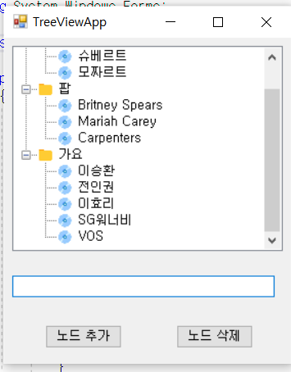
using System;
using System.Collections.Generic;
using System.ComponentModel;
using System.Data;
using System.Drawing;
using System.Linq;
using System.Text;
using System.Threading.Tasks;
using System.Windows.Forms;
namespace Ex11_02_TreeViewApp
{
public partial class Form1 : Form
{
public Form1()
{
InitializeComponent();
}
private void button1_Click(object sender, EventArgs e)
{
if (textBox1.Text != "" && treeView1.SelectedNode != null)
{
// 선택된 노드가 있으면, 그 노드의 자식 노드로 추가한다.
treeView1.SelectedNode.Nodes.Add(
new TreeNode(textBox1.Text, 1, 1));
textBox1.Text = "";
textBox1.Focus();
}
}
private void button2_Click(object sender, EventArgs e)
{
treeView1.Nodes.Remove(treeView1.SelectedNode);
}
private void Form1_Load(object sender, EventArgs e)
{
treeView1.ExpandAll(); // 트리 뷰의 모든 노드를 펼침.
}
}
}

Slide 28
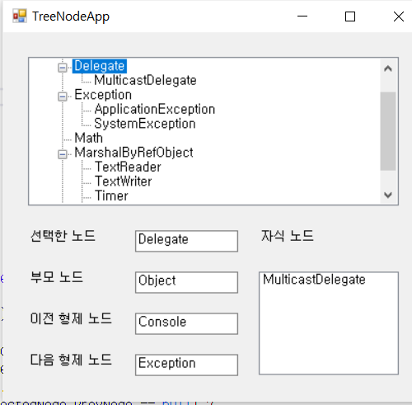
using System;
using System.Collections.Generic;
using System.ComponentModel;
using System.Data;
using System.Drawing;
using System.Linq;
using System.Text;
using System.Threading.Tasks;
using System.Windows.Forms;
namespace Ex11_03_TreeNodeApp
{
public partial class Form1 : Form
{
public Form1()
{
InitializeComponent();
}
private void treeView1_AfterSelect(object sender, TreeViewEventArgs e)
{
if (treeView1.SelectedNode != null)
{
textBox1.Text = treeView1.SelectedNode.Text;
textBox2.Text = (treeView1.SelectedNode.Parent == null) ?
"" : treeView1.SelectedNode.Parent.Text;
textBox3.Text = (treeView1.SelectedNode.PrevNode == null) ?
"" : treeView1.SelectedNode.PrevNode.Text;
textBox4.Text = (treeView1.SelectedNode.NextNode == null) ?
"" : treeView1.SelectedNode.NextNode.Text;
if (treeView1.SelectedNode.Nodes != null)
{
listBox1.Items.Clear();
foreach (TreeNode node in treeView1.SelectedNode.Nodes)
listBox1.Items.Add(node.Text);
}
}
}
private void Form1_Load(object sender, EventArgs e)
{
treeView1.ExpandAll(); // 트리 뷰의 모든 노드를 펼침.
}
}
}

Slide 29
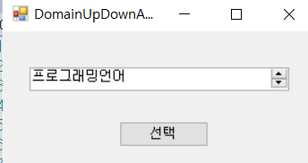
using System;
using System.Collections.Generic;
using System.ComponentModel;
using System.Data;
using System.Drawing;
using System.Linq;
using System.Text;
using System.Threading.Tasks;
using System.Windows.Forms;
namespace Ex11_04_DomainUpDownApp
{
public partial class Form1 : Form
{
public Form1()
{
InitializeComponent();
}
private void button1_Click(object sender, EventArgs e)
{
MessageBox.Show(domainUpDown1.SelectedItem.ToString());
}
}
}

Slide 30
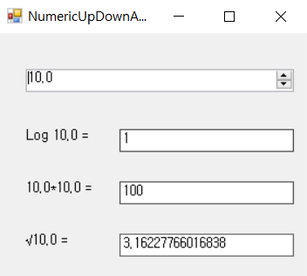
using System;
using System.Collections.Generic;
using System.ComponentModel;
using System.Data;
using System.Drawing;
using System.Linq;
using System.Text;
using System.Threading.Tasks;
using System.Windows.Forms;
namespace Ex11_05_NumericUpDownApp
{
public partial class Form1 : Form
{
public Form1()
{
InitializeComponent();
}
private void numericUpDown1_ValueChanged(object sender, EventArgs e)
{
decimal d = numericUpDown1.Value;
label1.Text = "Log " + d + " = ";
textBox1.Text = System.Math.Log10((double)d).ToString();
label2.Text = d + "*" +d + " = ";
textBox2.Text = System.Math.Pow((double)d, 2).ToString();
label3.Text = "√" + d + " = ";
textBox3.Text = System.Math.Sqrt((double)d).ToString();
}
}
}

Slide 31
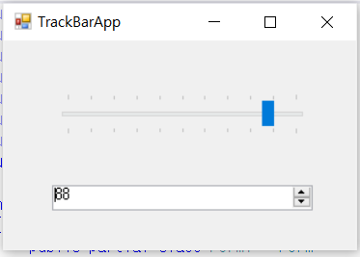
using System;
using System.Collections.Generic;
using System.ComponentModel;
using System.Data;
using System.Drawing;
using System.Linq;
using System.Text;
using System.Threading.Tasks;
using System.Windows.Forms;
namespace Ex11_06_TrackBarApp
{
public partial class Form1 : Form
{
public Form1()
{
InitializeComponent();
}
private void trackBar1_Scroll(object sender, EventArgs e)
{
numericUpDown1.Value = trackBar1.Value;
}
private void numericUpDown1_ValueChanged(object sender, EventArgs e)
{
trackBar1.Value = (int)numericUpDown1.Value;
}
}
}

Slide 32
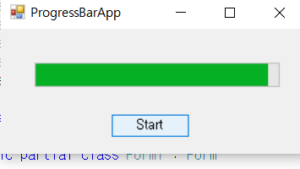
using System;
using System.Collections.Generic;
using System.ComponentModel;
using System.Data;
using System.Drawing;
using System.Linq;
using System.Text;
using System.Threading.Tasks;
using System.Windows.Forms;
namespace Ex11_07_ProgressBarApp
{
public partial class Form1 : Form
{
public Form1()
{
InitializeComponent();
}
private void button1_Click(object sender, EventArgs e)
{
for (int i = progressBar1.Minimum; i < progressBar1.Maximum; i++)
progressBar1.Value = i;
}
}
}

Slide 33
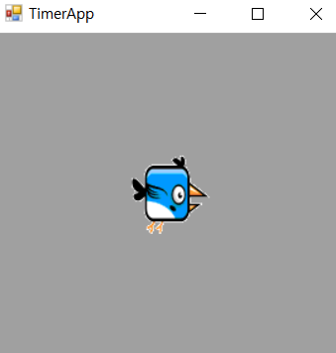
using System;
using System.Collections.Generic;
using System.ComponentModel;
using System.Data;
using System.Drawing;
using System.Linq;
using System.Text;
using System.Threading.Tasks;
using System.Windows.Forms;
namespace Ex11_08_TimerApp
{
public partial class Form1 : Form
{
public Form1()
{
InitializeComponent();
}
private int index = 0;
private void timer1_Tick(object sender, EventArgs e)
{
index %= imageList1.Images.Count;
label1.Image = imageList1.Images[index++];
}
}
}

