Slide 1
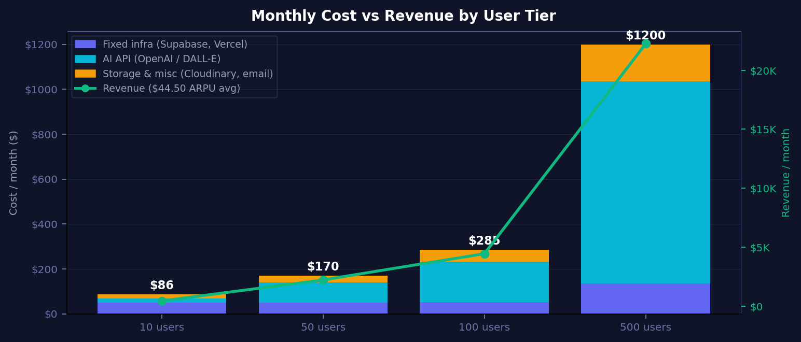
INFRASTRUCTURE
Cost Breakdown by User Scale
Monthly infrastructure cost vs revenue at 10 / 50 / 100 / 500 paying users · ARPU avg $44.50 · AI Gross Margin 80–95%
EARLY
80.7% GM
SEED
92.4% GM
GROWTH
93.6% GM
SCALE
94.6% GM
10 Users
50 Users
100 Users
500 Users
Cost
$86/mo
Cost
$170/mo
Cost
$285/mo
Cost
Revenue
$1,200/mo
$445/mo
Revenue
$2,225/mo
Revenue
$4,450/mo
Revenue
$22,250/mo
NEXUS AI · Infrastructure & Cost Analysis
INTERNAL / CONFIDENTIAL

