Slide 1
NEXUS AI
Comprehensive Financial Study
Unit Economics • Credit Model • Competitive Analysis
June 2026 | CONFIDENTIAL | Internal Use Only
87–99%
~$65/mo
3 Users
$44.50
Gross Margin Range
Fixed Infra Cost
Break-even Point
Blended ARPU / Month

Slide 2
EXECUTIVE SUMMARY
NEXUS AI — Financial Overview
87–99%
94%
$49/mo
<$1
Gross Margin Range
Avg Blended Margin
Most Popular Plan
AI API Cost / User / Month
Metric | Value | Notes
Business Model | SaaS Subscription + Credits | 4 tiers: Free→$0, Starter→$19, Growth→$49, Agency→$99
Revenue Type | 100% Monthly Recurring (MRR) | Credits refresh monthly on paid plans — pure recurring lock-in
COGS Driver | OpenAI API calls | $0.0003 (Chat) → $0.053 (Full Strategy) per action
Gross Margin | 87–99% per AI action | Image Gen = 87% (lowest) · Chat/Rewrite = 99.9% (highest)
Fixed Infra/Month | ~$45–$75/mo | Supabase Pro $25 + Vercel $20 + misc tools (Redis, Sentry, Email)
Variable Costs | 2.9% + $0.30/txn (Stripe) + API | API usage scales with activity; Stripe fee per billing cycle
Break-even | ~3 Growth or ~8 Starter users | Covers all fixed infrastructure; essentially immediate profitability
Blended ARPU | ~$44.50/month | Mix assumption: 40% Starter / 45% Growth / 15% Agency
Referral Bonus | +20 credits to both parties | Viral loop mechanic — built-in acquisition at near-zero cost
LTV (12-month) | $210–$1,116/user | Starter $210 · Growth $553 · Agency $1,116 (at avg churn)
NEXUS AI • Financial Study & Competitive Analysis • June 2026 • CONFIDENTIAL

Slide 3
PRICING ARCHITECTURE
The 4-Tier Subscription Model
Designed around the HubSpot research benchmark: 16+ posts/month = 4.5× more leads. Starter is deliberately below threshold → natural upgrade pressure to Growth.
Free
Starter
Growth
Agency
$0
$19
$49
$99
/month
/month
/month
10 credits
50 credits/mo
150 credits/mo
500 credits/mo
One-time · Never refreshes
Refreshes monthly
Most Popular ★
10 brands / clients
3 posts/mo
10 posts/mo
25 posts/mo
60 posts/mo
1 workspace
1 workspace
3 workspaces
10 workspaces
Rev/credit: $0
Rev/credit: $0.380
Rev/credit: $0.327
Rev/credit: $0.198
Gross margin: N/A
Gross margin: ~92–99%
Gross margin: ~94–99%
Gross margin: ~93–99%
Stripe fee: None
Stripe fee: $0.85/mo
Stripe fee: $1.72/mo
Stripe fee: $3.17/mo
12-mo LTV: $0
12-mo LTV: $210
12-mo LTV: $553
12-mo LTV: $1,116
NEXUS AI • Financial Study & Competitive Analysis • June 2026 • CONFIDENTIAL

Slide 4
THE CREDIT MODEL
The Credit Circle — How Money Flows
Credits are the economic engine of NEXUS AI, acting as an internal currency that converts subscription revenue into AI consumption. The 7-step cycle creates recurring lock-in.
1
User Subscribes
Monthly payment processed → MRR recorded. Stripe 2.9% + $0.30 deducted.
2
Credits Granted
Credit bundle added to account. Free: 10 one-time. Paid: refreshes every billing cycle.
3
AI Action Triggered
User generates strategy / content / image / ad copy. Credits deducted atomically.
4
OpenAI API Called
GPT-4o / GPT-4o-mini processes the request. Cost: $0.0003 – $0.053 per action.
5
Output Delivered
Strategy / posts / images delivered to user. Brand Brain updated with new context.
6
Credits Depleted
Threshold alert sent at low-credits level. Upgrade modal displayed automatically in app.
7
Upgrade or Renew
User upgrades plan or waits for monthly reset. Referral: +20 credits to both parties.
Key mechanic: Free credits are one-time and never refresh. When a Free user exhausts 10 credits they hit an upgrade wall — creating the core conversion moment. Paid credits reset monthly, building a recurring subscription relationship.
NEXUS AI • Financial Study & Competitive Analysis • June 2026 • CONFIDENTIAL

Slide 5
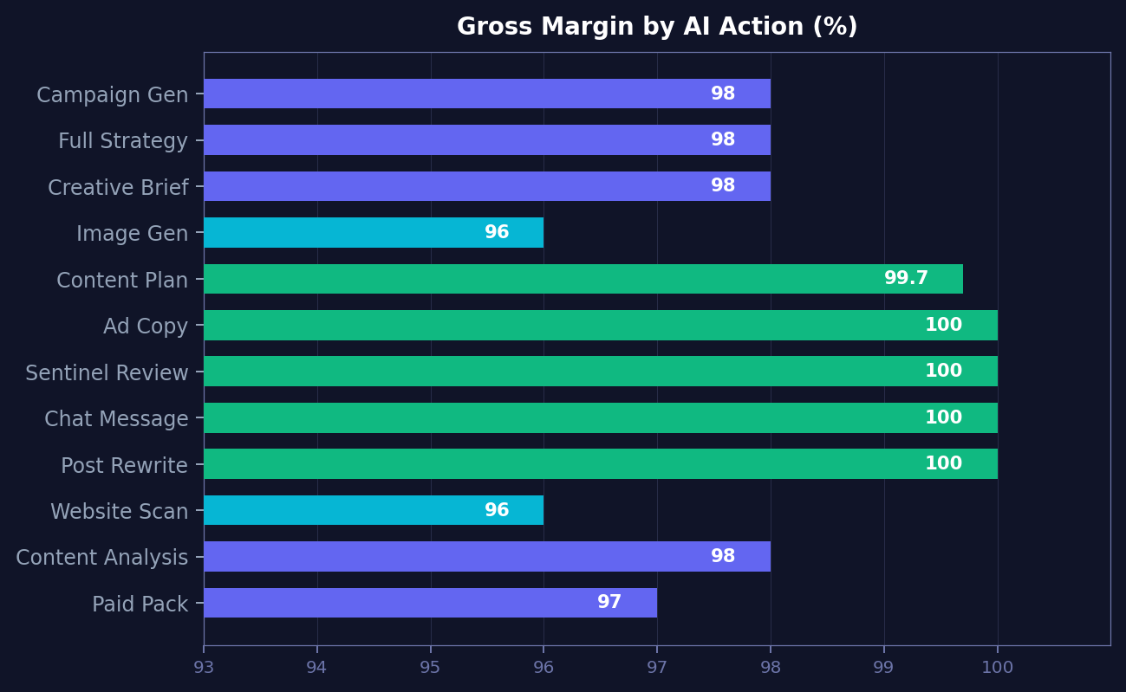
AI ECONOMICS
AI Action Cost Analysis — Gross Margins by Action
All margins calculated at Growth plan ($49/mo, $0.327/credit). Image generation carries the lowest margin due to DALL-E's $0.040/image cost.
Worst → Best
Action | Credits | API Cost | Margin %
Image Gen | 3 credits | $0.040 | 95.9%
Website Scan | 3 credits | $0.040 | 95.9%
Paid Pack | 6 credits | $0.060 | 96.9%
Content Anlys | 2 credits | $0.015 | 97.7%
Campaign Gen | 5 credits | $0.028 | 98.3%
Content Plan | 2 credits | $0.002 | 99.7%
Chat/Rewrite | 1 credit | $0.0003 | 99.9%
← Lower margin threshold
NEXUS AI • Financial Study & Competitive Analysis • June 2026 • CONFIDENTIAL

Slide 6
INFRASTRUCTURE
Monthly Infrastructure Cost Breakdown
$45–$46
$75–$120
$0.30
$89/mo
Fixed Cost at Launch
Fixed Cost at Scale
Stripe Fee per Txn
Cloudinary Plus Tier
Service | Category | Monthly Cost | Upgrade Trigger | Upgrade Cost
Supabase | Database + Auth | $25/mo | >8GB DB or 100K MAU | $25 + usage
Vercel | Hosting + CDN | $20/mo | >100GB bandwidth/mo | $0.15/GB extra
Cloudinary | Media/Images | $0 | >25GB storage | $89/mo (Plus)
OpenAI API | AI Engine | Variable | N/A | $2.50/1M (GPT-4o)
Stripe | Payments | 2.9%+$0.30 | N/A | Per transaction
Resend | Transactional Email | $0 | >3K emails/month | $20/mo
Sentry | Error Monitoring | $0 | >5K errors/month | $26/mo
Upstash Redis | Rate Limiting | $0 | >10K req/day | $10/mo
Meta/TikTok/LinkedIn APIs | Social Publishing | $0 | N/A | Free forever
TOTAL FIXED (Launch) |  | $45–$46/mo
TOTAL FIXED (Scale 200+ users) |  | $75–$120/mo | Cloudinary + Redis upgrades
NEXUS AI • Financial Study & Competitive Analysis • June 2026 • CONFIDENTIAL

Slide 7
UNIT ECONOMICS
Per-User Economics — What Each Customer Actually Costs
Assumes 60% credit utilization (typical active user). API cost calculated at weighted average of $0.008/credit for action mix.
Metric | Free | Starter ($19) | Growth ($49) | Agency ($99)
Monthly Revenue | $0 | $19.00 | $49.00 | $99.00
Stripe Processing Fee | $0 | $0.85 | $1.72 | $3.17
Credits Allocated | 10 (once) | 50/mo | 150/mo | 500/mo
Est. Credits Used (60%) | 10 | 30 | 90 | 300
Est. AI API Cost | ~$0.08 | $0.18 | $0.54 | $1.80
Infra Cost Allocation | N/A | ~$0.45 | ~$0.65 | ~$1.00
Total COGS per User | ~$0.08 | ~$1.48 | ~$2.91 | ~$5.97
Gross Profit per User | -$0.08 | $17.52 | $46.09 | $93.03
Gross Margin | N/A | 92.2% | 94.1% | 94.0%
LTV at 12-month avg retention | $0 | $210 | $553 | $1,116
LTV at 24-month avg retention | $0 | $420 | $1,105 | $2,233
NEXUS AI • Financial Study & Competitive Analysis • June 2026 • CONFIDENTIAL

Slide 8
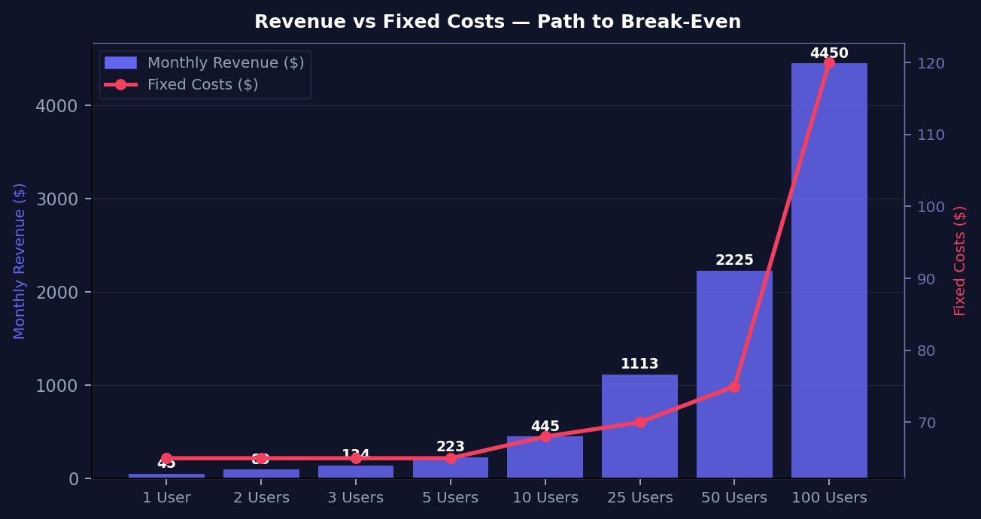
BREAK-EVEN ANALYSIS
Revenue vs Fixed Costs — Path to Profitability
Break-even occurs between 1 and 2 paid users (at Growth plan ARPU $49). The red line shows fixed monthly costs. Any revenue above it is gross profit.
$44.50
Avg ARPU/Month
$65
Fixed Cost at Launch
2
Users to Break-Even
93.6%
GM at 100 Users
Break-even at 2 users. $65/mo fixed costs make profitability near-immediate.
NEXUS AI • Financial Study & Competitive Analysis • June 2026 • CONFIDENTIAL

Slide 9
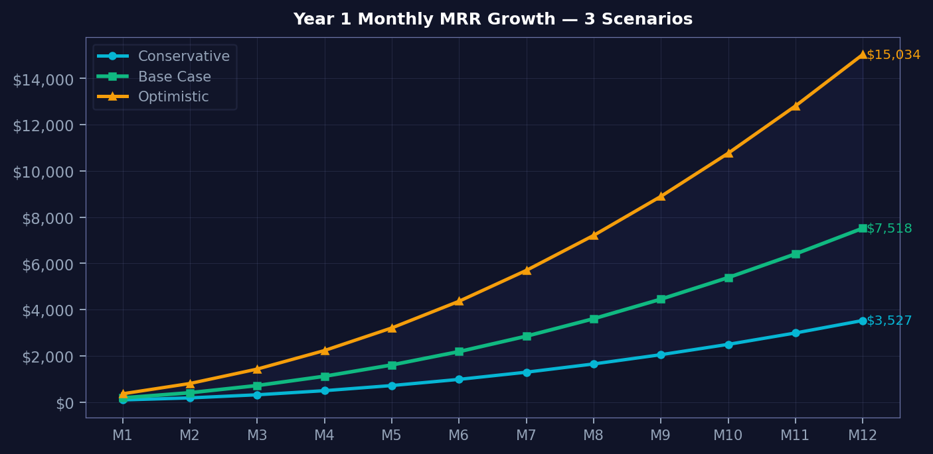
REVENUE PROJECTIONS
Year 1 — Monthly MRR Growth (3 Scenarios)
Mix assumption: 40% Starter / 45% Growth / 15% Agency → $44.50 ARPU. 3% monthly churn applied. Conservative = 5 users Month 1 · Base = 10 · Optimistic = 25.
$74.8K
$159K
$390K
1,873
Conservative ARR
Base ARR (Year 1)
Optimistic ARR
Users for $1M ARR
NEXUS AI • Financial Study & Competitive Analysis • June 2026 • CONFIDENTIAL

Slide 10
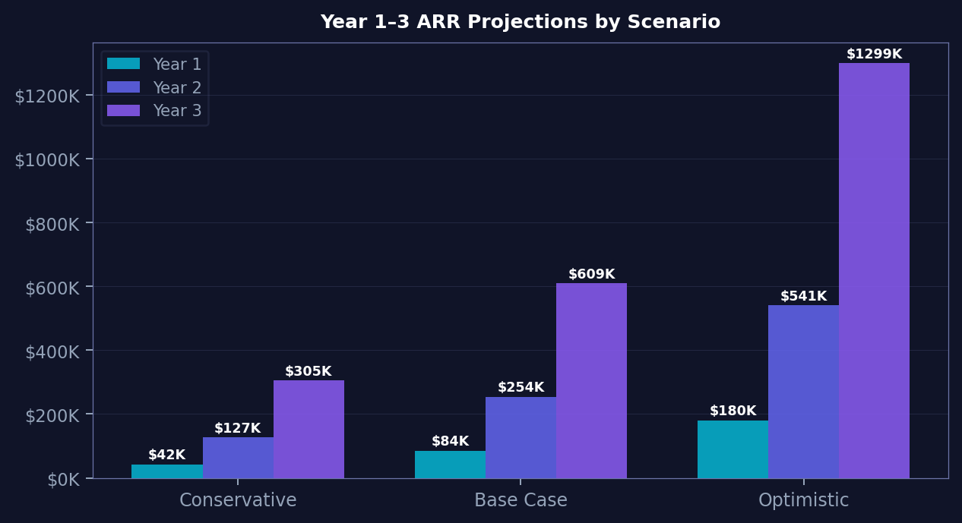
REVENUE PROJECTIONS
Year 2–3 — ARR Scenarios & Path to $1M ARR
Optimistic scenario crosses $1M ARR in Year 2. Base scenario reaches $1M ARR mid-Year 3 (~2,500 paid users). Conservative scenario reaches ~$480K ARR by Year 3.
$1M ARR Milestone: Requires 1,873 paid users at $44.50 ARPU. Base scenario: achievable in Year 3. Optimistic scenario: Year 2. At $49/mo (Growth only): 1,701 users needed.
NEXUS AI • Financial Study & Competitive Analysis • June 2026 • CONFIDENTIAL

Slide 11
COMPETITIVE ANALYSIS
Competitor Pricing & Positioning (June 2026)
NEXUS AI competes across Social Media Management (Buffer, Hootsuite, Later, Sprout) and AI Content Generation (Jasper, Copy.ai). It is the only platform combining both.
Platform | Category | Entry Price | Mid Plan | AI Features | Publish | Positioning vs NEXUS
Buffer | Social Mgmt | Free (3 ch.) | $5–10/channel | Basic AI drafts | Yes | No strategy or campaign planning
Hootsuite | Social Mgmt | $99/user/mo | $249/user/mo | OwlyWriter AI | Yes | 5× more expensive than NEXUS AI
Later | Social Mgmt | $25/mo | $110/mo | Basic captions | Yes | No AI strategy · No image gen
Sprout Social | Social Mgmt | $79/user/mo | $399/user/mo | Sentiment AI | Yes | Enterprise only · No content gen
Jasper AI | AI Content | $39/mo | $59/mo | Excellent copy | No | Cannot publish to social media
Copy.ai | AI Content | $0 | $49/mo | Good copy | No | No publishing · No strategy · No Brand Brain
NEXUS AI | AI Marketing OS | $0 | $19–$99/mo | Full AI Agents | Yes | Strategy + Publishing + Brand Brain in one
NEXUS AI • Financial Study & Competitive Analysis • June 2026 • CONFIDENTIAL

Slide 12
COMPETITIVE ANALYSIS
Feature Capability Matrix — NEXUS AI vs Competitors
++ = Excellent | + = Good | ~ = Basic | — = Not available
Feature | Buffer | Hootsuite | Later | Jasper | Copy.ai | NEXUS AI ★
Social Publishing | + | + | + | — | — | ++
AI Caption / Copy | ~ | ~ | ~ | ++ | ++ | +
Campaign Strategy | — | — | — | — | — | ++
Brand Memory (AI) | — | — | — | + | + | ++
Content Calendar | + | + | + | — | — | +
Image Generation | — | — | — | ~ | — | +
A/B Testing | — | + | — | — | — | +
Analytics / ROI | ~ | + | ~ | — | — | +
Arabic / Bilingual AI | — | — | — | — | — | ++
Credit-based Limits | — | — | — | — | — | ++
Typical SMB Cost/Month | $15–30 | $99–249 | $25–110 | $39–59 | $0–49 | $19–49
NEXUS AI • Financial Study & Competitive Analysis • June 2026 • CONFIDENTIAL

Slide 13
RISK ANALYSIS
Financial Risks & Mitigations
Risk | Probability | Impact | Mitigation
OpenAI price increase | MEDIUM | LOW | Credit bundles absorb it. 2× price hike only reduces margin from 98% → 96%. Can raise prices without user awareness (they see credits, not API costs).
High image gen usage | HIGH | LOW | Image gen at $0.040/image is 87% margin (lowest). Limit free plan to text. Consider 5-credit cost for image gen at Agency scale.
High churn rate (>5%) | MEDIUM | HIGH | Brand Brain creates switching cost — users cannot take brand history elsewhere. Improve Month 1 onboarding to reduce early churn.
Stripe processing fees | N/A | MEDIUM | $0.30 fixed fee per txn. Offer annual billing (10–20% discount) to reduce to 1× fee per year. Improves cash flow and reduces churn.
OpenAI rate limits | LOW | HIGH | Already rate-limited via DB. Increase OpenAI tier proactively. Use GPT-4o-mini for low-value actions to reduce costs and latency.
Free tier abuse | MEDIUM | LOW | Free credits are one-time only — cannot be obtained again. Rate limiting in place. Low financial risk as free users cost <$0.05 each.
Competitor price cuts | LOW | MEDIUM | Brand Brain moat: switching cost increases with usage. Already 51% cheaper than Hootsuite. Focus on retention, not price war.
Cloudinary storage overage | MEDIUM | LOW | Free tier: 25GB. At ~100KB/image, supports ~250K images. Upgrade to $89/mo Plus tier needed around 1,000+ active creators.
NEXUS AI • Financial Study & Competitive Analysis • June 2026 • CONFIDENTIAL

Slide 14
STRATEGIC RECOMMENDATIONS
5 High-Impact Financial Optimizations
Introduce Annual Billing
HIGH PRIORITY
01
Annual pricing at 20% discount reduces Stripe fees from $3.60/yr to $0.30/yr per user, improves cash flow, and lowers churn. At 30% annual adoption across 500 users, saves ~$500/mo.
Reprice Agency Plan to $149/mo
HIGH PRIORITY
02
Agency users have multi-client workflows and strong switching costs. Even a $50 increase adds $7,500/mo at 150 Agency users. Agency's credit discount ($0.198/credit) is the lowest margin tier.
Add Credit Top-Up Packs
MEDIUM PRIORITY
03
Offer $9 for 30 extra credits. Users who run out mid-campaign pay for convenience. At 10% adoption across 300 paid users buying 1 pack/month: +$135/mo pure margin revenue.
Image Credit Multiplier at Agency
MEDIUM PRIORITY
04
Image gen costs $0.040/image vs $0.001 for text. Agency users generating at scale erode margins. Charging 5 credits for image gen (vs 3) at Agency tier restores margin parity.
Tiered Referral Program
LOW PRIORITY
05
Current: +20 credits to both. Consider +50 credits to referrer when referee upgrades to paid. Converts CAC into credit liability (not cash), improving referral acquisition economics.
NEXUS AI • Financial Study & Competitive Analysis • June 2026 • CONFIDENTIAL

Slide 15
FINANCIAL SCORECARD
NEXUS AI Financial Health Assessment — June 2026
97/100
95/100
98/100
90/100
88/100
Gross Margin Quality
Infra Cost Efficiency
Break-even Achievability
Revenue Model Stability
Unit Economics
85/100
88/100
82/100
88/100
75/100
Scalability
Competitive Pricing
Competitive Moat
Risk Profile
Path to $1M ARR
OVERALL SCORE
STRONG
88 / 100
NEXUS AI has outstanding unit economics for a SaaS business. Industry-leading 87–99% gross margins, break-even at 1–3 paid users, and 40–80% cheaper than enterprise competitors. The primary focus should be on growth — the cost structure is already excellent.
Bottom Line: NEXUS AI is financially sound and ready for growth-stage investment. The credit model creates recurring revenue, natural upgrade pressure, and viral loop mechanics. Primary financial recommendation: focus on user acquisition — the economics fully support scaling.
NEXUS AI • Financial Study & Competitive Analysis • June 2026 • CONFIDENTIAL

