Slide 1
Artist Input
Musical Signal
Done by:
Defferrard, M. et al.
Feature Extraction
Track Info
MFCC
MFCC, Chroma, Tonnetz, Statistical Features
Classification
Logistic Regression
Logistic Regression
SVM
Logistic Regression
Accuracy Score
57 %
60.1 %
59.5 %
61.4 %

Slide 2
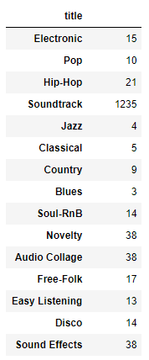
Missing Data in Top Genre Column
Genres
Genres_All
Top_Genre
76, 103
17, 10, 76, 103
Free-Folk

Slide 3
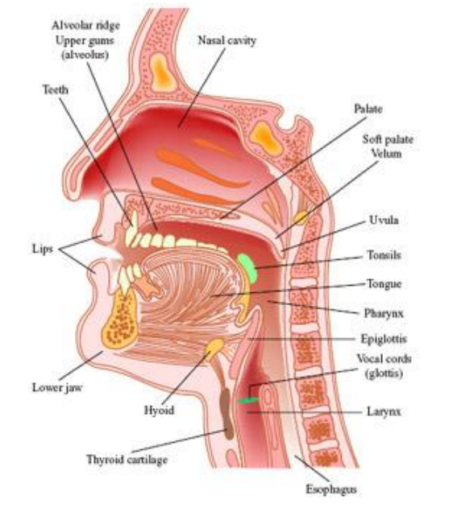
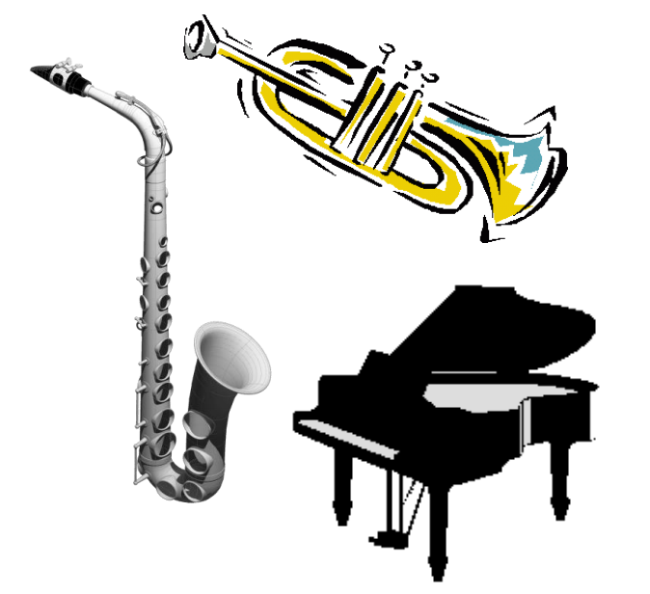
Audio Content
Speech
Music
Environment
Genre Classification
Tagging(Speech, Music, etc)
Hit Prediction
Playlist Generation

