Slide 1

Churn Modeling with Telecom Data

Slide 2
Churn Modeling with Telecom Data

Slide 3
Overview
Data Processing
Modeling
Tuning
Algorithm
Selection
Feature Selection
Fitting test
(over/under fit)
Standard-
ization
EDA
Validation
Feature Extraction
Randomized
Search
Ensemble

Slide 4
Data Processing
Feature selection and scatter matrix are used to figure out how to handle the features
Original DF
DF1
DF2
DF3
# Features
21 features
21 features
17 features
71 features
Data Processing
Drop phone # (but leave area code)
(Class is unbalanced)
Convert to dummy (n -1)
State
Intl plan
Vmail plan
Area code
Churn?
Feature selection
Drop State
Scatter matrix
Multi-collinearity between Charge and Min
Convert Vmail to 0 or 1

Slide 5
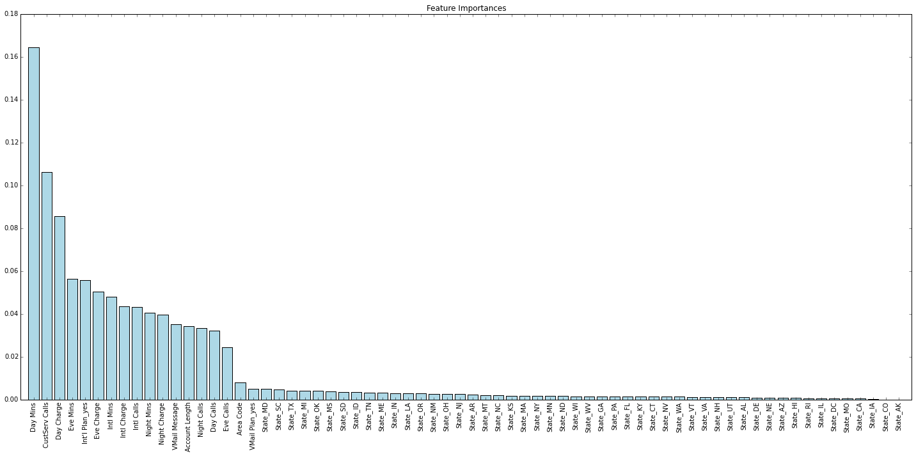
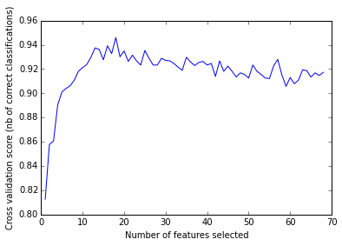
Data Processing: Feature Selection
By looking at feature importance and optimal number of features, area information are not useful.
DF2
Feature Importance with Random Forest
# Features
21 features
State
Data Processing
Feature selection
Drop State
Cross validated optimal number of features
Number of DF1 = 71
# of States = 51
Optimal = 18 features
Optimal
DF1 – State = close to optimal

Slide 6
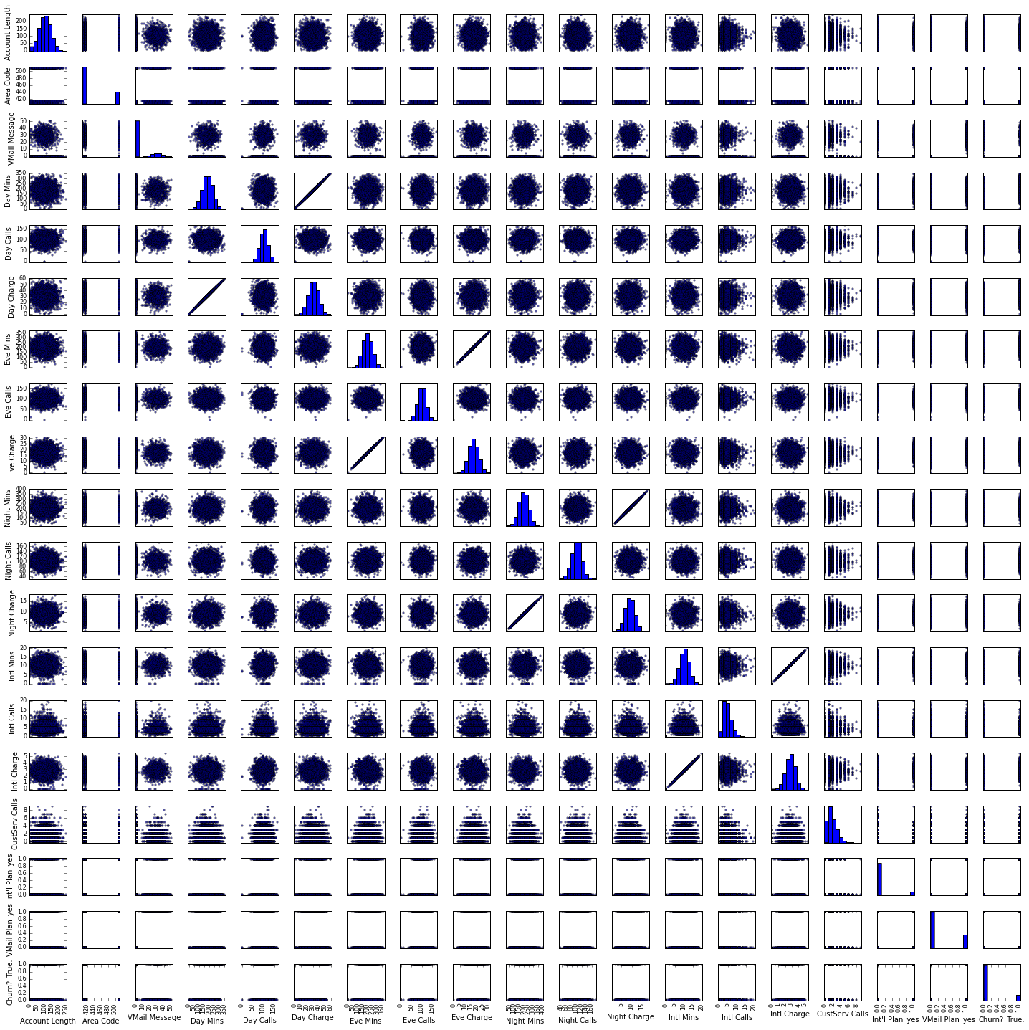
Data Processing: Scatter Matrix
Two issues. (1) Multi-collinearity between Charge and Min (2) distribution of Vmail
DF3
Scatter Matrix on DF3
# Features
17 features
Data Processing
Scatter matrix
Multi-collinearity between Charge and Min
Convert Vmail to 0 or 1
Corr.=.99

Slide 7
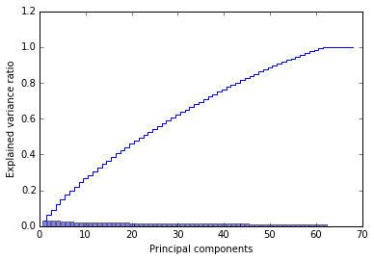
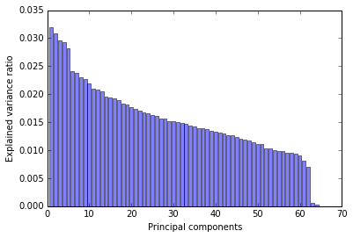
Data Processing: Feature Extraction
Since variances of principal components (PC) decrease smoothly, reducing dimensionality via PCA would not improve our model.
PCA and Explained Variance Ratio
With cumulated sum
Without cumulated sum

Slide 8
Modeling: Compare Algorithms
Top algorithms are gradient boosting and random forest.
Standardization doesn’t improve the scores on tree-based algorithms.
Increase with Standardization
Decrease with Standardization
No change
 | Accuracy | Accuracy w/ S.F. | Precision | Precision w/ S.F. | Recall | Recall w/ S.F. | F1 | F1 w/ S.F.
Gradient Boosting | 0.949 | 0.949 | 0.912 | 0.916 | 0.719 | 0.716 | 0.802 | 0.804
Random Forest | 0.929 | 0.925 | 0.935 | 0.925 | 0.580 | 0.555 | 0.710 | 0.679
Decision Tree Balanced | 0.919 | 0.920 | 0.718 | 0.712 | 0.727 | 0.725 | 0.715 | 0.711
Random Forest Balanced | 0.919 | 0.919 | 0.929 | 0.931 | 0.478 | 0.492 | 0.662 | 0.631
Decision Tree | 0.910 | 0.918 | 0.715 | 0.69 | 0.721 | 0.714 | 0.703 | 0.703
Ada Boost | 0.876 | 0.876 | 0.623 | 0.623 | 0.356 | 0.356 | 0.451 | 0.451
KNN | 0.868 | 0.879 | 0.603 | 0.738 | 0.240 | 0.253 | 0.34 | 0.375
Logistic Regression | 0.860 | 0.862 | 0.573 | 0.567 | 0.166 | 0.215 | 0.252 | 0.310
SVM | 0.855 | 0.913 | 0.00 | 0.872 | 0.00 | 0.468 | 0.00 | 0.607
Gaussian NB | 0.854 | 0.854 | 0.497 | 0.497 | 0.432 | 0.432 | 0.461 | 0.461
Note：w/ S.F. = with standardized features
Note: cross_val_score(cv=10)

Slide 9
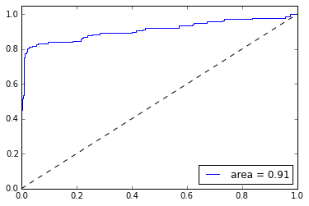
Modeling: Voting Classifier
Voting classifier of gradient boosting and random forest increases cross-validated scores
Gradient Boosting
Voting Classifier (VC)
Accuracy: .949
Precision: .912
Recall: .719
F1: .802
Weight = 1(RF):2(GB)
Accuracy: .951
Precision: .926
Recall: .716
F1: .805
ROC (Non-CV)
Random Forest
Accuracy: .929
Precision: .935
Recall: .580
F1: .710
Note: cross_val_score(cv=10)

Slide 10
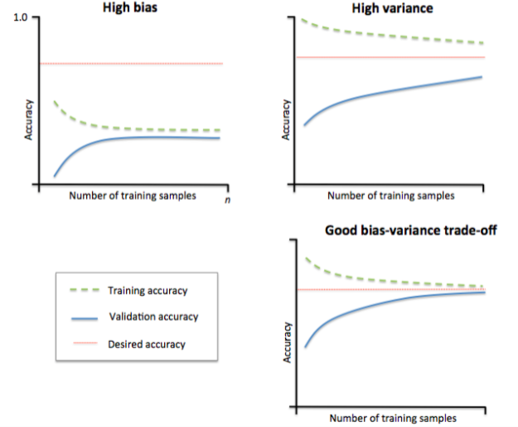
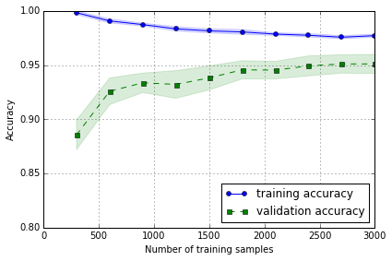
Tuning: Over/Under Fit
Learning curve shows that there is no major issue on fitting.
Example: Bias vs Variance
Learning Curve on VC
Low variance + Low bias
Source: Python Machine Learning

Slide 11
Tuning: Randomized Search
Optimizing parameters of voting classifier further increases accuracy measures.
Best Indiv. Algorithms
Voting Classifier
Randomized Search
Gradient Boosting
Voting Classifier
Randomized Search VC
Accuracy: .949
Precision: .912
Recall: .719
F1: .802
Accuracy: .951
Precision: .926
Recall: .716
F1: .805
Accuracy: .956
Precision: .907
Recall: .743
F1: .825
Optimized Parameters:
RandomForestClassifier(n_jobs=-1, max_depth=3, bootstrap=True, criterion='gini', max_features=4, min_samples_split=3, min_samples_leaf=8, warm_start=False, n_estimators = 6070, class_weight='balanced_subsample' )
GradientBoostingClassifier(learning_rate= 0.3175974111166098, n_estimators=4798, max_depth=None, max_features=5, warm_start=True, min_samples_split=6, min_samples_leaf=5, loss='exponential')
Random Forest
Accuracy: .929
Precision: .935
Recall: .580
F1: .710
Note: cross_val_score(cv=10)

Slide 12
Summary
Preprocessing
Feature importance to detect useful features
Cross-validated accuracy score to find optimal number of features
Model selection
Tree algorithms wins (Gradient boosting classifier and random forest)
Standardization doesn’t increase performance for tree algorithms unlike other algorithms
Voting classifier
Voting classifier increases accuracy measures
Randomized search
Randomized search increases accuracy measures

