Slide 1
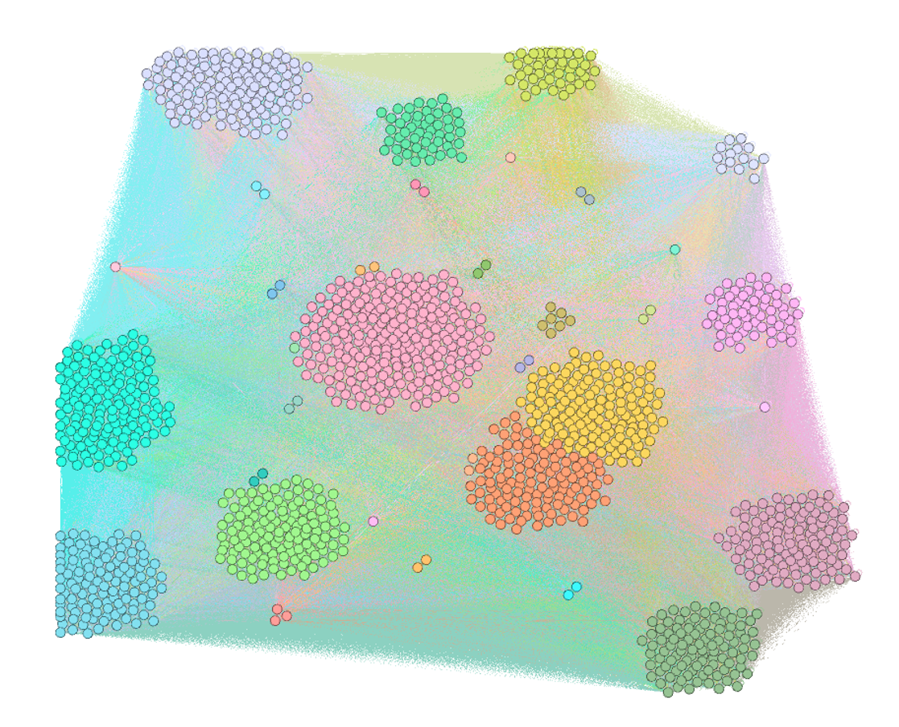
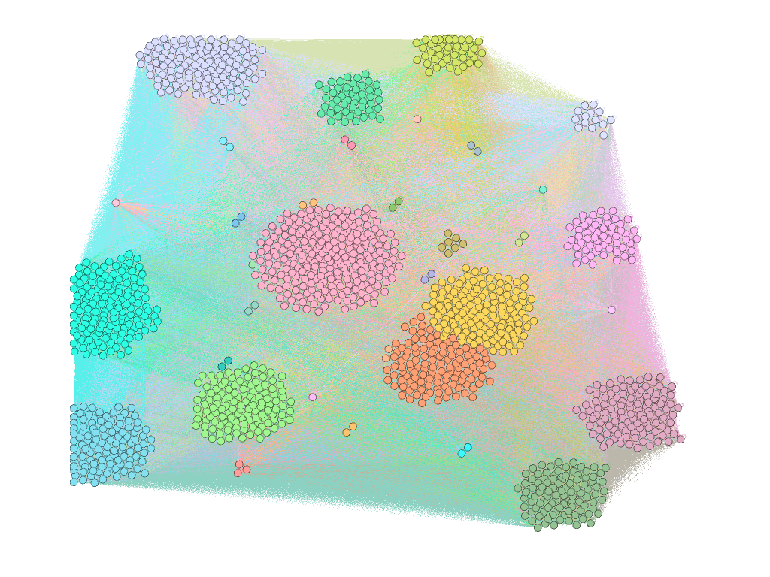
Plasma bonding of Cu/AlN
Biological antioxidant activities
Climate change prediction
Climate dynamics and fluid mechanics
Performance of waterproofing materials
Radio engineering
Semiconductor manufacturing
process
Energy control system
Security for IoT
Chemical image detection
Thermodynamics
Economic engineering
'The strength of material
Data modeling

