Slide 1
Local Storage Service
Ji-beom KIM

Slide 2
Outline
Summary of this week’s work
Your work
Your opinion/thought
Action item

Slide 3
Summary of work this week
Virtual machine install
k8s install
Golang install
cstor-operators build in progress

Slide 4


Your work(install)
Os : centOS 7
k8s : v1.23.4
Golang : 1.13

Slide 5
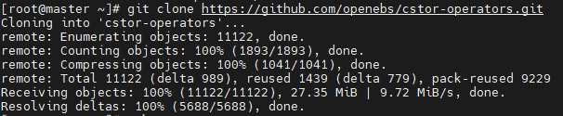

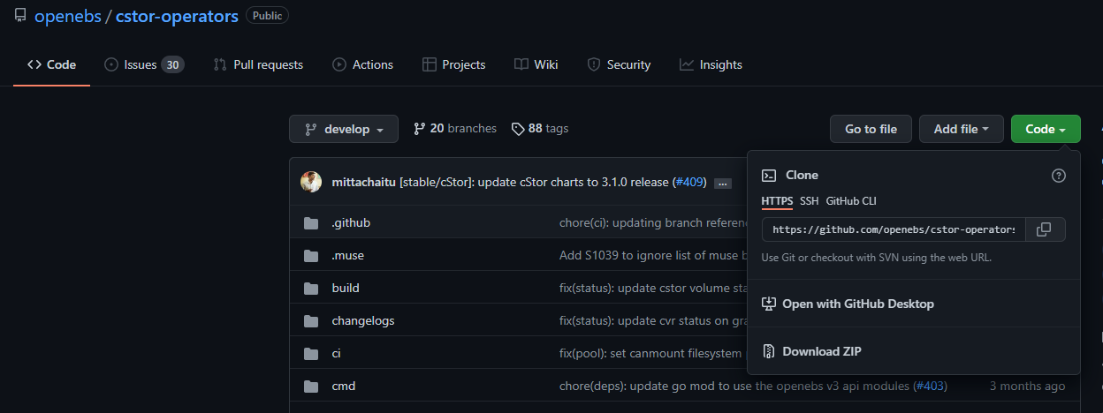
Your work(git clone)
Clones a repository(cstor-operators) into a newly created directory.

Slide 6

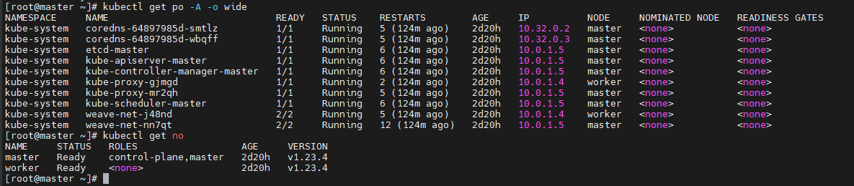
Your work(make)
Make The command works, but the pod doesn't go up.

Slide 7
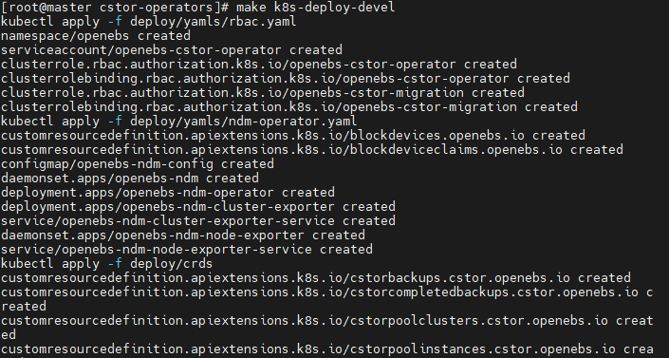
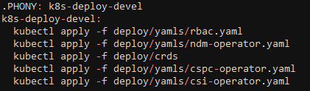
Your work(.PHONY)
The phony target is not the name of the actual file, but the target. There are two purposes for using the pony target.
1) To prevent conflicts with files of the same name
2) To improve performance
Command for run Phony target
$ make (Phony target name)
Phony target in Makefile

Slide 8
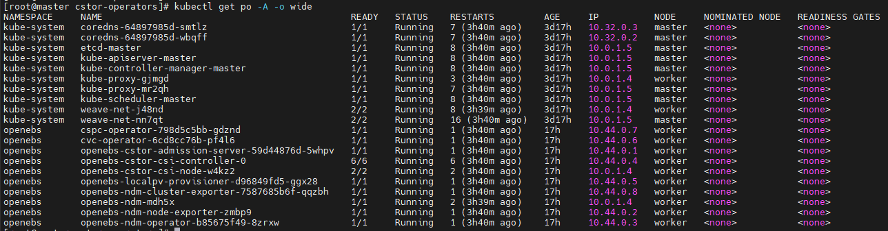
Your work(.PHONY)
The phony target is not the name of the actual file, but the target. There are two purposes for using the pony target.
1) To prevent conflicts with files of the same name
2) To improve performance
Check the pod goes up

Slide 9
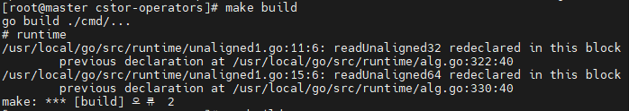
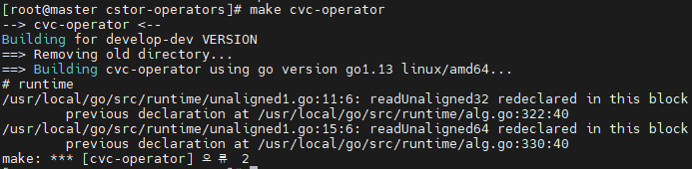
Your work(error)
However, errors occurred in other phony targets.
Error that a function with the same name was used.

Slide 10
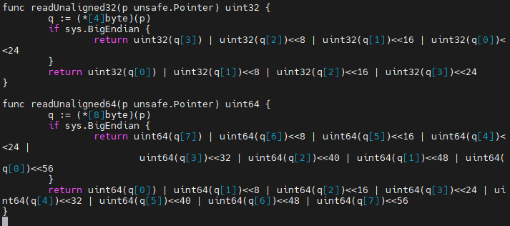
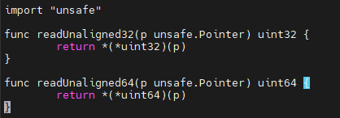
Your work(error)
However, errors occurred in other phony targets.
I tested the file to alternately annotate the functions, but another error occurred.
unaligned1.go
alg.go

Slide 11
Your opinion/thought
Makefile doesn’t work properly.
If the error is not resolved, klog cannot be added.

Slide 12
Action items
1. I will analyze the makefile more and correct the error.
2. Think of another way to create a container image and build a source code.

