Slide 1
How to Provision Kubernetes Local Volume Dynamically
JI-BEOM KIM

Slide 2
Outline
Environmental Constraints
Functional Implementation
Scheduler Extender Architecture
Dynamic PV Provisioner
Conclusion

Slide 3
Environmental Constraints
The kubernetes node we use has a single disk with one partition as the standard specification.
So we needed a way to dynamically allocate and use capabilities within one partition.
Single Disk Single Partition
Require Dynamic Capacity Allocation

Slide 4
Environmental Constraints
There was no network storage at the time of project development.
Decided to use stable Local Volume because the main is DB service operation.
Absence of a Network Storage
Need for use Local Volume

Slide 5
Environmental Constraints
Although there is a local volume provisioner provided by kubernetes, it only supports static provisioning.
Provisioner also support dynamic provisioning of local volumes, but in some cases we could not use them because we needed additional node environments such as lvm.
Absence of a Suitable Provisioner
Need to develop a New Provisioner

Slide 6
Functional Implementation
First, a scheduler was needed to place the pod on the appropriate node according to the disk spare capacity of the node.
We need a provisioner to create PersistentVolume and mount it to the selected path of the selected node.
Scheduler
Pod scheduling with Dynamic Capacity Allocation
Provisioner
Dynamic Local PV Provisioner

Slide 7
Functional Implementation
How to Add New Rules to Scheduler
First, re-compile after adding the desired features directly to the standard kubernetes scheduler.
Second, proprietary scheduler process that takes place instead of or in conjunction with the standard kubernetes scheduler.
Kubernetes Scheduler modification
Implementation of a new scheduler
Scheduler
Extender
Implementaion

Slide 8
Functional Implementation
The previous two methods were not adopted in the process of modifying or creating a new scheduler because it was difficult to manage the version and complicated to implement.
Kubernetes Scheduler modification
Implementation of a new scheduler
Scheduler
Extender
Implementaion

Slide 9
Functional Implementation
The third is to implement a Scheduler Extender that calls at the final stage of the kubernetes scheduler process.
Kubernetes Scheduler modification
Implementation of a new scheduler
Scheduler
Extender
Implementaion

Slide 10
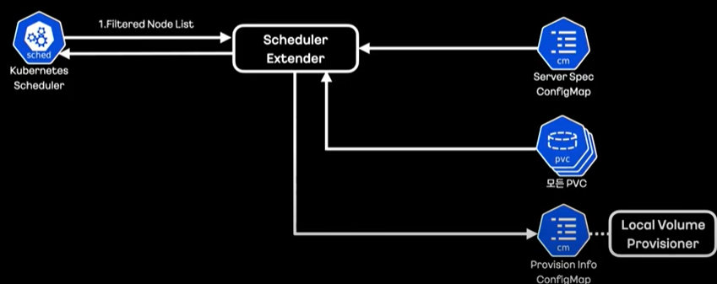
Scheduler Extender Architecture
This is a brief flow of how the extender receives the information to filter and how the provisioner delivers it.

Slide 11
Scheduler Extender Architecture
First, the extender receives a list of nodes filtered by kubernetes.

Slide 12
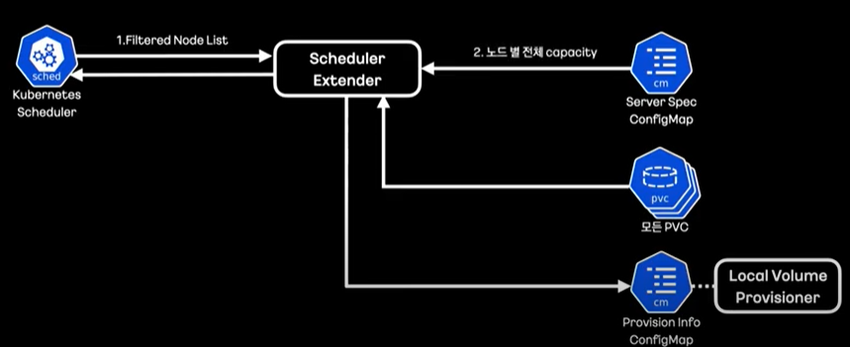
Scheduler Extender Architecture
In addition, we manage the disk capacity of all nodes in a config map called Server Spac. Get this information as well.

Slide 13
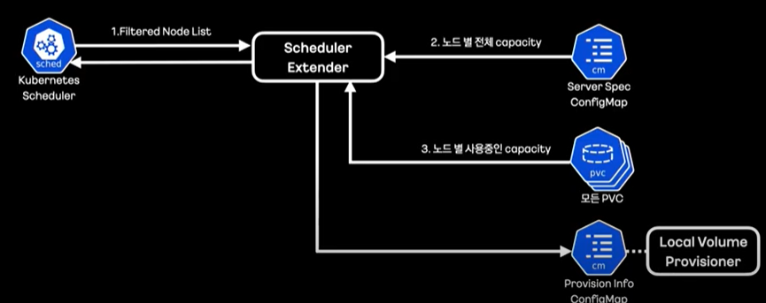
Scheduler Extender Architecture
Obtain volume information mounted per node to determine the capacity currently in use.

Slide 14
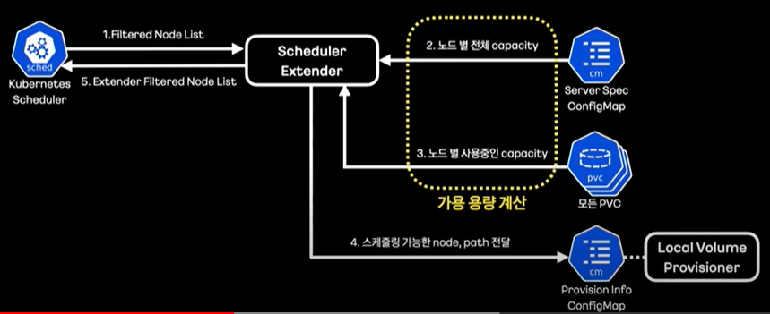
Scheduler Extender Architecture
Based on the difference between total and unused capacity, we derive a mount path list for available uploads.

Slide 15
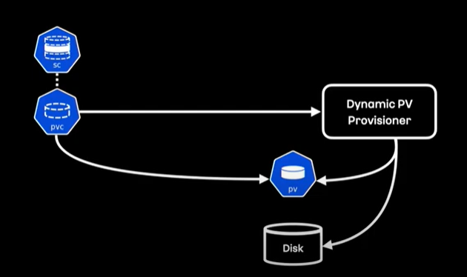
Dynamic PV Provisioner
This is the basic dynamic PV provisional operation flow of Kubernetes.

Slide 16
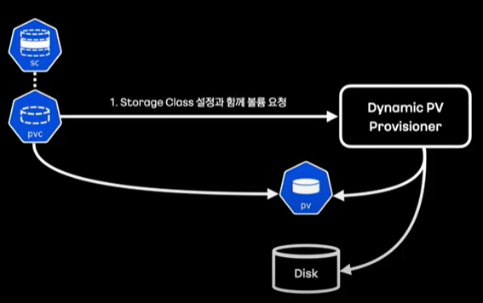
Dynamic PV Provisioner
When a PVC is created, the dynamic provisioner will receive the storage class configuration specified in the PVC and the PVC specification.
The storage class can be seen as specifying what type of storage you want to use for dynamic pv provisioning.

Slide 17
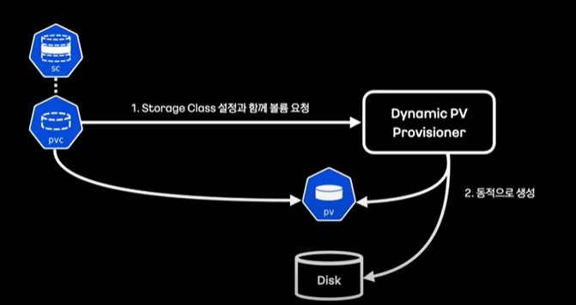
Dynamic PV Provisioner
Provisions create PVs and mount volumes
At this point, the volume will mount the type of volume specified in the provisional field of the storage class.

Slide 18
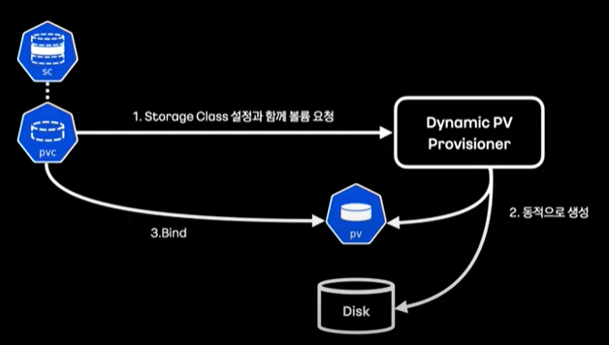
Dynamic PV Provisioner
After the pv is created, the pvc is bound.

Slide 19
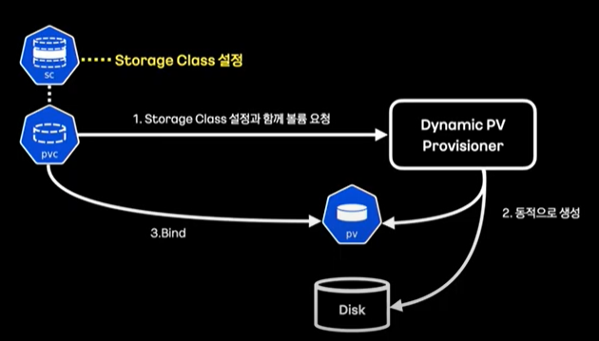
Dynamic PV Provisioner
Created a storage class with provisional-specific settings.

Slide 20
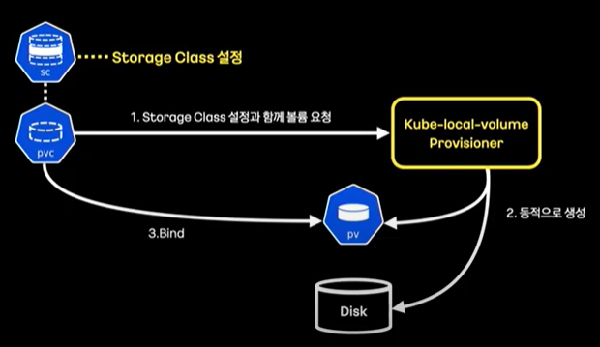
Dynamic PV Provisioner
A new provisioner that directly implements dynamic local volume provisioning.

Slide 21
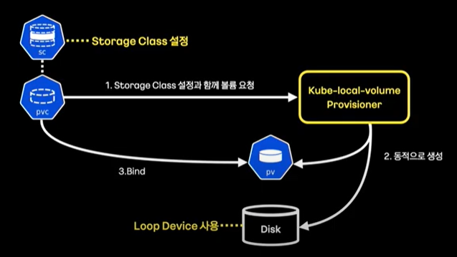
Dynamic PV Provisioner
As a volume, we used a virtual device called a loop device to limit the capacity inside the partition.

Slide 22
Conclusion
We're a block device-based project, and this project is a host path-based project and we haven't found much to help.

