Slide 1
Weekly Report
Jibeom Kim

Slide 2
Weekly Report
Summary of this week’s work
Gantt Chart
Action Item

Slide 3
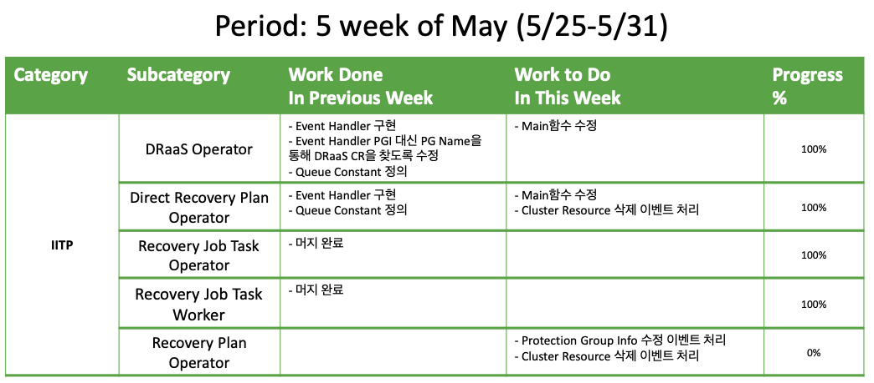
Weekly Report

Slide 4
Summary of this Week’s work
DRaaS Operator – Event Handler
Event Handler 구현
Event Handler PGI 대신 PG Name을 통해 DRaaS CR을 찾도록 수정
Queue Constant 정의
Direct Recovery Plan Operator – Event Handler
Event Handler 구현
Queue Constant 정의
Recovery Job Task Operator
머지 완료
Recovery Job Task Worker
머지 완료

Slide 5
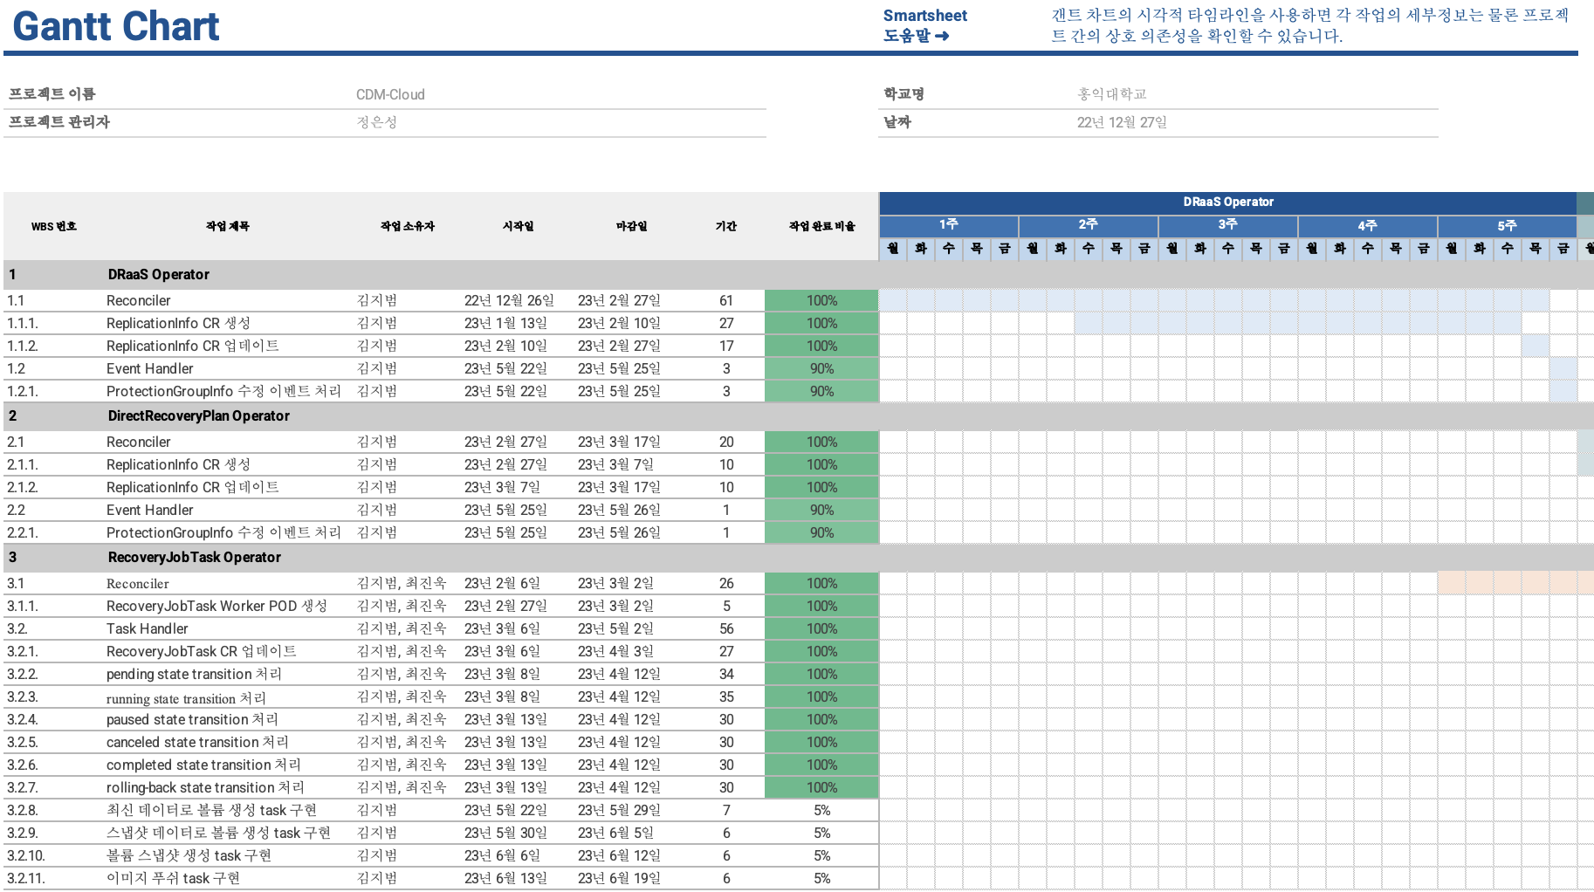
Gantt Chart

Slide 6
Action Item
DRaaS Operator
Main에 이벤트 핸들러 추가
Direct Recovery Plan Operator
Main에 이벤트 핸들러 추가
Recovery Plan Operator
Protection Group Info 수정 이벤트 처리
Cluster Resource 삭제 이벤트 처리
Gantt Chart 작성

