Slide 1
Weekly Report
Jibeom Kim

Slide 2
Weekly Report
Summary of this week’s work
Action Item

Slide 3
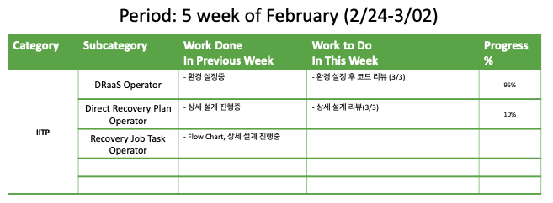
Weekly Report

Slide 4
Summary of this Week’s work
DRaaS Operator
환경 설정중 – import 오류 해결중
Direct Recovery Plan Operator
상세 설계 진행중

Slide 5
Action Item
DRaaS Operator
환경 설정 후 코드 리뷰 (3/3 금)
Direct Recovery Plan Operator
상세 설계 리뷰 (3/3 금)

