Slide 1
Weekly Report
Jibeom Kim

Slide 2
Weekly Report
Summary of this week’s work
Action Item

Slide 3
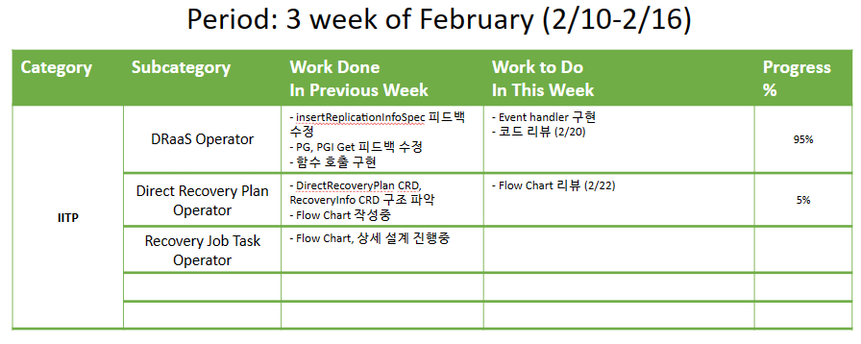
Weekly Report

Slide 4
Summary of this Week’s work
DRaaS Operator
insertReplicationInfoSpec 피드백 수정
PG, PGI Get 피드백 수정
함수 호출 구현
Direct Recovery Plan Operator
DirectRecoveryPlan CRD, RecoveryInfo CRD 구조 파악
Flow Chart 작성중

Slide 5
Action Item
DRaaS Operator
코드 리뷰 희망 (2/20 월)
Direct Recovery Plan Operator
Flow Chart 리뷰 희망 (2/22 수)

