Slide 1
Weekly Report
Jibeom Kim

Slide 2
Weekly Report
Summary of this week’s work
Action Item

Slide 3
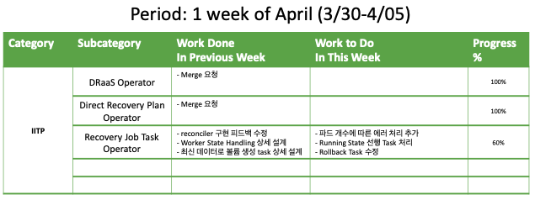
Weekly Report

Slide 4
Summary of this Week’s work
DRaaS Operator
Merge 요청
Direct Recovery Plan Operator
Merge 요청
Recovery Job Task Operator
reconciler 구현 피드백 수정
Worker State Handling 상세 설계
최신 데이터로 볼륨 생성 task 상세 설계

Slide 5
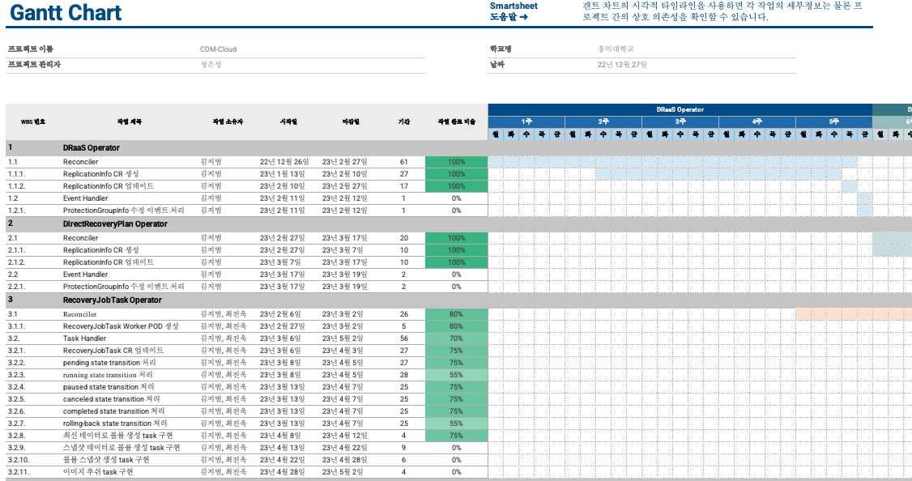
Gantt Chart

Slide 6
Action Item
Recovery Job Task Operator
Reconcile
파드 개수에 따른 에러 처리 추가
Task Handler
Running State 선행 Task 처리
Rollback Task 수정

