Slide 1
Weekly Report
Jibeom Kim

Slide 2
Weekly Report
Summary of this week’s work
Action Item

Slide 3
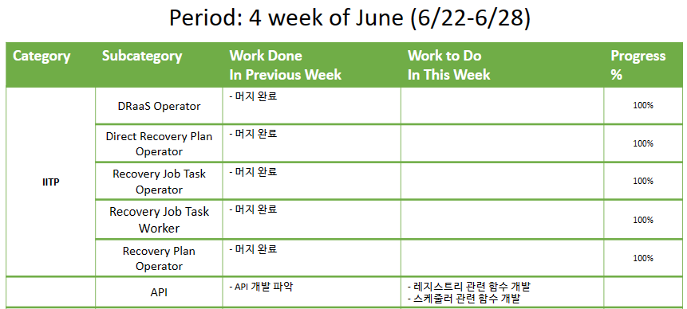
Weekly Report

Slide 4
Summary of this Week’s work
DRaaS Operator – Event Handler
머지 완료
Direct Recovery Plan Operator – Event Handler
머지 완료
Recovery Plan Operator – Event Handler
머지 완료
API
API 개발 파악
handler/handler.go · master · cdm / cdm-center-openshift / services / cluster-manager · GitLab
proto/cluster-manager.pb.micro.go · master · cdm / cdm-center-openshift / services / cluster-manager · GitLab

Slide 5
Action Item
API
레지스트리 관련 함수 개발
스케줄러 관련 함수 개발

