Slide 1
Weekly Report
Jibeom Kim

Slide 2
Weekly Report
Summary of this week’s work
Action Item

Slide 3
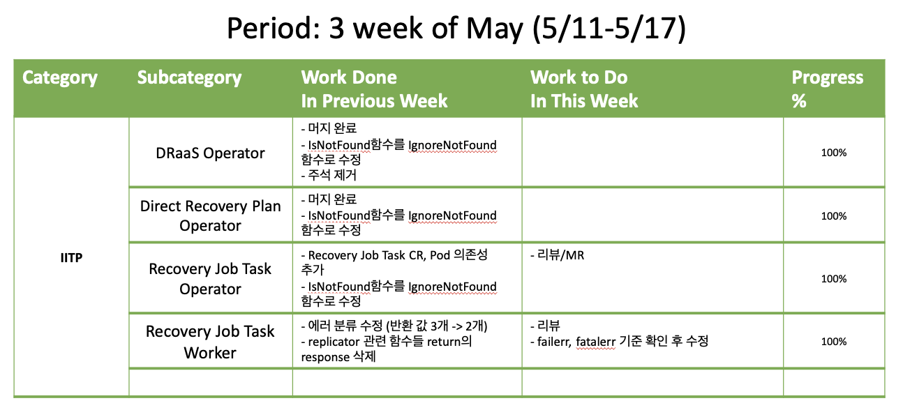
Weekly Report

Slide 4
Summary of this Week’s work
DRaaS Operator
머지 완료
IsNotFound함수를 IgnoreNotFound함수로 수정
주석 제거
Direct Recovery Plan Operator
머지 완료
IsNotFound함수를 IgnoreNotFound함수로 수정
Recovery Job Task Operator
RecoveryJobTask CR, Pod 의존성 추가
IsNotFound함수를 IgnoreNotFound함수로 수정
Recovery Job Task Worker
에러 분류 수정 (반환 값 3개 -> 2개)
replicator 관련 함수들 return의 response 삭제

Slide 5
Action Item
DRaaS Operator
Direct Recovery Plan Operator
Recovery Job Task Operator
리뷰/MR
Recovery Job Task Worker
리뷰
failerr, fatalerr 기준 확인 후 수정

