Slide 1
A new approach to disaster recovery as a service over cloud for database system
Jibeom Kim
Notes:
hello, my name is Ji-beom Kim. I’m in the master’s course in professor eun-sung jeong’s lab.
The paper I prepared is A new approach to disaster recovery as a service over cloud for database system

Slide 2
Paper information
Abstract
Introduction
Related work
Design of Optimal-DRaaS on cloud
Comparative analysis with other DRaaS solutions
Conclusions
Notes:
Contents is as follows: Paper information, Abstract, Introduction, Related work, Design of Optimal-DRaaS on cloud, Optimal-DRaaS operating modes, Comparative analysis with other DRaaS solutions, finally there is a conclusions.

Slide 3
Paper information
A new approach to disaster recovery as a service over cloud for database system
Authors: Saquib, Z., Tyagi, V., Bokare, S., Dongawe, S., Dwivedi, M., Dwivedi, J.
Published in: 2013 15th International Conference on Advanced Computing Technologies (ICACT)
Publisher: IEEE
Notes:
This is the paper information. It is a conference paper written by Saquib. and was published in International Conference on Advanced Computing Technologies (ICACT) and Publisher is IEEE.

Slide 4
Abstract
This paper presents a new approach to Disaster Recovery as a Service (DRaaS) over cloud for database system, which will ensure zero data loss and quick recovery.
The solution makes use of internet small computer system interface (iSCSI) protocol, used for replicating database transaction logs over cloud infrastructure assuring zero data loss.
Notes:
As a reference, we are currently working on providing disaster recovery services in the lab.
This solution is similar in direction to our research in that it pursues services with the goal of business continuity during disaster recovery, so we prepared a presentation.

Slide 5
Introduction
Many public and private sector enterprises use Disaster Recovery (DR) systems to provide data protection to their data and application services. A key challenge in providing a DR Service is to support Business Continuity (BC), allowing faster recovery but with price tag.
Today, cloud-based DR solutions replace legacy approaches and offer burdened infrastructure and operations (I&O) professionals a simple and cost effective solution.

Slide 6
Introduction
In practice, most traditional DR techniques rely on manual detection of disaster situation.
Cloud based DR systems can simplify this problem by monitoring the primary data center from cloud nodes making it simpler to differentiate between a simple network failure or disaster situation and react accordingly.

Slide 7
Introduction
Authors have designed an optimal Disaster Recovery solution which can be offered as a service on any cloud platform.
Authors named the solution as “Optimal Disaster Recovery as a Service” (Optimal-DRaaS). The solution is designed and specialized for database applications with efficient network utilization for data transfer.

Slide 8
Related work
The Cloud service providers usually tie up with the DR solutions vendors to offer Disaster Recovery as a Service (DRaaS) over cloud.
DRaaS solutions are pre-packaged cloud services that provides a standard DR failover to a cloud environment where responsibility of maintaining and managing periodic/continuous backup's lies with the DRaaS solution provider.
Using DRaaS, business professionals can use cloud infrastructure on a pay-per-use basis with varying rates based upon requirement of recovery point objective (RPO) and recovery time objective (RTO).

Slide 9
Related work
The DRaaS providers such as CA ARCserve have vendor lock-in for the cloud service provider or DR solution providers.
In short it will ease the DR activity but compromise the flexibility of business professionals for DR solution or cloud selection.

Slide 10
Related work
The RPO and RTO parameters provided by DRaaS solution depends on the data replication strategy used at the back-end.
Data replication may work at any of the following layers:
i) Application layer that uses file based replication
ii) OS layer that uses host based replication
iii) Virtualization layer that uses hypervisor based replication
iv) Device-driver layer that uses appliance based replication (usually block replication)
v) Storage layer that uses storage based replication mechanism.
Notes:
Each of these mechanisms has some challenges and limitation.
i), ii) The file based and host based replication degrade performance of user application.
iii) Hypervisor based replication is suitable for the private cloud based solution as it requires same virtualization architecture at production and DR site. Further these solution uses file based data replication that degrades performance.
iv) Appliance based solution may create kernel license problems as it interferes with disk drivers.
v) Most of the Storage based solutions available in the market provide faster data replication but with the penalty of vendor lock-in and non-flexibility to the business professionals for selecting DR storage.

Slide 11
Related work
In this paper, Authors designed an Optimal-DRaaS solution using DR-appliance based data replication technique. The DR-appliance uses iSCSI protocol for block level data access and transfer from production to DR site over cloud.
The most important part of the Optimal-DRaaS solution is its flexibility of working with any cloud architecture/platform.
The solution can be deployed on any cloud architecture as “Software as a Service (SaaS) “. Optimal DRaaS Solution will internally use “Infrastructure as a Service (IaaS)” of cloud for running the infrastructure required by its user.

Slide 12
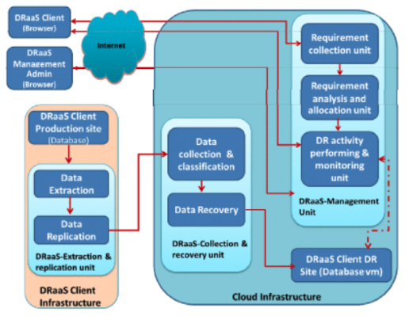
Design of Optimal-DRaaS on cloud
A)
Optimal-DRaaS mainly consists of the three working components
A) DRaaS-Management unit
B) DRaaS–extraction and replication unit
C) DRaaS- data collection and Recovery unit
Optimal-DRaaS uses cloud Infrastructure as a Service (IAAS) for hosting DRaaS management, data collection and recovery unit as shown in Figure The third component, DRaaS–data extraction and replication unit will work from client’s premises.
C)
B)
Block Diagram Optimal DRaaS

Slide 13
Design of Optimal-DRaaS on cloud
A)
A) DRaaS-Management Unit
It is developed using apache-tomcat server with Postgresql database server. The web pages are designed using JSP and servlets. It consists of three sub-components as shown in Figure.
Block Diagram Optimal DRaaS

Slide 14
Design of Optimal-DRaaS on cloud
A)
A) DRaaS-Management Unit
A-1) Requirement collection unit
It performs the front-end activity of user information and requirement gathering.
The user information details along with their requirement for DR such as production database OS type and version, storage requirement for database, RPO and RTO parameter requirement, back-up policy etc. are collected by this unit.
The information and requirement collected will be stored in the DRaaS database to be used further for performing future DR activities.
If user wishes to host their production applications along with the database, information for hosting it is also taken during requirement collection.
Block Diagram Optimal DRaaS

Slide 15
Design of Optimal-DRaaS on cloud
A)
A) DRaaS-Management Unit
A-2) Requirement Analysis and Allocation Unit
It performs the user requirement analysis and accordingly allocates DR storage LUN and virtual database instance to the user.
All the software components, such as operating system, database server, and applications, are installed during the DR Service initiation as per user’s requirement.
Along with the service initiation, DRaaS allocation unit also provides, database and DR volume scalability during the disaster at production site.
It uses logical volume manager feature of operating system. Alert for various DR and admin related activities such as back-up schedule, password notification etc. are done by this unit.
Block Diagram Optimal DRaaS

Slide 16
Design of Optimal-DRaaS on cloud
A)
A) DRaaS-Management Unit
A-3) DR Activity Performing and Monitoring Unit
It is an interactive platform to perform and monitor various DR activities on the virtual database instance allocated for the users.
It provides secure shell login to virtual database instance from web browser.
Using this user can test and perform various DR activities such as DR site configuration, data recovery status, performing test Drill, failover and failback during actual disaster.
Block Diagram Optimal DRaaS

Slide 17
Design of Optimal-DRaaS on cloud
Data Extraction and Replication Unit
Along with the DR Service initialization on cloud, DR- appliance is sent to the user for extracting data from production database, which needs to be configured at production site by the user.
User needs to install and configure the drivers provided along with the appliance and connect the DR-appliance in the network with its production database server.
B)
Block Diagram Optimal DRaaS

Slide 18
Design of Optimal-DRaaS on cloud
Data Extraction and Replication Unit
There is need of establishing an iSCSI connection for data replication from the production DR-appliance to DR solution running over cloud.
Connection establishment is a shared responsibility of the DRaaS management admin and user. It requires IP routing and port opening etc.
Once the iSCSI connection establishment and necessary configuration is done, the transaction log directory is mounted the DR- appliance.
Further any block data entry in the database transaction logs gets replicated to DR site using the block replication solution running on DR-appliance.
B)
Block Diagram Optimal DRaaS

Slide 19
Design of Optimal-DRaaS on cloud
Data Collection and Recovery Unit
The back-end activity of actual user data collection and data recovery is done by the DR-solution running on DR instance over cloud. Note that there is single DR instance running with DR-solution.
As per user subscription and requirement, DR storage LUN (storage volume) are attached or detached to the DR instance.
The DR-solution is based on Unix platform and uses iSCSI protocol for transfer and access to block data.
The DR-solution is designed with multitenancy and auto-reload features that ensure creation of new DR storage LUN for a new user request without disturbing earlier DR storage LUNS.
C)
Block Diagram Optimal DRaaS

Slide 20
Design of Optimal-DRaaS on cloud
Data Collection and Recovery Unit
DRaaS admin sends a signal for refreshing DR-solution with new DR storage LUN.
A user level signal handler is used to refresh DR-solution with new storage LUN.
At DR site, this working unit performs very important activity of data collection, classification as per user and storing to the particular storage LUN allocated to user.
C)
Block Diagram Optimal DRaaS

Slide 21
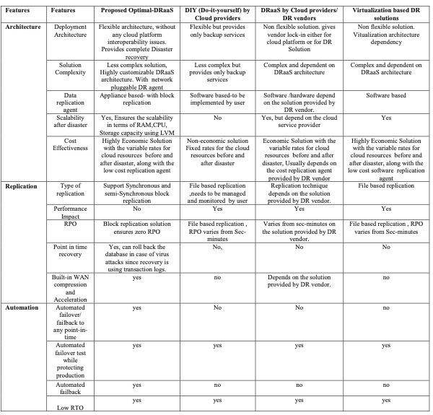
Comparative analysis with other DRaaS solutions
To provide a meaningful comparison, authors have categorized features into three different categories based on requirements for protecting any database applications as follows. i) Architecture, ii) Replication & iii) Automation. Table shows the comparative analysis.
I will focus on the fact that Optimal-DRaaS is superior to other DRaaS.

Slide 22
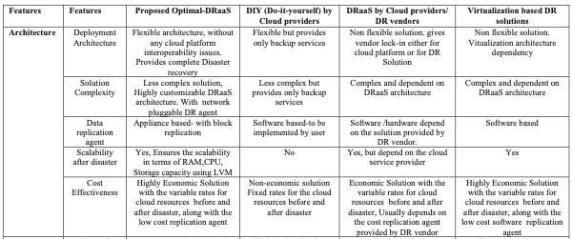
Comparative analysis with other DRaaS solutions
Optimal-DRaaS is a flexible architecture with no cloud platform interoperability issues compared to other DRaaS. Provides complete disaster recovery.
Solution complexity is a low-complexity solution, highly customizable DRaaS architecture, including network-pluggable DR agents.
Data replication agent is appliance-based - with block replication.

Slide 23
Comparative analysis with other DRaaS solutions
Scalability after disaster is Ensures the scalability in terms of RAM, CPU, Storage capacity using LVM.
Cost Effectiveness is Highly Economic Solution with the variable rates for cloud resources before and after disaster, along with the low cost replication agent.

Slide 24
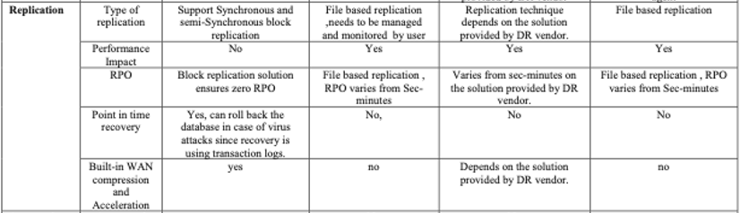
Comparative analysis with other DRaaS solutions
Replication type is Support Synchronous and semi-Synchronous block replication.
No performance impact.
Block replication solution ensures zero RPO.
Roll back the database in case of virus attacks since recovery is using transaction logs for point in time recovery.
Built-in WAN compression and acceleration capabilities available.

Slide 25
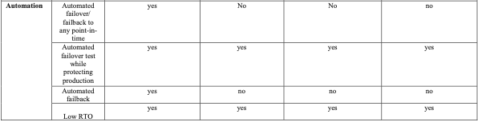
Comparative analysis with other DRaaS solutions
Optimal-DRaaS supports Automated failover/ failback to any point-in- time, Automated failover test while protecting production, Automated failback, Low RTO.
Other DRaaS does not support all four.

Slide 26
Conclusions
This solution uses database server and iSCSI based synchronous/semi-synchronous block replication solution to achieve zero RPO and negligible RTO.
The solution provides automatic failover and failback with the user friendly web based monitoring.
Further the solution gives cloud resource scalability which intern provides the cost effective DRaaS solution.

