Slide 1
scatter 14주차_01_06
한 동 대 학 교 김경미 교수

Slide 2
학습목표
기본 Plot 그리기
Scatter graph

Slide 3
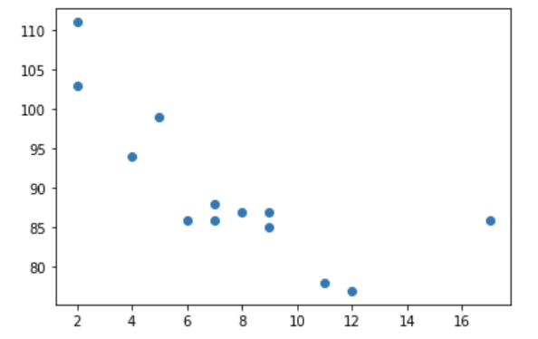
Matplotlib Scatter 1
각 observation에 대해 점으로 표시 함.
import matplotlib.pyplot as plt
import numpy as np
x = np.array([5,7,8,7,2,17,2,9,4,11,12,9,6])
y = np.array([99,86,87,88,111,86,103,87,94,78,77,85,86])
plt.scatter(x, y)
plt.show()

Slide 4
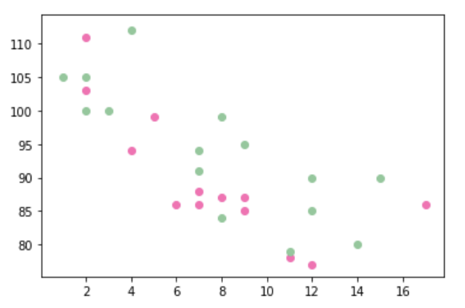
Matplotlib Scatter 2
import matplotlib.pyplot as plt import numpy as np x = np.array([5,7,8,7,2,17,2,9,4,11,12,9,6]) y = np.array([99,86,87,88,111,86,103,87,94,78,77,85,86]) plt.scatter(x, y, color = 'hotpink') x = np.array([2,2,8,1,15,8,12,9,7,3,11,4,7,14,12]) y = np.array([100,105,84,105,90,99,90,95,94,100,79,112,91,80,85]) plt.scatter(x, y, color = '#88c999') plt.show()

Slide 5
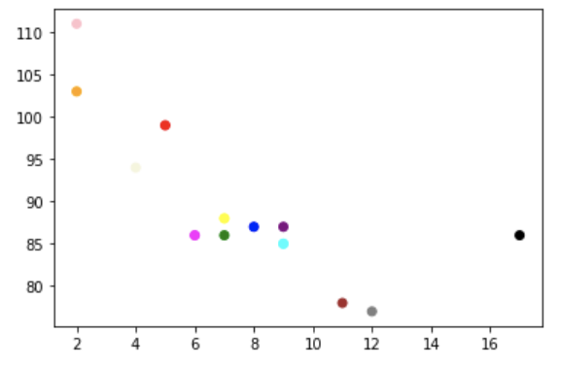
Matplotlib Scatter 3
import matplotlib.pyplot as plt
import numpy as np
x = np.array([5,7,8,7,2,17,2,9,4,11,12,9,6])
y = np.array([99,86,87,88,111,86,103,87,94,78,77,85,86])
colors = np.array(["red","green","blue","yellow","pink","black","orange","purple","beige","brown","gray","cyan","magenta"])
plt.scatter(x, y, c=colors)
plt.show()

Slide 6
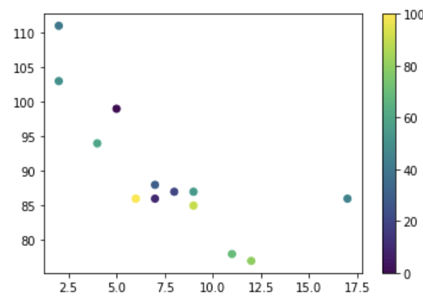
Matplotlib Scatter 4
import matplotlib.pyplot as plt
import numpy as np
x = np.array([5,7,8,7,2,17,2,9,4,11,12,9,6])
y = np.array([99,86,87,88,111,86,103,87,94,78,77,85,86])
colors = np.array([0, 10, 20, 30, 40, 45, 50, 55, 60, 70, 80, 90, 100])
plt.scatter(x, y, c=colors, cmap='viridis')
plt.colorbar()
plt.show()

Slide 7
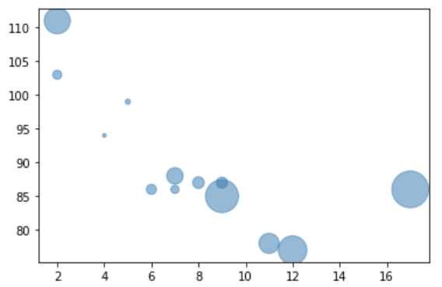
Matplotlib Scatter 5
import matplotlib.pyplot as plt
import numpy as np
x = np.array([5,7,8,7,2,17,2,9,4,11,12,9,6])
y = np.array([99,86,87,88,111,86,103,87,94,78,77,85,86])
sizes = np.array([20,50,100,200,500,1000,60,90,10,300,600,800,75])
plt.scatter(x, y, s=sizes, alpha=0.5)
plt.show()

Slide 8
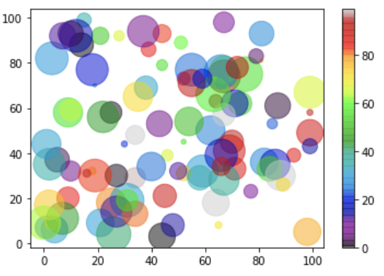
Matplotlib Scatter 6
import matplotlib.pyplot as plt
import numpy as np
x = np.random.randint(100, size=(100))
y = np.random.randint(100, size=(100))
colors = np.random.randint(100, size=(100))
sizes = 10 * np.random.randint(100, size=(100))
plt.scatter(x, y, c=colors, s=sizes, alpha=0.5, cmap='nipy_spectral')
plt.colorbar()
plt.show()

Slide 9
연습문제 1
(1,1), (3,3), (5,5), (7,7), (9,9)에 점이 분포하도록
산점도를 그리시오

Slide 10
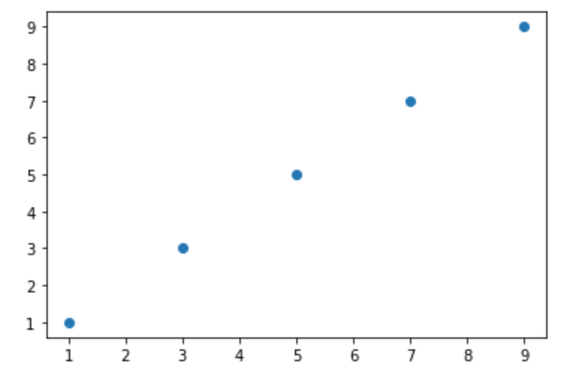
연습문제 1, 답안
import matplotlib.pyplot as plt
import numpy as np
x = np.array([1,3,5,7,9])
y = np.array([1,3,5,7,9])
plt.scatter(x, y)
plt.show()

Slide 11
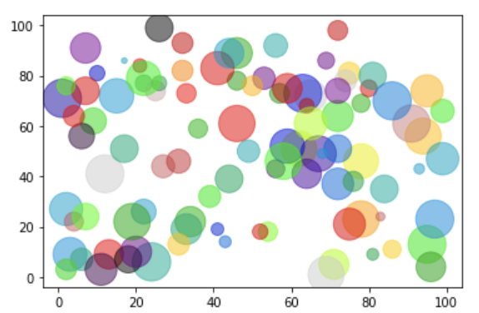
연습문제 2
아래 그림처럼 색과 크기가 랜덤이기 위한 알맞은 표현은?
import matplotlib.pyplot as plt
import numpy as np
x = (100, size=(100))
y = (100, size=(100))
colors = (100, size=(100))
sizes = 10 * (100, size=(100))
plt.scatter(x, y, c=colors, s=sizes, alpha=0.5, cmap='nipy_spectral')
plt.show()

Slide 12
연습문제 2 답안
아래 그림처럼 색과 크기가 랜덤이기 위한 알맞은 표현은?
import matplotlib.pyplot as plt
import numpy as np
x = (100, size=(100))
y = (100, size=(100))
colors = (100, size=(100))
sizes = 10 * (100, size=(100))
plt.scatter(x, y, c=colors, s=sizes, alpha=0.5, cmap='nipy_spectral')
plt.show()
np.random.randint
np.random.randint
np.random.randint
np.random.randint

Slide 13
강의 요약
기본 Plot 그리기
Scatter
각 observation에 대해 점으로 표시 함.
c
cmap
s
alpha

Slide 14
목표 달성 질문
scatter() 함수를 사용하면 어떤 형태의 그래프가 그려지는가?

Slide 15
감사합니다
14주차_01_06 scatter

