Slide 1
subplot 14주차_01_11
한 동 대 학 교 김경미 교수

Slide 2
학습목표
다양한 multiplot
Subplots
Subplot2grid
Grid

Slide 3
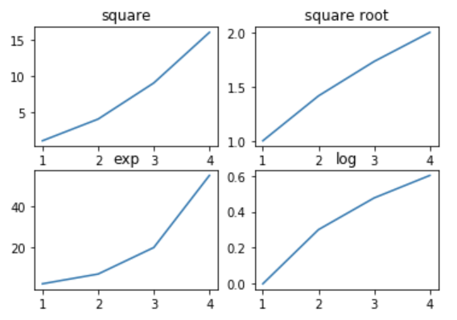
Subplot 1
한 번의 call로 enclosing figure object를 포함하여 subplot의 공통 레이아웃을 만드는데 도움.
import matplotlib.pyplot as plt
import numpy as np
fig,a = plt.subplots(2,2)
x = np.arange(1,5)
a[0][0].plot(x,x*x)
a[0][0].set_title('square')
a[0][1].plot(x,np.sqrt(x))
a[0][1].set_title('square root')
a[1][0].plot(x,np.exp(x))
a[1][0].set_title('exp')
a[1][1].plot(x,np.log10(x))
a[1][1].set_title('log')
plt.show()

Slide 4
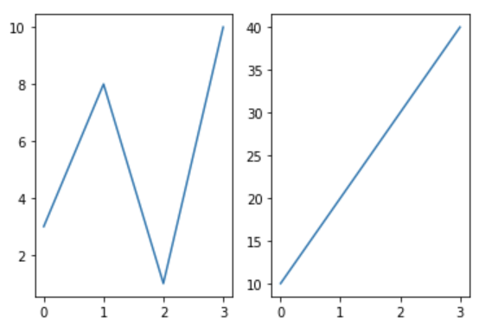
Subplot 2
import matplotlib.pyplot as plt
import numpy as np
#plot 1:
x = np.array([0, 1, 2, 3])
y = np.array([3, 8, 1, 10])
plt.subplot(1, 2, 1)
plt.plot(x,y)
#plot 2:
x = np.array([0, 1, 2, 3])
y = np.array([10, 20, 30, 40])
plt.subplot(1, 2, 2)
plt.plot(x,y)
plt.show()

Slide 5
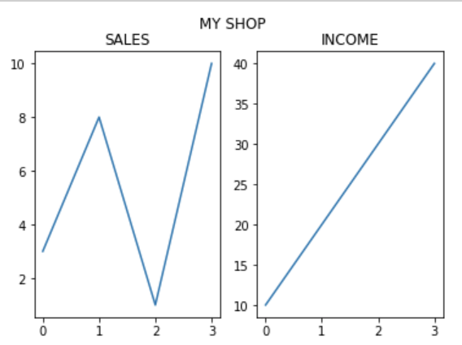
Subplot 3
import matplotlib.pyplot as plt
import numpy as np
x = np.array([0, 1, 2, 3])
y = np.array([3, 8, 1, 10])
plt.subplot(1, 2, 1)
plt.plot(x,y)
plt.title("SALES")
x = np.array([0, 1, 2, 3])
y = np.array([10, 20, 30, 40])
plt.subplot(1, 2, 2)
plt.plot(x,y)
plt.title("INCOME")
plt.suptitle("MY SHOP")
plt.show()

Slide 6
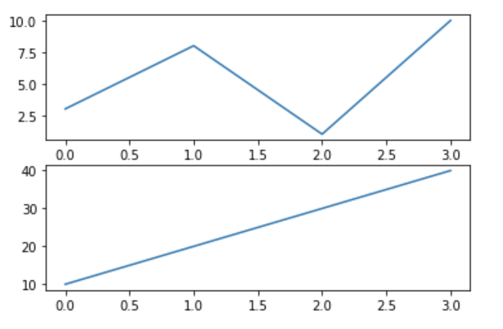
Subplot 4
import matplotlib.pyplot as plt
import numpy as np
#plot 1:
x = np.array([0, 1, 2, 3])
y = np.array([3, 8, 1, 10])
plt.subplot(2, 1, 1)
plt.plot(x,y)
#plot 2:
x = np.array([0, 1, 2, 3])
y = np.array([10, 20, 30, 40])
plt.subplot(2, 1, 2)
plt.plot(x,y)
plt.show()

Slide 7
Subplot 5
x = np.array([0, 1, 2, 3])
y = np.array([10, 20, 30, 40])
plt.subplot(2, 3, 4)
plt.plot(x,y)
x = np.array([0, 1, 2, 3])
y = np.array([3, 8, 1, 10])
plt.subplot(2, 3, 5)
plt.plot(x,y)
x = np.array([0, 1, 2, 3])
y = np.array([10, 20, 30, 40])
plt.subplot(2, 3, 6)
plt.plot(x,y)
plt.show()
import matplotlib.pyplot as plt
import numpy as np
x = np.array([0, 1, 2, 3])
y = np.array([3, 8, 1, 10])
plt.subplot(2, 3, 1)
plt.plot(x,y)
x = np.array([0, 1, 2, 3])
y = np.array([10, 20, 30, 40])
plt.subplot(2, 3, 2)
plt.plot(x,y)
x = np.array([0, 1, 2, 3])
y = np.array([3, 8, 1, 10])
plt.subplot(2, 3, 3)
plt.plot(x,y)

Slide 8
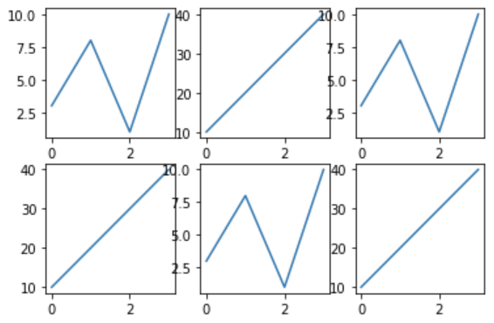
Subplot 5 결과

Slide 9
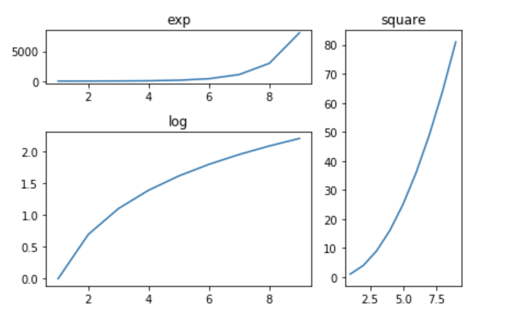
Subplot2grid
특정 위치에 axes object 만드는데 더 많은 유연성 제공
import matplotlib.pyplot as plt
import numpy as np
a1 = plt.subplot2grid((3,3),(0,0),colspan = 2)
a2 = plt.subplot2grid((3,3),(0,2), rowspan = 3)
a3 = plt.subplot2grid((3,3),(1,0),rowspan = 2, colspan = 2)
x = np.arange(1,10)
a1.plot(x, np.exp(x))
a1.set_title('exp')
a2.plot(x, x*x)
a2.set_title('square')
a3.plot(x, np.log(x))
a3.set_title('log')
plt.tight_layout()
plt.show()

Slide 10
연습문제 1
아래 그림이 결과로 나오기 위한 알맞은 표현은?
import matplotlib.pyplot as plt
import numpy as np
x = np.array([0, 1, 2, 3])
y = np.array([3, 8, 1, 10])
plt.plot(x,y)
x = np.array([0, 1, 2, 3])
y = np.array([10, 20, 30, 40])
plt.plot(x,y)
plt.show()

Slide 11
연습문제 1 답안
import matplotlib.pyplot as plt
import numpy as np
x = np.array([0, 1, 2, 3])
y = np.array([3, 8, 1, 10])
plt.subplot(2, 1, 1)
plt.plot(x,y)
x = np.array([0, 1, 2, 3])
y = np.array([10, 20, 30, 40])
plt.subplot(2, 1, 2)
plt.plot(x,y)
plt.show()

Slide 12
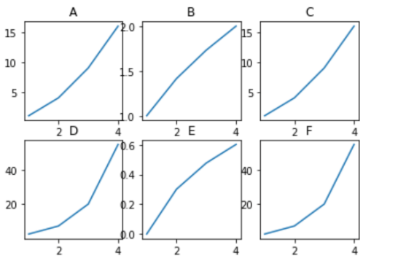
연습문제 2
다음 출력 결과가 나오기 위한 빈칸의 표현은?
import matplotlib.pyplot as plt
import numpy as np
x = np.arange(1,5)
a[0][0].plot(x,x*x)
a[0][0].set_title('A')
a[0][1].plot(x,np.sqrt(x))
a[0][1].set_title('B')
a[0][2].plot(x,x*x)
a[0][2].set_title('C')
a[1][0].plot(x,np.exp(x))
a[1][0].set_title('D')
a[1][1].plot(x,np.log10(x))
a[1][1].set_title('E')
a[1][2].plot(x,np.exp(x))
a[1][2].set_title('F')
plt.show()
1. fig,a = plt.subplots(6,0)
2. fig,a = plt.subplots(3,2)
3. fig,a = plt.subplots(0,6)
4. fig,a = plt.subplots(2,3)

Slide 13
연습문제 2 답안
import matplotlib.pyplot as plt
import numpy as np
x = np.arange(1,5)
a[0][0].plot(x,x*x)
a[0][0].set_title('A')
a[0][1].plot(x,np.sqrt(x))
a[0][1].set_title('B')
a[0][2].plot(x,x*x)
a[0][2].set_title('C')
a[1][0].plot(x,np.exp(x))
a[1][0].set_title('D')
a[1][1].plot(x,np.log10(x))
a[1][1].set_title('E')
a[1][2].plot(x,np.exp(x))
a[1][2].set_title('F')
plt.show()
1. fig,a = plt.subplots(6,0)
2. fig,a = plt.subplots(3,2)
3. fig,a = plt.subplots(0,6)
4. fig,a = plt.subplots(2,3)

Slide 14
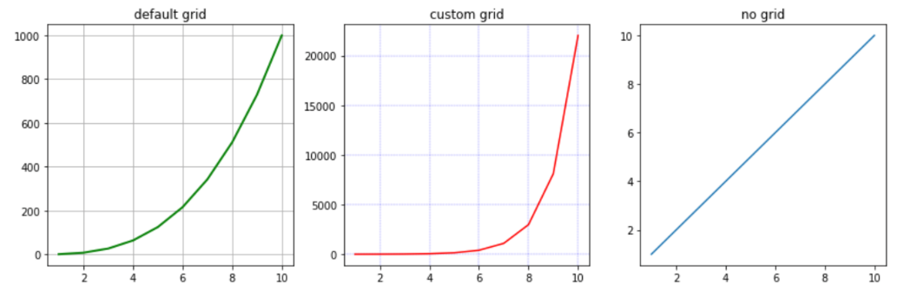
Grid
figure 내부에 grid의 visibility를 설정
import matplotlib.pyplot as plt
import numpy as np
fig, axes = plt.subplots(1,3, figsize = (12,4))
x = np.arange(1,11)
axes[0].plot(x, x**3, 'g',lw=2)
axes[0].grid(True)
axes[0].set_title('default grid')
axes[1].plot(x, np.exp(x), 'r')
axes[1].grid(color='b', ls = '-.', lw = 0.25)
axes[1].set_title('custom grid')
axes[2].plot(x,x)
axes[2].set_title('no grid')
fig.tight_layout()
plt.show()

Slide 15
Reference
https://www.tutorialspoint.com/matplotlib/matplotlib_jupyter_notebook.htm
https://www.w3schools.com/python/matplotlib_intro.asp
https://matplotlib.org/stable/index.html
https://realpython.com/python-matplotlib-guide/
https://datascienceschool.net/01%20python/05.02%20%EB%A7%B7%ED%94%8C%EB%A1%AF%EB%A6%AC%EB%B8%8C%EC%9D%98%20%EC%97%AC%EB%9F%AC%EA%B0%80%EC%A7%80%20%ED%94%8C%EB%A1%AF.html

Slide 16
강의 요약
Object-oriented Interface
Subplots
한 figure에 여러 plots을 그릴 수 있음
Subplot2grid
특정 위치에 axes object를 만드는데 더 많은 유연성 제공
Grid
figure 내부에 grid의 visibility를 설정

Slide 17
목표 달성 질문
특정 위치에 axes object를 만드는데 더 많은 유연성 제공하는 멀티플롯 함수는 무엇인가?

Slide 18
감사합니다
14주차_01_11 subplot

