Slide 1
FoodReal
Two Seniors
Week3
Kimlong Hor, Yunseo Claire Han [leader]
Presented by Luna R

Slide 2
Product Description
It is a social media app that allows users to casually share their daily foods and see what others are eating.
Main features to create:
Creating a user account
Using front and back cameras to capture images
Posting images publicly
Able to see images posted by other users
Getting a notification to post

Slide 3
User Manual
Sign up to create an account
Set up a notification to remind your meals
Whenever you are about to eat, navigate to the camera section of the app to take a picture with both front and back facing camera
Optionally add a description to the pictures then press post button
Navigate to the posting wall section of the app to see what other people ate throughout the day
Like other people’s food by pressing a button

Slide 4
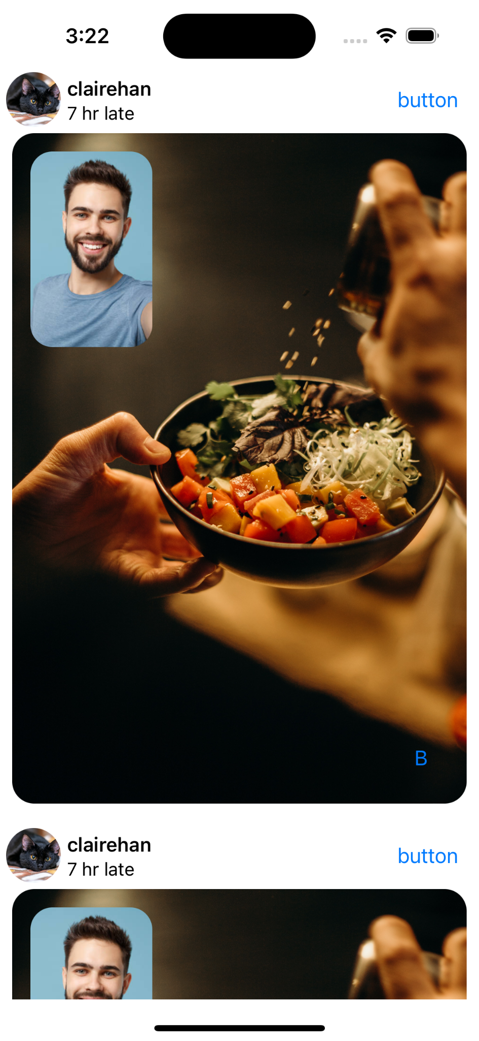
Use Cases
Posting your own recipes with end picture and reaction
Keeping track of what you’ve eaten
Maintain healthy eating habits
Share uncommon cuisines with friends

Slide 5



Technology
Frontend
Swift
SwiftUI
UIKit
Backend
Cloud Firestore
Tools
XCode

Slide 6
Job assignments
Kimlong Hor (Front end lead)
Posting wall
Plan UI structure and components
User onboarding instructions
Notification
Help with backend
Yunseo Han (Back end lead)
Set up Firestore
Set up user login
Plan database collection and document structure
Write CRUD Operations
Help with UI

Slide 7
Milestones and Deadlines
By the end of | These milestones will be reached
Week 2 | Plan UI structure and components Set up Firestore project
Week 4 | Plan database collection and document structure Write Create and Read operation for posting wall Base UI implementation of posting wall
Week 6 | Posting wall with functionality Set up firebase authentication
Week 8 | Implement picture taking functionality Write rest of CRUD operation
Week 10 | User onboarding screens Implement notification
Week 12 | Polish up the app Test the app

Slide 8
Ideas inspired by Two Seniors
If time permitted, we could also have a notification system for our website.
It would be convenient to enable our website users to upload pictures of their unknown words and let our website to recognize them and translate to English.

Slide 9
Areas where we can collaborate:
Suggestions for improvements:
We’ve never worked on an IOS app, so the help we can offer is limited. But we would want to learn together.
It would be good to have a comment section so that users can have more interaction.

Slide 10
