Slide 1
FoodReal
Two Seniors
Week4
Kimlong Hor, Yunseo Claire Han [leader]
Presented by Luna R

Slide 2
Accomplished works
Planed database and document structure
Wrote Create and read operation for posting wall
Implemented base UI implementation for the posting wall

Slide 3
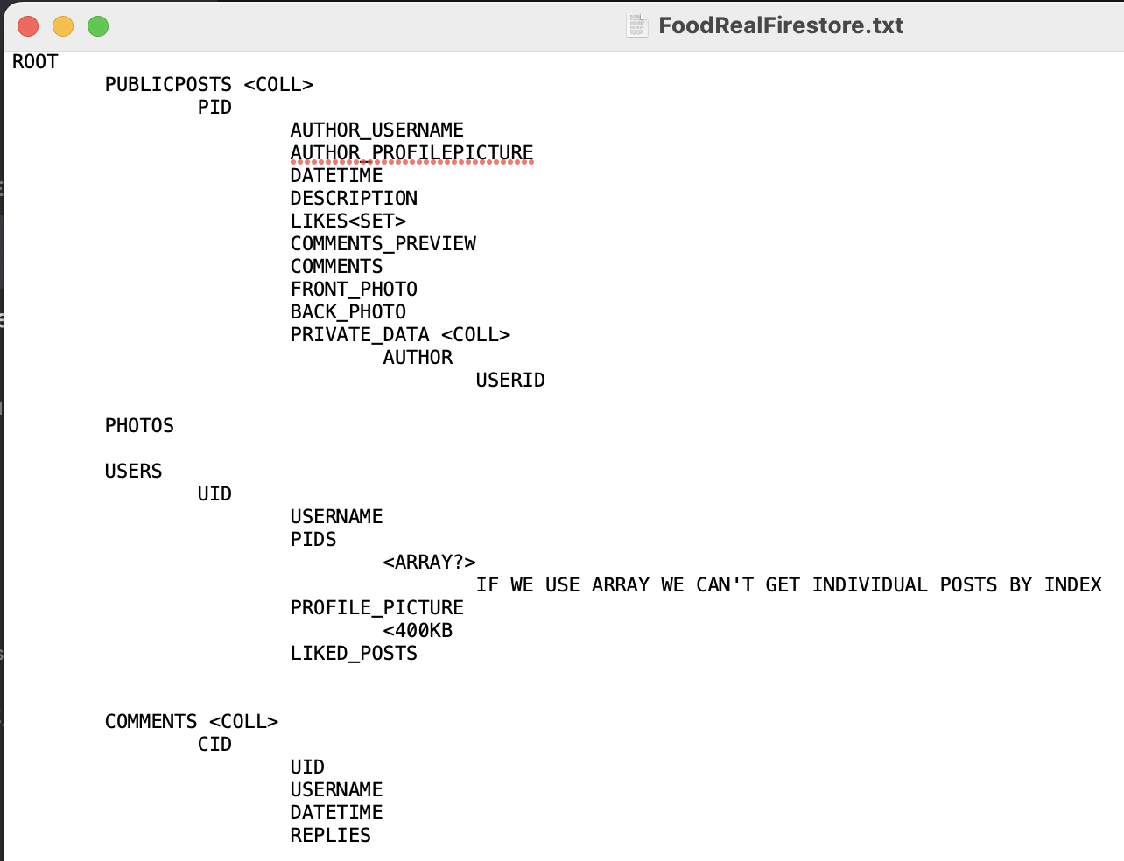
Database Plan
Researched Cloud Firestore rules to structure in a way that would reduce reads and writes
Denormalization
Some rules:
Documents have limits
<1mb in single document
<20,000 fields
Fields include number of elements in arrays and maps
Firestore keeps indexes in all fields
Documents with a lot of fields impact write performance
You can’t retrieve partial documents
When retrieving documents, you’re retrieving all the data in that document
You need to keep secret parts of the document in a separate document
Arrays are weird
Can’t query, insert, delete, or modify array elements at specific position

Slide 4
Posting Wall Create and Read Operation
“Meal” Model representing each post
Follows “Codable” protocol for easy mapping of values when adding and getting documents from Firestore
add(aPublicMeal meal: Meal)
Adds a Meal document to Firestore
getData()
Get 5 Meal documents from Firestore
Pagination for the scrolling table
Prevent unnecessary reads

Slide 5
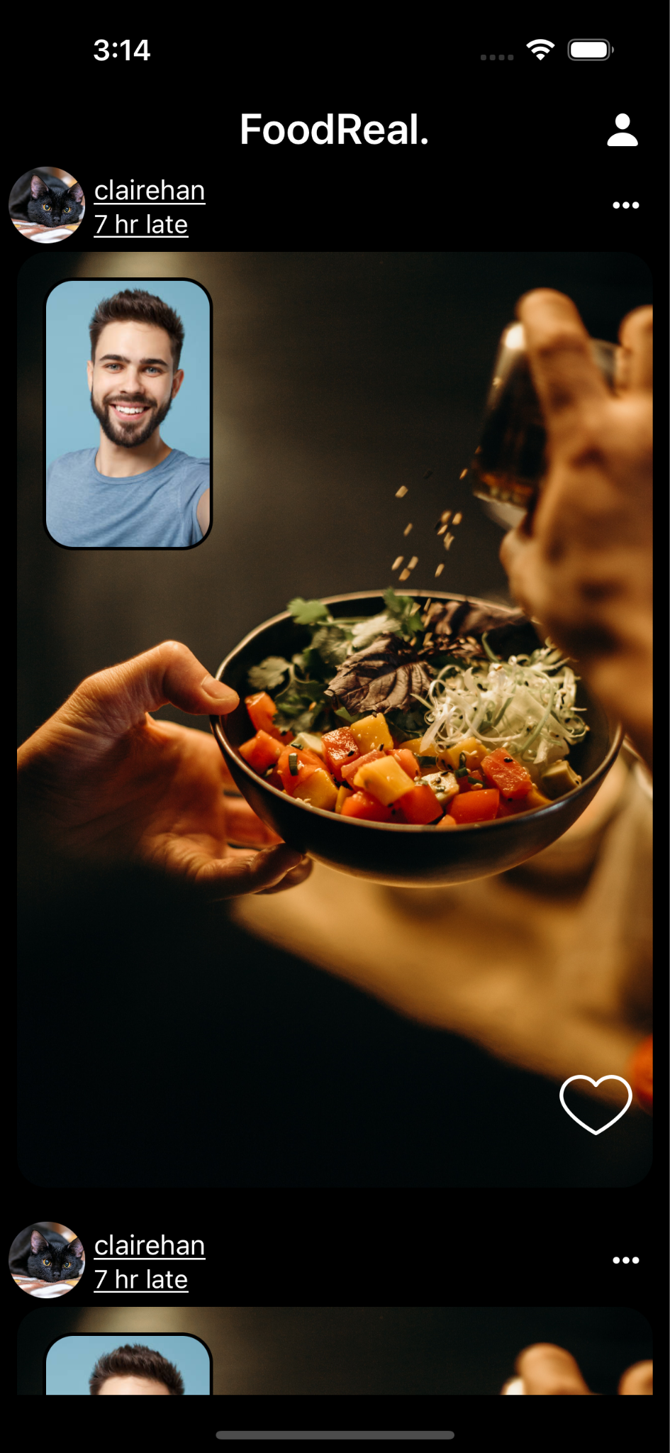
User Interface
In the PostingWallViewController:
An embedded Navigation Controller for navigating to different pages or controllers
An collection view, which is a scrollable view, for showing images and post-related information from users
A like button <3

Slide 6
Milestones and Deadlines
By the end of | These milestones will be reached
Week 2 | Plan UI structure and components Set up Firestore project
Week 4 | Plan database collection and document structure Write Create and Read operation for posting wall Base UI implementation of posting wall
Week 6 | Posting wall with functionality Set up firebase authentication
Week 8 | Implement picture taking functionality Write rest of CRUD operation
Week 10 | User onboarding screens Implement notification
Week 12 | Polish up the app Test the app

