Slide 1
FoodReal
Two Seniors
Week 5
Kimlong Hor, Yunseo Claire Han [leader]

Slide 2
This Week’s Update
Progress
Started working on user onboarding screen
Added a customized camera screen into the app
It only works for the back camera

Slide 3
Application Users Documentation
Follow the onboarding to create an account
Set up notification system to remind meals
Take a picture of your meal in the camera section
Press send to post your meal
Scroll through home section to see other’s post
Press heart to like others’ post
For more information: Documentation for Application Users

Slide 4
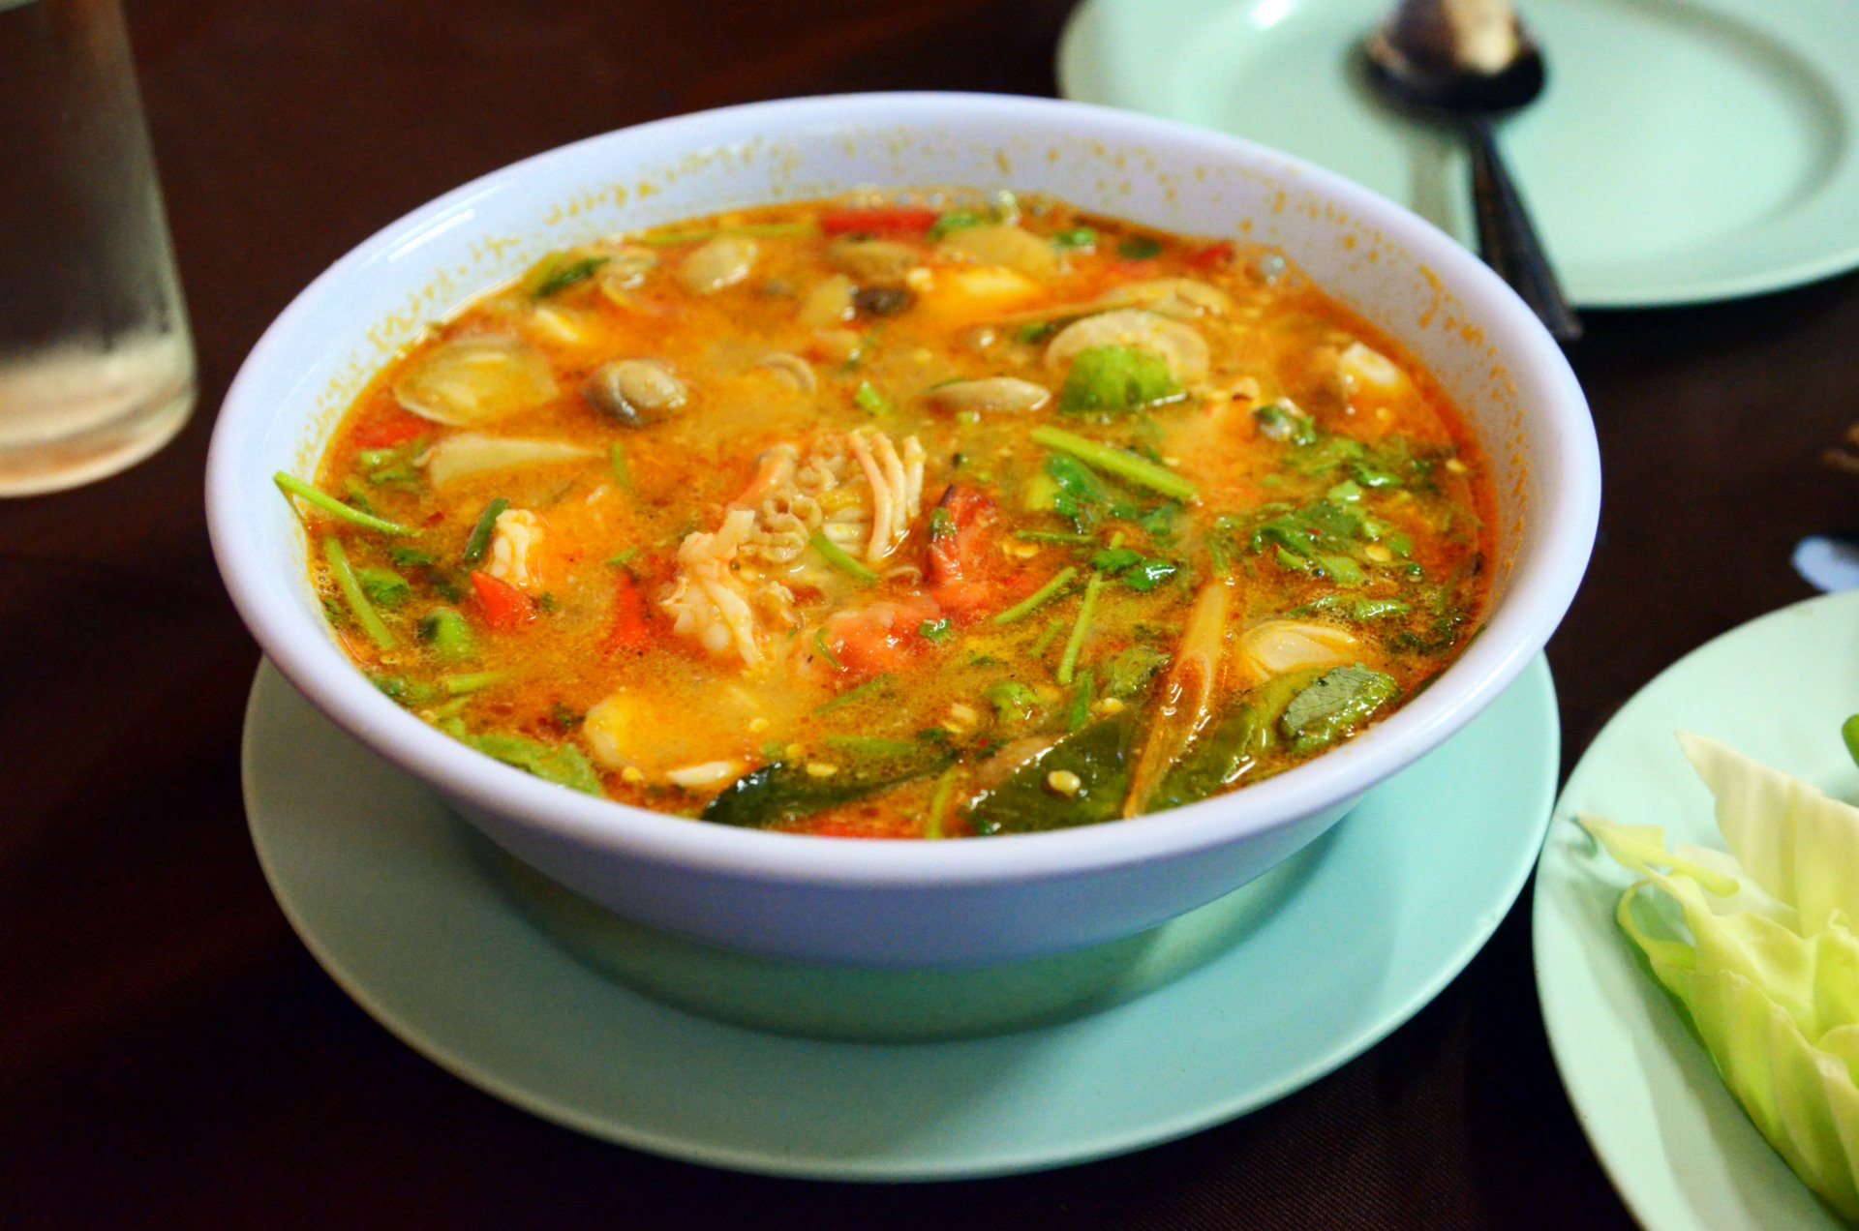

Application Users Use Cases
Post your own recipes with reaction
Keep track of what you’ve eaten
Maintain healthy eating habits
Share uncommon cuisines with friends
For more information: Documentation for Application Users

Slide 5

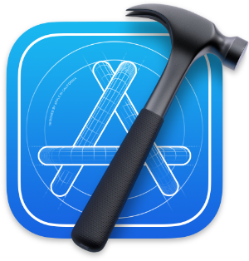

Expert Users Documentation
Xcode
Xcode command line tools
Install Homebrew
Install cocoapods
Download the project zip file from GitHub
Enter ‘pod install’ in project directory
Open .xcworkspace file
Run project
For more information: Documentation for Expert Users

Slide 6
Team Feedback

Slide 7
Expert User Feedback
It’s cool how the app looks like instagram but food
So the learning curve for new users will not be too high
It’s also really simple to take pictures and create a post

Slide 8
Use Case Feedback
It would be useful if users can select photos from their library to post instead of making them
Allowing users to have a network of friends would be good
The documentation is thorough and easy to read for new users who want to use/run the app

Slide 9
Feedback Response
We feel like letting users select from their photo library would discourage users from posting their meal on time
Maybe test the app with and without the feature and see if it affects user retention and posting
Adding ‘Friends’ feature would be beneficial, and would be a future milestone

