Slide 1





THE CRISIS OF PROTEOMICS REPRODUCIBILITY
A BIOINFORMATICS PERSPECTIVE
Kimberly Coetzer
kcoetzer@sun.ac.za
1
African Society for Bioinformatics and Computational Biology codeathon - October 2023

Slide 2

CONTEXT
Originally a proteomic reanalysis of two thalassemia studies
Authors gave insufficient metadata in article and after emailing
Common frustration of reproducing proteomics research using publicly available data
Overwhelming amount of tools available
Don’t know where to start and which tools to use
Limited information available on how to select appropriate tools
What insipired this study?
2

Slide 3
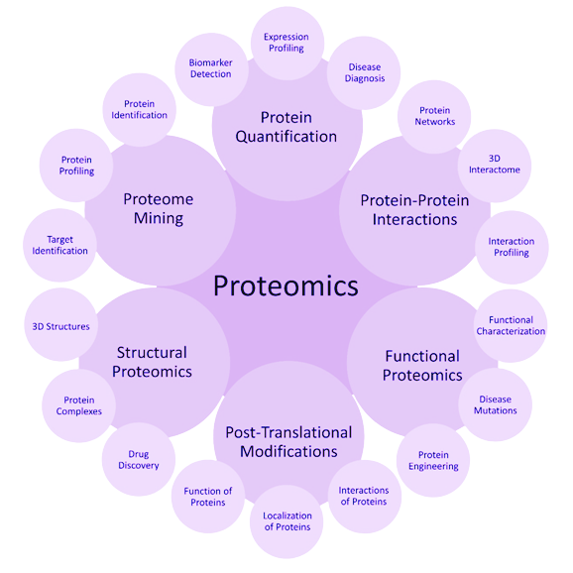
INTRODUCTION
Proteomics → large-scale study of proteins
Plays a vital role across disciplines
identifying disease biomarkers
drug targets
improving food safety
agricultural productivity
Proteome is dynamic → difficult to study
changes over time
between tissues
response to stimuli
It also provides valuable insight into features invisible to genomics or transcriptomics
Continues to face one major roadblock: reproducibility
Due to:
Inconsistent protocols
Opaque data reporting
Inconsistent and complex software
3

Slide 4
WHAT IS REPRODUCIBILITY?
Reproducibility is a foundational principle of scientific research.
Type | Data | Analysis | Person/Lab | Example | Ask yourself
Repeatable | Same | Same | Same | Same person reruns search engine with same settings and data | Can I get the same result if I do it again exactly the same way?
Reproducible | Same | Same | Different | Another lab reruns your nf-core pipeline with your shared data | Can someone else reproduce my findings with my data and my code?
Replicable | Different | Same | Different | Same proteins upregulated in a second independent cohort | Does the same biological phenomenon appear in another experiment?
Robust | Same | Different | Same/Different | Pathway enrichment stable across changes in normalization method | Do I still see the same key conclusions when I tweak the analysis?
4

Slide 5


CHALLENGES INFLUENCING REPRODUCIBILITY IN PROTEOMICS
PREPROCESSING CHALLENGES
Inconsistent preprocessing: Different peak picking, noise filtering, and smoothing methods alter results.
Missing value handling: Imputation strategies yield different results
TRANSPARENCY AND REPORTING
Undocumented parameters or tool versions: Not enough information given to replicate results
Incomplete metadata: Missing details on sample prep, digestion, labeling, or experimental design
No access to raw data or code: In-house pipelines, no GitHub, no DOI (Zenodo)
Black-box pipelines: Proprietary software or hidden steps
SOFTWARE DIVERSITY
Tool variation: Different tools produce different results on the same data.
Tool versions: Updates change algorithm behaviour and default parameters
Incompatible file formats: Lack of standards (e.g., mzTab, mzIdentML, SDRF)
Dependency conflicts: Environments break without containers or packaging
5

Slide 6

EXISTING AND EMERGING SOLUTIONS FOR IMPROVING REPRODUCIBILITY
Protein bioinformatics has made significant progress in the past two decades
Workflow Automation
Nextflow, Snakemake, Galaxy – Reproducible, version-controlled pipelines
Peer-reviewed, community-curated workflows
Cloud Integration
AWS, Google Cloud, Terra.bio – Scalable, consistent environments
Run anywhere and collaborate easily
AI & Machine Learning
Prosit, DIA-NN, AlphaPept – Deep learning for spectra prediction
Containerization
Docker, Singularity – Isolated, portable analysis environments
Biocontainers – Ready-made containers for proteomics tools
Data & Reporting Standards
mzML, mzIdentML, mzTab – Standardized data formats
PRIDE, ProteomeXchange – Public data sharing
Community Best Practices
Open-source collaboration – GitHub, nf-core
Transparent documentation – Protocols, notebooks, wikis
6

Slide 7
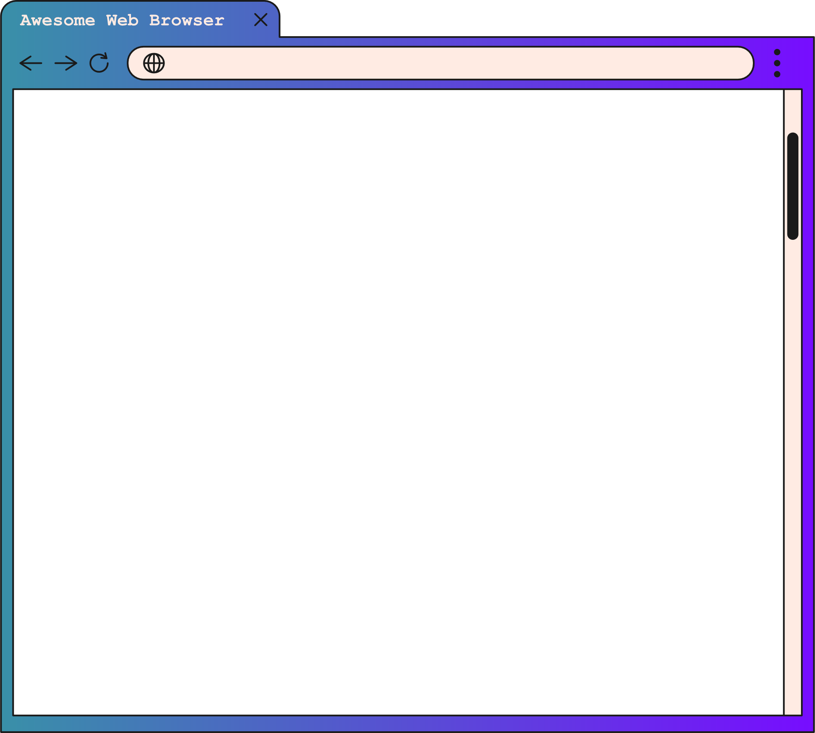
AIM AND OBJECTIVES
This study aimed to assess the reproducibility of currently available proteomics tools by:
Mining tool metadata from the bio.tools registry
Filtering and categorizing tools relevant to proteomics
Scoring tools using reproducibility-focused criteria based on FAIR principles
7

Slide 8
METHODS
Tool Discovery
Extracted proteomics tools from bio.tools and converted to TSV using Python
Key-word: proteomics
Extracted the following metadata:
Name (of tool)
Homepage (website URL)
Description (summary of tool)
Version (usually empty)
Tool type (Command line, GUI, web application, database etc.)
Topic (list of topics related to tool e.g. protein structure, biomarker)
Publications (DOI, title, abstract, publication year)
Citations (number of times publication is cited)
Documentation (usually empty or GitHub)
Operating system (Mac, Linux, Windows)
Language (Python, R, C# etc.)
Accessibility (open-source, proprietary)
License (MIT, GPL-3.0, Apache-2.0 etc.)
8

Slide 9
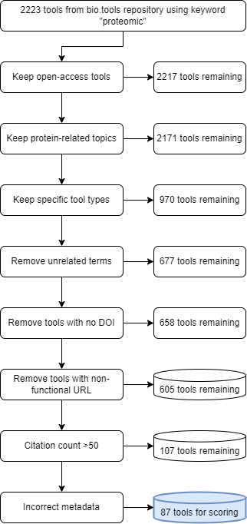
FILTERING CRITERIA
Filtering criteria:
Open-source status or missing license
Proteomics-specific topics (e.g. “protein”, “proteomic”)
Specific tool types (command-line, workflow, script, library)
Functional DOI and URL
Exclusion of non-proteomics tools
Additional tools were removed during scoring process
URL works but leads to nothing
Tool no longer exists
Incorrectly or missing information
Tools were also categorized by function, including:
Data Processing and Analysis
Niche and Miscellaneous Tools
Protein and Peptide Identification
Quantitative Proteomics
Machine Learning and Prediction
Data Visualization etc.
9

Slide 10
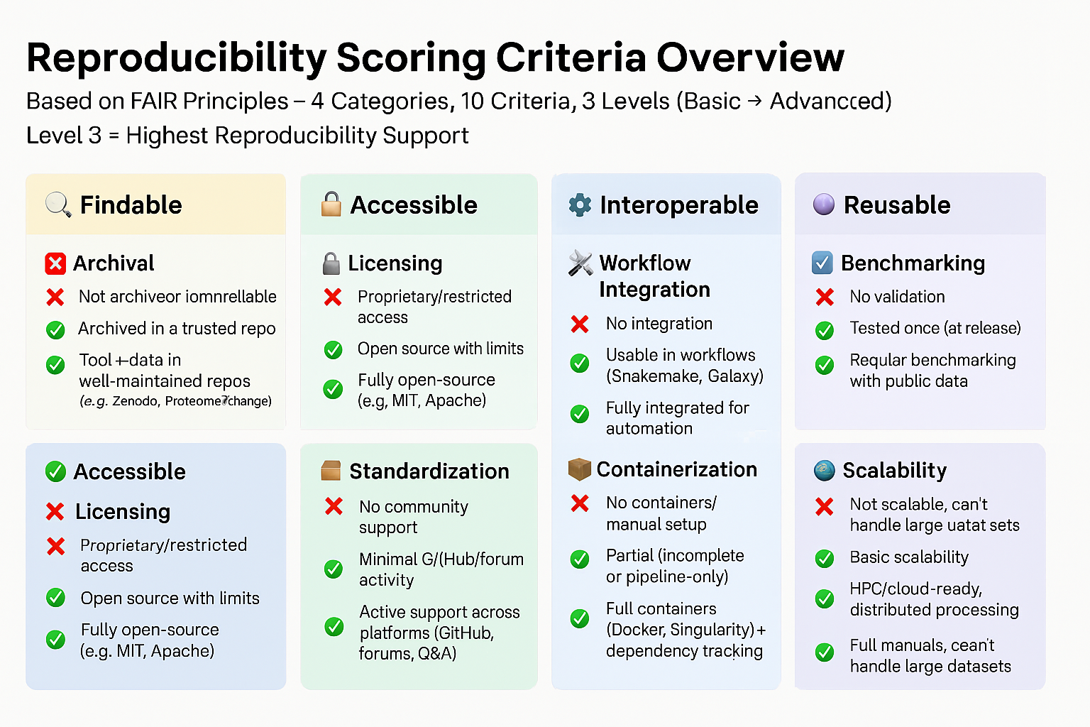




Preservation/archive of data and software
Not archived or hosted in unreliable locations
Archived in a trusted repository
Tool & data archived in Zenodo/ProteomeXchange
Version control
No version control; deprecated
Inconsistent or minimal updates
Active version control, changelogs, regular updates
Licensing and legal
Proprietary or restricted access
Open source with restrictions
Fully open-source (e.g., MIT, Apache)
Community engagement
No engagement or support
Minimal engagement on one platform
Active engagement across platforms (GitHub, forums, Q&A)
Workflow management systems
Cannot integrate with WMS
Usable in Snakemake, Galaxy
Fully integrated with WMS
Standardized input and output formats
Unknown or non-standard
Convertible with effort
Uses standardized formats
Assessment against benchmarks
No benchmarking reported
Tested only at launch
Regular benchmarking with updates
Containerization
Not containerized; manual management
Partial containers
Fully containerized
Manuals, documentation, logging, and reporting
No manual or unclear documentation
Partial documentation, limited logging
Full manual, detailed docs, complete logs
Scalability and parallelization
Cannot handle large datasets; no HPC/cloud support
Moderate scalability
Supports HPC, cloud, distributed computing
SCORING SYSTEM
The criteria are loosely based on the work done by Sandve et al., 2013 and Ziemann, Poulain, Bora, 2023.

Slide 11
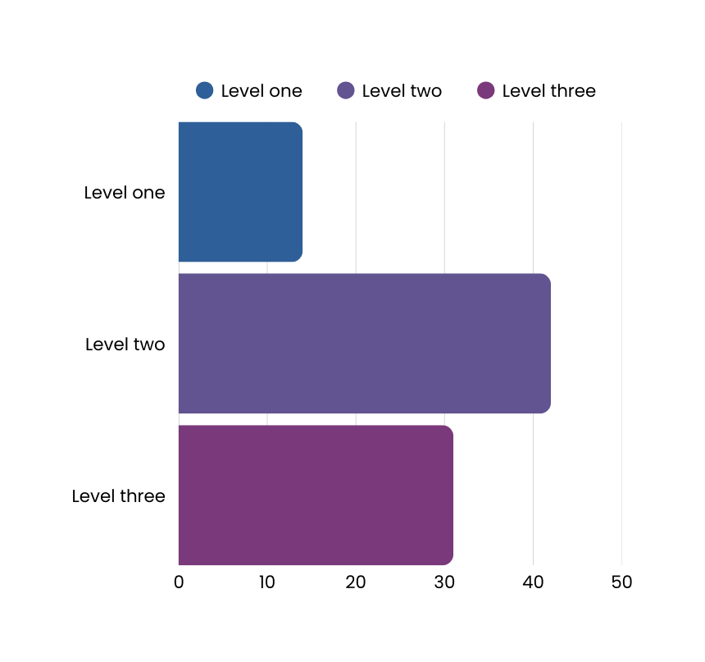
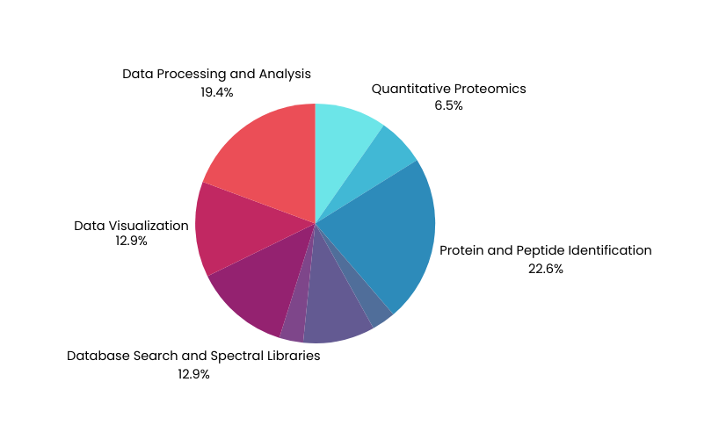

Tool distribution by reproducibility level:
🔴 14 tools: Performed poorly (Level 1)
🟡 42 tools: Average reproducibility (Level 2)
🟢 31 tools: Good reproducibility (Level 3)
High-scoring tools (Level 3) were largely:
Focused on protein and peptide identification
Related to data processing and analysis
Part of or compatible with the Trans-Proteomic Pipeline (TPP), including: Comet, MS-GF+, PeptideProphet, PeptideShaker
REPRODUCIBILITY DISTRIBUTION

Slide 12
DISCUSSION
1. The proteomic reproducibility crisis is real
Many tools lack basic reproducibility standards
2. Community-driven, open-source frameworks lead to higher reprodubility
Tools built around active user bases, modular designs, and containerization offer blueprints for sustainable, reproducible software
3. Usability matters just as much as reproducibility.
Tools that are hard to install or poorly documented may be technically sound but fail to gain adoption
4. High reproducibility didn’t always equal popularity
Some older, less reproducible tools remain widely used due to legacy compatibility or ease of use
5. Choice still driven by experimental needs, not reproducibility
Users will always choose easy-to-use tools that are ‘good enough’
6. A key barrier to adoption is usability as many tools are:
poorly documented
limited in funding and development
struggling with long-term maintenance and support
12

Slide 13

LIMITATIONS AND RECOMMENDATIONS
Limitation → limits the number of tools identified
Recommendation → Use more proteomics-related terms such as “structural biology”, “peptide”, “protein” etc.
ONLY ONE KEY WORD
Filtering criteria | Limitation | Recommendation
Missing information | Some tools have incomplete information and may be incorrectly filtered out | Can’t always be accounted for. Make the assumption that tools with missing information are not widely adopted
Non-functional URL | Some tools are important and widely adopted but have since changed their URL or it was recorded incorrectly | Individually inspect each tools URL after filtering
Citation count | Older tools will have higher citations compared to tools < 5 years | Gradient filtering based on the release date
NOTE: This study did not evaluate usability or user experience.
Future research could explore the trade-offs between reproducibility and other aspects of tool development
13

Slide 14

CONCLUSION
This study introduces a reproducibility scoring system tailored to proteomics tools
Scoring system will:
Help researchers evaluate and select software more confidently
OR develop reproducible software
Our findings emphasize the need for:
Standardized development and reporting practices
Transparent code and data sharing at all stages
Closer collaboration between tool developers and end-users → user-centered design
14

Slide 15





THANK YOU!
Coetzer, K.C., Aidoo, A.S., Adomako N.A., Ajiboye, I.O., Nortey H., Okello, O.I., and Awe, O.I.
Department Biomedical Sciences, Division of Molecular Biology and Human Genetics, Stellenbosch University, Cape Town, South Africa
Department of Virology, Noguchi Memorial Institute for Medical Research, College of Health Sciences, University of Ghana, Legon, Accra, Ghana.
Department of Clinical Pathology, Noguchi Memorial Institute for Medical Research, College of Health Sciences, University of Ghana, Legon, Accra, Ghana.
Department of Molecular Medicine, School of Medicine and Dentistry, Kwame Nkrumah University of Science and Technology, Kumasi, Ghana.
Covenant Applied Informatics and Communication Africa Centre of Excellence (CApIC-ACE), Covenant University, Ota, Nigeria.
Department of Computer and Information Sciences, College of Science and Technology, Covenant University, Ota, Nigeria.
Department of Immunology and Molecular Biology, College of Health Sciences, School of Biomedical Sciences, Makerere University, Kampala, Uganda.
African Society for Bioinformatics and Computational Biology, Cape Town, South Africa.
15

