Slide 1
00
10
45
40
50
05
15
25
30
35
20

Slide 2

Notes:
pecha kucha is a presentation technique invented in Tokio in 2003 by two architects.
It was meant for designers to share and discuss their design ideas in a public environment.
It is rather a performance than a presentation. pecha kucha it is a japanese word and describes the noise by many people chatting at the same time.
Death by PowerPoint
Performance rather than talk
Social event, information about projects and more
Any topic is welcome

Slide 3

Notes:
Imagine a lot of highly motivated designers having worked day and night
on the design of the next great tool. It will be awesome, the best thing ever thought of.
And, of course, they want to sell their ideas to the world.

Slide 4

Notes:
For this they are going to prepare a 30 minutes presentation starting with their first prototype
and chronologically iterating to explain how they reached their current state.
The audience is going to like it so much.

Slide 5
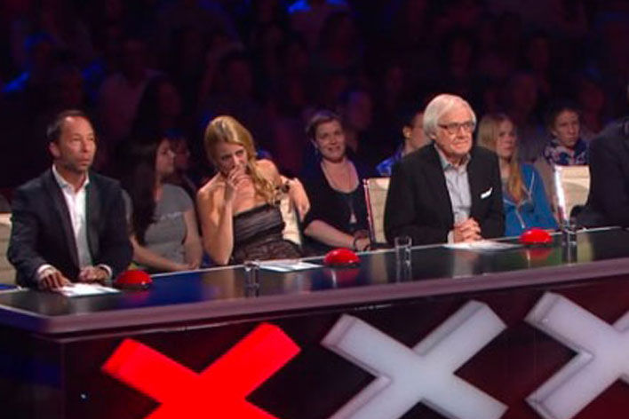
Notes:
Now imagine you would be in a jury that has to evaluate dozens of such designs and rate them.
Roughly after 10 minutes presentation filled with tons of bullet points you are going to fall
asleep and will not be objective anymore.

Slide 6
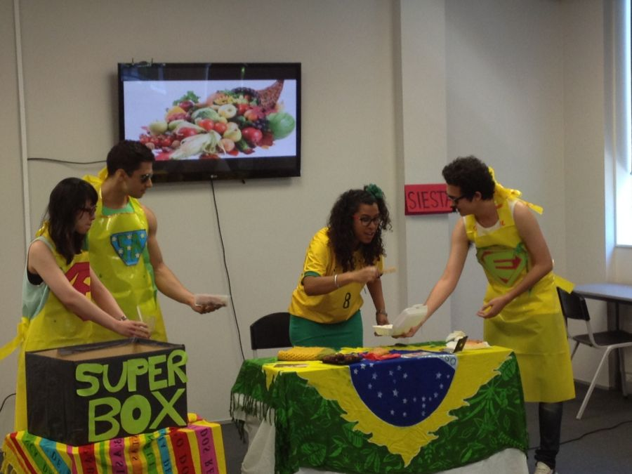
Notes:
Now imagine you would be given a presentation that focuses on the most relevant information and
moreover is well prepared and entertaining. This is what pecha kucha aims to solve by giving clear rules on how the
presentation has to be structured.

Slide 7
PECHA KUCHA
{20 x 20}
Notes:
First and foremost, the presentation is restricted to 20 slides
each slide is shown for exactly 20 seconds
which amounts in a total of 400 seconds
or 6 minutes and 20 seconds

Slide 8

Notes:
This sets clear time constraints to the presenter.
You have to carefully think about the most relevant information you want to pass on
to your audience. And you have to trains in advance to be able to stick to the time.

Slide 9
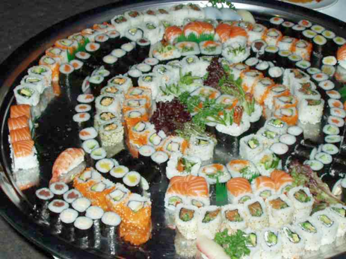
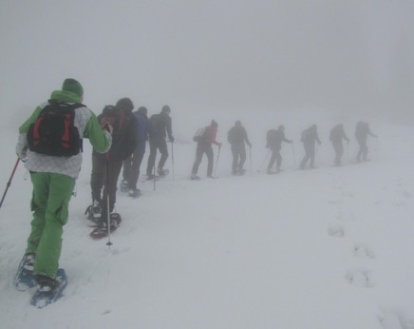
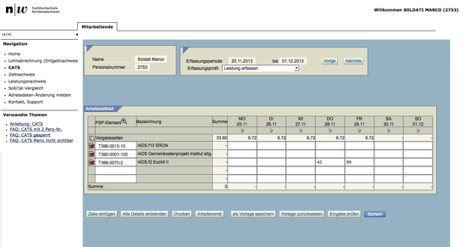

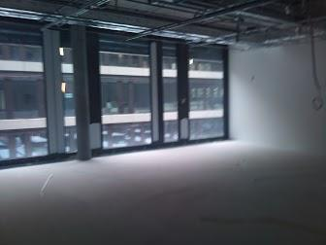
Notes:
Second important rules is to use pictures rather than text.
Images are much easier to digest for humans.
With text you risk to loose the attention of the audience.

Slide 10
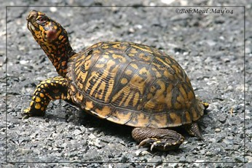
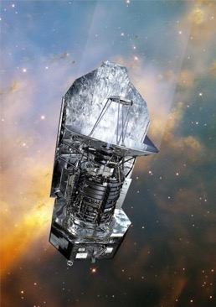
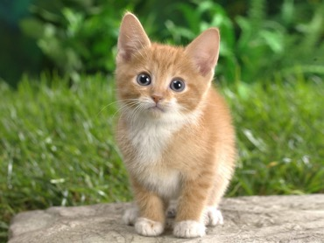
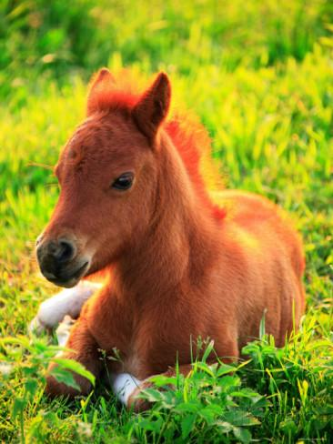
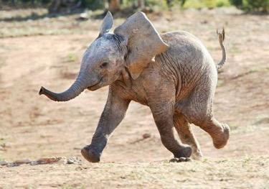
No animations!
No bullet lists!
Notes:
Absolutely forbitten are bullet lists as well as
slide transitions or other unmotivated animations.
you may sparsely use single words or embed a movie for illustration.

Slide 11
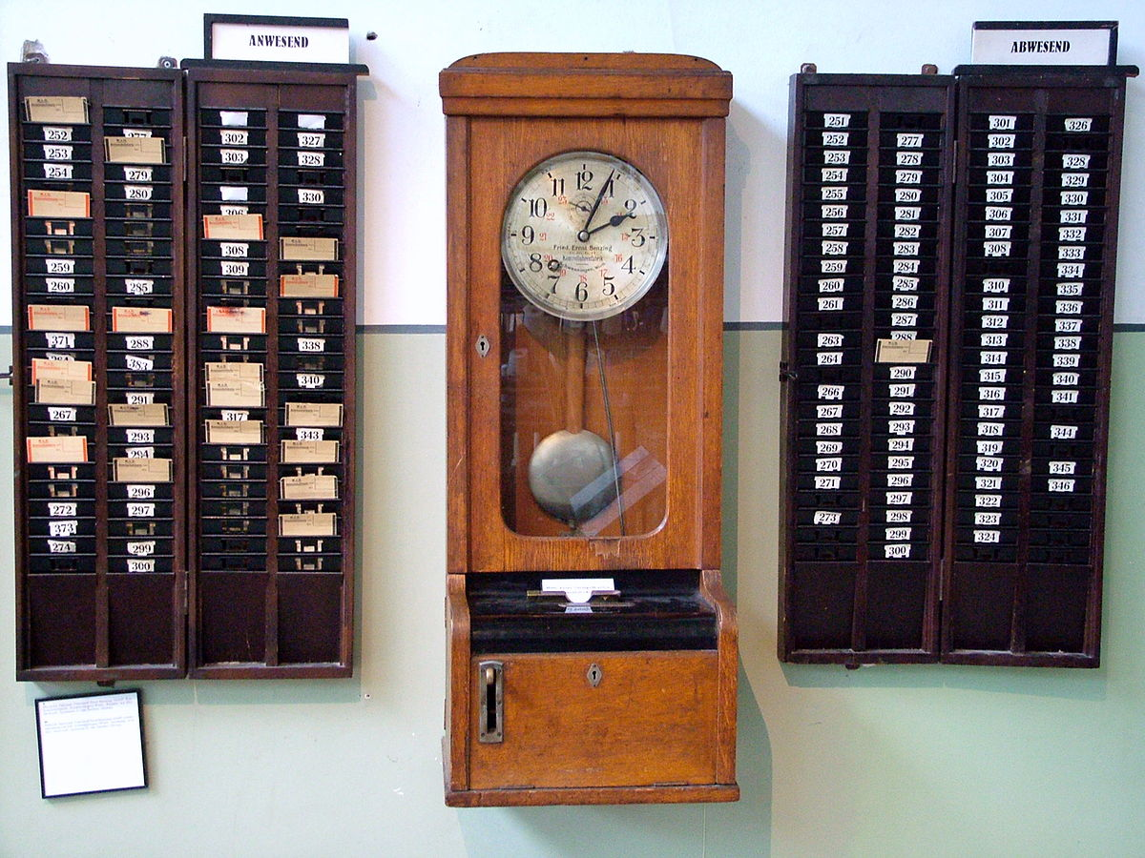
Notes:
btw. did you notice that I was talking for more than 20 seconds on these slides? if 20 seconds are not enough
and you may just duplicate the images. Cheating is allowed but not too much.

Slide 12
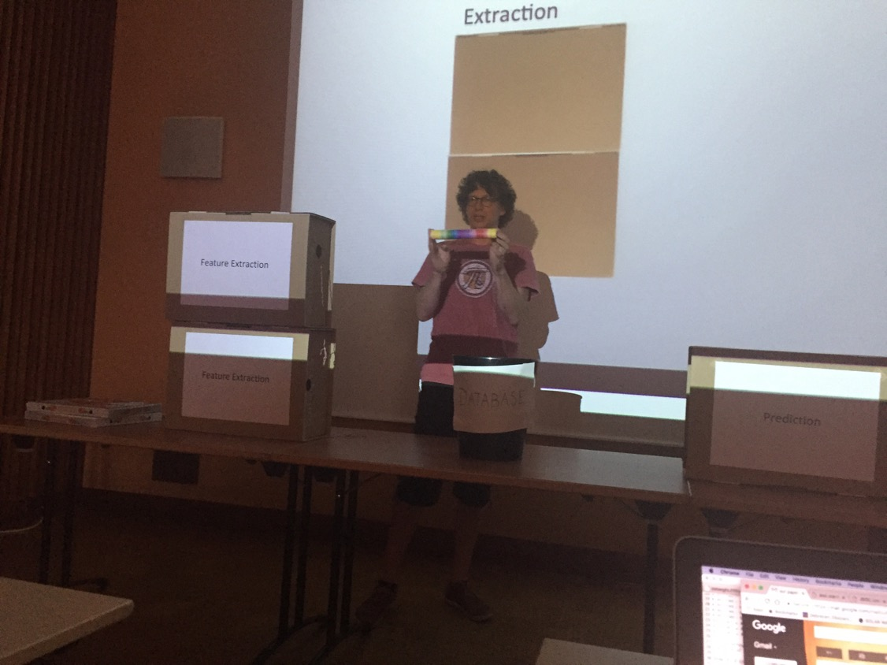
Notes:
here you see a science presentation we did last year about forecasting if a new pizza creation will be good or not.
Main topic was to explain to astronomers and mathematicians how
our machine learning framework will be working.
As science presentations tend to be very text centric we tried to experiment a bit.
For this presentation we got spontanous comments like: "best presentation of the meeting"

Slide 13
Notes:
here you see a science presentation we did last year about forecasting if a new pizza creation will be good or not.
Main topic was to explain to astronomers and mathematicians how
our machine learning framework will be working.
As science presentations tend to be very text centric we tried to experiment a bit.
For this presentation we got spontanous comments like: "best presentation of the meeting"

Slide 14
PREPARE?
Notes:
How to create a pecha kucha? before starting you should think about what you want to transport in your presentation:
* would you like to inform?
* would you like to inspire?
* would you like to motivate audience to do something?
* what don't you want to achieve with the talk?

Slide 15


Notes:
Now it is time to write down the story. Do not start looking for images now.
This is a very important step as having the complete story in the beginning will safe you a lot of time.
You can split the story in 20 seconds junk and associate images rather than to invent
20 second text blocks for given images. if you have images first you will have to adjust text which is much harder.

Slide 16
How to prepare
<start></start>
…
<end></end>
Notes:
Sit down, take some sheets of paper and start writing the beginning and the end of your presentation.
How do you attract the audience? You can make a joke, present some astonishing image, make them think, etc.
How do you conclude your presentation. Wake up your audience again and give them something to think about
start with the results, start with the main point of the story, put a picture in the viewers heads.
By now you should have filled about 5 slides.

Slide 17
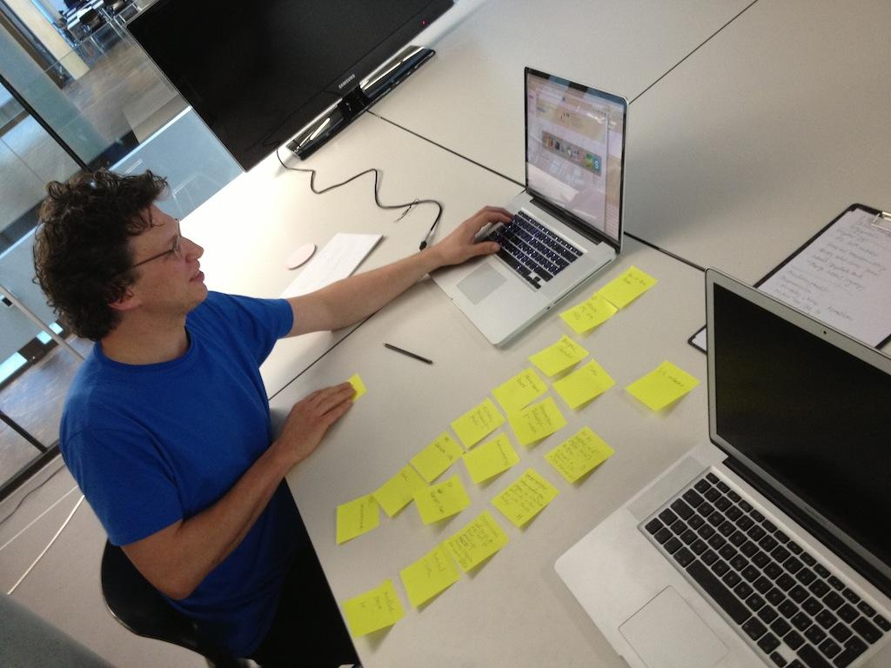
Notes:
Now fill in the gaps. Organize your ideas in a meaningful way.
While writing your text read it out loud and measure the time you need. Split the text in pieces of 20 seconds.
If you are bored you may start looking for images for those parts that are already defined, but only for those.

Slide 18



Notes:
Once the text is complete, search for images. Good resources are https://pixabay.com/, pinterest.ch or google image search.
you may also create simple slides with one or two words or a symbol like an emoticon.

Slide 19

Notes:
Now you have to train, train, train
Measure the time for each slide, adjust texts where needed and make sure to get a feeling for 20 seconds.
Automate your presentation programme and do not switch the slides manually.
If you don't train you will fail miserably.

Slide 20
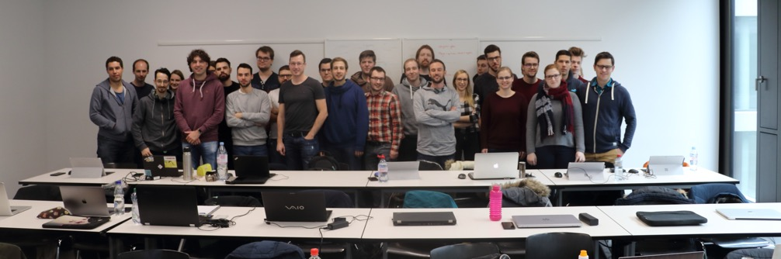
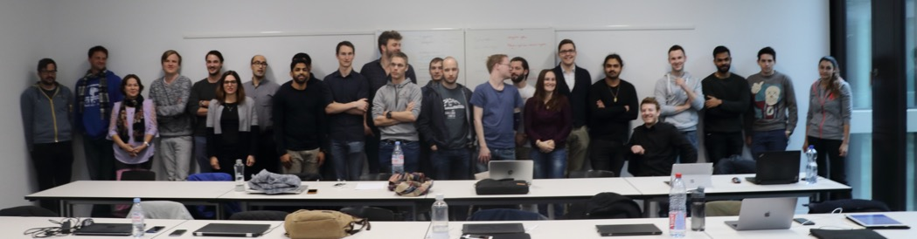
Notes:
For the end I'd like you to imagine yourself listening to 20 presentations of
your classmates all having prepared last-minute presentations of their work.
I'm sure you have experienced this before and you were slightly bored listening to all of them.

Slide 21
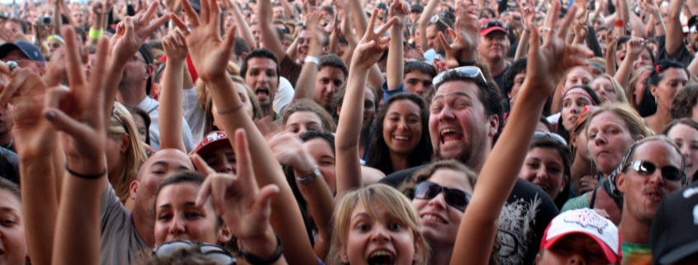
Notes:
Now imagine an afternoon with well-prepared and entertaining presentation of
informative visualisations that have been worked out durning in this semester.
You will probably remember one or another.
Please do your best to entertain and inform your class mates.

