Slide 1

Non-Profit Crowdfunding Recommendation System
Abraham, Anisha, Atindra, Kimmy, Sherlley

Slide 2
Overview
Background, scope, and EDA
Recommendation Systems
Performance
Conclusions and next steps

Slide 3



Background
Public school teachers in the US spend $1.6B of their own money on classroom supplies
DonorsChoose.org is a US nonprofit organization that allows individuals to donate directly to public school classroom projects
It has funded over 1.1 million classroom requests through the support of 3 million donors
https://www.kaggle.com/donorschoose/io
Data Source
Notes:
https://www.mckinsey.com/industries/telecommunications/our-insights/reducing-churn-in-telecom-through-advanced-analytics
- You can pick and choose and track where your money goes

Slide 4


Scope
Decision: Build targeted email campaigns recommending specific classroom requests to prior donors
Key Questions:
How to pair up classroom requests to donors that will motivate them most to make additional donations?
How to understand the interests of different donors to help them make better donation decisions?
Notes:
Not bringing in new people. Get repeat donors

Slide 5
1.2GB Data
Donations – DonorID, ProjectID, Donation amount
Donors – DonorID, Location, Teacher
Projects – ProjectID, Category, Title, Description, Funding
Resources – ProjectID, ResourceName, Quantity
Schools – SchoolID, Location, Percent w/ Free Lunch
Teachers – TeacherID, Active Since

Slide 6
Exploratory Analysis

Slide 7
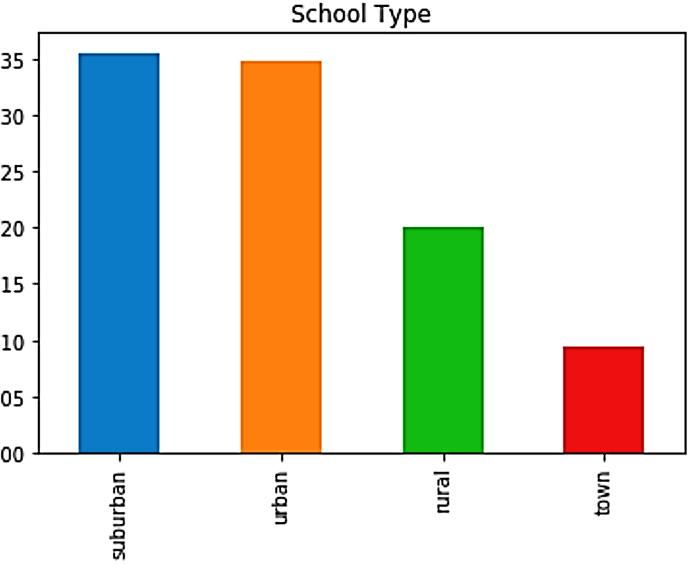
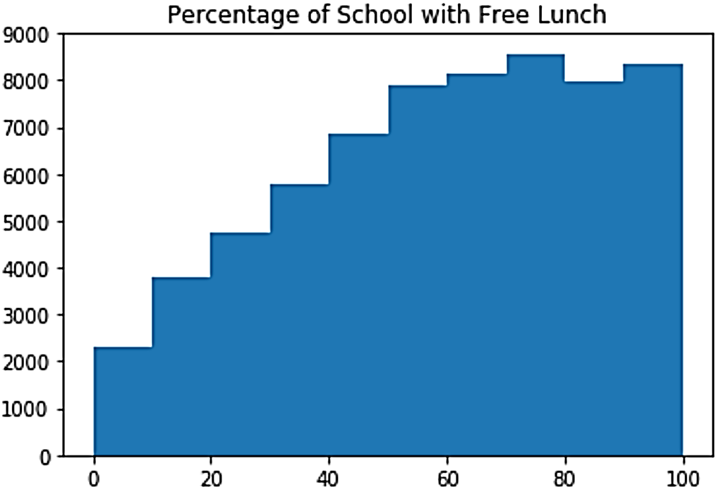
72,361 Schools
Percent of Schools
Number of Schools

Slide 8
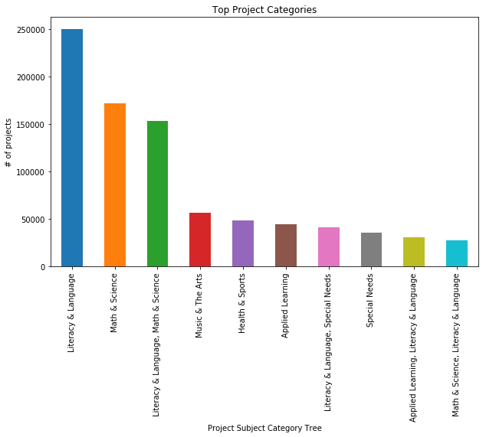
1,110,015 Projects
Project Categories
Literature
Math & Language
Math & Science
Lit, Math, & Science
Music & Arts
Health & Sports
Applied Learning
Special Needs Lit
Special Needs
Applied Learning Lit

Slide 9
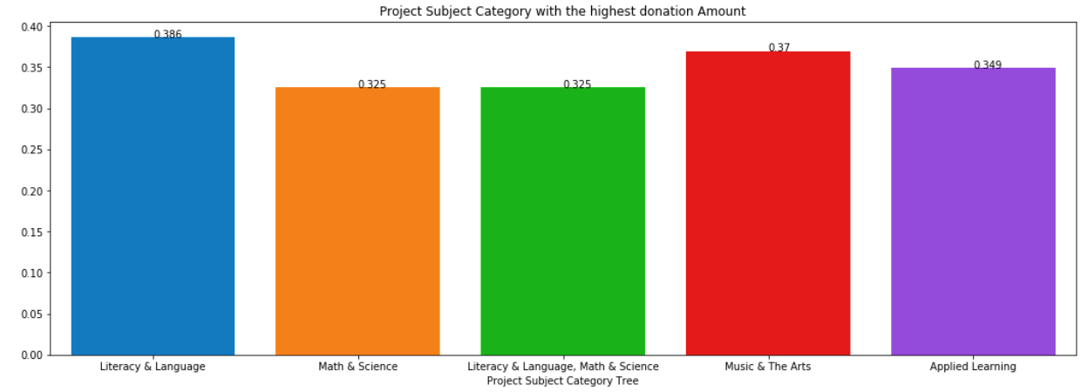
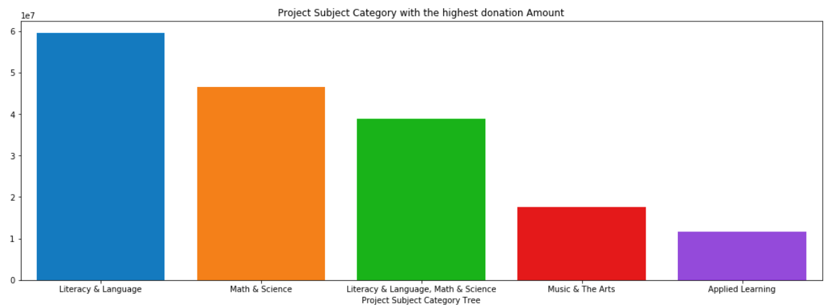
1,110,015 Projects
Percent of Goal Met
Total Amount Donated
40%
$60MM
35%
$50MM
30%
25%
$40MM
20%
$30MM
15%
$20MM
10%
5%
$10MM
0%
$0
Literacy & Language
Math & Science
Lit, Lang, Math & Sci
Music & Arts
Applied Learning
Literacy & Language
Math & Science
Lit, Lang, Math & Sci
Music & Arts
Applied Learning

Slide 10
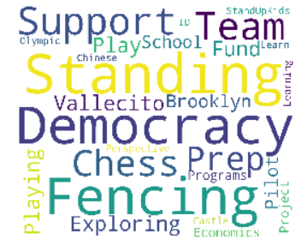
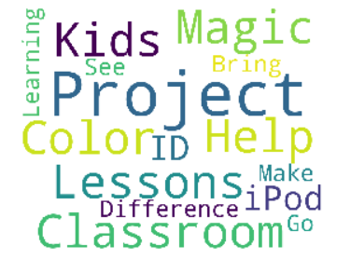
1,110,015 Projects
Most Funded Projects
Least Funded Projects

Slide 11
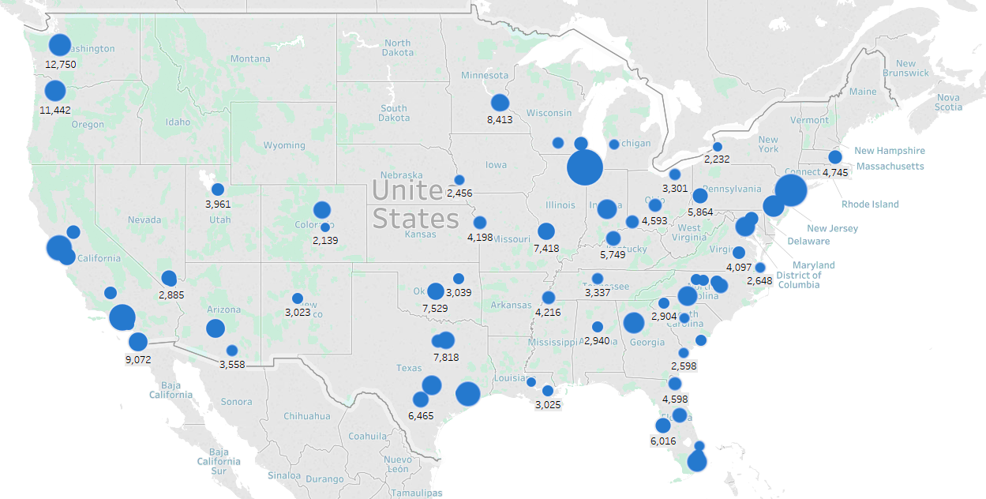
Donors

Slide 12
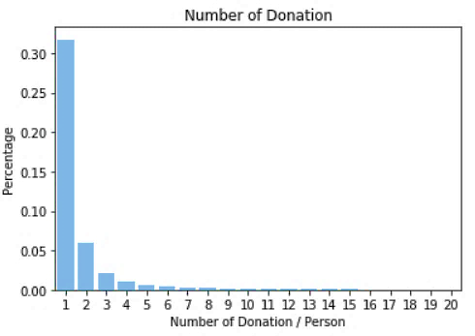
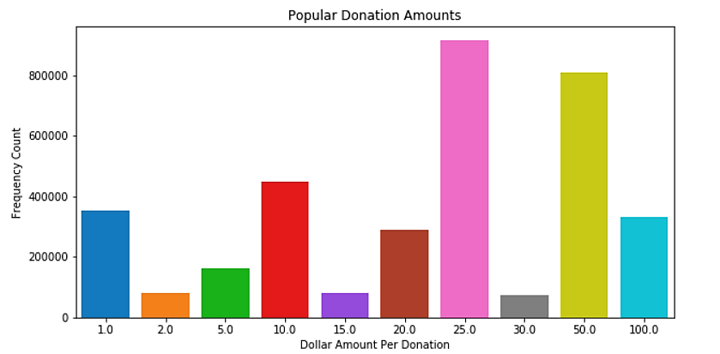
4,697,844 Donations

Slide 13
Recommendation Systems

Slide 14


Recommendation Systems
Content-based filtering uses an individual’s history to recommend similar topics in the future
Collaborative filtering uses others with similar (or opposing) histories to recommend new topics

Slide 15
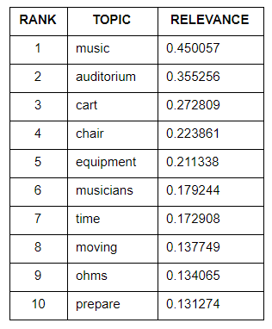
Content-based filtering
Content = project title and description
Strength of donation ≈ donation amount
Donor profile contains strongest topics
Recommend new projects based on cosine similarity with the donor profile
Notes:
Problem is it doesn’t work well when the individual has little to no history

Slide 16
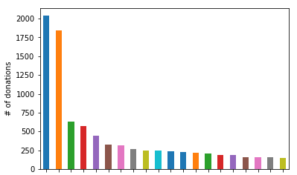
Most active donors
Donors

Slide 17
Content-based filtering example
Donor Profile
Recommended Projects

Slide 18
Content-based filtering example
“
Many of us need to move in order to work
Bouncy Bands let students quietly move their feet to release energy, help them focus, and stay active
Multiple top donors contributed to Bouncy Band projects
Notes:
Also mention it’s too cold outside to play outdoors in the winter

Slide 19
Matches from the Top 10 Recommended
4.4 average correct captures from the top 10 recommended projects
Potential to improve and capture the remaining 5 donations
. . .
Notes:
Different from classification accuracy and all previous misclassification rates

Slide 20


Collaborative filtering
Find others who donated to the same projects
Find nearest neighbors based on strength of donation
Recommend the strongest projects that the neighbors have donated to

Slide 21

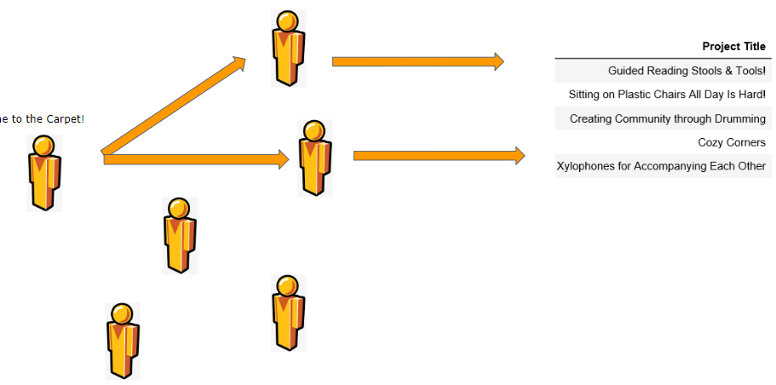
Collaborative filtering
Kids, come to the carpet

Slide 22
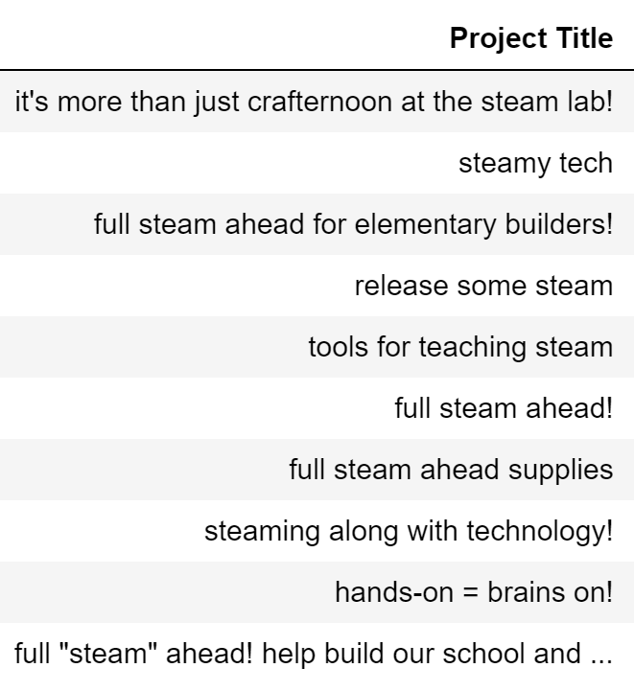
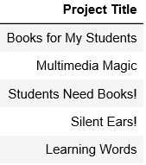
Content vs Collaborative Recommendation
Donor Profile
Content-based
Collaborative

Slide 23

Conclusions
Recommend projects to spread awareness and reduce the 30% of donations currently made by teachers
Use content-based filtering for donors with longer history, and collaborative filtering for new donors and leverage the experiences of others

Slide 24




Next steps
Hybrid model of history and collaborative filtering
Incorporate information on city and state
Include RFM information in donation strength metric
Live tests
Notes:
Location is already being used on their website

Slide 25
Appendix

Slide 26
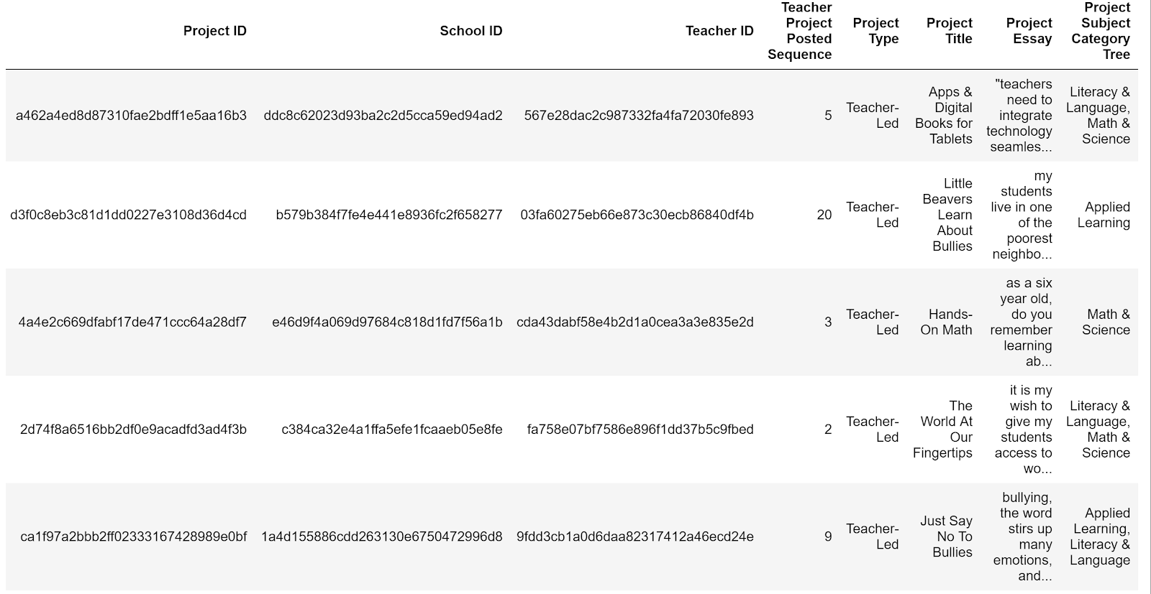
Project Data

Slide 27
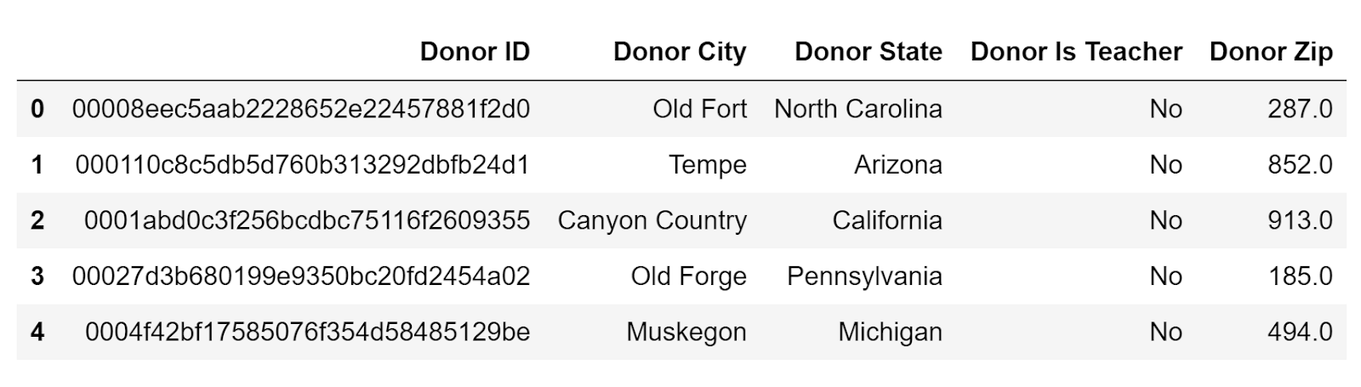
Donor Data

Slide 28
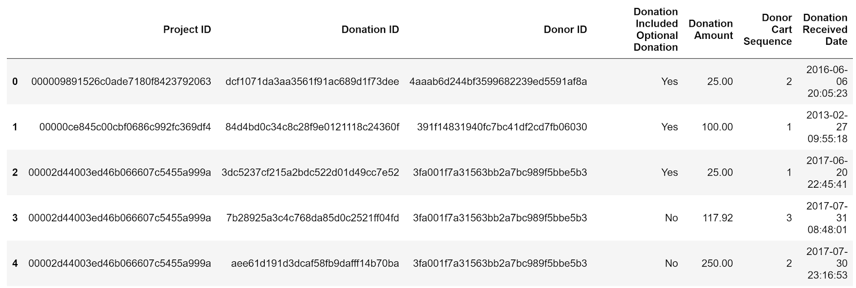
Donation Data

Slide 29
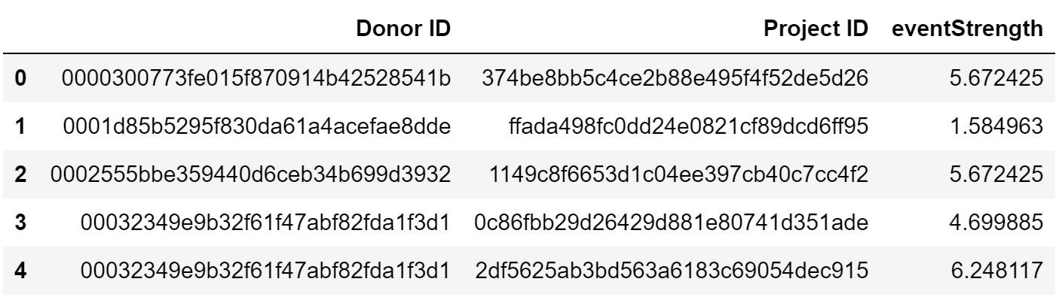
Donation Strength example

Slide 30
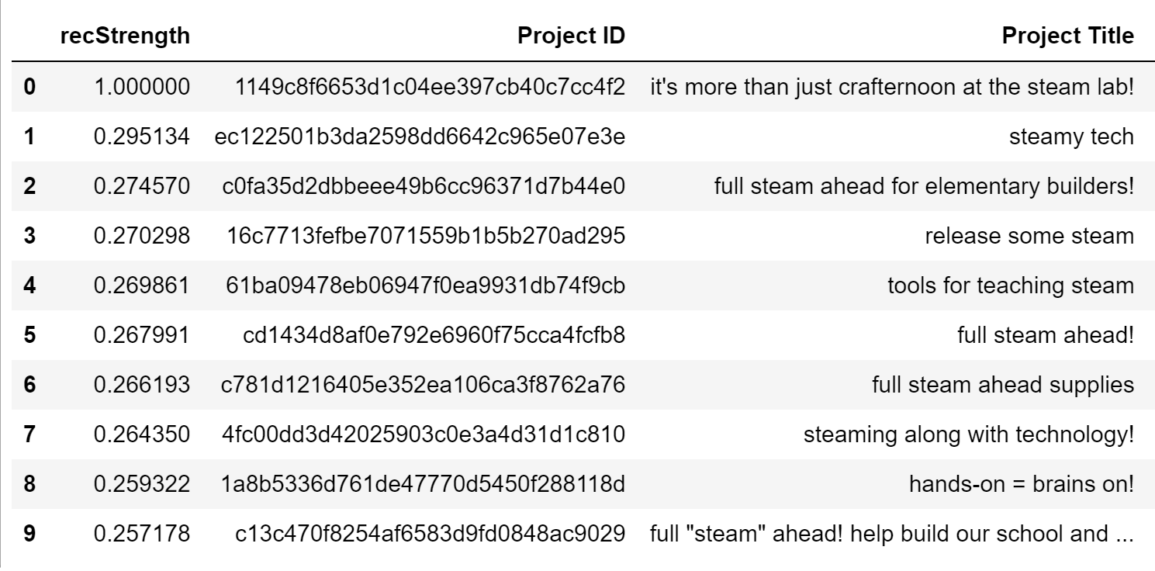
Recommendation Strength example

