Slide 1
Community Work Reflections
Task 3
by
Kimberly Parascandalo

Slide 2
Student Registration Form

Slide 3
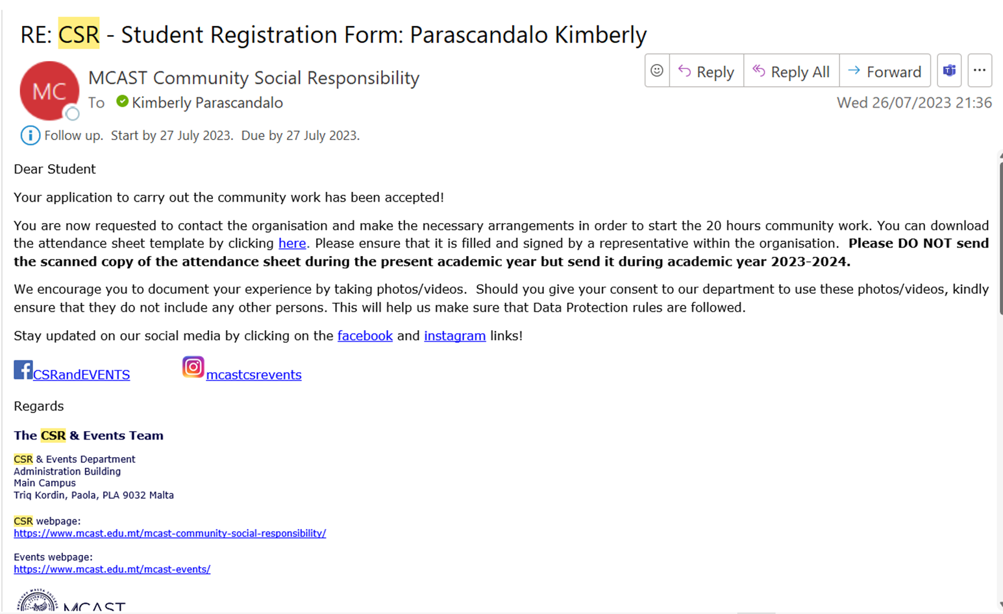
Approval for the Community Work

Slide 4
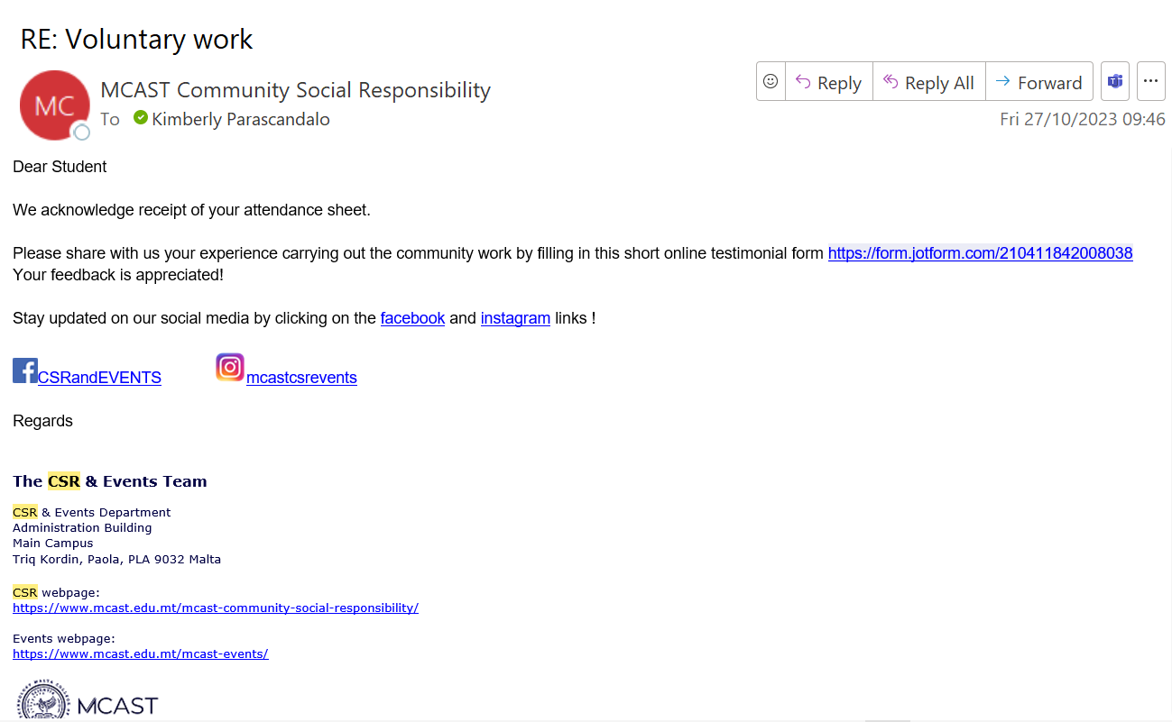
Confirmation from CSR Department

Slide 5
Malta Association of Occupational Therapists (MAOT)
I chose this Social Cause since they are doing a huge difference for patients who –
Had accidents or brain injury.
Patients who have disability.
Dementia.
MAOT is entirely voluntary work by occupational therapists and their job is –
To keep the members up to date
Current trends and issues

Slide 6
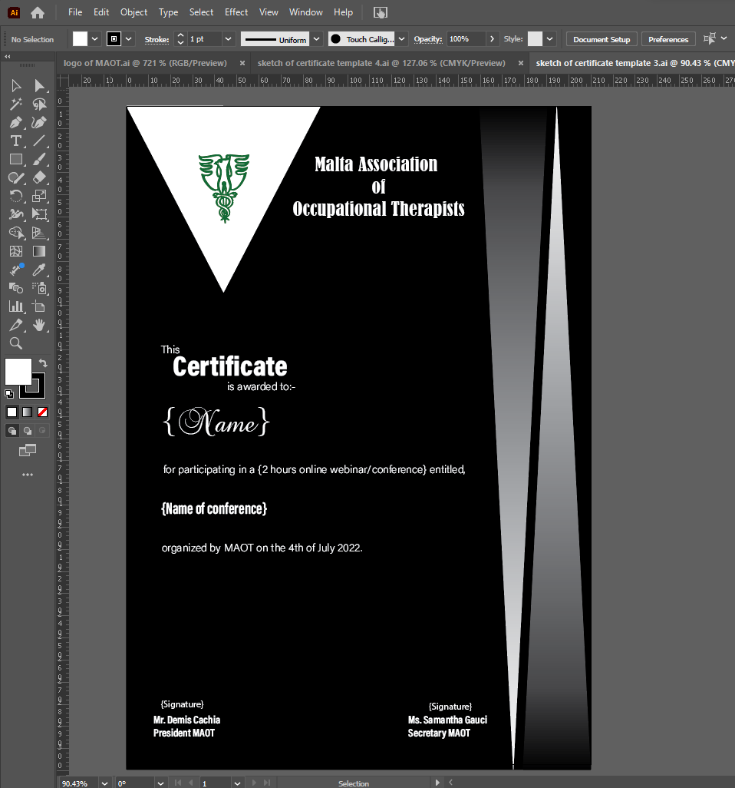
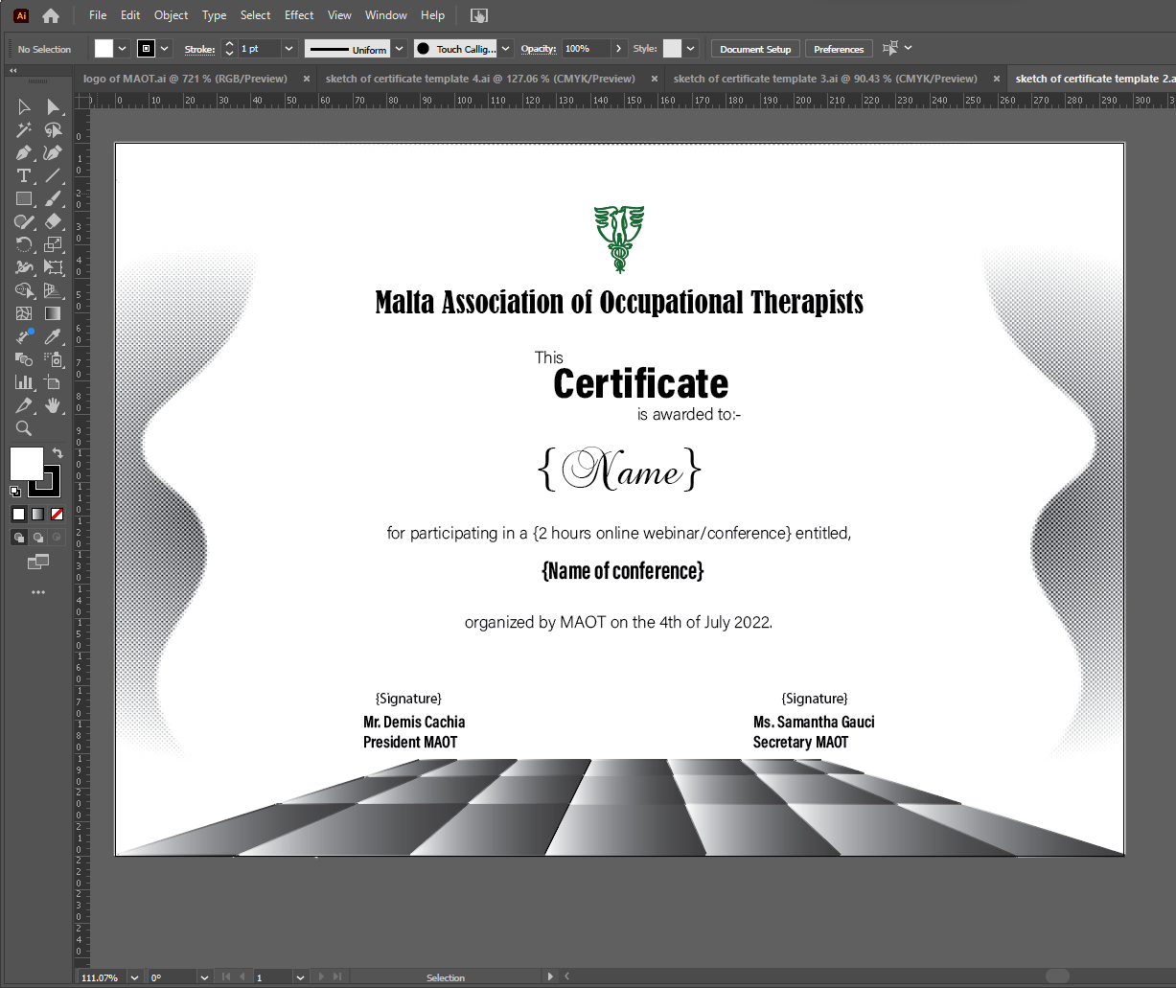
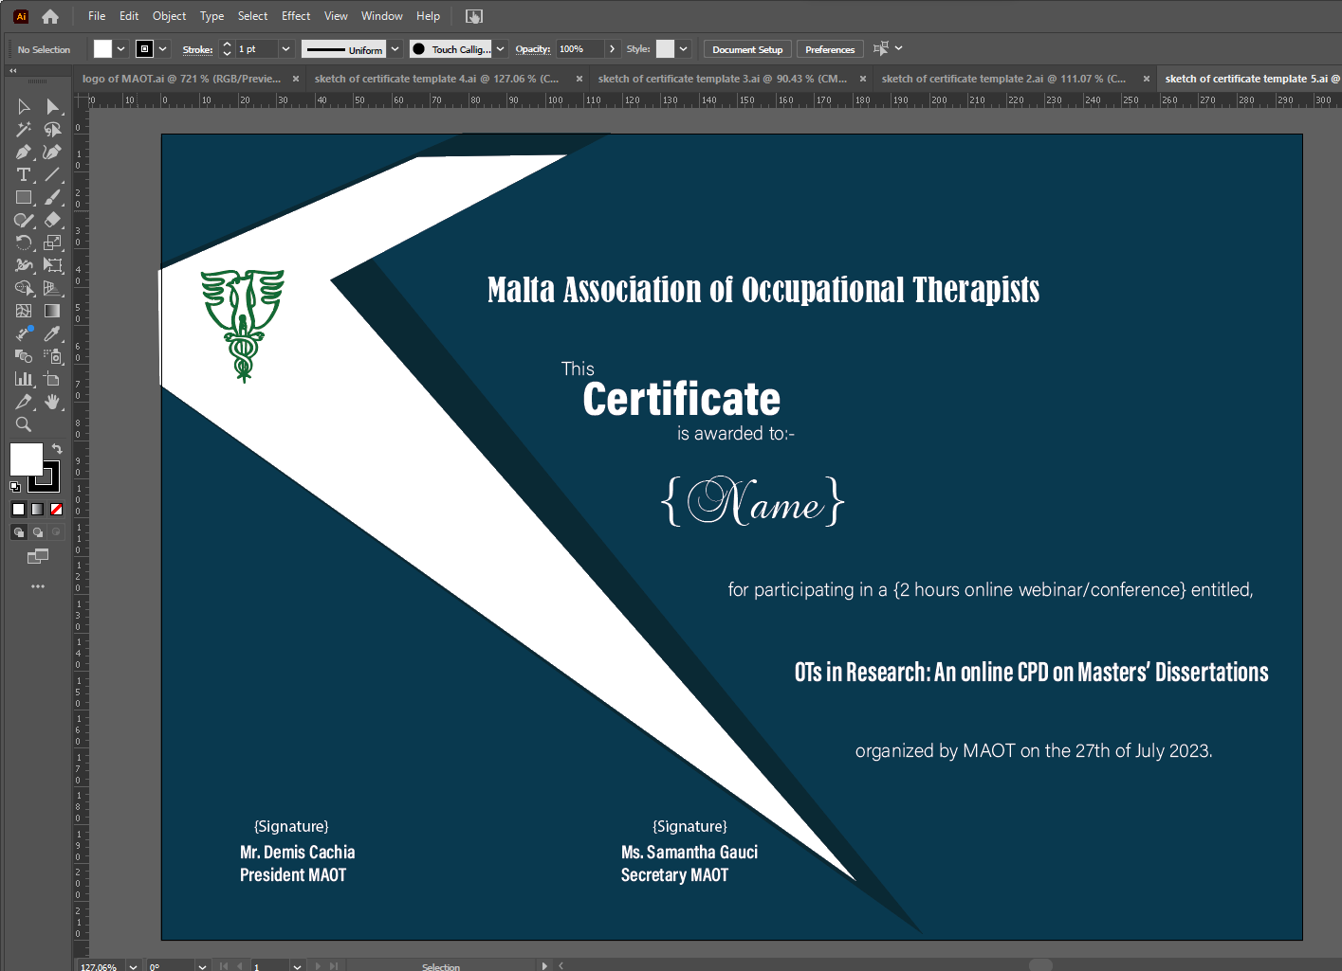

Certificate
These are some of the sketches which I designed and done their logo in vector.

Slide 7
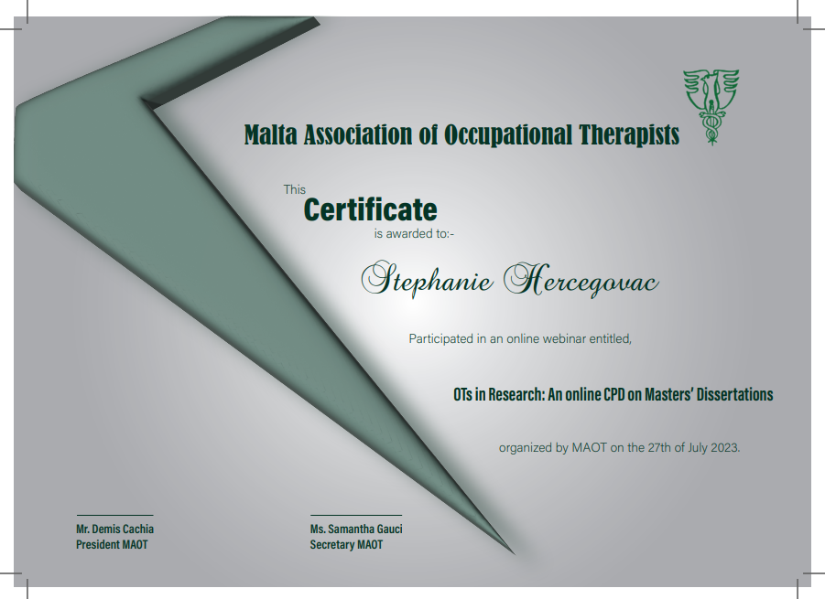
Final Certificate
This is the final certificate ready for printing.

Slide 8

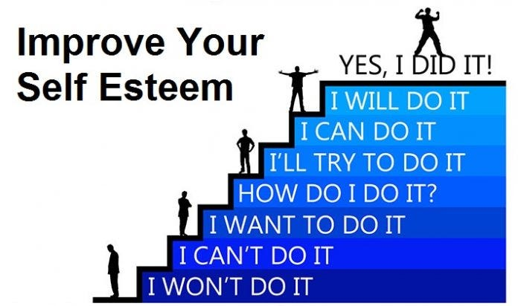
Benefits of Community Work
Volunteer work helps you to make new contacts
Friends
Career
Volunteering is beneficial for the body and mind
Increase self- confidence
Combats mental health issues
Stay physically healthy

Slide 9

Experience Gained
I learned how to explain myself better
By communicating in more depth
Ask more questions to confirm that I understood well
Sending visuals to help client understand better
I learned to listen more
The clients
Different ideas

Slide 10

Procedures and Structures
I done this community work online, as the job that I had to do was digital therefore it was easier to work at home with the software needed.
This made it a bit difficult for me to observe the procedures and structures of the NGO.
I noticed that –
Webinars and Seminars
Information on social media

Slide 11

Improvements
Updating the website
Events
Last minute
To communicate
To ask for something
Notifications

Slide 12

Successful with my Project
I believe that my project is a success –
I worked in a professional way
Listened to the client
Delivered on time

Slide 13
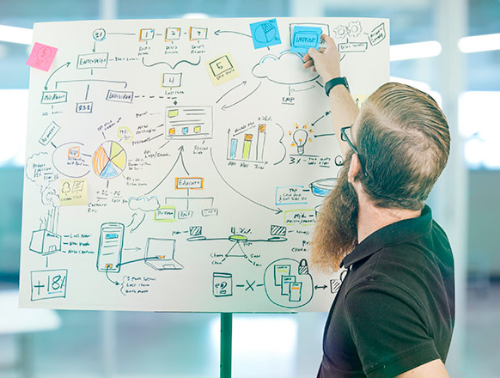
Improve my Project
I think that my project can improve –
Communicating with video calls not just e-mails
Getting feedback from audience not just from the client
Gain more experience

Slide 14

Impact
I think that the impact of my project –
Helped the MAOT with designing the certificate
OT’s were more encouraged to attend the webinars as they were receiving a certificate
Boost my career and self- confidence

Slide 15

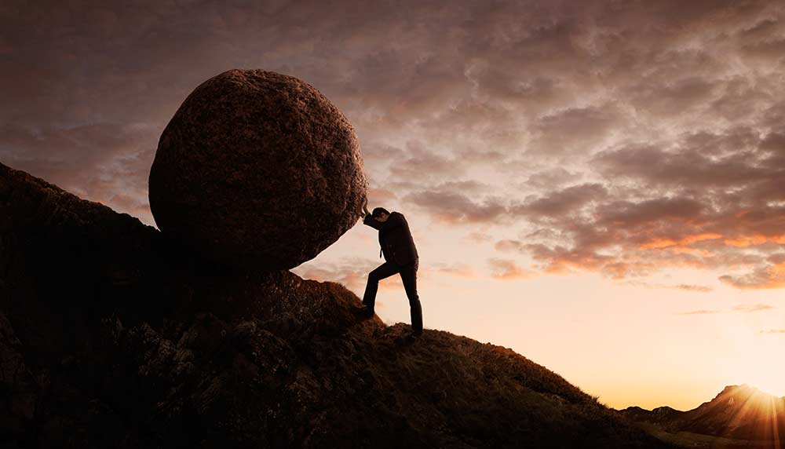
Intrapersonal Skills
Self- efficacy
Believing in myself
Believing in my abilities
Perseverance
Never give up even if it is hard
Keep working till the end

Slide 16


Interpersonal Skills
Empathy
to understand others
to listen others perspective
Patience
to be patient with last minute changes
I tried to explain certain things

