Slide 1

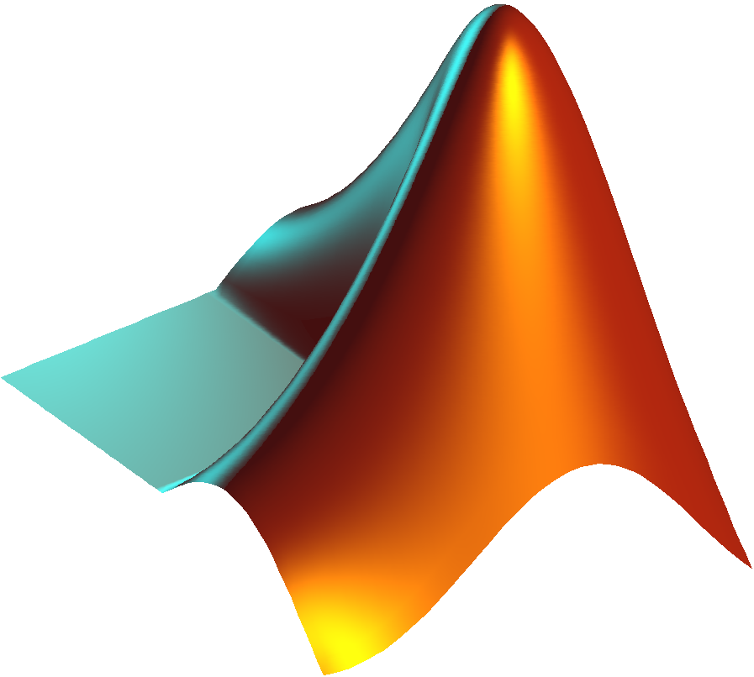

Matlab tutorial
Course: Data Communications
Professor: Dongkyun Kim

Slide 2

Introduction to Matlab

Slide 3
What is Matlab?
The name MATLAB stands for MATrix LABoratory.
MATLAB is a modern programming language environment:
It has sophisticated data structures, contains built-in editing and debugging tools, and supports object-oriented programming.
These factors make MATLAB an excellent tool for teaching and research.

Slide 4
Why we have to use that?
It has powerful built-in routines that enable a very wide variety of computations.
It also has easy-to-use graphics commands that make the visualization of results immediately available.
Specific applications are collected in packages referred to as toolboxes.
There are toolboxes for signal processing, symbolic computation, control theory, simulation, optimization, and several other fields of applied science and engineering

Slide 5
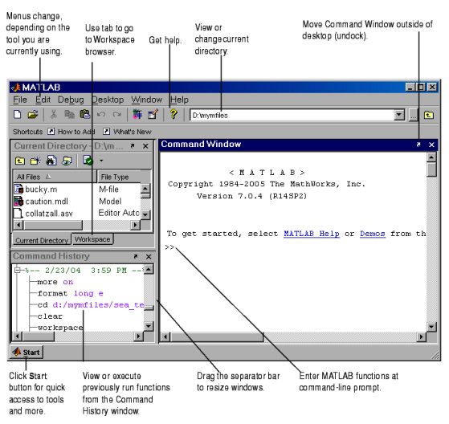
Graphical interface to the matlab workspace

Slide 6
Matlab Installation

Slide 7
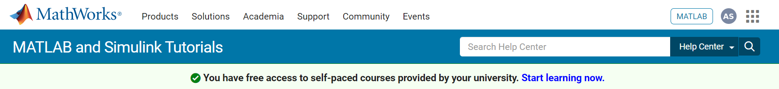
How to install matlab?
Our university provides free access to MATLAB
Online
Install

Slide 8
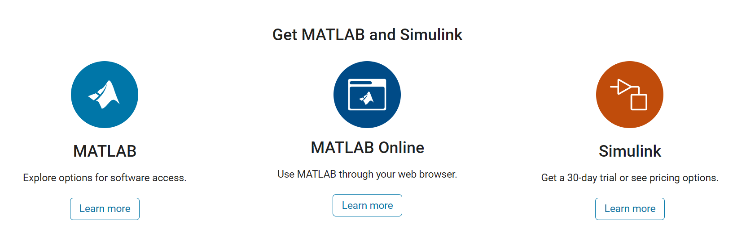
Getting start

Slide 9
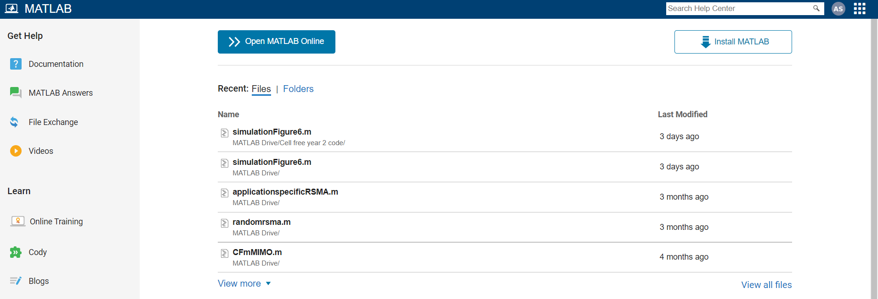
MATLAB

Slide 10
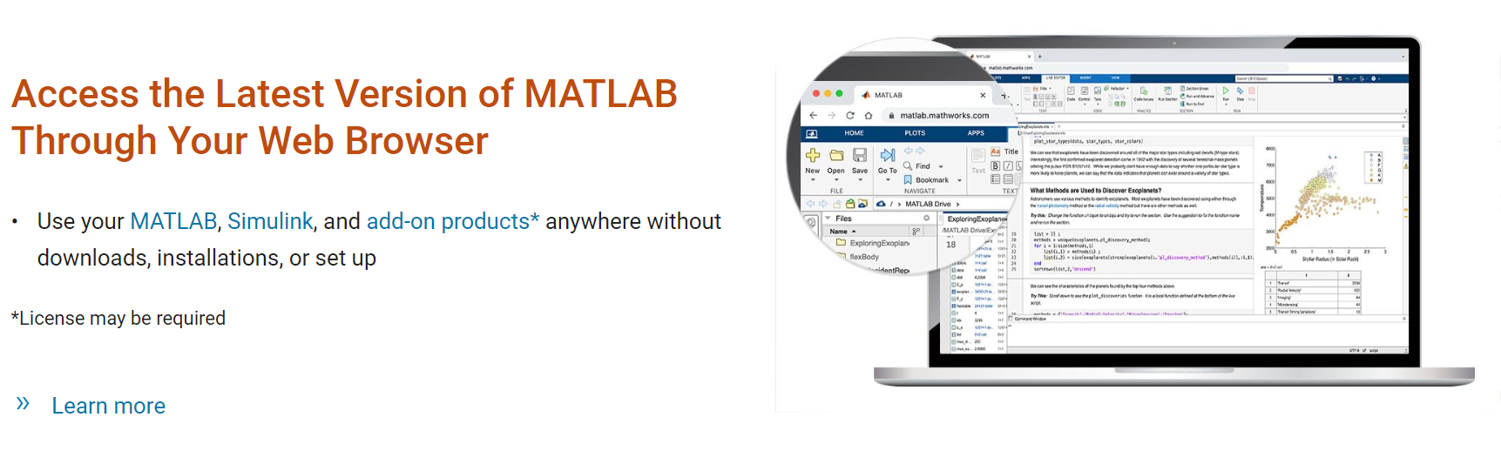
MATLAB online

Slide 11
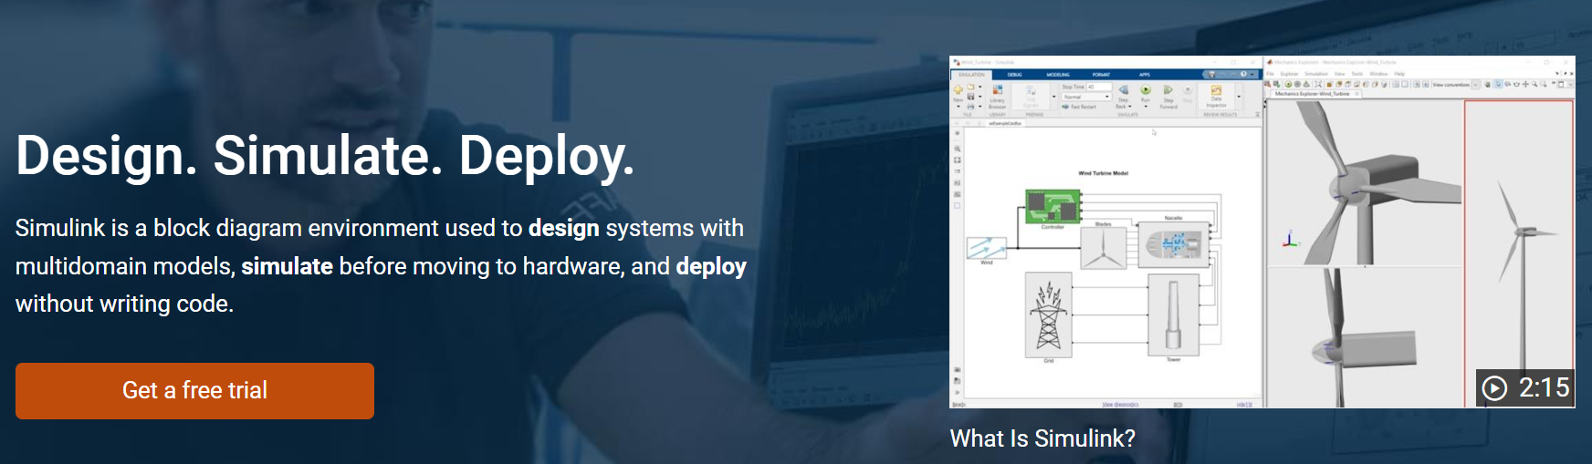
simulink
Notes:
https://www.mathworks.com/products/simulink.html

Slide 12
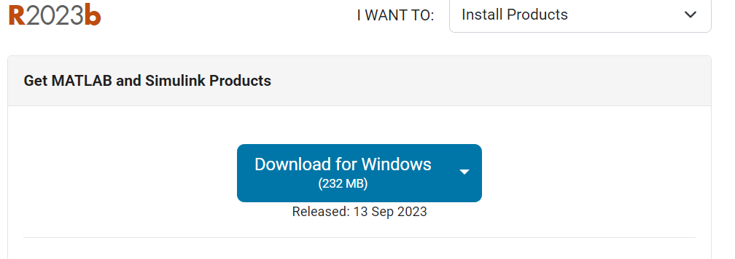

How to open matlab?
Install from the link
https://www.mathworks.com/downloads/
Create desktop icon
Double-click on the icon
Example:

Slide 13
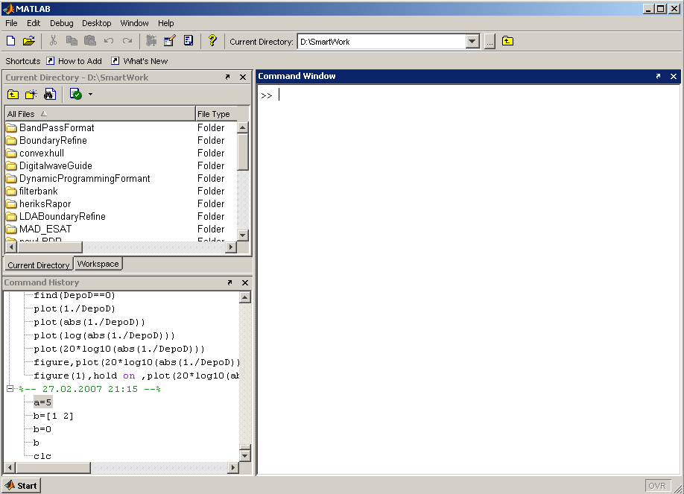
Matlab window
Command Window
type commands
Current Directory
View folders and m-files
Workspace
View program variables
Double-click on a variable to see it in the Array Editor
Command History
View past commands
save a whole session using a diary

Slide 14
How to write source code?

Slide 15

variables
No need to define variables
Semicolon?
int a;
a=1;
double b;
b=2+4;
>>a=1;
>>b=2+4;
C language
MATLAB

Slide 16


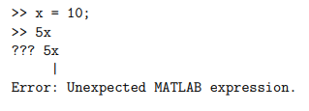

calculations
Syntax of variable:
Variable name= a value or expression

Slide 17
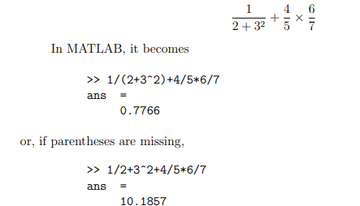
calculations

Slide 18
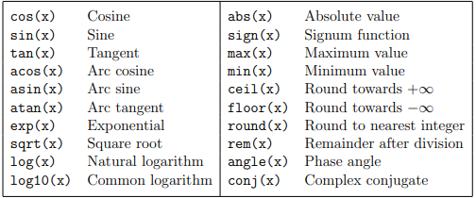
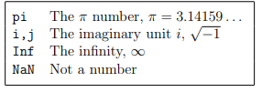
functions
Example 1:
A=5; x=2; y=8
y = exp(-a)*sin(x)+10*sqrt(y)
Example 2:
log(142)
ans = 4.9558
Example 3:
log10(142)
Ans = 2.1523
Example 4:
sin (pi/4)
ans = 0.7071
exp(10)
ans = 2.2026e+004

Slide 19
Creating Sine wave in matlab: case 1

Slide 20

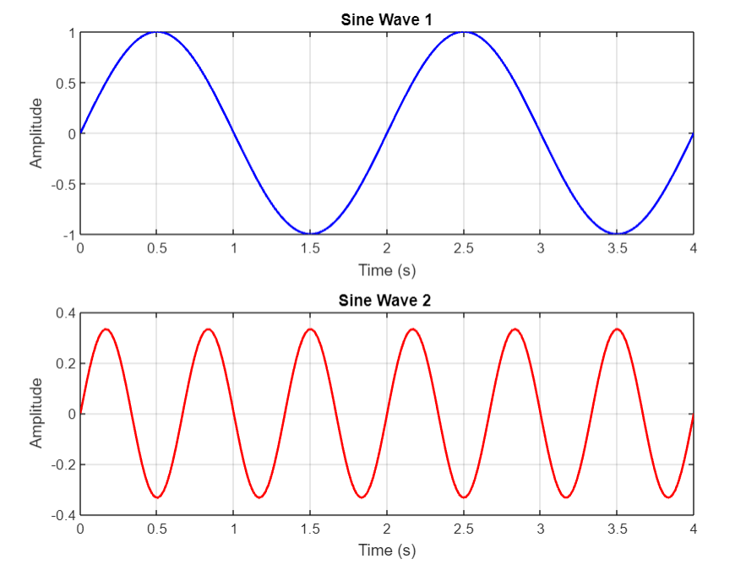
Example of program

Slide 21

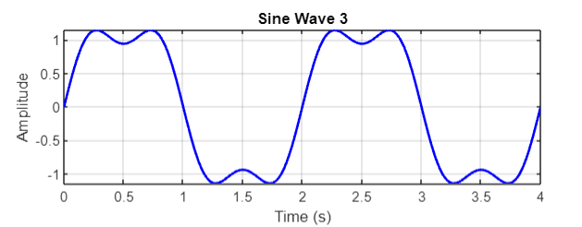
Example of program

Slide 22
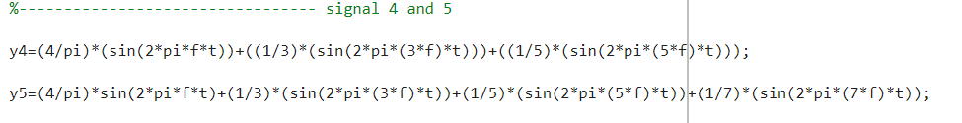
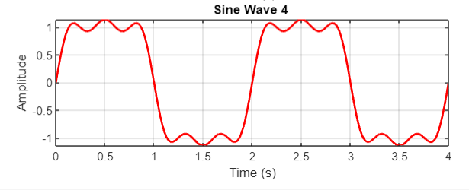
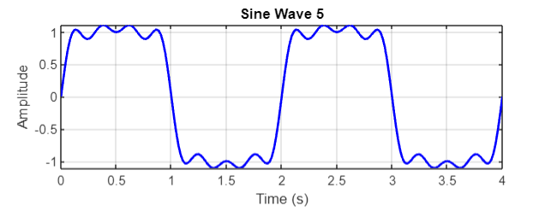
Example of program

Slide 23

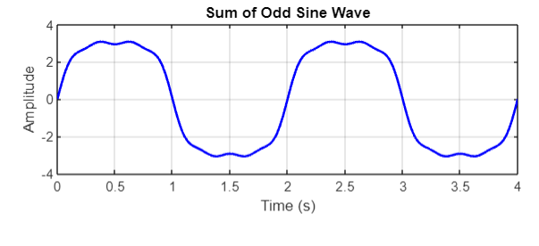
Example of program

Slide 24
Creating Sine wave in Matlab: Case 2 (Fourier Transformation)

Slide 25
Example of program

Slide 26

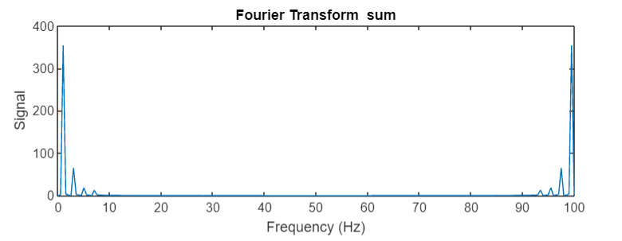
Example of program

Slide 27
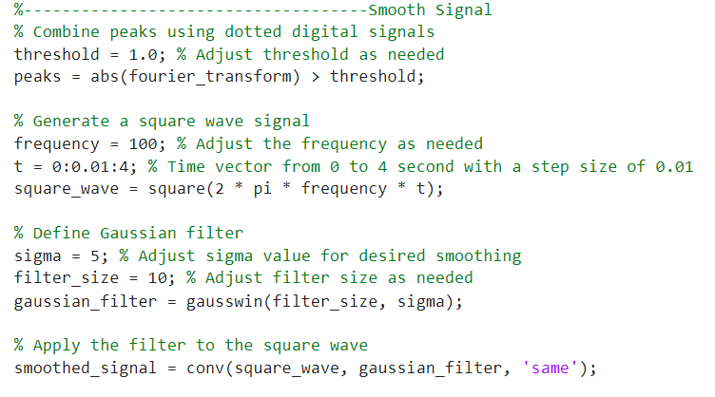
Remove noise

Slide 28
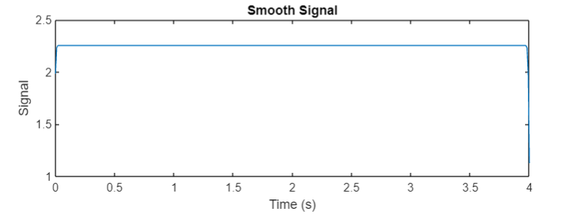
Remove noise

Slide 29
References
MATLAB Documentation
http://www.mathworks.com/help/matlab/
Cheat Sheets
http://web.mit.edu/18.06/www/Spring09/matlab-cheatsheet.pdf
https://www.mathworks.com/content/dam/mathworks/mathworks-dot-com/moler/intro.pdf

Slide 30


