Slide 1
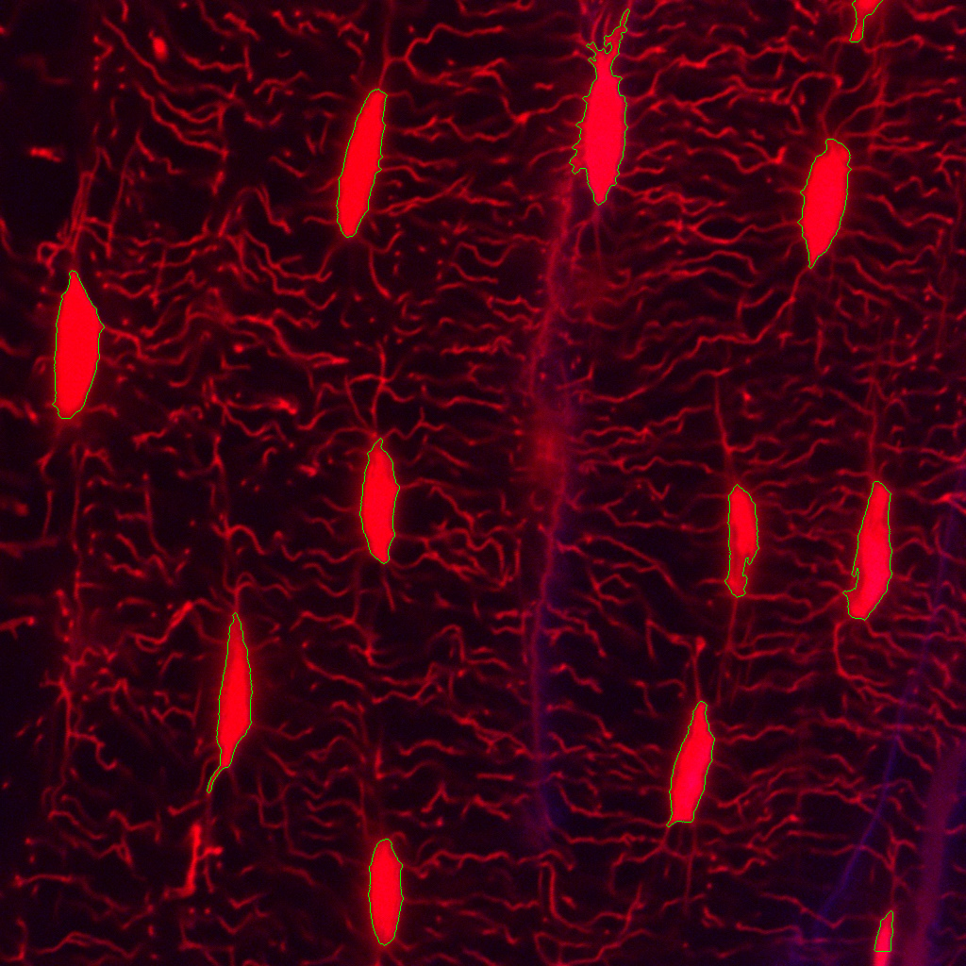
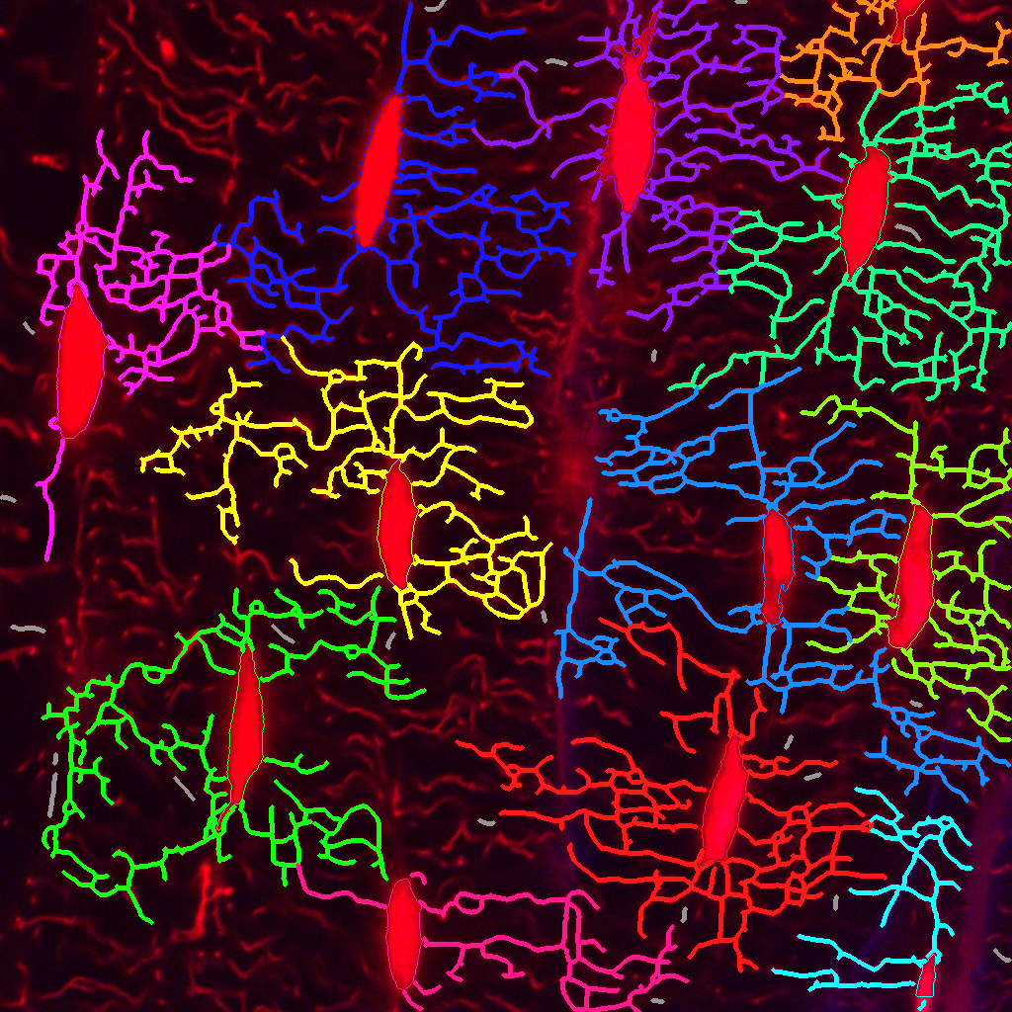
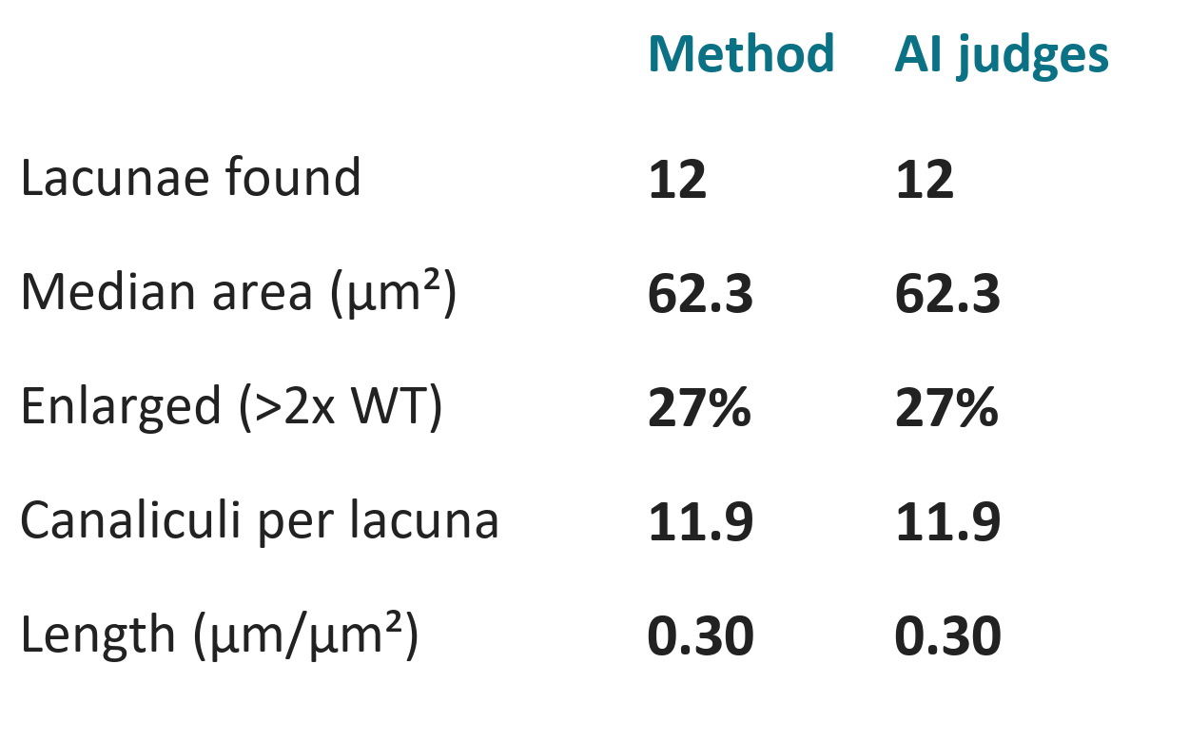
WT: 542_z18
Lacunae
Canaliculi
Comparison of numbers
12 lacunae | 0.70 per 1000 µm² | 62 µm canalicular length per lacuna | 11.9 canaliculi per lacuna
Notes:
This is one WT image, 542_z18, shown three ways. Left, the lacunae the pipeline found; middle, the canaliculi it traced from each lacuna; right, the key numbers of the method run next to the run with AI judges. Nothing is validated against manual counts yet.

Slide 2
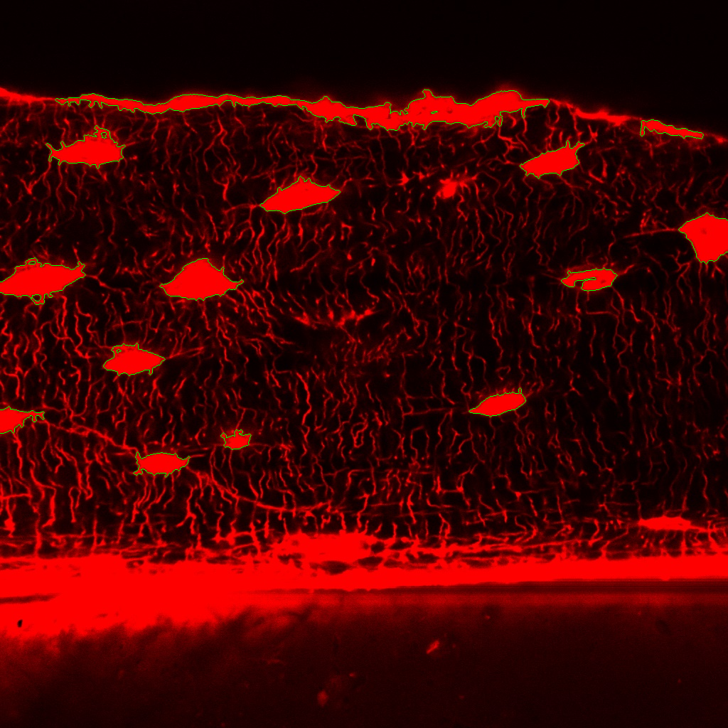
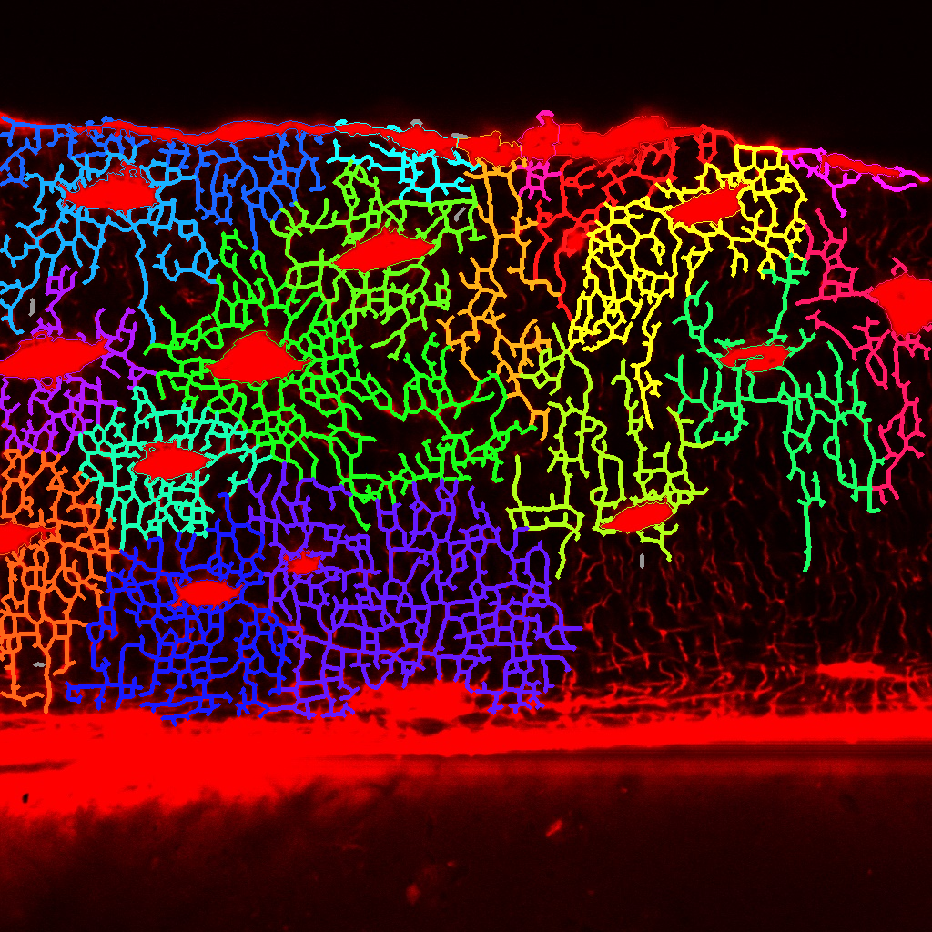
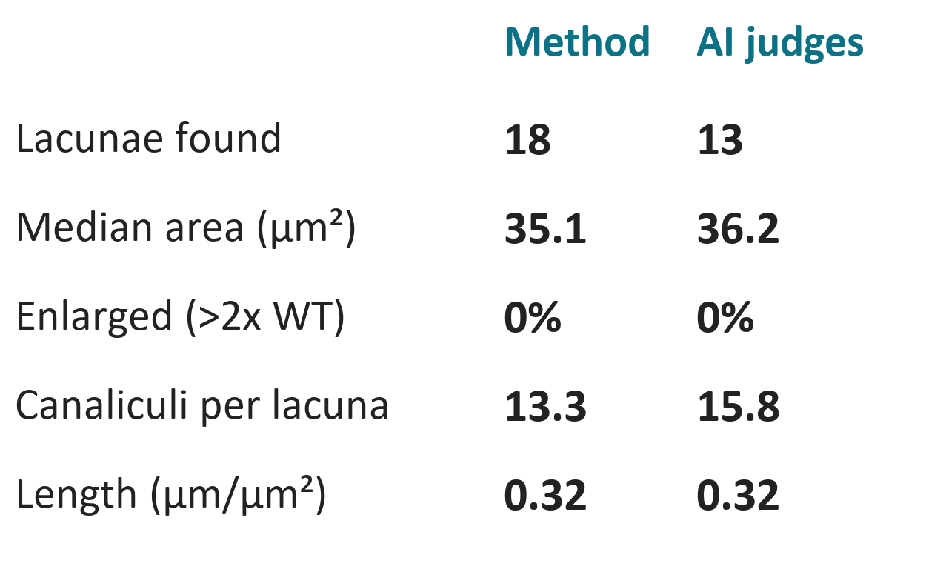
WT_HP: 872_wt_hp_z04
Lacunae
Canaliculi
Comparison of numbers
18 lacunae | 1.23 per 1000 µm² | 72 µm canalicular length per lacuna | 13.3 canaliculi per lacuna
Notes:
This is one WT_HP image, 872_wt_hp_z04, shown three ways. Left, the lacunae the pipeline found; middle, the canaliculi it traced from each lacuna; right, the key numbers of the method run next to the run with AI judges. Nothing is validated against manual counts yet.

Slide 3
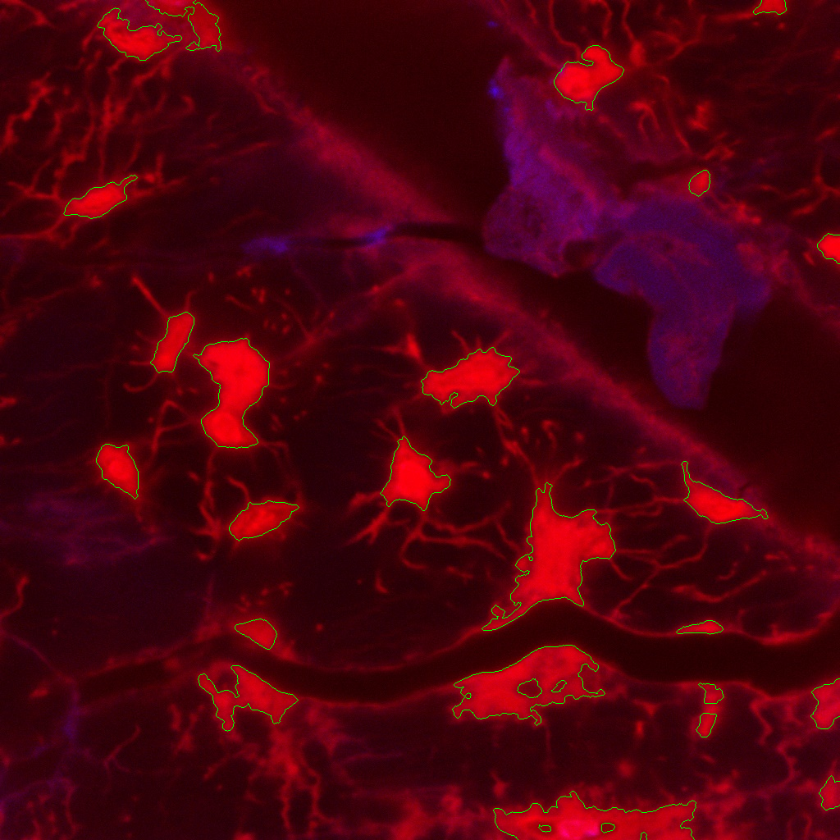
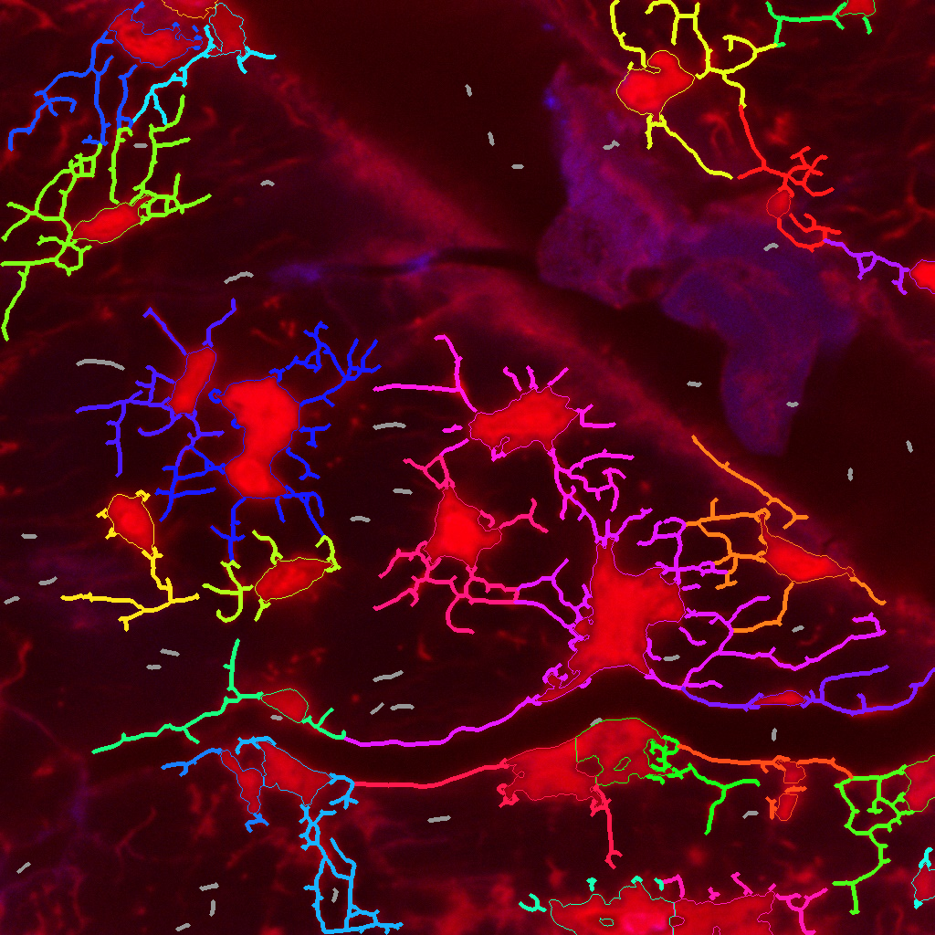
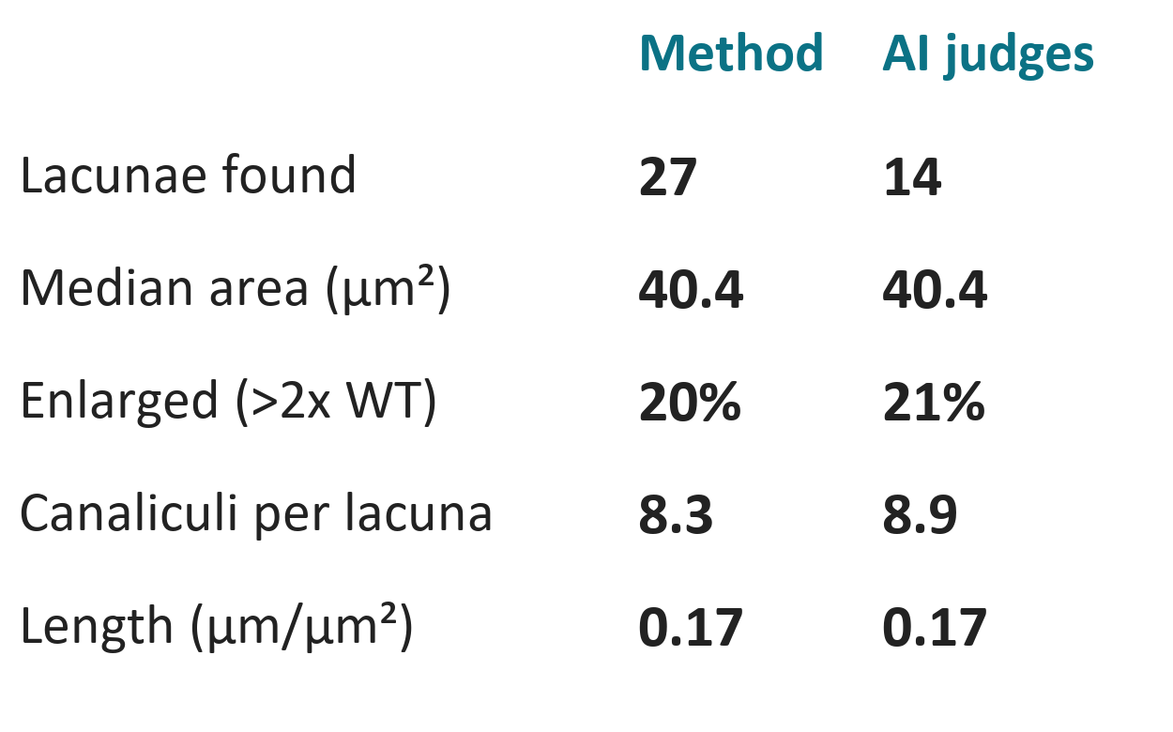
Hyp_RD: 535_z20c1-2
Lacunae
Canaliculi
Comparison of numbers
27 lacunae | 1.64 per 1000 µm² | 34 µm canalicular length per lacuna | 8.3 canaliculi per lacuna
Notes:
This is one Hyp_RD image, 535_z20c1-2, shown three ways. Left, the lacunae the pipeline found; middle, the canaliculi it traced from each lacuna; right, the key numbers of the method run next to the run with AI judges. Nothing is validated against manual counts yet.

Slide 4
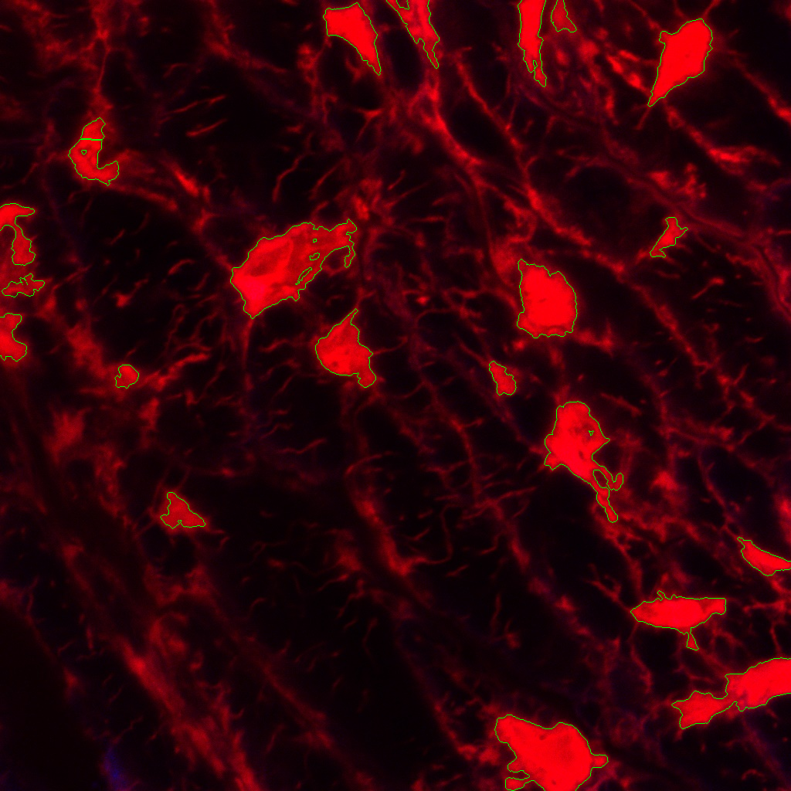
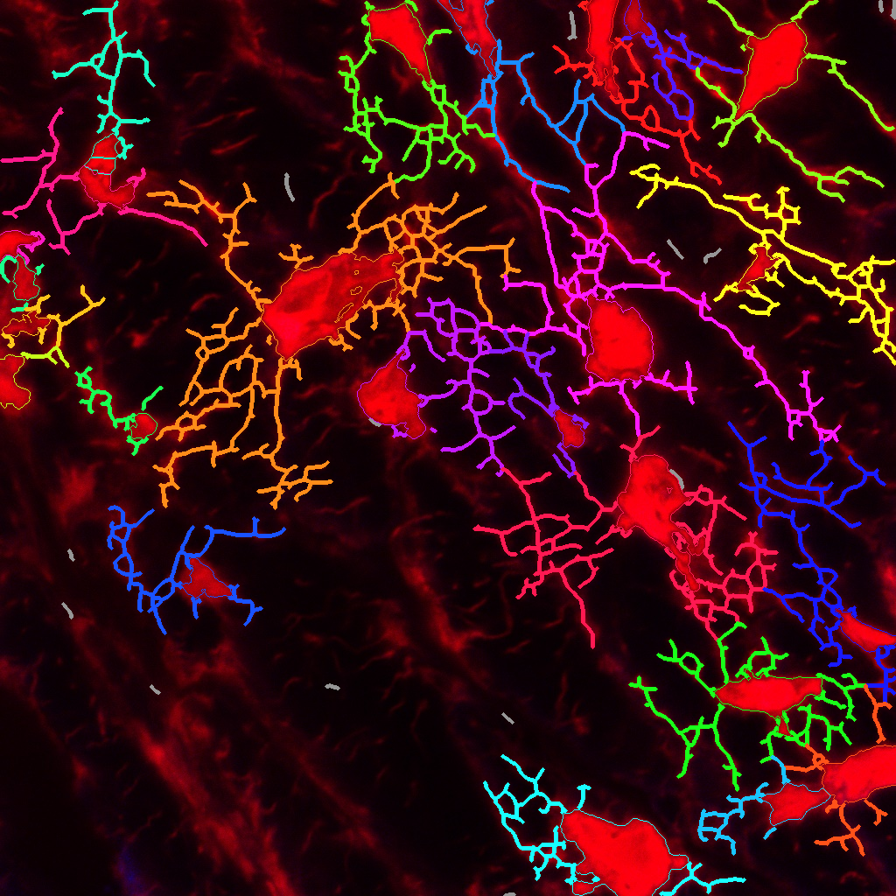
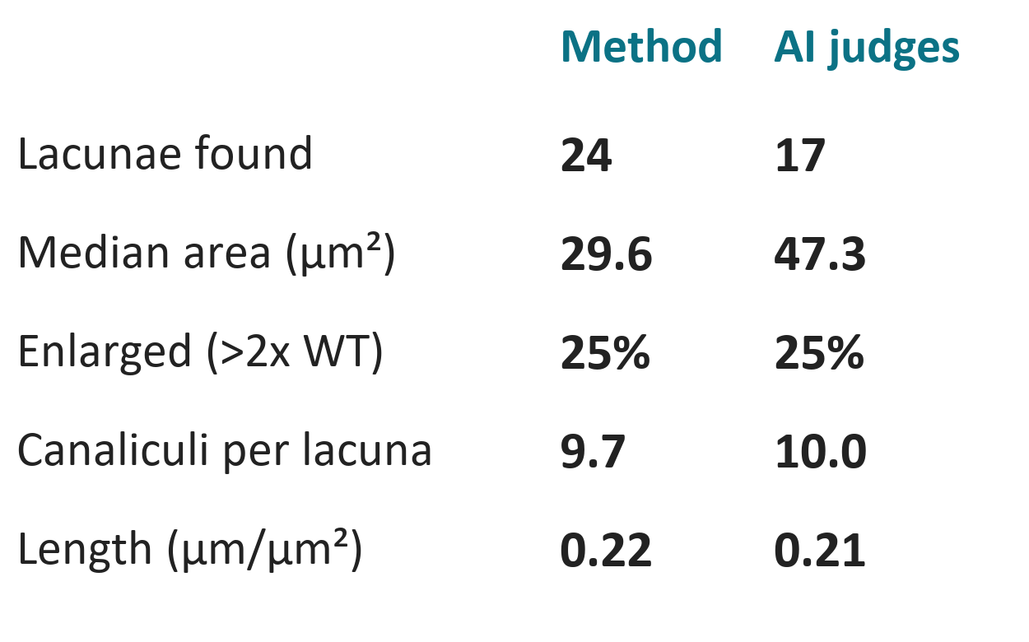
Hyp_HP: 548_hyp_HP_z14c1-2
Lacunae
Canaliculi
Comparison of numbers
24 lacunae | 1.45 per 1000 µm² | 40 µm canalicular length per lacuna | 9.7 canaliculi per lacuna
Notes:
This is one Hyp_HP image, 548_hyp_HP_z14c1-2, shown three ways. Left, the lacunae the pipeline found; middle, the canaliculi it traced from each lacuna; right, the key numbers of the method run next to the run with AI judges. Nothing is validated against manual counts yet.

Slide 5
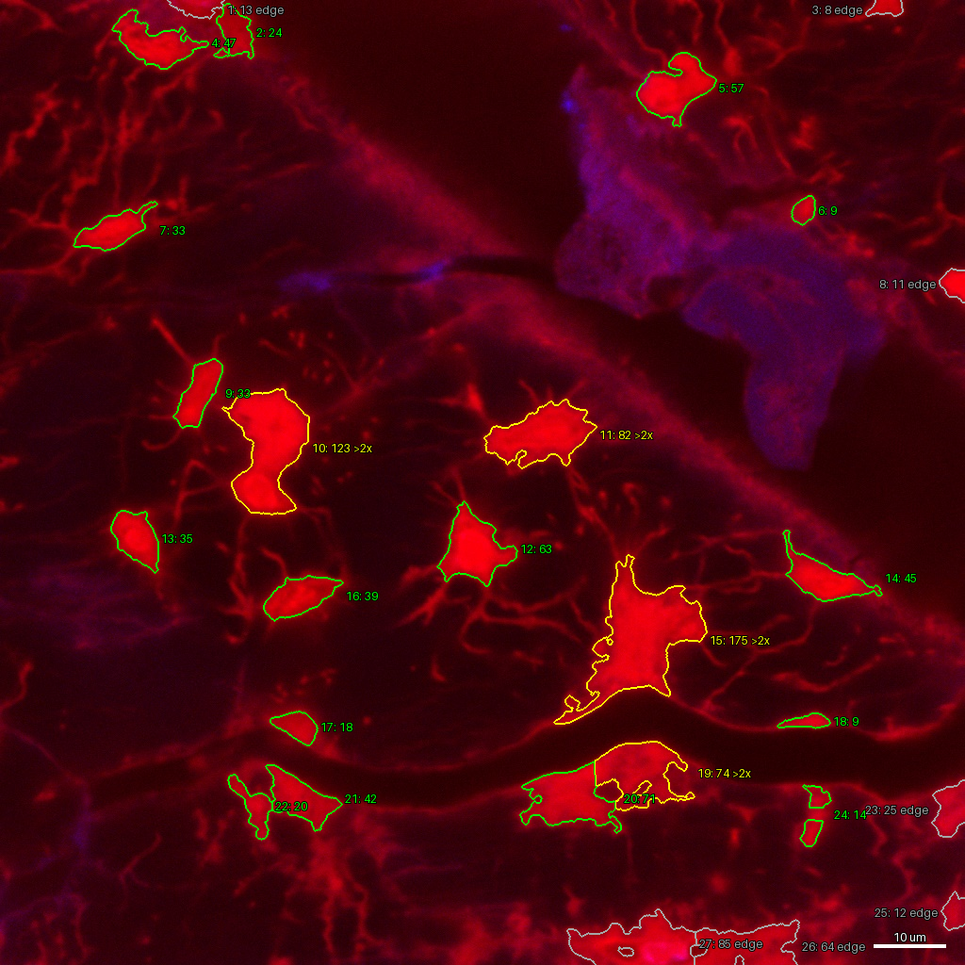
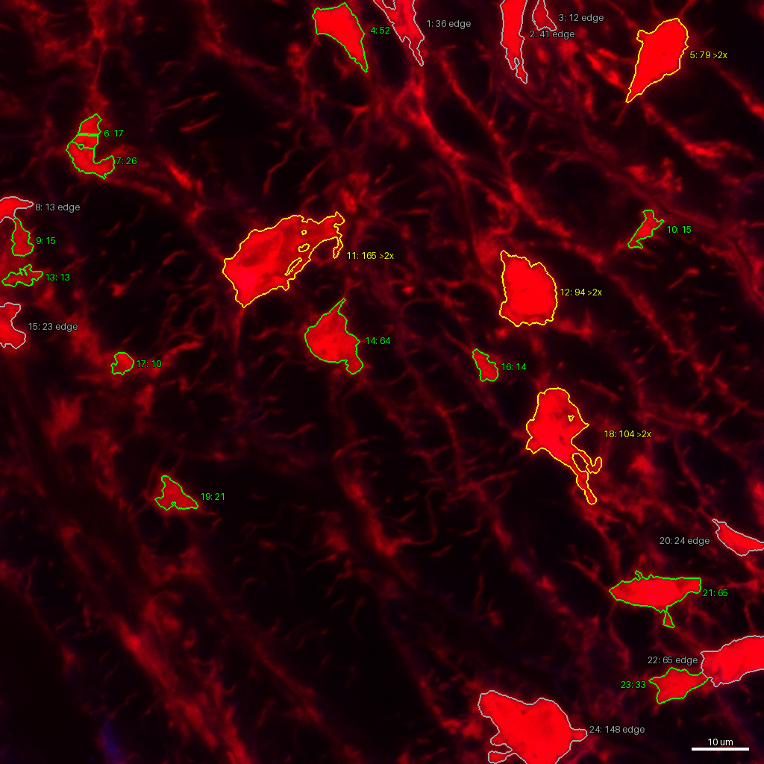
POLs: enlarged lacunar space
What counts as a POL
An enlarged, dye-filled lacunar space: a lacuna above 2x the WT median area (36.8 µm²).
Measured
POL area per analysed area
Share of lacunae above 2x WT
Lacuna area vs WT median
Hyp_RD: 535_z20c1-2
Hyp_HP: 548_hyp_HP_z14c1-2
Unvalidated, no ground truth yet
20% enlarged, POL area 7.0%
25% enlarged, POL area 6.5%
Question for the group: how do we define the POL boundary?
Notes:
Yellow outlines are lacunae above twice the WT median area, our working candidate POLs; green are normal size and grey touch the frame. The footprint is the lacuna outline itself, so the boundary is only as good as that definition. This is the open question I want input on.

