Slide 1
Computer Organization & Design The Hardware/Software Interface
Chapter 2
Instructions ：Language of the Machine

Slide 2
Topics to cover in Chapter 2
MIPS operations and operands
MIPS registers
Memory view
Instruction encoding
Arithmetic operations
Logic operations
Memory transfer operations

Slide 3
MIPS: Million Instructions Per Second每秒处理的百万级的机器语言指令数
The number of MIPS (million instructions per second) is a general measure of computing performance and, by implication, the amount of work a larger computer can do.
MIPS: Microprocessor without interlocked piped stages无内部互锁流水级的微处理器
MIPS (originally an acronym for Microprocessor without Interlocked Pipeline Stages) is a reduced instruction set computer (RISC) instruction set architecture (ISA) developed by MIPS Technologies

Slide 4
当前CPU的两种架构：RISC(Reduced Instruction Set Computer)
CISC(Complex Instruction Set Computer)
CISC架构，它的设计目的是要用最少的机器语言指令来完成所需的计算任务，复杂操作依赖于CPU中设计的逻辑来实现；
RISC架构要求软件来指定各个操作步骤，复杂操作都必须由软件来实现
四大CPU体系结构:ARM/MIPS/PowerPC/X86
ARM架构（价格低、能耗低），是一个32位精简指令集（RISC）处理器架构，其广泛地使用在许多嵌入式系统设计。由于节能的特点，ARM处理器非常适用于行动通讯领域，符合其主要设计目标为低耗电的特性
x86或80x86是英代尔Intel首先开发制造的一种微处理器体系结构的泛称。x86架构是重要地可变指令长度的CISC。
MIPS是世界上很流行的一种RISC处理器。其机制是尽量利用软件办法避免流水线中的数据相关问题。和英特尔采用的复杂指令系统计算结构(CISC)相比，RISC具有设计更简单、设计周期更短等优点，并可以应用更多先进的技术，开发更快的下一代处理器
PowerPC 是一种精简指令集（RISC）架构的中央处理器（CPU），其基本的设计源自IBM（国际商用机器公司）的IBM PowerPC 601 微处理器POWER（Performance Optimized With Enhanced RISC，特点是可伸缩性好、方便灵活

Slide 5
Introduction
Language of the machine
Instructions → Statement
Instruction set → Syntax
Design goals
Maximize performance
Minimize cost
Reduce design time
Our chosen instruction set: MIPS
Similar to other ones developed since the 1980's
Used by NEC, Nintendo, Silicon Graphics, Sony

Slide 6
MIPS Operations/Operands
“Operation” (instruction)
“Operand”
MIPS operations
Arithmetic operations (integer/floating-point) (add, sub,…)
Logical operations (and, or,…)
Shift operations (shift a certain number of bits to the left or right)
Compare operations (do something if one operand is less than another,…)
Load/stores to transfer data from/to memory
Branch/jump operations
System control operations/coprocessor operations

Slide 7
MIPS Operations/Operands
MIPS operands
General-purpose registers
Fixed registers, e.g., HI/LO registers
Memory location
Immediate value

Slide 8
Data Types
Data types:
Instructions are all 32 bits
byte(8 bits), halfword (2 bytes), word (4 bytes)
a character requires 1 byte of storage
an integer requires 1 word (4 bytes) of storage

Slide 9
MIPS Registers
32 bits
32 bits
32 bits
$zero
r0
r16
$s0
HI
$at
r1
r17
$s1
LO
$v0
r2
r18
$s2
$v1
r3
r19
$s3
$a0
r4
r20
$s4
$a1
r5
r21
$s5
$a2
r6
r22
$s6
$a3
r7
r23
$s7
$t0
r8
r24
$t8
$t1
r9
r25
$t9
$t2
r10
r26
$k0
$t3
r11
r27
$k1
$t4
r12
r28
$gp
$t5
r13
r29
$sp
$t6
r14
r30
$fp
$t7
r15
r31
$ra
PC
General-Purpose Registers
Special-Purpose Registers
$at is reserved by the assembler to handle large constants.

Slide 10
Registers
32 general-purpose registers
Register preceded by $ in assembly language instruction;
Two formats for addressing:
Using register number e.g. $0 through $31
Using equivalent names e.g. $t1, $sp
Special registers Lo and Hi used to store result of multiplication and division not directly addressable; contents accessed with special instruction mfhi ("move from Hi") and mflo ("move from Lo")
Stack grows from high memory to low memory

Slide 11
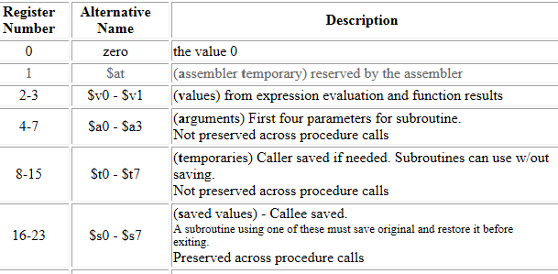
Description of 32 general-purpose registers

Slide 12
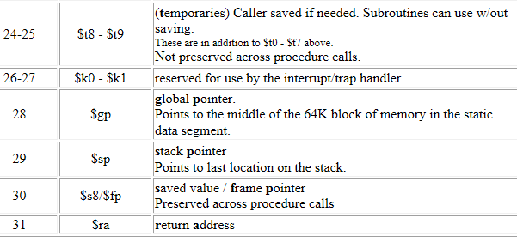
Description of 32 general-purpose registers

Slide 13
Instruction characteristics wide variety
wide variety
Operators
Op
Operands
The instruction sets can be differentiated by
Operand storage in the CPU
Number of explicit operands per instruction
Operand location
Operations
Type and size of operands

Slide 14
The type of internal storage in the CPU is the most basic differentiation
Stack: the operands are implicitly on top of the stack
Accumulator: one operand is implicitly the accumulator
Register: all operands are explicit either registers or memory locations

Slide 15
The code segment C = A + B how it would appear on the classes of instruction sets
Stack | Accumulator | Register
PUSH A | Load A | Load R1,A
PUSH B | ADD B | ADD R1,B
ADD | Store C | Store C,R1
POP C
Machine Type | Advantages | Disadvantages
Stack | Simple model of expression evaluation. Good code density. | A stack can't be randomly accessed. It makes it difficult to generate efficient code.
Accumulator | Minimizes internal state of machine. Short instructions | Since accumulator is only temporary storage, memory traffic is highest.
Register | Most general model for code generation | All operands must be named, leading to longer instructions.

Slide 16
Most early machines used stack or accumulator-style architectures, all machines designed in the past ten years use a general purpose registers architecture. The reason is the registers are: 1: Faster than memory 2: Easier for a compiler to use 3: Can be used more effectively

Slide 17
There are two major instruction set characteristics that divide GPR architectures. They concern
Whether an ALU instruction has two or three operands
ADD R3, R1, R2 R3 <-R1 + R2 | or | ADD R1, R2 R1 <- R1 + R2
How many of the operands may be memory addressed in ALU instruction
1. Register- Register (Load/Store)
ADD R3, R1, R2 (R3 <- R1 + R2)
2. Register – Memory
ADD R1, A (R1 <- R1 + A)
3. Memory – Memory
ADD C, A, B (C <- A + B)

Slide 18
The number of the memory operand In the instruction
Register-Register
Maximum number of operands allowed 3
Number of memory addresses is 0
Register-memory
Maximum number of operands allowed 2
Number of memory addresses is 1
Memory-memory
Maximum number of operands allowed 2 or 3
Number of memory addresses is 2 or 3

Slide 19
Variables difference
C
Int char f
Instruction Set
Register
Memory address
Displacement
Immediate
Stack

Slide 20
2.2 Operations of the Computer Hardware
Every computer must be able to perform arithmetic
Only one operation per instruction
Exactly three variables add a, b, c a←b+c
The natural number of operands for an operation like addition is three: the two numbers being added together and a place to put the sum.
Requiring every instruction to have exactly three operands, no more and no less, conforms to the philosophy of keeping the hardware simple: hardware for a variable number of operands is more complicated than hardware for a fixed number.

Slide 21
2.2 Operations of the Computer Hardware
Design Principle 1
Simplicity favors regularity
Example 2.1
Compiling two simple C statements into MIPS
C code:
a = b + c;
d = a – e;
MIPS code:
add a, b, c
sub d, a, e

Slide 22
Arithmetic
Example 2.2 Compiling a complex C statement
C code:
f = ( g + h ) – ( i + j );
MIPS code:
add t0, g, h # temporary variable t0 contains g + h
add t1, i, j # temporary variable t1 contains i + j
sub f, t0, t1 # f gets t0 – t1
MPIS assembly language
Category | Instruction | Example | Meaning | Comments
Arithmetic | add | add a,b,c | a←b+c | Always three operand
 | subtract | sub a,b,c | a←b-c | Always three operand

Slide 23
2.3 Operands of the Computer Hardware
Register Operands
Unlike programs in high-level languages, the operands of arithmetic instructions are restricted; they must be from a limited number of special locations built directly in hardware called registers.
Arithmetic instructions operands must be registers
Registers is limited number of
32 registers in MIPS
32 bits for each register in MIPS
Design Principle 2
Smaller is faster
MIPS convention for registers
$s0, $s1, … for registers corresponding to variables in C
$t0, $t1, … for temporary registers for compiler

Slide 24
Operate with Register Operands
Example 2.3 Compiling a C statement using registers
C code
f = ( g + h ) – ( i + j ) ;
MIPS code
add $t0, $s1, $s2 # $t0 contains g + h
add $t1, $s3, $s4 # $t1 contains i + j
sub $s0, $t0, $t1 # f gets $t0 - $t1

Slide 25
Memory operands
Save complex data structures
Arrays and structures
Complex data structures can contain many more data elements than there are registers in a computer. How can a computer represent and access such large structures?
Data transfer instructions
Load: from memory to register;
Store: from register to memory;
3
1
0
0
2
1
0
1
1
0
1
0
1
Address
D
a
t
a
Processor
Memory

Slide 26
Example 2.4 Compiling with an operand in memory
C code:
g = h + A[8] ; // A is an array of 100 words ( Assume: g ---- $s1 h ---- $s2 base address of A ---- $s3 )
MIPS code:
lw $t0, 8($s3) # temporary reg $t0 gets A[8]
add $s1, $s2, $ t0 # g = h + A[8]
Offset: the constant in a data transfer instruction →8($s3)
Base register: the register added to form the address
Byte addressing
→8($s3)
Alignment restriction
Addresses of words are multiples of 4 in MIPS
→32($s3)

Slide 27
Software/hardware interface
Compiler allocates data structures to memory Compiler associating variables with registers
Actual MIPS memory addresses and contents
C
1
0
0
Registers
8
1
0
4
1
0
1
0
1
Address
Data
Processor
Memory
The offset to be added to $s3 in Example 2.4 must be
4×8

Slide 28
Example 2.5 Compiling using load and store
C code:
A[12] = h + A[8] ; // A is an array of 100 words ( Assume: h ---- $s2 base address of A ---- $s3 )
MIPS code:
lw $t0 , 32($s3) # temporary reg $t0 gets A[8]
add $t0, $s2, $ t0 # temporary reg $t0 gets h + A[8]
sw $t0, 48($s3) # stores h + A[8] back into A[12]

Slide 29
Discussion：How to represent?
g = h + A[i]
( Assume: g, h, i -- $s1, $s2, $s4 base address of A -- $s3 )

Slide 30
g = h + A[i]
Example 2.6 Compiling using a variable array index
C code:
g = h + A[i] ; // A is an array of 100 words ( Assume: g, h, i -- $s1, $s2, $s4 base address of A -- $s3 )
MIPS code:
add $t1, $s4, $s4 # temp reg $t1 = 2 * i
add $t1, $t1, $t1 # temp reg $t1 = 4 * i
add $t1, $t1, $s3 # $t1 = address of A[i] (4 * i + $s3)
lw $t0 , 0($t1) # temp reg $t0 = A[i]
add $s1, $s2, $t0 # g = h + A[i]
Spilling registers Putting less commonly used variables(or those needed later)
into memory

Slide 31
Spilling registers
Many programs have more variables than computers have registers.
Consequently, the compiler tries to keep the most frequently used variables in registers and places the rest in memory, using loads and stores to move variables between registers and memory.
Putting less commonly used variables(or those needed later) into memory

Slide 32
Discussion：How to represent?
Constant
g = h + 55
Many time a program
will use a constant in an operation

Slide 33
Constant or immediate Operands
Many time a program will use a constant in an operation
Incrementing index to point to next element of array
Add the constant 4 to register $s3
Assuming AddrConstants4 is address pointer of constant 4
Prestored in memory
lw $t0, AddrConstant4($s1) # $t0=constant 4
add $s3, $s3, $t0 #$s3=$s3+$t0($t0==4)
$s1
….
AddrConstants 4
4

Slide 34
Immediate Operands
Prestored with in Instruction
Avoids the load instruction
Immediate: Other method for adding constant 4 to $s3
Offer versions of the instruction
addi $s3, $s3, 4 #$s3= $s3+ 4
Short Literal
Design Principle 3
Make the common case fast: (why?) Constant operands occur frequently it is very common Loading them from memory is very slow
OP
Short Literal

Slide 35
Brief summary
MIPS operands
Name | Example | Comments
32 register | $s0,$s1…… $t0, $t1……. | Fast locations for data. In MIPS, data must be in registers to perform arithmetic.
2³⁰ memory words | Memory[0], Memory[4] , Memory[8], …… , Menory[4294967292] | Accessed only by data transfer instructions in MIPS. MIPS uses byte addr. , so sequential word addr. Differ by 4. Memory holds data structures, arrays, and spilled registers.
MIPS assembly language
Category | Instruction | Example | Meaning | Comments
Arithmetic | add | add $s1,$s2,$s3 | $s1=$s2 + $s3 | Three register operands
 | subtract | sub $s1,$s2,$s3 | $s1=$s2－$s3 | Three register operands
 | Add immediate | addi $s1,$s2,100 | $s1=$s2+100 | Used to add constants
Data transfer | load word | lw $1, 100($s2) | $s1=Memory[$s2+100] | Data from memory to register
 | store word | sw $s1, 100($s2) | Memory[$s2+100]=$s1 | Data from register to memory

Slide 36
2.5 Representing Instructions in the Computer --Instruction Format
All information in computer consists of binary bits
Mapping registers into numbers(index)
Map registers $s0 to $s7 onto registers 16 to 23
Map registers $t0 to $t7 onto registers 8 to 15
Example 2.7 Translating assembly into machine instruction
MIPS code
add $t0, $s1, $s2
Decimal version of machine code
| 0 | 17 | 18 | 8 | 0 | 32 |
Binary version of machine code
| 000000 | 10001 | 10010 | 01000 | 00000 | 100000 |
6 bits 5 bits 5 bits 5 bits 5 bits 6 bits
Sometime use Hex!

Slide 37
MIPS fields (format)
Field size | 6bits | 5bits | 5bits | 5bits | 5bits | 6bits | All MIPS instruction 32 bits
R-format | op | rs | rt | rd | shamt | funct | Arithmetic instruction format
i-format | op | rs | rt | Imm/Word address |  |  | Data transfer ,branch format
J-format | op | target address (word) |  |  |  |  | Uncondition-al jump
Must bear in mind !
Region: ±2¹⁵
op：basic operation of the instruction, traditionally called the opcode.
rs： the first register source operand.
rt： the second register source operand.
rd： the register destination operand.
shamt： shift amount.
funct： function, this field selects the specific variant of the operation in the op field.

Slide 38
Design Principle 3
Good design demands good compromises
All instructions in MIPS have the same length
Conflict: same length ← → single format

Slide 39
Example 2.8 Translating assembly into machine instruction
C code:
A[300] = h + A[300] ; ( Assume: h ---- $s2 base address of A ---- $t1 )
MIPS assembly code:
lw $t0, 1200($t1) # temporary reg $t0 gets A[300]
add $t0, $s2, $t0 # temporary reg $t0 gets h + A[300]
sw $t0, 1200($t1) # stores h + A[300] back into A[300]
MIPS machine language code:
Decimal version address/
op rs rt rd shamt funct
| 35 | 9 | 8 | 1200 |
| 0 | 18 | 8 | 8 | 0 | 32 |
| 43 | 9 | 8 | 1200 |
lw
add
sw

Slide 40
Binary version
| 100011 | 01001 | 01000 | *0000 0100 1011 0000 |
| 000000 | 10010 | 01000 | 01000 | 00000 | 100000 |
| 101011 | 01001 | 01000 | 0000 0100 1011 0000 |
Note the only difference of the first and last instructions!
Two key principles of today’s computers
Instructions are represented as numbers
Programs can be stored in memory like numbers
lw
add
sw
Store-program

Slide 41
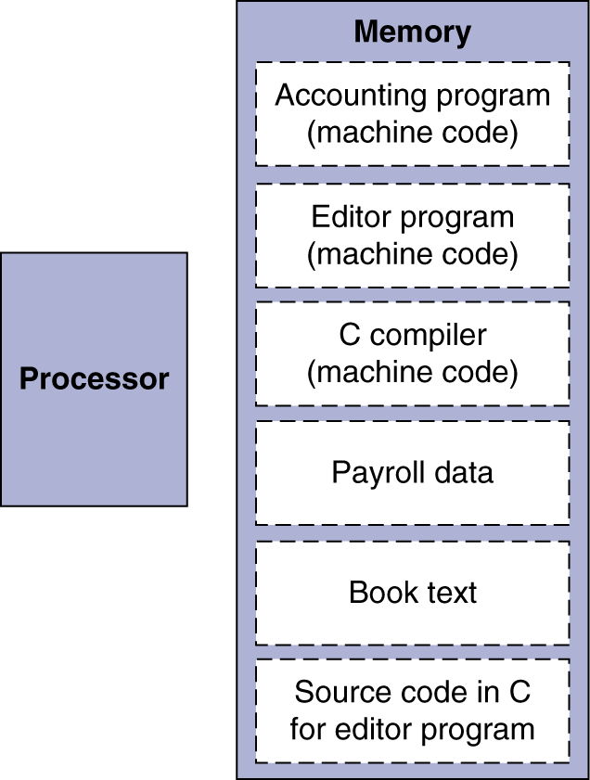
Stored-program computers
Instructions represented in binary, just like data
Instructions and data stored in memory
Programs can operate on programs
e.g., compilers, linkers, …
Binary compatibility allows compiled programs to work on different computers
Standardized ISAs

Slide 42
MIPS operands, assembly and machine language
Name | Example | Comments
32 register | $s0,$s1……,$s7 $t0, $t1…….,$t7 | Fast locations for data. In MIPS, data must be in registers to perform arithmetic. Registers $s0-$s7 map to 16-23 and $t0-$t7 map to 8-15.
2³⁰ memory words | Memory[0], Memory[4], Memory[8], …… , Menory[4294967292] | Accessed only by data transfer instructions in MIPS. MIPS uses byte addr., so sequential word addr. Differ by 4. Memory holds data structures,arrays, and spilled registers.
Category | Instruction | Example | Meaning | Comments
Arithmetic | add | add $s1,$s2,$s3 | $s1=$s2 + $s3 | Three register operands
 | subtract | sub $s1,$s2,$s3 | $s1=$s2－$s3 | Three register operands
 | Add immediate | addi $s1,$s2,100 | $s1=$s2+100 | Used to add constants
Data transfer | load word | lw $1, 100($s2) | $s1=Memory[$s2+100] | Data from memory to register
 | store word | sw $s1, 100($s2) | Memory[$s2+100]=$s1 | Data from register to memory
Name | Format | Example |  |  |  |  |  | Comment
add | R | 0 | 18 | 19 | 17 | 0 | 32 | add $s1, $s2, $s3
sub | R | 0 | 18 | 19 | 17 | 0 | 34 | sub $s1, $s2, $s3
addi | I | 8 | 18 | 17 | 100 |  |  | addi $s1,$s2,100
lw | I | 35 | 18 | 17 | 100 |  |  | lw $s1, 100($s2)
sw | I | 43 | 18 | 17 | 100 |  |  | sw $s1, 100($s2)
Field size |  | 6bits | 5bits | 5bits | 5bits | 5bits | 6bits | All MIPS instruction 32 bits
R-format | R | op | rs | rt | rd | shamt | funct | Arithmetic instruction format
I-format | I | op | rs | rt | address |  |  | Data transfer ,branch format

Slide 43
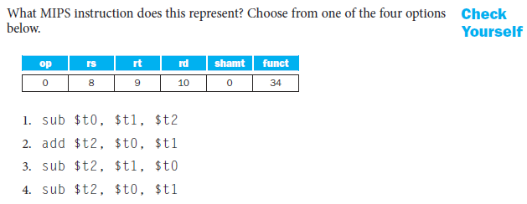

Slide 44
2.5 Logical Operation
Operating some bits within word or individual bit
Logic operations | C operators | Java operators | MIPS instructions
Shift left | 〈〈 | 〈〈 | sll
Shift right | 〉〉 | 〉〉〉 | srl
Bit-by-bit AND | & | & | And, andi
Bit-by-bit OP | | | | | Or, ori
Bit-by-bit NOT | ~ | ~ | nor

Slide 45
Shift operator
Move all the bits in a word to left or right, filling emptied bits with 0
Shifting left by i is same result as multiplying by 2^{i}
0000 0000 0000 0000 0000 0000 0000 1001 (9)₁₀
Shift left 4
0000 0000 0000 0000 0000 0000 1001 0000 (9×16=144)₁₀
sll $t2, $s0, 4 #reg $t2=reg $s0<<4 bit
op | rs | rt | rd | shamt | funct
0 | 0 | 16 | 10 | 4 | 0

Slide 46
AND operator
It is bit-by-bit
Result=1 : both bits of the operands are 1
$t2:
0000 0000 0000 0000 0000 1101 0000 0000
$t1:
0000 0000 0000 0000 0011 1100 0000 0000
and $t0, $t1, $t2 #reg $t0=reg $t1 & reg $t2
Result:
0000 0000 0000 0000 0000 1100 0000 0000

Slide 47
OR operator
It is bit-by-bit
Result=1 : either bits of the operands is 1
$t2:
0000 0000 0000 0000 0000 1101 0000 0000
$t1:
0000 0000 0000 0000 0011 1100 0000 0000
or $t0, $t1, $t2 #reg $t0=reg $t1 | reg $t2
Result:
0000 0000 0000 0000 0011 1101 0000 0000

Slide 48
NOT operator takes one operand and places a 1in the result if one operand bit is a 0, and vice versa.
In keeping with the three-operand format, the designers of MIPS decided to include the instruction NOR (NOT OR) instead of NOT.
NOR operator
NOT(A OR B)
A NOR 0 =NOT(A OR 0)=NOT(A)
$t1:
0000 0000 0000 0000 0011 1100 0000 0000
$t3:
0000 0000 0000 0000 0000 0000 0000 0000
nor $t0, $t1, $t3 #reg $t0=~(reg $t1 | reg $t3)
Result:
1111 1111 1111 1111 1100 0011 1111 1111

Slide 49
MIPS operands
Name | Example | Comments
32 register | $s0,$s1……,$s7 $t0, $t1…….,$t7 | Fast locations for data. In MIPS, data must be in registers to perform arithmetic. Registers $s0-$s7 map to 16-23 and $t0-$t7 map to 8-15.
2³⁰ memory words | Memory[0],Memory[4] , Memory[8] , …… , Menory[4294967292] | Accessed only by data transfer instructions in MIPS. MIPS uses byte addr., so sequential word addr. Differ by 4. Memory holds data structures,arrays, and spilled registers.
MIPS assembly language
Category | Instruction | Example | Meaning | Comments
Arithmetic | add | Add $s1,$s2,$s3 | $s1=$s2 + $s3 | Three register operands
 | subtract | Sub $s1,$s2,$s3 | $s1=$s2－$s3 | Three register operands
 | Add immediate | addi $s1,$s2,100 | $s1=$s2+100 | +constants; overflow detected
Data transfer | load word | lw $1, 100($s2) | $s1=Memory[$s2+100] | Data from memory to register
 | store word | sw $s1, 100($s2) | Memory[$s2+100]=$s1 | Data from register to memory
logical | and | and $s1,$s2,$s3 | $s1=$s2 & $s3 | three reg. operands;bit-by-bit AND
 | or | or $s1,$s2,$s3 | $s1=$s2 | $s3 | three reg. operands;bit-by-bit OR
 | nor | nor $s1,$s2,$s3 | $s1=~($s2 | $s3) | three reg. operands;bit-by-bit NOR
 | and immediate | addi $s1,$s2,100 | $s1=$s2 & 100 | Bit-by-bit AND reg with constant
 | or immediate | ori $s1,$s2,100 | $s1=$s2 | 100 | Bit-by-bit OR reg with constant
 | shift left logical | sll $s1,$s2,10 | $s1=$s2 << 10 | Shift left by constant
 | shift right logical | srl $s1,$s2,10 | $s1=$s2 >> 10 | Shift right by constant

Slide 50
2.6 Instructions for making decisions
Branch instructions
beq register1, register2, L1
bne register1, register2, L1
Example 2.9 Compiling an if statement to a branch
( Assume: f ~ j ---- $s0 ~ $s4 )
C code:
if ( i = = j ) goto L1 ;
f = g + h;
L1: f = f - i;
MIPS assembly code:
beq $s3, $s4, L1 # go to L1 if i equals j
add $s0, $s1, $s2 # f = g + h ( skipped if i equals j )
L1: sub $s0, $s0, $s3 # f = f - i ( always executed )

Slide 51
Example 2.10
Compiling if-then-else into Conditional Branches
( Assume: f ~ j ---- $s0 ~ $s4 )
C code:
if ( i = = j ) f = g + h ; else f = g - h ;
MIPS assembly code:
bne $s3, $s4, Else # go to Else if i ≠ j
add $s0, $s1, $s2 # f = g + h ( Executed if i = = j if)
j Exit # go to Exit
Else: sub $s0, $s1, $s2 # f = g - h ( Executed if i ≠ j else)
Exit: # the first instruction of the next C
…… statement
i↑j
i==j?
F=g+h
F=g - h
Exit:

Slide 52
Supports LOOPs
Example 2.11 Compiling a loop with variable array index
( Assume: g ~ j ---- $s1 ~ $s4 base of A[i] ---- $s5)
C code:
Loop: g = g + A[i] ; // A is an array of 100 words
i = i + j ;
if ( i != h ) goto Loop ;
MIPS assembly code:
Loop: add $t1, $s3, $s3 # temp reg $t1 = 2 * i
add $t1, $t1, $t1 # temp reg $t1 = 4 * i
add $t1, $t1, $s5 # $t1 = address of A[i]
lw $t0, 0($t1) # temp reg $t0 = A[i]
add $s1, $s1, $t0 # g = g + A[i]
add $s3, $s3, $s4 # i = i + j
bne $s3, $s2, Loop # go to Loop if i != h

Slide 53
Example 2.12 Compiling a while loop
( Assume: i ~ k---- $s3 ~ $s5 base of save ---- $s6 )
C code:
while ( save[i] = = k )
i = i + j ;
MIPS assembly code:
Loop: add $t1, $s3, $s3 # temp reg $t1 = 2 * i
add $t1, $t1, $t1 # temp reg $t1 = 4 * i
add $t1, $t1, $s6 # $t1 = address of save[i]
lw $t0, 0($t1) # temp reg $t0 = save[i]
bne $t0, $s5, Exit # go to Exit if save[i] != k
add $s3, $s3, $s4 # i = i + j
j Loop # go to Loop
Exit:

Slide 54
Most popular Compare Operation -- set on less than : slt
set on less than--slt
If the first reg. is less than second reg. then sets third reg to 1
slt $t0, $s3, $s4 # $t0=1 if $s3 < $s4
Example 2.13 Compiling a less than test
( Assume: a ---- $s0 b ---- $s1 )
C language:
if (a < b), goto Less
MIPS assembly code:
slt $t0, $s0, $s1 # $t0 gets 1 if $s0 < $s1 ( a < b)
bne $t0, $zero, Less # go to Less if $t0 != 0 (that is, if a < b )
MIPS architecture doesn’t include branch on less than because it is too complicated; either it would stretch the clock cycle time or it would take extra clock cycles per instruction. Two faster instructions are more useful.

Slide 55
Hold out Case/Switch
Used to select one of many alternatives
Example 2.14
( Assume: f ~ k ---- $s0 ~ $s5 $t2 contains 4 )
C code:
switch ( k ) {
case 0 : f = i + j ; break ; /* k = 0 */
case 1 : f = g + h ; break ; /* k = 1 */
case 2 : f = g - h ; break ; /* k = 2 */
case 3 : f = i - j ; break ; /* k = 3 */
}
Compiling a switch using jump address table

Slide 56
Jump register & jump address table
Jump with register content
jr $r
jump address table
 | …………
P1 address | Program 1
 | …………
P2 address | Program 2
 | …………
P3 address | Program 3
 | …………
P4 address | Program 3
 | …………
$r←$t4+4*K
K=0 | P1 address
K=1 | P2 address
K=2 | P3 address
K=3 | P4 address
$t4
The jump table is just an array of words containing addresses that correspond to labels in the code.

Slide 57
MIPS assembly code:
slt $t3, $s5, $zero # test if k < 0
bne $t3, $zero, Exit # if k < 0, go to Exit
slt $t3, $s5, $t2 # test if k < 4
beq $t3, $zero, Exit # if k >= 4, go to Exit
add $t1, $s5, $s5 # temp reg $t1 = 2 * k (0<=k<=3)
add $t1, $t1, $t1 # temp reg $t1 = 4 * k
add $t1, $t1, $t4 # $t1 = address of JumpTable[k]
lw $t0, 0($t1) # temp reg $t0 = JumpTable[k]
jr $t0 # jump based on register $t0
jump address table
$t1= $t4+4 * k:
L0: add $s0, $s3, $s4 # k = 0 so f gets i + j
j Exit # end of this case so go to Exit
L1: add $s0, $s1, $s2 # k = 1 so f gets g + h
j Exit # end of this case so go to Exit
L2: sub $s0, $s1, $s2 # k = 2 so f gets g - h
j Exit # end of this case so go to Exit
L3: sub $s0, $s3, $s4 # k = 3 so f gets i - j
Exit: # end of switch statement
L0:address
L1:address
L2: address
L3:address

Slide 58
Important conception--basic block
A sequence of instructions without branches and without branch target or branch lables
A compiler identifies basic blocks for optimization
An advanced processor can accelerate execution of basic blocks

Slide 59
2.7 Supporting Procedures in Computer Hardware
Procedure/function be used to structure programs
A stored subroutine that performs a specific task based on the parameters with which it is provided
easier to understand, allow code to be reused
Six step
Place Parameters in a place where the procedure can access them
Transfer control to the procedure：jump to
Acquire the storage resources needed for the procedure
Perform the desired task
Place the result value in a place where the calling program can access it
Return control to the point of origin

Slide 60
Registers for procedure calling
$a0 ~ $a3: four argument registers to pass parameters
$v0 ~ $v1: two value registers to return values
$ra: one return address register to return to origin point
Instruction for procedures: jal ( jump-and-link )
Caller jal ProcedureAddress
Callee jr $ra
PC+4→$ra
Special registers:
instruction address register

Slide 61
Using more registers
Suppose a compiler needs more registers for a procedure than the four argument and two return value registers. Since we must cover our tracks after our mission is complete, any registers needed by the caller must be restored to the values that they contained before the procedure was invoked.
Stack: ideal data structure for spilling registers
Push, pop
Stack pointer ( $sp )

Slide 62
Example 2.15 Compiling a leaf procedure
( Assume: g ~ j ---- $a0 ~ $a3 f ---- $s0)
C code:
int leaf_example ( int g, int h, int i, int j )
{
int f ;
f = ( g + h ) - ( i + j ) ;
return f ;
}
MIPS assembly code:
subi $sp, $sp,12 # adjust stack to make room for 3 items
sw $t1, 8($sp) #These three instructions save three
sw $t0, 4($sp) # register $t1,$t0,$s0
sw $s0, 0($sp) # Let’s consider why it need to be done.
High address
($t1)
($t0)
($s0)
$sp(-12)
Low address
Save value
Return value

Slide 63
add $t0, $a0, $a1 # register $t0 contains g + h
add $t1, $a2, $a3 # register $t1 contains i + j
sub $s0, $t0, $t1 # f = $t0 - $t1, which is ( g + h ) – ( i + j )
add $v0, $s0, $zero # returns f ( $v0 = $s0 + 0)
lw $s0, 0($sp) # restore register $s0 for caller
lw $t0, 4($sp) # restore register $t0 for caller
lw $t1, 8($sp) # restore register $t1 for caller
add $sp, $sp, 12 # adjust stack to delete 3 items
jr $ra # jump back to calling routine
But maybe some of the three are not used by the caller
So, this way might be inefficient
Two classes of registers
$t0 ~ $t9: 10 temporary registers , not preserved
$s0 ~ $s7: 8 saved registers, must be preserved

Slide 64
The values of the stack pointer and stack before, during and after procedure call in Example 2.15
High address
$sp
$sp
Content of register $t1
Content of register $t0
$sp
Content of register $s0
Low address
a
.
b
.
c
.
Conflict over the use of register both
Push all the registers to stack
Caller: pushes $a0~$a3 or $t0~$t9
Callee: pushes $ra (return address) and $s0~$s7

Slide 65
Nested Procedures
Example 2.16 Compiling a recursive procedure ( Assume: n -- $a0 )
C code for n!
int fact ( int n )
{
if ( n < 1 ) return ( 1 ) ;
else return ( n * fact ( n - 1 ) ) ;
}

Slide 66
Nested Procedures
Example 2.16 Compiling a recursive procedure ( Assume: n -- $a0 )
MIPS assembly code
fact: addi $sp, $sp, -8 # adjust stack for 2 items
sw $ra, 4($sp) # save the return address
sw $a0, 0($sp) # save the argument n
slti $t0, $a0, 1 # test for n < 1
beq $t0, $zero, L1 # if n >= 1, go to L1(else)
addi $v0, $zero, 1 # return if n <1
addi $sp, $sp, 8 # Recover $sp (Why not recover $ra and $a0 ?)
jr $ra # return to after jal
L1: addi $a0, $a0, -1 # n >= 1: argument gets ( n - 1 )
jal fact # call fact with ( n - 1 )
lw $a0, 0($sp) # return from jal: restore argument n
lw $ra, 4($sp) # restore the return address
addi $sp, $sp, 8 # adjust stack pointer to pop 2 items
mul $v0, $a0, $v0 # return n*fact ( n - 1 )
jr $ra # return to the caller

Slide 67
Nested Procedures
Why $a0 is saved? Why $ra is saved?
Preserved things across a procedure call
Saved registers( $s0 ~ $s7 ), stack pointer register( $sp ),
return address register( $ra ), stack above the stack pointer
Not preserved things across a procedure call
Temporary registers( $t0 ~ $t9 ), argument registers( $a0 ~ $a3 ),
return value registers( $v0 ~ $v1), stack below the stack pointer

Slide 68
MIPS operands
Name | Example | Comments
32 register | $s0,$s1……,$s7 $t0, $t1…….,$t7 | Fast locations for data. In MIPS, data must be in registers to perform arithmetic. Registers $s0-$s7 map to 16-23 and $t0-$t7 map to 8-15.
2³⁰ memory words | Memory[0],Memory[4] , Memory[8] , …… , Menory[4294967292] | Accessed only by data transfer instructions in MIPS. MIPS uses byte addr., so sequential word addr. Differ by 4. Memory holds data structures, arrays, and spilled registers.
Name | Register no. | Usage | Preserved on call
$zero | 0 | The constant value 0 | n,.a.
$v0-$v1 | 2-3 | Values for results and expression evaluation | no
$a0-$a3 | 4-7 | Arguments | no
$t0-$t7 | 8-15 | Temporaries | no
$s0-$s7 | 16-23 | Saved | yes
$t8-$t9 | 24-25 | More temporaries | no
$gp | 28 | Global pointer | yes
$sp | 29 | Stack pointer | yes
$fp | 30 | Framer pointer | yes
$ra | 31 | Return address | yes

Slide 69
MIPS assembly language
Category | Instruction | Example | Meaning | Comments
Arithmetic | add | Add $s1,$s2,$s3 | $s1=$s2 + $s3 | Three register operands
 | subtract | Sub $s1,$s2,$s3 | $s1=$s2－$s3 | Three register operands
Data transfer | load word | lw $1, 100($s2) | $s1=Memory[$s2+100] | Data from memory to register
 | store word | sw $s1, 100($s2) | Memory[$s2+100]=$s1 | Data from register to memory
logical | and | and $s1,$s2,$s3 | $s1=$s2 & $s3 | three reg. operands;bit-by-bit AND
 | or | or $s1,$s2,$s3 | $s1=$s2 | $s3 | three reg. operands;bit-by-bit OR
 | nor | nor $s1,$s2,$s3 | $s1=~($s2 | $s3) | three reg. operands;bit-by-bit NOR
 | and immediate | addi $s1,$s2,100 | $s1=$s2 & 100 | Bit-by-bit AND reg with constant
 | or immediate | ori $s1,$s2,100 | $s1=$s2 | 100 | Bit-by-bit OR reg with constant
 | shift left logical | sll $s1,$s2,10 | $s1=$s2 << 10 | Shift left by constant
 | shift right logical | srl $s1,$s2,10 | $s1=$s2 >> 10 | Shift right by constant
Conditional branch | branch on equal | beq $s1,$s2,L | If($s1==$s2) go to L | Equal test and branch
 | branch not eaqal | bne $s1,$s2,L | If($s1!=$s2) go to L | Not equal test and branch
 | set on less than | slt $s1,$s2,$s3 | If($s2<$s3) $s1=1 Else $s1=0 | Compare less than;used with beq, bne
 | set on less than immediate | slt $s1,$s2100 | If($s2<100) $s1=1 Else $s1=0 | Compare less than immediate; used with beq, bne
Uncondition-al jump | jump | j L | go to L | Jump to target address
 | jump register | jr $ra | go to $ra | For procedure return
 | jump and link | jal L | $ra=PC+4; go to L | For procedure call

Slide 70
MIPS machine language
Name | Format | Example |  |  |  |  |  | Comment
add | R | 0 | 18 | 19 | 17 | 0 | 32 | add $s1, $s2, $s3
sub | R | 0 | 18 | 19 | 17 | 0 | 34 | sub $s1, $s2, $s3
lw | I | 35 | 18 | 17 | 100 |  |  | lw $s1, 100($s2)
sw | I | 43 | 18 | 17 | 100 |  |  | sw $s1, 100($s2)
and | R | 0 | 18 | 19 | 17 | 0 | 36 | and $s1, $s2, $s3
or | R | 0 | 18 | 19 | 17 | 0 | 37 | or $s1, $s2, $s3
nor | R | 0 | 18 | 19 | 17 | 0 | 39 | nor $s1, $s2, $s3
addi | I | 12 | 18 | 17 | 100 |  |  | addi $s1, $s2,100
ori | I | 13 | 18 | 17 | 100 |  |  | ori $s1, $s2,100
sll | R | 0 | 0 | 18 | 17 | 10 | 0 | sll $s1, $s2,10
srl | R | 0 | 0 | 18 | 17 | 10 | 2 | srl $s1, $s2,10
beq | I | 4 | 17 | 18 | 25 |  |  | beq $s1, $s2,100
bne | I | 5 | 17 | 18 | 25 |  |  | bne $s1, $s2,100
slt | R | 0 | 18 | 19 | 17 | 0 | 42 | slt $s1, $s2,$s3
j | J | 2 | 2500 |  |  |  |  | j 10000(see section 2.9)
jr | R | 0 | 31 | 0 | 0 | 0 | 8 | j Sra
jal | J | 3 | 2500 |  |  |  |  | jar 10000(see section 2.9)
Field size |  | 6bits | 5bits | 5bits | 5bits | 5bits | 6bits | All MIPS instruction 32 bits
R-format | R | op | rs | rt | rd | shamt | funct | Arithmetic instruction format
i-format | I | op | rs | rt | address |  |  | Data transfer ,branch format

Slide 71
Exercise
C code:
int sum(int n, int acc)
{
if(n<1) return acc;
else return sum(n-1, acc+n);
}
sum:addi $sp, $sp, -4
sw $ra, 0($sp)
slti $t0, $s0, 1
beq $t0, $zero, L1
addi $sp, $sp, 4
add $v0, $s1, $zero
jr $ra
L1: add $s1, $s1, $s0
addi $s0, $s0, -1
jal sum
lw $ra, 0($sp)
addi $sp, $sp, 4
jr $ra
MIPS（n: $s0 acc: $s1）

Slide 72
2.8 Communicating with People Beyond Numbers
ASCII ( American Standard Code for Information Interchange )
Most computers today offer 8-bit bytes to represent characters, with the American Standard Code for Information Interchange (ASCII) being the representation that nearly everyone follows.
Instructions for moving bytes in MIPS
Because of the popularity of text in some programs, however, MIPS provides instructions to move bytes.
Load byte ( lb ): lb $t0, 0($sp) # loads a byte from memory, placing it in the rightmost 8 bits of a register;
Store byte ( sb ): sb $t0, 0($sp) # takes a byte from the rightmost 8 bits of a register and writes it to memory

Slide 73
2.8 Communicating with People Beyond Numbers
Characters are normally combined into strings, which have a variable number of characters.
Three choices for representing a string
Place the length of the string in the first position
An accompanying variable has the length
A character in the last position to mark the end of a string
C uses the third choice
Terminate a string with a byte whose value is 0 ( null in ASCII )
The string “Cal” is represented in C by the following 4 bytes, shown as decimal numbers: 67, 97, 108, 0.

Slide 74
Example 2.17 Compiling a string copy procedure
( Assume: base addresses for x and y ---- $a0 and $a1 i ---- $s0 )
C code： Y → X
void strcpy ( char x[ ] , char y[ ] )
{ int i ;
i = 0 ;
while ( ( x[ i ] = y[ i ] ) !=“\ 0” ) /* copy and test byte */
i += 1 ;
}
MIPS assembly code:
strcpy: addi $sp, $sp, -4 # adjust stack for 1 more item
sw $s0, 0($sp) # save $s0
add $s0, $zero, $zero # i = 0 + 0
L1: add $t1, $a1, $s0 # address of y[ i ] in $t1
lb $t2, 0($t1) # $t2 = y [ i ]
add $t3, $a0, $s0 # address of x[ i ] in $t3
sb $t2, 0($t3) # x[ i ] = y[ i ]
beq $t2, $zero, L2 # if y[ i ]==0, go to L2

Slide 75
addi $s0, $s0, 1 # i = i + 1
j L1 # go to L1
L2: lw $s0, 0($sp) # y[ i ] = = 0: end of string;
# restore old $s0
addi $sp, $sp, 4 # pop 1 word off stack
jr $ra # return
Optimization for example 2.17
strcpy is a leaf procedure
Allocate i to a temporary register $t0
For a leaf procedure
The compiler exhausts all temporary registers
Then use the registers it must save

Slide 76
2.9 MIPS Addressing for 32-Bit Immediate and Addresses
32-Bit Immediate
Although keeping all MIPS instructions 32 bits long simplifies the hardware, there are times where it would be convenient to have a 32-bit constant or 32-bit address.
Although constants are frequently short and fit into the 16-bit field, sometimes they are bigger.

Slide 77
Puzzle: How do we load a 32 bit immediate value into a register using core IS?
Suppose we want to load 0x76B52134 into $t0
What instruction will do this?
lw? Nope: lw loads a value from memory, e.g.,
lw $t0,4($t2) loads the word at M[4+$t2] into $t0
lbu? Nope: lbu also loads a value from memory, e.g.,
lbu $t0,4($t2) loads the byte at M[4+$t2] padded to left with 24 0s
lhu? Nope: lhu also loads a value from memory, e.g.,
lhu $t0,4($t2) loads the 16 bits at M[4+$t2] padded to left with 16 0s
lui? Nope:
lui $t0,0x7F40 loads a 16-bit immediate value followed by 16 0s
That’s all the load instructions in the core instruction set!

Slide 78
Puzzle: How we do we load a 32 bit immediate value into a register?
Let’s try defining an instruction:
li $t0, 0x76B52134
We need to choose an instruction format
R: op (6) rs (5) rt (5) rd (5) shmt (5) funct(6)
I: op(6), rs (5), rt (5), imm (16)
J: op(6), address (26)
MIPS: a key design decision is that all instructions are 32 bits. This is not true for many other ISAs
How will we fit a 32-bit immediate value into an instruction?

Slide 79
Puzzle: how will we fit a 32-bit immediate value into an instruction?
We can’t! Recall, we want: 0x76b52134 → $t0
li $t0,0x76b52134 is translated into 2 instructions [“li” is a pseudo instruction; not implemented in the hardware]
lui $at, 0x76b5
ori $t0, $at, 0x2134
There’s a tradeoff between simplicity of instructions and the number of instructions needed to do something
MIPS is RISC: reduced instruction set computer
This job falls to the assembler, as it does for MIPS software, the reserved register $at for the assembler.
$at
0111011010110101
0000000000000000
$t0
0111011010110101
0010000100110100

Slide 80
Addressing in branches and jumps
For jumps: J-format
Example:
j 10000 # go to location 10000
| 2 | 10000 |
6 bits 26 bits
Pseudo-direct addressing
26 bits of the instruction concatenated with the upper 4 bits of PC
For branches(Unlike the jump instruction, the conditional branch instruction must specify two operands in addition to the branch address):
Example:
bne $s0, $s1, Exit # go to Exit if $s0 != $s1
| 5 | 16 | 17 | Exit |
6 bits 5 bits 5 bits 16 bits
Newly PC={PC[31..28], 26 bits address, 00}
If addresses of the program had to fit in this 16-bit field, it would mean that no program could be bigger than 2¹⁶, which is far too small to be a realistic option today.

Slide 81
Addressing in branches and jumps
An alternative would be to specify a register that would always be added to the branch address, so that a branch instruction would calculate the following:
Program counter = Register + Branch address
Since the program counter (PC) contains the address of the current instruction, we can branch within ±2¹⁵ words of the current instruction if we use the PC as the register to be added to the address. Almost all loops and if statements are much smaller than 2¹⁶ words, so the PC is the ideal choice.
PC-relative addressing
PC = (PC + 4) + Branch address

Slide 82
MIPS stretches the distance of the branch by having PC-relative addressing refer to the number of words to the next instruction instead of the number of bytes.
Example 2.20 Show branch offset in machine language
C language: while (save[i]==k) i=i+j; MIPS assembler code in Example 2.12:
Loop: add $t1, $s3, $s3 # temp reg $t1 = 2 * i
add $t1, $t1, $t1 # temp reg $t1 = 4 * i
add $t1, $t1, $s6 # $t1 = address of save[i]
lw $t0, 0($t1) # temp reg $t0 = save[i]
bne $t0, $s5, Exit # go to Exit if save[i] != k
add $s3, $s3, $s4 # i = i + j
j Loop # go to Loop
Exit:

Slide 83
Assembled instructions and their addresses:
80000 | 0 | 19 | 19 | 9 | 0 | 32 |
80004 | 0 | 9 | 9 | 9 | 0 | 32 |
80008 | 0 | 9 | 22 | 9 | 0 | 32 |
80012 | 35 | 9 | 8 | 0 |
80016 | 5 | 8 | 21 | 2 (8) |
80020 | 0 | 19 | 20 | 19 | 0 | 32 |
80024 | 2 | 20000 (80000) |
80028 . . .
80028 – 80020 =8
Modification:
All MIPS instructions are 4 bytes long
PC-relative addressing refers to the number of words
The address field at 80016 above should be 2 instead of 8
Loop:
add
add
add
Lw
bne
add
j
Exit:
PC+4+offset=80028

Slide 84
While branch target is far away
Inserts an unconditional jump to target
Invert the condition so that the branch decides whether to skip the jump
Example 2.21 Branching far away
Given a branch:
beq $s0, $s1, L1
Rewrite it to offer a much greater branching distance:
bne $s0, $s1, L2
j L1
L2:

Slide 85
MIPS addressing mode summary
Register addressing: where the operand is a register.
add $s0,$s0,$s0
Base or displacement addressing: where the operand is at the memory location whose address is the sum of a register and a constant in the instruction
lw $s1,0($s0)
Immediate addressing: where the operand is a constant within the instruction itself
addi $s0,$s0,4
PC-relative addressing: where the branch address is the sum of the PC and a constant in the instruction
beq $s0,$s1,L1
Pseudodirect addressing: where the jump address is the 26 bits of the instruction concatenated with the upper bits of the PC
j Address1

Slide 86
Five MIPS addressing modes

Slide 87
Example 2.22 Decoding machine code
Machine instruction
( Bits: 31 28 26 5 2 0 )
0000 0000 1010 1111 1000 0000 0010 0000
Decoding
Determine the operation from opcode
op: 000000 → R-format instruction
op rs rt rd shamt funct
| 000000 | 00101 | 01111 | 10000 | 00000 | 100000 |
funct: 100000 → add instruction
Determine other fields
rs: $a1; rt: $t7; rd: $s0
Show the assembly instruction
add $s0, $a1, $t7 (Note: add rd,rs,rt)

Slide 88
Summary of MIPS architecture in Chapter 2
MIPS instruction format
MIPS operands
Name | Fields |  |  |  |  |  | Comments
Field size | 6bits | 5bits | 5bits | 5bits | 5bits | 6bits | All MIPS instruction 32 bits
R-format | op | rs | rt | rd | shamt | funct | Arithmetic instruction format
i-format | op | rs | rt | address/immediate |  |  | Transfer,branch,imm. format
J-format | op | target address (word) |  |  |  |  | Jump instruction format
Name | Example
32 registers | $s0~$s7, $t0~$t9,$zero, $a0~$a3, $v0~$v1, $gp $fp, $gp, $ra, $at
Mem words | | Memory[0], Memory[4], Memory[4], . . . , Memory[4294967292]

Slide 89
Register Usage Convention
NAME | REG. NUMBER | USAGE
$zero | 0 | zero
$at | 1 | reserved for assembler usage
$v0~$v1 | 2~3 | values for results and expression eval.
$a0~$a3 | 4~7 | arguments
$t0~$t7 | 8~15 | temporaries
$s0~$s7 | 16~23 | temporaries, saved
$t8~$t9 | 24~25 | more temporaries
$k0~$k1 | 26~27 | reserved for OS kernel
$gp | 28 | global pointer
$sp | 29 | stack pointer
$fp | 30 | frame pointer
$ra | 31 | return address

Slide 90
MIPS assembly language
Arithmetic
add add $s1, $s2, $s3
subtract sub $s1, $s2, $s3
add immediate addi $s1, $s2, -3 (Note:subi does not exist)
Data transfer
load word lw $s1, 100($s2)
store word sw $s1, 100($s2)
load byte lb $s1, 100($s2)
store byte sb $s1, 100($s2)
load upper immediate lui $s1, 100
Conditional branch
branch on equal beq $s1, $s2, 25
branch on not equal bne $s1, $s2, 25
set on less than slt $s1, $s2, $s3
set on less than immediate slti $s1, $s2, 100
Unconditional jump
jump j 2500
jump register jr $ra
jump and link jal 2500

Slide 91
2.10 Translanting and starting a Program
A translation hierarchy

Slide 92
Start a C program in a file on disk to run
object file
Compiling
C program → assembly language program
Assembling
Assembly language program → machine language module
Pseudo instructions
move $t0,$t1 # register St0 gets register $t1
add $t0,$zero, $t1 # register St0 gets 0+register $t1
Symbol table
A table that matches name of labels to the addresses of the memory words that instructions occupy.
Object file of UNIX (six distinct pieces)
object file header—size and position of the other pieces
Text segment—the machine language code
static data segment and dynamic data
simplifies translation and programming

Slide 93
The relocation information
identifies absolute addresses of instruction and data words when the program is loaded into memory
Symbol table
debugging information
Object file header
 | Name | Procedure A
 | Text size | 100_{hex}
 | Data size | 20_{hex}
Text segment | Address | instruction
 | 0 | lw $a0, 0($gp)
 | 4 | jal 0
 | …… | --
Data segment | 0 | (X)
 | …… | ……
Relocation information | Address | Instruction type | Dependency
 | 0 | Lw | X
 | 4 | jal | B
Symbol table | label | Address
 | X | --
 | B | --

Slide 94
A single change to one line of one procedure requires compiling and assembling the whole program.
Complete retranslation is a terrible waste of computing resources.
An alternative is to compile and assemble each procedure independently, so that a change to one line would require compiling and assembling only one procedure.
Link editor or linker, which takes all the independently assembled machine language programs and “stitches” them together.
Linking
Object modules(including library routine) → executable program
3 step of Link
Place code and data modules symbolically in memory
Determine the addresses of data and instruction labels
Patch both the internal and external references (Address of invoke)
Notes:
uyfgjygfuyfguy

Slide 95
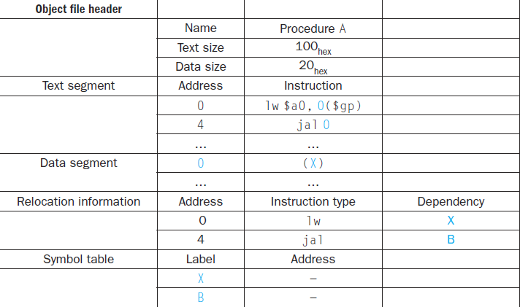
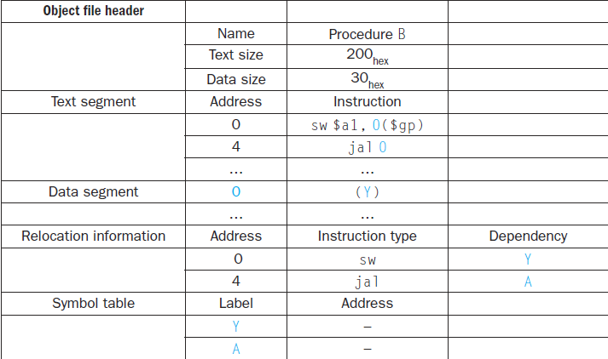
Link the two object files below. Show updated addresses of the first few instructions of the completed executable file.
Notes:
uyfgjygfuyfguy

Slide 96
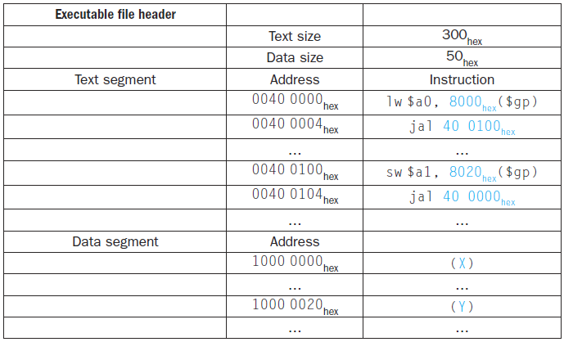
$sp
7fff fffc_{hex}
Stack
Dynamic data
1000 f f f f_{hex}
$gp
1000 8000_{hex}
Static data
1000 0000_{hex}
Text
PC
0040 0000_{hex}
Reserved
0
Notes:
uyfgjygfuyfguy

Slide 97
Loader: A systems program that places an object program in main memory so that it is ready to execute.
Loading
Determine size of text and data segments
Create an address space large enough
Copy instructions and data from executable file to memory
Copy parameters (if any) to the main program onto the stack
Initialize registers and set $sp to the first free location
Jump to a start-up routine

Slide 98
Statically Linked Library
Disadvantages of statically linked library .lib:
The library routines become part of the executable code. If a new version of the library is released that fixes bugs or supports new hardware devices, the statically linked program keeps using the old version.
It loads all routines in the library that are called anywhere in the executable, even if those calls are not executed. The library can be large relative to the program; for example, the standard C library is 2.5 MB.
Dynamically Linked Library: Library routines that are linked to a program during execution.

Slide 99
An introduction of SPIM: A MIPS32 Simulator
Program Structure
Just plain text file with data declarations, program code (name of file should end in suffix .s or .asm to be used with SPIM simulator)
Data declaration section followed by program code section
Data Declarations
Placed in section of program identified with assembler directive .data
Declares variable names used in program; storage allocated in main memory (RAM)
Code
Placed in section of text identified with assembler directive .text
Contains program code (instructions)
Starting point for code e.g.ecution given label main:
Ending point of main code should use exit system call (see below under System Calls)

Slide 100
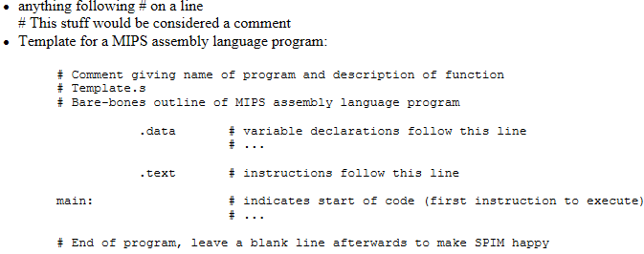

Slide 101
Data Declarations
Format for declarations:
name: storage_type value(s)
Create storage for variable of specified type with given name and specified value
Value(s) usually gives initial value(s); for storage type .space, gives number of spaces to be allocated
Note: labels always followed by colon ( : )

Slide 102
Example 1:
var1: .word 3 # create a single integer variable with initial value 3
array1: .byte 'a','b' # create a 2-element character array with elements
# initialized to a and b
array2: .space 40 # allocate 40 consecutive bytes, with storage uninitialized
# could be used as a 40-element character array, or a
# 10-element integer array; a comment should indicate which!
Example 2:
.data
var1: .word 23 # declare storage for var1; initial value is 23
.text
__start:
lw $t0, var1 # load contents of RAM location into register $t0: $t0 = var1
li $t1, 5 # $t1 = 5 ("load immediate")
sw $t1, var1 # store contents of register $t1 into RAM: var1 = $t1

Slide 103
SPIM: A MIPS32 Simulator
Spim is a self-contained simulator that runs MIPS32 programs. It reads and executes assembly language programs written for this processor.
Spim implements almost the entire MIPS32 assembler-extended instruction set.
For more information:
http://spimsimulator.sourceforge.net/

