Slide 1
Instructions: Language of the Computer
[Adapted from Computer Organization and Design,
Patterson & Hennessy]

Slide 2
Instruction Set
The repertoire of instructions of a computer
Different computers have different instruction sets
But with many aspects in common
Early computers had very simple instruction sets
Simplified implementation
Many modern computers also have simple instruction sets

Slide 3
The RISC-V Instruction Set
Used as the example throughout the book
Developed at UC Berkeley as open ISA
Now managed by the RISC-V Foundation (riscv.org)
Typical of many modern ISAs
See RISC-V Reference Data tear-out card
Similar ISAs have a large share of embedded core market
Applications in consumer electronics, network/storage equipment, cameras, printers, …

Slide 4
Arithmetic Operations
Add and subtract, three operands
Two sources and one destination
add a, b, c // a gets b + c
All arithmetic operations have this form
Design Principle 1: Simplicity favours regularity
Regularity makes implementation simpler
Simplicity enables higher performance at lower cost

Slide 5
Arithmetic Example
C code:
f = (g + h) - (i + j);
Compiled RISC-V code:
add t0, g, h // temp t0 = g + h add t1, i, j // temp t1 = i + j sub f, t0, t1 // f = t0 - t1

Slide 6
Register Operands
Arithmetic instructions use register operands
RISC-V has a 32 × 64-bit register file
Use for frequently accessed data
64-bit data is called a “doubleword”
32 x 64-bit general purpose registers x0 to x31
32-bit data is called a “word”
Design Principle 2: Smaller is faster
c.f. main memory: millions of locations

Slide 7
RISC-V Registers
x0: the constant value 0
x1: return address
x2: stack pointer
x3: global pointer
x4: thread pointer
x5 – x7, x28 – x31: temporaries
x8: frame pointer
x9, x18 – x27: saved registers
x10 – x11: function arguments/results
x12 – x17: function arguments

Slide 8
Register Operand Example
C code:
f = (g + h) - (i + j);
f, …, j in x19, x20, …, x23
Compiled RISC-V code:
add x5, x20, x21 add x6, x22, x23 sub x19, x5, x6

Slide 9
Memory Operands
Main memory used for composite data
Arrays, structures, dynamic data
To apply arithmetic operations
Load values from memory into registers
Store result from register to memory
Memory is byte addressed
Each address identifies an 8-bit byte
RISC-V is Little Endian
Least-significant byte at least address of a word
c.f. Big Endian: most-significant byte at least address
RISC-V does not require words to be aligned in memory
Unlike some other ISAs

Slide 10
Memory Operand Example
C code:
A[12] = h + A[8];
h in x21, base address of A in x22
Compiled RISC-V code:
Index 8 requires offset of 64
8 bytes per doubleword
ld x9, 64(x22) add x9, x21, x9 sd x9, 96(x22)

Slide 11
Registers vs. Memory
Registers are faster to access than memory
Operating on memory data requires loads and stores
More instructions to be executed
Compiler must use registers for variables as much as possible
Only spill to memory for less frequently used variables
Register optimization is important!

Slide 12
Immediate Operands
Constant data specified in an instruction
addi x22, x22, 4
Make the common case fast
Small constants are common
Immediate operand avoids a load instruction

Slide 13
Unsigned Binary Integers
Given an n-bit number
Range: 0 to +2^{n} – 1
Example
0000 0000 … 0000 10112 = 0 + … + 1×2³ + 0×2² +1×2¹ +1×2⁰ = 0 + … + 8 + 0 + 2 + 1 = 1110
Using 64 bits: 0 to +18,446,774,073,709,551,615

Slide 14
2s-Complement Signed Integers
Given an n-bit number
Range: –2^{n – 1} to +2^{n – 1} – 1
Example
1111 1111 … 1111 1100₂ = –1×2³¹ + 1×2³⁰ + … + 1×2² +0×2¹ +0×2⁰ = –2,147,483,648 + 2,147,483,644 = –4₁₀
Using 64 bits: −9,223,372,036,854,775,808 to 9,223,372,036,854,775,807

Slide 15
2s-Complement Signed Integers
Bit 63 is sign bit
1 for negative numbers
0 for non-negative numbers
–(–2^{n} ^{– 1}) can’t be represented
Non-negative numbers have the same unsigned and 2s-complement representation
Some specific numbers
0: 0000 0000 … 0000
–1: 1111 1111 … 1111
Most-negative: 1000 0000 … 0000
Most-positive: 0111 1111 … 1111

Slide 16
Signed Negation
Complement and add 1
Complement means 1 → 0, 0 → 1
Example: negate +2
+2 = 0000 0000 … 0010_{two}
–2 = 1111 1111 … 1101_{two} + 1 = 1111 1111 … 1110_{two}

Slide 17
Sign Extension
Representing a number using more bits
Preserve the numeric value
Replicate the sign bit to the left
c.f. unsigned values: extend with 0s
Examples: 8-bit to 16-bit
+2: 0000 0010 => 0000 0000 0000 0010
–2: 1111 1110 => 1111 1111 1111 1110
In RISC-V instruction set
lb: sign-extend loaded byte
lbu: zero-extend loaded byte

Slide 18
Representing Instructions
Instructions are encoded in binary
Called machine code
RISC-V instructions
Encoded as 32-bit instruction words
Small number of formats encoding operation code (opcode), register numbers, …
Regularity!

Slide 19
Hexadecimal
Base 16
Compact representation of bit strings
4 bits per hex digit
Example: eca8 6420
1110 1100 1010 1000 0110 0100 0010 0000
0 | 0000 | 4 | 0100 | 8 | 1000 | c | 1100
1 | 0001 | 5 | 0101 | 9 | 1001 | d | 1101
2 | 0010 | 6 | 0110 | a | 1010 | e | 1110
3 | 0011 | 7 | 0111 | b | 1011 | f | 1111

Slide 20
RISC-V R-format Instructions
funct7
rs2
rs1
funct3
rd
opcode
7 bits
5 bits
5 bits
3 bits
5 bits
7 bits
Instruction fields
opcode: operation code
rd: destination register number
funct3: 3-bit function code (additional opcode)
rs1: the first source register number
rs2: the second source register number
funct7: 7-bit function code (additional opcode)

Slide 21
R-format Example
funct7
rs2
rs1
funct3
rd
opcode
7 bits
5 bits
5 bits
3 bits
5 bits
7 bits
add x9,x20,x21
0000 0001 0101 1010 0000 0100 1011 0011_{two} = 015A04B3₁₆
0
21
20
0
9
51
0000000
10101
10100
000
01001
0110011

Slide 22
RISC-V I-format Instructions
immediate
rs1
funct3
rd
opcode
12 bits
5 bits
3 bits
5 bits
7 bits
Immediate arithmetic and load instructions
rs1: source or base address register number
immediate: constant operand, or offset added to base address
2s-complement, sign extended
Design Principle 3: Good design demands good compromises
Different formats complicate decoding, but allow 32-bit instructions uniformly
Keep formats as similar as possible

Slide 23
RISC-V S-format Instructions
imm[11:5]
rs2
rs1
funct3
imm[4:0]
opcode
7 bits
5 bits
5 bits
3 bits
5 bits
7 bits
Different immediate format for store instructions
rs1: base address register number
rs2: source operand register number
immediate: offset added to base address
Split so that rs1 and rs2 fields always in the same place

Slide 24
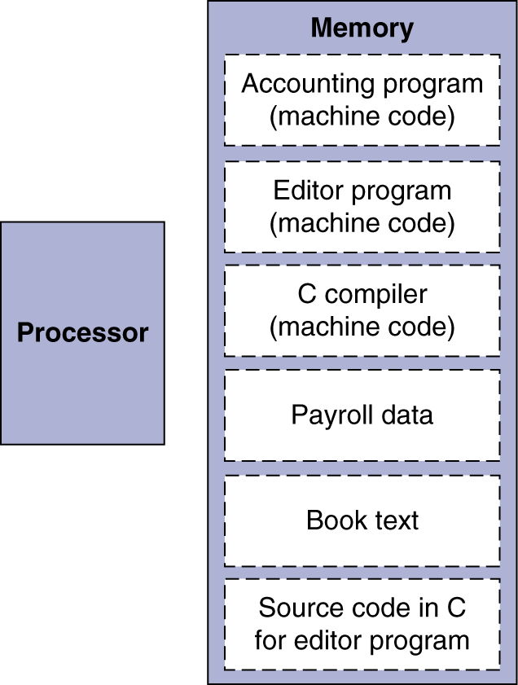
Stored Program Computers
Instructions represented in binary, just like data
Instructions and data stored in memory
Programs can operate on programs
e.g., compilers, linkers, …
Binary compatibility allows compiled programs to work on different computers
Standardized ISAs
The BIG Picture

Slide 25
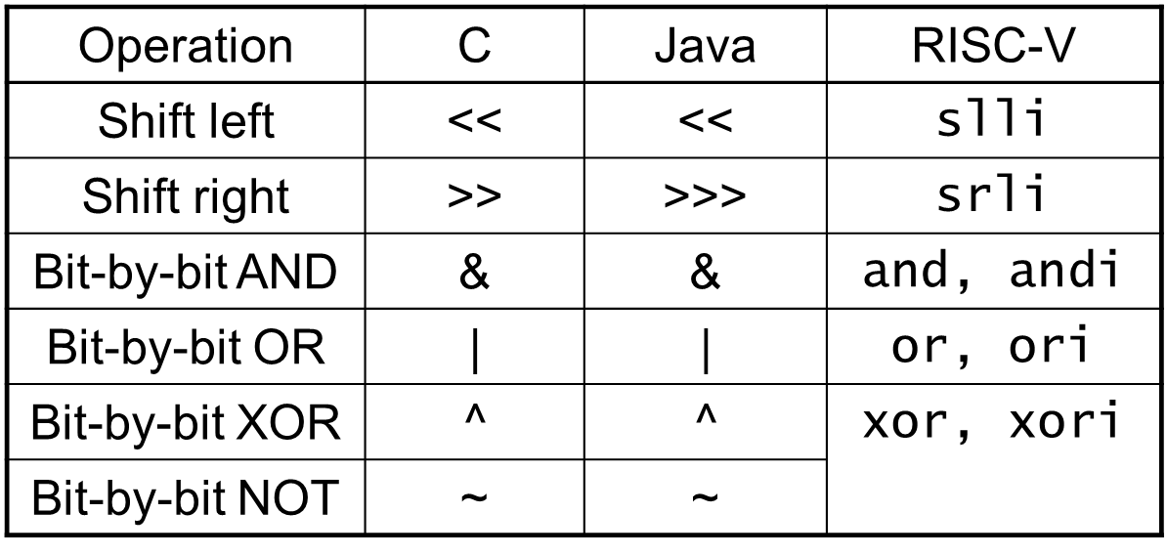
Logical Operations
Instructions for bitwise manipulation
Useful for extracting and inserting groups of bits in a word

Slide 26
Shift Operations
funct6
immed
rs1
funct3
rd
opcode
6 bits
6 bits
5 bits
3 bits
5 bits
7 bits
immed: how many positions to shift
Shift left logical
Shift left and fill with 0 bits
slli by i bits multiplies by 2^{i}
Shift right logical
Shift right and fill with 0 bits
srli by i bits divides by 2^{i} (unsigned only)

Slide 27
AND Operations
Useful to mask bits in a word
Select some bits, clear others to 0
and x9,x10,x11
x10
00000000 00000000 00000000 00000000 00000000 00000000 00001101 11000000
x11
00000000 00000000 00000000 00000000 00000000 00000000 00111100 00000000
x9
00000000 00000000 00000000 00000000 00000000 00000000 00001100 00000000

Slide 28
OR Operations
Useful to include bits in a word
Set some bits to 1, leave others unchanged
or x9,x10,x11
x10
00000000 00000000 00000000 00000000 00000000 00000000 00001101 11000000
x11
00000000 00000000 00000000 00000000 00000000 00000000 00111100 00000000
x9
00000000 00000000 00000000 00000000 00000000 00000000 00111101 11000000

Slide 29
XOR Operations
Differencing operation
complement some bits, leave others unchanged
xor x9,x10,x12 // NOT operation
x10
00000000 00000000 00000000 00000000 00000000 00000000 00001101 11000000
x12
11111111 11111111 11111111 11111111 11111111 11111111 11111111 11111111
x9
11111111 11111111 11111111 11111111 11111111 11111111 11110010 00111111

Slide 30
Conditional Operations
Branch to a labeled instruction if a condition is true
Otherwise, continue sequentially
beq rs1, rs2, L1
if (rs1 == rs2) branch to instruction labeled L1
bne rs1, rs2, L1
if (rs1 != rs2) branch to instruction labeled L1

Slide 31
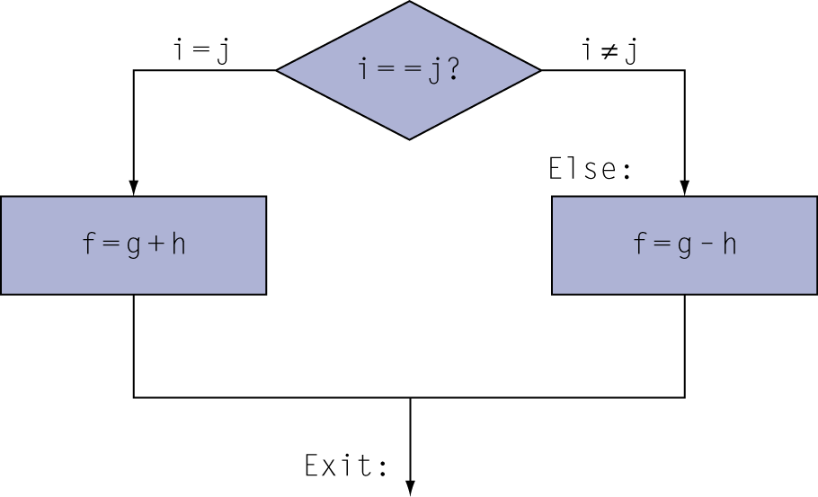
Compiling If Statements
C code:
if (i==j) f = g+h; else f = g-h;
f, g, … in x19, x20, …
Compiled RISC-V code:
bne x22, x23, Else add x19, x20, x21 beq x0,x0,Exit // unconditional Else: sub x19, x20, x21 Exit: …
Assembler calculates addresses

Slide 32
Compiling Loop Statements
C code:
while (save[i] == k) i += 1;
i in x22, k in x24, address of save in x25
Compiled RISC-V code:
Loop: slli x10, x22, 3 add x10, x10, x25 ld x9, 0(x10) bne x9, x24, Exit
addi x22, x22, 1 beq x0, x0, Loop Exit: …

Slide 33
Basic Blocks
A basic block is a sequence of instructions with
No embedded branches (except at end)
No branch targets (except at beginning)
A compiler identifies basic blocks for optimization
An advanced processor can accelerate execution of basic blocks

Slide 34
More Conditional Operations
blt rs1, rs2, L1
if (rs1 < rs2) branch to instruction labeled L1
bge rs1, rs2, L1
if (rs1 >= rs2) branch to instruction labeled L1
Example
if (a > b) a += 1;
a in x22, b in x23
bge x23, x22, Exit // branch if b >= a
addi x22, x22, 1
Exit:

Slide 35
Signed vs. Unsigned
Signed comparison: blt, bge
Unsigned comparison: bltu, bgeu
Example
x22 = 1111 1111 1111 1111 1111 1111 1111 1111
x23 = 0000 0000 0000 0000 0000 0000 0000 0001
x22 < x23 // signed
–1 < +1
x22 > x23 // unsigned
+4,294,967,295 > +1

Slide 36
Procedure Calling
Steps required
Place parameters in registers x10 to x17
Transfer control to procedure
Acquire storage for procedure
Perform procedure’s operations
Place result in register for caller
Return to place of call (address in x1)

Slide 37

Procedure Call Instructions
Procedure call: jump and link
jal x1, ProcedureLabel
Address of following instruction put in x1
Jumps to target address
Procedure return: jump and link register
jalr x0, 0(x1)
Like jal, but jumps to 0 + address in x1
Use x0 as rd (x0 cannot be changed)

Slide 38
Leaf Procedure Example
Procedure that doesn’t call all any other procedures
C code:
long long int leaf_example ( long long int g, long long int h, long long int i, long long int j) { long long int f; f = (g + h) - (i + j); return f; }
Arguments g, …, j in x10, …, x13
f in x20
temporaries x5, x6
Need to save x5, x6, x20 on stack

Slide 39
Leaf Procedure Example
RISC-V code:
leaf_example:
addi sp,sp,-24 Save x5, x6, x20 on stack
sd x5,16(sp)
sd x6,8(sp)
sd x20,0(sp)
add x5,x10,x11 x5 = g + h
add x6,x12,x13 x6 = i + j
sub x20,x5,x6 f = x5 – x6
addi x10,x20,0 copy f to return register
ld x20,0(sp) Resore x5, x6, x20 from stack
ld x6,8(sp)
ld x5,16(sp)
addi sp,sp,24
jalr x0,0(x1) Return to caller

Slide 40
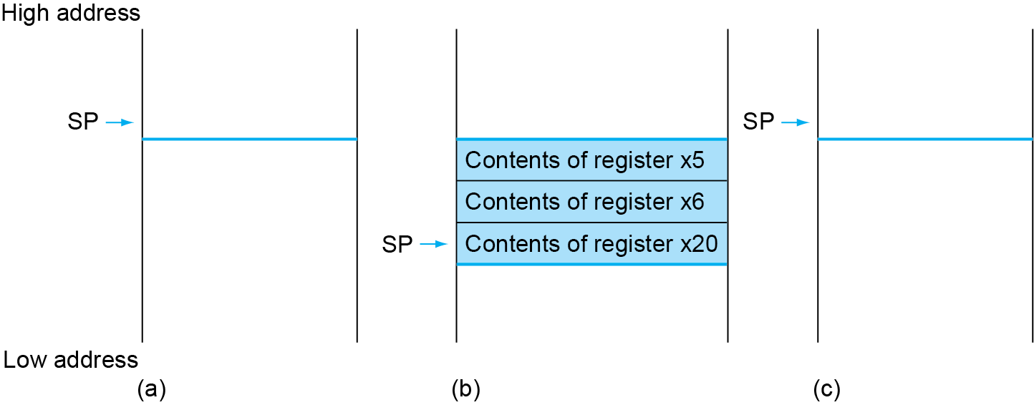
Local Data on the Stack

Slide 41
Register Usage
x5 – x7, x28 – x31: temporary registers
Not preserved by the callee
x8 – x9, x18 – x27: saved registers
If used, the callee saves and restores them

Slide 42
Non-Leaf Procedures
Procedures that call other procedures
For nested call, caller needs to save on the stack:
Its return address
Any arguments and temporaries needed after the call
Restore from the stack after the call

Slide 43
Non-Leaf Procedure Example
C code:
long long int fact (long long int n) { if (n < 1) return 1; else return n * fact(n - 1); }
Argument n in x10
Result in x10

Slide 44
Non-Leaf Procedure Example
RISC-V code:
fact:
addi sp,sp,-16 Save return address and n on stack
sd x1,8(sp)
sd x10,0(sp)
addi x5,x10,-1 x5 = n - 1
bge x5,x0,L1 if n >= 1, go to L1
addi x10,x0,1 Else, set return value to 1
addi sp,sp,16 Pop stack, don’t bother restoring values
jalr x0,0(x1) Return
L1: addi x10,x10,-1 n = n - 1
jal x1,fact call fact(n-1)
addi x6,x10,0 move result of fact(n - 1) to x6
ld x10,0(sp) Restore caller’s n
ld x1,8(sp) Restore caller’s return address
addi sp,sp,16 Pop stack
mul x10,x10,x6 return n * fact(n-1)
jalr x0,0(x1) return

Slide 45
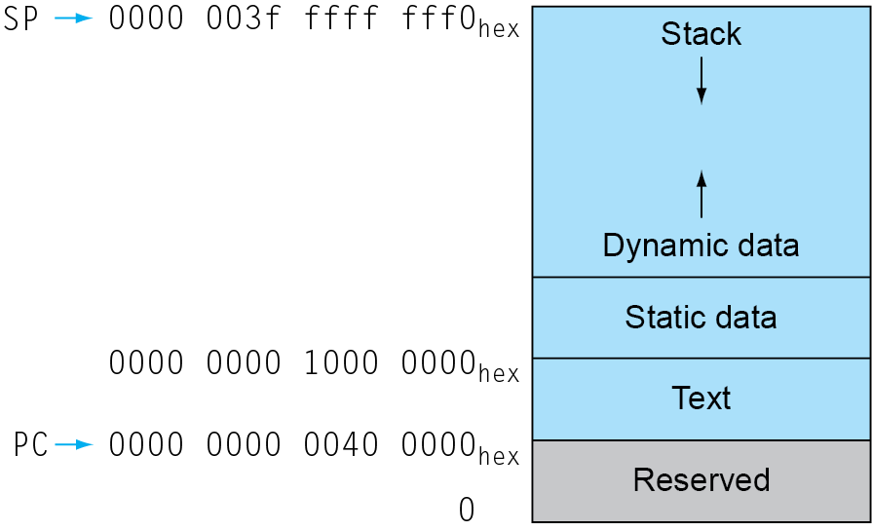
Memory Layout
Text: program code
Static data: global variables
e.g., static variables in C, constant arrays and strings
x3 (global pointer) initialized to address allowing ±offsets into this segment
Dynamic data: heap
E.g., malloc in C, new in Java
Stack: automatic storage

Slide 46
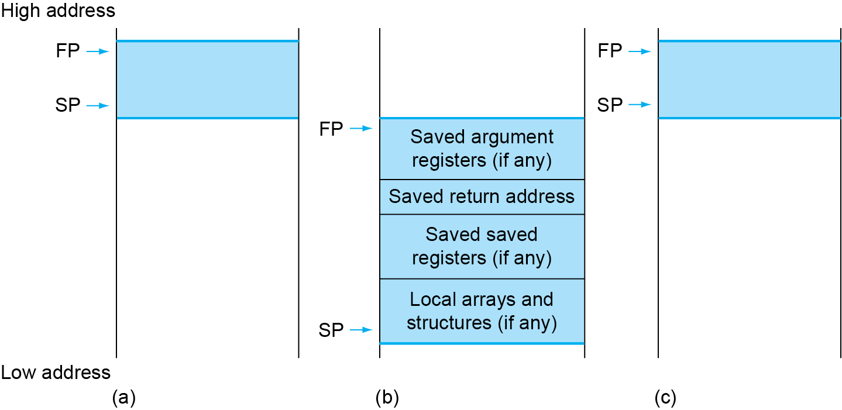
Local Data on the Stack
Local data allocated by callee
e.g., C automatic variables
Procedure frame (activation record)
Used by some compilers to manage stack storage

Slide 47
Byte/Halfword/Word Operations
RISC-V byte/halfword/word load/store
Load byte/halfword/word: Sign extend to 64 bits in rd
lb rd, offset(rs1)
lh rd, offset(rs1)
lw rd, offset(rs1)
Load byte/halfword/word unsigned: Zero extend to 64 bits in rd
lbu rd, offset(rs1)
lhu rd, offset(rs1)
lwu rd, offset(rs1)
Store byte/halfword/word: Store rightmost 8/16/32 bits
sb rs2, offset(rs1)
sh rs2, offset(rs1)
sw rs2, offset(rs1)

Slide 48
32-bit Constants
Most constants are small
12-bit immediate is sufficient
For the occasional 32-bit constant
lui rd, constant
Copies 20-bit constant to bits [31:12] of rd
Extends bit 31 to bits [63:32]
Clears bits [11:0] of rd to 0
lui x19, 976 // 0x003D0
0000 0000 0000 0000
0000 0000 0000 0000
0000 0000 0011 1101 0000
0000 0000 0000
addi x19,x19,1280 // 0x500
0000 0000 0000 0000
0000 0000 0000 0000
0000 0000 0011 1101 0000
0101 0000 0000

Slide 49
Branch Addressing
Branch instructions specify
Opcode, two registers, target address
Most branch targets are near branch
Forward or backward
SB format:
PC-relative addressing
Target address = PC + immediate × 2
imm [10:5]
rs2
rs1
funct3
imm [4:1]
opcode
imm[12]
imm[11]

Slide 50
Jump Addressing
Jump and link (jal) target uses 20-bit immediate for larger range
UJ format:
For long jumps, eg, to 32-bit absolute address
lui: load address[31:12] to temp register
jalr: add address[11:0] and jump to target
imm[10:1]
imm[19:12]
rd
opcode
imm[20]
imm[11]
5 bits
7 bits

Slide 51
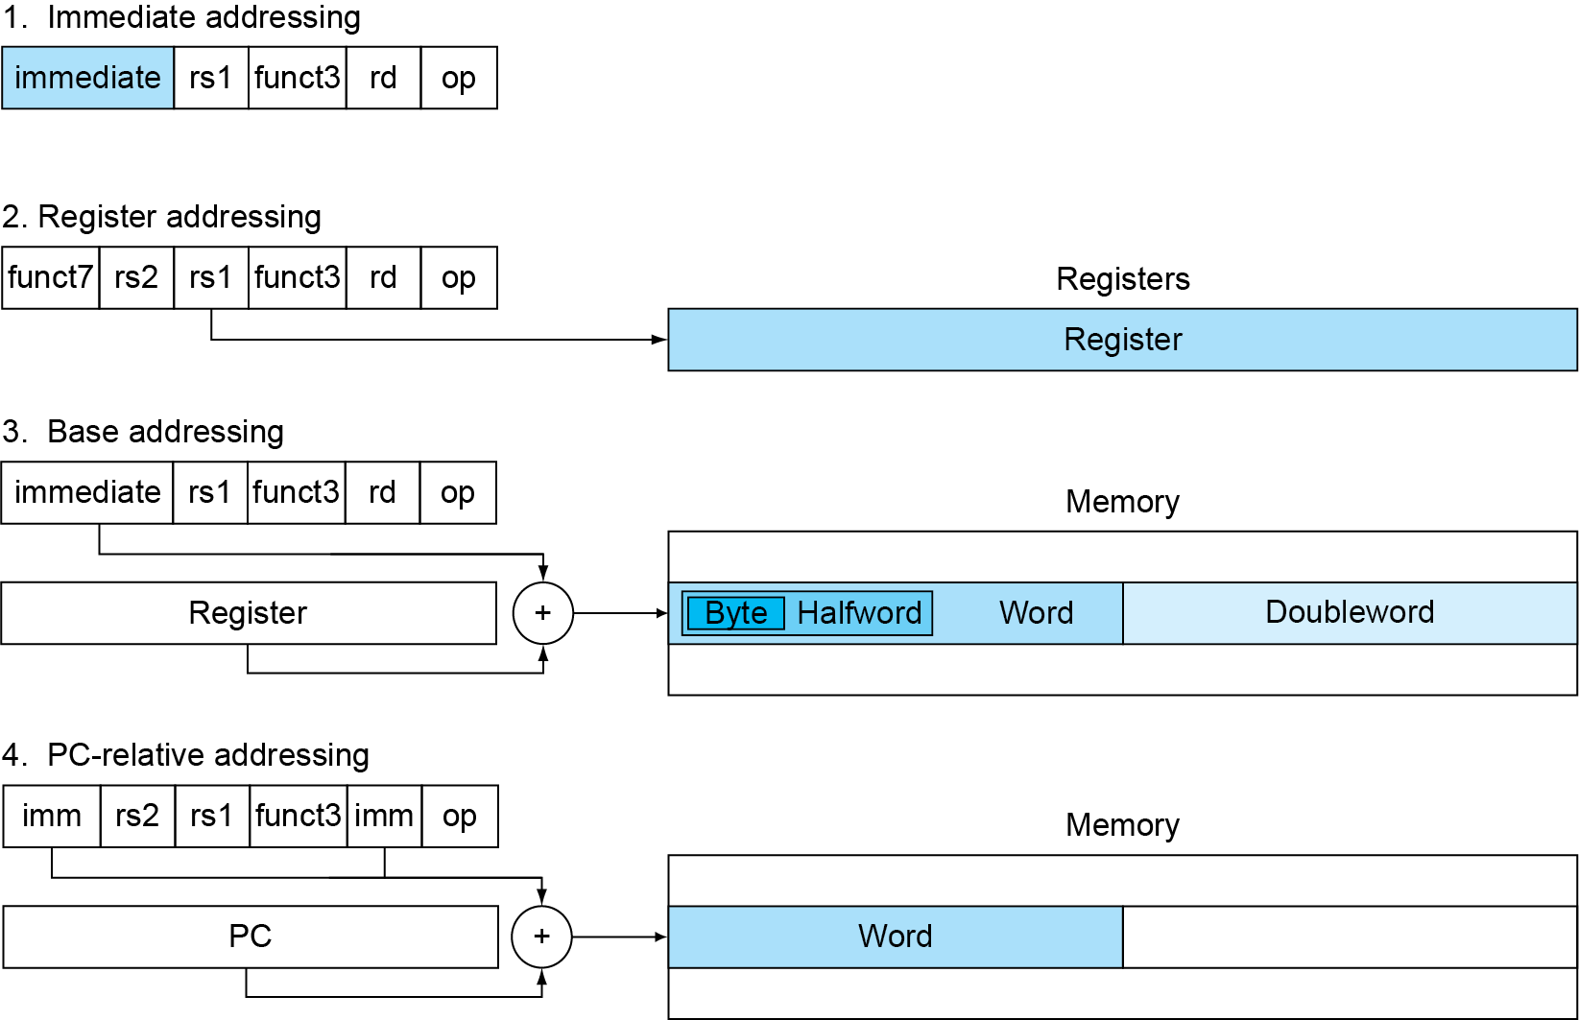
RISC-V Addressing Summary

Slide 52
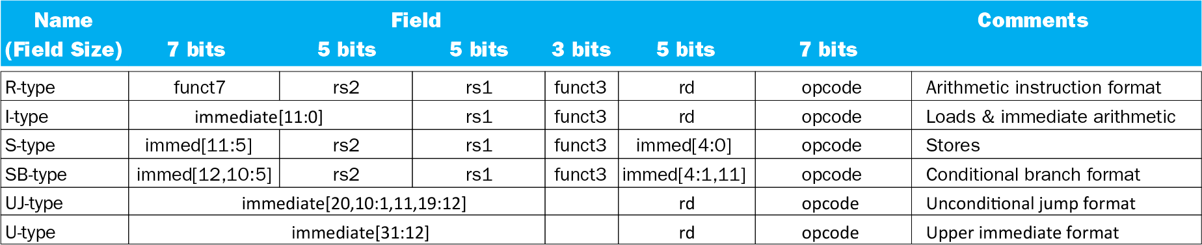
RISC-V Encoding Summary

Slide 53
Synchronization
Two processors sharing an area of memory
P1 writes, then P2 reads
Data race if P1 and P2 don’t synchronize
Result depends of order of accesses
Hardware support required
Atomic read/write memory operation
No other access to the location allowed between the read and write
Could be a single instruction
E.g., atomic swap of register ↔ memory
Or an atomic pair of instructions

Slide 54
Synchronization in RISC-V
Load reserved: lr.d rd,(rs1)
Load from address in rs1 to rd
Place reservation on memory address
Store conditional: sc.d rd,(rs1),rs2
Store from rs2 to address in rs1
Succeeds if location not changed since the lr.d
Returns 0 in rd
Fails if location is changed
Returns non-zero value in rd

Slide 55
Synchronization in RISC-V
Example 1: atomic swap (to test/set lock variable)
again: lr.d x10,(x20)
sc.d x11,(x20),x23 // X11 = status
bne x11,x0,again // branch if store failed
addi x23,x10,0 // X23 = loaded value
Example 2: lock
addi x12,x0,1 // copy locked value
again: lr.d x10,(x20) // read lock
bne x10,x0,again // check if it is 0 yet
sc.d x11,(x20),x12 // attempt to store
bne x11,x0,again // branch if fails
Unlock:
sd x0,0(x20) // free lock

Slide 56
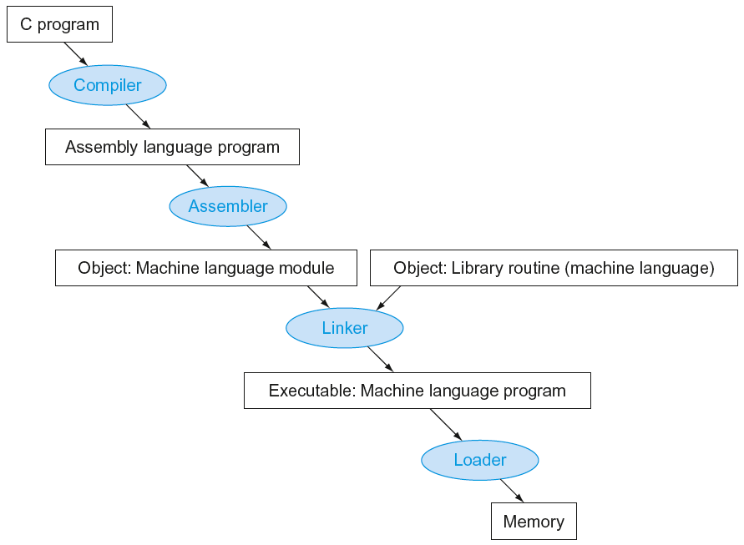
Translation and Startup
Static linking

Slide 57
Producing an Object Module
Assembler (or compiler) translates program into machine instructions
Provides information for building a complete program from the pieces
Header: described contents of object module
Text segment: translated instructions
Static data segment: data allocated for the life of the program
Relocation info: for contents that depend on absolute location of loaded program
Symbol table: global definitions and external refs
Debug info: for associating with source code

Slide 58
Linking Object Modules
Produces an executable image
1. Merges segments
2. Resolve labels (determine their addresses)
3. Patch location-dependent and external refs
Could leave location dependencies for fixing by a relocating loader
But with virtual memory, no need to do this
Program can be loaded into absolute location in virtual memory space

Slide 59
Loading a Program
Load from image file on disk into memory
1. Read header to determine segment sizes
2. Create virtual address space
3. Copy text and initialized data into memory
Or set page table entries so they can be faulted in
4. Set up arguments on stack
5. Initialize registers (including sp, fp, gp)
6. Jump to startup routine
Copies arguments to x10, … and calls main
When main returns, do exit syscall

Slide 60
Dynamic Linking
Only link/load library procedure when it is called
Requires procedure code to be relocatable
Avoids image bloat caused by static linking of all (transitively) referenced libraries
Automatically picks up new library versions

Slide 61
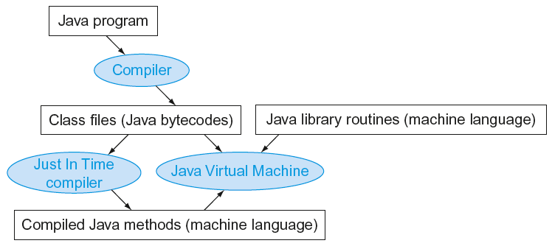
Starting Java Applications
Simple portable instruction set for the JVM
Interprets bytecodes
Compiles bytecodes of “hot” methods into native code for host machine

Slide 62
Effect of Compiler Optimization
Compiled with gcc for Pentium 4 under Linux

Slide 63
Effect of Language and Algorithm

Slide 64
Lessons Learnt
Instruction count and CPI are not good performance indicators in isolation
Compiler optimizations are sensitive to the algorithm
Java/JIT compiled code is significantly faster than JVM interpreted
Comparable to optimized C in some cases
Nothing can fix a dumb algorithm!

Slide 65
MIPS Instructions
MIPS: commercial predecessor to RISC-V
Similar basic set of instructions
32-bit instructions
32 general purpose registers, register 0 is always 0
32 floating-point registers
Memory accessed only by load/store instructions
Consistent use of addressing modes for all data sizes
Different conditional branches
For <, <=, >, >=
RISC-V: blt, bge, bltu, bgeu
MIPS: slt, sltu (set less than, result is 0 or 1)
Then use beq, bne to complete the branch

Slide 66
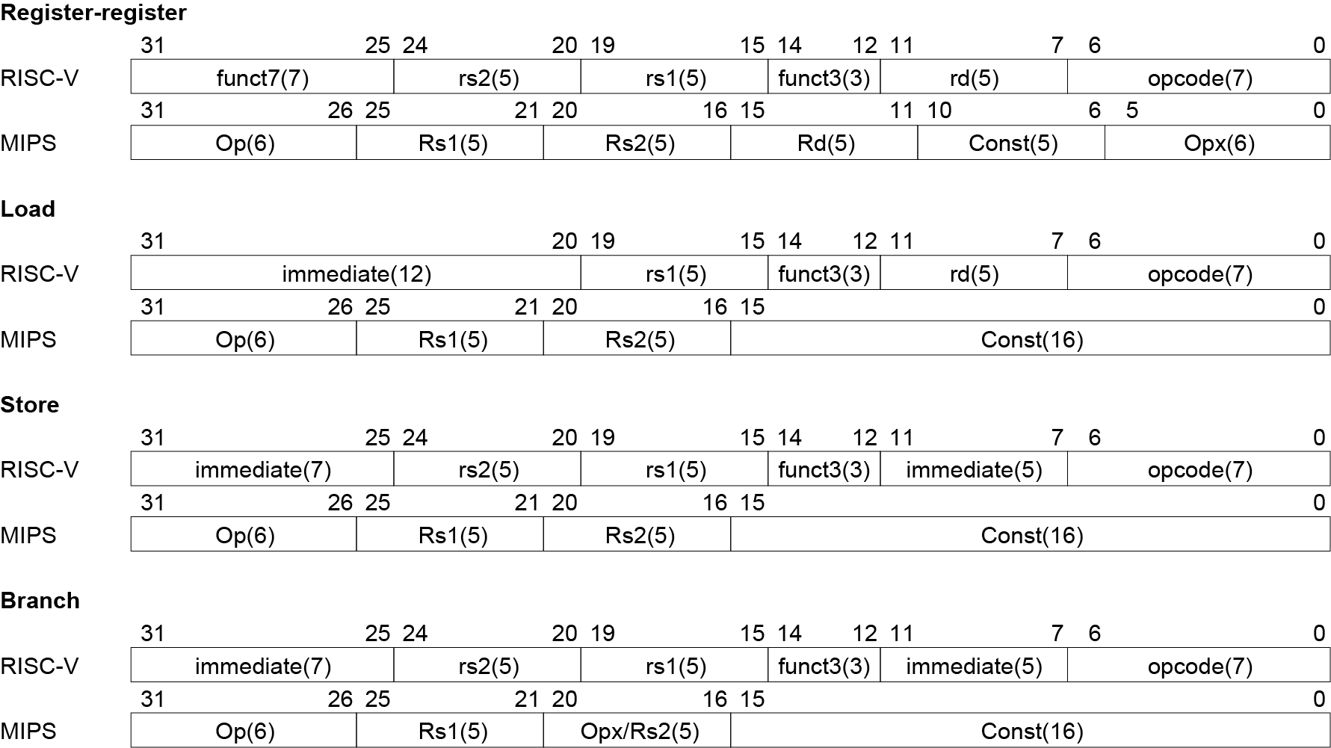
Instruction Encoding

Slide 67
Fallacies
Powerful instruction ⇒ higher performance
Fewer instructions required
But complex instructions are hard to implement
May slow down all instructions, including simple ones
Compilers are good at making fast code from simple instructions
Use assembly code for high performance
But modern compilers are better at dealing with modern processors
More lines of code ⇒ more errors and less productivity

Slide 68
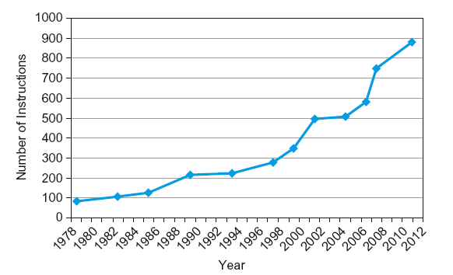
Fallacies
Backward compatibility ⇒ instruction set doesn’t change
But they do accrete more instructions
x86 instruction set

Slide 69
Pitfalls
Sequential words are not at sequential addresses
Increment by 4, not by 1!
Keeping a pointer to an automatic variable after procedure returns
e.g., passing pointer back via an argument
Pointer becomes invalid when stack popped

Slide 70
Concluding Remarks
Design principles
1. Simplicity favors regularity
2. Smaller is faster
3. Good design demands good compromises
Make the common case fast
Layers of software/hardware
Compiler, assembler, hardware
RISC-V: typical of RISC ISAs

