Slide 1
Computer Organization & Design
The Hardware/Software Interface
Chapter 3
Arithmetic for Computer

Slide 2
Contents of Chapter 3
3.1 Arithmetic--Addition & subtraction and ALU
3.2 Multiplication
3.3 Division
3.4 Floating point numbers

Slide 3
Addition & subtraction
We can do binary addition just as we do decimal arithmetic
Adding bit by bit, carries → next digit
  0000 0111 7₁₀
  + 0000 0110 6₁₀
  0000 1101 13₁₀
Subtraction
  Directly
  Addition of 2's complement
  0000 0111 7₁₀
  - 0000 0110 6₁₀
  0000 0001 1₁₀
  0000 0111 7₁₀
  + 1111 1010 -6₁₀
  0000 0001 1₁₀

Slide 4
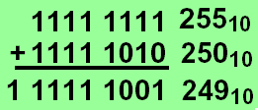
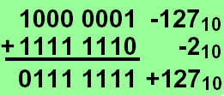
Overflow
The sum of two numbers can exceed any representation
The difference of two numbers can exceed any representation
2's complement:
Numbers change
sign and size

Slide 5
Overflow conditions
General overflow conditions
Reaction on overflow
  Ignore ?
  Reaction of the OS
  Signaling to application (Ada, Fortran,...)
Operation | Operand A | Operand B | Result overflow
A+B | ≧0 | ≧0 | <0 (01)
A+B | <0 | <0 | ≧0 (10)
A-B | ≧0 | <0 | <0 (01)
A-B | <0 | ≧0 | ≧0 (10)
Double sign-bits

Slide 6
Overflow process
Hardware detection in the ALU
  Generation of an exception (interrupt)
Save the instruction address (not PC) in special register EPC
Jump to specific routine in OS
  Correct & return to program
  Return to program with error code
  Abort program

Slide 7
Which instructions cause Overflow
Overflows in signed arithmetic instructions cause exceptions:
  add
  add immediate (addi)
  subtract (sub)
Overflows in unsigned arithmetic instructions don’t cause exceptions
  add unsigned (addu)
  add immediate unsigned (addiu)
  Subtract unsigned (subu)
Handle with care!
Unsigned integers are commonly used for memory addresses

Slide 8
New MIPS instructions
Byte instructions
  lbu: load byte unsigned
    Loads a byte into the lowest 8 bit of a register
    Fills the remaining bits with '0'
  lb: load byte (signed)
    Loads a byte into the lowest 8 bit of a register
    Extends the highest bit into the remaining 24 bits
Sign Extension e.g. 16 bit numbers to 32 bit numbers
  Take the lower 16 bits as they are
  Copy the highest bit to the remaining 16 bits
  0000 0000 0000 0010 → 2
  0000 0000 0000 0000 0000 0000 0000 0010
  1111 1111 1111 1110 → -2
  1111 1111 1111 1111 1111 1111 1111 1110

Slide 9
New MIPS instructions
Set instructions for conditional branches
  sltu: set on less than unsigned
  sltiu: set on less than unsigned immediate
Example: slt versus sltu
  li $t0,-4
  li $t1,10
  slt $t3,$t0,$t1 $t3 = 1
  sltu $t4,$t0,$t1 $t4 = 0 !!

Slide 10
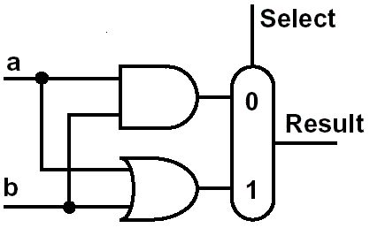
Constructing an ALU
Two methods constitute the ALU
  extended the adder
  Parallel redundant select
Step by step:
  build a single bit ALU
  and expand it to the
  desired width
First function:
  logic AND and OR
The 1-bit logical unit for AND and OR.

Slide 11
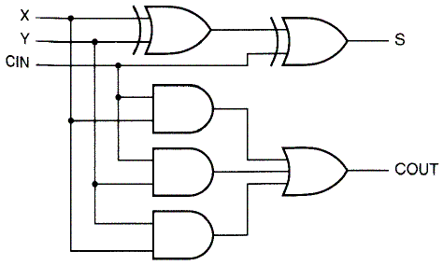
Second function
  Arithmetic
    A half adder to A full adder
      Sum = a ⊕ b
      Carry = a b
Accepts a carry in
    Sum = a ⊕ b ⊕ C_{In}
    C_{Out} = b C_{In} + a C_{In} + ab
a
Carry
b
Sum
+

Slide 12
A full adder
Accepts a carry in
Sum = A + B + Carry_{In}
Carry_{Out} = B Carry_{In} + A Carry_{In} + A B
Inputs |  |  | Outputs |  | Comments
A | B | Carry_{In} | Carry_{Out} | Sum
0 | 0 | 0 | 0 | 0 | 0+0+0=00
0 | 0 | 1 | 0 | 1 | 0+0+1=01
0 | 1 | 0 | 0 | 1 | 0+1+0=01
0 | 1 | 1 | 1 | 0 | 0+1+1=10
1 | 0 | 0 | 0 | 1 | 1+0+0=01
1 | 0 | 1 | 1 | 0 | 1+0+1=10
1 | 1 | 0 | 1 | 0 | 1+1+0=10
1 | 1 | 1 | 1 | 1 | 1+1+1=11

Slide 13
Full adder Logic circuit
Full adder in 2-level design

Slide 14
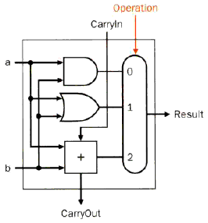
1 bit ALU
ALU
  AND
  OR
  ADD

Slide 15
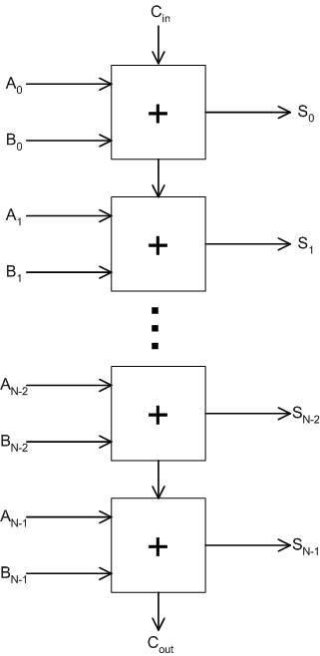
N-bit Adder
An N-bit adder can be constructed with N one-bit adders
  A carry generated in one stage is propagated to the next (“ripple carry adder”)
3 inputs
  A: N-bit input A
  B: N-bit input B
  C_{in}: input C (carry in)
2 outputs
  S: N-bit sum
  C_{out}: carry out

Slide 16
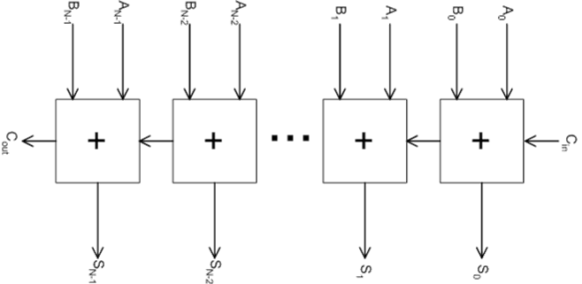
N-bit Ripple-Carry Adder
(0)
 | (0) |  | (1) |  | (1) |  | (0) |  | (0)
 | 0 |  | 0 |  | 1 |  | 1 |  | 1
 | 0 |  | 0 |  | 1 |  | 1 |  | 0
(0) | 0 | (0) | 1 | (1) | 1 | (1) | 0 | (0) | 1
…

Slide 17
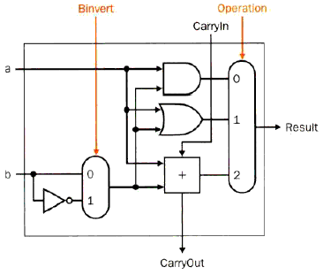
Extended 1 bit ALU-- Subtraction
Subtraction
a - b
  Inverting b
  1st CarryIn= 1

Slide 18
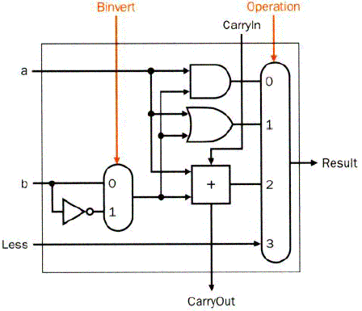
Extended 1 bit ALU-- comparison
Functions
  AND
  OR
  Add
  Subtract
Missing: comparison
  slt rd, rs, rt
  If rs < rt, rd=1, else rd=0
  All bits = 0 except the least significant
  Subtraction (rs - rt), if the result is negative→ rs < rt
  Use of sign bit as indicator

Slide 19
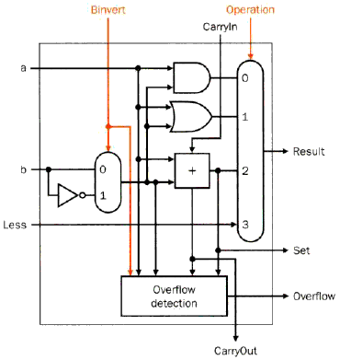
Most significant bit
  Set for comparison
  Overflow detect
Last
significant bit
Most
significant bit
Operation | Operand A | Operand B | Result overflow
A+B | ≧0 | ≧0 | <0 (01)
A+B | <0 | <0 | ≧0 (10)
A-B | ≧0 | <0 | <0 (01)
A-B | <0 | ≧0 | ≧0 (10)

Slide 20
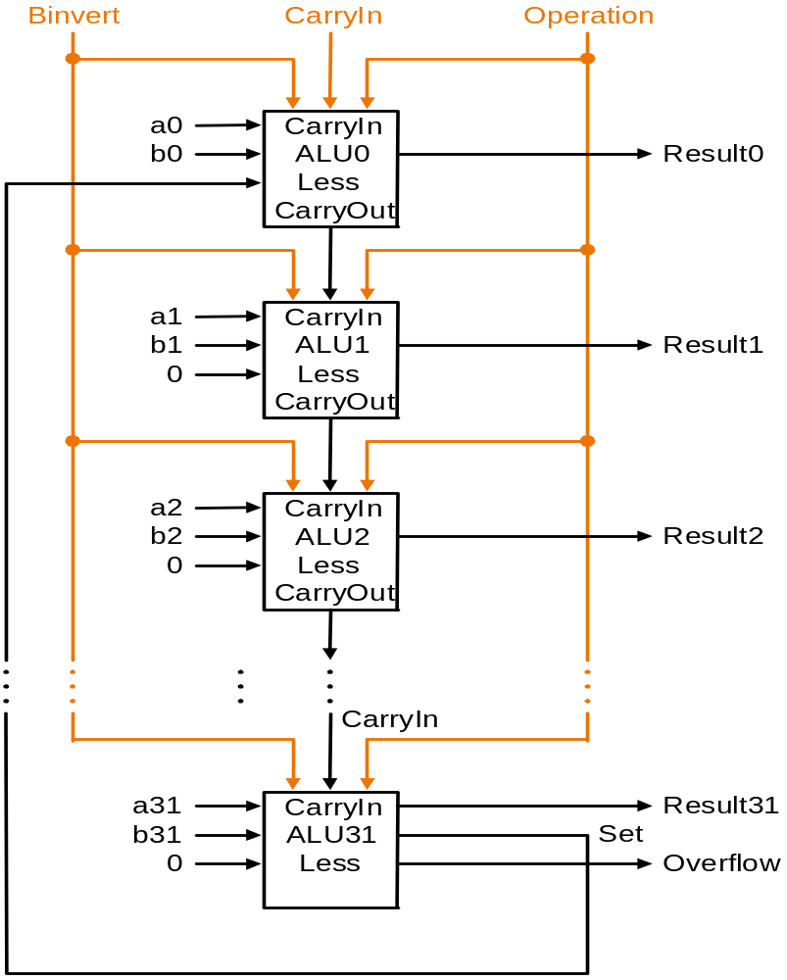
Complete ALU
Input
  A、B
Control lines
  Binvert
  Operation
  Carry in
Output
  Result
  Overflow
Slow, but simple
  Inputs parallel
  Carry is cascaded
    Ripple carry adder
Iterative Circuit

Slide 21
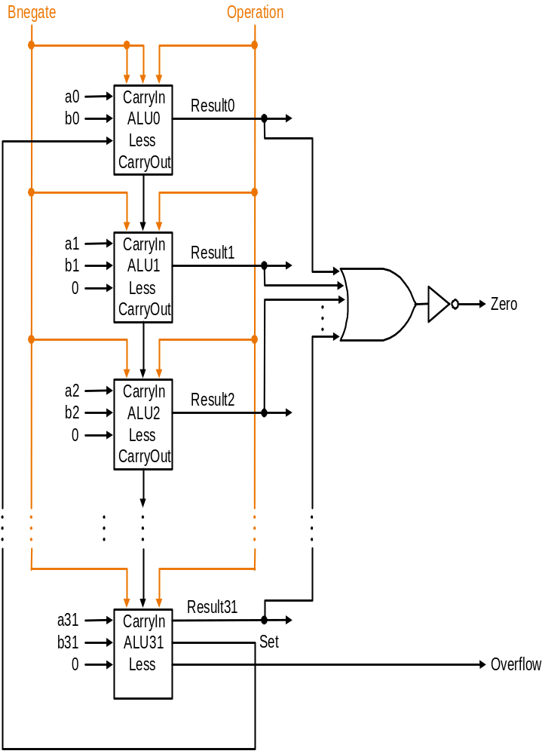
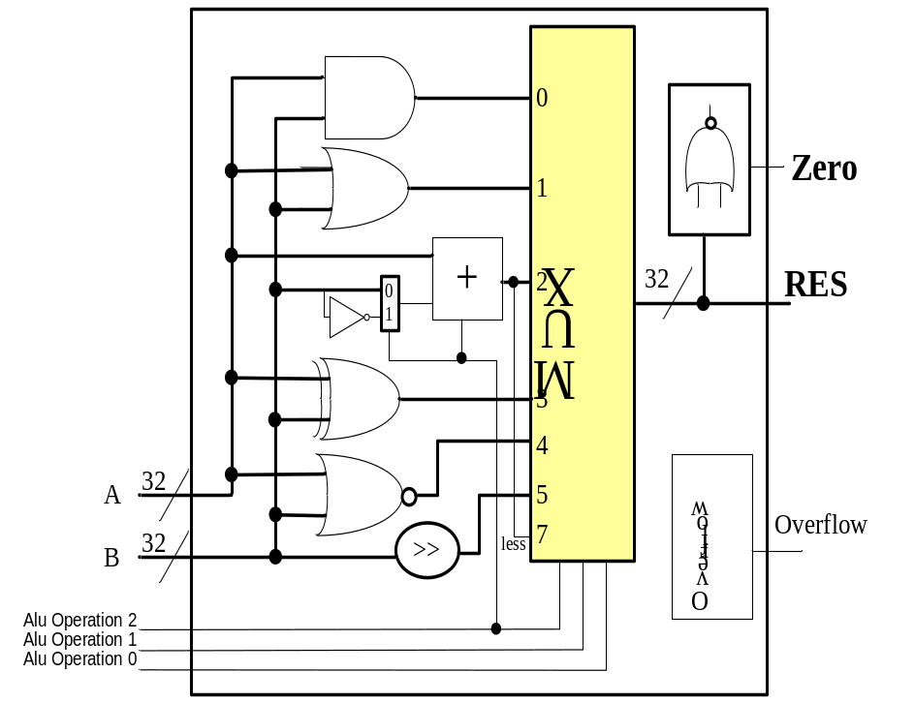
Complete ALU
—with Zero detector
Add a Zero detector

Slide 22
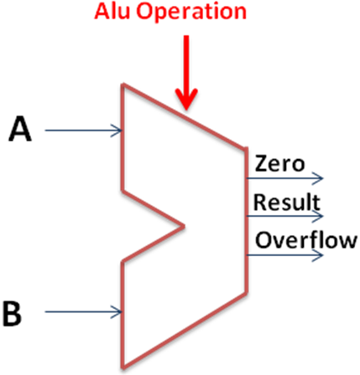
ALU symbol & Control
Symbol of the ALU
Control：Function table
ALU Control Lines | Function
000 | And
001 | Or
010 | Add
110 | Sub
111 | Set on less than
100 | nor
101 | srl
011 | xor

Slide 23
How to get carry fast?
C₁=F(A,B,C₀)
C₂=F(A,B,C₁)
C₃=F(A,B,C₂)
......
C_{n-2}=F(A,B,C_{n-3})
C_{n-1}=F(A,B,C_{n-2})
C_{n} =F(A,B,C_{n-1})
C₁=F(A,B,C₀)
C₂=F(A,B,C₀)
C₃=F(A,B,C₀)
......
C_{n-2}=F(A,B,C₀)
C_{n-1}=F(A,B,C₀)
C_{n} =F(A,B,C₀)

Slide 24
3.3 Multiplication
Multiplication is vexation,
Division is as bad;
The rule of three doth puzzle me,
And practice drives me mad.
Anonymous,
《Elizabethan manuscript》,
1570

Slide 25
3.3 Multiplication
More complicated than addition
Outline
  Human longhand, to remind ourselves of the steps involved
  Multiplication hardware
    Text has 3 versions, showing evolution to help you understand how the circuits work

Slide 26
3.3 Multiplication
Longhand Binary multiplication
Multiplicand × Multiplier
1000 × 1001
Look at current bit position
  If multiplier is 1
    then add multiplicand
    Else add 0
  shift multiplicand left by 1 bit
 |  |  |  | 1 | 0 | 0 | 0
 |  |  | × | 1 | 0 | 0 | 1
 |  |  |  | 1 | 0 | 0 | 0
 |  |  | 0 | 0 | 0 | 0
 |  | 0 | 0 | 0 | 0
+ | 1 | 0 | 0 | 0
 | 1 | 0 | 0 | 1 | 0 | 0 | 0
Multiplicand
Multiplier
Product
In fact, if we ignore the sign bits, the length of the multiplication of an n-bit multiplicand and an m-bit multiplier is a product that is n＋m bits long.

Slide 27
Sequential multiplication
Use add operation of ALU to add numbers
Use several clock cycles
Store multiplicand, multiplier, and product-so-far in registers

Slide 28
Algorithm
For each bit of the multiplier:
  If it is 1, then add the multiplicand to the product (if 0, add 0 == do nothing)
  Shift something so we will be working on the right column next time

Slide 29
Algorithm
For each bit of the multiplier:
  If it is 1, then add the muliplicand to the product (if it 0, add 0 == do nothing)
  Shift something so we will be working on the right column next time

Slide 30
Algorithm
Test multiplier[0]
  If it is 1, add the multiplicand to the product
  Shift multiplier register 1 to the right
  Shift something so we will be working on the right column next time

Slide 31
Algorithm
Test multiplier[0]
  If it is 1, add the multiplicand to the product
  Shift multiplier register 1 to the right
  Shift something so we will be working on the right column next time
    Option 1: use 2n-bit register for multiplicand, and shift it left by 1
    Option 2: we’ll see this on a later slide….

Slide 32
Multiplier V1– Logic Diagram
32 bits: multiplier
64 bits: multiplicand, product, ALU
0010*0011
M
u
l
t
i
p
l
i
c
a
n
d
0000 0010
S
h
i
f
t
l
e
f
t
6
4
b
i
t
s
0011
M
u
l
t
i
p
l
i
e
r
6
4
-
b
i
t
A
L
U
S
h
i
f
t
r
i
g
h
t
3
2
b
i
t
s
P
r
o
d
u
c
t
C
o
n
t
r
o
l
t
e
s
t
0000 0110
W
r
i
t
e
6
4
b
i
t
s

Slide 33
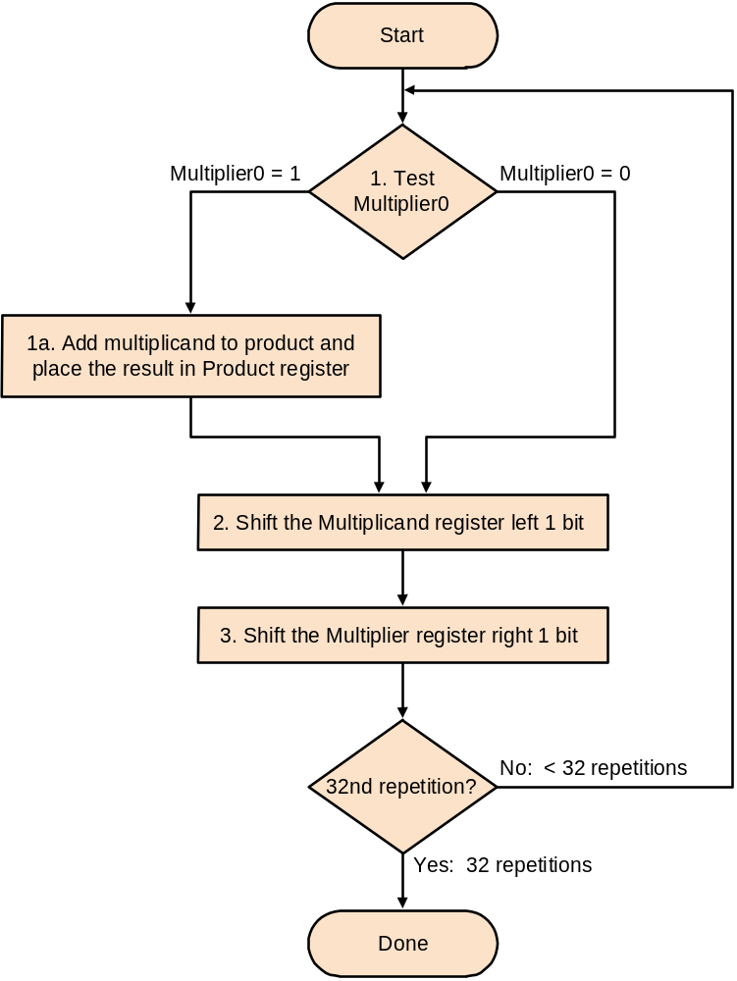
Multiplier V1--Algorithmic rule
Requires 32 iterations
  Addition
  Shift
  Comparison
Almost 100 cycles
Very big, Too slow!

Slide 34
Multiplier V2
Real addition is performed only with 32 bits
Least significant bits of the product don't change
New idea:
  Don’t shift the multiplicand
  Instead, shift the product
  Shift the multiplier
ALU reduced to 32 bits!

Slide 35
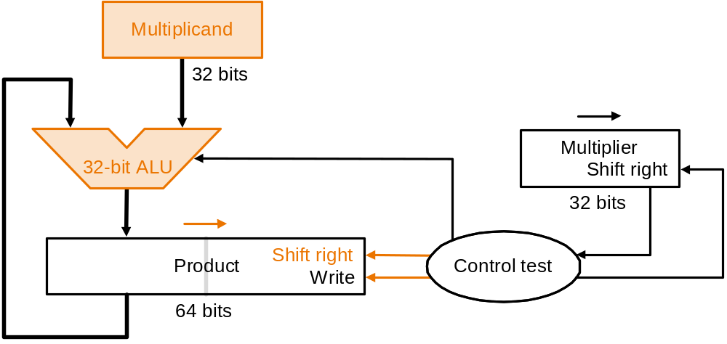
Multiplier V2-- Logic Diagram
Diagram of the V2 multiplier
Only left half of product register is changed

Slide 36
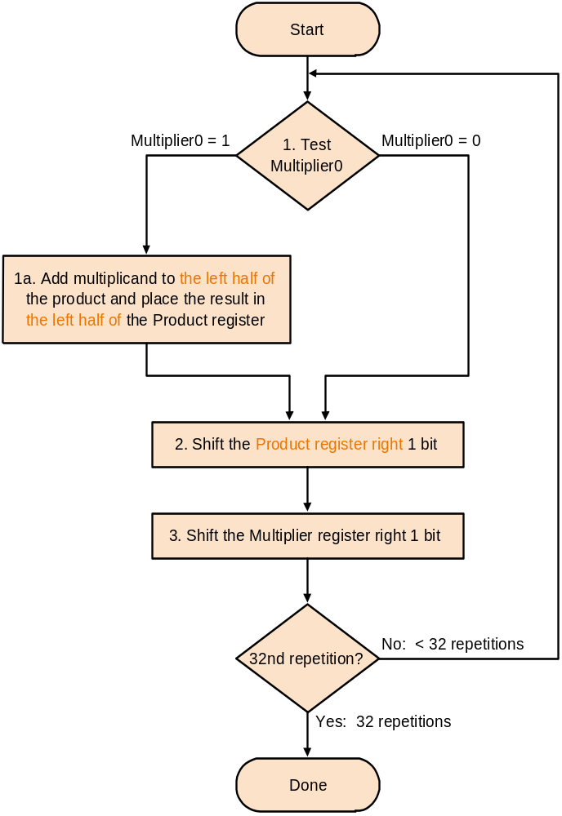
Multiplier V2----Algorithmic rule
Addition performed
only on left half of
product register
Shift of product register

Slide 37
Revised 4-bit example with V2
Multiplicand x multiplier: 0001 x 0111
Multiplicand: | 0001
Multiplier:× | 0111
 | 0000 | 0000 |  | #Initial value for the product
1 | 0001 | 0000 |  | #After adding 0001, Multiplier=1
 | 0000 | 1000 | 0 | #After shifting right the product one bit
 | 0001
2 | 0001 | 1000 |  | #After adding 0001, Multiplier=1
 | 0000 | 1100 | 0 | #After shifting right the product one bit
 | 0001 |  |  | #After adding 0001, Multiplier=1
3 | 0001 | 1100
 | 0000 | 1110 | 0 | #After shifting right the product one bit
 | 0000
4 | 0000 | 1110 |  | #After adding 0001, Multiplier=0
 | 0000 | 0111 | 0 | #After shifting right the product one bit
Shift out

Slide 38
Multiplier V 3
Further optimization
At the initial state the product register contains only '0'
The lower 32 bits are simply shifted out
Idea:
use these lower 32 bits for the multiplier
multiplier
0 | 0 | 0 | 1 | 0 | 0 | 0 | 0
0 | 0 | 0 | 1 | 1 | 0 | 0 | 0 | 0
0 | 0 | 0 | 1 | 1 | 1 | 0 | 0 | 0 | 0
0 | 0 | 0 | 0 | 1 | 1 | 1 | 0 | 0 | 0 | 0
0 | 0 | 0 | 0 | 0 | 1 | 1 | 1 | 0 | 0 | 0 | 0

Slide 39
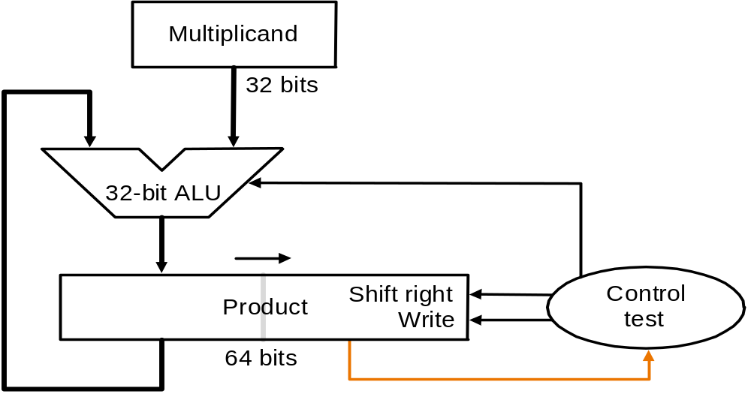
Multiplier V3 Logic Diagram

Slide 40
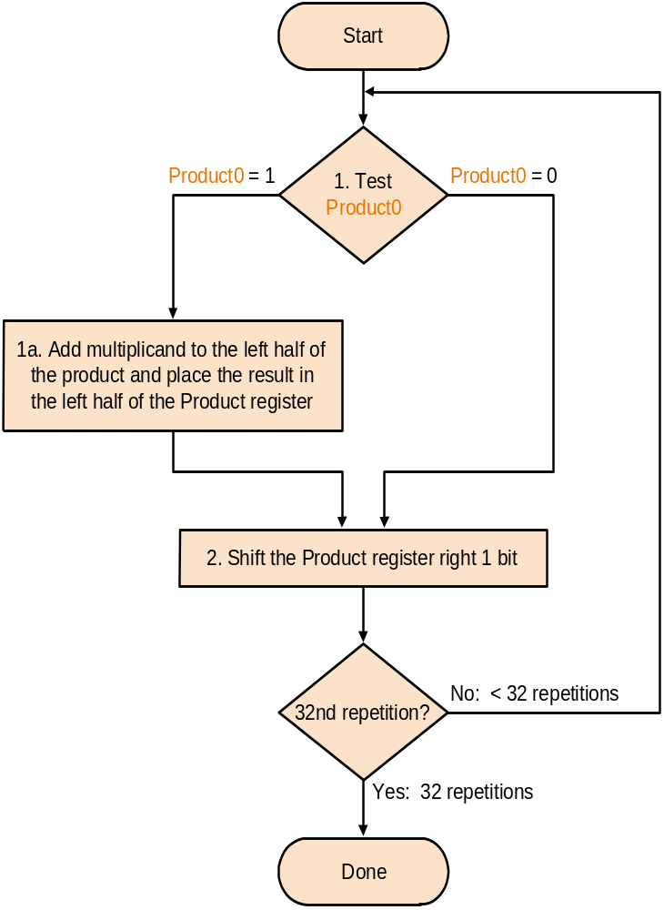
Multiplier V3--Algorithmic rule
Set product register to '0'
Load lower bits of product
register with multiplier
Test least significant bit
of product register

Slide 41
Example with V3
Multiplicand x multiplier: 0001 x 0111
Multiplicand: | 0001
Multiplier:× | 0111
 | 0000 | 0111 |  | #Initial value for the product
1 | 0001 | 0111 |  | #After adding 0001, Multiplier=1
 | 0000 | 1011 | 1 | #After shifting right the product one bit
 | 0001
2 | 0001 | 1011 |  | #After adding 0001, Multiplier=1
 | 0000 | 1101 | 1 | #After shifting right the product one bit
 | 0001 |  |  | #After adding 0001, Multiplier=1
3 | 0001 | 1101
 | 0000 | 1110 | 1 | #After shifting right the product one bit
 | 0000
4 | 0000 | 1110 |  | #After adding 0001, Multiplier=0
 | 0000 | 0111 | 0 | #After shifting right the product one bit
Shift out

Slide 42
Signed multiplication
Basic approach:
  Store the signs of the operands
  Convert signed numbers to unsigned numbers
  (most significant bit (MSB) = 0)
  Perform multiplication
  If sign bits of operands are equal
  sign bit = 0, else
  sign bit = 1
Improved method:
Booth's Algorithm
Assumption: addition and subtraction are available

Slide 43
Principle -- Decomposable multiplication
Assumes： Z=y×10111100
Z=y(10000000+111100+100-100)
=y(1×2⁷+1000000-100)
=y(1×2⁷+1×2⁶-2²)
=y(1×2⁷+1×2⁶+0×2⁵+0×2⁴+0×2³+0×2²+0×2¹+0×2⁰ -1×2² )
= y(1×2⁷+1×2⁶+0×2⁵+0×2⁴+0×2³+0×2²-1×2² +0×2¹+0×2⁰)
= y×2⁷+y×1×2⁶+0×2⁵+0×2⁴+0×2³ +0×2²-y×2² +0×2¹+0×2⁰)
add
Only shift
sub
Only shift
1 01 11 1 00

Slide 44
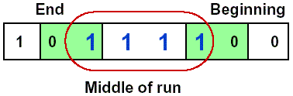
Booth's Algorithm
Idea: If you have a sequence of '1's
  subtract at first '1' in multiplier
  shift for the sequence of '1's
  add where prior step had last '1‘
Result:
  Possibly less additions and more shifts
  Faster, if shifts are faster than additions

Slide 45
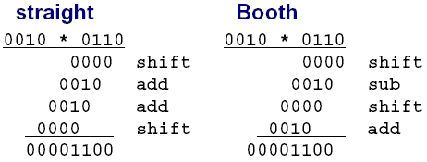
Example for Booth's Algorithm
Logic required identifying the run

Slide 46
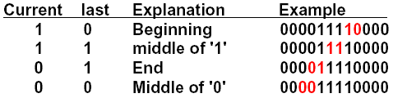
Booth's Algorithm rule
Analysis of two consecutive bits
Action
      1 0 subtract multiplicand from left
      1 1 no arithmetic operation-shift
      0 1 add multiplicand to left half
      0 0 no arithmetic operation-shift
Bit₋₁ = '0'
Arithmetic shift right:
  keeps the leftmost bit constant
  no change of sign bit !

Slide 47
Example with negative numbers
2 * (-3) = - 6
0010 * 1101 = 1111 1010
iteration | step | Multiplicand | product
0 | Initial Values | 0010 | 0000 1101 0
1 | 1.c:10→Prod=Prod-Mcand | 0010 | 1110 1101 0
 | 2: shift right Product | 0010 | 1111 0110 1
2 | 1.b:01→Prod=Prod+Mcand | 0010 | 0001 0110 1
 | 2: shift right Product | 0010 | 0000 1011 0
3 | 1.c:10→Prod=Prod-Mcand | 0010 | 1110 1011 0
 | 2: shift right Product | 0010 | 1111 0101 1
4 | 1.d: 11 → no operation | 0010 | 1111 0101 1
 | 2: shift right Product | 0010 | 1111 1010 1

Slide 48
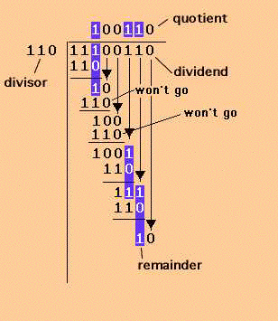
3.5 Division
Paper and pencil method
Notes:
Dividend=被除数，Divisor=除数

Slide 49
3.5 Division
Dividend = quotient × divisor + remainder
  Remainder < divisor
  Iterative subtraction
Result:
  Greater than 0: then we get a 1
  Smaller than 0: then we get a 0
Notes:
Dividend=被除数，Divisor=除数

Slide 50
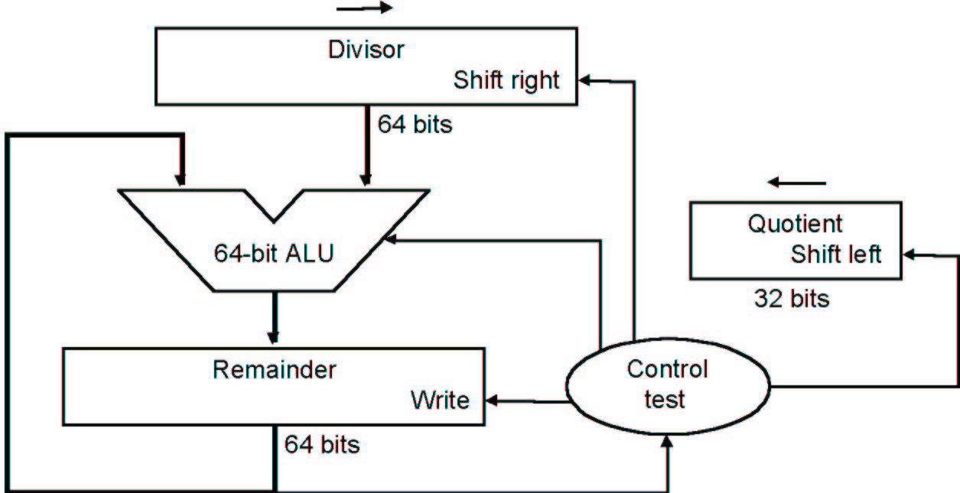
Division V1 --Logic Diagram
At first, the divisor is in the left half of the divisor register,
the dividend is in the right half of the remainder register.
Shift right the divisor register each step
dividend

Slide 51
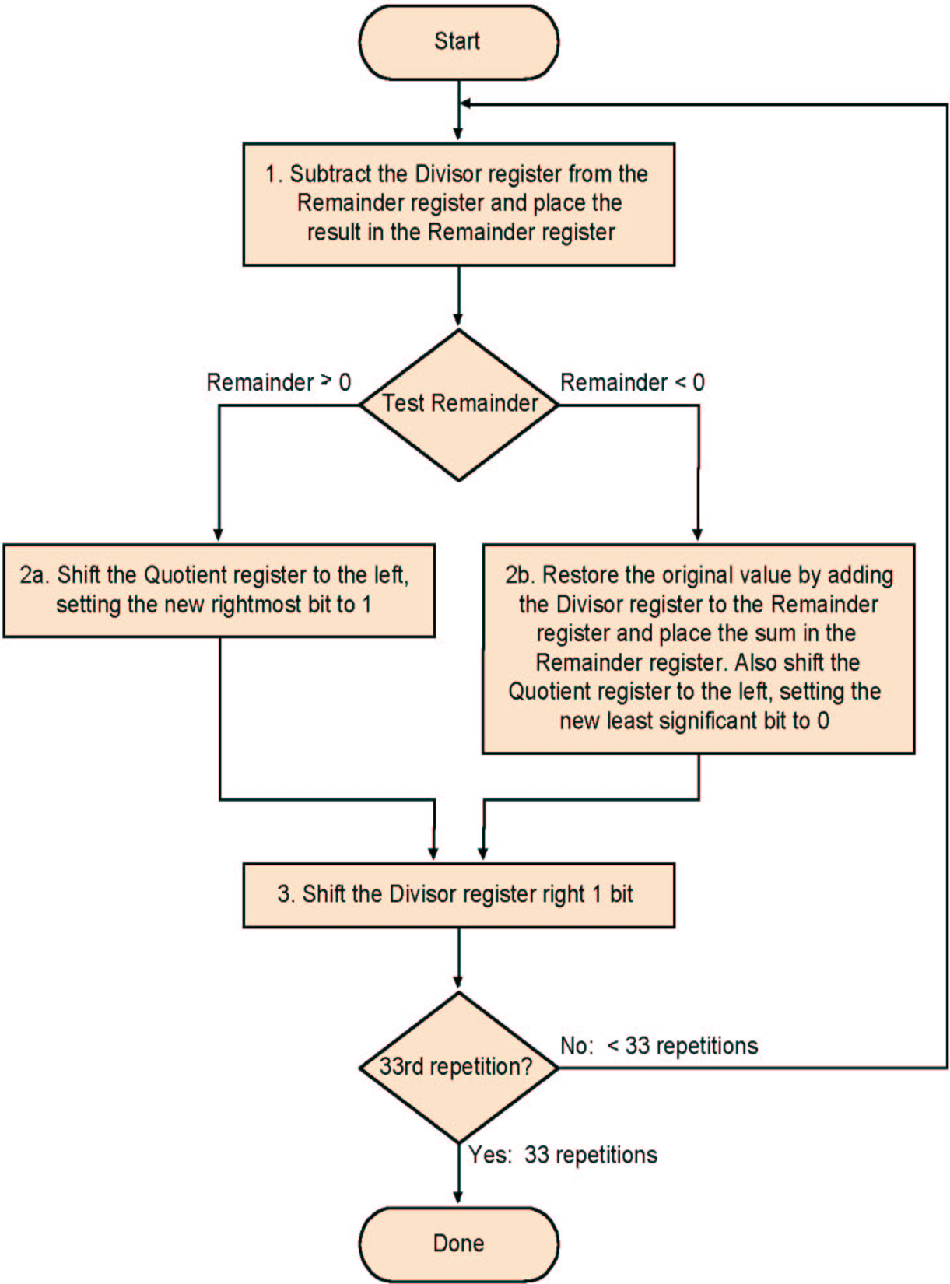
Algorithm V 1
Each step:
  Subtract divisor
  Depending on Result
    Leave or
    Restore
  Depending on Result
    Write '1' or
    Write '0'

Slide 52
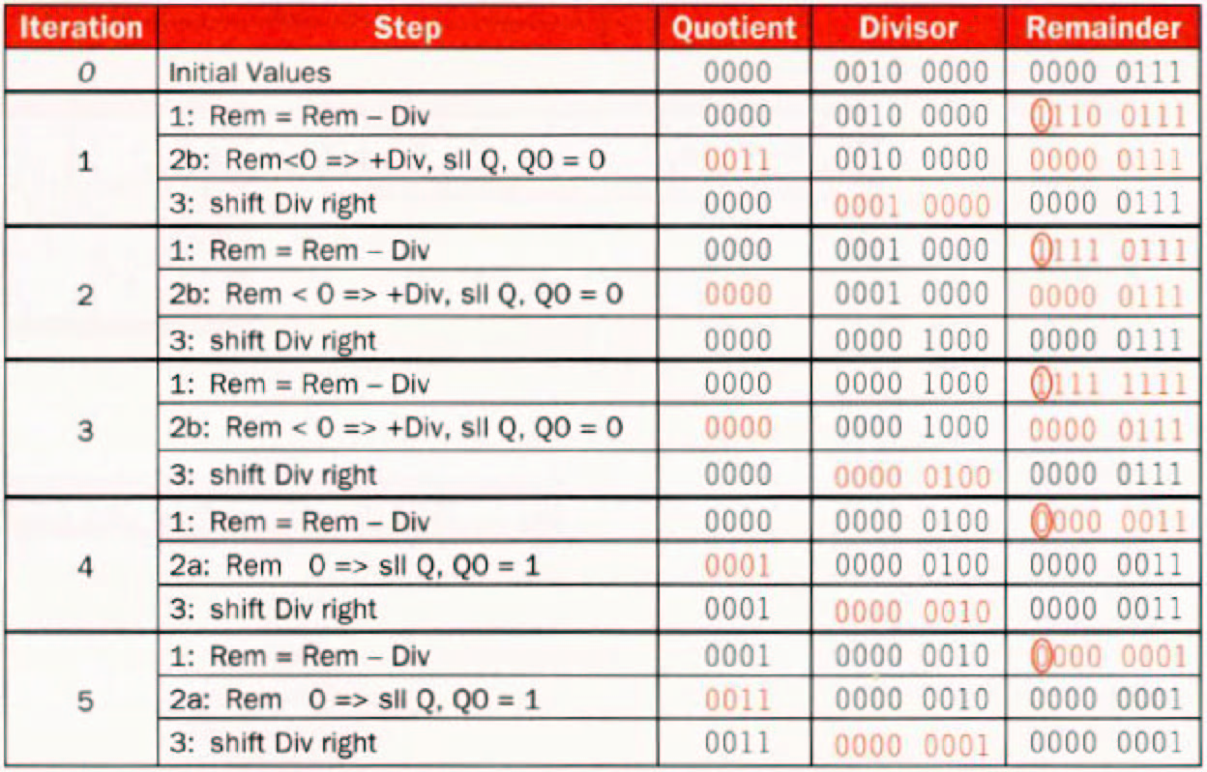
Example 7/2 for Division V1

Slide 53
Two questions
1.Why should the divisor be shifted right one bit each time?
2.Why should the divisor be placed in the left half of the divisor register , and the dividend be placed in the right half of the remainder register at first ?
quotient
divisor
dividend
- divisor
remainder
- divisor
0
remainder
…………

Slide 54
Observation on Divide V1
½ bits in divisor always 0
  ½ of 64-bit adder is wasted
  ½ of divisor is wasted
Instead of shifting divisor to right, shift remainder to left?
1st step can not produce a 1 in quotient bit
  switch order to shift first and then subtract, can save 1 iteration

Slide 55
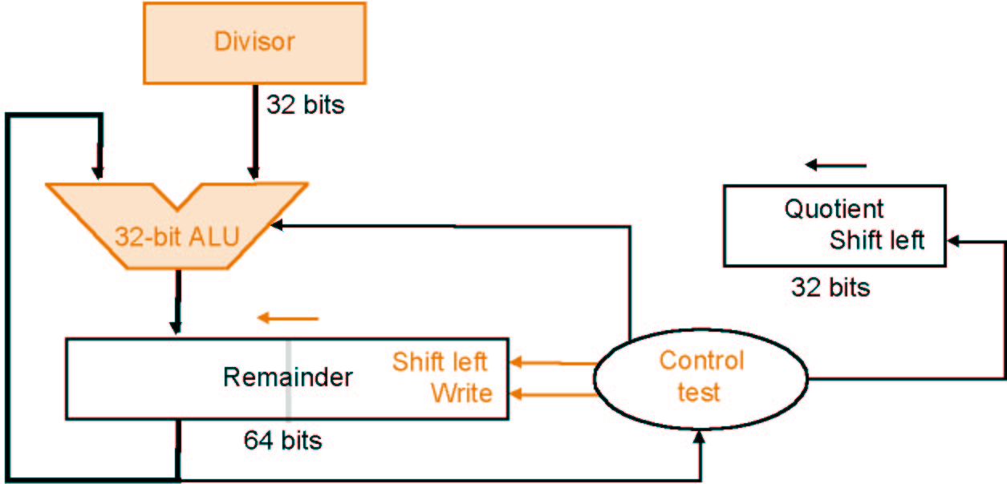
Division V 2
Reduction of Divisor and ALU width by half
Shifting of the remainder
Saving 1 iteration
dividend

Slide 56
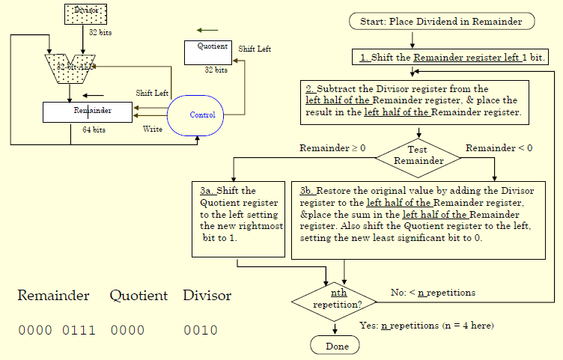
Algorithm V 2

Slide 57
Observation on Divide V2
Eliminate Quotient register by combining with Remainder as shifted left
  Start by shifting the Remainder left as before.
  Thereafter loop contains only two steps because the shifting of the Remainder register shifts both the remainder in the left half and the quotient in the right half.
  The consequence of combining the two registers together and the new order of the operations in the loop is that the remainder will shifted left one time too many.
  Thus the final correction step must shift back only the remainder in the left half of the register.

Slide 58
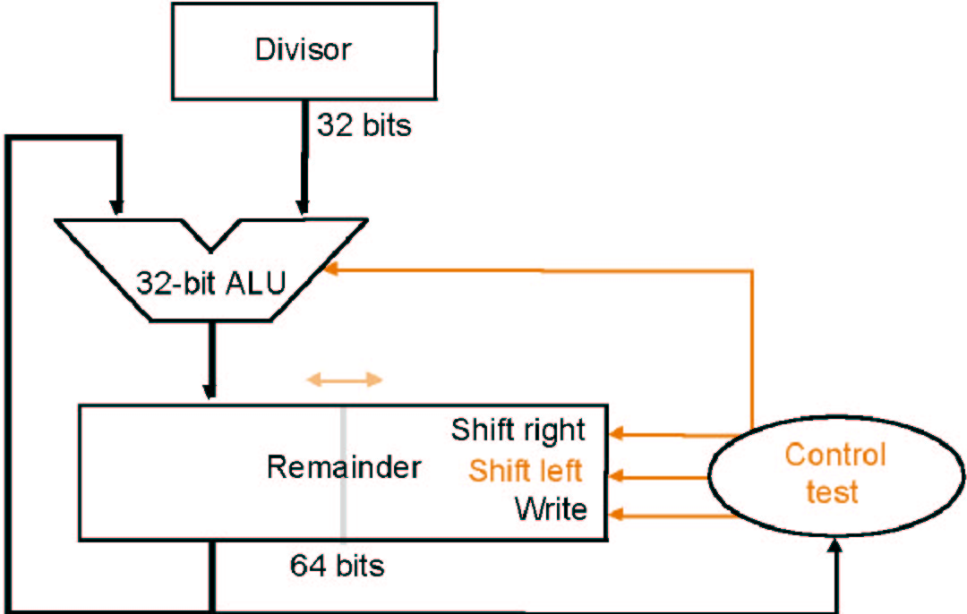
Division V 3
Remainder register keeps quotient
No quotient register required
dividend

Slide 59
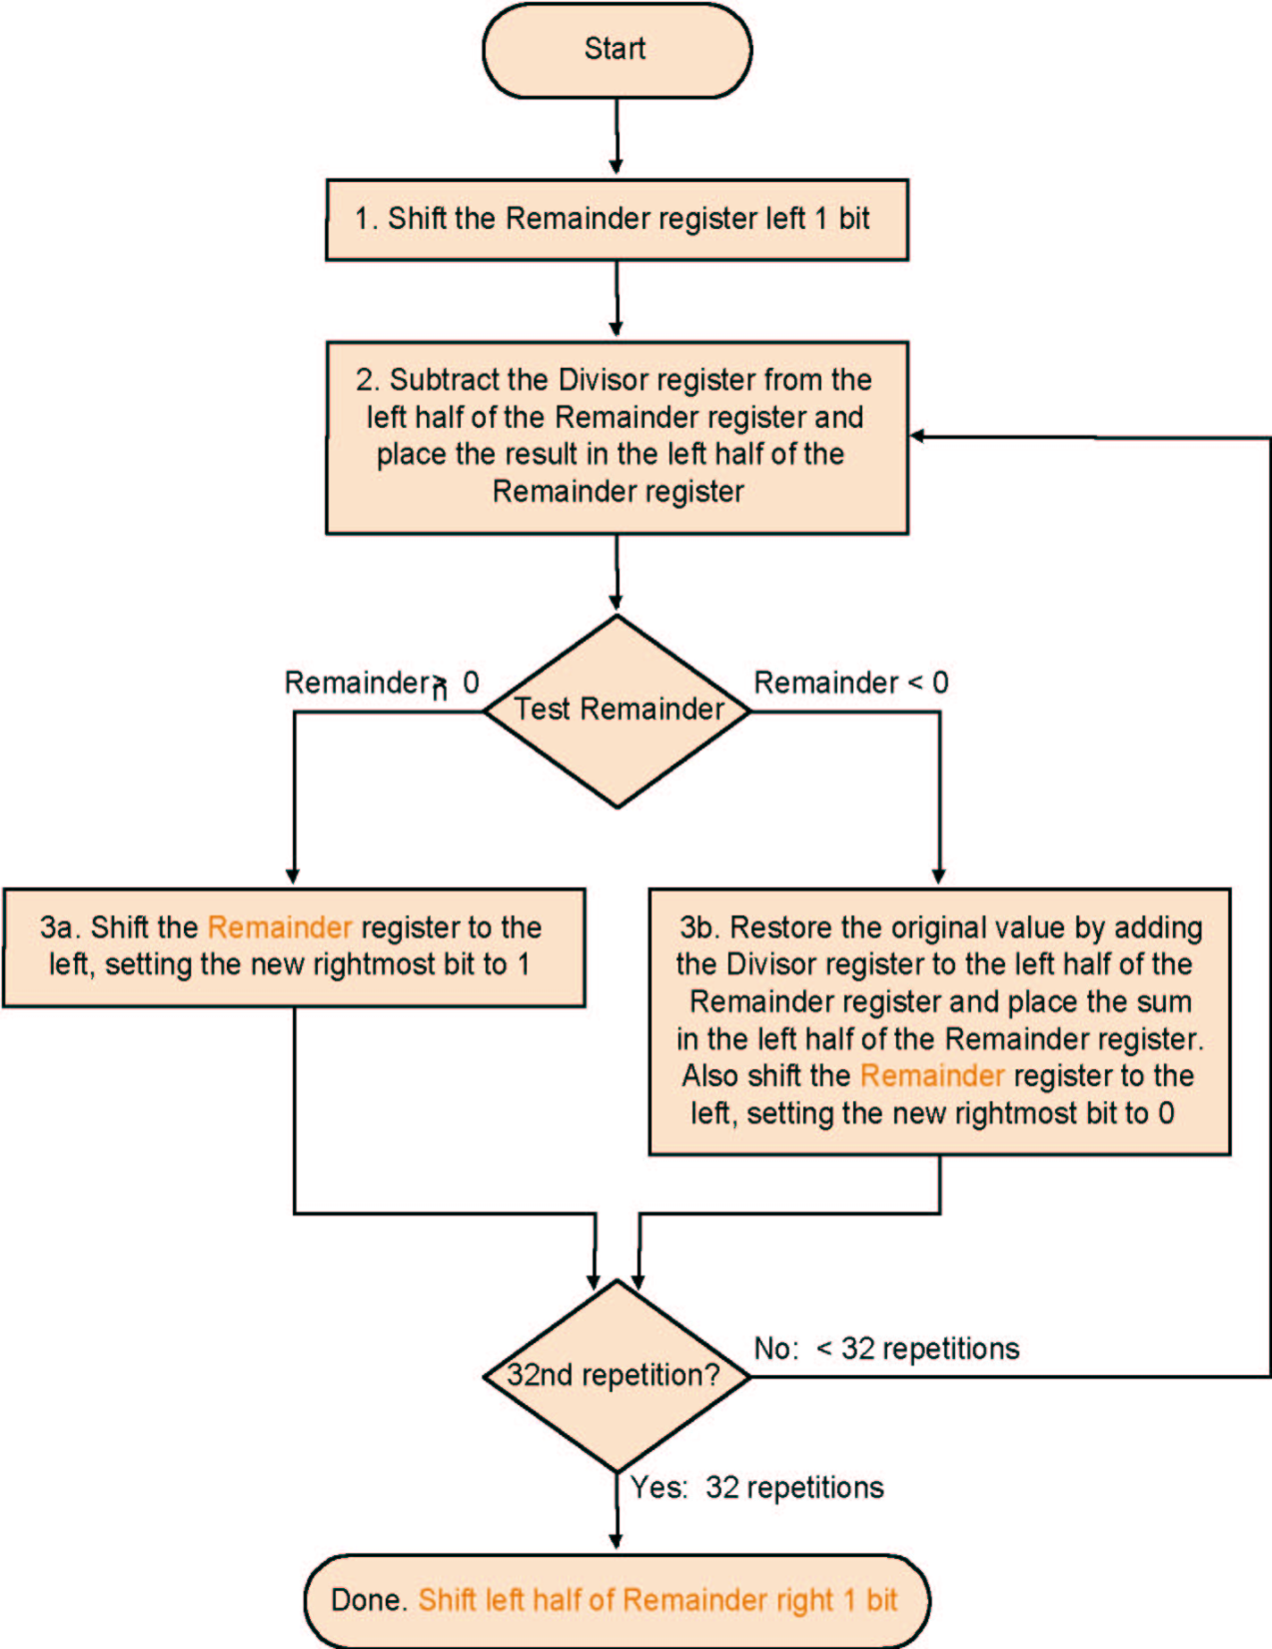
Algorithm V 3
Much the same than
the last one
Except change of
register usage

Slide 60
Example 7/2 for Division V3
Well known numbers: 0000 0111/0010
iteration | step | Divisor | Remainder
0 | Initial Values | 0010 | 0000 0111
 | Shift Rem left 1 | 0010 | 0000 1110
1 | 1.Rem=Rem-Div | 0010 | 1110 1110
 | 2b: Rem<0 →+Div,sll R,R₀=0 | 0010 | 0001 1100
2 | 1.Rem=Rem-Div | 0010 | 1111 1100
 | 2b: Rem<0 →+Div,sll R,R₀=0 | 0010 | 0011 1000
3 | 1.Rem=Rem-Div | 0010 | 0001 1000
 | 2a: Rem>0 →sll R,R₀=1 | 0010 | 0011 0001
4 | 1.Rem=Rem-Div | 0010 | 0001 0001
 | 2a: Rem>0 →sll R,R₀=1 | 0010 | 0010 0011
 | Shift left half of Rem right 1 |  | 0001 0011

Slide 61
Signed division
Keep the signs in mind for Dividend and Remainder
  (+ 7) ÷( + 2) = + 3 Remainder = +1
  7 = 3 × 2 + (+1) = 6 + 1
  (- 7 ) ÷(+ 2) = - 3 Remainder = -1
  -7 = -3 × 2 + (-1) = - 6 - 1
  (+ 7 ) ÷( - 2) = - 3 Remainder = +1
  (- 7 ) ÷( - 2) = + 3 Remainder = -1
One 64 bit register : Hi & Lo
  Hi: Remainder, Lo: Quotient
Instructions: div, divu
Divide by 0 → overflow : Check by software

