Slide 1
Computer Organization & Assembly Language
Introduction

Slide 2
Info
Instructor: Zheng Li
Cell: 13882153765
Email:lizheng@scu.edu.cn

Slide 3
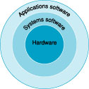
Layered Approach in Computer Design
Computer Architecture or
Instruction Set Architecture
Architecture
Microarchitecture
Logic gates
Transistors

Slide 4
Course Architecture – Software
Data Structure & Algorithm Analysis
Operating System
Compiler Theory
C, C++, Java, C#
Assembly Language
Software Engineering

Slide 5
Machine Code Example
void swap(int v[], int k)
{
int temp;
temp = v[k];
v[k] = v[k+1];
v[k+1] = temp;
}
swap:
muli $t0, $a0, 4
add $t0, $a1, $t0
lw $t1, 0($t0)
lw $t2, 4($t0)
sw $t2, 0($t0)
sw $t1, 4($t0)
jr $ra
compiler
00000000101000010…
00000000000110000…
10001100011000100…
10001100111100100…
10101100111100100…
10101100011000100…
00000011111000000…
assembler

Slide 6
High-Level Language vs. Assemble Language
Function: If the value of x+y-z is greater than 0, then set var1 to x+y-z. Or else, set var1 to 0.
C Language:
if((var1=x+y-z)<=0) var1 = 0;

Slide 7
High-Level Language vs. Assemble Language
Assemble Language:
mov al, x
add al, y
sub al, z
ja l1
jmp l2
l1: mov var1, al
jmp l3
l2: mov var1, 0
l3: ……

Slide 8
Basic Unit of Assemble Language
Instruction is the smallest executable unit of any software.
Atom Property: If an instruction is to be execute, it must be execute completely.

Slide 9
Relationship between Assemble Language and Machine Language
Assemble language is the symbol version of machine language.
Generally, one assemble instruction is correspondent to one machine instruction.

Slide 10
High-Level Language vs. Assemble Language
Program Language | Byte Number
High Level Language (C) | CSUM.EXE | 4330
8086 Assemble Language （MASM） | ASMSUM.COM | 21
8086 Machine Language （IBM PC） | MACHINE.COM | 21

Slide 11
Course Architecture – Hardware
Computer Architecture
Computer Organization
Computer Principle & Interface Technology
Digital Logic
Architecture
Microarchitecture
Analogous Circuit
Logic gates
Transistors

Slide 12
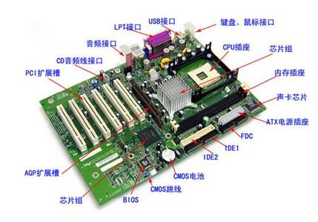
Hardware Architecture Example

Slide 13
Relationship between Digital Logic and Computer Organization
Digital Logic: Applying logic gates as basic unit, construct logic circuits with specified function.
Computer Organization: Applying logic circuits as basic unit, construct the whole computer system.

Slide 14
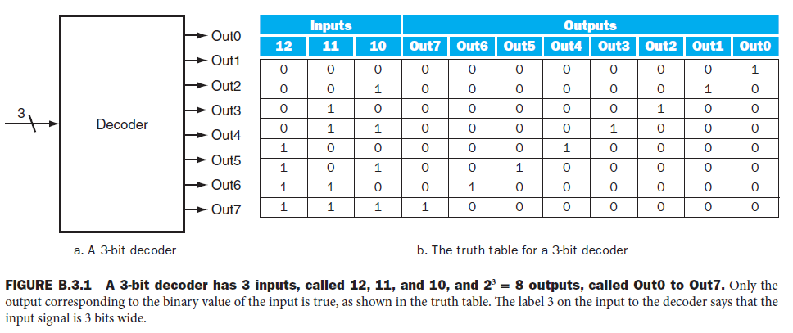
Basic idea of Digital Logic – Combinational Logic

Slide 15
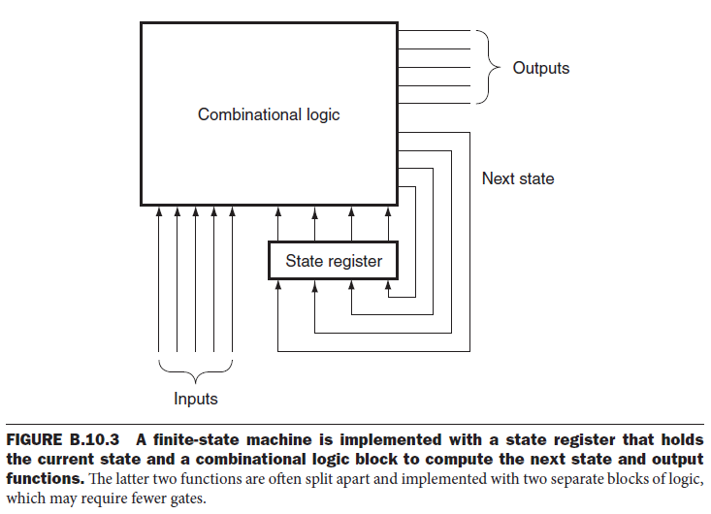
Basic idea of Digital Logic – Sequential Logic

Slide 16
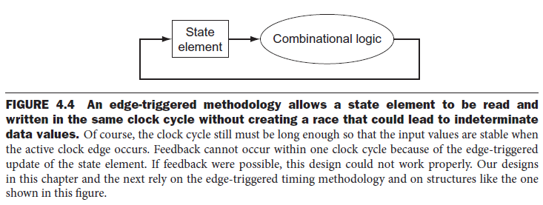
Basic idea of Digital Logic – Edge triggered methodology

Slide 17
Relationship between Software and Hardware
Software provide instruction sequence, tell hardware what work to do.
Hardware explain instructions and decide how to carry out the work.
Thinking: Relationship between algorithm and program.

Slide 18
Course Architecture
Assembly Language: symbol version of machine language
Machine Language: will be translate to sequential procedure of hardware
It is the software layer which is closet to hardware.

Slide 19
Course Architecture
Computer Organization: hardware architecture and sequential procedure
Most sequential procedures in computer are caused by machine instructions.
It is the hardware layer which is closet to software.

Slide 20
Course Objective
Based on Assembly Language and the theory of Computer Organization, construct an important convergence between software and hardware knowledge.
This knowledge convergence will show significant effect for following relative courses.

Slide 21
Architecture Understanding
CPU
Memory
Bus（Data, Address, Control）
I/O Interface
I/O Interface
I/O Interface
I/O Device
I/O Device
I/O Device

Slide 22


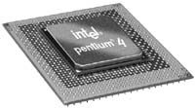

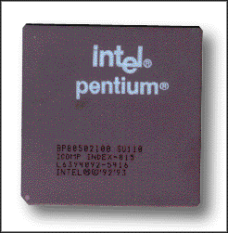
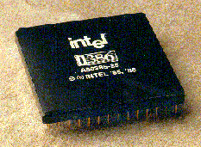

CPU
Pentium 4
80386
Pentium
8088CPU

Slide 23
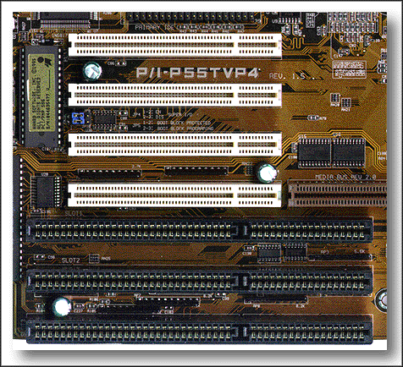
System Bus
PCI Bus
ISA Bus

Slide 24
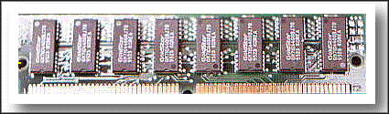
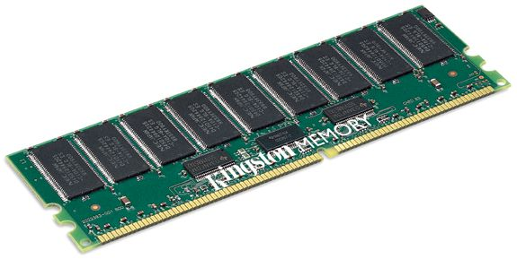
Memory

Slide 25
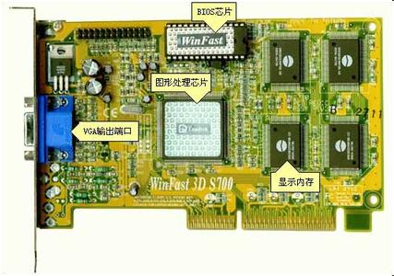
I/O Interface

Slide 26
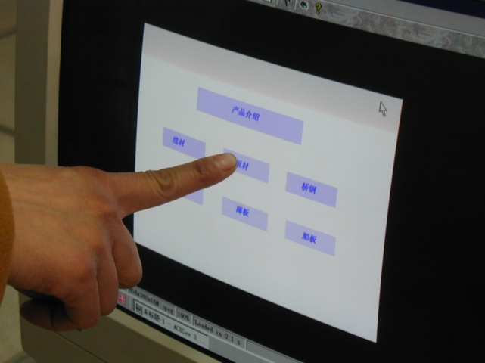
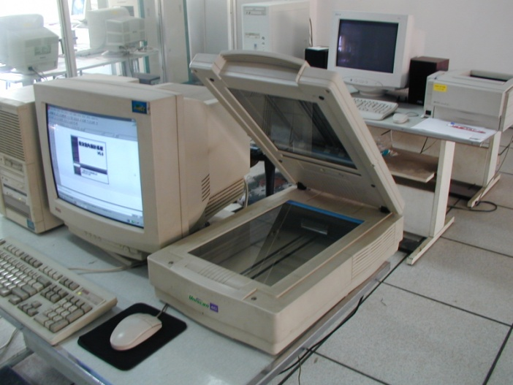



I/O Device

Slide 27

Architecture Understanding

Slide 28
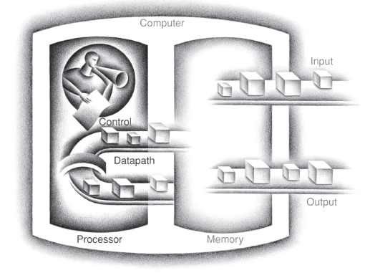
Micro-architecture Understanding

Slide 29
6 contradictions in design
(1) simple or complex
(2) regular or non-regular
(3) Bit Competition of two information parts
(4) few long units, or more short units
(5) serial or parallel
(6) speed or capacity(cost)

Slide 30
(1) simple or complex
Example: Consider delivery path between 3 station, A, B, and C.
Complex Design: AB, BC, and AC
Simple Design: AB, BC
Problem: How to realize path AC?
How about delivery distance? Is this design really simple?

Slide 31
(1) simple or complex
Example: realize add, sub, mul, div function in CPU
Complex Design: realize four instruction and corresponding sequential control
Simple Design: only realize add and sub instruction
Problem: How to realize mul and div function in CPU?
How about performance? Is this design really simple?

Slide 32
(1) simple or complex
Example: RISC or CISC
RISC: Reduced Instruction Set Computer
CISC: Complex Instruction Set Computer
Parallelism (especially pipeline) optimization favors RISC
Complier simplification favors CISC
Simplifying instruction set may make writing complier harder.

Slide 33
(2) regular or non-regular
Example: There are many objects with different size. Objects need to be loaded in boxes with minimized space waste. How to design the box size?
Non-Regular Design: many box size, each one is corresponding to one object size
Regular Design: only one box size
Problem: How to realize the minimized space waste?
Is regular design always simple?

Slide 34
(2) regular or non-regular
Example:
1) Same or different bit number for different instruction?
CISC: different bit number
RISC: same bit number

Slide 35
(2) regular or non-regular
2) If the bit number is the same, apply same or different format for different instruction?
Regular: same format
Non-regular: different format
But even in RISC, non-regular format is applied.

Slide 36
(3) Bit Competition of two information parts
Example: Consider a limited transportation to a disaster area. More medical supplies or more food?
Design: A compromise must be taken.
Problem: How to know whether this design is really the best one?

Slide 37
(3) Bit Competition of two information parts
Example: In a instruction format, assign more bits to OP code or address?
More OP code: supply more instruction type or function
More address: supply more register or memory cell accessing ability

Slide 38
(4) few long units, or more short units
Example: Consider 5 object with different length. The size of object is 2mm, 3mm, 8mm, 200mm,400mm,500m separately.
Precise measurement: Apply ruler based on mm unit.
Effective measurement: Apply ruler based on cm unit.
Which one is better?

Slide 39
(4) few long units, or more short units
Example: In CPU, for instruction A, signal pass through 1 component; for instruction B, signal pass through 5 component. More component used, more time expended.
Design problem: One can use 1 clock cycle or 5 cycles for these two instruction. If only one scheme can be applied, which design is better?

Slide 40
(5) serial or parallel
Example: Consider the airport security.
1) less or more check gates?
Multiple-core CPU
2) Apply ID check and security check sequentially or Apply pipeline for these two checks?
Pipeline
How about the operation order? Does parallel design always work correctly?

Slide 41
(6) speed or capacity(cost)
Example: Consider two aircraft type. One is small but fast; another is big but slow. The fast one is expensive; the slow one is cheap.
Problem: How to assign passengers to these two aircraft type?
Compromise: Frequent passengers to fast aircraft; others to slow aircraft

Slide 42
important questions
(1) How are programs written in a high-level language, such as C or Java, translated into the language of the hardware, and how does the hardware execute the resulting program?
Evaluation about macro-converge of software and hardware understanding

Slide 43
important questions
(2) What determines the performance of a program, and how can a programmer improve the performance?
Evaluation about ideas of software design with hardware understanding

Slide 44
important questions
(3) What techniques can be used by hardware designers to improve performance?
Evaluation about understanding of hardware design techniques

Slide 45
important questions
(4) What techniques can be used by hardware designers to improve energy efficiency?
Evaluation about understanding of hardware design techniques

Slide 46
important questions
(5) Since the first commercial computer in 1951, what great ideas did computer architects come up with that lay the foundation of modern computing?
Evaluation about overall understanding of this course

Slide 47

8 great ideas in design
(1) Design for Moore’s Law
The one constant for computer designers is rapid change, which is driven largely by Moore’s Law.
Like a skeet shooter, computer architects must anticipate where the technology will be when the design finishes rather than design for where it starts.

Slide 48
Moore’s Law
The term Moore's Law has been coined by Carver Mead around 1970.[4] Moore's original statement can be found in his publication "Cramming more components onto integrated circuits", Electronics Magazine 19 April 1965:
“The complexity for minimum component costs has increased at a rate of roughly a factor of two per year ... Certainly over the short term this rate can be expected to continue, if not to increase. Over the longer term, the rate of increase is a bit more uncertain, although there is no reason to believe it will not remain nearly constant for at least 10 years. That means by 1975, the number of components per integrated circuit for minimum cost will be 65,000. I believe that such a large circuit can be built on a single wafer.[1]
Astounding that it has held for so long!!!

Slide 49
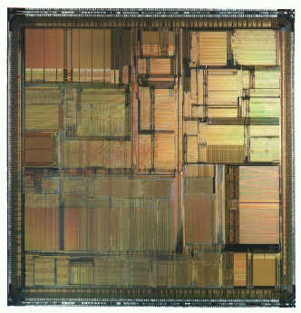
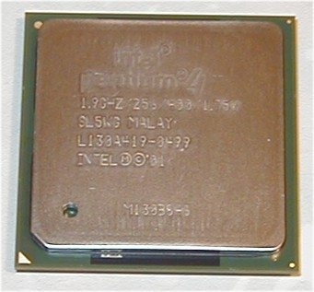
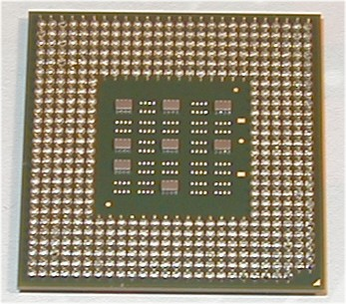
Integrated Circuits
1mm~25mm on a side
100 ~ 1000M transistors
25 ~ 250M “logic gates”

Slide 50
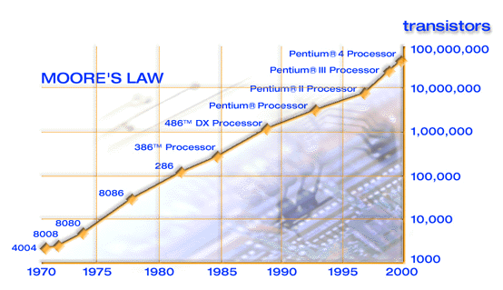
Technology Trend (Processor Complexity)
2x transistors/chip every 1.5 years!

Slide 51
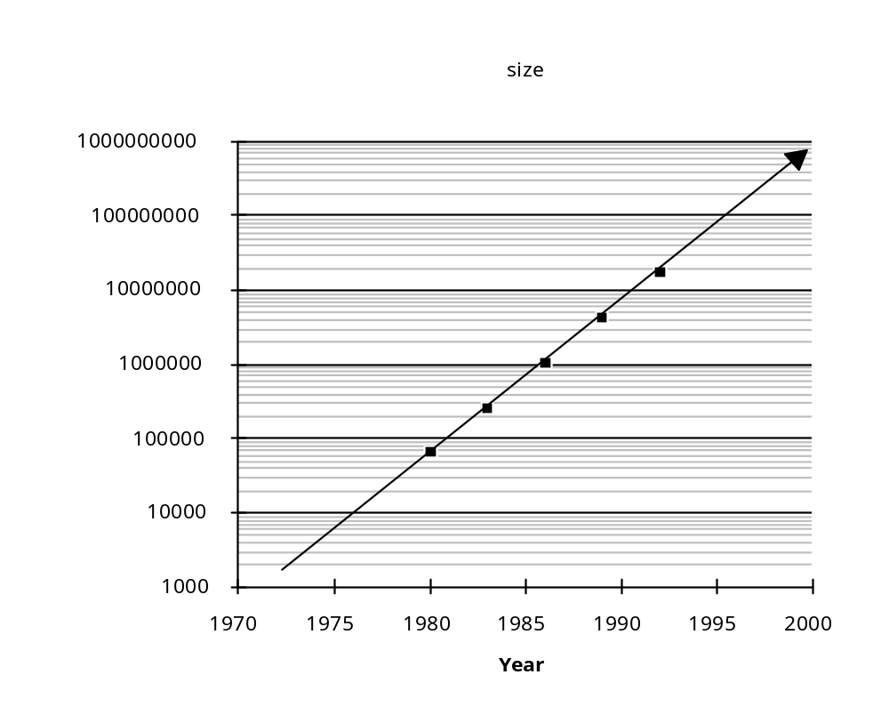
Memory Capacity Trend (DRAM)
1.4x/year or 2x every 2 years
8000x since 1980!

Slide 52
Technology Advances (!)
Memory
  DRAM capacity: 2x / 2 years (since ’96)
  64x size improvement in last decade
Processor
  Speed (in terms of clock frequency): 2x / 1.5 years (since ’85)
  100x performance improvement in last decade
Disk
  Capacity: 2x / 1 year (since ’97)
  250x size improvement in last decade

Slide 53

8 great ideas in design
(2) Use Abstraction to Simplify Design
A major productivity technique for hardware and software is to use abstractions to represent the design at different levels of representation; lower-level details are hidden to offer a simpler model at higher levels.

Slide 54

8 great ideas in design
(3) Make the Common Case Fast
Making the common case fast will tend to enhance performance better than optimizing the rare case.
Ironically, the common case is oft en simpler than the rare case and hence is often easier to enhance.

Slide 55

8 great ideas in design
(4) Performance via Parallelism
Since the dawn of computing, computer architects have offered designs that get more performance by performing operations in parallel.

Slide 56

8 great ideas in design
(5) Performance via Pipelining
A particular pattern of parallelism is so prevalent in computer architecture that it merits its own name: pipelining.
Example: The townsfolk form a human chain to carry a water source to fire, as they could much more quickly move buckets up the chain instead of individuals running back and forth.

Slide 57

8 great ideas in design
(6) Performance via Prediction
In some cases it can be faster on average to guess and start working rather than wait until you know for sure, assuming that the mechanism to recover from a misprediction is not too expensive and your prediction is relatively accurate.

Slide 58

8 great ideas in design
(7) Hierarchy of Memories
The shape indicates speed, cost, and size: the closer to the top, the faster and more expensive per bit the memory; the wider the base of the layer, the bigger the memory.

Slide 59

8 great ideas in design
(8) Dependability via Redundancy
Computers not only need to be fast; they need to be dependable.
Since any physical device can fail, we make systems dependable by including redundant components that can take over when a failure occurs and to help detect failures.

