Slide 1
Computer Organization & Assembly Language
Chapter 3

Slide 2
Topics
Negative binary integers
  Sign magnitude, 1’s complement, 2’s complement
  Sign extension, ranges, arithmetic
Signed versus unsigned operations
Overflow (signed and unsigned)
Branch instructions: branching backwards
Implementation of addition
Chapter 3 Part 2 will cover:
  Implementations of multiplication, division
  Floating point numbers
    Binary fractions
    IEEE 754 floating point standard
    Operations
      underflow
      Implementations of addition and multiplication (less detail than for integers)
      Floating-point instructions in MIPS
      Guard and Round bits

Slide 3
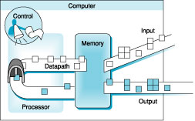
Computer Organization

Slide 4
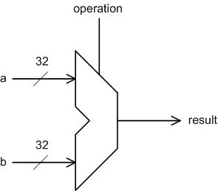
Binary Arithmetic
So far we have studied
  Instruction set basics
  Assembly & machine language
We will now cover binary arithmetic algorithms and their implementations
Binary arithmetic will provide the basis for the CPU’s “datapath” implementation

Slide 5
Binary Number Representation
We looked at unsigned numbers before
  B₃₁B₃₀…B₂B₁B₀
  B₃₁×2³¹+B₃₀×2³⁰+…+B₂×2²+B₁×2¹+B₀×2⁰
We will deal with more complicated cases
  Negative integers
  Real numbers (a.k.a. floating-point numbers)

Slide 6
Unsigned Binary Numbers
Limited number of binary numbers (patterns of 0s and 1s)
  8-bit number: 256 patterns, 00000000 to 11111111
  General: 2^{N} bit patterns in N bits
    16 bits: 2¹⁶ = 65,536 bit patterns
    32 bits: 2³² = 4,294,967,296 bit patterns
Unsigned numbers use the patterns for 0 and positive numbers
  8-bit number range corresponds to
    00000000 0
    00000001 1
    …
    11111111 255
  32-bit number range [0..4294967296]
  In general, the range is [0…2^{N}-1]
Addition and subtraction: as in decimal (on board)

Slide 7
Unsigned Binary Numbers in MIPS
MIPS instruction set provides support
  addu $1,$2,$3 - adds two unsigned numbers
  Addiu $1,$2,33 – adds unsigned number with SIGNED immediate
  Subu $1,$2,$3
  Etc
In MIPS: the carry/borrow out is ignored
  Overflow is possible, but hardware ignores it
  Signed instructions throw exceptions on overflow
Unsigned memory accesses: lbu, lhu
  Loaded value is treated as unsigned
  Convert from smaller bit width (8, 16) to 32 bits
  Upper bits in the 32-bit destination register are set to 0s

Slide 8
Important 7-bit Unsigned Numbers
American Standard Code for Information Interchange (ASCII)
  7 bits used for the characters
  8th bit may be used for error detection (parity)
Unicode: A larger encoding; backward compatible with ASCII

Slide 9
Signed Numbers
How shall we represent both positive and negative numbers?
We still have a limited number of bits
  N bits: 2^{N} bit patterns
We will assign values to bit patterns differently
  Some will be assigned to positive numbers and some to negative numbers
3 Ways: sign magnitude, 1’s complement, 2’s complement

Slide 10
Method 1: Sign Magnitude
{sign bit, absolute value (magnitude)}
  Sign bit
    “0” – positive number
    “1” – negative number
  EX. (assume 4-bit representation)
    0000: 0
    0011: 3
    1001: -1
    1111: -7
    1000: -0
Properties
  two representations of zero
  equal number of positive and negative numbers

Slide 11
Method 2: One’s Complement
((2^{N}-1) – number): To multiply a 1’s Complement number by -1, subtract the number from (2^{N}-1)_unsigned. Or, equivalently (and easily!), simply flip the bits
1CRepOf(A) + 1CRepOf(-A) = 2^{N}-1_unsigned (interesting tidbit)
Let’s assume a 4-bit representation (to make it easy to work with)
Examples:
    0011: 3
    0110: 6
    1001: -6 1111 – 0110 or just flip the bits of 0110
    1111: -0 1111 – 0000 or just flip the bits of 0000
    1000: -7 1111 – 0111 or just flip the bits of 0111
Properties
  Two representations of zero
  Equal number of positive and negative numbers

Slide 12
Method 3: Two’s Complement
(2^{N} – number): To multiply a 2’s Complement number by -1, subtract the number from 2^{N}_unsigned. Or, equivalently (and easily!), simply flip the bits and add 1.
2CRepOf(A) + 2CRepOf(-A) = 2^{N}_unsigned (interesting tidbit)
Let’s assume a 4-bit representation (to make it easy to work with)
Examples:
    0011: 3
    0110: 6
    1010: -6 10000 – 0110 or just flip the bits of 0110 and add 1
    1111: -1 10000 – 0001 or just flip the bits of 0001 and add 1
    1001: -7 10000 – 0111 or just flip the bits of 0111 and add 1
    1000: -8 10000 – 1000 or just flip the bits of 1000 and add 1
Properties
  One representation of zero: 0000
  An extra negative number: 1000 (this is -8, not -0)

Slide 13
Ranges of numbers
Range (min to max) in N bits:
  SM and 1C: -2^{(N-1)} -1 to +2^{(N-1)} -1
  2C: -2^{(N-1)} to +2^{(N-1)} -1

Slide 14
Sign Extension
#s are often cast into vars with more capacity
Sign extension (in 1c and 2c): extend the sign bit to the left, and everything works out
la $t0,0x00400033
addi $t1,$t0, 7
addi $t2,$t0, -7
R[rt] = R[rs] + SignExtImm
SignExtImm = {16{immediate[15]},immediate}

Slide 15
Summary
Code | Sign-Magnitude | 1’s Complement | 2’s Complement
000 | +0 | +0 | +0
001 | +1 | +1 | +1
010 | +2 | +2 | +2
011 | +3 | +3 | +3
100 | -0 | -3 | -4
101 | -1 | -2 | -3
110 | -2 | -1 | -2
111 | -3 | -0 | -1
Issues
  # of zeros
  Balance (and thus range)
  Operations’ implementation

Slide 16
2’s Complement Examples
32-bit signed numbers
  0000 0000 0000 0000 0000 0000 0000 0000 = 0
  0000 0000 0000 0000 0000 0000 0000 0001 = +1
  0000 0000 0000 0000 0000 0000 0000 0010 = +2
  …
  0111 1111 1111 1111 1111 1111 1111 1110 = +2,147,483,646
  0111 1111 1111 1111 1111 1111 1111 1111 = +2,147,483,647
  1000 0000 0000 0000 0000 0000 0000 0000 = - 2,147,483,648 -2^31
  1000 0000 0000 0000 0000 0000 0000 0001 = - 2,147,483,647
  1000 0000 0000 0000 0000 0000 0000 0010 = - 2,147,483,646
  …
  1111 1111 1111 1111 1111 1111 1111 1101 = -3
  1111 1111 1111 1111 1111 1111 1111 1110 = -2
  1111 1111 1111 1111 1111 1111 1111 1111 = -1

Slide 17
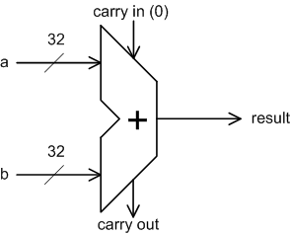
Addition
We can do binary addition just as we do decimal arithmetic
  Examples in lecture
Can be simpler with 2’s complement (1C as well)
  We don’t need to worry about the signs of the operands!
  Examples in lecture

Slide 18
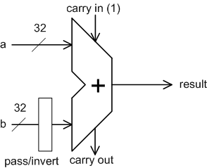
Subtraction
Notice that subtraction can be done using addition
  A – B = A + (-B)
  We know how to negate a number
  The hardware used for addition can be used for subtraction with a negating unit at one input
Add 1
Invert (“flip”) the bits

Slide 19
Signed versus Unsigned Operations
“unsigned” operations view the operands as positive numbers, even if the most significant bit is 1
Example: 1100 is 12_unsigned but -4_2C
Example: slt versus sltu
  li $t0,-4
  li $t1,10
  slt $t3,$t0,$t1 $t3 = 1
  sltu $t4,$t0,$t1 $t4 = 0 !!

Slide 20
Signed Overflow
Because we use a limited number of bits to represent a number, the result of an operation may not fit → “overflow”
No overflow when
  We add two numbers with different signs
  We subtract a number with the same sign
Overflow when
  Adding two positive numbers yields a negative number
  Adding two negative numbers yields a positive number
  How about subtraction?

Slide 21
Overflow
On an overflow, the CPU can
  Generate an exception
  Set a flag in a status register
  Do nothing
In MIPS:
  add, addi, sub: footnote (1) May cause overflow exception

Slide 22
Overflow with Unsigned Operations
addu, addiu, subu
  Footnote (1) is not listed for these instructions
  This tells us that, In MIPS, nothing is done on unsigned overflow
  How could it be detected for, e.g., add?
    Carry out of the most significant position (in some architectures, a condition code is set on unsigned overflow, which IS the carry out from the top position)

Slide 23
Branch Instructions: Branching Backwards
# $t3 = 1 + 2 + 2 + 2 + 2; $t4 = 1 + 3 + 3 + 3 + 3
li $t0,0 li $t3,1 li $t4, 1
loop: addi $t3,$t3,2
addi $t4,$t4,3
addi $t0,$t0,1
slti $t5,$t0,4
bne $t5,$zero,loop machine code: 0x15a0fffb
BranchAddr = {14{imm[15]}, imm, 2’b0}

Slide 24
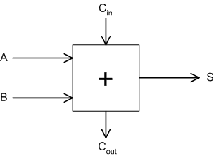
1-bit Adder
With a fully functional single-bit adder
  We can build a wider adder by linking many one-bit adders
3 inputs
  A: input A
  B: input B
  C_{in}: input C (carry in)
2 outputs
  S: sum
  C_{out}: carry out

Slide 25
Boolean Logic formulas
Input |  |  | Output
A | B | C_{in} | S | C_{out}
0 | 0 | 0 | 0 | 0
0 | 0 | 1 | 1 | 0
0 | 1 | 0 | 1 | 0
0 | 1 | 1 | 0 | 1
1 | 0 | 0 | 1 | 0
1 | 0 | 1 | 0 | 1
1 | 1 | 0 | 0 | 1
1 | 1 | 1 | 1 | 1
S = A’B’C_{in}+A’BC_{in}’+AB’C_{in}’+ABC_{in}
Cout = AB+BC_{in}+AC_{in}
Can implement the adder using logic gates

Slide 26
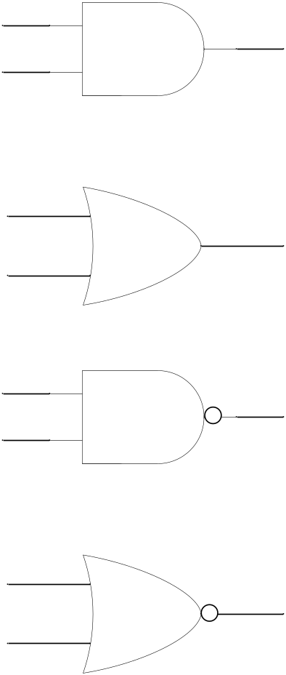
Logic Gates
A
2-input AND
Y
Y=A&B
B
A
Y=A|B
2-input OR
Y
B
2-input NAND
A
Y=~(A&B)
Y
B
A
2-input NOR
Y
Y=~(A|B)
B

Slide 27
Implementation in logic gates
Cout = AB+BC_{in}+AC_{in}
We’ll see more boolean logic and circuit implementation when we finish with numbers
OR GATES
AND GATES

Slide 28
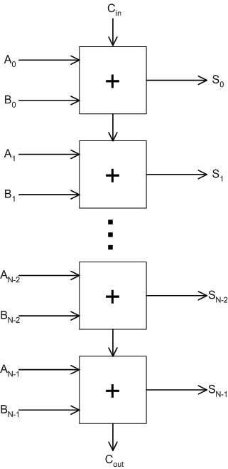
N-bit Adder
(0)
An N-bit adder can be constructed with N one-bit adders
  A carry generated in one stage is propagated to the next (“ripple carry adder”)
3 inputs
  A: N-bit input A
  B: N-bit input B
  C_{in}: input C (carry in)
2 outputs
  S: N-bit sum
  C_{out}: carry out

Slide 29
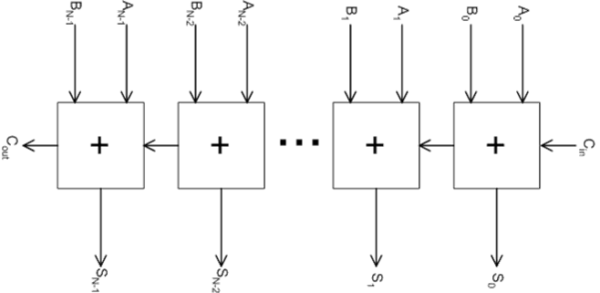
N-bit Ripple-Carry Adder
(0)
 | (0) |  | (1) |  | (1) |  | (0) |  | (0)
 | 0 |  | 0 |  | 1 |  | 1 |  | 1
 | 0 |  | 0 |  | 1 |  | 1 |  | 0
(0) | 0 | (0) | 1 | (1) | 1 | (1) | 0 | (0) | 1
…

Slide 30
Describing a single-bit adder
  A truth table will tell us about the operation of a single-bit adder
Input |  |  | Output
A | B | C_{in} | S | C_{out}
0 | 0 | 0 | 0 | 0
0 | 0 | 1 | 1 | 0
0 | 1 | 0 | 1 | 0
0 | 1 | 1 | 0 | 1
1 | 0 | 0 | 1 | 0
1 | 0 | 1 | 0 | 1
1 | 1 | 0 | 0 | 1
1 | 1 | 1 | 1 | 1

