Slide 1
Computer Organization & Assembly Language
Chapter 3

Slide 2
Topics
Implementations of multiplication, division
Floating point numbers
  Binary fractions
  IEEE 754 floating point standard
  Operations
    underflow
    Implementations of addition and multiplication (less detail than for integers)
    Floating-point instructions in MIPS
    Guard and Round bits

Slide 3
Multiplication of unsigned integers
More complicated than addition
Outline
  Human longhand, to remind ourselves of the steps involved
  Multiplication hardware
    Text has 3 versions, showing evolution to help you understand how the circuits work

Slide 4
Longhand Multiplication
1010 Multiplicand 10 decimal
0101 Multiplier 5 decimal
-------
1010
0000
1010
0000
--------------
0110010 Product 50 decimal
Spaces are 0s

Slide 5
Sequential multiplication of unsigned integers
Use add operation of ALU to add numbers
Use several clock cycles
Store multiplicand, multiplier, and product-so-far in registers

Slide 6
Algorithm
For each bit of the multiplier:
  If it is 1, then add the multiplicand to the product (if 0, add 0 == do nothing)
  Shift something so we will be working on the right column next time

Slide 7
Algorithm
For each bit of the multiplier:
  If it is 1, then add the muliplicand to the product (if it 0, add 0 == do nothing)
  Shift something so we will be working on the right column next time
How can we do the underlined part?

Slide 8
Algorithm
Test multiplier[0]
  If it is 1, add the multiplicand to the product
  Shift multiplier register 1 to the right
  Shift something so we will be working on the right column next time

Slide 9
Algorithm
Test multiplier[0]
  If it is 1, add the multiplicand to the product
  Shift multiplier register 1 to the right
  Shift something so we will be working on the right column next time
    Option 1: use 2n-bit register for multiplicand, and shift it left by 1
    Option 2: we’ll see this on a later slide….

Slide 10
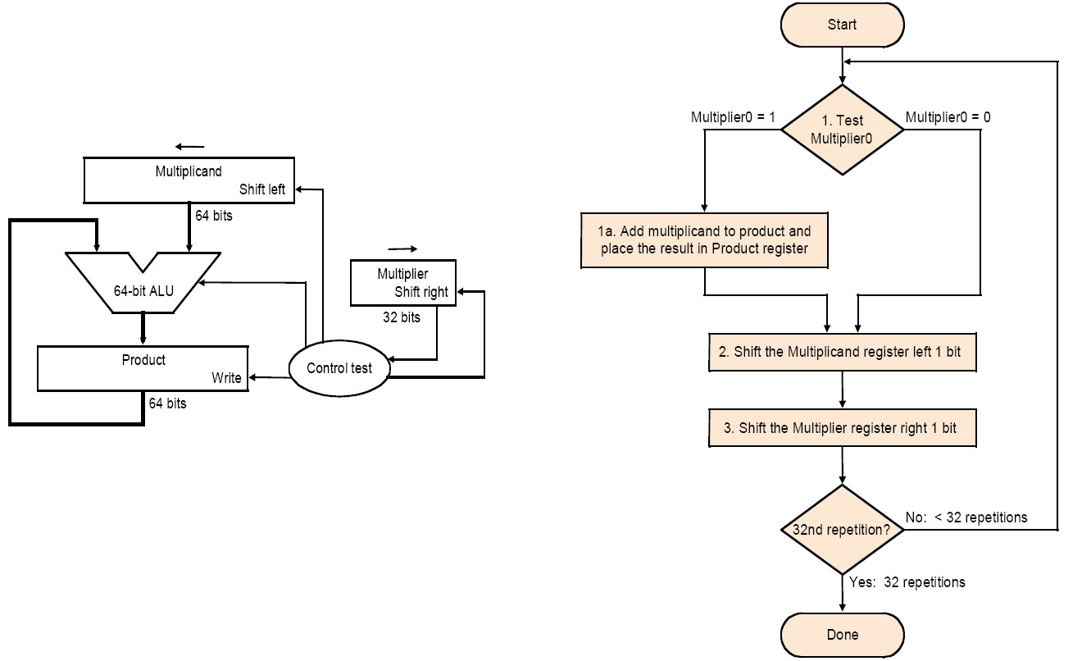
Implementation 1

Slide 11
Example for reference:
1010
0101
------
1010
0000
1010
0000
------------
0110010
Repeat n times:
Step 1: Test multiplier[0]
Step 2: if 1, add multiplicand to product
Step 3: shift multiplier right 1 bit
Step 4: shift multiplicand left 1 bit
Trace: in lecture

Slide 12
How can we improve Implementation 1?
Note:
  As we shift the multiplicand left, 0s are getting shifted into the right. Those 0s don’t affect any later additions.

Slide 13
1111
x 1111
--------
00000000
+ 00001111
--------------
00001111
+ 00011110
--------------
00101101
+ 00111100
-------------
01101001
+ 01111000
-------------
11100001
At each point, we are doing n-bit addition (with
possible carry out)
Cannot be affected by this addition
Cannot be affected by this addition
Cannot be affected by this addition
To check: 15 * 15 = 225 = 128 + 64 + 32 + 1

Slide 14
How can we Improve Implementation 1?
We don’t really need 64-bit addition!
We’ll use a 32-bit multiplicand and a 32-bit ALU
The addition step: add the multiplicand to the left half of the product and place the result in the left half of the product register
  [Warning: carries need to be retained. If there was a carry, shift a 1 rather than 0 into the product register]

Slide 15
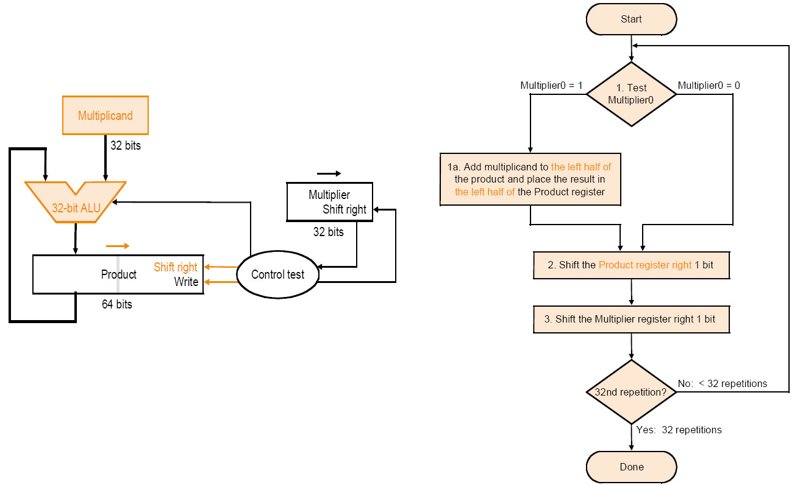
Implementation 2

Slide 16
Repeat n times:
Step 1: Test multiplier[0]
Step 2: if 1, add multiplicand to left half of product
and place the result in the left half of
the product register
Step 3: shift multiplier right 1 bit
Step 4: shift product register right 1 bit
1111
* 1111
-----------
00000000 1
+ 11110000
-------------
11110000
01111000 2
+ 11110000
-------------
1 01101000
10110100 3
+ 11110000
-------------
1 10100100
11010010 4
+ 11110000
-------------
1 11000010
11100001
Trace: in lecture
Check: 15 * 15 = 225 = 128 + 64 + 32 + 1

Slide 17
One more improvement
As the unused space in the product register becomes smaller, also the multiplier disappears!
We only need 2 registers, not 3

Slide 18
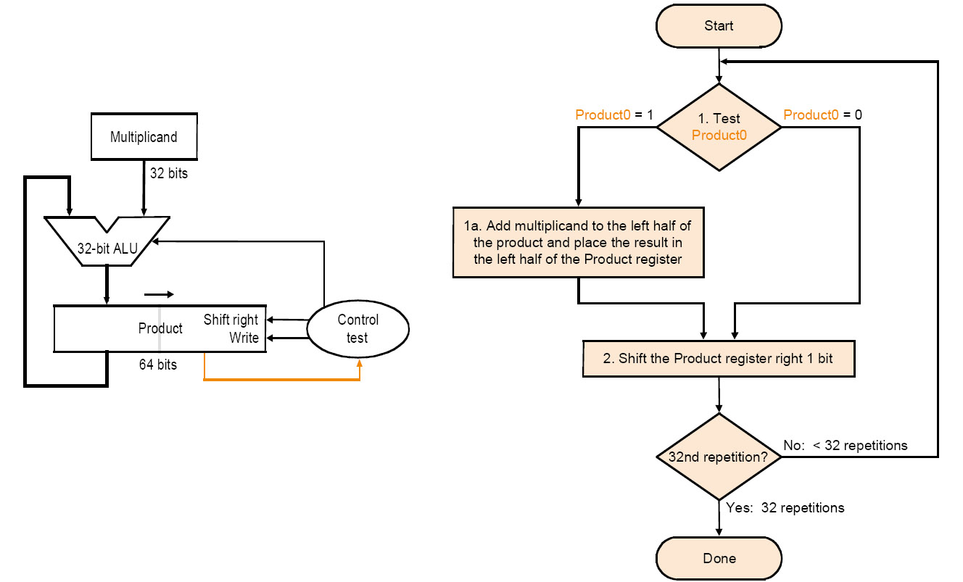
Implementation 3
Product initialized to {32{0},multiplier}

Slide 19
Initialize:
product = {n{0},n-bit multiplier}
multiplicand = multiplicand (n bits)
Repeat n times:
Step 1: Test product[0]
Step 2: if 1, add multiplicand to left half of product
and place the result in the left half of
the product register
Step 3: shift product register right 1 bit
1111
1111
-----------
00000000 1
00001111
-------------
00001111 2
+ 00011110
-------------
00101101 3
+ 00111100
-------------
01101001 4
+ 01111000
-------------
11100001
Trace: in lecture

Slide 20
Another Example
Let’s do 0010 x 0110 (2 x 6), unsigned
Iteration | Multiplicand | Implementation 3
 |  | Step | Product
0 | 0010 | initial values | 0000 0110
1 | 0010 | 1: 0 -> no op | 0000 0110
 |  | 2: shift right | 0000 0011
2 | 0010 | 1: 1 -> product = product + multiplicand | 0010 0011
 |  | 2: shift right | 0001 0001
3 | 0010 | 1: 1 -> product = product + multiplicand | 0011 0001
 |  | 2: shift right | 0001 1000
4 | 0010 | 1: 0 -> no op | 0001 1000
 |  | 2: shift right | 0000 1100

Slide 21
How about 2’s complement
These method are for unsigned numbers.
Why not for 2’s complement?
x_{two}*y_{two} = (2^{N}+x)*(2^{N}+y) = 2^{2N}+2^{N}*x+2^{N}*y+x*y
It should be 2^{2N}+x*y.
2’s complement must be transformed to unsigned forms before multiplication.

Slide 22
Booth’s Algorithm
Handles multiplication of 2’s complement numbers
Can reduce the number of addition operations that need to be performed
Same basic algorithm as implementation 3
But we sometimes add the multiplicand and sometimes subtract it (add its two’s complement)

Slide 23
Booth’s Algorithm
Basic idea
00011110 =
00100000 -
00000010

Slide 24
Booth’s Algorithm
Basic idea
x * 00011110 = x*(00100000 - 00000010)
00011110 =
00100000 -
00000010
subtract x from product

Slide 25
Booth’s Algorithm
Basic idea
x * 00011110 = x*(00100000 - 00000010)
00011110 =
00100000 -
00000010
no operation

Slide 26
Booth’s Algorithm
Basic idea
x * 00011110 = x*(00100000 - 00000010)
00011110 =
00100000 -
00000010
add x to product

Slide 27
Booth’s Algorithm
Basic idea
x * 00011110 = x*(00100000 - 00000010)
00011110 =
00100000 -
00000010
no operation

Slide 28
Example of Booth’s algorithm
Let’s do 0010 x 1101 (2 x -3)
Iteration | Multiplicand | Implementation 3
 |  | Step | Product
0 | 0010 | initial values | 0000 1101 0
1 | 0010 | 1: 10 -> product = Product - multiplicand | 1110 1101 0
 |  | 2: shift right | 1111 0110 1
2 | 0010 | 1: 01 -> product = product + multiplicand | 0001 0110 1
 |  | 2: shift right | 0000 1011 0
3 | 0010 | 1: 10 -> product = product - multiplicand | 1110 1011 0
 |  | 2: shift right | 1111 0101 1
4 | 0010 | 1:11 -> no op | 1111 0101 1
 |  | 2: shift right | 1111 1010 1

Slide 29
Booth’s Algorithm
It can handle 2’s complement.
Example
Consider x*(-1)
x_{two}*11111111 = 0_{two} - x_{two} = 2^{N} - x_{two}
Detail in theory: check the pdf document

Slide 30
Binary Division of Unsigned Integers
Dividend = Divider × Quotient + Remainder
Even more complicated
  Still, it can be implemented by way of shifts and addition/subtraction
  We will see a method based on the paper-and-pencil method

Slide 31
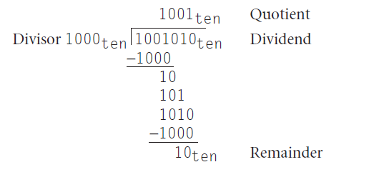
paper and pencil method

Slide 32
Is overflow possible?
Yes
Consider a very small divisor or zero divisor.

Slide 33
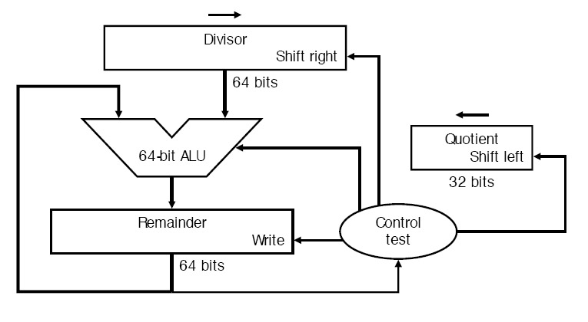
Implementation

Slide 34

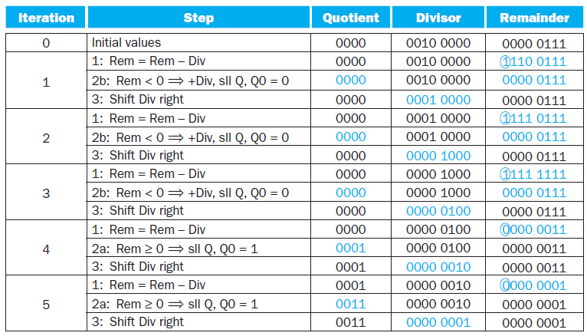
Example

Slide 35
Algorithm
Size of dividend is 2 * size of divisor
Initialization:
  quotient register = 0
  remainder register = dividend
  divisor register = divisor in left half

Slide 36
Algorithm continued
Repeat for 33 iterations (size divisor + 1):
  remainderReg = remainderReg–divisorReg
  If remainderReg >= 0:
    shift quotientReg left, placing 1 in bit 0
  Else:
    remainderReg = remainderReg + divisorReg
    Shift quotientReg left, placing 0 in bit 0
  Shift divisorReg right 1 bit
Example in lecture

Slide 37
Multiply in MIPS
li $t0,999999999
li $t1,999999999
mult $t0,$t1 #999999999 * 999999999
#Least significant word → register lo
#Most significant word → register hi
mflo $t3 # lo → $t3
mfhi $t4 # hi → $t4
We can see this in MIPS
There is also a multu instruction, which treats its operands as unsigned

Slide 38
Division in MIPS
Div, Divu
Remainder → Hi
Quotient → Lo

Slide 39
Circuits for Arithmetic: comments before moving to floating point
There are more efficient implementations of addition/subtraction, multiplication, and division, but they (conceptually) build from the ones you saw here
When we cover logic design, we’ll look at the internal workings of the ALU (but not multiplication or division circuits)

Slide 40
Floating-Point (FP) Numbers
Computers need to deal with real numbers
  Fraction (e.g., 3.1416)
  Very small number (e.g., 0.000001)
  Very large number (e.g., 2.7596×10¹¹)
Components: sign, exponent, mantissa
  (-1)^{sign}×mantissa×2^{exponent}
  More bits for mantissa gives more accuracy
  More bits for exponent gives wider range
A case for FP representation standard
  Portability issues
  Improved implementations
  ⇒ IEEE754 standard

Slide 41
Binary Fractions for Humans
Lecture: binary fractions and their decimal equivalents
Lecture: translating decimal fractions into binary
Lecture: idea of normalized representation
Then we’ll go on with IEEE standard floating point representation

Slide 42
IEEE 754
A standard for FP representation in computers
  Single precision (32 bits): 8-bit exponent, 23-bit mantissa
  Double precision (64 bits): 11-bit exponent, 52-bit mantissa
Leading “1” in mantissa is implicit (since the mantissa is normalized, the first digit is always a 1…why waste a bit storing it?)
Exponent is “biased” for easier sorting of FP numbers
N-1
N-2
M
M-1
0
sign
exponent
Fraction (or mantissa)

Slide 43
“Biased” Representation
We’ve looked at different binary number representations so far
  Sign-magnitude
  1’s complement
  2’s complement
Now one more representation: biased representation
  000…000 is the smallest number
  111…111 is the largest number
  To get the real value, subtract the “bias” from the bit pattern, interpreting bit pattern as an unsigned number
  Representation = Value + Bias
Bias for “exponent” field in IEEE 754
  127 (single precision)
  1023 (double precision)

Slide 44
IEEE 754
A standard for FP representation in computers
  Single precision (32 bits): 8-bit exponent, 23-bit mantissa
  Double precision (64 bits): 11-bit exponent, 52-bit mantissa
Leading “1” in mantissa is implicit
Exponent is “biased” for easier sorting of FP numbers
  All 0s is the smallest, all 1s is the largest
  Bias of 127 for single precision and 1023 for double precision
Getting the actual value: (-1)^{sign}×(1+significand)×2^{(exponent-bias)}
N-1
N-2
M
M-1
0
sign
exponent
significand (or mantissa)

Slide 45
IEEE 754 Example
-0.75_{ten}
  Same as -3/4
  In binary -11/100 = -0.11
  In normalized binary -1.1_{two}x2⁻¹
  In IEEE 754 format
    sign bit is 1 (number is negative!)
    mantissa is 0.1 (1 is implicit!)
    exponent is -1 (or 126 in biased representation)
31
30
23
22
0
1
0 1 1 1 1 1 1 0
1 0 0 0 … 0 0 0
sign
8-bit exponent
23-bit significand (or mantissa)

Slide 46
IEEE 754 Encoding Revisited
Single Precision |  | Double Precision |  | Represented Object
Exponent | Fraction | Exponent | Fraction
0 | 0 | 0 | 0 | 0
0 | non-zero | 0 | non-zero | +/- denormalized number
1~254 | anything | 1~2046 | anything | +/- floating-point numbers
255 | 0 | 2047 | 0 | +/- infinity
255 | non-zero | 2047 | non-zero | NaN (Not a Number)

Slide 47
FP Operations Notes
Operations are more complex
  We should correctly handle sign, exponent, significand
We have “underflow”
Accuracy can be a big problem
  IEEE 754 defines two extra bits to keep temporary results accurately: guard bit and round bit
  Four rounding modes
  Positive divided by zero yields “infinity”
  Zero divided by zero yields “Not a Number” (NaN)
Implementing the standard can be tricky
Not using the standard can become even worse
  See text for 80x86 and Pentium bug!

Slide 48
underflow
Example
Consider tow code with exponent 1, which is actually 1-127 = -126.
If the computing mantissa is less 1, then underflow happens.

Slide 49
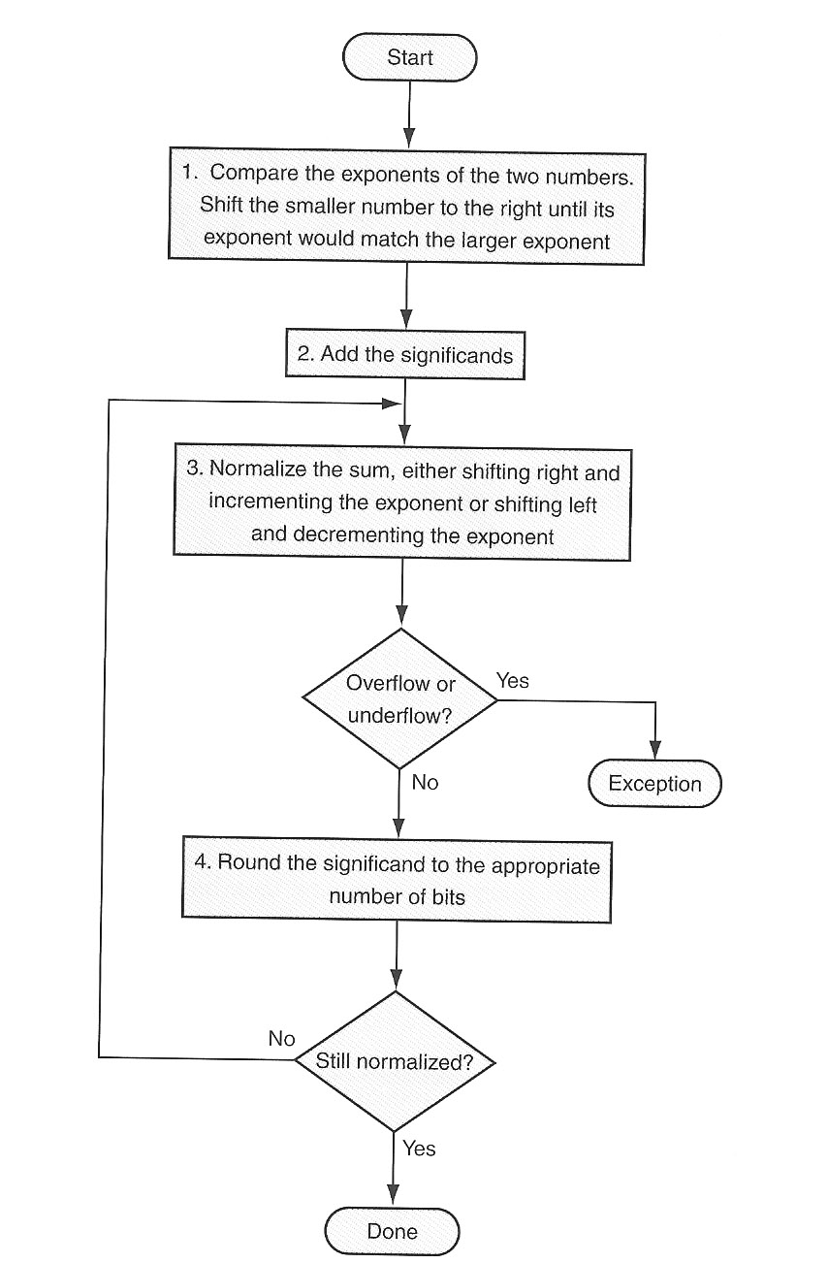
Floating-Point Addition
1. Shift smaller
number to make
exponents match
2. Add the significands
3. Normalize sum
Overflow or underflow? Yes: exception
no:
Round the significand
If not still normalized,
Go back to step 3
0.5_{ten} – 0.4375_{ten}
=1.000_{two}×2⁻¹ – 1.110_{two}×2⁻²

Slide 50
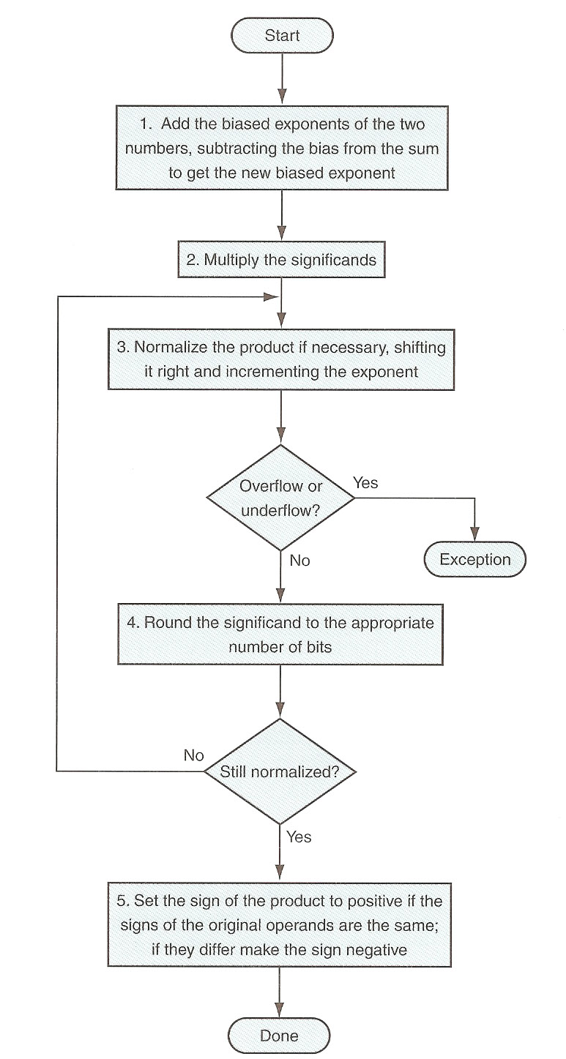
Floating-Point Multiplication
(1.000_{two}×2⁻¹)×(-1.110_{two}×2⁻²)
1. Add exponents and
subtract bias
2. Multiply the significands
3. Normalize the product
4: overflow? If yes,
raise exception
5. Round the significant to
appropriate # of bits
6. If not still normalized, go
back to step 3
7. Set the sign of the result

Slide 51
Floating Point Instructions in MIPS
.data
nums: .float 0.75,15.25,7.625
.text
la $t0,nums
lwc1 $f0,0($t0)
lwc1 $f1,4($t0)
add.s $f2,$f0,$f1
#0.75 + 15.25 = 16.0 = 10000 binary = 1.0 * 2^4
#f2: 0 10000011 000000... = 0x41800000
swc1 $f2,12($t0)
#1001000c now contains that number
# Click on coproc1 in Mars to see the $f registers
code: fp.asm

Slide 52
Another Example
.data
nums: .float 0.75,15.25,7.625
.text
loop: la $t0,nums
lwc1 $f0,0($t0)
lwc1 $f1,4($t0)
c.eq.s $f0,$f1 # cond = 0
bc1t label # no branch
c.lt.s $f0,$f1 # cond = 1
bc1t label # does branch
add.s $f3,$f0,$f1
label: add.s $f2,$f0,$f1
c.eq.s $f2,$f0
bc1f loop # branch (infinite loop)
#bottom of the coproc1 display shows condition bits
code: fp1.asm

Slide 53
nums: .double 0.75,15.25,7.625,0.75
#0.75 = .11-bin. exponent is -1 (1022 biased). significand is 1000...
#0 01111111110 1000... = 0x3fe8000000000000
la $t0,nums
lwc1 $f0,0($t0)
lwc1 $f1,4($t0)
lwc1 $f2,8($t0)
lwc1 $f3,12($t0)
add.d $f4,$f0,$f2
#{$f5,$f4} = {$f1,$f0} + {$f3,$f2}; 0.75 + 15.25 = 16 = 1.0-bin * 2^4
#0 10000000011 0000... = 0x4030000000000000
# value+0 value+4 value+8 value+c
# 0x00000000 0x3fe80000 0x00000000 0x402e8000
# float double
# $f0 0x00000000 0x3fe8000000000000
# $f1 0x3fe80000
# $f2 0x00000000 0x402e800000000000
# $f3 0x402e8000
# $f4 0x00000000 0x4030000000000000
# $f5 0x40300000
Code: fp2.asm; see also fp3.asm

Slide 54
Guard, Round, and Sticky bits
To round accurately, hardware needs extra bits
IEEE 274 keeps extra bits on the right during intermediate additions
  guard and round bits; plus, a sticky bit
Note: there are 4 types of rounding in the IEEE standard. We won’t cover the details.

Slide 55
Example (in decimal)
With Guard and Round bits
2.56 * 10^0 + 2.34 * 10^2
Assume 3 significant digits
0.0256 * 10^2 + 2.34 * 10^2
2.3656 [guard=5; round=6]
Round step 1: 2.366
Round step 2: 2.37

Slide 56
Example (in decimal)
Without Guard and Round bits
2.56 * 10^0 + 2.34 * 10^2
0.0256 * 10^2 + 2.34 * 10^2
But with 3 sig digits and no extra bits:
  0.02 + 2.34 = 2.36
So, we are off by 1 in the last digit

Slide 57
Sticky Bit
Suppose that more than 2 bits are affected by denormalization/alignment during addition. Suppose n bits are.
The “sticky bit” is the OR of the n-2 bits after the guard and round bits
E.g., in 8 bits: suppose the mantissa is 10101110, and we need to shift it right 5 positions before adding (say the exponents are 0 and 5).
00000101|01110
00000101|011
Guard bit; round bit; sticky bit

