Slide 1
CS/COE0447
Computer Organization & Assembly Language
Chapter 4
Part 1

Slide 2
We will study the datapath and control using only these instructions
[similar ideas apply to others]
Memory reference instructions
  lw (load word) and sw (store word)
Arithmetic-logical instructions
  add, sub, and, or, and slt
Control-transfer instructions
  beq (branch if equal)
  j (unconditional jump)

Slide 3
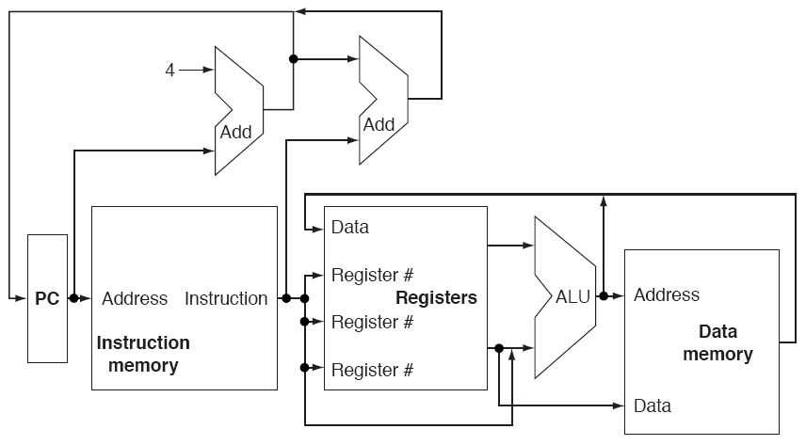
An Abstract Implementation
Combinational logic
  ALU, adder
Sequential logic
  Register file, instruction memory, data memory

Slide 4
An Abstract Implementation
“Start” of cycle: read the IM to fetch an instr; read the register file (the operands)

Slide 5
An Abstract Implementation
“Middle” of cycle: Execute – ALU; lw to read memory

Slide 6
An Abstract Implementation
“End” of cycle: Write to register file (arithmetic ops and lw); Write to memory (sw)

Slide 7
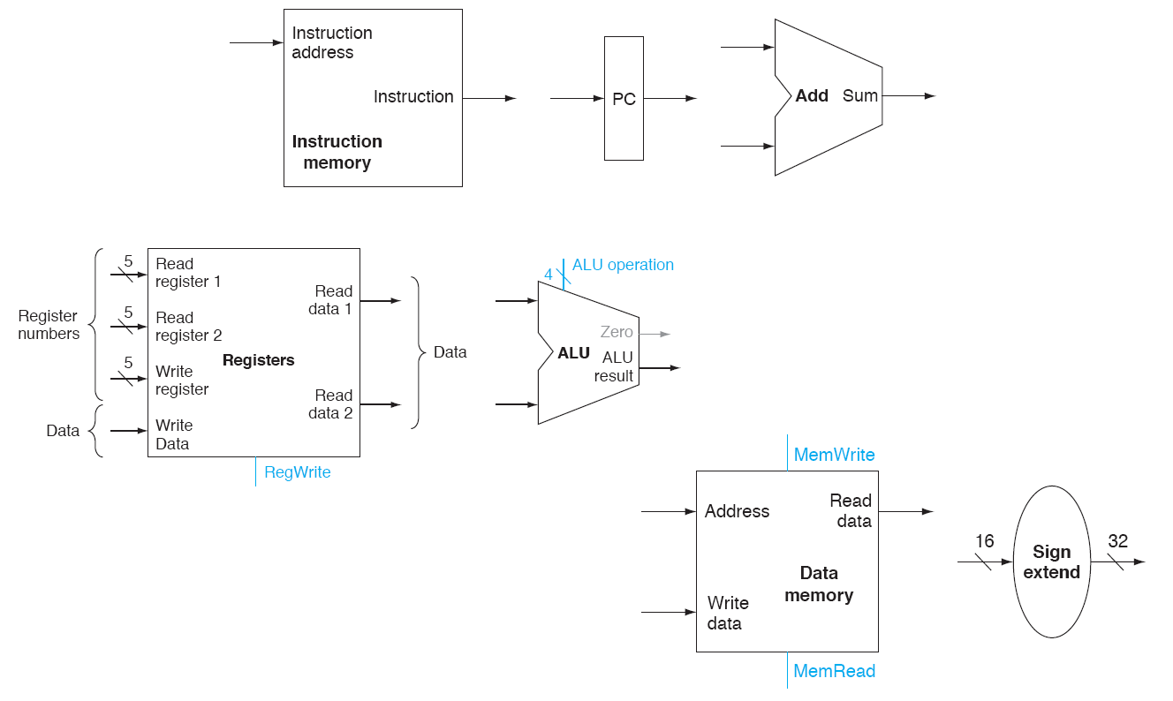
Building Blocks

Slide 8
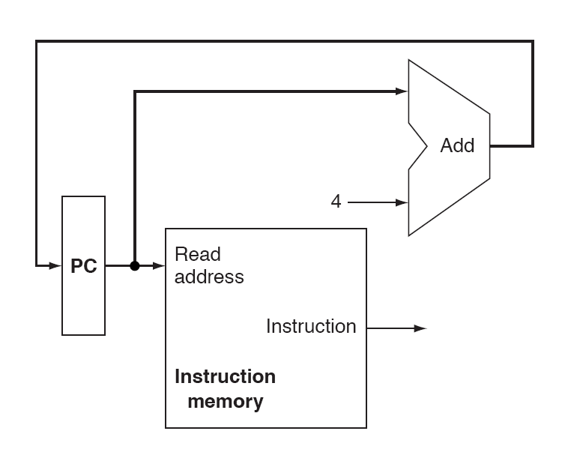
Instruction Fetch
Instruction width
is 4 bytes!
PC keeps the current
memory address
from which instruction
is fetched
Instruction read from
Memory – send to rest
Of data path

Slide 9
Instruction Execution
lw (load word)
  Fetch instruction and add 4 to PC lw $t0,-12($t1)
  Read the base register $t1
  Sign-extend the immediate offset fff4 → fffffff4
  Add two values to get address X = fffffff4 + $t1
  Access data memory with the computed address M[X]
  Store the memory data to the destination register $t0

Slide 10
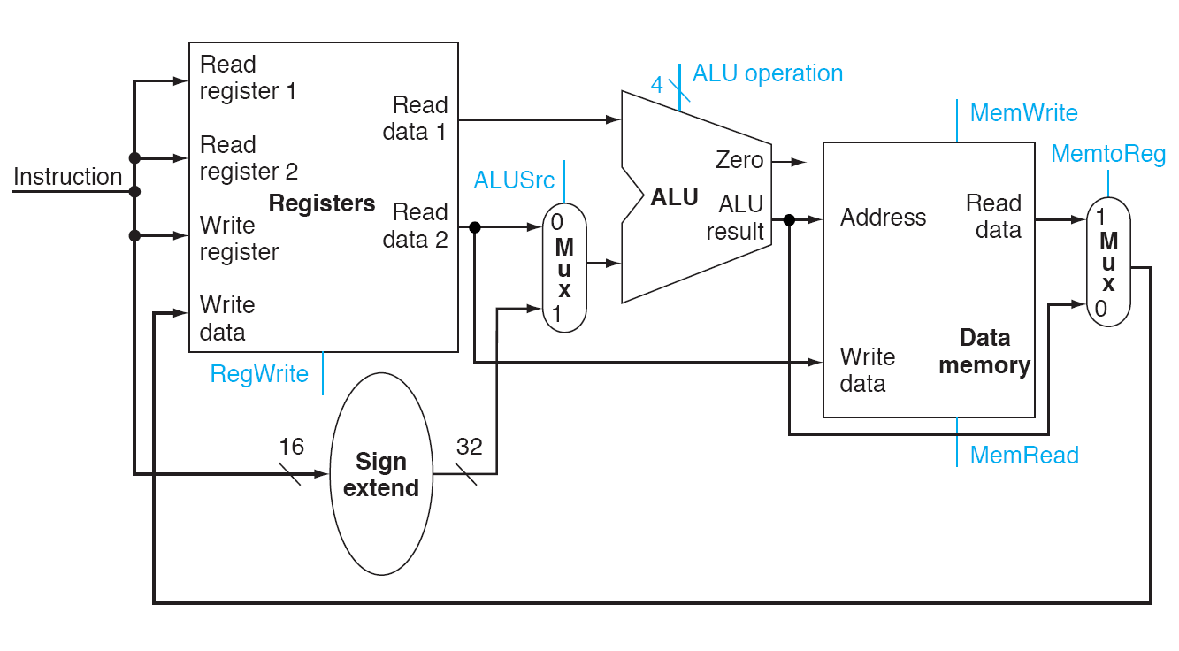
Memory + R-Instructions
E.G: lw $t0,8($t1)
Imm. offset
for address
To be in
a register!
Load data
from memory

Slide 11
Instruction Execution
sw (store word)
  Fetch instruction and add 4 to PC sw $t0,-4($t1)
  Read the base register $t1
  Read the source register $t0
  Sign-extend the immediate offset fffc → fffffffc
  Add two values to get address X = fffffffc + $t1
  Store the contents of the source register to the computed address $t0 → Memory[X]

Slide 12
Memory + R-Instructions
E.G: sw $t0,-4($t1) Suppose: $t0 = 0x5 $t1 = 0x10010010
$t1
Add
10010010
1
?
$t0
?
NA
1
1001000c
5
5 → 1001000c
5
0
fffffffc
fffc
0

Slide 13
Instruction Execution
add
  Fetch instruction and add 4 to PC add $t2,$t1,$t0
  Read two source registers $t1 and $t0
  Add two values $t1 + $t0
  Store result to the destination register $t1 + $t0 → $t2

Slide 14
Memory + R-Instructions
E.G: add $t2,$t1,$t0 Suppose: $t0 = 0x5 $t1 = 0x10
$t1
Add
10
0
?
$t0
?
0
0
15
5
$t2
15 → $t2
15
1
15
0

Slide 15
Instruction Execution
beq
  Fetch instruction and add 4 to PC beq $t0,$t1,L
    Assume that L is +4 instructions away
  Read two source registers $t0,$t1
  Sign Extend the immediate, and shift it left by 2
    0x0003 → 0x0000000c
  Perform the test, and update the PC if it is true
    If $t0 == $t1, the PC = PC + 0x0000000c

Slide 16
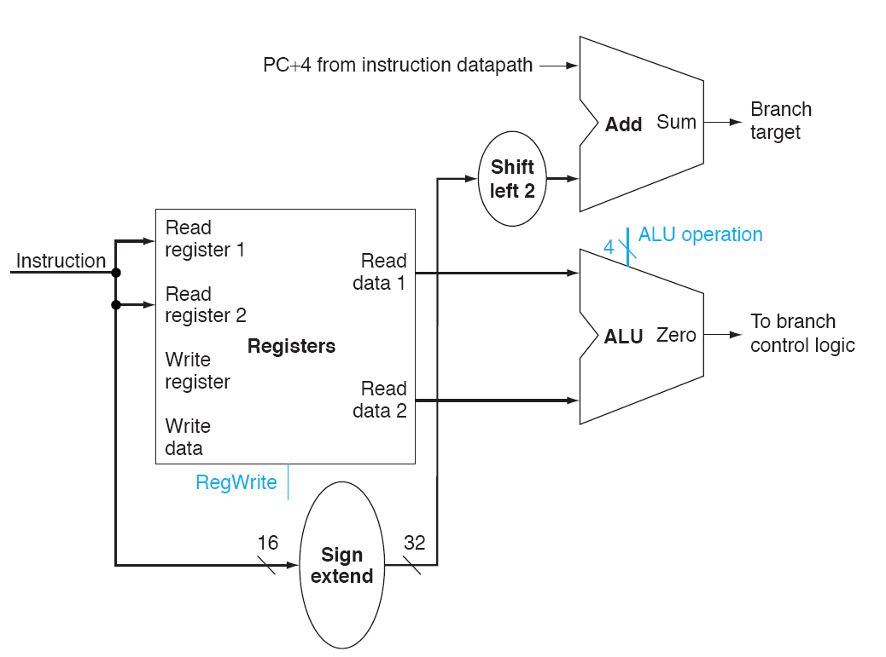
Branch Datapath
Beq $t0,$t1,L stored in 0x10010004,
where L is +4 away
0x10010008
0x10010014
0x0000000c
8
Contents of $t0
?
Sub
9
Contents of $t1
If Zero == 1, then
PC = 0x10010014
0
0x0003
0x00000003

Slide 17
Instruction Execution, cont’d
j
  Fetch instruction and add 4 to PC
  Take the 26-bit immediate field
  Shift left by 2 (to make 28-bit immediate)
  Get 4 bits from the current PC and attach to the left of the immediate
  Assign the value to PC

Slide 18
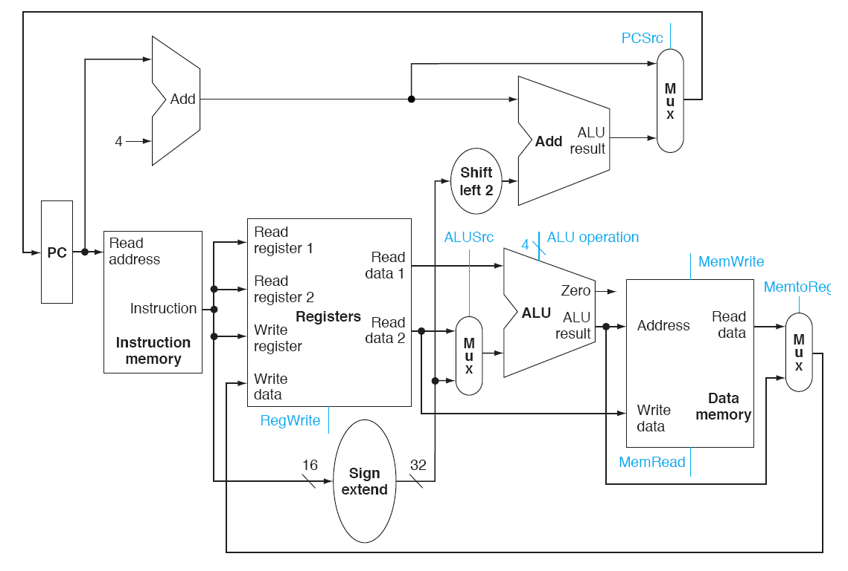
Datapath so far
j not considered
so far!

Slide 19
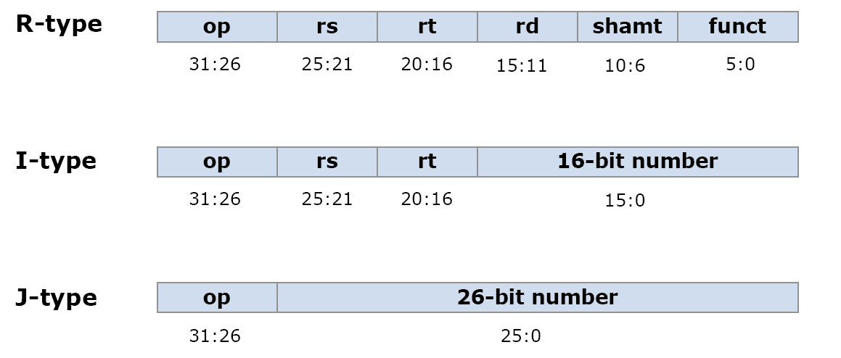
Instruction Format

Slide 20
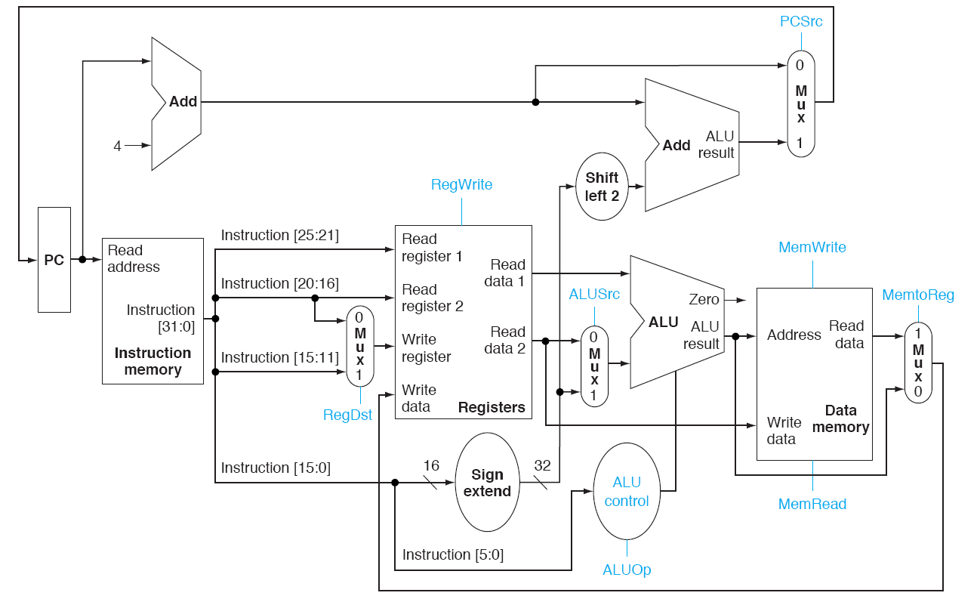
More Elaborated Design
rs
rt
rd
Write register #
selection
imm
Compare:
add $t0,$t1,$t2
lw $t0,4($t1)
ALU control bits
from I[5:0]
Funct!

Slide 21
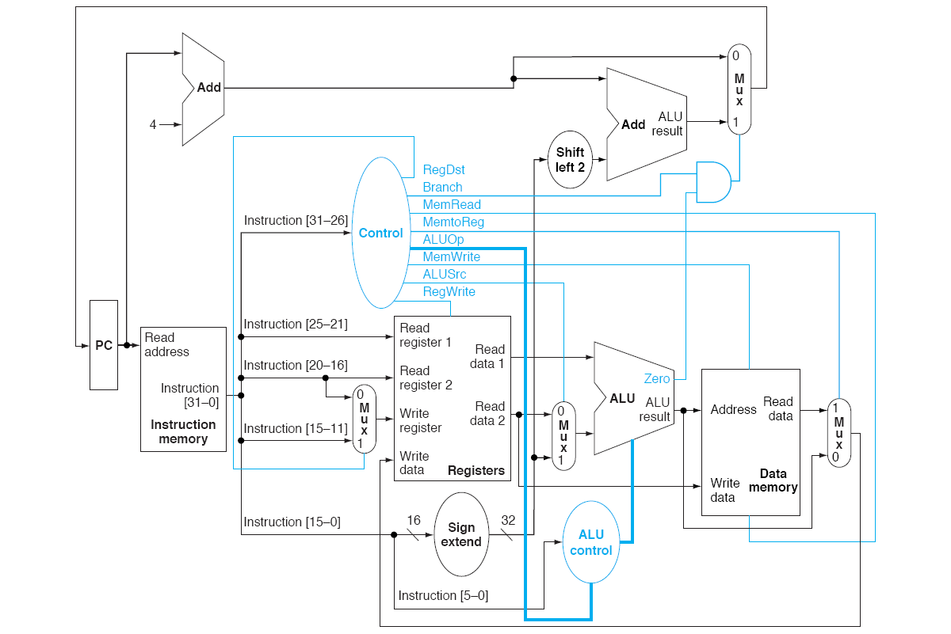
Adding in more control signals
If a branch instruction
and Zero == 1
[beq is the only branch
in these diagrams]
opcode

Slide 22
Control Signals Overview
RegDst: which instr. field to use for dst. register specifier?
  instruction[20:16] vs. instruction[15:11]
ALUSrc: which one to use for ALU src 2?
  immediate vs. register read port 2
MemtoReg: is it memory load?
RegWrite: update register?
MemRead: read memory?
MemWrite: write to memory?
Branch: is it a branch?
ALUop: what type of ALU operation?

