Slide 1
CS/COE0447
Computer Organization & Assembly Language
Chapter 4 Part 2

Slide 2
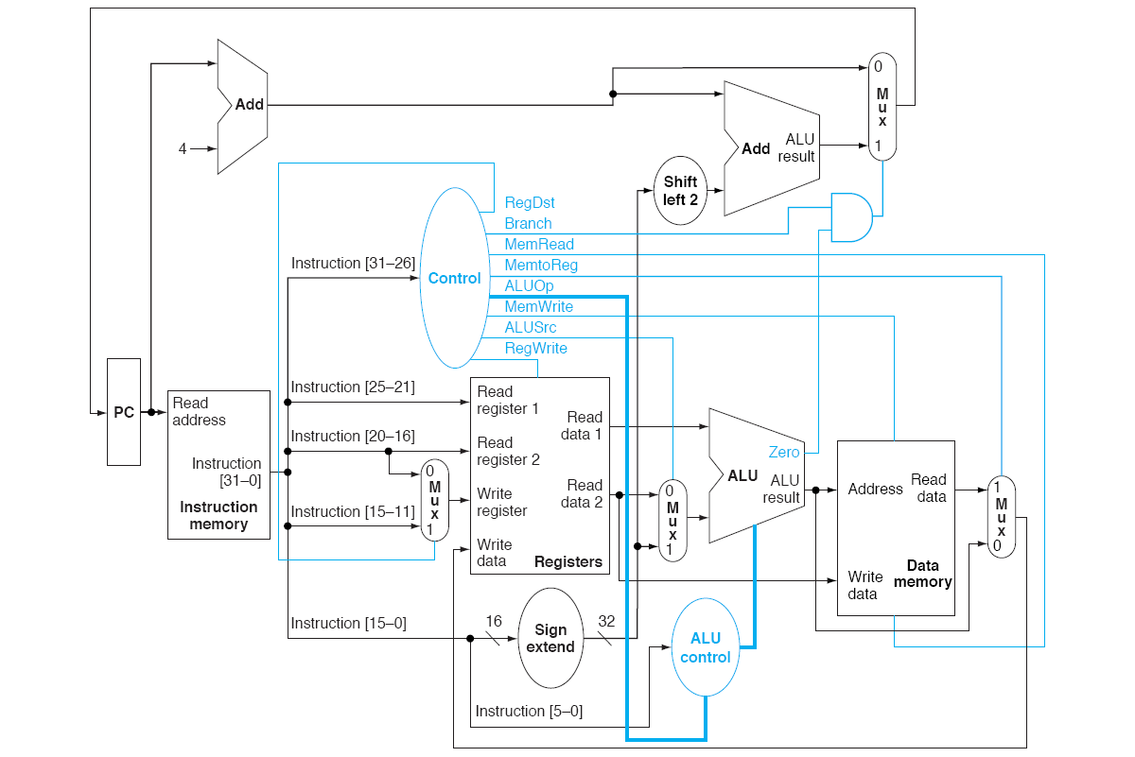

Slide 3
Control Unit
Implements (in hardware) an if statement:
  If opcode == 000000 # r-type instruction
    MemWrite = 0
    MemRead = 0
    MemToReg = 0
    … # values assigned for all the control unit’s output signals
  Elif opcode == 0x23 # lw
    MemWrite = 0
    MemRead = 1
    MemToReg = 1
    …
  Elif opcode == 0x4 # beq
    MemWrite = 0
    MemRead = 0
    MemToReg = X # don’t care
    …
  … # an Elif test for each opcode

Slide 4
Examples
In Lab, you did examples for an R-type instruction and for sw
Now, let’s look at examples for beq and lw

Slide 5
Instruction Execution (reminder)
beq
  Fetch instruction and add 4 to PC beq $t0,$t1,L
    Assume that L is +4 instructions away
  Read two source registers $t0,$t1
  Sign Extend the immediate, and shift it left by 2
    0x0003 → 0x0000000c
  Perform the test, and update the PC if it is true
    If $t0 == $t1, the PC = PC + 4 + 0x0000000c

Slide 6
0x10010000: beq $t0,$t1,L
L == 10010010; $t0 = 4; $t1 = 4
0x10010010
0x10010004
0x10010004
0x10010010
X
0x0000000c
1
000100
1
later
01000
0
0
0
4
1
X
01001
4
0
00000
4
Sub
0x0003
0x00000003
0
000011

Slide 7
lw r8,32(r18)
r18 = 1000; M[1032] = 0x11223344
(PC+4)
(PC+4)
Branch=0
35
RegWrite
(PC+4)
18
1000
8
0x11223344
RegDest=0
ALUSrc=1
8
1032
0
32
MemtoReg=1
0x11223344
32
32
MemRead
0x11223344

Slide 8
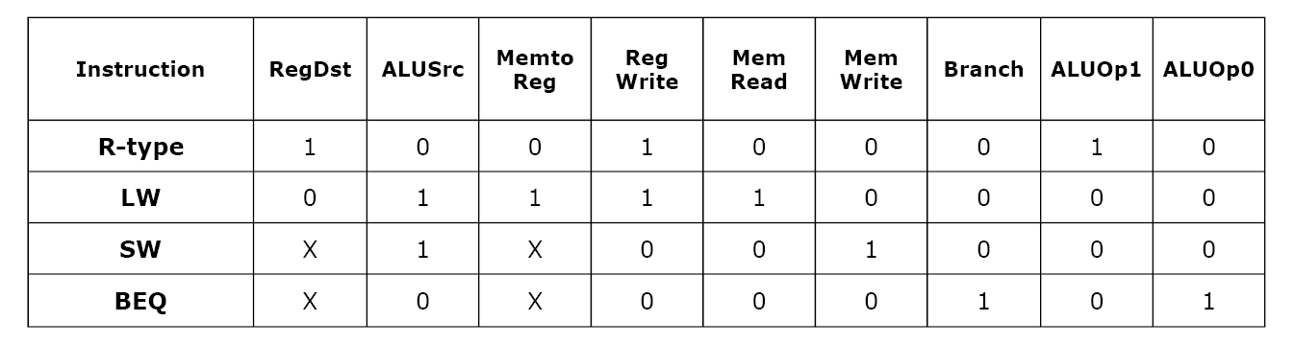
Control Signal Table
Now let’s understand these,
and the other ALU signals
The setting of the control lines is completely determined by the opcode field

Slide 9
Actual operation of ALU
Input based on opcode
Input from funct field of instruction

Slide 10
lw,sw: add; beq: sub;
R-inst: depends on funct
ALUOp1 ALUOp0
Funct = 0x20 for add; 0x22 for sub;
0x24 for and; etc.

Slide 11
ALU Control
ALU control input
  000: AND
  001: OR
  010: ADD
  110: SUB
  111: SET-IF-LESS-THAN
On the diagram (next slide)

Slide 12
000:and
001:or
010:add
110:sub
111:slt
Actual operation of ALU

Slide 13
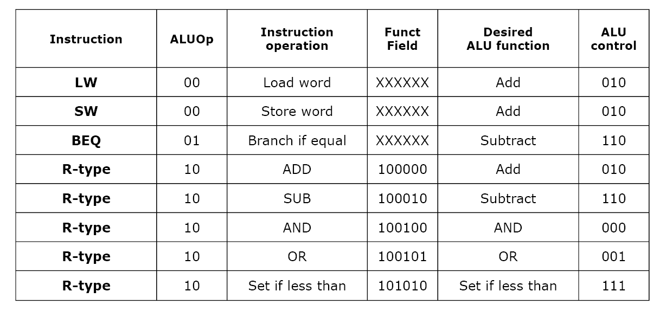
ALU Control
Next slide: just the truth table values

Slide 14
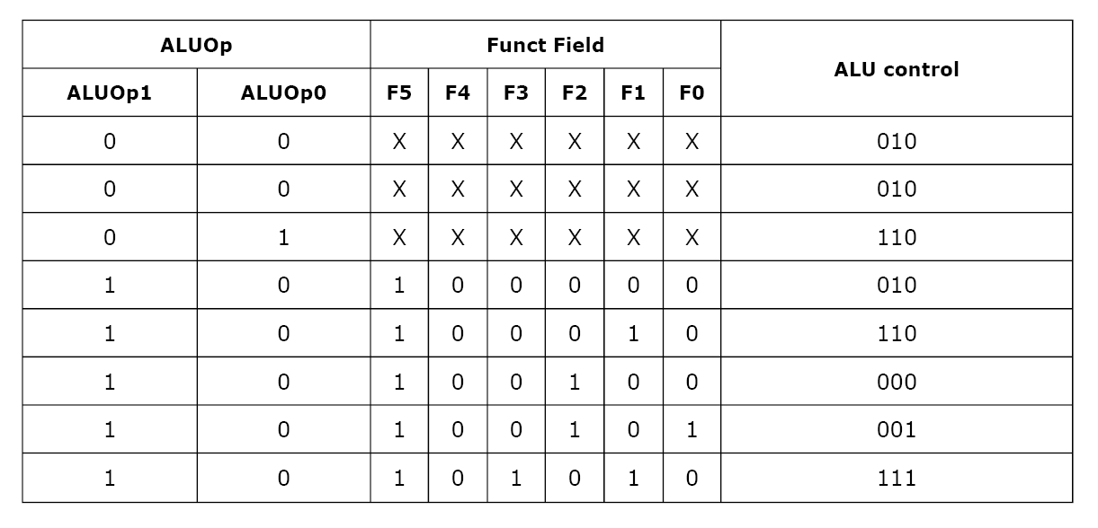
ALU Control Unit Truth Table
Output from ALU control unit
[input to ALU itself]
Input to ALU control unit

Slide 15
000:and
001:or
010:add
110:sub
111:slt
Output
Inputs

Slide 16
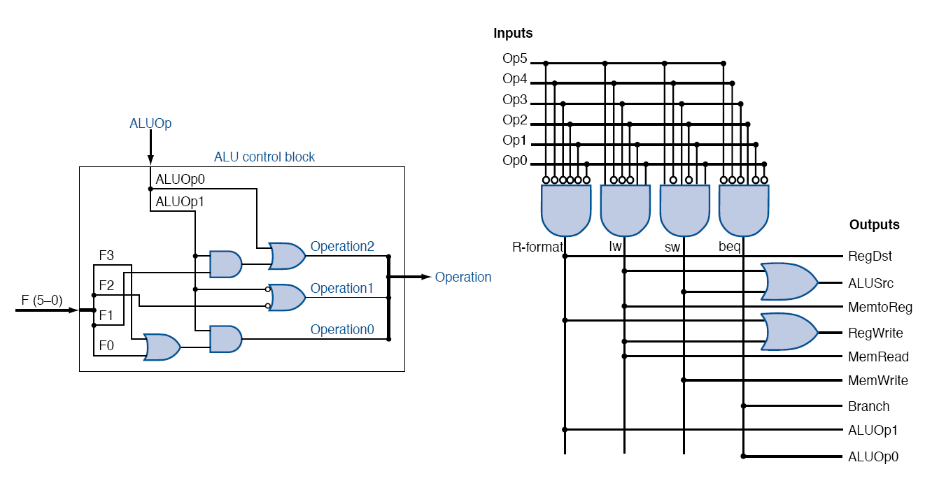
Control Unit Design
Control Unit
ALU Control Unit
Trace through pieces of this logic: in lecture

Slide 17
RegDst = 1 if opcode is
000000.

Slide 18
ALU Control

Slide 19
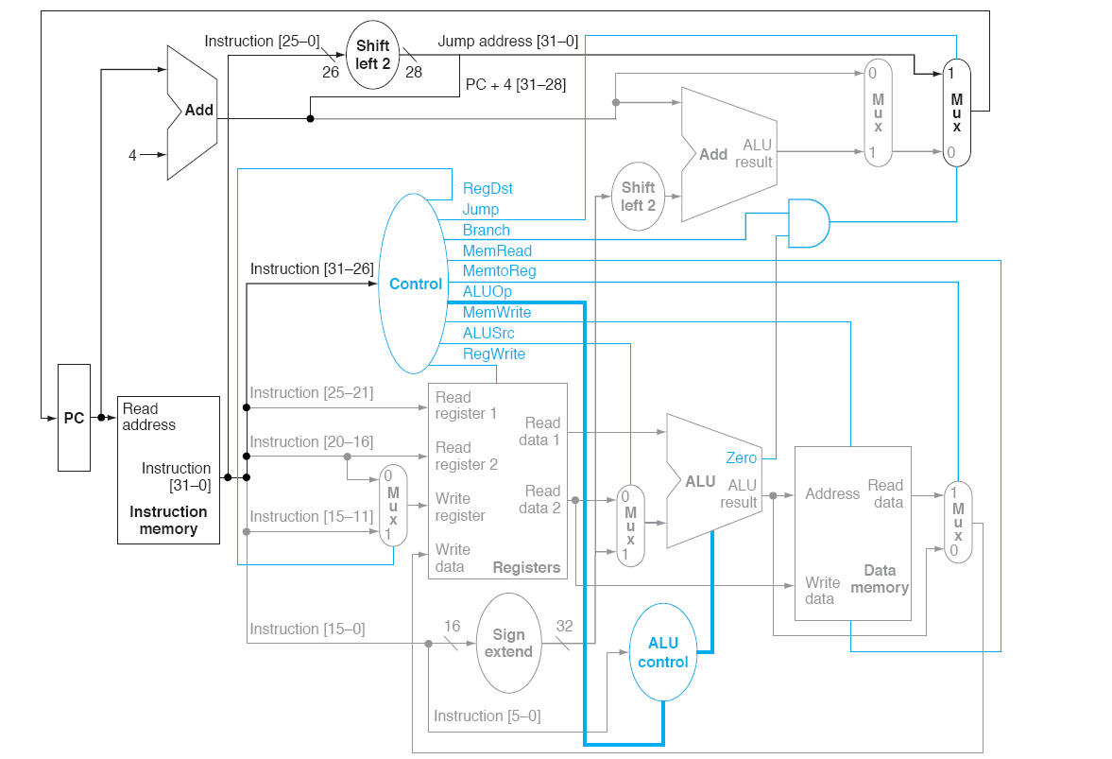
Datapath w/ Jump

Slide 20
Transition to Multi-Cycle Control
So far: ideas of functional units, datapath, control. We’ll continue to use these ideas…
But so far, all instructions take a single cycle
It turns out that this is too inefficient

Slide 21
What We Have Now

Slide 22
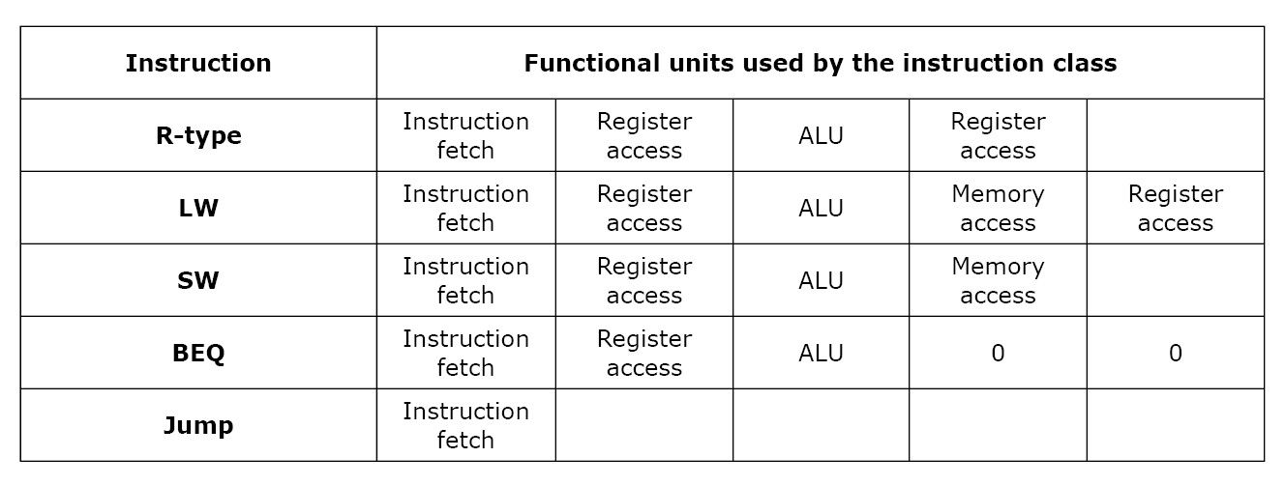
Functional Units Used

Slide 23
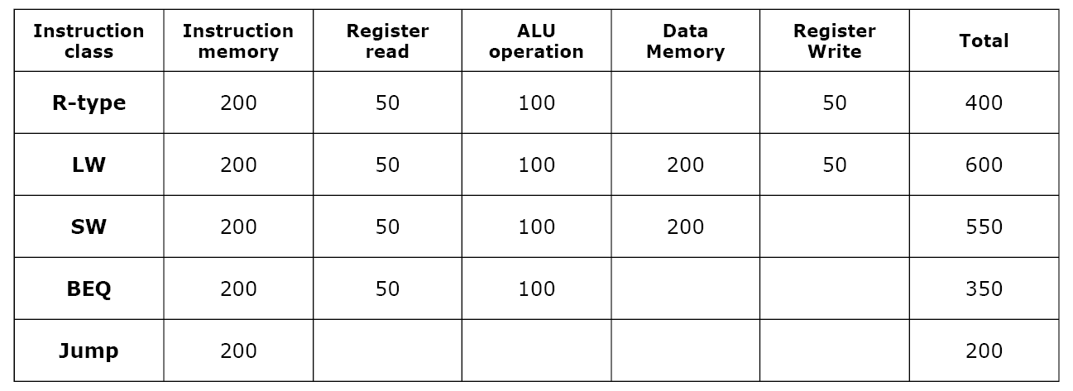
Single-Cycle Execution Timing
(in pico-seconds)

Slide 24
Single-Cycle Exe. Problem
The cycle time depends on the most time-consuming instruction
  What happens if we implement a more complex instruction, e.g., a floating-point mult.
  All resources are simultaneously active – there is no sharing of resources
Multi-cycle solution
  Use a faster clock
  Allow a different number of clock cycles per instruction

Slide 25
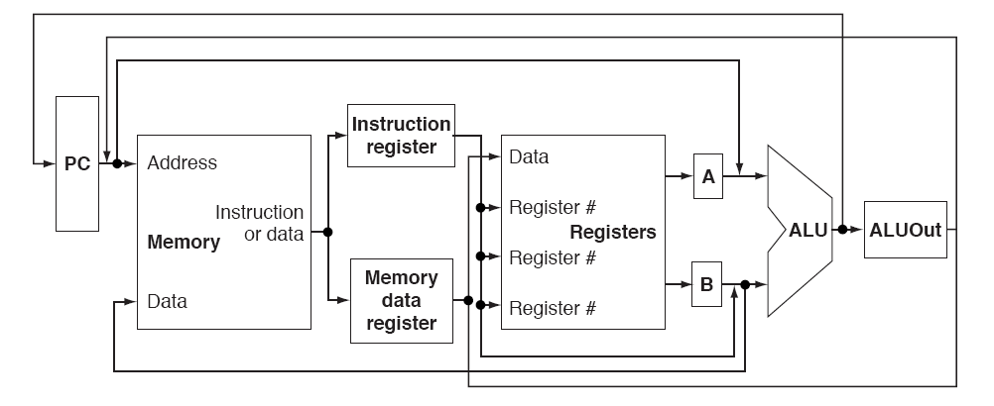
A Multi-cycle Datapath
A single memory unit for both instructions and data
Single ALU rather than ALU & two adders
Registers added after every major functional unit to hold the output until it is used in a subsequent clock cycle

Slide 26
Multi-cycle Approach
Reusing functional units
  Break up instruction execution into smaller steps
  We’ll need more and expanded MUX’s
At the end of a cycle, keep results in registers
  So, registers are added to the datapath
Now, control signals are NOT solely determined by the instruction bits, but they also depend on which cycle it is
Controls will be generated by a finite state machine

