Slide 1
8088 CPU External Pins, Timing, and
IBM PC BUS
四川大学计算机学院
李征
Tel: 13882153765
Oicq:1340915
Email: lizheng@cs.scu.edu.cn

Slide 2
8088 CPU External Pins, Timing, and
IBM PC BUS
Crucial Content
Pin functions of 8088 Minimum Mode
Bus generating of 8088 Minimum Mode
Timing of 8088 Minimum Mode
IBM PC Bus

Slide 3
（1）Pins of 8086
GND
AD₁₄
AD₁₃
AD₁₂
AD₁₁
AD₁₀
AD₉
AD₈
AD₇
AD₆
AD₅
AD₄
AD₃
AD₂
AD₁
AD₀
NMI
INTR
CLK
GND
1
2
3
4
5
6
7
8
9
10
11
12
13
14
15
16
17
18
19
20
40
39
38
37
36
35
34
33
32
31
30
29
28
27
26
25
24
23
22
21
VCC
AD₁₅
A₁₆/ S₃
A₁₇ / S₄
A₁₈ / S₅
A₁₉ / S₆
BHE*/S₇
MN / MX*
RD*
HOLD (RQ0*/ GT0*)
HLDA (RQ1* /GT1*)
WR* (LOCK*)
M / IO* ( S2* )
DT / R* ( S1* )
DEN ( S0 )
ALE (QS0)
INTA (QS1)
TEST*
READY
RESET
8086

Slide 4
（2）Pins of 8088
GND
A₁₄
A₁₃
A₁₂
A₁₁
A₁₀
A₉
A₈
AD₇
AD₆
AD₅
AD₄
AD₃
AD₂
AD₁
AD₀
NMI
INTR
CLK
GND
1
2
3
4
5
6
7
8
9
10
11
12
13
14
15
16
17
18
19
20
40
39
38
37
36
35
34
33
32
31
30
29
28
27
26
25
24
23
22
21
VCC
A₁₅
A₁₆ / S₃
A₁₇ / S₄
A₁₈ / S₅
A₁₉ / S₆
SS0* (HIGH)
MN / MX*
RD*
HOLD (RQ0*/ GT0*)
HLDA (RQ1* /GT1*)
WR* (LOCK*)
M */ IO ( S2* )
DT / R* ( S1* )
DEN ( S0 )
ALE (QS0)
INTA (QS1)
TEST*
READY
RESET
8088

Slide 5
（2）8088的引脚图
Naming Tradition of Signal：
MX or MX* represents that this signal is valid as 0.

Slide 6
（3） 8088的两种组态模式
There are two operation modes in 8086/8088.
Minimum Mode
  Used for small system
  8088 generate system bus with pins directly
Maximum Mode
  Used for large system, and 8087 can be included
  System bus is generated by 8088 and System Bus Controller 8288

Slide 7
（3） How to decide operation mode of 8088
Input signal from MN/MX* pin decide the CPU operation mode
  Inputting 1 to MN/MX* for Minimum Mode
  Inputting 0 to MN/MX* for Maximum Mode

Slide 8
（4）8088 Pins in Minimum Mode
Data and Address Pins
Reading and Writing Pins
Interrupt Requesting and Accepting Pins
DMA Requesting and Accepting Pins
Other Pins

Slide 9
1. Data and Address Pins
AD₇～AD₀（Address/Data）(8088)
Multiplexed (分时复用) pins, Bidirectional, Three-State
Multiplexed pin has different meanings at different clock cycles.
The purpose of multiplexed pin is to decrease pin numbers.

Slide 10
1. Data and Address Pins
Bidirectional Pin: There are two possible signal directions on bidirectional pin.
Three-State Pin: There are three possible states on Three-State Pin, which are 0, 1, and blocking state.

Slide 11
1. Data and Address Pins—Three-State
Three-State of pins is realized by three-state output gate.
Functions of Three-State Output Gate：power amplification, breakable connection
Chip pin is connected with system bus through three-state output gate.

Slide 12
1. Data and Address Pins—Three-State
Three-State output gate
Three State, One Direction
if T=0：
Blocking State
if T=1：
F = A
Inside
Outside
A
F
T
A
F
A
F
A
F
T
T
T
Represent ‘Not’

Slide 13
1. Data and Address Pins—Three-State
Bidirectional
Three-State Gate
Three State, Two Direction
Inside
Outside
A
B
T
OE*＝0，connected
T＝1 A→B
T＝0 A←B
OE*＝1，blocked
OE*

Slide 14
1. Data and Address Pins
Thinking：
1）Whether data or address signal is bidirectional?
2）Why is there three states at chip pin?

Slide 15
1. Data and Address Pins
AD₇～AD₀（Address/Data） (8088)
Timing:
In bus operation, for memory or interface, these pins output lowest 8-bit address signal (A₇～A₀) at 1st CLK cycle.
These pins transfer 8-bit data signal at other CLK cycles in bus operation.

Slide 16
1. Data and Address Pins
A₁₅～A₈（Address）
Address Pins, Output, Three-State

Slide 17
1. Data and Address Pins
A₁₉/S₆～A₁₆/S₃（Address/Status）
Multiplexed Pins, Output, Three-State
In memory operation, these pins output highest 4-bit address (A₁₉～A₁₆) at 1st CLK cycle.
In port operation, these pins output 0 (invalid) at 1st CLK cycle. (Why? 16-bit address for I/O ports)
At other CLK cycles of bus operation, they output status signal (S₆～S₃ ).

Slide 18
1. Data and Address Pins
S₆ is always 0；
S₅ is the ‘IF’ flag state；
S₄ and S₃ represent which segment register is used in current bus operation，00 for ES，01 for SS，10 for CS，11 for DS.
These four pins are blocked in DMA cycles.

Slide 19
2. Reading or Writing Control Pins
ALE（Address Latch Enable）
Output, Three-State, 1 is valid
If ALE=1，AD₇～AD₀ and A₁₉/S₆～A₁₆/S₃ are transfer address signal.
Because address only appear on these pins temporarily, system bus can latch them in register by ALE signal.

Slide 20
2. Reading or Writing Control Pins
Address Latching
20个触发器构成的1个存储单元可以锁存全部20位物理地址
A_{X}
D Q
C Q
上升沿锁存
由晶振片产生，经过整形、分频后，提供给各芯片同步操作的基准信号，系统中的“时钟周期”即为此信号的周期
ALE
CLK

Slide 21
2. Reading or Writing Control Pins
IO/M*（Input and Output/Memory）
Output, Three-State
If IO/M*=1, CPU accesses I/O port, and A₁₅～A₀ output I/O port address.
If IO/M*=0, CPU accesses memory cell, and A₁₉～A₀ output memory cell address.

Slide 22
2. Reading or Writing Control Pins
WR*（Write）
Output, Three-State, 0 is valid
If WR* is valid, CPU is writing data into memory cell or I/O port.

Slide 23
2. Reading or Writing Control Pins
RD*（Read）
Output, Three-State, 0 is valid
When RD* is valid, CPU is reading data from memory cell or I/O port.

Slide 24
2. Reading or Writing Control Pins
IO/M*, WR*, and RD* are basic control signals
They distinguish 4 basic bus operations.
Bus Cycle | IO/M* | WR* | RD*
Memory Reading | 0 | 1 | 0
Memory Writing | 0 | 0 | 1
I/O Reading | 1 | 1 | 0
I/O Writing | 1 | 0 | 1

Slide 25
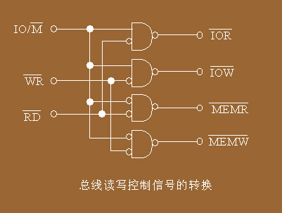
2. Reading or Writing Control Pins—(IBM-PC Bus)
I/O读
I/O写
存储器读
存储器写

Slide 26
2. Reading or Writing Control Pins
READY
Input, 1 is valid
In bus operation, 8088 CPU will test this pin at descending edge (1rt edge) of 3rd CLK cycle.
  If READY=1, bus operation of CPU enter 4th CLK cycle.
  If READY=0, bus operation of CPU will insert waiting cycle (Tw) between 3rd and 4th CLK cycles.
CPU will test this pin in waiting cycle too. If READY is valid, bus operation enter 4th CLK cycle. Or else, new waiting cycle is inserted.

Slide 27
2. Reading or Writing Control Pins
DEN*（Data Enable）
Output, Three-State, 0 is valid
If DEN* is valid, CPU begins data transfer on data bus.
This signal can be used to drive data bus.

Slide 28
2. Reading or Writing Control Pins
DT/R*（Data Transmit/Receive）
Output, Three-State
This signal represent the direction of data transfer on bus.
If DT/R*=1, CPU sends data to bus.
If DT/R*=0, CPU receives data from bus.

Slide 29
2. Reading or Writing Control Pins
SS0*（System Status 0）
8088 pin, Output (Only valid in Minimum Mode)
SS0*, IO/M*, and DT/R* can represent 8 different bus operation in 8088 minimum mode:
  1. Instruction Read 5. Interrupt Accept
  2. Memory Read 6. I/O Read
  3. Memory Write 7. I/O Write
  4. Passive 8. Halt

Slide 30
3. Interrupt Request and Acknowledge Pins
INTR（Interrupt Request, Maskable）
Input, 1 is valid
If INTR=1, there is at least one device send interrupt request to CPU.
Maskable interrupt request can be blocked by IF flag. If IF=0, CPU will not accept any maskable interrupt requets.

Slide 31
3. Interrupt Request and Acknowledge Pins
INTA*（Interrupt Acknowledge）
Output, 0 is valid
If INTA* is valid, the request from INTR has been accepted by CPU, and the timing will enter interrupt accept cycle.

Slide 32
3. Interrupt Request and Acknowledge Pins
NMI（Non-Maskable Interrupt）
Input, Ascending Edge is valid
If NMI is valid, there is non-maskable interrupt request to CPU.
The request from NMI can not be blocked in CPU.

Slide 33
3. Interrupt Request and Acknowledge Pins
Maskable interrupt is often used for data exchange between CPU and I/O devices.
Non-Maskable interrupt is often used for system failure.

Slide 34
4. DMA Request and Acknowledge Pins
HOLD
Input, 1 is valid
If HOLD is valid, there is at least one device requests for system bus control.
In most situations, system bus is controlled by CPU. However, other DMA devices can request bus control from CPU.

Slide 35
4. DMA Request and Acknowledge Pins
HLDA（HOLD Acknowledge）
Output, 1 is valid
If HLDA is valid, request from HOLD has been accepted, CPU has release system bus, and most pins of CPU is at blocking state.
In the mean time, DMA interface can use system bus without disturbances.
When HOLD is invalid, CPU cancels HLDA, and obtain the bus control again.

Slide 36
5. Other Pins
RESET
Input, 1 is valid
If RESET is valid, CPU enter initial state and does not work. After RESET is invalid again, CPU will work again.
After 8088/86 resetting
CS＝FFFFH、IP＝0000H，
Rebooting Address: FFFF0H

Slide 37
5. Other Pins
CLK（Clock）
Clock Input
Reference of CPU and system bus timing.
Standard 8088 clock frequency is 5MHz.
8088 in IBM PC/XT uses 4.77MHz clock, the CLK cycle is about 210ns.
CLK is provided by clock generator 8284.

Slide 38
5. Other Pins
Vcc
Power Input for CPU, ＋5V
GND
Ground input for CPU，ground reference of CPU

Slide 39
5. Other Pins
MN/MX*（Minimum/Maximum）
Operation Mode Choice, Input
If this pin is 1, 8088 is at minimum mode. Otherwise, 8088 is at maximum mode.

Slide 40
5. Other Pins
TEST*
Input, 0 is valid
This pin is used for synchronization between 8088 and 8087.
When CPU execute WAIT instruction, it will test this pin in every CLK cycle.
If TEST* is invalid, CPU will continue this pin testing. Otherwise, CPU will execute following instructions.

Slide 41
（4）Summery for Pins in 8088 Minimum Mode
Crucial properties of Pins：
⑴ Function
⑵ Direction
⑶ Valid Signal
⑷ Three-State
(5) Multiplexed

Slide 42
（4）Summery for Pins in 8088 Minimum Mode
Three pin types in CPU：
8-bit Data Pins：D₀～D₇
20-bit Address Pins：A₀～A₁₉
Control Pins：
  ALE、IO/M*、WR*、RD*、READY
  INTR、INTA*、NMI，HOLD、HLDA
  RESET、CLK、Vcc、GND

Slide 43
（4）Summery for Pins in 8088 Minimum Mode
Questions：
How do these CPU pins connect with other chips?
System Bus Generating
How can these signals on CPU pins be transferred orderly?
System Bus Timing

Slide 44
（5）System Bus Generating in 8088 Minimum Mode
系统总线信号
MN/MX*
IO/M*
RD*
WR*
+5V
IO/M*
RD*
WR*
A₁₉/S₆～A₁₆/S₃
8282
A₁₉～A₁₆
STB
OE*
8088
A₁₅～A₈
8282
A₁₅～A₈
STB
OE*
AD₇～AD₀
8282
A₇～A₀
ALE
STB
OE*
DT/R*
DEN*
8286
D₇～D₀
T
OE*

Slide 45
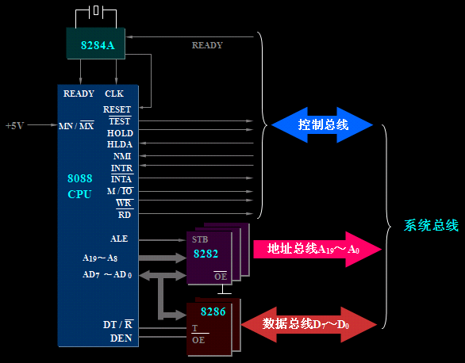
最小组态总线形成
(Intel产品手册推荐电路)

Slide 46
（5）System Bus Generating in 8088 Minimum Mode
(1) 20-bit address bus: use 3 8282 chips (三态透明锁存器) to latch address and drive bus
(2) 8-bit data bus: drove by 8286 chips (数据收发器)
(3) Control bus: provided by CPU pins directly (少量信号需要外接简单的组合逻辑电路来生成)

Slide 47
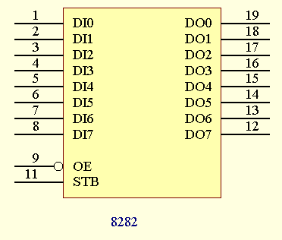
Pins of 8282
DI: Address Input
DO: Address Output
STB: Latching Control
OE* : Output Enable

Slide 48
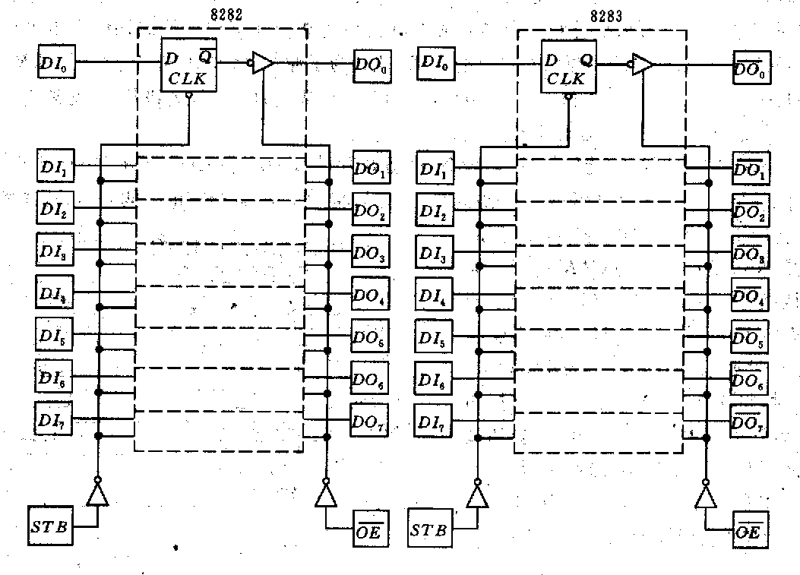
Internal structure of 8282

Slide 49
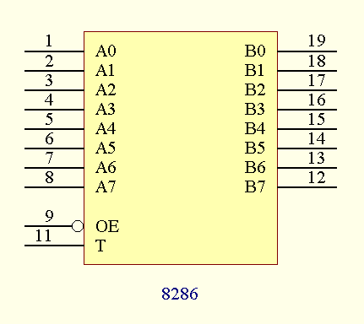
Pins of 8286
OE*＝0，导通
T＝1 A→B
T＝0 A←B
OE*＝1，不导通

Slide 50
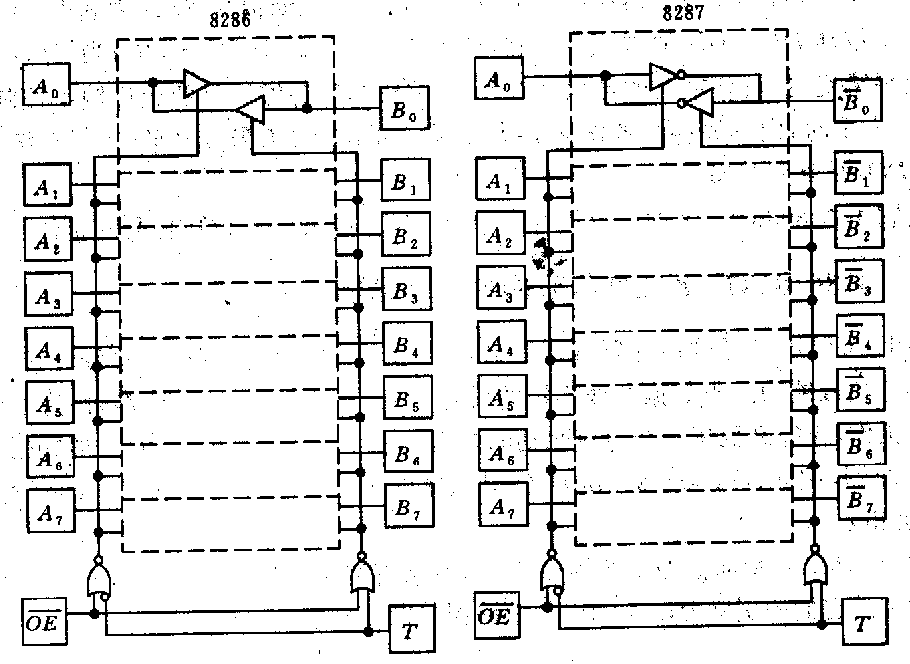
Internal Structure of 8286

Slide 51
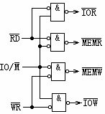
Control Bus Generation in 8088 Minimum Mode

Slide 52
Clock Generator 8284
The clock of 8086/8088 is provided by 8284 chip.
There are three parts in 8284, and each part perform one single task.
1) Clock Generating Circuit
2) Reset Controlling Circuit
3) Ready Signal Processing Circuit

Slide 53
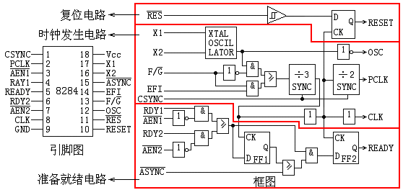
Pins and Internal Structure of 8284

Slide 54
Principles of 8284
(1) There is a Crystal Oscillator in 8284. It generates a periodic signal (osc, 14.32MHz).
(2) OSC (14.32MHz) is provided for display interface and display.
(3) CLK (4.77MHz, generated by osc, 3分频, 1/3 占空比) is provided for 8086/8088 CPU.
(4) PCLK (2.38MHz, generated by osc, 6分频, 1/2 占空比) is provided for 8253 chip.

Slide 55
Principles of 8284
(5) EFI provide external Crystal Oscillator input.
(6) F/G* is used to select internal or external Crystal Oscillator for clock generating.
Generally, if multiple 8284 chips are used in system, external Crystal Oscillator is needed.

Slide 56
Pins and Internal Structure of 8284

Slide 57
Principles of 8284
(7) CSYNC is used for multiple 8284 synchronization.
When CSYNC=0, 8284 chips start counting synchronously (分频器同步).
If single 8284 is used, CSYNC should be connected with GND.

Slide 58
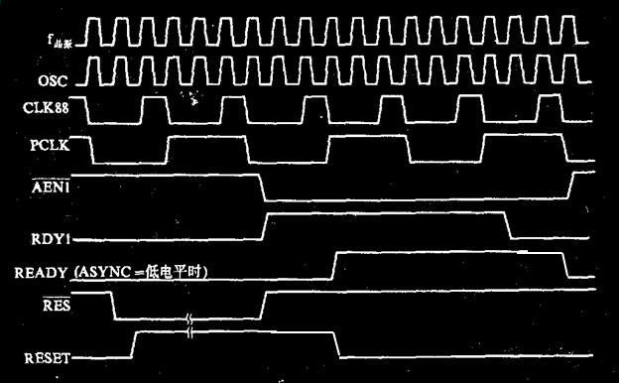
Principles of 8284

Slide 59
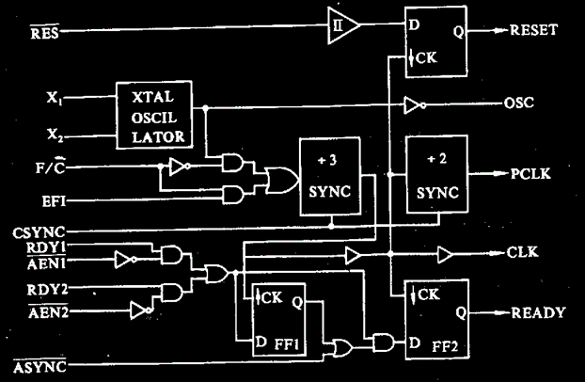
Principles of 8284

Slide 60
Principles of 8284
(8) ASYNC is used to select synchronization mode of ready signal.
If ASYNC = 1, 1-level synchronization is selected.
If ASYNC = 0, 2-level synchronization is selected.
In 2-level synchronization, generation of ready signal is delayed by one cycle.

Slide 61
Principles of 8284

Slide 62
(6) Bus Timing of 8088
Timing: The temporal order of signal generation.
CLK is the basic signal for timing.
Timing is controlled by control circuit in EU of 8086/8088.
Bus Timing: The temporal order of signal generation on system bus. It can describe the operation order in bus operation.

Slide 63
(6) Bus Timing of 8088
Timing level:
1) Clock Cycle: the cycle of clock signal
It is the minimal time period for one single operation in system.
2) Bus Cycle: the time period consumed in bus operation, composed of multiple clock cycles

Slide 64
(6) Bus Timing of 8088
3) Instruction Cycle: the time period consumed in instruction reading and execution, composed of multiple clock cycles
Composed of instruction reading cycle and execution cycle
May include multiple bus cycles
Note: Bus cycle may not include in execution cycle.

Slide 65
(6) Bus Timing of 8088
Bus cycle:
1) memory reading cycle: may be instruction reading cycle or data reading cycle
2) memory writing cycle: data writing cycle only

Slide 66
(6) Bus Timing of 8088
3) I/O reading cycle: may be caused by ‘IN’ instruction or interrupt accepting
4) I/O writing cycle: caused by ‘OUT’ instruction
5) Transition cycle: Transition between two neighbor bus cycles (Logic address to Physic address)
6) Suspending cycle: No bus operation, caused by ‘HALT’ instruction

Slide 67
(6) Bus Timing of 8088
Note:
Except ‘Halt’ has been executed, there are always bus cycles for instruction reading.

Slide 68
(6) Bus Timing of 8088
Timing synchronization: The mechanism to keep operation order correspondence between CPU and other chips.
Timing synchronization types:
Synchronous Timing : All chips are reference to CLK, and fast chip waits slow chip by inserting waiting cycle in timing.

Slide 69
(6) Bus Timing of 8088
Asynchronous Timing : Chips interact with each other by signal acknowledgements.
In PC system, synchronous and asynchronous timing are both used.
CLK signal is sent to CPU, but not to all chips.
The interaction between CPU and other chips is mainly based on signal acknowledgements.

Slide 70
(7) Bus Timing of 8088 Minimum Mode
Four bus timings:
1) Memory reading cycle
2) Memory writing cycle
3) I/O reading cycle
4) I/O writing cycle

Slide 71
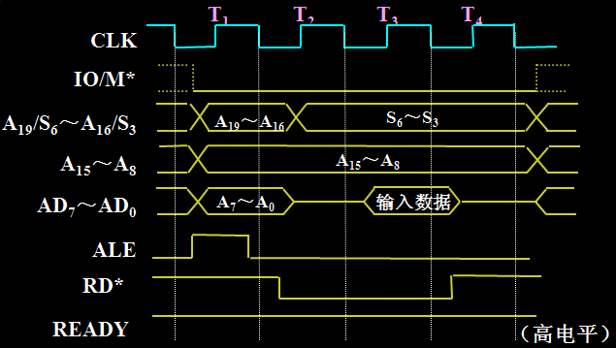
Memory Reading Cycle
T₁： IO/M*输出低电平，表示存储器操作
T₁：输出20位存储器地址A₁₉～A₀
T₁：ALE输出正脉冲，表示复用总线输出地址
T₂：输出控制信号RD*
T₃和T_{W} ：在前沿（下降沿）检测数据传送是否能够完成
T₄：前沿读取数据，完成数据传送

Slide 72
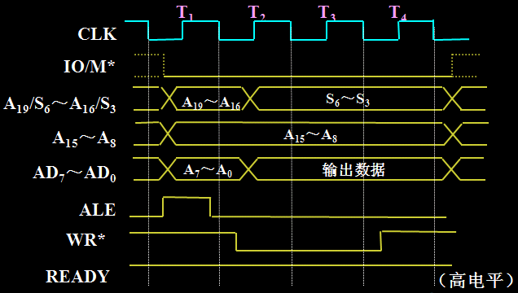
Memory Writing Cycle
T₁： IO/M*输出低电平，表示存储器操作
T₁：输出20位存储器地址A₁₉～A₀
T₁：ALE输出正脉冲，表示复用总线输出地址
T₂：输出数据D₇～D₀
T₂：输出控制信号WR*
T₃和T_{W} ：在前沿（下降沿）检测数据传送是否能够完成
T₄：完成数据传送

Slide 73
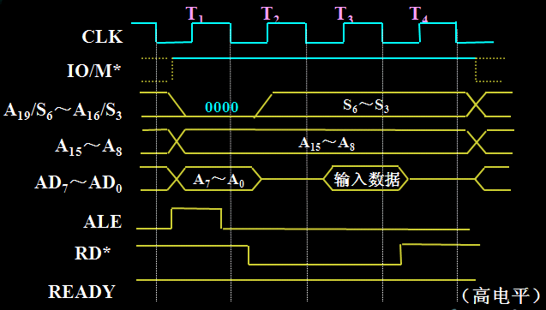
I/O Reading Cycle
T₁： IO/M*输出高电平，表示I/O操作
T₁：输出16位端口地址A₁₅～A₀
T₁：ALE输出正脉冲，表示复用总线输出地址
T₂：输出控制信号RD*
T₃和T_{W} ：在前沿（下降沿）检测数据传送是否能够完成
T₄：前沿读取数据，完成数据传送

Slide 74
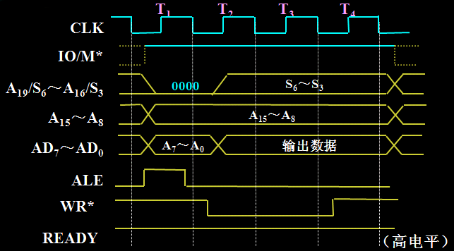
I/O Writing Cycle
T₁： IO/M*输出高电平，表示I/O 操作
T₁：输出16位端口地址A₁₅～A₀
T₁：ALE输出正脉冲，表示复用总线输出地址
T₂：输出数据D₇～D₀
T₂：输出控制信号WR*
T₃和T_{W} ：在前沿（下降沿）检测数据传送是否能够完成
T₄：完成数据传送

Slide 75
Waiting Cycle T_{w}
In bus cycle, CPU may insert waiting cycle T_{w} between T₃ and T₄ to wait slow chips (memory or interface).
1) Check ready pin at first edge of T₃.
2) If ready is invalid, insert T_{w} and turn back to step 1.
3) If ready is valid, enter T₄.

Slide 76
(8) Pins of 8088 Maximum Mode
GND
A₁₄
A₁₃
A₁₂
A₁₁
A₁₀
A₉
A₈
AD₇
AD₆
AD₅
AD₄
AD₃
AD₂
AD₁
AD₀
NMI
INTR
CLK
GND
1
2
3
4
5
6
7
8
9
10
11
12
13
14
15
16
17
18
19
20
40
39
38
37
36
35
34
33
32
31
30
29
28
27
26
25
24
23
22
21
VCC
A₁₅
A₁₆ / S₃
A₁₇ / S₄
A₁₈ / S₅
A₁₉ / S₆
SS0* (HIGH)
MN / MX*
RD*
HOLD (RQ0*/ GT0*)
HLDA (RQ1* /GT1*)
WR* (LOCK*)
M */ IO ( S2* )
DT / R* ( S1* )
DEN ( S0 )
ALE (QS0)
INTA (QS1)
TEST*
READY
RESET
8088

Slide 77
(8) Pins of 8088 Maximum Mode
S2* S1* S0* | CPU的工作状态
0 0 0 | 中断响应
0 0 1 | I/O读
0 1 0 | I/O写
0 1 1 | 暂停
1 0 0 | 取指
1 0 1 | 存储器读
1 1 0 | 存储器写
1 1 1 | 过渡状态

Slide 78
(8) Pins of 8088 Maximum Mode
LOCK*: used to lock system bus, deny DMA request
‘LOCK’ instruction prefix, remember ?
QS1, QS2: status of instruction queue, used for synchronization between 8088 and 8087
RQ*/GT0*、RQ*/GT1*: Two DMA requests and acknowledgements

Slide 79
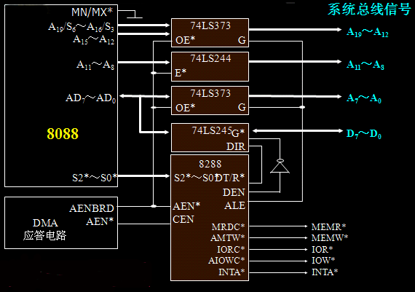
(8) System Bus Generation of 8088 Maximum Mode

Slide 80
(8) System Bus Generation of 8088 Maximum Mode
1) Address Bus:三态透明锁存器74LS373和三态单向缓冲器74LS244
2) Data Bus:三态双向缓冲器74LS245
3) Control Bus: Generated by 8288
MEMR*、MEMW*、IOR*、IOW*、INTA*

Slide 81
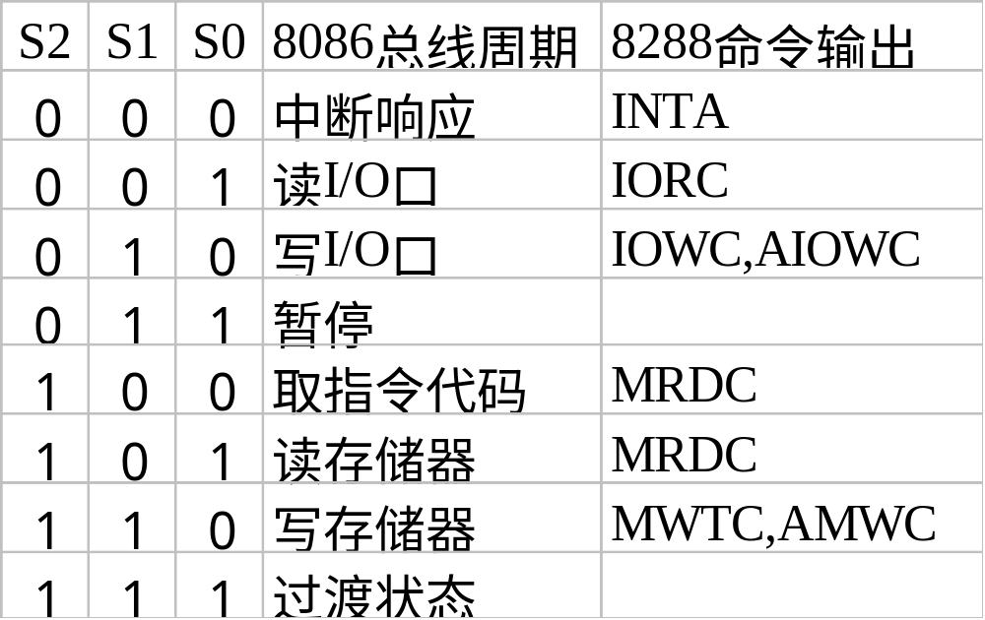
(8) System Bus Generation of 8088 Maximum Mode

Slide 82
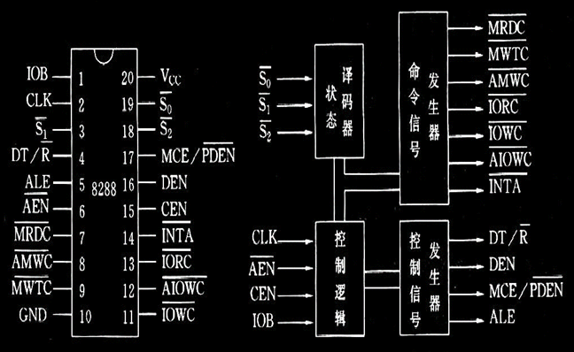
Pins and Internal Structure of 8288

Slide 83
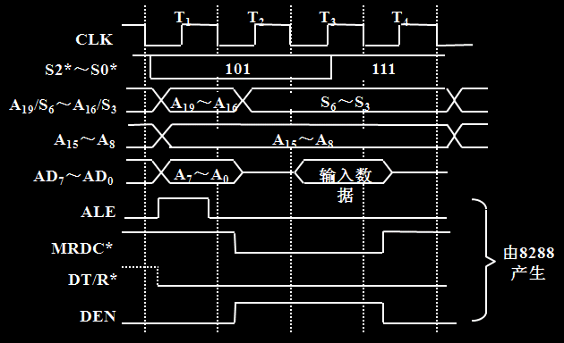
Memory Reading Cycle of 8088 Maximum Mode

Slide 84
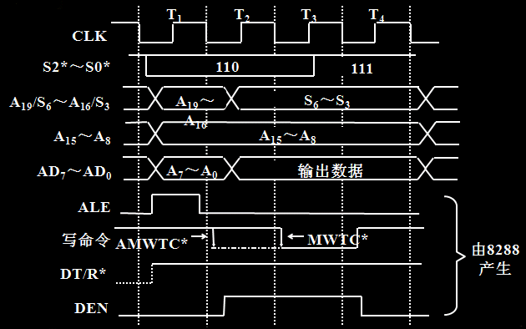
Memory Writing Cycle of 8088 Maximum Mode

Slide 85
I/O Reading and Writing Cycle of 8088 Maximum Mode
I/O reading and writing cycle is similar to memory reading and writing cycle.
The difference is the status signal.

Slide 86
(9) System Bus
CPU, memory, and I/O interface are all connected with system bus.
They exchange information with each other through system bus.

Slide 87
(9) System Bus
In modern computer system, architecture of system bus has been standardized.
When one designs an I/O interface, one consider its interaction with system bus, not with CPU or other chips.
System bus makes computer system easy to be extended.

Slide 88
(9) System Bus
Different bus level:
1) Chip bus: connection between components in chip or connection between chips.
2) Internal bus (system bus): connection between mainboard and interface-board.
3) External bus: connection between computer system and devices.

Slide 89
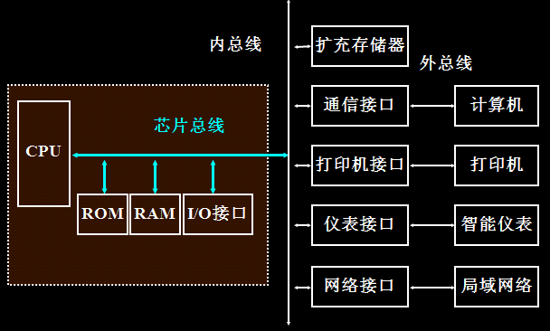
(9) System Bus

Slide 90
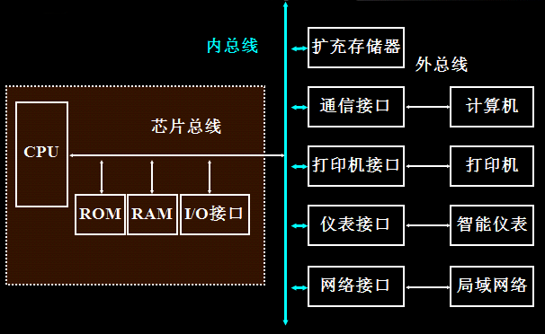
(9) System Bus

Slide 91
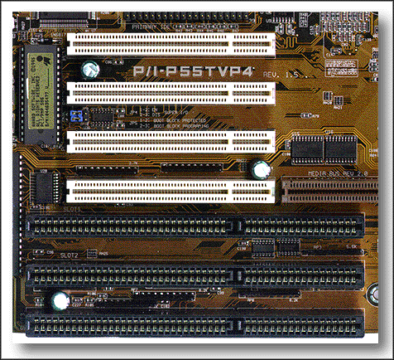
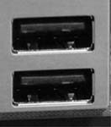
(9) System Bus
USB总线
PCI总线
ISA总线

Slide 92
(9) System Bus
Familiar system bus:
1) For industry control: STD
2) For personal computer: ISA, EISA, VESA, PCI, USB

Slide 93
CPU Operation Mode and System Bus
Minimum and Maximum mode provide different explanation about CPU pins.
Bus standard use these pins to generate system bus.
Some pins may be used, but some may be not.
In most situations, system bus will add some new chips or circuits for bus generation.

Slide 94
IBM PC Bus
8-bit system bus used in IBM PC/XT computer. There are 62 leads in 2 columns.
There are two faces in interface-board. (A面-元件面和B面-焊接面) Each face has 31 leads.
Signals transferred to these leads will be magnified in interface.

Slide 95
IBM PC Bus
D₀～D₇——8-bit bidirectional data leads
A₀～A₁₉——20-bit address output
ALE——Address Latch enable, be valid in T1, 1 is valid
MEMR*——Memory reading, output, 0 is valid
MEMW*——Memory writing, output, 0 is valid
IOR*——I/O reading, output, 0 is valid
IOW*——I/O writing, output, 0 is valid
I/O CH RDY——I/O channel ready, input, 1 is valid

Slide 96
IBM PC Bus

Slide 97
IBM PC Bus
IRQ₂～IRQ₇——Interrupt request, input, to 8259, 1 is valid
AEN——Address Enable, output, 1 is valid，valid in DMA cycle
DRQ₀～DRQ₃——DMA request, input, to 8237, 1 is valid
DACK₀*～DACK₃*——DMA acknowledgement, output, from 8237, 0 is valid
T/C——DMA end signal, output, from 8237, positive pulse is valid

Slide 98
IBM PC Bus
RESET——System reset, output, 1 is valid, from 8284
IOCHCK*——I/O channel check, input, 0 is valid
OSC——output, 14.31818MHz periodic signal
CLK——system clock, output, 4.77MHz periodic signal
＋5V、－5V、＋12V、－12V、GND——Power and Ground

Slide 99
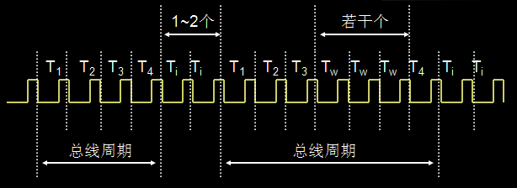
Bus cycle of IBM PC BUS
T_{i}: Transition Cycle
T_{w}: Waiting Cycle

Slide 100
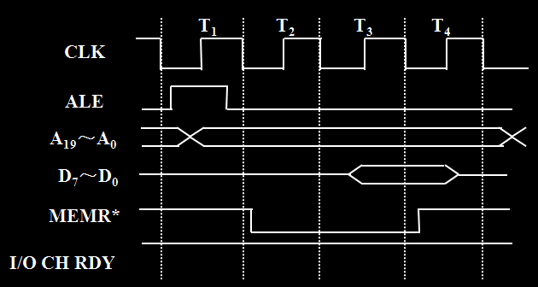
Memory Reading Cycle
T₁：送存储器地址
T₂：存储器读控制信号有效
T₃：检测I/O CH RDY准备好信号，确定是否插入等待状态Tw
T₄：读取存储器送来的数据

Slide 101
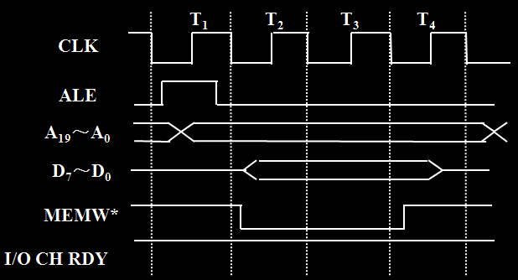
Memory Writing Cycle
T₁：送出存储器地址
T₂：存储器写控制信号有效；同时送出数据
T₃：检测I/O CH RDY准备好信号，确定是否插入等待状态Tw
T₄：存储器读取数据

Slide 102
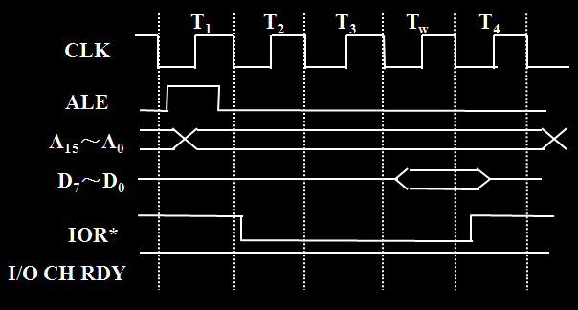
I/O Reading Cycle
T₁：送出I/O地址
T₂： I/O读控制信号有效
T₃：确定插入一个等待状态Tw
T_{W}：检测I/O CH RDY准备好信号，确定是否再插入等待状态Tw
T₄： CPU读取外设送来的数据

Slide 103
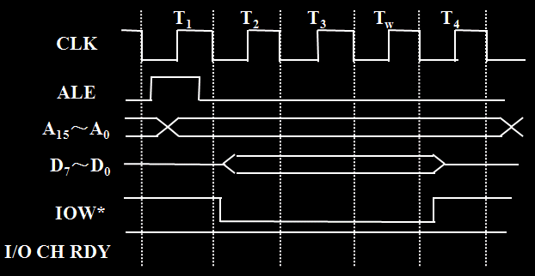
I/O Writing Cycle
T₁：送出I/O地址
T₂： I/O写控制信号有效；同时在送出数据
T₃：确定插入一个等待状态Tw
T_{W}：检测I/O CH RDY准备好信号，确定是否再插入等待状态Tw
T₄：外设读取CPU送来的数据

Slide 104
Summary
(1) Pins and Timing of 8088 Minimum Mode
(2) Pins and Timing of 8088 Maximum Mode
(3) Concept of System Bus and Bus level
(4) leads and Timing of IBM PC BUS

