Slide 1
Instruction System -
Transfer Instruction
计算机学院 李征
Tel：13882153765
Email：lizheng@scu.edu.cn
OICQ: 1340915

Slide 2

Transfer Instruction
All transfer instructions only move data from one cell to another.
ALU is not used in these instructions.
So, transfer instruction does not affect flags unless FR is its destination.

Slide 3
Transfer Instruction
(1) MOV
(2) XCHG
(3) LAHF
(4) SAHF
(5) PUSH (PUSHF)
(6) POP (POPF)
(7) LEA

Slide 4
(1) MOV (Move)
Example:
mov al, 06h
mov 0100h[bx], al
mov ds, ax

Slide 5
(1) MOV (Move)
Error Usage:
mov [bx], [0102h]
mov 0020h[si], 03h
mov ds, 1000h
mov ds, es

Slide 6
(2) XCHG (Exchange)
Example: exchange the data in var1 and var2 cell.
mov al, var1
xchg al, var2
mov var1, al

Slide 7
(2) XCHG (Exchange)
Error Usage:
XCHG AL, 03H
XCHG VAR1, VAR2

Slide 8
(3) LAHF (Load AH from FR)
LAHF
No operation data, but two implied address used.
AH <=（FR）7-0
Usage: protect FR temporally

Slide 9
(3) LAHF (Load AH from FR)
ＡＨ
 |  |  |  | ＯＦ | ＤＦ | ＩＦ | ＴＦ | ＳＦ | ＺＦ |  | ＡＦ |  | ＰＦ |  | ＣＦ
ＦＲ

Slide 10
(4) SAHF (Store AH into FR)
SAHF
No operation data, but two implied address used.
FR7-0 <= (AH)
Usage: Restore previous FR

Slide 11
(4) SAHF (Store AH into FR)
ＡＨ
 |  |  |  | ＯＦ | ＤＦ | ＩＦ | ＴＦ | ＳＦ | ＺＦ |  | ＡＦ |  | ＰＦ |  | ＣＦ
ＦＲ

Slide 12
Example for LAHF and SAHF
CMP BYTE PTR [BX], 02H
LAHF ; Protect FR
INC BX
SAHF ; Restore FR
JZ L1 ; FR is from CMP, not INC
JMP L2
……

Slide 13
(5) PUSH (PUSHF)
PUSH SRC
SP <=（SP）-2
(SP) <= (SRC)
PUSHF : Send FR to stack top

Slide 14
新栈顶
旧栈顶
源地址
ＳＰ

Slide 15
(6) POP (POPF)
POP DEST
DEST <= （（SP））
SP <= （SP）+2
POPF: Restore FR from stack top.

Slide 16
旧栈顶
新栈顶
目的地址
ＳＰ

Slide 17
Example for Stack Operation
…
STACK1 SEGMENT STACK
DB 40H DUP（0） ；堆栈空间为32个字
STACK1 ENDS
…
PUSH AX ；假定（AX）=0E43DH
PUSH DS ；假定（DS）=3638H
PUSH DATAW ；假定（DATAW）=0D245H
PUSHF ；假定（FR）=0C243H
POPF
POP DATAW
POP DS
POP AX
…

Slide 18
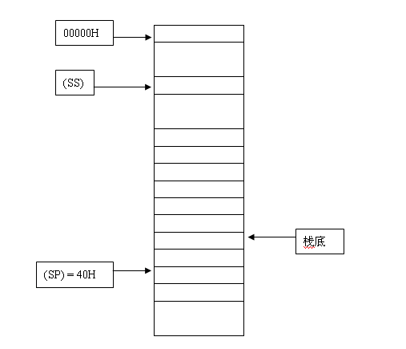

Slide 19
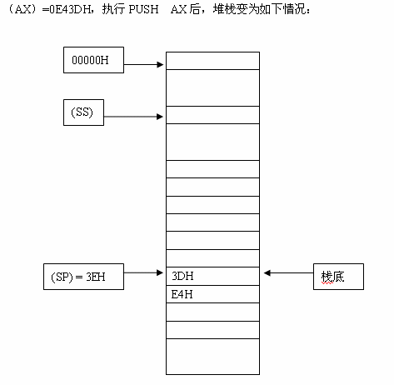

Slide 20
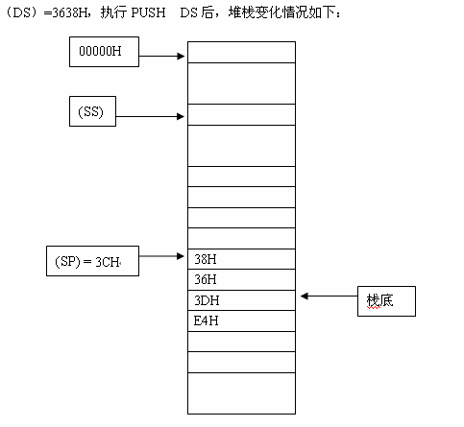

Slide 21
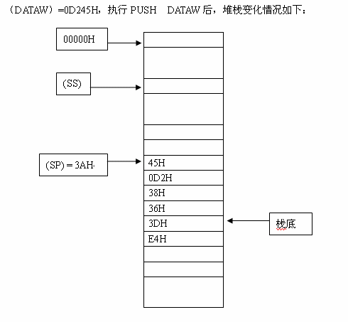

Slide 22
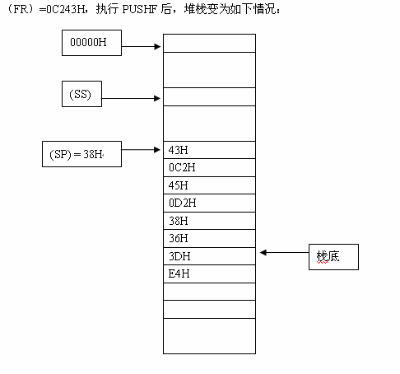

Slide 23
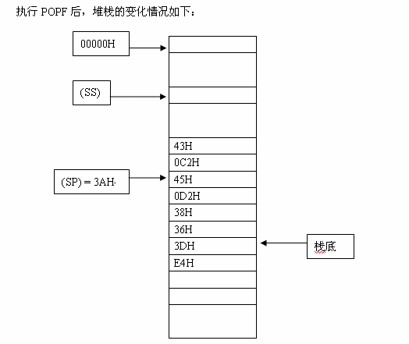

Slide 24
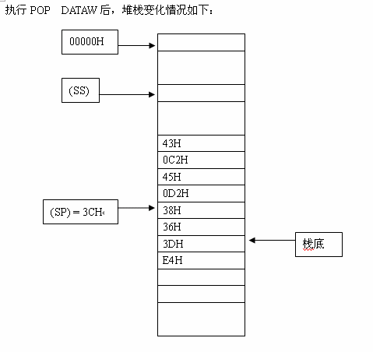

Slide 25
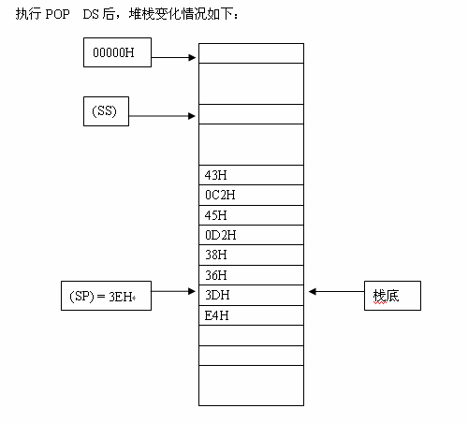

Slide 26
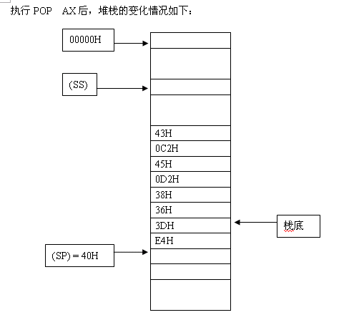

Slide 27
Note for all stack operation
Important:
The pop order is inverse to the push order.

Slide 28
(7) LEA (Load Effective Address)
LEA DEST，SRC
DEST <= EA of SRC
SRC can only be memory cell. Why?
DEST can only be 16-bit register. Why?

Slide 29
１６位目的地址
ＥＡ

Slide 30
(7) LEA (Load Effective Address)
Example:
MOV BX，0024H
LEA BX，[BX]
Data stored in（DS）：0024H is 0056H.
So, after instruction execution, (BX)=?

Slide 31
(7) LEA (Load Effective Address)
Example:
LEA SI，DS：[0056H]
Data stored in（DS）：0056H is 0048H.
So, after execution, (SI)=?

