Slide 1
Principles and Methods of Program Design Lecture 5: Polymorphic ADTs
Yuting Wang
SEIEE
John Hopcroft Center for Computer Science
2022.3.14

Slide 2
Road Map
Basics of Imperative Programming (C++)
Programming with Abstractions
Implementing Abstractions
Here!

Slide 3
Last Time
Abstract Data Types
Strings
Aliasing of Variables
Streams

Slide 4
This Time
Parametric Polymorphism
C++ Templates
Polymorphic ADT
Collections
Recursion over Collections

Slide 5
Polymorphism

Slide 6
Polymorphism
Polymorphism: a single interface for entities of multiple different types
Three kinds of polymorphism
Ad-hoc polymorphism (Overloading)
Polymorphic functions (ADT) behave differently depending on types
Parametric polymorphism (Templates)
Polymorphic functions (ADT) behave uniformly with different types
Subtyping (Class Inheritence)
Subtypes of an ADT have the same interface, but may behave differently
We delay the discussion of subtyping to later lectures

Slide 7
Ad-hoc Polymorphism
(Overloading)

Slide 8
Overloading
Overloading: Ad-hoc polymorphism in C++
We have seen many examples
Overloaded operators:
<<, >>, +, +=, ==, …
Overloaded methods:
str.insert, str.erase, str.substr, ….
Function Overloading:
A function may have different implementations depending on parameter types

Slide 9
Function Overloading
Overloading with different types
Function names are the same
Function types are different
At call sites:
Choose based on arguments types
int add(int x, int y)
{
cout << "Running add for integers." << endl;
return x + y;
}
double add(double x, double y)
{
cout << "Running add for doubles." << endl;
return x + y;
}
int main()
{
cout << add(3, 5) << endl << endl;
cout << add(1.0, 3.14159) <<endl;
return 0;
}

Slide 10
Function Overloading
Overloading with different numbers of parameters:
Function names are the same
Function types are the same
# of parameters are different
At call site:
Choose based on # of arguments
int add(int x, int y)
{
cout << "Running add for integers (2-inputs)."
<< endl;
return x + y;
}
int add(int x, int y, int z)
{
cout << "Running add for integers (3-inputs)."
<< endl;
return x + y + z;
}
int main()
{
cout << add(3, 5) << endl << endl;
cout << add(3, 5, 7) <<endl;
return 0;
}

Slide 11
Notes
For overloading:
It is possible to combine different parameter types and numbers
It is impossible to overload based on return types
// Example: Ambiguous overloaded add
int add(int x, int y)
{
return x + y;
}
double add(int x, int y)
{
return x + y;
}

Slide 12
Parametric Polymorphism
(Templates)

Slide 13
Templates
Templates: parametric polymorphism in C++
Template functions
Syntax:
T is a type parameter
The function prototype or definition may use T as a regular type
The function prototype or definition cannot inspect the internal structure of T
template <class T>
function prototype/definition
// An identity template function
template <class T>
T id(T v)
{
return v;
}

Slide 14
Instances of Templates
Given any instances of type parameters, a template generate an instance:
// An identity template function
template <class T>
T id(T v)
{
return v;
}
T=int
T=char
T=string
// An identity for int
int id(int v)
{
return v;
}
// An identity for char
char id(char v)
{
return v;
}
// An identity for string
string id(string v)
{
return v;
}

Slide 15
Calling Template Functions
At the call sites:
Instances of templates are chosen based on argument types
Explicit instances may be specified
// Calling a template function
cout << id(65) << endl;
cout << id('c') << endl;
string s = "Hello world!";
cout << id(s) << endl;
// Explicit instaniation
cout << id<char>(65) << endl;

Slide 16
Template Swap
Swapping two values may be defined as a template function
We name it as swap_val to avoid conflict with swap in the standard library
template <class T>
void swap_val(T& t1, T& t2)
{
T temp;
temp = t1;
t1 = t2;
t2 = temp;
}

Slide 17
Parametricity
Every instance of a template works in the same way!
No special treatment for different type parameters
This property is known as parametricity.
int main()
{
// Swap two integers
int x = 3, y = 5;
cout << "Before swapping: x = " << x << ", y = " << y << endl;
swap_val(x, y);
cout << “After swapping: x = ” << x << “, y = ” << y << endl << endl;
// Swap two strings
string s1 = "Red", s2 = "Blue";
cout << "Before swapping: s1 = " << s1 << ", s2 = " << s2 << endl;
swap_val(s1, s2);
cout << "After swapping: s1 = " << s1 << ", s2 = " << s2 << endl;
return 0;
}

Slide 18
Polymorphic ADT

Slide 19
Template Classes
Abstract data types can also be parameterized over other types
Key Property: Different instances, uniform behavior
Parametric polymorphic ADTs are known as Template Classes in C++
We will delay their definitions to a later class…
We first learn how to use them
datatype<T>
T=int
T=string
T=char
datatype<int>
datatype<char>
datatype<string>

Slide 20
Collections
Collections: Data structures for representing a collection of values
We will introduce five of them: Vector, Stack, Queue, Map, and Set.
Collections may be represented as polymorphic ADTs in C++
We DO NOT need to understand how they are implemented for now
We first learn how to make use of objects of such types
Note:
C++ Standard Template Library (STL) supports all of the collections above
We DO NOT use them in this course because of their complexity
Instead, we use StanfordCppLib (more lightweight than STL)

Slide 21
StanfordCppLib
Download cs1604_lib.zip on Canvas
Unzip, make and configure in your IDE
Run a test program
Note:
we have stripped away the graphical functionality from StanfordCppLlib
If you encounter any bug, please report

Slide 22
Vectors

Slide 23
Vectors
Vector: A finite sequence of values of the same type
Example: an integer vector of size 7
Syntax for defining vector variables (need to #include<Vector.h>):
Define a empty vector named vec
The vector may only contain elements of type T
Example: Vector<int> vec;
34
6
101
-99
42
0
9
0
1
2
3
4
5
6
Vector<T> vec;

Slide 24
Vector vs. String
String may be viewed as a vector of characters
Why we specifically need a string ADT then?
String is a specialized vector suitable for operations over sequences of characters
Different internal representations
Various optimizations in the string class are not implemented in the vector class
Convert a vector to a printable string
Directly print a vector
Vector<char> str;
vec.toString()
cout << vec;

Slide 25
Add Elements
Appending the value v to the vector vec
vec and v must have compatible type!
The length of vector is NOT fixed:
vec.add(v)
// Example
Vector<int> vec;
vec.add(34);
vec.add(6);
vec.add(101);
34
6
101
0
1
2
vec.add(-99);
34
6
101
-99
0
1
2
3

Slide 26
Insert and Remove
Insert the value v into vec at index i
Remove the value at index i from vec
vec.insert(i, v)
vec.insert(2, 15);
34
6
15
101
-99
0
1
2
3
4
vec.remove(i)
vec.remove(2);
34
6
101
-99
0
1
2
3

Slide 27
Get and Set
Get the value at index i in vec:
Set the value at index i in vec to v:
vec.get(i)
vec.get(2);
34
6
101
-99
0
1
2
3
vec.set(i, v)
vec.set(2, -13);
34
6
-13
-99
0
1
2
3

Slide 28
Selection
The indexing operator [_] is overloaded for vectors
Get value
Set value
Example:
vec[i]
vec[i] = expr;
cout << vec[2] << endl;
34
6
101
-99
0
1
2
3
vec[2] = -13;
34
6
-13
-99
0
1
2
3

Slide 29
Bounds Checking
Vector operations enforce bounds-checking
34
6
101
-99
0
1
2
3
// Error: 10 is outside of valid range
vec.insert(10, 15);
vec.remove(10);
vec.get(10);
vec.set(10, 15);
cout << vec[10];
vec[10] = 15;

Slide 30
Initialization
Vectors may be initialized with a list
Vectors may be initialized to a given length
Vector<T> vec = { … };
// Example
Vector<int> vec1 = {42, 0, 9};
Vector<T> vec(n, v);
// Example
Vector<char> vec1(10, ‘A’);

Slide 31
Concatenation
+, += are overloaded operators for concatenation
Examples:
// Concatenation of vec1 and vec2
vec1 + vec2
// Append vec2 to the end of vec1
vec1 += vec2
34
6
101
-99
+
42
0
9
0
1
2
3
4
5
6
Vector<int> vec1 = {34, 6, 101, -99};
Vector<int> vec2 = {42, 0, 9};
cout << vec1 + vec2 << endl;

Slide 32
Other Operations
size(): get the number of elements
isEmpty(): check if the vector is empty
clear(): remove all the elements

Slide 33
Programming with Vectors

Slide 34
Iteration
Patterns for iteration over strings are applicable to vectors as well
// Forward iteration
for (int i = 0; i < vec.size(); i++) {
body of the loop that manipulates vec[i]
}
// Backward iteration
for (int i = vec.size()-1; i >= 0; i--) {
body of the loop that manipulates vec[i]
}
// Iterative concatenation
for (loop condition) {
vec += the next vector
}

Slide 35
Example: Filtering
Given a vector of integers, remove all the negative values in it
Question: Why iterate over the vector backwards?
Exercise: What would be a solution that loops forward?
// Remove all negative values in vec
Vector<int> removeNegValues(Vector<int> vec)
{
for (int i = vec.size()-1; i >= 0; i--) {
if (vec[i] < 0)
vec.remove(i);
}
return vec;
}

Slide 36
Passing References
The previous implementation is not very efficient
The vector is copied twice: one at function call and another at return
Solution: pass references (call-by-value)
// Remove all negative values in vec
void removeNegValues(Vector<int>& vec)
{
for (int i = vec.size()-1; i >= 0; i--) {
if (vec[i] < 0)
vec.remove(i);
}
}

Slide 37
Passing Constant References
The first solutions has the benefit of not changing program state
This is highly desirable in some situations
// Remove all negative values in vec
Vector<int> removeNegValues(const Vector<int>& ivec)
{
Vector<int> vec = ivec;
for (int i = vec.size()-1; i >= 0; i--) {
if (vec[i] < 0)
vec.remove(i);
}
// Most compiler will optimize away the copy at return
return vec;
}

Slide 38
Exercise: Concatenation
Given a vector of strings, how to concatenate them into a single string where adjacent elements are separated by a single space?
string concatStrings(Vector<string> words)
{
string result;
// Fill in the code here
return result;
}

Slide 39



Recursion
Recursion over vectors work as before
Break a problem about vector into problems about smaller vectors
Get an immediate solution at base cases
Compose the results of sub-problems to solve the original problem
Original Problem:
$$S$$
Sub Problems:
$$S_{1}$$
$$S_{2}$$
● ● ●
$$S_{n}$$
Base Cases:
● ● ●

Slide 40
Example: Filtering
Recursively remove all negative values in a vector
// Remove all negative values in vec
Vector<int> removeNegValues(Vector<int> vec)
{
if (vec.isEmpty())
return Vector<int>();
else {
Vector<int> head;
// Keep vec[0] if it is not a negative value
if (vec[0] >= 0) head.add(vec[0]);
// Get the rest elements
vec.remove(0);
Vector<int> rest = removeNegValues(vec);
return head + rest;
}
}

Slide 41
Search for an Element
Given a vector, we would like to find a specified value v in it
If so, return the index of v
A straightforward solution: linear search
42
-13
101
-99
42
0
9
0
1
2
3
4
5
6
// Linear search
int find_element(const Vector<int>& vec, int v)
{
for (int i = 0; i < vec.size(); i++)
if (vec[i] == v)
return i;
return -1;
}

Slide 42
Search a Sorted Vector
Assume a sorted vector, we would like to find a specified value in it
Can we do better than linear search?
Yes! Use binary search
-99
-13
0
9
42
42
101
0
1
2
3
4
5
6

Slide 43
Binary Search
Binary search is easily described using a recursive process
Find the middle element, if equal the search ends
If bigger than the given value, search the lower half, search the upper half o.w.
Example: find -13
-99
-13
0
9
42
42
101
Middle element is 9;
-13 < 9
0
1
2
3
4
5
6
-99
-13
0
Middle element is -13
0
1
2

Slide 44
Recursive Solution
// Search for v in vec[st…ed]
int binary_search_rec(const Vector<int>& vec, int v, int st, int ed)
{
if (ed < st)
return -1;
int mid = (st+ed)/2;
if (vec[mid] == v)
return mid;
else if (v < vec[mid])
return binary_search_rec(vec, v, st, mid-1);
else
return binary_search_rec(vec, v, mid+1, ed);
}

Slide 45
Iterative Solution
Exercise: complete the while loop
Question: What is the loop invariant?
int binary_search_iter(const Vector<int>& vec, int v)
{
int st = 0, ed = vec.size()-1;
while (st <= ed) {
???
}
return -1;
}

Slide 46
Sorting

Slide 47
Sorting
Sorting a sequence of integers in ascending order
42
-13
101
-99
42
0
9
0
1
2
3
4
5
6
-99
-13
0
9
42
42
101
0
1
2
3
4
5
6

Slide 48
Bubble Sort
Idea: repeatedly reorder adjacent elements if they are out of order
42
-13
101
-99
42
0
9
0
1
2
3
4
5
6
-13
42
101
-99
42
0
9
0
1
2
3
4
5
6
-13
42
101
-99
42
0
9
0
1
2
3
4
5
6
-13
42
-99
101
42
0
9
0
1
2
3
4
5
6

Slide 49
Pseudo Code
Given a vector vec:
void bubble_sort(Vector<int>& vec)
{
while (vec is not sorted){
Check every adjacent pair of elements in vec
If they are out of order, swap their values
}
}

Slide 50
Check if Sorted
Note the early exit pattern
// Check if vec is sorted in ascending order
bool is_sorted(const Vector<int>& vec)
{
for (int i = 0; i < vec.size()-1; i++)
if (vec[i] > vec[i+1])
return false;
return true;
}

Slide 51
Bubble Sort in C++
Implementation in C++:
void bubble_sort(Vector<int>& vec)
{
while (!is_sorted(vec)) {
for (int i = 0; i < vec.size()-1; i++) {
if (vec[i] > vec[i+1]) {
int temp = vec[i];
vec[i] = vec[i+1];
vec[i+1] = temp;
}
}
}
}
swap(vec[i], vec[i+1]);

Slide 52
Is the Implementation Optimal?
Observation: every iteration pushes the next greatest value that is out-of-place to its rightful place
42
-13
101
-99
42
0
9
0
1
2
3
4
5
6
-13
42
-99
42
0
9
101
0
1
2
3
4
5
6
-13
-99
42
0
9
42
101
0
1
2
3
4
5
6

Slide 53
Optimized Bubble Sort
In the worst case, iterations are needed!
Question: Is there any missed optimization?
n-1
void bubble_sort(Vector<int>& vec)
{
for (int k = 0; k < vec.size()-1; k++){
for (int i = 0; i < vec.size()-1; i++) {
if (vec[i] > vec[i+1])
swap(vec[i], vec[i+1]);
}
}
}

Slide 54
Loop Invariants
Recall: we can use assertion to check if the loop invariant holds
Q: What is the loop invariant for bubble sort?
void bubble_sort(Vector<int>& vec)
{
for (int k = 0; k < vec.size()-1; k++){
// vec starting from vec.size()-k-1 is sorted
for (int i = 0; i < vec.size()-1; i++) {
if (vec[i] > vec[i+1])
swap(vec[i], vec[i+1]);
}
}
// vec is sorted
}
// What is the loop invariant about vec?

Slide 55
Check Sortedness
Generalization of is_sorted
// vec starting from the index start is sorted
bool is_sorted(const Vector<int>& vec, int start)
{
for (int i = start; i < vec.size()-1; i++)
if (vec[i] > vec[i+1])
return false;
return true;
}
i = 0

Slide 56
Loop Invariants
Assertion of Loop Invariants
Question: Is there any missed optimization?
Answer: The inner loop only need to iterate for n-k-1 times!
void bubble_sort(Vector<int>& vec)
{
for (int k = 0; k < vec.size()-1; k++) {
assert(is_sorted(vec, vec.size()-k-1));
for (int i = 0; i < vec.size()-1 ; i++) {
if (vec[i] > vec[i+1])
swap(vec[i], vec[i+1]);
}
}
assert(is_sorted(vec, 0));
}
-k

Slide 57
Higher-Dimension Vectors

Slide 58
Two Dimension Vectors
Defined as (spaces are needed for some compilers!)
Example: Matrices
Vector< Vector<type> >
42
-13
101
Vector< Vector<int> > matrix = { {42, -13, 101},
{10, -99, 62},
{-80, 33, 28},
{9, 0, 12} };
10
-99
62
-80
33
28
9
0
12

Slide 59
Matrix Addition
Only allow addition of matrices of the same shapes
42
-13
101
1
2
3
10
-99
62
4
5
6
+
=
?
-80
33
28
7
8
9
9
0
12
10
11
12

Slide 60
Vector Addition
Addition of two vectors
// Addition of Vector
Vector<int> addVec(const Vector<int>& v1,
const Vector<int>& v2)
{
assert (v1.size() == v2.size());
Vector<int> vec;
for (int i = 0; i < v1.size(); i++)
vec.add(v1[i]+v2[i]);
return vec;
}

Slide 61
Matrix Addition
Addition of two matrices
// Abbreviated name of matricies
typedef Vector<Vector<int>> Matrix;
// Addition of matrix
Matrix addMatrix(const Matrix& m1, const Matrix& m2)
{
assert(m1.size() == m2.size()
&& m1[0].size() == m2[0].size());
Matrix result;
for (int i = 0; i < m1.size(); i++)
result.add(addVec(m1[i], m2[i]));
return result;
}

Slide 62
Matrix Multiplication
Only allow matrices of size N * M and M * O to multiple
Result is a N * O matrix
Result[i][j] =
Row i of m1 * Column j of m2
1
2
3
42
-13
101
9
4
5
6
10
-99
62
0
X
=
?
7
8
9
-80
33
28
12
10
11
12
Compute result[1][2]

Slide 63
Vector Multiplication
Multiple two vectors
// Multiplication of Vector
int multVec(const Vector<int>& v1, const Vector<int>& v2)
{
assert (v1.size() == v2.size());
int result = 0;
for (int i = 0; i < v1.size(); i++)
result += (v1[i]*v2[i]);
return result;
}

Slide 64
Get Columns
Get a column of a matrix
// Get column
Vector<int> getColumn(const Matrix& m, int i)
{
Vector<int> vec;
for (int k = 0; k < m.size(); k++)
vec.add(m[k][i]);
return vec;
}

Slide 65
Multiplication of Vector and Matrix
Compute the multiplication of every row in m1 with m2:
1
2
3
4
5
6
42
-13
101
9
X
=
?
7
8
9
10
11
12

Slide 66
Multiplication of Vector and Matrix
Multiple a vector with a matrix
// Multiplication of vector and matrix
Vector<int> multVecMatrix(const Vector<int>& vec, const Matrix& m)
{
Vector<int> result;
for (int i = 0; i < m[0].size(); i++) {
// Get the i-th column of m
Vector<int> col = getColumn(m, i);
// Compute and add vec * column i
result.add(multVec(vec, col));
}
return result;
}

Slide 67
Matrix Multiplication
Multiple two matrices
// Multiplication of matrix
Matrix multMatrix(const Matrix& m1, const Matrix& m2)
{
assert(m1[0].size() == m2.size());
Matrix result;
for (int i = 0; i < m1.size(); i++) {
// Compute the i-th row * m2
Vector<int> row = multVecMatrix(m1[i], m2);
// Add to the result
result.add(row);
}
return result;
}

Slide 68
Subsequences
Find all the subsequences of a vector
42
-13
101
It has subsequences:
42
-13
101
42
-13
101
42
-13
101
{42}
{-13}
{-101}
42
-13
101
42
-13
101
42
-13
101
{42，-13}
{-13，101}
{42，-101}
42
-13
101
42
-13
101
{42，-13，-101}
{}

Slide 69
A Recursive Solution
If the vector is empty, the solution is trivial
If not, break the vector into a head and tail
Sub Problem
Subsequences
Of {-13, 101}:
-13
101
Recursive
solution
{}
{-13}
{101}
{-13,101}
Original Problem
42
-13
101
Final result
{42}
{42, -13}
{42, 101}
{42, -13,101}

Slide 70
Adding a Head
The subsequences are stored in a 2-dimension vector
// Add v to the head of vectors in vecs
Vector<Vector<int>> addHead
(int v, const Vector<Vector<int>>& vecs)
{
Vector<Vector<int>> result;
for (int i = 0; i < vecs.size(); i++) {
Vector<int> vec = vecs[i];
vec.insert(0, v);
result.add(vec);
}
return result;
}

Slide 71
Get Subsequences
Implements the recursive solution
Unfortunately, there is a bug in this implementation, can you find it?
Vector<Vector<int>> getSubseq(const Vector<int>& vec)
{
if (vec.isEmpty()) {
Vector<Vector<int>> emptySeq= {};
return emptySeq;
}
else {
// Get the subsequences of the tail
Vector<int> svec = vec;
svec.remove(0);
Vector<Vector<int>> tvecs = getSubseq(svec);
Vector<Vector<int>> hvecs = addHead(vec[0], tvecs);
return tvecs + hvecs;
}
}

Slide 72
Exercise
Implement the iterative version of getSubseq

Slide 73
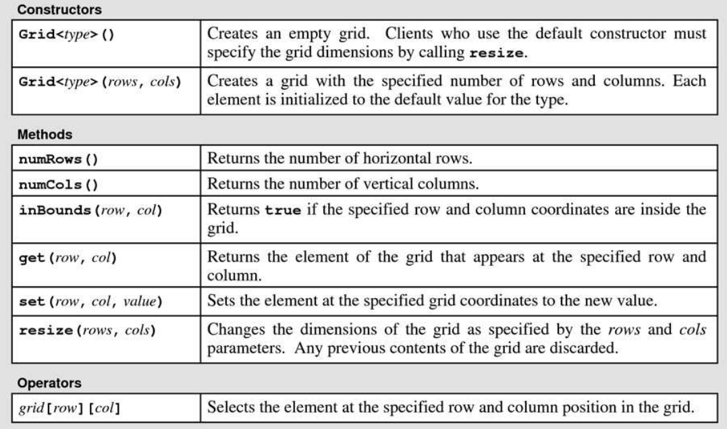
Grids
<Grid.h> provides a special class for handling 2-dimension vectors

Slide 74
Grid Through Examples
Usage of grids
// Examples
Grid<int> emptyGrd;
Grid<int> NonemptyGrd(3, 4);
cout << emptyGrd << endl;
cout << NonemptyGrd << endl;
cout << NonemptyGrd.numRows() << endl;
cout << NonemptyGrd.numCols() << endl;
cout << emptyGrd.inBounds(2, 1) << endl;
cout << NonemptyGrd.inBounds(2, 1) << endl;
NonemptyGrd.set(2, 1, 5);
cout << NonemptyGrd.get(2,1) << endl;
NonemptyGrd[2][1] = 19;
cout << NonemptyGrd[2][1] << endl;

Slide 75
Tic-Tac-Toe
Tic-Tac-Toe Game
“two players who take turns marking the spaces in a three-by-three grid with X or O. ”
Example:
X
X
O
X
O
X
O
X
X
O
X
O
O
X
O
O
X
O
X has won!
X
X
X
X
X
O
X
O
X
O

Slide 76
Implementation
The main logic of the game resides in the following loop
Query for the input from the current player
The current player places X or O on the board at a given coordinate
Check if the current player has won the game
If so, game ends
If not, the other play takes over, go back to Step 1
Take a look at the implementation in tic_tac_toe directory
You will find the checking of winning conditions is not complete, could you finish it?

Slide 77
Generic Procedures

Slide 78
Duplication of Functions
Operations for different instances of poly ADTs may behave the same
Example: reverse a vector
// Reverse vectors of ints
Vector<int> reverseVectorInt
(const Vector<int>& vec) {
Vector<int> result;
for (int i = vec.size()-1;
i >= 0; i--)
result.add(vec[i]);
return result;
}
// Reverse vectors of strings
Vector<string> reverseVectorString
(const Vector<string>& vec) {
Vector<string> result;
for (int i = vec.size()-1;
i >= 0; i--)
result.add(vec[i]);
return result;
}

Slide 79
Generic Procedures
A single function that captures a collection of equivalent operations under different type instances
Example: template function for reversing vectors:
// Reverse a vector of type T
template<class T>
Vector<T> reverseVector(const Vector<T>& vec)
{
Vector<T> result;
for (int i = vec.size()-1; i >= 0; i--)
result.add(vec[i]);
return result;
}

Slide 80
When Can be Used?
The operation is ignorant of the specific type instance
E.g., we do not need to inspect the elements of a vector for reversing it
// Get subsequences of a vector
template<class T>
Vector<Vector<T>> getSubseq(const Vector<T>& vec)
{
if (vec.isEmpty()) {
Vector<Vector<T>> emptySeq= {{}};
return emptySeq;
}
else {
Vector<T> svec = vec;
svec.remove(0);
Vector<Vector<T>> tvecs = getSubseq(svec);
Vector<Vector<T>> hvecs = addHead(vec[0], tvecs);
return tvecs + hvecs;
}
}

Slide 81

When Cannot be Used?
The operation is aware of the specific type instances
Example: Remove negative values from a vector
We need to check if an element is less than 0!
// Remove all negative values in vec
Vector<int> removeNegValues(Vector<int> vec)
{
if (vec.isEmpty())
return Vector<int>();
else {
Vector<int> head;
if (vec[0] >= 0) head.add(vec[0]);
vec.remove(0);
Vector<int> rest = removeNegValues(vec);
return head + rest;
}
}

Slide 82
Exercises
Which of the following operations over vectors are generic?
Concatenate two vectors
Linear search of a vector
Binary search of a vector
Matrix multiplication
Finding all the permutation of a vector

Slide 83
Stack

Slide 84
Structure of Stacks
A stack stores a sequence of values
Must be added and removed from the top
No way to look into the element below the top one
E
D
C
C
E
B
B
B
B
A
A
A
A

Slide 85
Stack ADT
Syntax (need to include in <Stack.h>):
Key operations:
push(value)
Push value on top of the stack (value becomes the topmost element)
peek()
Return the topmost element
pop()
Remove the topmost element and return it
Note: peek and pop reports an error for empty stacks
// Define an empty stack s of type T
Stack<T> s;
// Define a stack with initial values
Stack<T> s = { a1, a2, …, an };
This is the topmost value!

Slide 86
Example
// Initialize an empty stack
Stack<char> s;
cout << s << endl;
// Push values
s.push('A');
s.push('B');
s.push('C’);
// Print the topmost element
cout << s.peek() << endl;
// Pop the topmost element
s.pop();
cout << s << endl;
// More pops
s.pop();
s.pop();
// Errors: popping and peeking empty stacks
s.pop();
s.peek();

Slide 87
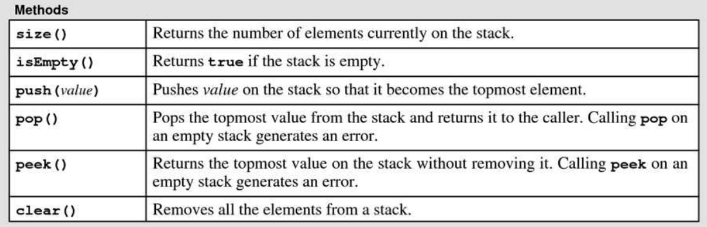
Summary of Stack Operations
Table 5-3 Textbook

Slide 88
Iteration of Stacks
Iteration can only be accomplished destructively
Pattern:
// Iterate over the stack s
while (!s.isEmpty()) {
int v = s.pop();
perform operation on v;
}

Slide 89
Reverse Strings
Reverse a string by using a stack
//Reverse a string
string reverseString(const string& str)
{
// rev stores str in reverse order
Stack<char> rev;
for (int i = 0; i < str.length(); i++)
rev.push(str[i]);
// transform rev into a string
string result;
while (!rev.isEmpty()) {
char ch = rev.pop();
result += ch;
}
return result;
}

Slide 90
Exercise
How to use a stack to check if a string is a palindrome?
// Check if a string is a palindrome
bool isPalindrome(const string& str)
{
// rev stores str in reverse order
Stack<char> rev;
for (int i = 0; i < str.length(); i++)
rev.push(str[i]);
bool result;
// Fill in here
return result;
}

Slide 91
Recursion over Stacks
Q: How to perform recursion over a stack?
A: Divide a problem about the stack into subproblems for smaller stacks
// Recursion over the stack
void f(Stack<T> s) {
if (s.isEmpty()) return;
int v = s.pop();
…
f(s);
…
}

Slide 92
Duplicate Elements
Duplicate every element in the stack
// Duplicate elements in s
void duplicate(Stack<int>& s)
{
if (s.isEmpty()) return;
int v = s.pop();
duplicate(s);
s.push(v);
s.push(v);
}

Slide 93
More Applications of Stacks

Slide 94
Stack Frames
Recall that
At each function call a frame containing local variables is created
At each function return the frame is destroyed
Example:
void g() {}
void f()
{
h();
h();
}
Frame for main
Frame for f
Frame for g
int main()
{
f();
g();
return 0;
}
Frame for h
Frame for h

Slide 95
ADT to Mimic Stack Frames
Use a string stack to mimic the stack frames
Push an element at function entry
Pop an element at function return
// Push a pseudo frame for function fname and print a message
void pushAndPrint(Stack<string>& frames, const string& fname)
{
frames.push(string("Frame " + fname);
cout << "Push: " << frames << endl;
}
// Pop a pseudo frame and print a message
void popAndPrint(Stack<string>& frames)
{
frames.pop();
cout << "Pop: " << frames << endl;
}

Slide 96
Simulation of Stack of Frames
Simulation Example:
// Function G
void g(Stack<string>& frames)
{
pushAndPrint(frames, "G");
popAndPrint(frames);
}
// Function Main
int main()
{
Stack<string> frames;
pushAndPrint(frames, "Main");
f(frames);
g(frames);
popAndPrint(frames);
return 0;
}
// Function H
void h(Stack<string>& frames)
{
pushAndPrint(frames, "H");
popAndPrint(frames);
}
// Function F
void f(Stack<string>& frames)
{
pushAndPrint(frames, "F");
h(frames);
h(frames);
popAndPrint(frames);
}

Slide 97
Balanced Symbols
How to decide if a string contains balanced pairs of ‘{‘, ‘}’, ‘(‘, ‘)’, and ‘[‘, ‘]’?
Examples:
The following string is balanced
The following string is NOT balanced
(This [is { a valid } [ test case] ])
(This [is { a valid } [ test case] ])
(This {is [not] {a valid} ] test case)
(This {is [not] {a valid} ] test case)
Symbols NOT matching!

Slide 98
How to Check the Balance?
Search from left to right
Keep a stack of symbols not yet matched
Grow the stack if a left symbol occurs (‘{‘, ‘(‘, ‘[‘)
Pop the matching left symbol when a right symbol occur (‘}’, ‘)’, ‘]’)
Example:
(This [is { a valid } [ test case] ])
(
[
{
[
(This {is [not] {a valid} ] test case)

Slide 99
Implementation
Checking symbols
// Check if a left symbol
bool isLeftSymbol(char ch)
{ return ch == ‘(’ || ch == ‘[’ || ch == ‘{‘; }
// Check if a right symbol
bool isRightSymbol(char ch)
{ return ch == ‘)’ || ch == ‘]’ || ch == ‘}‘; }
// Check if brackets are matching
bool isMatching(char left, char right)
{
return (left == '(' && right == ')') ||
(left == '[' && right == ']') ||
(left == '{' && right == '}');
}

Slide 100
Implementation
Check if a string is balanced
bool isBalanced(const string& str) {
Stack<char> pstack;
for (int i = 0; i < str.size(); i++) {
char ch = str[i];
// Push left symbols on to the stack
if (isLeftSymbol(ch))
pstack.push(ch);
// Do checking for right symbols
else if (isRightSymbol(ch)) {
// Return if no matching left symbol
if (pstack.isEmpty())
return false;
// Pop the paring left symbol and check
else {
char left = pstack.pop();
if (!isMatching(left, ch))
return false;
}
}
}
// Check if all the left symbol has been matched
return pstack.isEmpty();
}

Slide 101
Tower of Hanoi Revisited
Assume the disks are numbered in the tower of Hanoi
When moving disk n to from X to Y, we would like to print
Move disk n: X -> Y
1
2
3
4
5
A B C

Slide 102
Exercise
Implement a solution to the revised tower of Hanoi game
// The original solution
void hanoi(int n, char src, char tgt, char aux)
{
if (n <= 0) return;
if (n == 1)
cout << src << " -> " << tgt << endl;
else {
hanoi(n-1, src, aux, tgt); // Move n-1 disks
cout << src << " -> " << tgt << endl;
hanoi(n-1, aux, tgt, src); // Move n-1 disks
}
}
int main()
{
Stack<int> disks = {5, 4, 3, 2, 1};
hanoi(disks.size(), 'A', 'B', 'C');
return 0;
}

Slide 103
RPN Calculator
RPN (reverse Polish notation) calculator is a class of calculators
Read an operator only after ALL of its operands are supplied
Example:
Regular form:
3.14 * 5.0 * 5.0 + 1.72 / 2.0
Explicit Precedence:
((3.14 * 5.0) * 5.0) + (1.72 / 2.0)
RPN:
((3.14 5.0 *) 5.0 *) (1.72 2.0 /) +

Slide 104
Computation via a Stack
Use a stack to store the operands and immediate values
Example:
((3.14 5.0 *) 5.0 *) (1.72 2.0 /) +
3.14
5.0
*
5.0
*
1.72
2.0
/
+
2.0
5.0
5.0
1.72
1.72
0.86
3.14
3.14
15.7
15.7
78.5
78.5
78.5
78.5
79.35

Slide 105
Single Operations
// Perform operation op and check if succeeded
bool calculate(Stack<double>& vstack, char op, double& result)
{
if (vstack.size() < 2) return false;
double v2 = vstack.pop();
double v1 = vstack.pop();
switch (op) {
case '+':
result = v1 + v2;
break;
…
default:
return false;
}
vstack.push(result);
return true;
}

Slide 106
Main Loop
Stack<double> vstack; // Stack of values
string input; // User input
double result; // Intermediate result
// Main loop
while (true) {
getline(cin, input);
if (input == "Quit") break;
if (input == "Print") {
cout << vstack << endl;
continue;
}
if (isdigit(input[0]))
vstack.push(atof(input.c_str()));
else if (calculate(vstack, input[0], result))
cout << result << endl;
else {
cout << "Error encountered!" << endl;
return -1;
}
}

Slide 107
Queue

Slide 108






Structure of Queues
A queue stores a sequence of values
A value can only be added from the tail
A value can only be fetched from the head
$$V_{0}$$
enqueue
$$V_{n}$$
$$…$$
$$V_{2}$$
$$V_{2}$$
$$V_{1}$$
dequeue
head
tail
Structure of a Queue

Slide 109












FIFO and LIFO
Stack is a last-in-first-out (LILO) data structure
Queue is a first-in-first-out (FIFO) data structure
$$V_{0}$$
push
A Stack
$$V_{n}$$
$$…$$
$$V_{2}$$
$$V_{2}$$
$$V_{1}$$
bottom
top
pop
$$V_{0}$$
enqueue
A Queue
$$V_{n}$$
$$…$$
$$V_{2}$$
$$V_{2}$$
$$V_{1}$$
dequeue
head
tail

Slide 110
Queue ADT
Syntax (need to include in <Queue.h>):
Key operations:
enqueue(value)
Add value to the tail of the queue
peek()
Return the head element
dequeue()
Remove the head element and return it
Note: peek and dequeue reports an error for empty queues
// Define an empty queue q of type T
Queue<T> q;
// Define a queue with initial values
Queue<T> q = { a1, a2, …, an };
This is the tail!

Slide 111
Example
// Initialize an empty queue
Queue<int> q;
cout << q << endl;
// Add values
q.enqueue(1);
q.enqueue(2);
q.enqueue(3);
cout << q << endl;
// Print the head element
cout << q.peek() << endl;
// Remove the head element
q.dequeue();
cout << q << endl;
// More dequeues
cout << q.dequeue() << endl;
cout << q.dequeue() << endl;
// Errors: dequeuing and peeking empty queues
q.dequeue();
q.peek();

Slide 112





Applications of Queues
Filtering
Feed a sequence of elements into a queue and filter out certain class of elements
Routing & Scheduling
Collect elements from incoming channels and dispatch them to outgoing channels
Dequeue &
filter
$$V_{n}$$
$$…$$
$$V_{2}$$
$$V_{2}$$
$$V_{1}$$
feed
head
tail
Router/
Scheduler
Outgoing channels
Incoming channels

Slide 113









Filtering Negative Values
Generator: generates N integers between (-100, 100)
Filter: filter out all negative values
Generator
$$V_{n}$$
$$…$$
$$V_{2}$$
$$V_{2}$$
$$V_{1}$$
Filter
head
tail
$$I_{1}$$
$$I_{2}$$
$$…$$
$$I_{k}$$

Slide 114
Implementation
Randomly generate N integers (use randomInteger in <Random.h>)
Filter out all negative integers
void generateIntegers(int n, Queue<int>& q) {
for (int i = 0; i < n; i++)
q.enqueue(randomInteger(-100, 100));
}
Vector<int> filterNegInts(Queue<int>& q) {
Vector<int> result;
while (!q.isEmpty()) {
int v = q.dequeue();
if (v >= 0)
result.add(v);
}
return result;
}

Slide 115
Implementation
Main Function
// Generate and filter out negative values
int main()
{
int n = 20;
Queue<int> q;
generateIntegers(n, q);
cout << "The original values are: " << q << endl;
Vector<int> filtered = filterNegInts(q);
cout << "The filtered values are: " << filtered;
return 0;
}

Slide 116
Routing Messages
A generator sends string messages through a channel
A message beginning with an exclamation mark (!) is important
Router must forward the important messages to a special channel
Regular channel
Incoming channels
Router
Generator
Special channel

Slide 117
Implementation
Message generation
// Generate a random letter
char randomLetter() {
int i = randomInteger(0, 25)
return char(‘a’+ i);
}
// Generate a random message
string randomMessage() {
int len = randomInteger(1, 10);
string res;
// Randomly generate importance
if (randomBool())
res += '!';
for (int i = 0; i < len; i++)
res += randomLetter();
return res;
}
// Generator
void generateMessages
(int n, Queue<string>& ichannel)
{
for (int i = 0; i < n; i++)
ichannel.enqueue(randomMessage());
}

Slide 118
Implementation
Message routing
// Check if a message is important
bool isImportant(const string& msg)
{ return msg.size() !=0 && msg[0] == ‘!‘; }
// Router
void routeMessages(Queue<string>& ichannel,
Queue<string>& specialOut,
Queue<string>& regularOut) {
while (!ichannel.isEmpty()) {
string s = ichannel.dequeue();
if (isImportant(s))
specialOut.enqueue(s);
else
regularOut.enqueue(s);
}
}

Slide 119
Implementation
Main function:
// Generate and route messages
int main()
{
int n = 10;
Queue<string> ichannel, specialOut, regularOut;
generateMessages(n, ichannel);
cout << "Incoming messages: " << ichannel << endl;
routeMessages(ichannel, specialOut, regularOut);
cout << "Outgoing regular messages: " << regularOut << endl;
cout << "Outgoing special messages: " << specialOut << endl;
return 0;
}

Slide 120
Exercise
How to let the router to handle multiple generators?
Generator 1
Regular channel
Router
Incoming channels
● ● ●
Special channel
Generator n

Slide 121
Simulation
Operations on queues often happen at real time
We design discrete-time models to simulate such operations
A global clock records the current time
An operation may (repeatedly) happen at certain times
A loop simulates the progress of time
Every loop represent passing of one tick
Operation 1
+1s
……
Operation n

Slide 122





Simulation of a Filter
We use the filter of negative values as an example
At every tick
The generator may enqueue a value if it is time
The filter may filter a value if it is time
Generator
$$V_{n}$$
$$…$$
$$V_{2}$$
$$V_{2}$$
$$V_{1}$$
Filter
head
tail
$$I_{1}$$
$$I_{2}$$
$$…$$
$$I_{k}$$

Slide 123
A Global Clock
We use a global counter to represent the clock
We define the speed of every operation
// Global clock
int CLOCK = 0;
// Filter runs every 3 ticks
const int FILTER_TIME = 3;
// Generator runs every 2 tick
const int GENINT_TIME = 2;

Slide 124
Simulation of the Integer Generator
Generates an integer and add to the queue if it is the time
// Generator
bool generateInteger(Queue<int>& q)
{
if (CLOCK % GENINT_TIME != 0)
return false;
int v = randomInteger(-100, 100);
cout << "Generated: " << v << endl;
q.enqueue(v);
return true;
}

Slide 125
Simulation of the Filter Function
Read from the queue and filter the value if it is the time
// Filter
bool filterNegInt(Queue<int>& q, Vector<int>& res)
{
if (CLOCK % FILTER_TIME != 0)
return false;
if (q.isEmpty()) {
cout << "Nothing to filter" << endl;
return false;
}
else {
int v = q.dequeue();
if (v >= 0) {
res.add(v);
cout << "Kept: " << v << endl;
} else
cout << "Discarded: " << v << endl;
return true;
}
}

Slide 126
Simulation Loop
// Simulation loop, n denotes the # of integers to be generated
void simulate(int n) {
Queue<int> q; Vector<int> vec;
// i denotes the number of integers already generated
int numGen = 0;
// Every loop performs an operation if it is ready
while (true) {
CLOCK++;
cout << "Time (ticks): " << CLOCK << endl;
// Run the generator
if (numGen < n && generateInteger(q))
numGen++;
// Run the filter
filterNegInt(q, vec);
cout << "---------------------" << endl;
// All numbers has been generated and filtered
if (numGen == n && q.isEmpty())
break;
}
cout << "The final result is: " << vec << endl;
}

Slide 127
Simulation of a Router
The simulation of the previous router follows the same idea
A global clock
Simulation of the message generator
Simulation of the routing function
Simulation of the progress of time
See the 33_router_sim directory for details

Slide 128
Queue for Algorithms
Many algorithms need queues
Breadth First Search
Edmond Karp Algorithm
Fibonacci Heap
….
We will not further delve into non-trivial algorithms
Instead, we revisit a previous problem …

Slide 129
Find Subsequences
Find all the subsequences of a vector
The subsequences of {42, -13, 101} are
We have seen a recursive solution using 2-dimension vectors
We can also have an iterative solution (assume there is N elements)
For 0 to (N-1)-th elements, we can either choose to include the element or not
Every unique sequence of choices result in a distinct subsequence
{}
{42}
{-13}
{101}
{42，-13}
{-13，101}
{42，101}
{42，-13，101}

Slide 130
Iterative Solution
{}
{}
{101}
{}
Not include the 0-th element
{-13}
{-13}
{-13, 101}
42
-13
101
{}
{42}
Include the 0-th element
{42}
{42, 101}
{42}
{42,-13}
{42,-13}
{42,-13,101}

Slide 131
Implementation
i=3(done)
i=2
{}
i=1
{}
// Iteratively find subsequences
Queue<Vector<int>> findSubseqs
(const Vector<int>& vec) {
Queue<Vector<int>> subSeqs = { {} };
for (int i = 0; i < vec.size(); i++) {
// subSeqs contains i-th column
int n = subSeqs.size();
for (int j = 0; j < n; j++) {
Vector<int> s = subSeqs.dequeue();
// Not include the i-th element
subSeqs.enqueue(s);
// Include the i-th element
s.add(vec[i]);
subSeqs.enqueue(s);
}
}
return subSeqs;
}
i=0
{101}
{}
{-13}
{-13}
{-13, 101}
{}
{42}
{42}
{42, 101}
{42}
{42,-13}
{42,-13}
{42,-13,101}

Slide 132
Pair

Slide 133
Pairs
pair: A polymorphic ADT representing an ordered pair of values
Syntax (Defined in C++ standard library and in namespace std):
Access the values
// Define pair of elements of type T and S
// The values are set to default ones
pair<T, S> p;
// The first value is initialized to t
// The second value is initialized to s
pair<T, S> p(t, s)
// Same as above but without explicit types
make_pair(t, s)
// Read the first value of p
p.first
// Get the second value of p
p.second

Slide 134
Example
Defining and accessing pairs
// Define pairs
pair<string, int> p;
pair<string, int> p1("abc", 1);
pair<char, double> p2 = make_pair('C', 2.0);
// Access pairs
cout << "(" << p.first << ", " << p.second << ")" << endl;
cout << "(" << p1.first << ", " << p1.second << ")" << endl;
cout << "(" << p2.first << ", " << p2.second << ")" << endl;

Slide 135
Phone Table
Define a table of which each entry is a pair of names and phone numbers
Operations: find entry, add entry, remove entry
// The type of phone books
Vector<pair<string, int>>
// Examples
Vector<pair<string, int>> table;
addEntry(table, "ZhangSan", 13300010002);
addEntry(table, "LiSi", 13912345678);
addEntry(table, "WangWu", 13507071212);
printTable(table);
cout << findEntry(table, "WangWu") << endl;
removeEntry(table, "WangWu");
printTable(table);
cout << findEntry(table, "WangWu") << endl;

Slide 136
Find Entries
// Find the entry with the name and return its index
// Return -1 if there is no such index
int findEntry(const Vector<pair<string, int>>& table, string name)
{
for (int i = 0; i < table.size(); i++)
if (table[i].first == name)
return i;
return -1;
}

Slide 137
Add and Remove Entries
// Add an entry to the table if there is no entry with name
bool addEntry(Vector<pair<string, int>>& table, string name, int number)
{
if (findEntry(table, name) >= 0)
return false;
table.add(make_pair(name, number));
return true;
}
// Remove an entry from the table
void removeEntry(Vector<pair<string, int>>& table, string name)
{
int i = findEntry(table, name);
if (i < 0) return;
table.remove(i);
}

Slide 138
Print Tables
// Print the student table
void printTable(const Vector<pair<string, int>>& table)
{
cout << "{";
for (int i = 0; i < table.size(); i++)
cout << "(" << table[i].first << ", " << table[i].second << "); ";
cout << "}" << endl;
}

Slide 139
Exercise
Question: Which of the following operations are GENERIC?
int findEntry(const Vector<pair<string, int>>& table, string name);
bool addEntry(Vector<pair<string, int>>& table, string name, int number);
void removeEntry(Vector<pair<string, int>>& table, string name);
void printTable(const Vector<pair<string, int>>& table);

Slide 140
Generic Tables
The operation on phone tables are ignorant of element types
A generic table may be implemented following the same idea
// The type of generic tables
Vector<pair<S, T>>
// Generic Operations
template <class T, class S>
int findEntry(const Vector<pair<T, S>>& table, T key);
template <class T, class S>
bool addEntry(Vector<pair<T, S>>& table, T key, S value);
template <class T, class S>
void removeEntry(Vector<pair<T, S>>& table, T key);
template <class T, class S>
void printTable(const Vector<pair<T, S>>& table)

Slide 141
Find Entries
Note:
the key and values becomes generic types
The implementation is the same as before
// Find the entry with the key and return the index
// Return -1 if there is no such index
template <class T, class S>
int findEntry(const Vector<pair<T, S>>& table, T key)
{
for (int i = 0; i < table.size(); i++)
if (table[i].first == key)
return i;
return -1;
}

Slide 142
Add and Remove Entries
// Add an entry to the table if there is no entry with key
template <class T, class S>
bool addEntry(Vector<pair<T, S>>& table, T key, S value)
{
if (findEntry(table, key) >= 0)
return false;
table.add(make_pair(key, value));
return true;
}
// Remove an entry from the table
template <class T, class S>
void removeEntry(Vector<pair<T, S>>& table, T key)
{
int i = findEntry(table, key);
if (i < 0) return;
table.remove(i);
}

Slide 143
Print Table
// Print the table
template <class T, class S>
void printTable(const Vector<pair<T, S>>& table)
{
cout << "{";
for (int i = 0; i < table.size(); i++)
cout << "(" << table[i].first << ", " << table[i].second << "); ";
cout << "}" << endl;
}

Slide 144
Map

Slide 145
Structure of Maps
Map: a collection of pairs
The first element is called the key
The second element is called the value
Usage: look up a value by supplying a key
Examples: dictionaries, address books, menus
Keys(name) Values (price per kilo)
“Cabbage” → 11.4
“Pork” → 17.6
“Beef” → 20.1

Slide 146
Map ADT
Syntax (need to include in <Map.h>):
Note: the ordering of pairs are not important
The following maps behave equivalently
// Define an empty map m from K to V
Map<K, V> m;
// Define a map with initial pairs
Map<K, V> m = {{k1, v1}, …, {kn, vn}};
Map<string, double> m1 = {{“Cabbage”, 11.4},
{“Pork”, 17.6},
{“Beef”, 20.1}};
Map<string, double> m2 = {{“Beef”, 20.1},
{“Pork”, 17.6},
{“Cabbage”, 11.4}};

Slide 147
Put
m.put(key, value): add a key value pair to the map
Replace old pair if the key is defined
Add a new pair if the key is not defined
Keys Values
“Cabbage” → 11.4
“Pork” → 17.6
“Beef” → 20.1
Keys Values
“Cabbage” → 11.4
“Pork” → 17.6
“Beef” → 19.0
m.put(“Beef”, 19.0)
Keys Values
“Cabbage” → 11.4
“Pork” → 17.6
“Beef” → 20.1
Keys Values
“Cabbage” → 11.4
“Pork” → 17.6
“Beef” → 20.1
“Lamb” → 22.2
m.put(“Lamb”, 22.2)

Slide 148
Get
m.get(key): return the value associated to the key in the map
Return the current value if the key is defined
Return a default value if the key is not defined
Keys Values
“Cabbage” → 11.4
“Pork” → 17.6
“Beef” → 20.1
m.get(“Beef”) = 20.1
Keys Values
“Cabbage” → 11.4
“Pork” → 17.6
“Beef” → 20.1
m.get(“Lamb”) = 0

Slide 149
Remove
m.remove(key): remove the pair associated with key in the map
Remove the value alongside the key if it is defined
Does nothing if the key is not defined
Keys Values
“Cabbage” → 11.4
“Pork” → 17.6
“Beef” → 20.1
Keys Values
“Cabbage” → 11.4
“Pork” → 17.6
m.remove(“Beef”)
Keys Values
“Cabbage” → 11.4
“Pork” → 17.6
“Beef” → 20.1
Keys Values
“Cabbage” → 11.4
“Pork” → 17.6
“Beef” → 20.1
m.remove(“Lamb”)

Slide 150
[] Operator
[_] is overloaded for maps
m[key] = value is equivalent to m.put(key, value)
m[key] is equivalent to m.get(key)
Note: Maps are like vectors with non-linear indices
Keys Values
“Cabbage” → 11.4
“Pork” → 17.6
“Beef” → 20.1
Keys Values
“Cabbage” → 11.4
“Pork” → 17.6
“Beef” → 19.0
M[“Beef”] = 19.0
Keys Values
“Cabbage” → 11.4
“Pork” → 17.6
“Beef” → 20.1
m[“Beef”] == 20.1

Slide 151
Check Keys
m.containsKey(key) returns true if key is defined and false otherwise,
Keys Values
“Cabbage” → 11.4
“Pork” → 17.6
“Beef” → 20.1
m.containKeys(“Pork”) = true
Keys Values
“Cabbage” → 11.4
“Pork” → 17.6
“Beef” → 20.1
m.containKeys(“Lamb”) = false

Slide 152
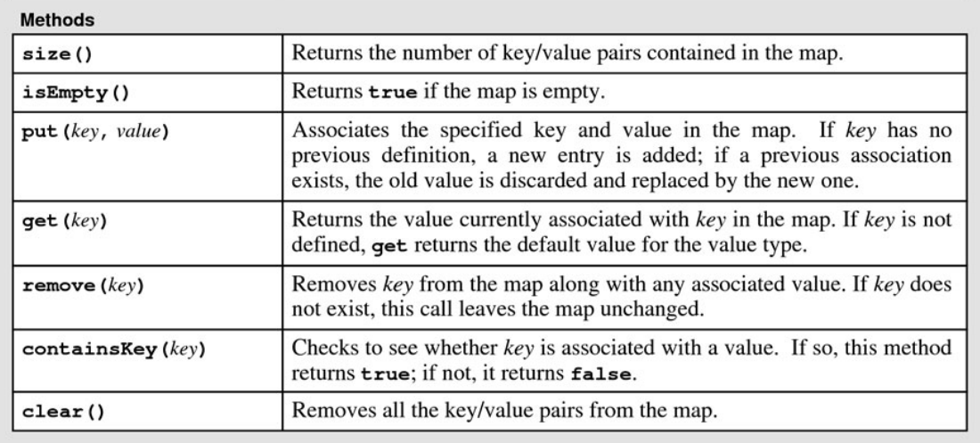
Summary of Methods

Slide 153
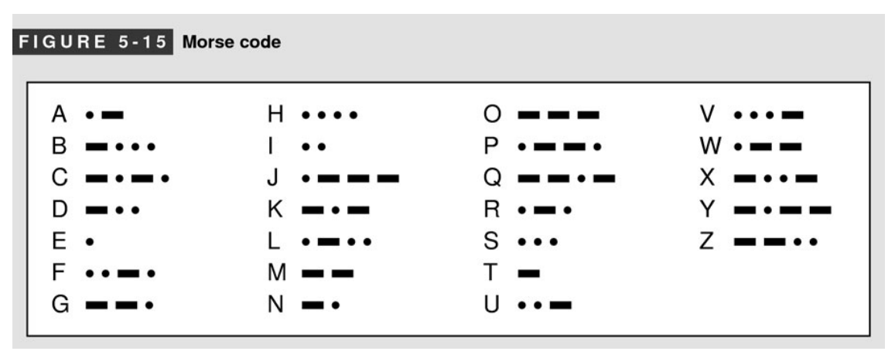
Morse Code
Represent each letter with a sequence of long and short signals (also know as dots and dashes)
The sequences of dots and dashes are separated by spaces
Example: “CHINA” is encoded as
—•—• •••• •• —• •—

Slide 154
Representation
Use a map to store the encoding of each letter
Morse code map is created as follows:
// Mapping from letter to morse code
// true represent a dash, false a dot
Map<char, Vector<bool>> morseCodeMap;
// Create the map for morse code
Map<char, Vector<bool>> createMap()
{
Map<char, Vector<bool>> m;
m.put('A', {false, true});
m.put('B', {true, false, false, false});
m.put('C', {true, false, true, false});
…
return m;
}

Slide 155
Encoding a Single Letter
// Encode a letter ch into morse code
string encodeLetter(const MorseCodeMap& m, char ch)
{
if (!m.containsKey(ch))
return "";
const Vector<bool>& v = m[ch];
string result;
for (int i = 0; i < v.size(); i++) {
if (v[i])
result += '-';
else
result += '.';
}
return result;
}

Slide 156
Encoding a String
Q: any problem with the implementation? If so, how to fix them?
// Encode a string into morse code
string encodeString(const MorseCodeMap& m, const string& str)
{
string result;
for (int i = 0; i < str.size(); i++) {
char ch = str[i];
string s = encodeLetter(m, ch);
if (s.empty())
return "";
result += s + " ";
}
return result;
}

Slide 157
Set

Slide 158
Structure of Sets
A set stores an unordered collection of values
No duplication of values
Typical operations on sets: membership, subset, union, intersection, etc
“Cabbage”
“Beef”
“Lamb”
“Pork”
Structure of a Set

Slide 159
Set ADT
Syntax (need to include in <Set.h>):
Examples:
// Define an empty set
Set<T> s;
// Define a set with values v1,…, vn
Set<T> s = { v1, …, vn };
// An empty set of integers
Set<int> s;
// A set of strings
Set<string> s1 = {"Beef", "Cabbage", "Pork", "Lamb"};

Slide 160
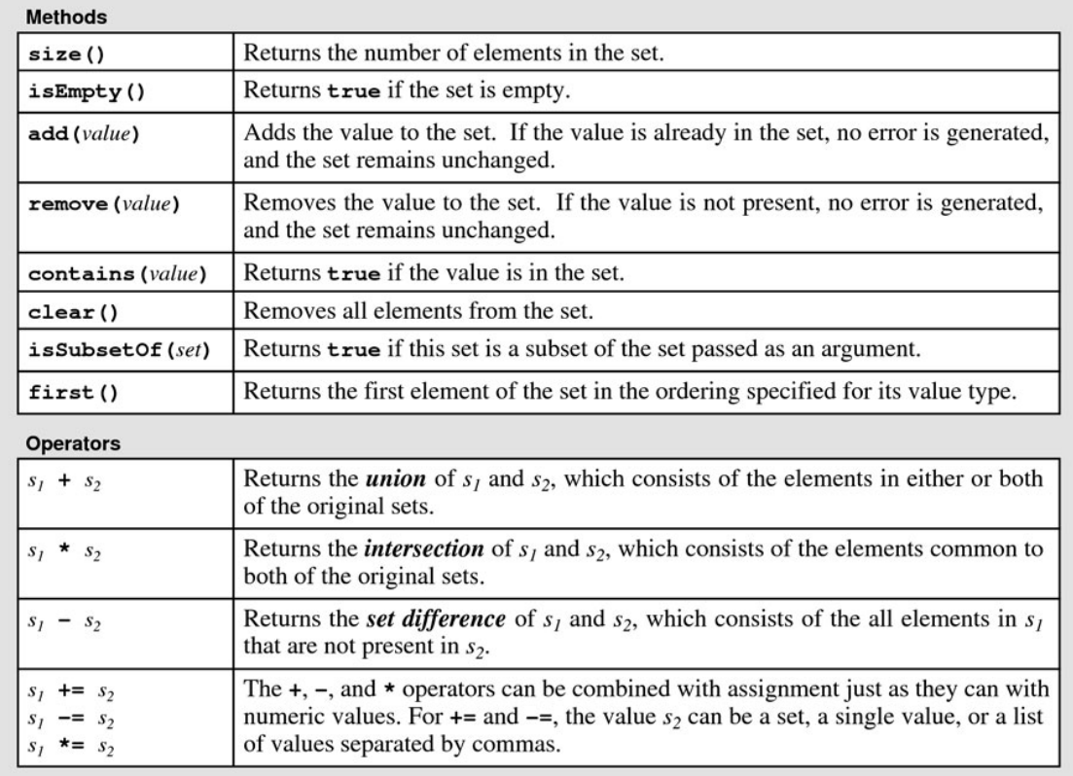
Operations
See Table 5-6 of the textbook.

Slide 161
Examples
Set<int> s;
Set<string> s1 = {"Beef", "Cabbage", "Pork", "Lamb"};
s.add(100);
s.add(200);
s.add(100);
s.add(300);
cout << s << endl;
s.remove(100);
cout << s << endl;
cout << s.contains(100) << endl;
cout << s.contains(200) << endl;
Set<string> s2 = {"Beef", "Cabbage", "Beef"};
cout << s2.isSubsetOf(s1) << endl;
s2.add("Crab");
cout << s2 << endl;
cout << s2.isSubsetOf(s1) << endl;
cout << s1 + s2 << endl;
cout << s1 * s2 << endl;
cout << s1 - s2 << endl;

Slide 162
Implementing <cctype>
Implement isalpha
Set<char> getAlphas()
{
Set<char> s;
for (char ch = 'a'; ch <= 'z'; ch++) {
s.add(ch);
s.add(ch-'a'+'A');
}
return s;
}
bool isalpha(char ch)
{
Set<char> letters = getAlphas();
return letters.contains(ch);
}

Slide 163
Iteration over Collections

Slide 164
Iteration Pattern
Pattern:
Example:
// Iterate over every element the collection
// Every iteration assigns an element to var
for (<type> <var>: <collection>) {
body of the loop
}
// Iterate over a vector
Vector<int> vec = {1, 2, 3, 4, 5};
for (int v : vec)
cout << v << " ";

Slide 165
Iteration Order
Depends on the type of collection
Vector: in the sequential order
Grid: in row-major order
Map: in the natural order for the key type
Set: in the natural order for the value type
Grid<double> matrix = { {42, -13, 101},
{10, -99, 62},
{-80, 33, 28},
{9, 0, 12} };
for (double v : matrix)
cout << v << " ";
Map<string, double> m = {{"Cabbage", 11.4}, {"Pork", 17.6}, {"Beef", 20.1}};
for (string key: m)
cout << key << ", " << m[key] << endl;
cout << endl;

Slide 166
Invalid Usage
The previous iteration pattern cannot be used on stacks and queues
Question: Why?
// Error: No Iteration for Stacks
Stack<int> stack = {1, 2, 3, 4, 5};
for (int v : stack)
cout << v << " ";
cout << endl << endl;

Slide 167
Elimination of Duplication
Given a vector of integers, eliminate all of its duplicated values
// Eliminate the duplication in vec
void elimDup(Vector<int>& vec)
{
Set<int> s;
for (int v : vec)
s.add(v);
vec.clear();
for (int v : s)
vec.add(v);
}

Slide 168
Decoding of Morse Code
The following code revert the map for encoding morse code
Q: How to decode morse code using this map?
/* Decoding */
Map<string, char> decodeMap()
{
MorseCodeMap m = createMap();
Map<string, char> dm;
for (char l : m) {
string s = encodeLetter(m, l);
dm.put(s, l);
}
return dm;
}

Slide 169
Next Time
Designing ADT/Classes
Object Initialization and Finalization
Operator Overloading
Interfaces vs. Implementations
You should read Chapter 6 in the text book

