Slide 1
Principles and Methods of Program Design Lecture 7: Pointers & Dynamic Resources
Yuting Wang
SEIEE
John Hopcroft Center for Computer Science
2022.5.10

Slide 2
Road Map
Basics of Imperative Programming (C++)
Programming with Abstractions
Implementing Abstractions
Here!

Slide 3
Last Time
Designing ADT/Classes
Object Initialization and Finalization
Operator Overloading
Interfaces vs. Implementations
Concrete Data Types

Slide 4
This Time
Execution Model Revisited
Pointers
Arrays
C-Style Strings
Heap and Dynamic Allocation
Dynamic Resource Management

Slide 5
Execution Model Revisited

Slide 6
Key Ideas
To understand pointers and pointer variables, we need an in-depth understanding of the execution model of C++ programs
Key Concepts:
In-memory objects
Environments: Mapping of variable symbols to memory regions
Memory addresses as data values
L-value and R-value expressions
L-value and R-value positions

Slide 7


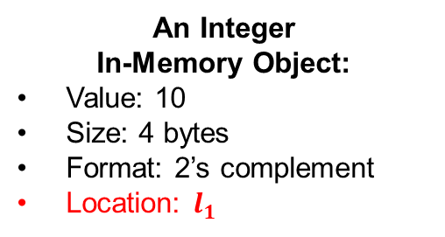
In-Memory Objects
An in-memory object is a piece of memory with
Data values stored in this memory
Type information that determines
The size of the data (e.g., 1 byte for char, 4 bytes for int)
The format of the data (e.g., ASCII code for char, 2’s complement for int)
A unique identifier called the location of the object (given upon creation)
Created and destroyed during execution (global and stack variables)
4 bytes
$$l_{1}$$
$$l_{1}$$
1010
binary form
10
An Integer
In-Memory Object:
Value: 10
Size: 4 bytes
Format: 2’s complement
Location: $l_{1}$
We often omit
some details

Slide 8

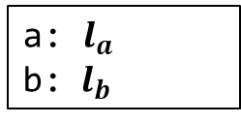

Variable Definitions Revisited
A variable definition:
By defining T p, we denote
an in-memory object storing values of type T will be created at the right time
p will be mapped to location of that object
// Defines a variable
<type> <name>;
<type> <name> = <expr>;
$$l_{a}$$
$$l_{b}$$
int a = 10;
int main()
{
int b = 3;
return 0;
}
10
3
Created at the
start of program
Created at the
start of main function
a: $l_{a}$
b: ${ l}_{b}$

Slide 9


Composite In-Memory Objects
In-memory objects may be created from ADT/CDT
ADT/CDT with member variables denotes composite in-memory objects
// Point structure
class Point {
public:
Point(int px, int py)
: x(px), y(py) {}
...
private:
int x;
int y;
};
int main() {
Point p(2, 3);
return 0;
}
4 bytes
4 bytes
$$l_{p}$$
2
3
x
y
p: $l_{p}$
PC

Slide 10

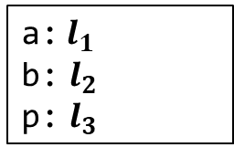


Memory States and Environments
Memory states: a collection of in-memory objects
Note: they may either contain primitive data or an ADT/CDT object
Environments: a mapping from variable names to locations
int a = 10;
int main()
{
int b = 3;
Point p(2,3);
…
return 0;
}
Global
Memory
Stack
Memory
$$l_{1}$$
$$l_{2}$$
10
3
$$l_{3}$$
PC
2
3
a:$l_{1}$
b: $l_{2}$
p: $l_{3}$
Environment:

Slide 11
C++ Abstract Machine
A C++ program executes by running an abstract machine
A C++ abstract machine has the following components
The program being executing (may contain multiple modules)
The program state, including:
The program counter (points to the current command)
The environment
The memory state
I/O devices
The machine runs by executing the command pointed to by PC, which
Query the environment and memory state for evaluating expressions
Execute the commands and change the state (assignment, I/O etc)
Adjust PC (sequential execution, branching, loop, … etc)

Slide 12






Memory Addresses
A memory address ($l$, $o$) is a pair of location $l$and an integer offset $o$ bytes
Example: Assume $l$ is the location of an in-memory object
($l$, $0$) points to the first byte of the object
($l$, $1$) points to the second byte of the object
... (and so on)
1 byte:
$$l$$
($l$, $0$)
($l$, $1$)
($l$, $2$)
($l$, $3$)
● ● ●

Slide 13





Memory Addresses
We often group bytes according to data types
Example: $l_{p}$ is the location of an in-memory object with two adjacent integers (4 bytes)
($l_{p}$, $0$) points to the beginning of the object (the beginning of the first integer)
($l_{p}$, $4$) points to the middle of the object (the beginning of the second integer)
($l_{p}$, $8$) points to the end of the object
4 bytes
4 bytes
$$l_{p}$$
0
0
($l_{p}$, $0$)
($l_{p}$, $8$)
($l_{p}$, $4$)

Slide 14

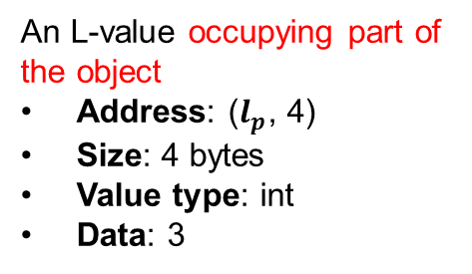


L-values
An L-value is a part of some in-memory object
An L-value as the following properties
A memory address ($l$, $o$)
Data value stored at the address
A type T determining the size and format of stored data
4 bytes
4 bytes
4 bytes
$$l_{1}$$
$$l_{p}$$
10
2
3
x
y
An L-value occupying the whole in-memory object
Address: ($l_{1}$, 0)
Size: 4 bytes
Value type: int
Data: 10
An L-value occupying part of the object
Address: ($l_{p}$, 4)
Size: 4 bytes
Value type: int
Data: 3

Slide 15
R-values
An R-value is a data value not in memory
They include temporary values or objects generated during computation
void print(string s)
{ cout << s << endl; }
int main()
{
print(“Hello, world!”)
return 0;
}
int main()
{
int a = 10;
int b = 3;
cout << a + b << endl;
return 0;
}
The result of a + b is an R-value
A temporary string object is generated from C-style string

Slide 16
L-value Expressions
An L-value expression evaluates to an L-value
Denotes data in memory
The following are L-value expressions:
Variable expressions
Assignment expressions
Member Variable Access
Reference variables
Pointer dereferences (discussed later)
… (not an exhaustive list)
Note: we often conflate L-values with L-value expressions

Slide 17
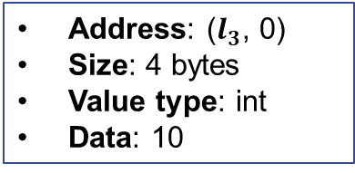

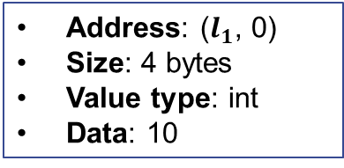
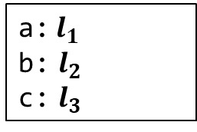


Variable Expressions
Evaluates to the in-memory object for the variable
int a = 10;
int main()
{
int b = 3;
Counter c(a);
c.get();
return 0;
}
Global
Memory
Stack
Memory
$$l_{1}$$
$$l_{2}$$
10
3
PC
$$l_{3}$$
10
a:$l_{1}$
b: $l_{2}$
c: $l_{3}$
Address: ($l_{1}$, 0)
Size: 4 bytes
Value type: int
Data: 10
Address: ($l_{3}$, 0)
Size: 4 bytes
Value type: int
Data: 10
Environment:

Slide 18


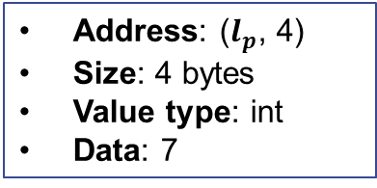
Member Variable Access
Evaluate to a part of the in-memory object for the object variable
Stack
Memory
// Point structure
struct Point {
Point(int px, int py)
: x(px), y(py) {}
int x;
int y;
};
int main() {
Point p(5, 7);
cout << p.y << endl;
return 0;
}
4 bytes
4 bytes
$$l_{p}$$
5
7
x
y
Environment:
p: $l_{p}$
Address: ($l_{p}$, 4)
Size: 4 bytes
Value type: int
Data: 7
PC

Slide 19
Sizes of Data in L-values
Given a value, its size is determined by its type
Use the sizeof function to find out (returns the size in bytes)
sizeof can also be applied to types
int main()
{
Point p(3, 5);
int a = 10;
cout << sizeof(a) << endl;
cout << sizeof(p) << endl;
cout << sizeof(p.x) << endl;
cout << sizeof(p.y) << endl;
return 0;
}
cout << sizeof(int) << endl;
cout << sizeof(double) << endl;

Slide 20
R-value Expressions
An R-value expression evaluates to an R-value
Denotes data not in memory
Note: any expression not an L-value is an R-value expression
The following are R-value expressions:
Arithmetic expressions (e.g., expr1 + expr2, expr1 - expr2, expr1 * expr2, …)
Relational expressions(e.g., expr1 == expr2, expr1 != expr2, expr1 < expr2, …)
Logical expressions(e.g., expr1 && expr2, expr1 || expr2, !expr, …)
Function/method calls(e.g., add(expr1, expr2), c.get(), …)
Address-of expression (discussed later)
… (not an exhaustive list)
Note: we often conflate R-values with R-value expressions

Slide 21
L-value Positions
L-value positions: positions expecting L-values
Left of assignments:
The initial value of reference definitions: T& <var> = <expr>
Operand of & operator (discussed later): &<expr>
… (not an exhaustive list)
L-value positions are where in-memory data is expected
Place an R-value expression into L-value position results in error
<expr1> = <expr2>
// Error: cannot assign to an R-value
// because it is not in memory
a + b = c;
// Error: cannot bind a new name for a
// R-value because it is not in memory
int& a = 3;

Slide 22


R-value Positions
Positions that expects R-values
Any position that is not an L-value position is an R-value position:
<expr1> + <expr2>
f(<expr_1>,…,<expr_n>)
T a = <expr>
… (and many others)
An L-value in an R-value position is automatically converted to the data it contains!
Global
Memory
Stack
Memory
int a = 10;
int main() {
cout << a << endl;
return 0;
}
$$l_{1}$$
10
Converted to 10
Environment:
a:$l_{1}$

Slide 23

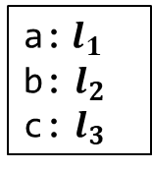


Implicit Conversion of L-value
Conversion happens every time an R-value is expected while an L-value is provided (very often!)
Question: how many conversion happens below?
Global
Memory
Stack
Memory
int a = 10;
int main()
{
int b = 3;
int c = a;
cout << a + b + c << endl;
return 0;
}
$$l_{1}$$
$$l_{2}$$
10
3
$$l_{3}$$
PC
10
a:$l_{1}$
b: $l_{2}$
c: $l_{3}$
Environment:

Slide 24
Key Points
The key points to remember so far…
At an abstract level:
Memory is a collection of in-memory objects with unique locations
A memory address a pair of location and offset
An L-value (expression) represents data in memory
Can be assigned values
Can be taken its memory address
An R-value (expression) represents data NOT in memory
Cannot be assigned values
Cannot be taken address
An L-value is automatically converted into an R-value when necessary
The R-value is the value stored in the L-value

Slide 25
Assignments Revisited

Slide 26



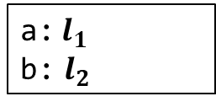
Evaluation of Assignments
Evaluation of the following assignment expression
Evaluate expr1 to an L-value with address ($l$, $o$)
Evaluate expr2 to an R-value $v$
Stores $v$ into the memory location at ($l$, $o$)
Data conversion happens if the types of expr1 and expr2 do not match
expr1 = expr2
int a = 10;
int main() {
int b;
b = a + 5;
return 0;
}
Global
Memory
Stack
Memory
$$l_{1}$$
$$l_{2}$$
10
?
PC
15
Environment:
a:$l_{1}$
b: $l_{2}$

Slide 27
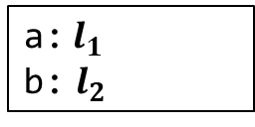


Assignment Revisited
Assignment expression is an L-value expression
Evaluates to the L-value of expr1
expr1 = expr2
Global
Memory
Stack
Memory
int a = 10;
int main() {
int b;
(b=a+5) = 7;
cout << b << endl;
return 0;
}
$$l_{1}$$
$$l_{2}$$
10
?
7
PC
Environment:
a:$l_{1}$
b: $l_{2}$

Slide 28
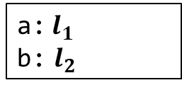
Other Forms
expr1 += expr2 is equivalent to expr1 = expr1 + expr2
similarly for -=, *=, etc.
int a = 10;
int main() {
int b = a;
b += 5;
return 0;
}
Global
Memory
Stack
Memory
$$l_{1}$$
$$l_{2}$$
10
10
PC
15
Environment:
a:$l_{1}$
b: $l_{2}$

Slide 29

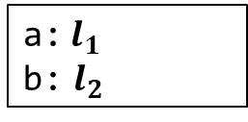
++ Operators
++expr is equivalent to expr = expr + 1
expr++ is somewhat complicated:
expr must be an L-value at some location ($l$, $o$)
The whole expression is an R-value equal to the data stored at ($l$, $o$)
Increases the values stored at ($l$, $o$) by 1
int a = 10;
int main() {
int b = a;
cout << b++ << endl;
return 0;
}
Global
Memory
Stack
Memory
$$l_{1}$$
$$l_{2}$$
10
10
PC
11
The R-value is 10
a:$l_{1}$
b: $l_{2}$
Environment:

Slide 30

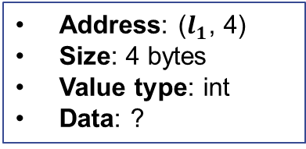

Assignment to Member Variables
Assignment of member variable access is similar to regular assignment:
The data stored in the L-value expr1.field is overwritten by R-value expr2
expr1.field = expr2
// Point structure
struct Point {
int x;
int y;
};
int main() {
Point p;
p.x = 10;
p.y = p.x + 10;
return 0;
}
Global
Memory
Stack
Memory
$$l_{1}$$
10
?
20
Address: ($l_{1}$, 4)
Size: 4 bytes
Value type: int
Data: ?
PC
Environment:
p:$l_{1}$

Slide 31
References Revisited

Slide 32



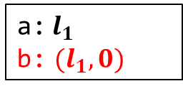
References and Evaluation
Syntax:
expr must be an L-value
The definition binds v to the memory address of expr
Introduce new mapping to environments
v behaves like expr after the definition
T& v = expr
Global
Memory
Stack
Memory
int a = 10;
int main() {
int& b = a;
cout << b << endl;
b = 12;
cout << a << endl;
return 0;
}
PC
$$l_{1}$$
10
12
a:$l_{1}$
Address: ($l_{1}$, 0)
Size: 4 bytes
Value type: int
Data: 10
Environment:
a:$l_{1}$
b: ${(l}_{1},0)$

Slide 33

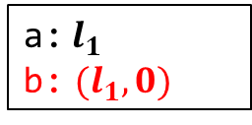
Reference Variables
References introduce new mapping into environments
References behave like variable expressions
int a = 10;
int main() {
int& b = a;
cout << b << endl;
return 0;
}
Global
Memory
Stack
Memory
$$l_{1}$$
PC
10
Environment:
a:$l_{1}$
b: ${(l}_{1},0)$
Address: ($l_{1}$, 0)
Size: 4 bytes
Value type: int
Data: 10

Slide 34


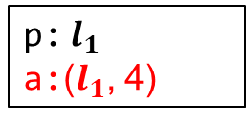
References to Member Variables
Representing L-values for member variables:
// Point structure
struct Point {
int x;
int y;
};
int main() {
Point p;
int& a = p.y;
p.x = 10;
a = p.x + 10;
cout << p.y << endl;
return 0;
}
Global
Memory
Stack
Memory
Address: ($l_{1}$, 4)
Size: 4 bytes
Value type: int
Data: ?
$$l_{1}$$
?
?
10
20
PC
p:$l_{1}$
a:($l_{1}$, 4)
Environment:
p:$l_{1}$

Slide 35
Changes of States and Environments

Slide 36

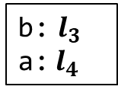
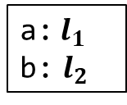



Evolution of Memory States and Environments
Locations are unique
Environment mapping may change
Stack
Memory
// Example
void p(int b)
{
int a = 4;
cout << a << b << endl;
}
int main()
{
int a = 2, b = 3;
cout << a << b << endl;
p(b);
return 0;
}
$$l_{1}$$
main
Environment:
2
a:$l_{1}$
b: $l_{2}$
$$l_{2}$$
3
$$l_{3}$$
p
Environment:
3
b: $l_{3}$
a:$l_{4}$
$$l_{4}$$
PC
4

Slide 37


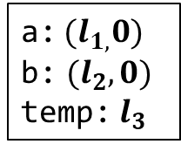

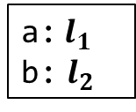
Evolution of Environments with References
Stack
Memory
// Swap two integers
void swap(int& a, int& b)
{
int temp = a;
a = b;
b = temp;
}
int main()
{
int a = 3, b = 5;
swap(a, b);
return 0;
}
$$l_{1}$$
main
3
Environment:
5
a:$l_{1}$
b: $l_{2}$
$$l_{2}$$
5
3
Environment:
PC
a:${(l}_{1,}0)$
b: ${(l}_{2},0)$
temp: $l_{3}$
$$l_{3}$$
swap
?
3

Slide 38
Pointers

Slide 39


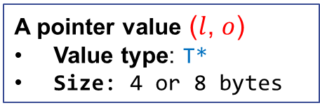
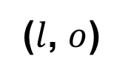
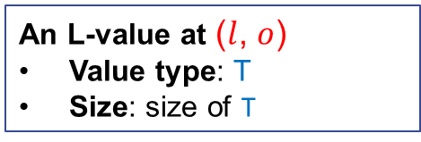

Pointers
Pointers: memory addresses as values
Value: ($l$, $o$)
Type: T* (the data value stored at ($l$, $o$) is of type T)
Size: 4 bytes (32-bit machine) or 8 bytes (64-bit machine)
A pointer points to an L-value
$$o$$
$$l$$
($l$, $o$)
A pointer value ($l$, $o$)
Value type: T*
Size: 4 or 8 bytes
An L-value at ($l$, $o$)
Value type: T
Size: size of T

Slide 40
Why We Need Pointers?
Multiple references to the shared in-memory data
Passing references to memory without copying their data
Optional references (Some or None)
Efficient navigation of memory (using pointer arithmetic)
Reserve new memory during execution (dynamic allocation)
Describe relationship between data structures

Slide 41


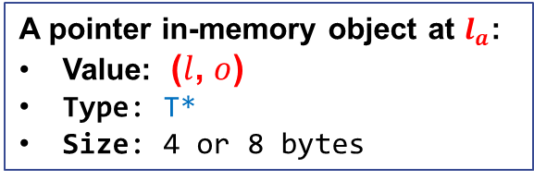
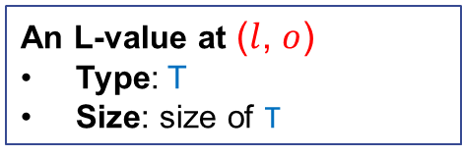


Pointer Variables
Syntax:
By defining T* p, we denote
an in-memory object storing pointers of type T* will be created at the right time
p will be mapped to location of that object
// Defines a pointer variable
<type> *<name1>, *<name2>, …;
$$o$$
$$l_{a}$$
$$l$$
$$\text{(}l\text{,} o\text{) }$$
A pointer in-memory object at $l_{a}$:
Value: ($l$, $o$)
Type: T*
Size: 4 or 8 bytes
An L-value at ($l$, $o$)
Type: T
Size: size of T

Slide 42

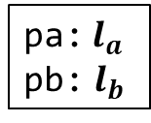

Examples
Pointer variables functions like regular variables
The L-value being points to is determined by its type
May store locations for integer L-values
May store locations for double L-values
int *pa;
int main()
{
double *pb;
return 0;
}
$$l_{a}$$
$$l_{b}$$
?
?
Created at the
start of program
Created at the
start of main function
pa:$l_{a}$
pb: $l_{b}$

Slide 43
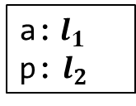



Address-of Operator
Syntax:
<expr> must be an L-value expression (i.e., <expr> is an L-value position)
This is an R-value expression
The R-value is a pointer to (memory address of) <expr>
The R-value’s type is T* where T is the type of <expr>
// Taking the address of expr
&<expr>
int a = 10;
int main()
{
int *p;
p = &a;
return 0;
}
Global
Memory
Stack
Memory
$$l_{1}$$
$$l_{2}$$
10
?
$$(l_{1},0)$$
PC
Environment:
a:$l_{1}$
p: $l_{2}$

Slide 44



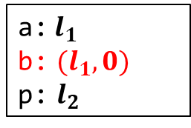
Address-of References
References are L-values
int a = 10;
int main() {
int& b = a;
int *p = &b;
return 0;
}
Global
Memory
Stack
Memory
$$l_{1}$$
$$l_{2}$$
PC
10
?
$$(l_{1},0)$$
Environment:
a:$l_{1}$
b: ${(l}_{1},0)$
p: $l_{2}$
Address: ($l_{1}$, 0)
Size: 4 bytes
Value type: int
Data: 10

Slide 45



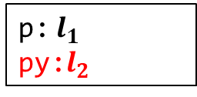
Address-of Members
Member variable accesses are L-values
// Point structure
struct Point {
int x;
int y;
};
int main() {
Point p;
int* py = &p.y;
…
return 0;
}
Global
Memory
Stack
Memory
$$l_{1}$$
?
?
$$l_{2}$$
?
PC
$$(l_{1},4)$$
Address: ($l_{1}$, 4)
Size: 4 bytes
Value type: int
Data: ?
p:$l_{1}$
py:$l_{2}$
Environment:

Slide 46
Exercises
Which of the following address-of expressions are invalid?
&3
&(a + b)
&(a || b)
&&p (suppose p is variable of type int)
&(a = a+b)
&(++x)
&(x++)
int id(int x) { return x; }
int main() {
int a;
int *p = &id(a);
return 0;
}
int& id(int& x) { return x; }
int main() {
int a;
int *p = &id(a);
return 0;
}

Slide 47



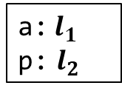
Dereference Operator
Syntax:
<expr> expects an R-value (i.e., <expr> is an R-value position)
The value of <expr> must be a pointer (of some type T*)
This is an L-value expression
It denotes the L-value of type T pointed by the pointer
// Dereference
*<expr>
int a = 10;
int main()
{
int *p;
p = &a;
*p = 3;
cout << *p << endl;
cout << a << endl;
return 0;
}
Global
Memory
Stack
Memory
$$l_{1}$$
$$l_{2}$$
10
3
$$(l_{1},0)$$
PC
Environment:
a:$l_{1}$
p: $l_{2}$

Slide 48

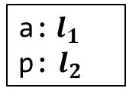
Implicit Conversion in Dereferencing
For example, in *p = 3;
The L-value p is implicitly converted to the pointer it contains
Then the dereference operator takes the pointer and convert it into an L-value
int a = 10;
int main()
{
int *p;
p = &a;
*p = 3;
cout << *p << endl;
cout << a << endl;
return 0;
}
Global
Memory
Stack
Memory
$$l_{1}$$
$$l_{2}$$
10
$$(l_{1},0)$$
PC
Environment:
a:$l_{1}$
p: $l_{2}$
R-value positions

Slide 49

Pointer Variables as Containers
In essence, a pointer variable T* p is a container for pointers of type T*
Creation of the container: according to the definition (global or stack)
Write to the container: Assignment to p
Read from the container: Implicit conversion of the L-value p to R-value
int a = 10;
int main()
{
int *p;
p = &a;
*p = 3;
cout << *p << endl;
cout << a << endl;
return 0;
}
Global
Memory
Stack
Memory
$$l_{1}$$
$$l_{2}$$
10
?
PC
3
$$(l_{1},0)$$
Environment:
a:$l_{1}$
p: $l_{2}$

Slide 50



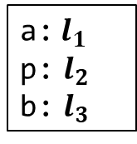
Why Need Pointer Containers?
Store and retrieve pointers
Modify the contained pointers as needed
int a = 10;
int main() {
int *p;
p = &a;
*p = 3;
cout << *p << endl;
cout << a << endl;
int b = 5;
p = &b;
*p = *p + 1;
cout << *p << endl;
cout << b << endl;
return 0;
}
Global
Memory
Stack
Memory
$$l_{1}$$
$$l_{2}$$
3
$$(l_{1},0)$$
$$(l_{3},0)$$
$$l_{3}$$
5
6
PC
Environment:
a:$l_{1}$
p: $l_{2}$
b: $l_{3}$

Slide 51

Dereferencing References
References function like ordinary variables
int a = 10;
int main() {
int& b = a;
int *p = &b;
*p = 3;
cout << *p << endl;
cout << a << endl;
cout << b << endl;
return 0;
}
Global
Memory
Stack
Memory
$$l_{1}$$
$$l_{2}$$
PC
10
?
3
$$(l_{1},0)$$
Environment:
a:$l_{1}$
b: ${(l}_{1},0)$
p: $l_{2}$

Slide 52


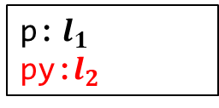
Dereferencing Members
// Point structure
struct Point {
int x;
int y;
};
int main() {
Point p;
int *py = &p.y;
*py = 10;
cout << *py << endl;
cout << p.y << endl;
return 0;
}
Global
Memory
Stack
Memory
$$l_{1}$$
?
?
10
$$l_{2}$$
($l_{1}$, 4)
PC
Environment:
p:$l_{1}$
py:$l_{2}$

Slide 53


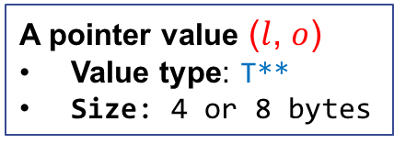




Pointers of Pointers
A pointer of type T** is a pointer to pointer
A variable holding a pointer to pointer is defined by T **p
$$l$$
$$l_{1}$$
($l$, $o$)
($l_{1}$, $o_{1}$)
A pointer value ($l$, $o$)
Value type: T**
Size: 4 or 8 bytes
An L-value at ($l$, $o$)
Value type: T*
Size: 4 or 8 bytes
An L-value at ($l_{1}$, $o_{1}$)
Value type: T
Size: size of T

Slide 54







Example
int main() {
int a = 10;
int *p = &a;
int **pp = &p;
**pp = 5;
cout << **pp << endl;
cout << a << endl;
int b = 7;
// Switch of address
p = &b;
**pp = 16;
cout << **pp << endl;
cout << b << endl;
return 0;
}
Global
Memory
Stack
Memory
PC
$$l_{1}$$
10
5
$$l_{2}$$
?
$$(l_{4},0)$$
$$(l_{1},0)$$
$$l_{3}$$
?
$$(l_{2},0)$$
$$l_{4}$$
?
16
7
Environment:
a: $l_{1}$
p:$l_{2}$
pp:$l_{3}$
b: $l_{4}$

Slide 55
Const Pointer
Syntax:
With const T *p, p holds a pointer to an L-value that cannot be modified
// Defines a const pointer variable
const <type> *<name1>, *<name2>, …;
const int a = 10;
int main() {
const int *p = &a;
cout << *p << endl;
// Error: modify a const L-value
*p = 11;
const int b = 5;
// p itself can be modified!
p = &b;
cout << *p << endl;
return 0;
}

Slide 56
Exercise
Which of the following dereference expressions are invalid?
*10
int a; *&a
int a; *&*&*&*&a
int a; **&a
int *a; **&a

Slide 57






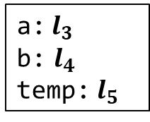
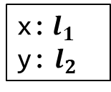

Pointers as Function Parameters
Pointers arguments are still passed using Call-By-Value
Stack
// Swap two integers
void swap(int* a, int* b) {
int temp = *a;
*a = *b;
*b = temp;
}
int main() {
int x = 3, y = 5;
swap(&x, &y);
cout << x << y << endl;
return 0;
}
$$l_{1}$$
3
main
Environment:
5
x:$l_{1}$
y: $l_{2}$
$$l_{2}$$
5
3
Environment:
$$l_{3}$$
a:$l_{3}$
b: $l_{4}$
temp: $l_{5}$
$${(l}_{1},0)$$
PC
$$l_{4}$$
swap
$${(l}_{2},0)$$
$$l_{5}$$
?
3

Slide 58
Invalid Pointers
Dereferencing an invalid pointer result in an undefined behavior
An invalid pointer may come from
Uninitialized pointer variable
Pointer to destroyed in-memory object
Out-of-bound pointers from pointer arithmetic
NULL pointer
...
// Error: x is dead after return
int* getX() {
int x;
return &x;
}
int main() {
cout << *getX() << endl;
return 0;
}
// Error: p is not initialized
int main() {
int *p;
cout << *p << endl;
return 0;
}

Slide 59
NULL Pointer
NULL: is a special invalid pointer reserved by C++
Usage of NULL:
Initialize or reset pointer variables
Return NULL pointer to indicate failure
Compare with NULL pointer to guard against errors
Note: Always instantiate a pointer variable to NULL if it is not given an initial value
// allocate space
int* allocate(int size) {
int *p = NULL;
if (enough space) {
p = newly allocated space;
return p;
}
// make use of allocate
int main() {
int *spc = allocate(10);
if (spc == NULL)
return -1;
// Otherwise, proceed
…
}

Slide 60
Pointers to Object Variables
Pointer and pointer variables for ADT/CDT objects work as usual
// Point structure
struct Point {
int x;
int y;
};
int main() {
Point p;
Point *pp = &p;
(*pp).x = 3;
(*pp).y = 5;
cout << (*pp).x << (*pp).y;
return 0;
}
// Counter as defined previously
class Counter { … };
int main()
{
Counter c;
Counter *p = &c;
for (int i = 0; i < 10; i++)
(*p).incr();
cout << (*p).get() << endl;
return 0;
}

Slide 61
Syntactic Sugar
Special syntax for accessing members through pointers
p->var is equivalent to (*p).var
p->f(…) is equivalent to (*p).f(…)
// Point structure
struct Point {
int x;
int y;
};
int main() {
Point p;
Point *pp = &p;
pp->x = 3;
pp->y = 5;
cout << pp->x << pp->y;
return 0;
}
// Counter as defined previously
class Counter { … };
int main()
{
Counter c;
Counter *p = &c;
for (int i = 0; i < 10; i++)
p->incr();
cout << p->get() << endl;
return 0;
}

Slide 62
This Pointer
A special pointer called this is used to refer to the current object
References to member variables implicitly refer to the this pointer
// Counters
class Counter {
public:
void reset()
{ cnt = 0; }
int get()
{ return cnt; }
void incr()
{ cnt++; }
private:
int cnt;
};
// Counters
class Counter {
public:
void reset()
{ this->cnt = 0; }
int get()
{ return this->cnt; }
void incr()
{ this->cnt++; }
private:
int cnt;
};
Expands

Slide 63
This Pointer
Definitions of member function contains the implicit this parameter
void Counter::reset()
{
cnt = 0;
}
int Counter::get() const
{
return cnt;
}
void Counter::incr()
{
cnt++;
}
void reset(Counter *this)
{
this->cnt = 0;
}
int get(const Counter *this)
{
return this->cnt;
}
void incr(Counter *this)
{
this->cnt++;
}
Compiles

Slide 64
This Pointer
Calls to member functions implicitly passes the this pointer
int main()
{
Counter c;
c.reset();
int n;
cin >> n;
for (int i = 0; i < n; i++)
c.incr();
cout << c.get() << endl;
return 0;
}
int main()
{
Counter c;
reset(&c);
int n;
cin >> n;
for (int i = 0; i < n; i++)
incr(&c);
cout << get(&c) << endl;
return 0;
}
Compiles

Slide 65
Pointers vs. References

Slide 66
Comparison
Pointers: a typed memory address
Is also a regular value
May be stored in variables
May be part of the memory state
Can be uninitialized
Can be modified
Usage:
Multiple references to the shared in-memory data
Passing references to memory without copying their data
Navigation of memory
Reserve new memory
Describe relationship between data
References: an aliasing of L-value
Is NOT a value (but a name binding)
CANNOT be stored in variables
NOT part of the memory
MUST be bound to some L-value
NO WAY to modify references
Usage:
Multiple references to the shared in-memory data
Passing references to memory without copying their data

Slide 67
When to use which
Use references if you need to
Describe aliases to L-values (variables, fields, etc)
Bind to some L-values throughout the entire execution
Use pointers if you ALSO need to
Have optional references (None or SOME reference)
Modify the pointer value during execution (navigate memory space)
Note: pointers exposes the underlying memory structure, be very careful when using them together with ADTs!

Slide 68
Pointer Arithmetic

Slide 69


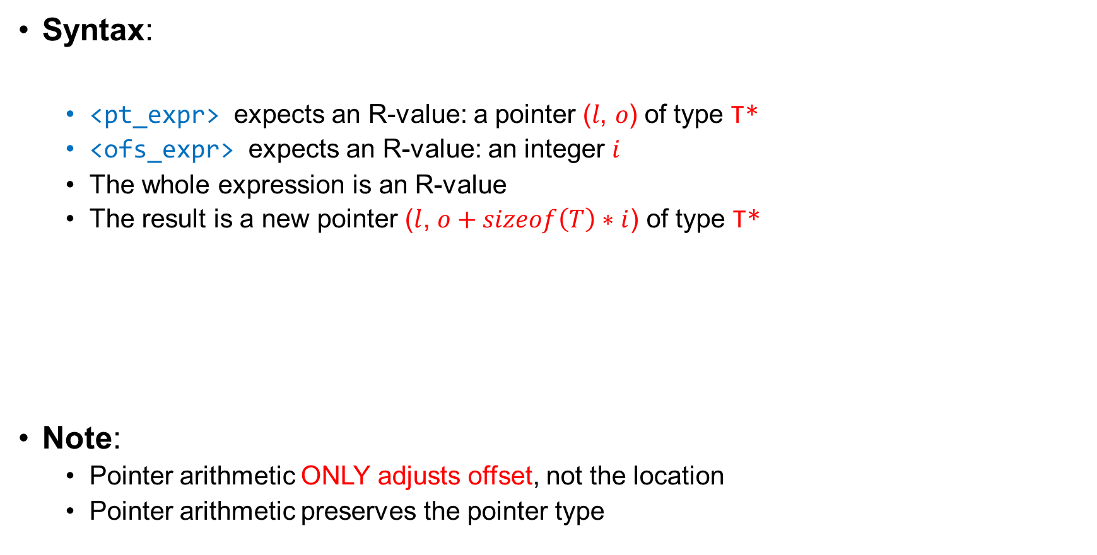


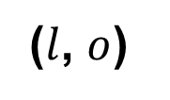
Pointer Arithmetic
Syntax:
<pt_expr> expects an R-value: a pointer $\text{(}l\text{, }o\text{)}$ of type T*
<ofs_expr> expects an R-value: an integer $i$
The whole expression is an R-value
The result is a new pointer ($l$, $o+sizeof\left(T\right)∗i$) of type T*
Note:
Pointer arithmetic ONLY adjusts offset, not the location
Pointer arithmetic preserves the pointer type
// Adjust pointers
<pt_expr> + <ofs_expr>
$$o$$
$$l$$
($l$, $o$)
($l$, $o+sizeof\left(T\right)∗i$)
$$sizeof\left(T\right)∗i$$

Slide 70




Usage
Navigate the space in memory
Stack
Memory
struct Line {
Line(int px1, int py1, int px2, int py2)
: x1(px1), y1(py1), x2(px2), y2(py2) {}
int x1, y1, x2, y2;
};
int main() {
Line line(2, 3, 7, 9);
int *p = &line.x1;
cout << *p << endl;
cout << *(p+1) << endl;
cout << *(p+2) << endl;
cout << *(p+3) << endl;
return 0;
}
$$l_{1}$$
2
3
7
9
4 bytes
$$l_{2}$$
($l_{1}$, 0)
Environment:
line:$l_{1}$
p:$l_{2}$
PC
p+1 = ($l_{1}$, 4)
p+2 = ($l_{1}$, 8)
p+3 = ($l_{1}$, 12)

Slide 71





Pointer Arithemtic
The offset can also decrease
<pt_expr> - <ofs_expr> is equivalent to <pt_expr> + (-<ofs_expr>)
$$o$$
$$l$$
($l$, $o−sizeof\left(T\right)∗i$)
($l$, $o$)
$$sizeof\left(T\right)∗i$$

Slide 72


Usage
Navigate the space in memory
Stack
Memory
struct Line {
Line(int px1, int py1, int px2, int py2)
: x1(px1), y1(py1), x2(px2), y2(py2) {}
int x1, y1, x2, y2;
};
int main() {
Line line(2, 3, 7, 9);
int *p = &line.y2;
cout << *p << endl;
cout << *(p-1) << endl;
cout << *(p-2) << endl;
cout << *(p-3) << endl;
return 0;
}
$$l_{1}$$
2
3
7
9
4 bytes
$$l_{2}$$
($l_{1}$, 12)
Environment:
line:$l_{1}$
p:$l_{2}$
PC
p-1 = ($l_{1}$, 8)
p-2 = ($l_{1}$, 4)
p-3 = ($l_{1}$, 0)

Slide 73



Pointers to the End of Objects
Pointers to the end of objects are invalid
Accessing them result in error
Note: this kind of pointers have a special use in accessing arrays
struct Line {
Line(int px1, int py1, int px2, int py2)
: x1(px1), y1(py1), x2(px2), y2(py2) {}
int x1, y1, x2, y2;
};
int main() {
Line line(2, 3, 7, 9);
int *p = &line.x1;
// Error: invalid pointer
cout << *(p+4) << endl;
return 0;
}
($l_{1}$, $16$)
Stack
Memory
$$l_{1}$$
2
3
7
9
4 bytes
$$l_{2}$$
($l_{1}$, 0)
Environment:
line:$l_{1}$
p:$l_{2}$

Slide 74

Compare Pointers
The pointers may be compared by boolean operators
Let p1 and p2 denote two pointers ($l_{1}$, $o_{1}$) and ($l_{2}$, $o_{2}$)
p1 == p2 iff $l_{1}==l_{2}$ and ${o_{1}==o}_{2}$
p1 != p2 iff !(p1 == p2)
p1 < p2 iff $l_{1}==l_{2}$ and ${o_{1}<o}_{2}$
p1 <= p2 iff $l_{1}==l_{2}$ and ${o_{1}≤o}_{2}$
p1 > p2 iff $l_{1}==l_{2}$ and ${o_{1}>o}_{2}$
p1 >= p2 iff $l_{1}==l_{2}$ and ${o_{1}≥o}_{2}$
Note: only pointers to the same location may be compared!
Positions in different in-memory objects have no relative order
int main() {
int a, b;
if (&a < &b) // Undefined behavior
cout << “&a < &b” << endl;
return 0;
}

Slide 75




Distances between Pointers
Syntax:
<pt_expr1> and <pt_expr2> expects to be pointers ($l$, $o_{1}$) and ($l$, $o_{2}$) of type T*
The whole expression is an integer value $(o_{1}−o_{2})/sizeof(T)$
Note:
Distances between pointers only make sense for pointers to the same in-memory object
// Compute the distance between pointers
<pt_expr1> - <pt_expr2>
$$l$$
($l$, $o_{2}$)
($l$, $o_{1}$)
$$(o_{1}−o_{2})/sizeof(T)$$

Slide 76



Example
Compute distances
Stack
Memory
struct Line {
Line(int px1, int py1, int px2, int py2)
: x1(px1), y1(py1), x2(px2), y2(py2) {}
int x1, y1, x2, y2;
};
int main() {
Line line(2, 3, 7, 9);
int *p1 = &line.y2;
int *p2 = &line.x1
cout << (p1-p2) << endl;
return 0;
}
$$l_{1}$$
2
3
7
9
4 bytes
$$l_{2}$$
($l_{1}$, 12)
$$l_{3}$$
($l_{1}$, 0)
PC
p1-p2 = 3
Environment:
line:$l_{1}$
p1:$l_{2}$
p2:$l_{3}$

Slide 77
Concrete Layout of In-Memory Objects

Slide 78




Abstract Memory Spaces
We have assumed that every variable has its independent memory space
// Examples
int main()
int age=18;
double pi=3.14159, psi=4.2222, phi= 1.1111;
…
}
age
pi
psi
phi
$$l_{1}$$
$$l_{2}$$
$$l_{3}$$
$$l_{4}$$
18
3.14159
4.2222
1.1111
Stack Memory:

Slide 79





Abstract Memory Spaces
Impossible to reach from a pointer ($l_{1}$, $o_{1}$) to ($l_{2}$, $o_{2}$) if $l_{1} !=l_{2}$
Question: why work with such an abstract memory model?
// Examples
int main()
int age=18;
double pi=3.14159, psi=4.2222, phi= 1.1111;
int *p = &age;
// We can never get a pointer to pi, psi and phi from p
…
}
age
pi
psi
phi
$$l_{1}$$
$$l_{2}$$
$$l_{3}$$
$$l_{4}$$
18
3.14159
4.2222
1.1111
Stack Memory:

Slide 80
Memory Layout
The concrete layout of memory is determined by the compiler
Different concrete layout depending on the choices of compilers
User have no way to predict the relation between different locations
age
pi
psi
phi
Memory State of C++ Abstract Machine
18
3.14159
4.2222
1.1111
Mapped by Compiler
Memory State of Physical Machine
(4GB)
18
3.14159
4.2222
1.1111
age
pi
psi
phi
0
0x300000
0x100000000

Slide 81
Example
A counter example for predicting relative locations
Suppose we assume age, pi, psi, phi are adjacent
We print the value of psi by running the code below
Compiler find out that pi is not used and removed it from memory
End result: print the 1.1111 instead of 4.2222
int *p = &age; cout << *(p+2) << endl
age
pi
psi
phi
Memory State of C++ Abstract Machine
18
3.14159
4.2222
1.1111
Mapped by Compiler
Memory State of Physical Machine
(4GB)
18
4.2222
1.1111
age
psi
phi
0
0x300000
0x100000000

Slide 82
Lessons
Treat every variable as having its own disjoint memory space
Note: member variables in structures are indeed adjacent to each other (take into account of alignment)
Treat memory addresses as pairs of unique locations plus offsets
Do not try to guess what concrete memory looks like at the source level
struct Line {
Line(int px1, int py1, int px2, int py2)
: x1(px1), y1(py1), x2(px2), y2(py2) {}
int x1, y1, x2, y2;
};
x1
y1
x2
y2

Slide 83
Arrays

Slide 84

Arrays
An array is a fixed-sized sequence of elements of the same type
Syntax:
The size expression must be constant
The index expression must be an integer value
// Define an array of a given size
<type> name[<size>]
// Access the element at the given index
name[<index>] // Note: an L-value
Stack
Memory
// Example
const int N = 5;
int a[N];
for (int i = 0; i < N; i++)
a[i] = rand();
for (int i = 0; i < N; i++)
cout << a[i] << " ";
$$l_{1}$$
?
?
?
?
?
Environment:
a:$l_{1}$

Slide 85
Initialization and Assignment
Array may be initialized with a sequence of elements
Use sizeof to get the sizes of arrays
An array is a non-modifiable l-value:
// Examples
int a[5] = {4, 2, 1, 3, 5};
// Do not need to specify a size
int a[] = {4, 2, 1, 3, 5}
int n = sizeof(a)/sizeof(a[0]);
cout << n << endl;
// Example
int a[5] = {4, 2, 1, 3, 5};
int b[5];
b = a; // Cannot assign to an array

Slide 86


Decay to Pointers
An array variable of type T[] decays to a pointer of type T* at R-value positions
Stack
Memory
int main()
{
int a[5] = {4, 2, 1, 3, 5};
// Print 4
cout << *a << endl;
}
$$l_{1}$$
4
2
1
3
5
Environment:
a:$l_{1}$
Decay to the R-value
Address: ($l_{1}$, 0)
Size: 4 bytes
Value type: int
Data: 4

Slide 87


Pointer Arithmetic
Pointer arithmetic is applicable to array variables
(a+i) is equivalent to &a[i]
*(a+i) is equivalent to a[i]
int main()
{
int a[5] = {4, 2, 1, 3, 5};
cout << *(a+2) << endl;
for (int i = 0; i < 5; i++)
cout << *(a+i) << endl;
// Alternatively, use p++
for (int *p = a; p != a+5; p++)
cout << *p << endl;
return 0;
}
Stack
Memory
$$l_{1}$$
4
2
1
3
5
Environment:
a:$l_{1}$
Evaluate to the pointer ($l_{1}$, 8) of type int*

Slide 88

Pointer Arithmetic
Reverse pointer arithmetic for array variables
Stack
Memory
int main()
{
int a[5] = {4, 2, 1, 3, 5};
int *p = a+5;
for (int i = 1; i <= 5; i++)
cout << *(p-i) << endl;
return 0;
}
$$l_{1}$$
4
2
1
3
5
Environment:
a:$l_{1}$

Slide 89
Arrays as Function Parameters
Often pass the length of array as a second argument
Array may decay to a pointer
// Pass an array and its size
void printArray1(int a[], int n)
{
for (int i = 0; i < n; i++)
cout << a[i] << " ";
cout << endl;
}
// Pass the decayed pointer
void printArray2(int* a, int n)
{
for (int i = 0; i < n; i++)
cout << a[i] << " ";
cout << endl;
}
// Main
int main()
{
int a[5] = {4, 2, 1, 3, 5};
printArray1(a, 5);
printArray2(a, 5);
return 0;
}

Slide 90
Higher-Dimension Arrays
Syntax:
// Define a higher-dimension array
<type> name[<size_1>]...[<size_n>]
// Access the element at the given index
name[<index_1>]..[<index_n>]
int main()
{
int a[4][3] = {{1, 2, 3}, {4, 5, 6}, {7, 8, 9}, {10, 11, 12}};
for (int i = 0; i < 4; i++) {
for (int j = 0; j < 3; j++)
cout << setw(4) << a[i][j] << " ";
cout << endl;
}
return 0;
}

Slide 91

Layout in Memory
Higher-dimension arrays reside in a linear address
int a[4][3] = {{1, 2, 3}, {4, 5, 6}, {7, 8, 9}, {10, 11, 12}};
$$l_{1}$$
1
2
3
4
5
6
7
8
9
10
11
12
Environment:
a:$l_{1}$
a[i][j] is equivalent to *(a+(i*3+j)*sizeof(int))
// Example
cout << a[0][2] << endl;
cout << a[3][2] << endl;

Slide 92
C-Style Strings

Slide 93
C-Style Strings
An array of characters ending with a NULL character ‘\0’ (ASCII value 0)
Example: (note the last NULL character)
Functions for Manipulation in <cstring>:
‘H’
‘e’
‘l’
‘l’
‘o’
‘,’
‘ ’
‘w’
‘o’
‘r’
‘l’
‘d’
‘!’
‘\0’
0
1
2
3
4
5
6
7
8
9
10
11
12
13
Function | Effect
strcpy(dst, src) | Copy the string in src to dst
strcat(dst, src) | Append the string in src to dst
strlen(s) | Return the length of the string
strcmp(s1, s2) | Compare s1 and s2, return +/0/- if s1 > s2 / s1=s1 / s1<s2
strstr(s1, s2) | Find s2 in s1 and return a pointer to the first occurrence

Slide 94
Buffer Overflow
Be careful of overwriting beyond the end of C-style strings when copying
Q: what happens if you execute the above code?
A: In theory, undefined behavior
In practice, much worse can happen. See:
https://www.eecs.umich.edu/courses/eecs588/static/stack_smashing.pdf
// Example of buffer overflow
int main()
{
int a = 10;
char dst[10];
char str[] = "beauty is only skin deep";
strcpy(dst, str);
cout << a << endl;
return 0;
}

Slide 95
Heap and Dynamic Allocation

Slide 96


Heap Memory
Heap memory is a third memory region besides global and stack memory
Objects must be explicitly allocated and released from heap
known as dynamic (de-)allocation
Every in-memory objects in heap has a unique location
Heap allocation may fail if there is not enough free space
Global
Memory
Heap
Memory
Stack
Memory
$$l_{1}$$
$$l_{2}$$
$$l_{3}$$
● ● ●
● ● ●
● ● ●
Grows

Slide 97

Dynamic Allocation and Deallocation
Syntax for Allocation:
Returns a pointer to the allocated object
Syntax for Deallocation:
<expr> must evaluate to a pointer ($l$, 0)
Attention: the offset must be 0! (meaning it points to the head of the object)
Remove the in-memory object with location $l$
Note: Once a location is used for a heap object, it will never be reused!
// Allocate an in-memory object of type T on heap
new T
// Remove the in-memory object from the heap
delete <expr>

Slide 98




A First Example
Note:
Remember to deallocate heap objects before exiting (o.w., memory leaks occur)
The value in variable p is an invalid pointer after deallocation
Reset the value of those pointer variables to NULL if it will be reused later!
int main()
{
int *p = new int;
*p = 10;
cout << *p << endl;
delete p;
return 0;
}
Heap
Memory
Stack
Memory
PC
$$l_{2}$$
$$l_{1}$$
?
?
10
($l_{2}$, 0)
Environment:
p:$l_{1}$

Slide 99




Allocation of ADT Objects
int main()
{
Counter* c = new Counter;
c->reset();
int n;
cin >> n;
for (int i = 0; i < n; i++)
c->incr();
cout << "The value of the counter is: "
<< c->get() << endl;
delete c;
return 0;
}
Heap
Memory
Stack
Memory
PC
$$l_{2}$$
$$l_{1}$$
?
?
0
($l_{2}$, 0)
Environment:
c:$l_{1}$

Slide 100
Whack-A-Mole Revisited
// The field where moles happily live
class Field {
public:
// Constructor
Field(int sz);
// Get the information of a mole (if any)
const Mole* getMole(int row, int col) const;
// Add a mole
const Mole* addMole(int row, int col, bool big);
// Remove mole
bool removeMole(int row, int col);
...
private:
// Size (n x n) of the filed
int size;
// Moles in the field
Grid<Mole*> moles;
};

Slide 101

Dynamic Arrays
Syntax for Allocation:
Returns a pointer to the allocated array
Syntax for Deallocation:
<expr> must evaluate to a pointer ($l$, 0) to a dynamic array
Remove the array with location $l$
// Allocate an dynamic array of T on heap
new T[<size>]
// Example
new int[5];
$$l_{1}$$
?
?
?
?
?
// Remove the in-memory object from the heap
delete[] <expr>

Slide 102
Fixed-Length Vector
We can define a vector of integers with fixed length using a dynamic array
// Vectors with a fixed length
class FVector {
public:
// Constructors and destructors
FVector(int n);
~FVector();
int length() const;
void set(int i, int v);
int at(int i) const;
private:
int n;
int* arr;
};
FVector::FVector(int l) : n(l)
{ arr = new int[l]; }
FVector::~FVector()
{ delete[] arr; }
int FVector::at(int i) const {
if (i >= 0 && i < n)
return arr[i];
return -1;
}
void FVector::set(int i, int v) {
if (i >= 0 && i < n)
{ arr[i] = v; }
}

Slide 103
Ownership of Resources

Slide 104
Ownership of Dynamic Memory
An object owns a piece of memory if it is responsible for its destruction
This memory may be created by its constructor and other methods
Or transferred over by another owner
The internal structure of the memory is usually not visible outside
Examples: An FVector owns its dynamic array
// Vectors with a fixed length
class FVector {
public:
...
private:
int n;
int* arr;
};
// Allocation and deallocation
FVector::FVector(int l) : n(l)
{ arr = new int[l]; }
FVector::~FVector()
{ delete[] arr; }

Slide 105
Resource Acquisition is Initialization
RAII is a programming idiom
Lifetime of resource is tied to the lifetime of objects
Resources are acquired during object initialization (constructor)
Resources are released during object finalization (destructor)
Slogan: No object leaks, No memory leaks
When resources are memory, RAII ensures ownership of memory
Resources may also be anything other than memory
File handlers
Internet sockets
Process identifiers
...

Slide 106
Shallow Copying
Copying of objects copies their member variables by default
This is called shallow copying
// What goes wrong with the following code?
void test()
{
FVector vec(5);
for (int i = 0; i < vec.length(); i++)
vec.set(i, randomInteger(1, 100));
FVector vec1(3);
vec1 = vec;
}
int main()
{
test();
return 0;
}

Slide 107








Shallow Copying
Shallow copying may violate resource ownerships
Memory leak
Unwanted sharing
Stack
Memory
Heap
Memory
$$l_{1}$$
$$l_{2}$$
5
($l_{2}$, 0)
?
?
?
?
?
Shallow Copying
$$l_{3}$$
$$l_{4}$$
4
($l_{4}$, 0)
?
?
?
5
($l_{2}$, 0)
Environment:
vec:$l_{1}$
vec1:$l_{3}$

Slide 108




Deep Copying
Make a copy of owned resources when duplicating objects
Release the owned resources when overwriting objects
Stack
Memory
Heap
Memory
$$l_{1}$$
$$l_{2}$$
5
($l_{2}$, 0)
?
?
?
?
?
Deep Copying
Deep Copying
$$l_{3}$$
$$l_{5}$$
4
($l_{4}$, 0)
5
($l_{5}$, 0)
?
?
?
?
?
Environment:
vec:$l_{1}$
vec1:$l_{3}$
$$l_{4}$$
?
?
?

Slide 109
Deep Copying
Define a private function for deep copying
// Vectors with a fixed length
class FVector {
public:
...
private:
void deepCopy(const FVector& vec);
int n;
int* arr;
};
// Deep copy of FVector
void FVector::deepCopy(const FVector& vec)
{
arr = new int[vec.n];
for (int i = 0; i < vec.n; i++)
arr[i] = vec.arr[i];
n = vec.n;
}

Slide 110
Assignment Overloading
Overload the assignment operator for the objects
This will overwrite the behavior of shallow copying
Note:
Do not overwrite self!
Release the resources before copying
class FVector {
public:
...
// Overloaded Assignment
FVector& operator=(const FVector& vec);
private:
...
};
FVector& FVector::operator=(const FVector& vec)
{
if (this != &vec) {
delete[] arr;
deepCopy(vec);
}
return *this;
}

Slide 111
Copy Constructors
Overload the copy constructor for creating objects using deep copying
class FVector {
public:
...
// Copy constructor
FVector(const FVector& vec);
private:
...
};
FVector::FVector(const FVector& vec)
{
deepCopy(vec);
}

Slide 112
Other Methods for Managing Heap Memory
Reference Counting
Keep a counter of references/pointers to a heap object
When the counter drops to 0, delete the object
Need to break cycles of references
No run-time needed
Garbage Collection (GC)
Garbage refers to heap memory allocated but no longer referenced
A garbage collector scans the memory to reclaim garbages
Many different implementations
Need run-time to support GC
High-overhead and hard-to-control performance

Slide 113
Relations between Data Structures

Slide 114

Linked Lists
A data structure representing a sequence of values linked by pointers
// Linked lists of integers
struct LinkedList{
LinkedList() : value(0), next(NULL) {}
int value;
LinkedList* next;
};

Slide 115
Basic Operations
We define the following operations for using linked lists
// Push to the head of linked lists
LinkedList* push(LinkedList* l, int value);
// Peek the head value
int peek(LinkedList* l);
// Pop the head of the linked lists
LinkedList* pop(LinkedList* l);
// Destroy the whole list
void destroy(LinkedList* l);
// Print the values
void print(LinkedList* l);

Slide 116
Basic Operations
LinkedList* push(LinkedList* l, int value) {
LinkedList* newl = new LinkedList;
newl->value = value;
newl->next = l;
return newl;
}
int peek(LinkedList* l) {
if (l == NULL) return 0;
return l->value;
}
LinkedList* pop(LinkedList* l) {
if (l == NULL) return NULL;
LinkedList* next = l->next;
delete l;
return next;
}

Slide 117
Basic Operations
The following operations traverses the lists using iterations
Q: How to destroy and print lists by using recursion?
void destroy(LinkedList* l) {
while (l != NULL)
l = pop(l);
}
void print(LinkedList* l) {
for (LinkedList* p = l; p != NULL; p = p->next)
cout << p->value << " ";
cout << endl;
}

Slide 118
Copying Linked Lists
Follow the pointers to performed a deep copy
Exercise: write a version of copy that uses iteration instead of recursion
// Deep copy using recursion
LinkedList* copy(LinkedList* l)
{
if (l == NULL)
return NULL;
LinkedList* newl = new LinkedList;
newl->value = l->value;
newl->next = copy(l->next);
return newl;
}

Slide 119
Get the I-th Element
It is convenient to get both the i-th element in its predecessor
pair<LinkedList*, LinkedList*> getIthPrev(LinkedList* l, int i)
{
assert(i >= 0);
LinkedList* prev = NULL;
while (l != NULL && i != 0) {
prev = l;
l = l->next;
i--;
}
return make_pair(prev, l);
}
LinkedList* getIth(LinkedList* l, int i) {
return getIthPrev(l, i).second;
}

Slide 120
Designing Collections

Slide 121
Design Collections
Define collections by using dynamic memory
Elements in collections are resources owned by collections
We use vectors of integers as an example and discuss two approaches
Vectors implemented using linked lists

Slide 122
Vector of Integers
Class definition
class IVector{
public:
IVector();
~IVector();
int size() const;
bool isEmpty() const;
void clear();
int get(int i) const;
void set(int i, int v);
void add(int v);
void insert(int i, int v);
void remove(int i);
private:
LinkedList* lst;
};

Slide 123
Add Elements
Append elements to the end
Navigate to the last element
Create a new last element
Append it
void IVector::add(int v)
{
LinkedList *prev = NULL, *cur = lst;
while (cur != NULL) {
prev = cur;
cur = cur->next;
}
LinkedList* newl = new LinkedList;
newl->value = v;
if (prev != NULL)
prev->next = newl;
else
lst = newl;
}

Slide 124
Insert Elements
Insert an element to i-th position
Find the i-th element and its predecessor
Create a new element
Insert it into between the i-th element and its predecessor
Note: if i >= size, then insert functions like add
void IVector::insert(int i, int v)
{
if (i < 0) return;
std::pair<LinkedList*, LinkedList*>
p = getIthPrev(lst, i);
LinkedList *prev = p.first,
*cur = p.second;
LinkedList* newl = new LinkedList;
newl->value = v;
newl->next = cur;
if (prev != NULL)
prev->next = newl;
else
lst = newl;
}

Slide 125
Remove Elements
Remove the i-th element
Find the i-th element and its predecessor
Remove the i-th element and adjust the next pointer of the predecessor
Note: if i >= size, then remove has no effect
void IVector::remove(int i)
{
if (i < 0) return;
std::pair<LinkedList*, LinkedList*> p = getIthPrev(lst, i);
LinkedList *prev = p.first, *cur = p.second;
if (cur == NULL) return;
if (prev != NULL)
prev->next = cur->next;
else
lst = cur->next;
}

Slide 126
Constructors and Destructors
void IVector::clear()
{
destroy(lst);
lst = NULL;
}
IVector::IVector() : lst(NULL) {}
IVector::~IVector()
{
clear();
}
int IVector::size() const
{
int i = 0;
LinkedList* l = lst;
while (l != NULL) {
i++;
l = l->next;
}
return i;
}
bool IVector::isEmpty() const
{
return lst == NULL;
}

Slide 127
Copying and Assignment
Perform deep copying for copy construction and assignment
Release the memory before copying in assignments
//Copy constructor
IVector::IVector(const IVector& vec)
{
lst = copy(vec.lst);
}
//Assignment operator
IVector& IVector::operator=(const IVector& vec)
{
if (this != &vec) {
clear();
lst = copy(vec.lst);
}
return *this;
}

Slide 128
Generic Collections

Slide 129
Template Classes
Define a collection of classes parameterized by type variables
Syntax:
Examples: Vector, Stack, Map, ..., etc
Note: The definitions and declarations must be in the same header files
Template functions/classes are patterns for generating code (not the code themselves)
The users of templates must see ALL the definitions for instantiation
Programming using templates is known as Generic Programming
template <class T1, ..., class Tn>
class <name>{
...
}

Slide 130
Generic Linked Lists
Similar to previous definition but with a type parameter
By instantiating T, we get linked lists containing different types of values
// Definition of generic linked lists
template <class T>
struct LinkedList{
LinkedList(T v) : value(v), next(NULL) {}
T value;
LinkedList* next;
};
// Different instances of linked list
LinkedList<int>
LinkedList<double>
LinkedList<LinkedList<int>>
...

Slide 131
Generic Operations
Some operations:
template <class T>
LinkedList<T>* push(LinkedList<T>* l,
T value) {
LinkedList<T>* newl =
new LinkedList<T>;
newl->value = value;
newl->next = l;
return newl;
}
template <class T>
LinkedList<T>* pop(LinkedList<T>* l) {
if (l == NULL) return NULL;
LinkedList<T>* next = l->next;
delete l;
return next;
}
template <class T>
T peek(LinkedList<T>* l) {
if (l == NULL) return 0;
return l->value;
}
template <class T>
LinkedList<T>* copy(LinkedList<T>* l) {
if (l == NULL)
return NULL;
LinkedList<T>* newl =
new LinkedList<T>(l->value);
newl->next = copy(l->next);
return newl;
}

Slide 132
Generic Vectors
Similar to IVector but with a type parameter
template <class T>
class Vector{
public:
Vector() : lst(NULL) {}
~Vector() { clear(); }
//Copy constructor
Vector(const Vector& vec) {
lst = copy(vec.lst);
}
...
private:
LinkedList<T>* lst;
};

Slide 133
Generic Member Functions
T get(int i) const{
if (i < 0) return 0;
LinkedList<T>* l = getIth(lst, i);
if (l == NULL)
return T();
else
return l->value;
}
void set(int i, T v)
{
if (i < 0) return;
LinkedList<T>* l = getIth(lst, i);
if (l != NULL)
l->value = v;
}
void insert(int i, T v)
{
if (i < 0) return;
std::pair<LinkedList<T>*, LinkedList<T>*>
p = getIthPrev(lst, i);
LinkedList<T> *prev = p.first,
*cur = p.second;
LinkedList<T>* newl =
new LinkedList<T>(v);
newl->next = cur;
if (prev != NULL)
prev->next = newl;
else
lst = newl;
}

Slide 134
Next Time
We will discuss
Subtyping of ADTs
Inheritance of Classes
Dynamic Binding and Virtual Functions
Design Patterns
You should read Chapter 19 of the text book

