Slide 1
Principles and Methods of Program Design Lecture 9: Future Directions
Yuting Wang
SEIEE
John Hopcroft Center for Computer Science
2022.3.14

Slide 2
Road Map
Basics of Imperative Programming (C++)
Programming with Abstractions
Implementing Abstractions
Here!

Slide 3
Future Directions
Topics we have yet covered
Concurrent Programming
Generic Programming
Problem domains
Systems programming
AI programming
Other Programming Paradigms
Functional Programming
Logic Programming
Programming Language Theories
Logic Foundations
Type Theory & Proof Theory
Program Logics & Testing & Correctness

Slide 4
Concurrent Programming
Concurrency: multiple programs/threads running at the same time, competing for shared resources
Extremely important as we face the end of Moore’s Law
Topics:
Multi-process and multi-threadness
Race conditions & Accessing Shared Resources (mutexes or locks)
Synchronizations (conditional variables, futures, ...)
C++ Memory Models
Concurrent Objects & Concurrent Data Structures
Lock-free Data Structures

Slide 5
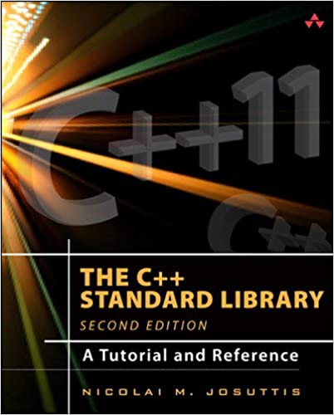
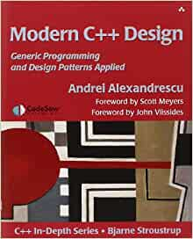
Generic Programming
Design and Use Template Libraries
Combination of Generic Programming and Design Patterns

Slide 6

Programming Domains
Systems programming
Compilers
Operating Systems
Device Derivers
Embedded Systems
AI Programming
Expert Systems
Neural Networks
...
The Rust Programming Language
Brining Rust to Linux Kernel:
https://lwn.net/Articles/829858/?utm_source=thenewstack&utm_medium=website&utm_campaign=platform

Slide 7




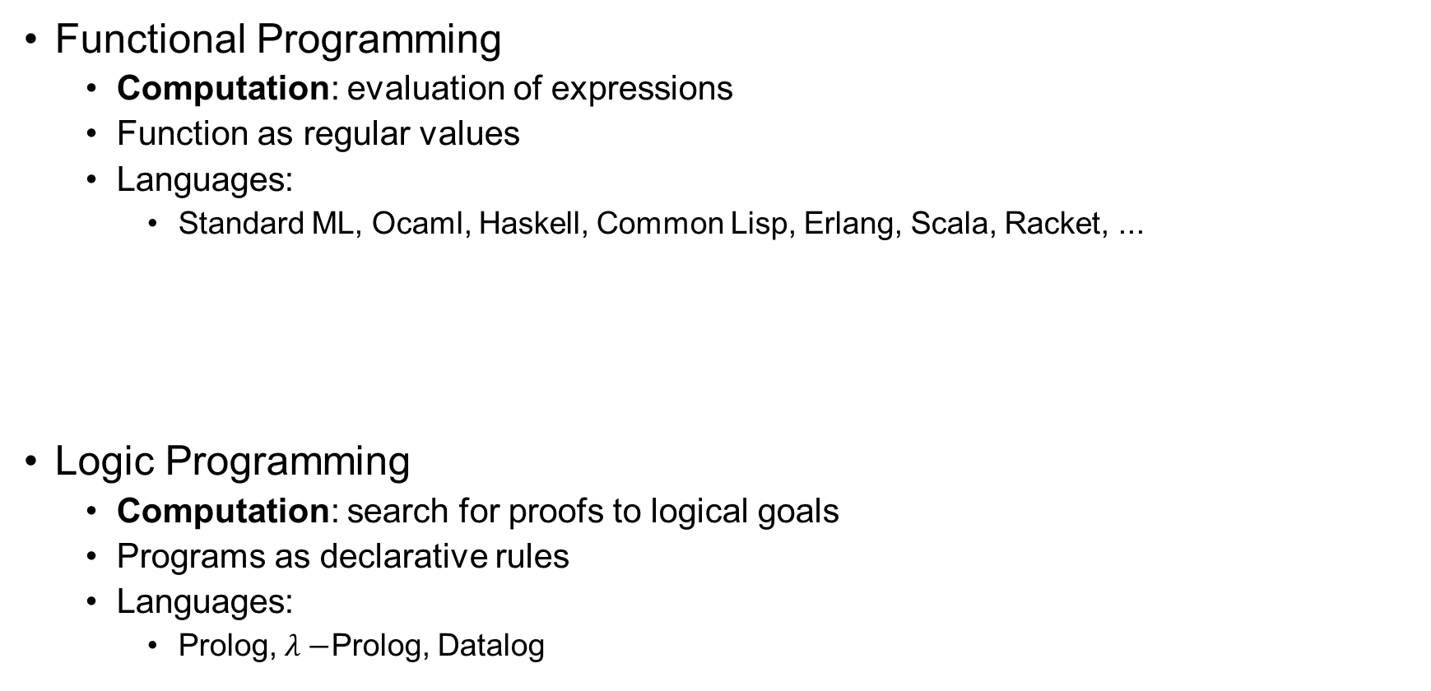
Programming Paradigms
Functional Programming
Computation: evaluation of expressions
Function as regular values
Languages:
Standard ML, Ocaml, Haskell, Common Lisp, Erlang, Scala, Racket, ...
Logic Programming
Computation: search for proofs to logical goals
Programs as declarative rules
Languages:
Prolog, $λ−$Prolog, Datalog

Slide 8
Testing
Learn the basic testing techniques and frameworks
Unit Tests
Regression Tests
Integration Tests
...
See:
https://sourceforge.net/projects/cppunit/
https://github.com/google/googletest

Slide 9
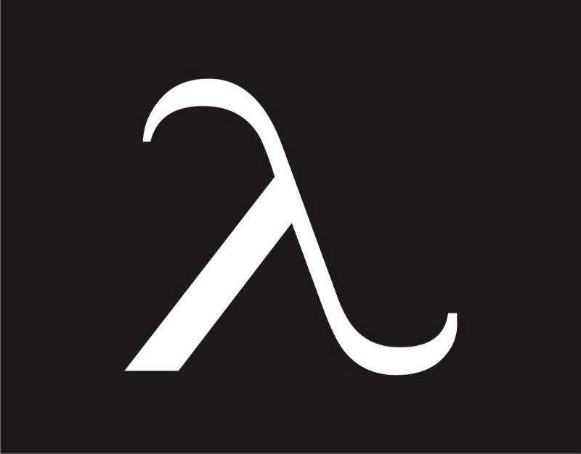
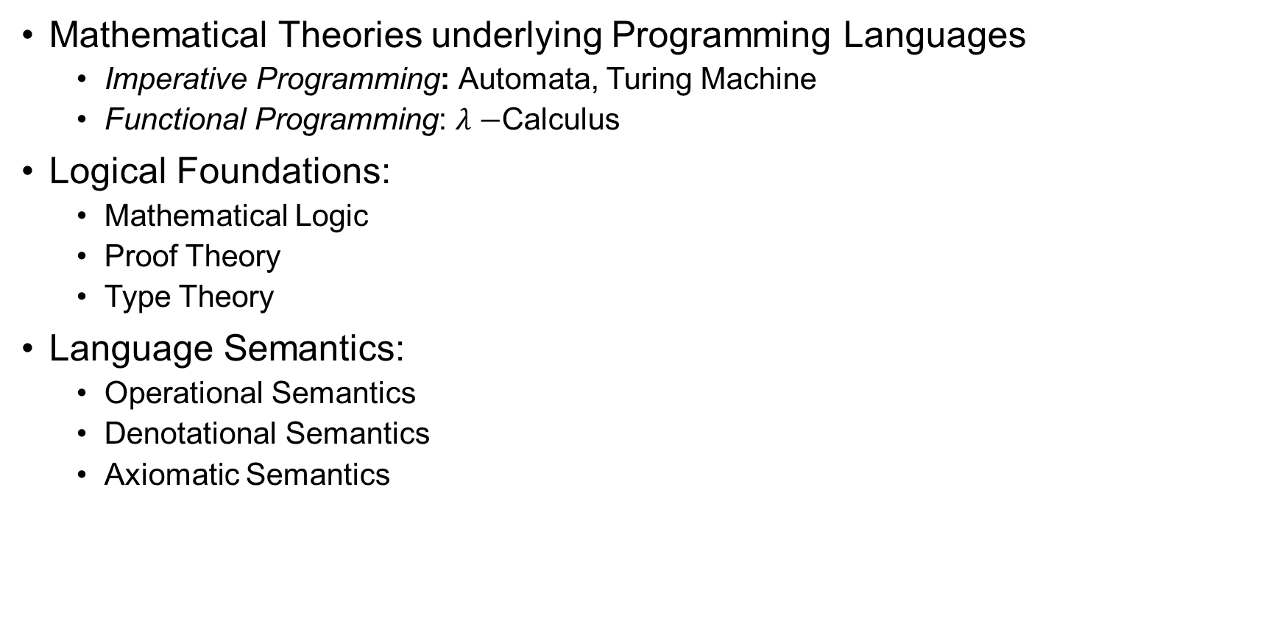
Programming Language Theories
Mathematical Theories underlying Programming Languages
Imperative Programming: Automata, Turing Machine
Functional Programming: $λ−$Calculus
Logical Foundations:
Mathematical Logic
Proof Theory
Type Theory
Language Semantics:
Operational Semantics
Denotational Semantics
Axiomatic Semantics

Slide 10
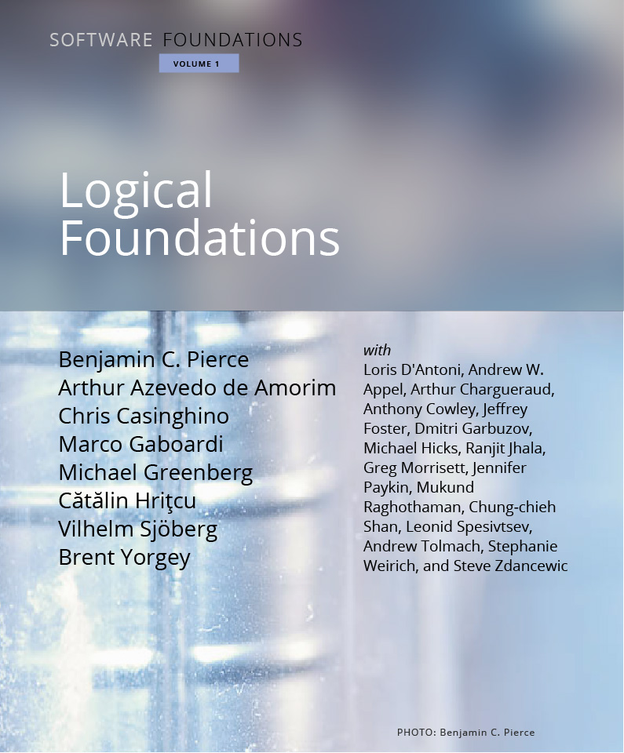
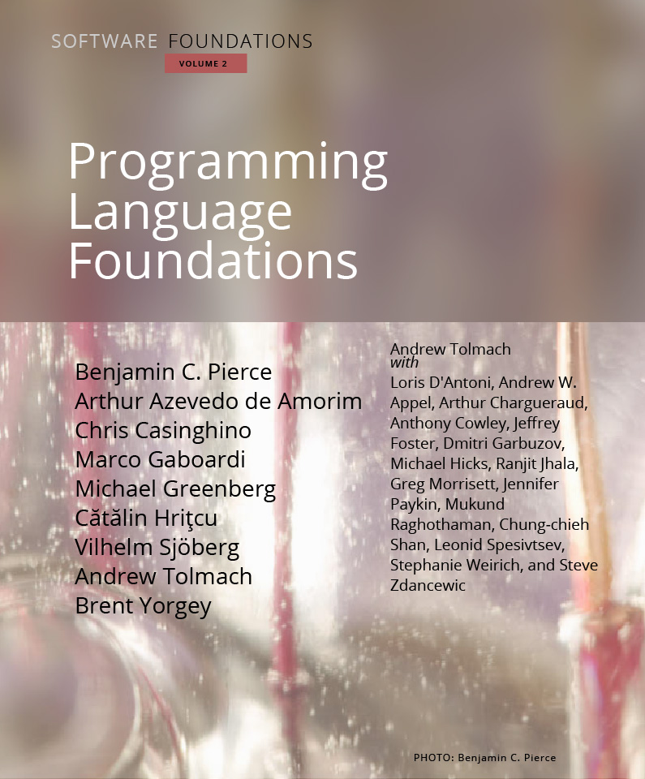
Program Verification
Prove the Correctness of Programs
Algorithms based on logics (SAT/SMT Solving), Model Checking
Program Logics (Hoare Logic/ Separation Logic), Formal Verification
Software Foundations: https://softwarefoundations.cis.upenn.edu/

Slide 11
Have Fun Programming!

