Slide 1
More About Turing Machines
“Programming Tricks”
Restrictions
Extensions
Closure Properties
Notes:
Now, we’re going to explore the Turing machine in some depth. We start off with what I like to think of as programming tricks for Turing machines. It’s not that anyone is really going to program a Turing machine, but we need to argue about what a Turing machine COULD do if we really needed it to. That is how we argue about the capabilities of Turing machines. For example, we argue that it can simulate a real computer.
Then, we delve into the matter of Turing machines with less capability, but the same ability to define exactly the recursively enumerable languages. And we argue that some natural extensions of the Turing-machine idea, for example – make them nondeterministic, do not add power. They still accept only the recursively enumerable languages. The conclusion I want to draw from these restrictions and extensions is that the class of recursively enumerable languages is a really important class, with many definitions, and that it really does represent what can be computed by any realistic notion of what computation means.
Finally, we’ll look at some of the closure properties of the recursive and recursively enumerable languages.

Slide 2
Programming Trick: Multiple Tracks
Think of tape symbols as vectors with k components, each chosen from a finite alphabet.
Makes the tape appear to have k tracks.
Let input symbols be blank in all but one track.
Notes:
The first programming trick is thinking of the tape as if it had multiple tracks. This idea enables us to describe Turing machines that do things like leave markers on their tape so they can find their way back to an important place.
Click 1
We get k tracks if we think of each tape symbol as a vector with k components, each component chosen from some finite alphabet.
Click 2
We can think of the i-th component of each tape symbol as forming the i-th track.
Click 3
Input symbols will have the blank symbol in all components but one, which then becomes the track on which the input is placed.

Slide 3

Picture of Multiple Tracks
Represents
input symbol 0
q
Represents
the blank
0
X
B
B
Y
B
B
Z
B
Represents one symbol [X,Y,Z]
Notes:
Here’s how we can visualize a Turing machine with three tracks.
Click 1
This symbol is viewed as the vector {X,Y,Z], but it is really just one tape symbol.
Click 2
Let’s suppose the input is written on track 1. Then the input symbol 0 must be thought of as the vector [0,B,B].
Click 3
And the blank symbol is thought of as the vector {B,B,B].

Slide 4
Programming Trick: Marking
A common use for an extra track is to mark certain positions.
Almost all tape squares hold B (blank) in this track, but several hold special symbols (marks) that allow the TM to find particular places on the tape.
Notes:
A good use of the idea of marking is to use one track for data and another track for “marks.” In the marking track, almost all the tape squares have a blank value, but one or more have special symbols – the marks – that indicate a place on the tape that the Turing machine needs to find later.

Slide 5
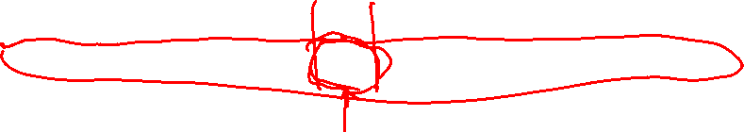
Marking
q
B
X
B
W
Y
Z
Unmarked
W and Z
Marked Y
Notes:
Here’s an example. The bottom track holds the data and the top track is the marking track.
Click 1
This symbol [X,Y[, represents a marked Y.
Click 2
And these symbols are unmarked W and Z, respectively.

Slide 6
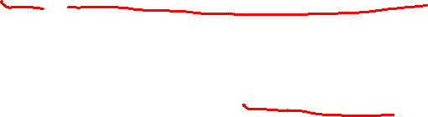
Programming Trick: Caching in the State
The state can also be a vector.
First component is the “control state.”
Other components hold data from a finite alphabet.
Notes:
A similar trick is to think of the state as a vector, with each component from some finite alphabet. The first component is used to control operation – what we normally think of as “the state.” But other components are used as a “cache,” to hold values the Turing machine needs to remember. Typically, these values are bits or tape symbols, but they can be anything as long as they are chosen from a finite alphabet.

Slide 7
Example: Using These Tricks
This TM doesn’t do anything terribly useful; it copies its input w infinitely.
Control states:
  q: Mark your position and remember the input symbol seen.
  p: Run right, remembering the symbol and looking for a blank. Deposit symbol.
  r: Run left, looking for the mark.
Notes:
Click 1
Here’s an example that will illustrate the three tricks we talked about. The Turing machine is not really useful – all it does is copy its input over and over again, moving right on the tape.
Click 2
Here are the values that will appear in the control component of the state, along with the intuition about what they are supposed to be doing.
Click 3
In control state q, we mark the current position, store the current input symbol in the cache component of the state, and move right.
Click 4
From q, we also enter the control state p. In state p we run to the right, looking for a blank. When we find it, we deposit the symbol that we’ve stored in the cache on the data track, and move left.
Click 5
From state r, we also enter control state r, in which we run left, looking for the mark that was left by state q. When we find it, we remove the mark, enter state q, and repeat the process.

Slide 8
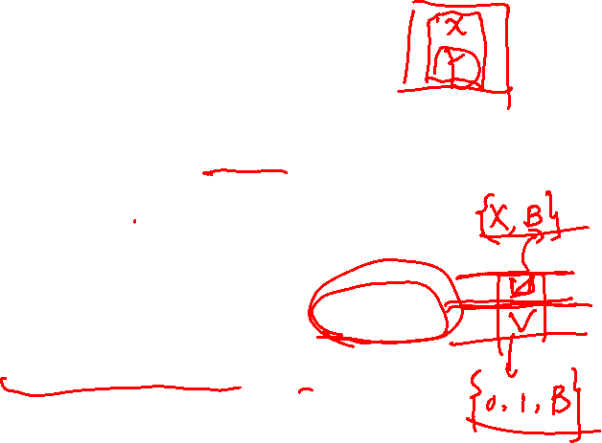
Example – (2)
States have the form [x, Y], where x is q, p, or r and Y is 0, 1, or B.
  Only p uses 0 and 1.
Tape symbols have the form [U, V].
  U is either X (the “mark”) or B.
  V is 0, 1 (the input symbols) or B.
  [B, B] is the TM blank; [B, 0] and [B, 1] are the inputs.
Notes:
Click 1
A state is a vector [x,Y]. Here, little x is q, p, or r, one of the control states, and Y is the cache component. It’s values are 0, 1, or B. Incidentally, we shall see that only state p uses 0 or 1 in the cache; the other two states just have B in the cache. Thus, there are really only four states.
Click 2
Tape symbols will be vectors [U,V]. The first component represents the marking track, so U is either X (the mark), or B (no mark). The second component is the data track, so V can be either 0, 1, or B. We regard {B,B] as the blank symbol. [B,0] as input symbol 0, and [B,1] as input symbol 1.

Slide 9
The Transition Function
Convention: a and b each stand for “either 0 or 1.”
δ([q,B], [B,a]) = ([p,a], [X,a], R).
  In state q, copy the input symbol under the head (i.e., a ) into the state.
  Mark the position read.
  Go to state p and move right.
Notes:
we’ll now describe the transition function for this Turing machine.
Click 1
Before we do, let’s understand that “a” and b can each have the value 0 or 1, but in a rule, all occurrences of one of these letters has the same value.
Click 2
This is a pair of rules, one for each value of “a”
Click 3
It says that if the control state is q, copy whatever symbol “a” is on the data track into the cache (DRAW an arrow from “a” in the tape to “a” in the state).
Click 4
The position under the head is marked with an X (POINT).
Click 5
And the head moves right (POINT). Also, the control state becomes p (POINT)

Slide 10
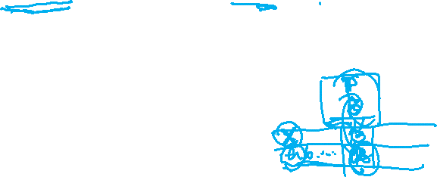
Transition Function – (2)
δ([p,a], [B,b]) = ([p,a], [B,b], R).
  In state p, search right, looking for a blank symbol (not just B in the mark track).
δ([p,a], [B,B]) = ([r,B], [B,a], L).
  When you find a B, replace it by the symbol (a ) carried in the “cache.”
  Go to state r and move left.
Notes:
There are two families of rules for control state p.
Click 1
If the current tape symbol does not have a blank in the data track, then stay in the same state, leave the tape symbol as it is, and move right. Note that “a” and little b can represent either 0 or 1 independently, so there are really four rules represented here.
Click 2
When the blank symbol [B,B] is reached, place the symbol “a” that is in the cache in the data track of the square currently reached (DRAW arrow from cache to tape). Go to control state r with and empty cache (POINT) and move left (POINT).

Slide 11
Transition Function – (3)
δ([r,B], [B,a]) = ([r,B], [B,a], L).
  In state r, move left, looking for the mark.
δ([r,B], [X,a]) = ([q,B], [B,a], R).
  When the mark is found, go to state q and move right.
  But remove the mark from where it was.
  q will place a new mark and the cycle repeats.
Notes:
And here are the rules for control state r.
Click 1
In state r, as long as we do not see the mark in the first track we simply move left, withno change in state or tape symbol.
Click 2
When we find the square that has the mark (POINT), we do three things. We remove the mark (POINT), we go to control state q (POINT), and we move right. We’ll be at the position just to the right of where the mark was. We’re back in state q, so the whole cycle will repeat again, with whichever input 0 or 1 is at the next square.

Slide 12
Simulation of the TM
q
B
. . . B B B B . . .
. . . 0 1 B B . . .
Notes:
Here’s a motion picture. We are in control state q with an empty, or blank cache, and we’re at the left end of the input 01. We’re going to pick up the 0 for the cache and mark the current square, going to control state p and moving right.

Slide 13

Simulation of the TM
p
0
. . . X B B B . . .
. . . 0 1 B B . . .
Notes:
We did all that. Now we fail to see a blank in the data track, so we just move right again.

Slide 14

Simulation of the TM
p
0
. . . X B B B . . .
. . . 0 1 B B . . .
Notes:
Now, we see the blank, so we deposit the 0 in the cache, go to state r, and move left.

Slide 15

Simulation of the TM
r
B
. . . X B B B . . .
. . . 0 1 0 B . . .
Notes:
Bingo. We haven’t found the mark, so we move left again.

Slide 16

Simulation of the TM
r
B
. . . X B B B . . .
. . . 0 1 0 B . . .
Notes:
Now here’s the mark. We remove the mark, go to control state q, and move right.

Slide 17
Simulation of the TM
q
B
. . . B B B B . . .
. . . 0 1 0 B . . .
Notes:
And here we are in a situation similar to that in which we started. We’ll pick up the 1, mark the square we’re at, and move right in state p.

Slide 18
Simulation of the TM
p
1
. . . B X B B . . .
. . . 0 1 0 B . . .
Notes:
Here we go, off on another cycle. It never ends. We keep writing 010101… on the data track.

Slide 19
Semi-infinite Tape
We can assume the TM never moves left from the initial position of the head.
Let this position be 0; positions to the right are 1, 2, … and positions to the left are –1, –2, …
New TM has two tracks.
  Top holds positions 0, 1, 2, …
  Bottom holds a marker, positions –1, –2, …
Notes:
We’re now going to start exploring restrictions of the original Turing-machine model that are powerful enough to simulate the original model and therefore also define exactly the recursively enumerable languages.
Click 1
Our first restriction is a minor one, compared with some of the amazingly strong restrictions we are going to see later. The restriction is that we can assume the tape is infinite to the right of the input only. Tape squares to the left of where the input is placed do not exist and may not be used. The Turing machine halts if it tries to move left into a nonexistent square, but we shall see in the construction that simulates a two-way infinite tape by a one-way infinite tape, that it is also possible to design the Turing machine so it never makes that mistake and never falls off the tape.
Click 2
Suppose we have an ordinary Turing machine with a 2-way infinite tape. We want to simulate it with a one-way infinite tape. Call the initial position of the head square 0. Positions to the left are –1, -2, and so on, while positions to the right are +1, +2, and so on.
Click 3
The new Turing machine will have two tracks on its tape, and never move left from position 0. The top track holds the positions 0, 1, 2, and so on of the original Turing machine. In the bottom track, paired with position 0 is a special marker, a star. It is the presence of this marker that warns the new Turing machine not to go left. Also on the bottom track are all the negative positions of the original Turing machine, with position –i paired with position i.

Slide 20

Simulating Infinite Tape by Semi-infinite Tape
State remembers whether
simulating upper or lower
track. Reverse directions
for lower track.
q
U/L
0 1 2 3 . . .
* -1 -2 -3 . . .
Put * here
at the first
move
You don’t need to do anything,
because these are initially B.
Notes:
Here’s a picture of the new Turing machine. It’s state holds the state of the original Turing machine, plus a bit U or L that tells it whether to look at the upper or lower track to simulate a move of the original. When that bit is U, the new Turing machine moves the head in the same direction as the original, but if the bit is L, then it moves in the direction opposite that of the original.
Click 1
At the first move, the marker star will be placed on the lower track.
Click 2
However, there is no need to modify the input symbols, since the negative positions of the original Turing machine initially hold blank, and we can treat each of the input symbols and the blank of the new Turing machine as if they had a second component that is blank.

Slide 21
More Restrictions
Two stacks can simulate one tape.
  One holds positions to the left of the head; the other holds positions to the right.
In fact, by a clever construction, the two stacks to be counters = only two stack symbols, one of which can only appear at the bottom.
Factoid: Invented by Pat Fischer,
whose main claim to fame is that
he was a victim of the Unabomber.
Notes:
there are several other restrictions that are discussed in the text, but that we are not going to cover here.
Click 1
It might be surprising, but if you give a pushdown automaton, even a deterministic pushdown automaton, a second stack, then it can simulate a Turing machine. The idea is that one stack holds whatever is to the left of the head, including the head position itself, with the top of stack at the right end of this string. The second stack holds what is to the right of the head position, with the top of stack at the left end. The two-stack PDA can figure out a move of the Turing machine. If the head moves left, then a symbol is popped off the first stack and pushed onto the second. If the head move right, then the top symbol is moved from the second stack to the first.
Click 2
Moreover, an even stronger restriction on the two-stack PDA can be made, in addition to determinism. The two stacks can each be a counter, that is, a stack that has only two stack symbols, and one of these symbols, the bottom-marker, can only appear as the bottom symbol. Thus the stacks each act like counters. You can add 1 or subtract 1, but you can only tell when the count is 0. You can’t tell one large count from another.
Click 3
This comment speaks for itself. The guy who discovered the construction that lets two counters simulate a Turing machine was Patrick Fischer. He was one of the rreally early computer science professors, and apparently attracted the attention of the Unabomber when the Unabomber. Pat was sent an exploding package, which was opened by his secretary, who was injured in the blast but fortunately survived.

Slide 22
Extensions
More general than the standard TM.
But still only able to define the RE languages.
  Multitape TM.
  Nondeterministic TM.
  Store for name-value pairs.
Notes:
Click 1
We’re going to look at several extensions to the basic Turing machine that we have described. These extensions have some use when we talk about closure properties of the recursively enumerable languages, but mainly they are considered to convince you that the basic Turing machine is “good enough.” It captures all of what we might think of as computing by any means.
Click 2
That is, our goal is to simulate each of the extensions with the basic model, and thus to show that the extensions define only the recursively enumerable languages.
Click 3
Our first extension will allow any finite number of tapes.
Click 4
Then we add nondetermnism.
Click 5
The last extension is really a demonstration of how a Turing machine can simulate a name-value store, that is a storage system that lets us associate any value with any name – we’ll assume names are integers. Recently, very large-scale name-value stores have become a significant factor in the “big data” world, with systems like Google’s BigTable. However, our purpose here is more mundane. A name-value store is the hardest part of a computer to simulate, In essence, the memory hierarchy of a computer can be thought of as a place where we store values in locations, whether the locations are memory addresses, cache addresses, or block numbers on a disk. If we can show how a Turing machine simulates a general name-value store, then we should have a good idea of how the Turing machine can simulate a real computer.

Slide 23
Multitape Turing Machines
Allow a TM to have k tapes for any fixed k.
Move of the TM depends on the state and the symbols under the head for each tape.
In one move, the TM can change state, write symbols under each head, and move each head independently.
Notes:
Click 1
A multitape Turing machine has k tapes for some fixed k. There is one head for each tape, and each head is positioned at one square of its own tape.
Click 2
To determine a move of the multitape Turing machine, we have to look at the tape symbol under each head, as well as the state.
Click 3
And the action of the multitape Turing machine consists of a new state, a new symbol for each tape square that is scanned, and a direction for each of the heads. The heads move independently, and some heads may choose to stay where they are rather than move at a step.

Slide 24
Simulating k Tapes by One
Use 2k tracks.
Each tape of the k-tape machine is represented by a track.
The head position for each track is represented by a mark on an additional track.
Notes:
Click 1
To simulate k tapes, we’ll use a Turing machine with a single tape, but we’ll regard this tape as having 2k tracks.
Click 2
k of the tracks are used to simulate each of the k tapes.
Click 3
While the other k tracks are used to mark the head position of each of the tapes. That is, these tracks are blank, except for a single X in one of its squares.

Slide 25
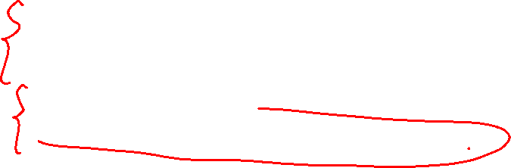
Picture of Multitape Simulation
q
X head for tape 1
. . . A B C A C B . . . tape 1
X head for tape 2
. . . U V U U W V . . . tape 2
Notes:
Here’s a picture of a one-tape Turing machine simulating a two-tape Turing machine. There are four tracks. Two of these tracks hold the contents of the two tapes, while the other two tracks hold only a single X each, marking the positions of the two tape heads. That is, the two-tape Turing machine has the head of its first tape scanning this C (POINT), and the head of its second tape scanning this W here (POINT).
I hope it is clear that the ordinary TM can, to simulate one move of the two-tape Turing machine, visit each of the X marks, store the symbols that the two-tape Turing machine sees in cache components of its own state, and finally figure out the move the two-tape machine would make. The one-tape machine then visits each of the positions with the X’s again, changes symbols as the two-tape machine would, and moves the X’s to reflect the head moves of the two-tape machine.
The one-tape machine needs to be careful to remember, in a component of its own state, how many X’s are to its left, so it can always find them all on its own tape. But if we design the one-tape machine to do that correctly, then it is possible for it to simulate the two-tape machine, although it will obviously take many of its own moves to do so.

Slide 26
Nondeterministic TM’s
Allow the TM to have a choice of move at each step.
  Each choice is a state-symbol-direction triple, as for the deterministic TM.
The TM accepts its input if any sequence of choices leads to an accepting state.
Notes:
Now, let’s look at the nondeterministic version of a Turing machine. We’ll talk only about one-tape, nondeterministic machines, but the addition of several tapes along with nondeteminism doesn’t add power either.
Click 1
The basic idea is that the Turing machine is allowed to have more than one choice of move for any state-tape-symbol pair. Once a choice is made, then the next state, new symbol, and head direction are determined. That is, you may have several choices, but you can’t pick a state from one, a symbol from another and a direction from a third.
Click 2
As for the nondeterministic finite automata and pushdown automata, the nondeterministic Turing machine is said to accept if any sequence of choices leads to an ID wirh an accepting state.

Slide 27
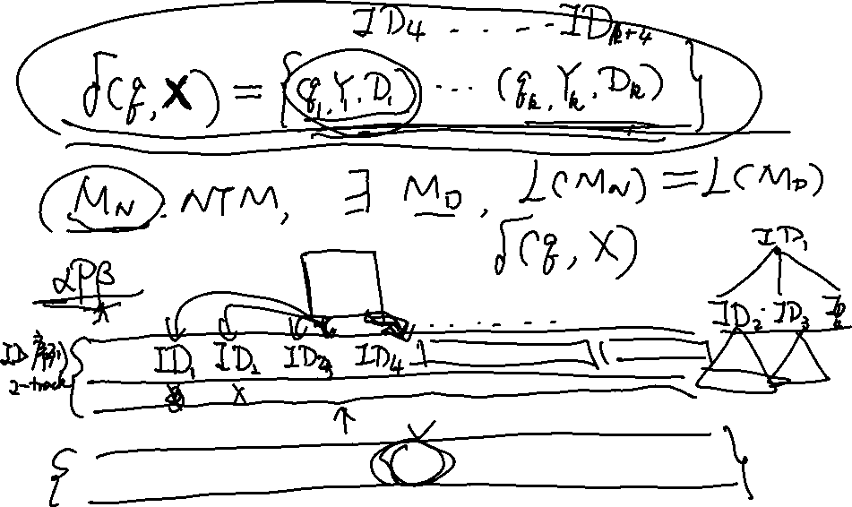

Slide 28
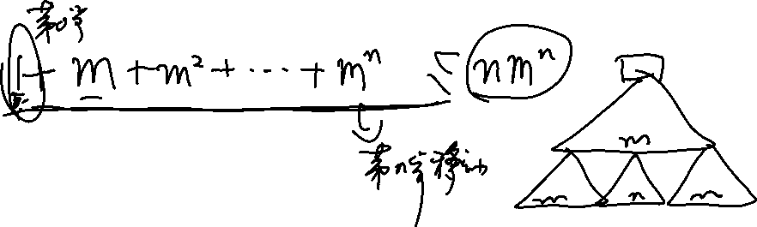

Slide 29
Simulating a NTM by a DTM
The DTM maintains on its tape a queue of ID’s of the NTM.
A second track is used to mark certain positions:
  A mark for the ID at the head of the queue.
  A mark to help copy the ID at the head and make a one-move change.
Notes:
Click 1
The basic trick is to use the tape of the determnistic machine to represent a queue of ID’s of the nondeterministic machine. The deterministic machine will make a systematic search of all the ID’s the nondeterministic machine can reach. If it finds one with a final state, then the deterministic machine accepts. If it never finds one, the simulation may go on forever, but the deterministic machine will never accept.
Incidentally, we should start to become aware of a surprising behavior of Turing machines. Sometimes, they run forever without accepting or halting. Moreover, we can’t tell whether the Turing machine is going to do that or, whether it will eventually halt, either accepting or not. That is, you can’t tell whether a Turing machine is an algorithm.
Click 2
Anyway, back to our description of how the deterministic machine simulates the nondeterministic. The deterministic machine needs a second track, in addition to the track that holds the ID’s of the nondeterministic machine.
Click 3
One purpose of this track to to mark the ID that is currently at the head of the queue of ID”s.
Click 4
And we need another mark whose job is to allow the detemrinistic machine to make a copy of the ID at the queue head – one symbol at a time – while it changes this ID to reflect one of the choices of move of the nondeterministic machine.

Slide 30
Picture of the DTM Tape
Where you are
copying ID_{k} with
a move
Front of
queue
X
Y
ID₀ # ID₁ # … # ID_{k} # ID_{k+1} … # ID_{n} # New ID
Rear of
queue
Notes:
Here’s a picture of the tape of the deterministic machine. On the data track there is a sequence of ID’s separated by a special symbol pound-sign, which we assume is not a symbol that can appear in the ID’s themselves
The mark X is at the pound-sign just before the ID that is at the head of the queue.The ID’s to the left of this point will never be useful again, since they have already been processed, but it is more trouble to erase them from the tape than it is to just leave them there.
The mark Y indicates the last position of the front ID that has been copied, with one choice of move of the nondeterministic machine. The deterministic machine will run back and forth, between the Y and the first blank it sees to its right, storing the symbol under the Y in its state and depositing it at the first blank. When it returns to the Y, it moves the Y one position right, until it has copied the entire ID, however, making the changes that reflect one move. The process is just a little more complex than the simple Turing machine we gave as our example of the use of multiple tracks, which ran back and forth copying its input.

Slide 31
Operation of the Simulating DTM
The DTM finds the ID at the current front of the queue.
It looks for the state in that ID so it can determine the moves permitted from that ID.
If there are m possible moves, it creates m new ID’s, one for each move, at the rear of the queue.
Notes:
Click 1
Here is how the deterministic machine processes the front ID on the queue.
Click 2
First, the deterministic machine looks for the state within the front ID. By storing this state and the symbol to its right in its own state, it now knows all the choices of moves for the nondeterministic machine.
Click 3
Suppose there are m choices of move. Then the deterministic machine will create m new ID’s at the rear of the queue, that is, to the right of the portion of its tape currently holding ID’s.

Slide 32
Operation of the DTM – (2)
The m new ID’s are created one at a time.
After all are created, the marker for the front of the queue is moved one ID toward the rear of the queue.
However, if a created ID has an accepting state, the DTM instead accepts and halts.
Notes:
Click 1
The deterministic machine decides on an order for the m choices, and creates an ID reflecting each choice, one at a time.
Click 2
After creating all m, it finds the X marker and moves it to the pound-sign to the right, thus moving to the next ID in the queue.
Click 3
However, as an exception, if the deterministic machine ever creates a new ID with an accepting state, then it accepts and halts its operation.

Slide 33
Why the NTM -> DTM Construction Works
There is an upper bound, say k, on the number of choices of move of the NTM for any state/symbol combination.
Thus, any ID reachable from the initial ID by n moves of the NTM will be constructed by the DTM after constructing at most (k^{n+1}-k)/(k-1)ID’s.
Sum of k+k²+…+k^{n}
Notes:
I described the workings of the deterministic machine fairly informally, but I hope you are convinced that the deterministic machine really could be programmed to do what I suggested. That is, you could write down a delta transition function that did all the things I talked about.
However, there is an additional concern that must be addressed. Can we be sure that if any sequence of choices by the nondeterministic machine leads to a final state, then the deterministic machine will eventually follow each ID in this sequence and thus will also accept. To prove that, we first observe that there is an upper bound, say k, on the number of choices of move the nondeterministic machine has in any situation.
Click 1
Thus, there are at most k ID’s reachable after one move, k-squared reachable after two moves, k-cubed after three moves, an so on. Suppose the final state is reached after n moves for some n. Then the number of ID’s the deterministic machine might have to look at is at most this (POINT), which is the sum of the first n powers of k, before it sees the ID with the final state. The exact formula is not important. The point is that k is finite and n is finite, so the number of ID’s examined is finite.
To see this point, notice that all the ID’s reachable after one move are put on the queue before any ID reachable by two moves. And all the ID’s reachable by two moves are placed there before we get to any ID’s that take three moves to reach, and so on. That is, the queue is organized shortest-distance first.

Slide 34
Why? – (2)
If the NTM accepts, it does so in some sequence of n choices of move.
Thus the ID with an accepting state will be constructed by the DTM in some large number of its own moves.
If the NTM does not accept, there is no way for the DTM to accept.
Notes:
Click 1
To sumarize, if the nondeterministic machine accepts, it does so in n moves for some finite n.
Click 2
Therefore, the deterministic machine will eventually construct the accepting ID of the nondeterministic machine, even though it may take a number of its own moves that is exponential in n.
Click 3
However, if no sequence of nondeterministic choices leads to acceptance, then the deterministic machine does not accept. Thus, the two machines define the same language.

Slide 35
Taking Advantage of Extensions
We now have a really good situation.
When we discuss construction of particular TM’s that take other TM’s as input, we can assume the input TM is as simple as possible.
  E.g., one, semi-infinite tape, deterministic.
But the simulating TM can have many tapes, be nondeterministic, etc.
Notes:
All the constructions we just showed will turn out to be quite useful in the future. We’re going to have to do several important constructions involving Turing machines. Whe we do that, we’ll assume the Turing machine that is input is as simple as possible. In particular, we’ll assume it is deterministic, with one tape infinite only to the right.
However, when we do the simulation, we are free to use a Turing machine that is as powerful as we need. In particular, we can allow it to be nondeterministic and to have as many tapes as we need.

Slide 36
Simulating a Name-Value
Store by a TM
The TM uses one of several tapes to hold an arbitrarily large sequence of name-value pairs in the format #name*value#…
Mark, using a second track, the left end of the sequence.
A second tape can hold a name whose value we want to look up.
Notes:
But first, let’s take up how we simulate name-value stores by a Turing machine.
Click 1
The Turing machine will have several tapes that we’ll describe later. But one of the tapes is used to hold the sequence of name-value pairs. As suggested here (POINT), the format we use is to separate pairs by pound-signs and to separate the name from the value by a star. We assume neither pound not star are symbols that can appear in any name or value.
Click 2
A second track of this tape will be used to mark the left end of the sequence. This mark never moves. it is just there so we can find the beginning of the sequence and scan it looking for a particular name.
Click 3
A second tape will be used to hold the name we want to look up.

Slide 37
Lookup
Starting at the left end of the store, compare the lookup name with each name in the store.
When we find a match, take what follows between the * and the next # as the value.
Notes:
to lookup the value associated with a name, use the marker to find the left end of the store. Compare each name with the name on the second tape. If we find a match, then the associated value is between the star and the next pound-sign.

Slide 38
Insertion
Suppose we want to insert name-value pair (n, v), or replace the current value associated with name n by v.
Perform lookup for name n.
If not found, add n*v# at the end of the store.
Notes:
Click 1
However, one operation we need to be able to perform on a name-value store is insertion. This operation is like what happens when we store into a computer’s memory. When we insert name-value pair (n,v), if there was no value previously associated with n, then v will now be associated with n. However, if there was an old value associated with name n, then that value is replaced by v.
Click 2
Regardless of which case applies, the first thing we need to do is lookup the name n, using a second tape to hold n, as we just discussed.
Click 3
If we scan the entire store, and we never find n, then append n*v# to the right end of the store.

Slide 39
Insertion – (2)
If we find #n*v’#, we need to replace v’ by v.
If v is shorter than v’, you can leave blanks to fill out the replacement.
But if v is longer than v’, you need to make room.
Notes:
Click 1
But if we find some (n,v’) in the store, we have to replace ‘ by v.
Click 2
If v is shorter than v’, then you can leave blanks to fill out the value.
Click 3
But the hard case is when v is longer than v’. Here, we have to shift the entire portion of the store that follows, far enough to the right to make room for v.

Slide 40
Insertion – (3)
Use a third tape to copy everything from the first tape to the right of v’.
Mark the position of the * to the left of v’ before you do.
On the first tape, write v just to the left of that star.
Copy from the third tape to the first, leaving enough room for v.
Notes:
Click 1
Here’s how we’ll do it. We use a third tape, and we copy the entire portion of the first tape that is at or to the right of v’.
Click 2
But make sure to mark the position on the first tape that holds the star to the left of v’. Remember this tape has a second track for marks.
Click 3
Now, write v on the first tape where v’ was. It is OK to overwrite any squares to the right of where v’s was.
Click 4
Then, we restore the first tape by copying from the third tape everything that was copied there. The net effect is that the portion of the first tape that held data to the right of v’s has been moved right as many squares as was necessary to fit v in place of v’s.

Slide 41
Picture of Shifting Right
Tape 1
. . . # n * v’ # blah blah blah . . .
v
# blah blah blah . . .
Tape 3
Notes:
Here’s a picture of this sequence of moves.
Click 1
First, we copy everything to the right of v’ onto tape 3.
Click 2
Then we overwrite v on tape 1, covering anything we have to.

Slide 42
Picture of Shifting Right
Tape 1
. . . # n * # blah blah blah . . .
v
# blah blah blah . . .
Tape 3
Notes:
Then, we copy tape 3 onto tape 1, positioning it to the right of whatever space v has taken.

Slide 43
Closure Properties of Recursive and RE Languages
Both closed under union, concatenation, star, reversal, intersection, inverse homomorphism.
Recursive closed under difference, complementation.
RE closed under homomorphism.
Notes:
Next, let’s see something of the closure properties for both the recursively enumerable languages – those that are defined by Turing machines that may run forever if they don’t accept, and the recursive languages, those defined by Turing machines that will eventually halt without accepting if they choose not to accept the input.
Click 1
Each of these classes is closed under the regular-expression operations – union, concatenation, and star. They are also closed under reversal, intersection, and inverse homomorphism.
Click 2
The recursive languages, but not the recursively enumerable languages, are closed under difference, and therefore complementation.
Click 3
The recursively enumerable languages, but not the recursive languages, are closed under homomorphisms.

Slide 44
Union
Let L₁ = L(M₁) and L₂ = L(M₂).
Assume M₁ and M₂ are single-semi-infinite-tape TM’s.
Construct 2-tape TM M to copy its input onto the second tape and simulate the two TM’s M₁ and M₂ each on one of the two tapes, “in parallel.”
Notes:
Let’s first look at closure under union.
Click 1
Let L1 and L2 be languages accepted by final state by Turing machines M1 and M2, respectively.
Click 2
To make things simple, we may assume M1 and M2 are one-tape machines, with a semi-infinite tape.
Click 3
For the language L1 union L2, we construct a Turing machine M with two tapes. The first thing M does is to copy its input from the first tape to the second. Then, M uses one tape to simulate M1 and the other tape to simulate M2. M accepts if either accepts.

Slide 45
Union – (2)
Recursive languages: If M₁ and M₂ are both algorithms, then M will always halt in both simulations.
RE languages: accept if either accepts, but you may find both TM’s run forever without halting or accepting.
Notes:
Click 1
To show that the recursive languages are closed under union, observe that both M1 and M2 will eventually halt, whether or not they accept. M will accept if either does. But if neither accepts, then M will eventually halt without accepting. So M is also an algorithm.
Click 2
For closure of the recursively enumerable languages under union, we know that M1 or M2 may run forever if they do not accept. If either accepts, then M will accept. However, if neither accepts, then M may run forever. But that is OK, since we only want to prove that L1 union L2 is recursively enumerable in this case.

Slide 46
Picture of Union/Recursive
M₁
Accept
Reject
OR
Accept
Input w
M
M₂
Accept
AND
Reject
Reject
Remember: = “halt
without accepting
Notes:
We’re going to use picture proofs for Turing machines quite a bit. Here’s how we represent an algorithm – a Turing machine that always halts (POINT to M2). It is just a box with two output signals, Accept and “Reject.” We should understand that reject just means that the machine halts without accepting. We know that an algorithm will eventually make one of these signals, but not both.
Then the design of M can be expressed by this diagram. It gets its input w from the outside (POINT), and feeds it to M1 and M2, which it simulates. M produces the Accept signal if either M1 or M2 does (POINT). If neither produces accept, then they both eventually produce Reject. When both do, M produces the reject signal (POINT). Thus, M will make one of these signals but not both.

Slide 47
Picture of Union/RE
M₁
Accept
OR
Accept
Input w
M
M₂
Accept
Notes:
And here’s how we represent a Turing machine that is not necessarily an algorithm (POINT to M2). It makes an Accept signal if it accepts, but we cannot expect it to make a Reject signal. It may just keep making moves, but never accept.
This diagram is the design of M for the case where M1 and M2 are general Turing machines. Again M feels both the input w. If either raises the Accept signal, M does too. We have no idea what M does if neither accepts, but it doesn’t matter. M has the form needed to show that the union of the languages of M1 and M2 is a recursively enumerable language.

Slide 48
Intersection/Recursive – Same Idea
M₁
Accept
Reject
AND
Accept
Input w
M
M₂
Accept
OR
Reject
Reject
Notes:
Here’s a picture proof of the fact that recursive languages are closed under intersection. M1 and M2 are algorithms. We design M to feed its input to simulated M1 and M2 (POINT). M accepts if both accept (POINT) and M rejects if either rejects (POINT).

Slide 49
Intersection/RE
M₁
Accept
AND
Accept
Input w
M
M₂
Accept
Notes:
And here’s a picture proof for intersection of recursively enumerable languages. M feeds its input to M1 and M2 and accepts if both accept.

Slide 50
Difference, Complement
Recursive languages: both TM’s will eventually halt.
Accept if M₁ accepts and M₂ does not.
  Corollary: Recursive languages are closed under complementation.
RE Languages: can’t do it; M₂ may never halt, so you can’t be sure input is in the difference.
Notes:
Difference and complement give us very different stories for the two classes of langauges recursive and recursively enumerable.
Click 1
If you want to accept the difference of the languages of algorithms M1 and M2, simulate them both until they halt.
Click 2
Accept if M1 accepts and M2 rejects, and otherwise reject. The picture is much like what we saw for union and intersection of recursive languages. Only the logic combining the signals is different.
Click 3
An important consequence is that the complement with respect to some alphabet Sigma of a recursive language is recursive. Surely Sigma-star, the set of all strings over Sigma, is recursive.
Click 4
This approach does not work for the recursively enumerable languages. They are in fact not closed under difference or complementation. We’ll see a particular recursively enumerable language whose complement is not recursively enumerable soon. But just to see why the construction for recursive languages doesn’t work, remember that M2 may never halt. So if M1 accepts, we may never know that the input is in the difference.

Slide 51
Concatenation/RE
Let L₁ = L(M₁) and L₂ = L(M₂).
Assume M₁ and M₂ are single-semi-infinite-tape TM’s.
Construct 2-tape Nondeterministic TM M:
  Guess a break in input w = xy.
  Move y to second tape.
  Simulate M₁ on x, M₂ on y.
  Accept if both accept.
Notes:
Now, let’s show the recursively enumerable languages are closed under concatenation.
Click 1
Let L1 and L2 be defined by Turing machines M1 and M2.
Click 2
Assume M1 and M2 have one semiinfinite tape each.
Click 3
For the concatenation, construct M, a two-tape nondeterministic machine.
Click 4
Given input w, M guesses a prefix x of w that is in L1. Let y be the remainder of w, which must be in L2.
Click 5
M moves y to its second tape.
Click 6
M simulates M1 on input x and M2 on y.
Click 7
If both accept, then M accepts. Since it is nondeterministic, it will guess every possible way to break w into two pieces, so it always accepts w if w is n L1 concatenated with L2.

Slide 52
Concatenation/Recursive
Can’t use a NTM.
Systematically try each break w = xy.
M₁ and M₂ will eventually halt for each break.
Accept if both accept for any one break.
Reject if all breaks tried and none lead to acceptance.
Notes:
Next, we claim the recursive languages are also closed under concatenation.
Click 1
We can’t use the nondeterministic trick, or at least it is rather hard to do so.
Click 2
However, M will systematically try each possible breakpoint for w into xy, run M1 on x and M2 on y.
Click 3
M1 and M2 always halt on each x and y.
Click 4
If for any breakpoint, both accept their pieces, then M accepts.
Click 5
But if all breakpoints lead to rejection by one or both of M1 and M2, then M eventually runs out of things to try and rejects.

Slide 53
Star
Same ideas work for each case.
RE: guess many breaks, accept if M₁ accepts each piece.
Recursive: systematically try all ways to break input into some number of pieces.
Notes:
For closure under star, the same ideas work as for concatenation. Suppose M1 is a Turing machine for some language L, and we want a Turing machine for L-star.
For the recursively enumerable languages, guess how many pieces to break input w into, and guess where the points of separation are. Accept if M1 accepts each piece.
For the recursive languages, don’t guess, but enumerate the breaks systematically. Since M1 is guaranteed to halt any time it is given a piece of the input w to examine, we’ll eventually get through testing each of the possible ways to break the input.

Slide 54
Reversal
Start by reversing the input.
Then simulate TM for L to accept w if and only w^{R} is in L.
Works for either Recursive or RE languages.
Notes:
Reveral is easy for both classes of languages. First, reverse the input, and then simulate the Turing machine for langauge L on the reversed input. We’ll not say anything more about this simple idea.

Slide 55
Inverse Homomorphism
Apply h to input w.
Simulate TM for L on h(w).
Accept w iff h(w) is in L.
Works for Recursive or RE.
Notes:
Inverse homomorphism is also quite simple. Suppose L is a language, either recursive or recursively enumerable. Let M be a Turing machine for L. And let h be a homomorphism
Click 1
We’ll design a Turing machine for h-inverse(L). Start by applying h to the given input w.
Click 2
Simulate M on h(w).
Click 3
Accept if M accepts.
Click 4
If L is recursively enumerable, then we’ve got a Turing machine, which may not always halt, for h-inverse(L).
But if L is recursive, then we know M will always halt, and thus so will the machine we just designed.

Slide 56
Homomorphism/RE
Let L = L(M₁).
Design NTM M to take input w and guess an x such that h(x) = w.
M accepts whenever M₁ accepts x.
Note: won’t work for Recursive languages.
Notes:
Last, let’s show the recursively enumerable languages are closed under homomorphism.
Click 1
Suppose L has a turing machine M1.
Click 2
We’ll construct a nondeterministic Turing machine M for h(L). Given input w, M guesses a string x and checks that h(x)=w. If so, M simulates M1 on input x.
Click 3
If M1 accepts x, then M accepts w. Thus, M accepts h(L).
Click 4
This construction won’t work for the recursive langauges. The reason is that if h maps some symbols to epsilon, then the string x that M1 accepts may be arbitrarily long, and M may have to simulate an infinite number of possible x’s. It can neer be sure that there is no x in L for which h(x) = w.

