Slide 1
More NP-Complete Problems
NP-Hard Problems
Tautology Problem
Node Cover
Knapsack
Notes:
Now it’s time for the “payload” of the theory of NP-completeness. We’re going to see some perfectly ordinary problems – not apparently related to computation in any way – that are also NP-complete. Of course we can cover only a tiny fraction of the problems that are known to be NP-complete.
But the methods – ways of designing reductions – are the things to take away from this discussion. If you encounter a problem in your work and can’t come up with an efficient solution, there is a good chance that you can devise a reduction that proves it NP-complete. That proof guides your thinking. You need to consider, for example, whether you need to solve the problem in all its generality, or whether a simpler special case would give you what you need. You need to consider efficient algorithms that offer an approximation to what you really want. Without the assurance that the problem is NP-complete, you are less likely to want to attempt – or to justify to your boss – taking one of these simplifying steps.
But before moving on to reductions that show the problems Node-Cover and Knapsack to be NP-complete, we introduce one more nuance into the theory. NP-hard problems are those that would be NP-complete, if only they were in NP, but that are probably or certainly harder than anything in NP. We talk about the tautology problem, which is an example of such a problem, even though it is very closely related to the problem SAT.

Slide 2
Next Steps
We can now reduce 3-SAT to a large number of problems, either directly or indirectly.
Each reduction must be polytime.
Usually we focus on length of the output from the transducer, because the construction is easy.
Notes:
Click 1
We are ready to reduce 3-SAT to a number of other problems, thus showing each of them NP-complete. These reductions can be directly from 3-SAT or from another problem that we previously proved NP-complete.
Click 2
Remember that the key issue is that each reduction must be polytime.
Click 3
However, in most cases, the construction is computationally simple, so as long as the output is of length polynomial in the input, it will be easy to argue that the running time of the transducer is polynomial.

Slide 3
Next Steps – (2)
Another essential part of an NP-completeness proof is showing the problem is in NP.
Sometimes, we can only show a problem NP-hard = “if the problem is in P, then P = NP,” but the problem may not be in NP.
Notes:
Click 1
Of course for a problem is NP-complete, it must be in NP. Usually, this part of the proof is quite simple, since a nondeterministic polytime Turing machine can use its nondeterminism to guess a solution in linear time, and then check that it has guessed a solution in some polynomial time.
Click 2
However, there are some interesting cases where we can only show a problem to be “NP-hard,” meaning that if it is in P, then P=NP, but the problem itself may or may not be in NP.

Slide 4
Example: NP-Hard Problem
The Tautology Problem is: given a Boolean expression, is it satisfied by all truth assignments?
  Example: x + -x + yz
Not obviously in NP, but it’s complement is.
  Guess a truth assignment; accept if that assignment doesn’t satisfy the expression.
Notes:
Click 1
A curious example of an NP-hard problem is the tautology problem. An expression is a tautology if it is true for EVERY truth assignment. For example, this (POINT) expression is a tautology. Every truth assigment makes x either true or false. so one of the first two terms (POINT) will have to be true, and therefore the whole expression is true. We don’t even need the term y AND z.
If you look at Cook’s original paper on NP-completeness. he was really trying to show that tautologies required exponential time to recognize. Because tautologies are the theorems of logic. That’s what logicians care about, not satisfiable expressions. Cook was able to reduce all of NP to satisfiability, but that is enough to show that if there were a polytime algorithm for tautologies, then P=NP. We’ll address this point in a few slides.
Click 2
In fact, there is good reason to believe the tautology problem is not in NP. On the other hand, its complement – the nontautologies (including those inputs that don’t make sense as a Boolean expression) – IS in NP. We use nondeterminism to guess a truth assignment, and evaluate the expression in polytime for this truth assignment. If the value is false, then the nondeterministic machine accepts its input.
On the other hand, if the nondeterministic machine accepts whenever it finds the value to be true, it accepts the satisfiable expressions, not the tautologies.

Slide 5
Co-NP
A problem/language whose complement is in NP is said to be in Co-NP.
Note: P is closed under complementation.
Thus, P ⊆ Co-NP.
Also, if P = NP, then P = NP = Co-NP.
Notes:
Click 1
The class of languages co-NP is those languages whose complement is in NP. For example, we just argued that the Tautology problem is in Co-NP, because the nontautologies is in NP.
Click 2
We didn’t prove this exactly, but it is easy to show that the class P is closed under complementation. If I have a deterministic Turing machine that halts within p(n) steps for some polynomial p(n), we can modify it to accept the complement language. Just have the new machine simulate the original. It halts without accepting if the original machine accepts, and it goes to a new accepting state if the original halts.
Click 3
Since the complement of every language in P is also in P, it is surely in NP. That proves the class P is a subset of co-NP as well as of NP.
Click 4
Another important connection is that if P does equal NP, then P also equals co-NP, and therefore NP and co-NP are equal. However, it is possible, but unlikely, that NP and co-NP are the same, but that they are bigger than P.

Slide 6
Tautology is NP-Hard
While we can’t prove Tautology is in NP, we can prove it is NP-hard.
Suppose we had a polytime algorithm for Tautology.
Take any Boolean expression E and convert it to NOT(E).
  Obviously linear time.
Notes:
We can prove the Tautology problem to be NP-hard. For the proof, suppose there is a polytime algorithm for the Tautology problem. Then given a Boolean expression E, convert it to NOT(E), which takes only linear time, since all we have to do is add NOT and a pair of parentheses.

Slide 7
Tautology is NP-Hard – (2)
E is satisfiable if and only NOT(E) is not a tautology.
Use the hypothetical polytime algorithm for Tautology to test if NOT(E) is a tautology.
Say “yes, E is in SAT” if NOT(E) is not a tautology and say “no” otherwise.
Then SAT would be in P, and P = NP.
Notes:
Click 1
Notice that E is satisfiable if and only if NOT(E) is *not* a tautology.
Click 2
So use the hypothetical algorithm for the Tautology problem to tell whether or not NOT(E) is a tautology in polynomial time.
Click 3
Then, just complement the answer. That is, say E is in SAT whenever the answer you got is that NOT (E) is not a tautology, and say E is not satisfiable whenever NOT(E) is found to be a tautology.
Click 4
That would be a polytime algorithm for SAT, which would show P=NP. That is all we need for a proof that tautology is NP-hard.

Slide 8
The Node Cover Problem
Given a graph G, we say N is a node cover for G if every edge of G has at least one end in N.
The problem Node Cover is: given a graph G and a “budget” k, does G have a node cover of k or fewer nodes?
Notes:
Click 1
Now, let’s meet a real problem from Operations Research that Karp proved NP-complete. A NODE COVER for a graph is a set of nodes of that graph such that every edge has at least one of its two nodes in the set.
Click 2
We need to express the problem of finding a smallest possible node cover as a yes/no problem. We do so by asking whether, given a graph G and an integer k, does G have a node cover of size k or less. This is the formal problem or language called Node Cover.
Notice that if we had a polytime algorithm for the minimization problem, that is, given a graph, find a node cover of smallest size. then we could prove that the formal problem Node Cover was in P. Just use the hypothetical polytime algorithm to find a smallest node cover, count the number of nodes in the cover, and see if it is at most k. That means that, once we prove the formal node-cover problem to be NP-complete, we also know there is no polytime algorithm for the minimization version unless P=NP.

Slide 9
Example: Node Cover
A
B
C
D
E
F
One possible node cover
of size 3: {B, C, E}
Notes:
Here’s an example of a graph. One of the interesting things about NP-complete problems – and Node-cover is one such – is that even small instances of the problem seem hard. So how small a node cover can we find for this graph? Do you see the answer yet?
Well let’s work it out. We have to pick either C or D for our node cover, or else the edge CD isn’t covered. We may as well pick C, because C covers every edge that D covers, and more. We also have to pick either A or E, else the edge AE is not covered. But picking C and either A or E does not cover the edge BF. So we need at least three nodes in the node cover.
Click 1
But here’s one example that works/ B, C, and E together cover all the edges. Thus given this graph and the budget k=3 the answer is “yes.” The same answer applies if the instance of node cover is this graph with a higher budget. However, if we are given this graph with a budget 2 or less, the answer is “no.”

Slide 10
NP-Completeness of Node Cover
Reduction from 3-SAT.
For each clause (X+Y+Z) construct a “column” of three nodes, all connected by vertical edges.
Add a horizontal edge between nodes that represent any variable and its negation.
Budget = twice the number of clauses.
Notes:
We are now going to prove Node Cover to be NP-complete.
Click 1
We shall give a polytime reduction from 3-SAT.
Click 2
Given an instance of 3-SAT, we construct a graph. There is a node for each literal of each clause, so the number of nodes is 3 times the number of clauses. It helps to imagine the nodes arranged in a rectangle, where the columns correspond to the clauses. Each column has three nodes, one for each of its clauses. There are vertical edges connecting each pair of nodes in a column, thus there are three vertical edges per column.
Click 3
There are also horizontal edges that connect nodes in different columns. Two nodes are connected if they represent literals with the same variable, and exactly one of those literals has the variable negated.
click 4
Finally, the budget k is twice the number of clauses, which is also exactly 2/3 of the nodes.

Slide 11
Example: The Reduction to Node Cover
(x + y + z)(-x + -y + -z)(x + -y +z)(-x + y + -z)
x
-x
x
-x
Budget
= 8
y
-y
-y
y
z
-z
z
-z
Notes:
Here’s an example of an instance of 3-SAT with 4 clauses. We’ll construct the graph that has a node cover of 8 nodes if and only if the expression is satisfiable.
Click 1
Here’s the column for the first clause. The literals of the first clause are x, y ,and z, with no negations, so those are the labels of the three nodes in the column.
Clicks 2, 3, 4
And similarly we construct a column for each of the other clauses. It is convenient that all four clauses have the same three variables, in order, either negated or not, so this graph is going to turn out to be easier to understand than might otherwise be the case.
Click 5
Now we add the horizontal edges. For example, in the top row, where all the x’s are, each node labeled x is connected to each node labeled NOT x. Again, because all the x-nodes line up, the horizontal edges are truly horizontal. In more complex examples, they would not be, although they always go between columns.
Similarly, we see connections in the second row between nodes y and nodes NOT y. In the third row are the edges between z and NOT z.
Click 6
And the final part of the output is the budget k. Since there are four clauses, the budget is k = twice that, or 8.

Slide 12
Example: Reduction – (2)
A node cover must have at least two nodes from every column, or some vertical edge is not covered.
Since the budget is twice the number of columns, there must be exactly two nodes in the cover from each column.
Satisfying assignment corresponds to the node in each column not selected.
Notes:
Click 1
The first thing to observe about the constructed graph is that a node cover must have at least two of the three nodes in every column. If it has only one node in a column, then the vertical edge between the two unselected nodes will not be covered. And if the node cover has zero nodes from a column, then all three edges in that column will be uncovered.
Click 2
But the budget is exactly twice the number of clauses. So if all three nodes of one column were in the node cover, then some other column would be short-changed – it could only get one node, and we would not have a node cover. The conclusion is that there can be no node cover with fewer than k nodes, and if there is a node cover of exactly k nodes, then these k nodes must be exactly two from each column.
Click 3
We’re going to show that there is a tight relationship between node covers and truth assignments, and this connection goes through the nodes that are NOT selected for the node cover. That is, a satisfying assignment for the 3-SAT instance will yield a node cover if we omit from the node cover one of the nodes from each column that is made true by the assignment. And conversely, a node cover with 2 nodes per column will give us a satisfying assignment by making all the literals whose nodes are uncovered be true. We’ll prove all this in a minute, but first an example.

Slide 13
Example: Reduction – (3)
(x + y + z)(-x + -y + -z)(x + -y +z)(-x + y + -z)
Truth assignment: x = y = T; z = F
Pick a true node in each column
x
-x
x
-x
y
-y
-y
y
z
-z
z
-z
Notes:
For example, here’s the 3-SAT instance we saw earlier, and here’s the graph, with budget 8, that we constructed. Here’s a truth assignment (POINT). It happens to be a satisfying assignment, so we can pick a node from each column that is made true by the assignment.
Click 1
Here’s one such choice. There are others. For example, in the first column we could have picked y instead of x.

Slide 14
Example: Reduction – (4)
(x + y + z)(-x + -y + -z)(x + -y +z)(-x + y + -z)
Truth assignment: x = y = T; z = F
The other nodes form a node cover
x
-x
x
-x
y
-y
-y
y
z
-z
z
-z
Notes:
I claim that if we take the other two nodes from each column, we get a node cover. Surely all the vertical edges are covered, since we have two nodes in each column. But what about the horizontal edges. Suppose we have a horizontal edge, say with x at one end and NOT x at the other, and neither end is in the node cover. That means both were selected as the literal that made their clause true. But how could that be? They can’t both be true in any one truth assignment, so they can’t simultaneously make their clauses true.

Slide 15
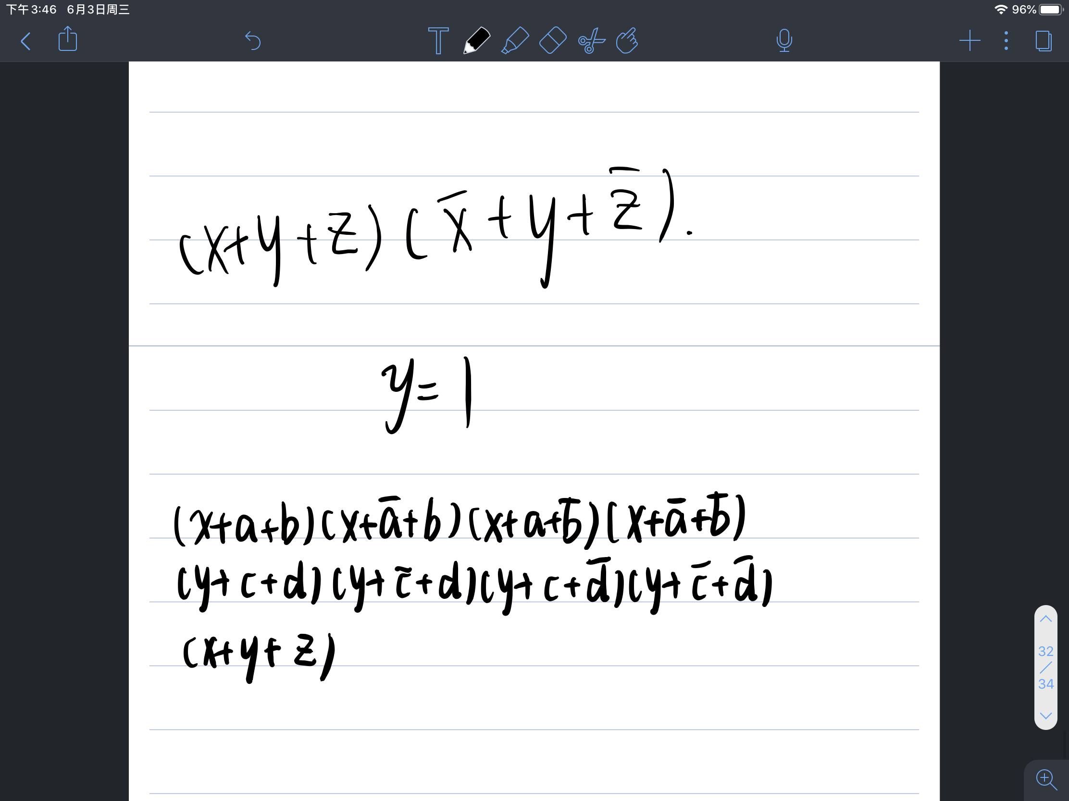

Slide 16
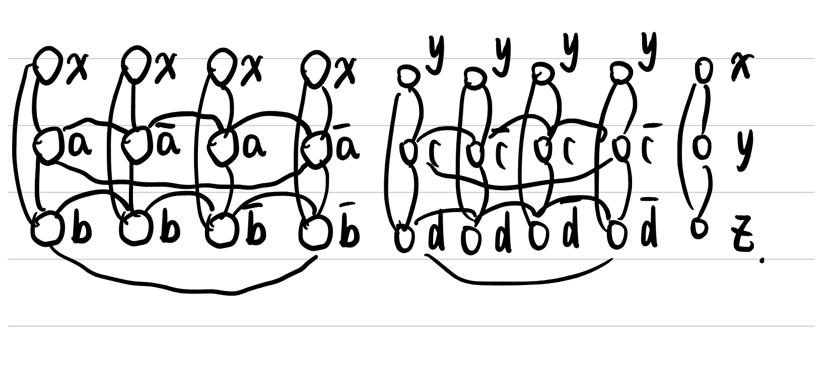

Slide 17
Proof That the Reduction Works
The reduction is clearly polytime.
Need to show: If we construct from 3-SAT instance E for a graph G and a budget k, then G has a node cover of size < k if and only if E is satisfiable.
Notes:
Click 1
We need to show that what we described is a polytime reduction from 3-SAT to Node Cover. It is easy to see the transducer takes polynomial time. It works clause by clause, generating no more nodes than there are literals. The vertical edges can be generated at the same time, and the number only three per clause.
The horizontal edges can be generated easily if we list all the nodes labeled by each literal. After seeing all the clauses, we can generate horizontal edges. For each variable x, we look at the lists of nodes for literals x and NOT x. We generate edges for all pairs, one from each list. The total number of edges generated is no more than quadratic in the length of the input, and the edges can be generated in constant time each.
Click 2
We also need to show the reduction is correct, of course. That is, if we construct graph G and budget k from 3-SAT expression E, then G has a node cover of size k or less if and only if E is satisfiable.

Slide 18
Proof: If
Suppose we have a satisfying assignment A for E.
For each clause of E, pick one of its three literals that A makes true.
Put in the node cover the two nodes for that clause that do not correspond to the selected literal.
Total = k nodes – meets budget.
Notes:
Click 1
For one direction, suppose E is satisfiable, and let A be a satisfying truth assignment.
Click 2
The argument that G has a node cover of size k is really just the argument we gave for our example earlier. That is, we begin to construct the node cover by selecting, for each clause of E, one of the literals that truth assignment A makes true. We know there is one, because A is a satisfying assignment, and the only way to make a 3-SAT expression true is to make each clause true.
Click 3
Then the node cover consists of the two unselected nodes from each column. Notice that some of these nodes may also have their literal made true by assignment A, but it doesn’t matter. The important thing is that the *unselected* nodes all correspond to true literals.
Click 4
This selection of nodes has exactly k nodes, since k is twice the number of clauses. So if we can prove it is a node cover, then we have shown that G has a node cover of size at most k – in this case exactly k.

Slide 19
Proof: If – (2)
The selected nodes cover all vertical edges.
  Why? Any two nodes for a clause cover the triangle of vertical edges for that clause.
Horizontal edges are also covered.
  A horizontal edge connects nodes for some x and -x.
  One is false in A and therefore its node must be selected for the node cover.
Notes:
We claim the nodes we selected include at least one end of each edge, so indeed we have selected a node cover.
Click 1
First, consider the vertical edges.
Click 2
We selected two nodes from each column. There are only three nodes per column, so only one is unselected. Thus, any edge in that column has at least one selected end.
Click 3
How about the horizontal edges?
Click 4
Each horizontal edge has ends corresponding to literals x and NOT x for some propositional variable x.
Click 5
The truth assignment A has to make either x or NOT x false. whichever is false could not have been selected as the literal that makes its clause true. Therefore, it is surely selected for the node cover. That means every horizontal edge is covered, and the k selected nodes do indeed form a node cover.

Slide 20
Proof: Only If
Suppose G has a node cover with at most k nodes.
One node cannot cover the vertical edges of any column, so each column has exactly 2 nodes in the cover.
Construct a satisfying assignment for E by making true the literal for any node not in the node cover.
Notes:
The converse also follows the outline of the proof we gave for our example.
Click 1
So suppose G has a node cover with k or fewer nodes.
Click 2
Since all the vertical edges must be covered, there must be at least 2 selected nodes in each column, because one selected node can cover only two of the three edges.
Click 3
We claim that from the nodes not selected for the node cover, we can figure out a satisfying assignment for E. If there is an unselected node corresponding to literal x, then make propositional variable x true in the truth assignment. If there is an unselected node corresponding to literal NOT x, then make x false. We’ll see why this works on the next slide.

Slide 21
Proof: Only If – (2)
Worry: What if there are unselected nodes corresponding to both x and -x?
  Then we would not have a truth assignment.
But there is a horizontal edge between these nodes.
Thus, at least one is in the node cover.
Notes:
Click 1
Well what could go wrong? We might have made a truth assignment that makes some variable x be both true and false. That is, nodes corresponding to both literals x and NOT x might have been outside the node cover.
Click 2
But that can’t happen because there is a horizontal edge between these two nodes,
Click 3
and therefore, at least one is in the node cover. Thus, we do have a consistent satisfying assignment, and the expression E is in 3-SAT whenever G has a node cover of size up to k.

Slide 22
The Knapsack Problem
We shall prove NP-complete a version of Knapsack with a target:
  Given a list L of integers and a target k, is there a subset of L whose sum is exactly k?
Later, we’ll reduce this version of Knapsack to our earlier one: given an integer list L, can we divide it into two equal parts?
Notes:
Now, lets revisit our old friend the Knapsack problem.
Click 1
We’re going to prove Knapsack is NP-complete. But it is easier first to reduce 3-SAT to a variant of Knapsack, which we’ll call Knapsack-with-target. That is, given a list of integers L and an integer budget k, is there a subset of L that sums to exactly k?
Click 2
Once we’ve shown Knapsack-with-target NP-complete, we’ll reduce it to the real Knapsack problem: given a list of integers L, can we divide L into two parts whose sums are the same?

Slide 23
Knapsack-With-Target is in NP
Guess a subset of the list L.
Add ‘em up.
Accept if the sum is k.
Notes:
We have to show Knapsack-with-target is in NP, but that, as usual, is an easy argument.
Click 1
Use the nondeterminism to guess a subset of L.
Click 2
Compute the sum of the integers in the guessed subset.
Click 3
And accept if that sum is exactly k.

Slide 24
Polytime Reduction of 3-SAT to Knapsack-With-Target
Given 3-SAT instance E, we need to construct a list L and a target k.
Suppose E has c clauses and v variables.
L will have base-32 integers of length c+v, and there will be 3c+2v of them.
Notes:
Click 1
We’re going to reduce 3-SAT to Knapsack-with-target. So suppose we have an expression E in 3-CNF and target k.
Click 2
Let E have c clauses and v propositional variables.
Click 3
We’re going to thing of the integers in the list L we construct as written in base 32. We can write them in binary, so we need five characters per digit, but the factor of 5 is of no importance if we are only worrying about performing the transduction from 3-SAT instances to Knapsack instances in polynomial time.
The length of each integer will be c+v, so each integer could be as long as the entire expression E. There will be 3c+2v integers. That means the length of the output could be on the order of the square of the length of the input, but that’s OK – it’s still a polytime transduction, as long as we can generate the integers in time proportional to their length, which we can.

Slide 25
Picture of Integers for Literals
1
1 1 1 1 11
v
c
i
1 in i-th position
if this integer is
for x_{i} or -x_{i}.
1’s in all positions
such that this literal
makes the clause true.
All other positions are 0.
Notes:
Here’s a picture of some of the base-32 integers we will use – those for the literals. Notice that each digit will be either 0 or 1, but the base is still 32. We need a base that large to avoid carries from place to place when we add integers.
Click 1
The high-order v positions represent the variables. We’ll have one integer for each literal x_i or NOT x_i. Thus, there will be 2v such integers. The integer has a 1 in the i-th position from the left end of the first v positions if it corresponds to a literal based on propositional variable x_i, that is, either x_i or NOT x_i.
Click 2
The c low-order positions correspond to the clauses. The integer for a literal will have a 1 in the position for each clause that it makes true.
Click 3
And all other positions are 0.

Slide 26
Pictures of Integers for Clauses
5
6
7
i
For the i-th clause
Notes:
There will also be three integers for each clause. The integers for the i-th clause have, respectively, the base-32 digits 5, 6, and 7 in the i-th position from the left end. All other positions are 0.

Slide 27
Example: Base-32 Integers
(x + y + z)(x + -y + -z)
c = 2; v = 3.
Assume x, y, z are variables 1, 2, 3, respectively.
Clauses are 1, 2 in order given.
Notes:
Click 1
Here’s a tiny example.
Click 2
There are two clauses and three variables in this expression, so c=2 and v=3.
Click 3
Let’s number the three variables x, y ,and z 1, 2, and 3, respectively.
Click 4
And number the clauses 1 and 2 in the order shown.

Slide 28
Example: (x + y + z)(x + -y + -z)
For x: 00111
For -x: 00100
For y: 01001
For -y: 01010
For z: 10001
For -z: 10010
For first clause: 00005, 00006, 00007
For second clause: 00050, 00060, 00070
Notes:
Let’s see the base-32 integers constructed for this example.
Click 1
First, consider the literal x. There are three variables, so the first three positions correspond to the variables (POINT). x is the first, so its position is at the left end of the first three positions (POINT). Thus, we see 1 there and 0’s in the first two positions.
The last two positions correspond to the two clauses (POINT). When x is true, both clauses are made true, so we have 1’s in each of the last two positions.
Click 2
Now, consider literal NOT x. The first three positions are the same as for literal x. But NOT x doesn’t make either clause true, so the last two positions are both 0.
Clicks 3 and 4
Here are the integers for y and NOT y. Among the first three positions, they both have their 1’s in the middle (POINT). y makes the first clause but not the second true, so it has 1 in the low-order position (POINT) – the one that corresponds to clause 1, and 0 in the second-from-last position. These digits are switched for literal NOT y (POINT).
Clicks 5 and 6
And here are the integers for z. In the three high-order positions, they each have 1 in the highest position (POINT). Like y, z makes the first but not the second clause true, so the two low order positions look like the previous two integers.
Click 7
Now let’s look at the integers for the clauses. For clause 1, we have integers with 5, 6, and 7 in the low-order position.
Click 8
And for clause 2, we have the same digits in the second-lowest position.

Slide 29
The Target
k = 8(1+32+32²+…+32^{c-1}) + 32^{c}(1+32+32²+…+32^{v-1})
That is, 8 for the position of each clause and 1 for the position of each variable.
  k = (11…188…8)₃₂.
Key Point: Base-32 is high enough that there can be no carries between positions.
Notes:
Click 1
Pick target k as shown.
Click 2
Note that k in base 32 is v 1’s followed by c 8’s. Thus, it is easy to write down in time proportional to the length of the input to the transducer.
Click 3
We claim that when we add a subset of the 2v+3c integers, there cannot be any carries from one place to the next higher place. We’ll see why on the next slide.

Slide 30
Key Point: Details
Among all the integers, the sum of digits in the position for a variable is 2.
And for a clause, it is 1+1+1+5+6+7 = 21.
  1’s for the three literals in the clause; 5, 6, and 7 for the integers for that clause.
Thus, the target must be met on a position-by-position basis.
Notes:
Click 1
In the high-order positions, only two integers have a 1 in any position, so there can be no carries there.
Click 2
For the low-order positions, corresponding to the clauses, each position has integers with 5, 6, and 7 there. Even if all three are in the selected set, that’s only 18 – not enough. But what other integers could contribute to a low-order position? Only the three integers for literals that appear in the clause that corresponds to that position. But these three integers only have 1 in that position, so the maximum sum in any position is 21. So there are no carries.
We could have made the base 22 instead of 32, but 32 is easier to convert to binary, so we went with 32.
Click 3
The important consequence of “no carries” is that the target can only be met by making each position in the sum match the corresponding position of the target. We’ll see how this connects satisfying truth assignments to Knapsack solutions on the next slide.

Slide 31
Key Point: Concluded
Thus, if a set of integers matches the target, it must include exactly one of the integers for x and -x.
For each clause, at least one of the integers for literals must have a 1 there, so we can choose either 5, 6, or 7 to make 8 in that position.
Notes:
Click 1
First, consider the high-order positions, the positions for the variables. If the sum of a set of integers matches the target, then the sum must be 1 in that position. That means either x or NOT x is true for each propositional variable x, but not both. That in turn means that the selected integers correspond to a truth assignment.
Click 2
Now, let’s look at the low-order positions for the clauses. The target has 8 in that position. We can’t have two or three of the integers that have 5, 6, or 7 in that position – the sum would be too great. The only way we’re going to have integers that sum to 8 in the position for a clause is if between 1 and 3 of the integers corresponding to the literals of the clause are chosen, and we can use one of the integers with 5, 6, or 7 to make up the difference and reach exactly 8.

Slide 32
Proof the Reduction Works
Each integer can be constructed from the 3-SAT instance E in time proportional to its length.
  Thus, reduction is O(n²).
If E is satisfiable, take a satisfying assignment A.
Pick integers for those literals that A makes true.
Notes:
Now, we need to prove the construction we just gave works.
Click 1
First, I hope you see how to construct a single integer for the output in time proportional to n, which is both the length of the input expression E and, to within a constant factor, the length of the integer itself. Since the number of integers is proportional to the number of clauses plus the number of variables, and there can’t be more than n variables in an expression of length n, it is also true that the number of integers in the output is at most proportional to n. Thus, the output can be constructed in time O(n^2), and the transduction is polytime.
Click 2
We need to show it is a correct reduction. As always, there are two parts. First, we’ll show that if E is satisfiable, then there is a subset of integers summing to exactly k; that is, the output instance of Knapsack-with-target has a solution. Then we’ll show the converse: that if there is a solution to the output instance, then the input expression is satisfiable.
For the first direction, assume E is satisfiable, and let A be a truth assignment that makes E true.
Click 3
For our subset of integers, we’ll start with the integers that correspond to the literals that A makes true. That gives us the necessary 1 in the position for each of the variables – the high-order positions.

Slide 33
Proof the Reduction Works – (2)
The selected integers sum to between 1 and 3 in the digit for each clause.
For each clause, choose the integer with 5, 6, or 7 in that digit to make a sum of 8.
These selected integers sum to exactly the target.
Notes:
Click 1
The integers we selected so far, make each clause true, so their sum in the positions corresponding to clauses – the low-end positions – will each sum to 1, 2, or 3.
Click 2
So for each clause, add to the set of integers we are choosing the integer that has 5, 6, or 7 in that position, whatever is needed to make the sum be 8 in that position.
Click 3
Now we have a set that sums to 1 in each of the high-order positions for the variables and to 8 for each of the low-order positions for the clauses. That sum is exactly the target, so there is a solution to the output Knapsack instance.

Slide 34
Proof: Converse
We must also show that a sum of integers equal to the target k implies E is satisfiable.
In each digit for a variable x, either the integer for x or the digit for -x, but not both is selected.
Let truth assignment A make this literal true.
Notes:
Click 1
Now we must show the converse. Assume the output instance has a solution – a subset of its integers whose sum is the target.
Click 2
First, look at the high-order positions, those corresponding to the variables. The subset of selected integers matches the target, so it has 1 in each of these positions. The only way that could happen is if we select exactly one of the two integers for the variable corresponding to that position. If x is that variable, that means we picked either the integer for x or the integer for NOT x, but not both.
Click 3
That means we have a truth value for each variable x. If we picked the integer for x itself, then make x true. If we picked the integer for NOT x, make x false. Either way, the literal for the integer we picked is true in this truth assignment, which we’ll refer to as A in what follows.

Slide 35
Proof: Converse – (2)
In the digits for the clauses, a sum of 8 can only be achieved if among the integers for the variables, there is at least one 1 in that digit.
Thus, truth assignment A makes each clause true, so it satisfies E.
Notes:
Click 1
Now look at the position for one of the clauses. We discussed earlier that with only 5, 6 ,and 7 available for a given position, we have to pick exactly one of them if we are to reach 8 in that position. But we can only reach 8 if the selected integers for the variables have, among them, something between 1 and 3 1’s in that position.
Click 2
That means the truth assignment A must make each clause true. And therefore, A is a satisfying assignment. We have now proved that when the output instance has a solution, the input instance is satistfiable. That was the second of the two needed directions, so now we know the transduction is correct – the output has a solution if and only if the input is satisfiable.

Slide 36
The Partition-Knapsack Problem
This problem is what we originally referred to as “knapsack.”
Given a list of integers L, can we partition it into two disjoint sets whose sums are equal?
Partition-Knapsack is NP-complete; reduction from Knapsack-With-Target.
Notes:
We’re now going to prove the original Knapsack problem is NP-complete.
Click 1
We’ll refer to it as Partition-Knapsack, but it is exactly what we earlier called just “Knapsack.”
Click 2
That is, given a list of integers, can we partition them into two disjoint sets with equal sums?
Click 3
We’ll show Partition-Knapsack to be NP-complete by reducing Knapsack-With-Target to it. Remember, we already saw that Partition-Knapsack is in NP. But if you forgot, just guess the partition and sum the two sets.

Slide 37
Reduction of Knapsack-With-Target to Partition-Knapsack
Given instance (L, k) of Knapsack-With-Target, compute the sum s of all the integers in L.
  Linear in input size.
Output is L followed by two integers: 2k and s.
Example: L = 3, 4, 5, 6; k = 7.
  Partition-Knapsack instance = 3, 4, 5, 6, 14, 18.
Solution
Solution
Notes:
Here’s the essence of the reduction from Knapsack-With-Target to Partition-Knapsack.
Click 1
Suppose we are given an instance of Knapsak-With-Target, say the list L and target k. The first thing we need to do is compute the sum s of all the integers. That takes time proportional to the input length n.
Click 2
Now, we can make our output, an instance of Partition-Knapsack. This output is a copy of the list L followed by two more integers. One of those integers is 2k, that is, twice the target, and the other is s the sum of all the integers on list L, .
Click 3
Here’s an example of a Knapsack-With-Target instance, the list L consisting of integers 3, 4, 5, and 6, and a target of 7. The resulting instance of Partition-Knapsack has these same integers, then 2k, which is 14 in this case, and finally the sum s of 3+4+5+6, which is 18.
Click 4
This instance of Knapsack-With-Target has a solution. We can select the integers 3 and 4 from L; their sum is the target 7.
Click 5
The output instance of Partition-Knapsack also has a solution. Take the integers in the solution to the input instance, that is, 3 and 4, and include the last integer, the sum of all the integers on list L. Notice that both the selected integers, 3, 4 and 18, and the unselected integers, 5, 6 ,and 14, sum to 25, which means we have a solution to Partition-Knapsack. That turns out not to be a coincidence. Including the integer that is the sum of L always turns in a solution to the input instance into a solution to the output instance. We’ll see that when we prove the correctness of this polytime reduction.

Slide 38
Proof That Reduction Works
The sum of all integers in the output instance is 2(s+k).
  Thus, the two partitions must each sum to s+k.
If the input instance has a subset of L that sums to k, then pick it plus the integer s to solve the output instance.
Notes:
So here’s the proof of correctness.
Click 1
First observe that the sum of the integers in the output instance of Partition-Knapsack is 2 times s+k. That is, the integers on list L sum to s, and there is another integer s in the output list, so that makes 2s. and there is an integer 2k in the output list which makes 2s + 2k. Therefore, if we are to partition the output list into two equal parts, each part must sum to s+k.
Click 2
First, suppose the input instance of Partition-With-Target has a solution. That means there is a subset of L that sums to k. In the output instance, we can pick this subset of L, plus the integer s to sum to s+k. Of course what remains will also sum to s+k, so we have a solution to the output instance.

Slide 39
Proof: Converse
Suppose the output instance of Partition-Knapsack has a solution.
The integers s and 2k cannot be in the same partition.
  Because their sum is more than half 2(s+k).
Thus, the subset of L that is in the partition with s sums to k.
  Thus, it solves the input instance.
Notes:
Click 1
Conversely, suppose there is a solution to the output instance.
Click 2
We claim that the two integers s and 2k cannot be in the same partition, because their sum, s+2k is more than half the sum of all the integers in the output instance, which recall is 2s + 2k.
Click 3
Now if the output instance of Partition-Knapsack has a solution, then the subset of L that is in the same partition as the integer s must sum to s+k – half the total. That means this subset of L sums to exactly k. Now look at the input instance of Knapsack-With-Target. We just showed that there is a subset of L that sums to k, so this subset is a solution to the input instance. That completes the proof that the input instance has a solution if and only if the output instance has a solution. We therefore have a valid polytime reduction from Knapsack-With-Target to Partition-Knapsack, and we know that Partition Knapsack is also NP-complete.

Slide 40
