Slide 1
LECTURE 2 SOFTWARE DEVELOPMENT LIFE CYCLE(SDLC)
DINF 0122 & DCS 0122 :SYSTEM ANALYSIS AND DESIGN
COURSE INSTRUCTOR: Akram Ali Omar
Email: akram.ali.omar@gmail.com
Mobile: +255778695626

Slide 2
What is the System Development Cycle?
Structured step-by-step approach for developing information systems
It describe the process of planning, building, using, and updating an information system.
Provides overall framework for managing systems development process

Slide 3
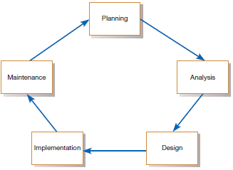
Phases of SDLC

Slide 4
Phases of SDLC
Project planning – initiate, ensure feasibility, plan schedule, obtain approval for project
Analysis – understand business needs and processing requirements
Design – define solution system based on requirements and analysis decisions
Implementation – construct, test, train users, and install new system
Support – keep system running and improve

Slide 5
SDLC Models
The followings are most common SDLC Models:
Waterfall Model
Iterative Model
Spiral Model
V – model
Prototyping Models
Agile Model
Big Bang Model
Rapid Application Development

Slide 6
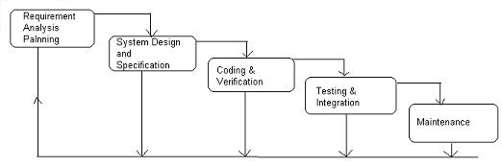
Waterfall Model
All the phases of SDLC will function one after another in linear manner
Each phase must be completed fully before the next phase can begin
In this model software testing starts only after the development is complete.
In waterfall model phases do not overlap

Slide 7
Waterfall Model
Requirement Gathering and analysis
All possible requirements of the system to be developed are captured in this phase and documented in a requirement specification document
System Design
The requirement specifications from first phase are studied in this phase and the system design is prepared.
This system design helps in specifying hardware and system requirements and helps in defining the overall system architecture

Slide 8
Waterfall Model
Implementation
With inputs from the system design, the system is first developed in small programs called units, which are integrated in the next phase.
Each unit is developed and tested for its functionality, which is referred to as Unit Testing
Integration and Testing
All the units developed in the implementation phase are integrated into a system after testing of each unit.
Finally after integration the entire system is tested for any faults and failures.

Slide 9
Waterfall Model
Maintenance
There are some issues which come up in the client environment.
To fix those issues, patches are released.
Also to enhance the product some better versions are released

Slide 10
When to use Waterfall Model?
Some situations where the use of Waterfall model is most appropriate are
Requirements are very well documented, clear and fixed.
Product definition is stable.
Technology is understood and is not dynamic.
There are no ambiguous requirements.
The project is short.

Slide 11
Advantages of waterfall model
Easy to explain to the user
Stages and activities are well defined
Helps to plan and schedule the project
Verification at each stage ensures early detection of errors / misunderstanding

Slide 12
Disadvantages of waterfall model
No working software is produced until late during the life cycle.
High amounts of risk and uncertainty.
Not a good model for complex and object-oriented projects.
Poor model for long and ongoing projects.
Not suitable for the projects where requirements are at a moderate to high risk of changing. So, risk and uncertainty is high with this process model.
It is difficult to measure progress within stages.
Cannot accommodate changing requirements.
Customers can not use anything until the entire system is complete

Slide 13
Project Output in a Waterfall Model
Requirement document
Project plan
System design document
Detailed design document
Test plan and test report
Final code
Software manuals (user manual, installation manual etc.)
Review reports

Slide 14
Prototyping model
Prototyping model is one of the risk reduction models
It involves building a small version of the intended system called prototype
Instead of freezing the requirements before a design or coding can proceed, small version (called prototype) of the intended system is developed based on the currently known requirements
The client can get an “actual feel” of the system, since the interactions with prototype can enable the client to better understand the requirements of the desired system

Slide 15
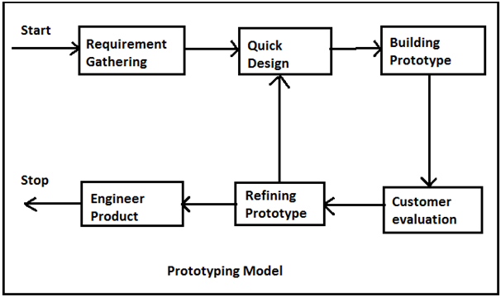
Prototyping model

Slide 16
Advantages of Prototype model
Users are actively involved in the development
The users get a better understanding of the system being developed.
Errors can be detected much earlier.
Quicker user feedback is available leading to better solutions.
Missing functionality can be identified easily
Confusing or difficult functions can be identified
Requirements validation, Quick implementation of incomplete but functional application.

Slide 17
Disadvantages of Prototype model
Leads to implementing and then repairing way of building systems.
Practically, this methodology may increase the complexity of the system as scope of the system may expand beyond original plans.
Incomplete application may cause application not to be used as the full system was designed
Incomplete or inadequate problem analysis.

Slide 18
When to use Prototype model
When the desired system needs to have a lot of interaction with the end users.
Typically, online systems, web interfaces have a very high amount of interaction with end users, are best suited for Prototype model

Slide 19

Iterative & Incremental model
The whole requirement is divided into various builds
Multiple development (“multi-waterfall”) cycles take place here
Cycles are divided up into smaller, more easily managed modules
Each module passes through the requirements, design, implementation and testing phases
A working version of software is produced during the first module
Each subsequent release of the module adds function to the previous release.
The process continues till the complete system is achieved.
For example

Slide 20
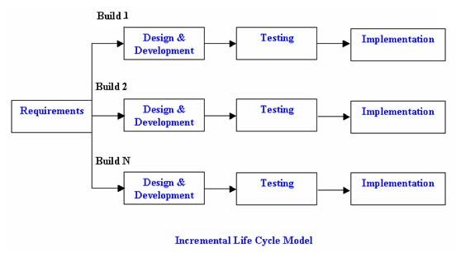
Iterative & Incremental model

Slide 21
Advantages of Iterative & Incremental model
Generates working software quickly and early during the software life cycle.
This model is more flexible – less costly to change scope and requirements.
It is easier to test and debug during a smaller iteration.
In this model customer can respond to each built.
Lowers initial delivery cost.
Easier to manage risk because risky pieces are identified and handled during it’s iteration.

Slide 22
Disadvantages of Iterative & Incremental model
Needs good planning and design.
Needs a clear and complete definition of the whole system before it can be broken down and built incrementally.
Total cost is higher than waterfall.

Slide 23
When to use the Iterative & Incremental model
This model can be used when the requirements of the complete system are clearly defined and understood.
Major requirements must be defined; however, some details can evolve with time.
There is a need to get a product to the market early.
A new technology is being used
Resources with needed skill set are not available
There are some high risk features and goals

Slide 24
Agile development model
Is also a type of Incremental model
Breaks tasks into small increments with minimal planning
Iterations are short time frames that typically last from one to four weeks
Each iteration involves planning, requirements analysis, design, coding, unit testing, and acceptance testing
At the end of the iteration a working product is demonstrated to stakeholders

Slide 25
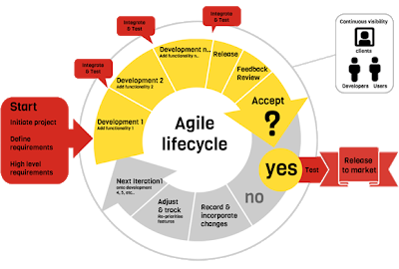
Agile development model

Slide 26
Advantages of Agile model
Customer satisfaction by rapid, continuous delivery of useful software.
People and interactions are emphasized rather than process and tools.
Customers, developers and testers constantly interact with each other.
Working software is delivered frequently (weeks rather than months).
Face-to-face conversation is the best form of communication.
Close, daily cooperation between business people and developers.
Regular adaptation to changing circumstances.
Even late changes in requirements are welcomed

Slide 27
Disadvantages of Agile model
In case of some software deliverables, especially the large ones, it is difficult to assess the effort required at the beginning of the software development life cycle.
There is lack of emphasis on necessary designing and documentation.
The project can easily get taken off track if the customer representative is not clear what final outcome that they want.
Only senior programmers are capable of taking the kind of decisions required during the development process. Hence it has no place for newbie programmers, unless combined with experienced resources.

Slide 28
Choosing the right Software development life cycle model
Selecting the right SDLC is a process in itself that organization can implement internally or consult for
Steps to get the right selection.
STEP 1: Learn the about SDLC Models - already covered
STEP 2: Assess the needs of Stakeholders
STEP 3: Define the criteria
STEP 4: Decide

Slide 29
STEP 2: Assess the needs of Stakeholders
We must study the business domain, stakeholders concerns and requirements, business priorities, our technical capability and ability, and technology constraints to be able to choose the right SDLC against their selection criteria.

Slide 30
STEP 3: Define the criteria
Some of the selection criteria or arguments that you may use to select an SDLC are:
Is the SDLC suitable for the size of our team and their skills?
Is the SDLC suitable for the selected technology we use for implementing the solution?
Is the SDLC suitable for client and stakeholders concerns and priorities?
Is the SDLC suitable for the geographical situation (distributed team)?
Is the SDLC suitable for the size and complexity of our software?
Is the SDLC suitable for the type of projects we do?
Is the SDLC suitable for our software engineering capability?

Slide 31
Some Recommended criteria
Factors | Waterfall | V-Shaped | Prototyping | Spiral | Iterative & Incremental | Agile
Unclear User Requirement | Poor | Poor | Good | Excellent | Good | Excellent
Unfamiliar Technology | Poor | Poor | Excellent | Excellent | Good | Poor
Complex System | Good | Good | Excellent | Excellent | Good | Poor
Reliable system | Good | Good | Poor | Excellent | Good | Good
Short Time Schedule | Poor | Poor | Good | Poor | Excellent | Excellent
Strong Project Management | Excellent | Excellent | Excellent | Excellent | Excellent | Excellent
Cost limitation | Poor | Poor | Poor | Poor | Excellent | Excellent
Visibility of Stakeholders | Good | Good | Excellent | Excellent | Good | Excellent
Skills limitation | Good | Good | Poor | Poor | Good | Poor
Documentation | Excellent | Excellent | Good | Good | Excellent | Poor
Component reusability | Excellent | Excellent | Poor | Poor | Excellent | Poor

Slide 32
Software Development Approaches to SDLC
Two common approaches in software development
Traditional Approach(structured approach)
object-oriented (OO) approach

Slide 33
Traditional Approach(structured approach)
It adopts a formal step-by-step approach to the SDLC phases and activities
The activities of one phase must be completed before moving to the next phase
At the completion of each activity or phase, a document is produced that must be approved by the stakeholders before moving to the next activity or phase.
This is necessary as teams of developers with varying skills and responsibilities

Slide 34
Traditional Approach(structured approach)
The structured approach looks at a system from a top-down view
The center of the structured approach is the process model, which depicts the business processes of a system, and the primary model that presents the processes is the data-flow diagram (DFD)

Slide 35
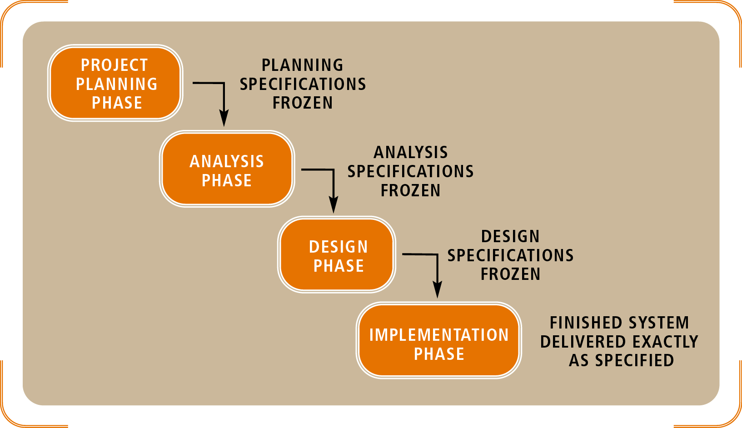
Structured approach to SDLC (Waterfall Model)
The activities of the software development process represented in the waterfall model.
There are several other models to represent this process.

Slide 36
The Object-Oriented Approach
It is a new way of thinking about problems using models based on real world concepts
The object-oriented methodology views a system as a bottom-up approach to systems development.
The basic construct is object which combines both data structure and behavior in a single entity

Slide 37
Object-Oriented Analysis and Design
Analysis model is built to abstract essential aspects of application domain which contains objects found in application, their properties and behavior.
Then design model is made to describe and optimize the implementation.
Finally the design model is implemented in a programming language, database or hardware.
Graphical notation is used for expressing object-oriented models.

Slide 38
Structured vs. OO Methodology
 | Structured Methodology | Object Oriented (Unified Process)
Use of development activities (Planning, Analysis..) | Each activity covers a whole phase | All activities run in each phase, several times (iterations)
Names of development phases | Planning, Analysis, Design, Implementation, Installation/Testing | Inception, Elaboration, Construction, Transition
Appropriate to use | When system goals certain, static IT | When system goals less certain, dynamic IT
Modeling technique | Data Flow Diagrams, Entity-Relationship Diagrams | Diagrams defined by Unified Modeling Language (Use Cases, Class Diagrams…)
Relation to reality | Predictive | Adaptive

Slide 39
END!

