Slide 1
CPE 314 · FINAL DEFENSE
Plate N Platter
A desktop meal planner that finds recipes, plans meals by day and shows your eating habits
Team 01 · EDP 69167 · Section 3A · Theme: Meal Planner
Kimberly M. Luistro · Nesley Cate S. Librea · Venice M. Nadela · Yvonne Mae M. Tapan · Kirk Ryan P. Quisagan · Kenneth V. Tamidles
Notes:
Replace the project name, team number, section and member names. Keep this slide up while you set up the demo machine.

Slide 2
Defense plan
OVERVIEW
1
Live Demo 4 min
One realistic end-to-end task
Who speaks
Demo driver: Kimberly
Architecture: Kirk and Kenneth
Justification: Kimberly + class owner
Everyone: Q&A
2
Architecture Walkthrough 3 min
Class hierarchy, ER diagram, requirement-to-code map
3
Design Justification 2-3 min
Answer 1-2 instructor questions about a design choice
4
Individual Q&A 2-3 min each
Each member explains code they committed
Notes:
Total group time is 10-12 minutes, then individual Q&A of 2-3 minutes per member. Decide who speaks on each segment before the day.

Slide 3

Project overview
OVERVIEW
What to cover
Problem: people choose meals at the last minute and cannot see their own habits
Users: students and home cooks who plan their own meals
API: TheMealDB, a public REST service that returns JSON
Features: plan recipes by day and meal slot, a shopping list per recipe, a streak and weekly chart
Notes:
30-45 seconds. State the problem, the user, and the API your app consumes.

Slide 4
Live demo: one end-to-end task
LIVE DEMO
Scenario script (4 min)
Log in: wrong password, then the right one
Search chicken: TheMealDB runs on a background thread
Type calories, then Add to my plan
Import 30,000 rows, then open Analytics and its chart
Close the app, reopen, log in: data is still there
Edge cases to show
Empty prep time: the app asks for it
Prep time abc, or a wrong password: refused with a message
Wi-Fi off: red banner with Retry, no crash
Notes:
Run on the actual presentation machine. Graders check: runs start to finish without crashing and handles at least one invalid or empty input.

Slide 5
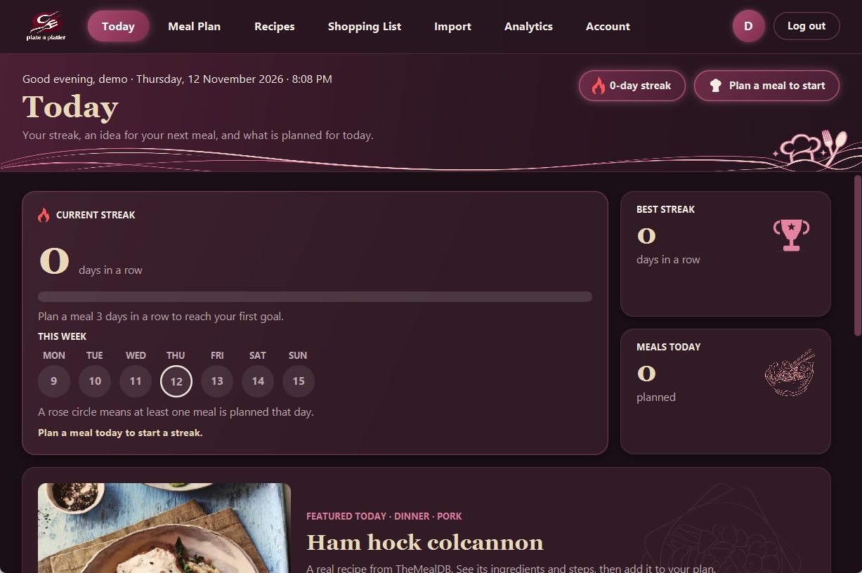
User interface: main screen
EVIDENCE: UI
Explain
Today page
The user sees the streak, a featured meal and today's meals, and adds a meal to an empty slot
Goal progress bar, Plan this meal, Add breakfast, Find a recipe, Open shopping list
Built by ui.TodayScreen inside ui.AppShell
Notes:
Show a real screenshot, not a mockup. Name the screen, what the user does here, and which handler runs.

Slide 6
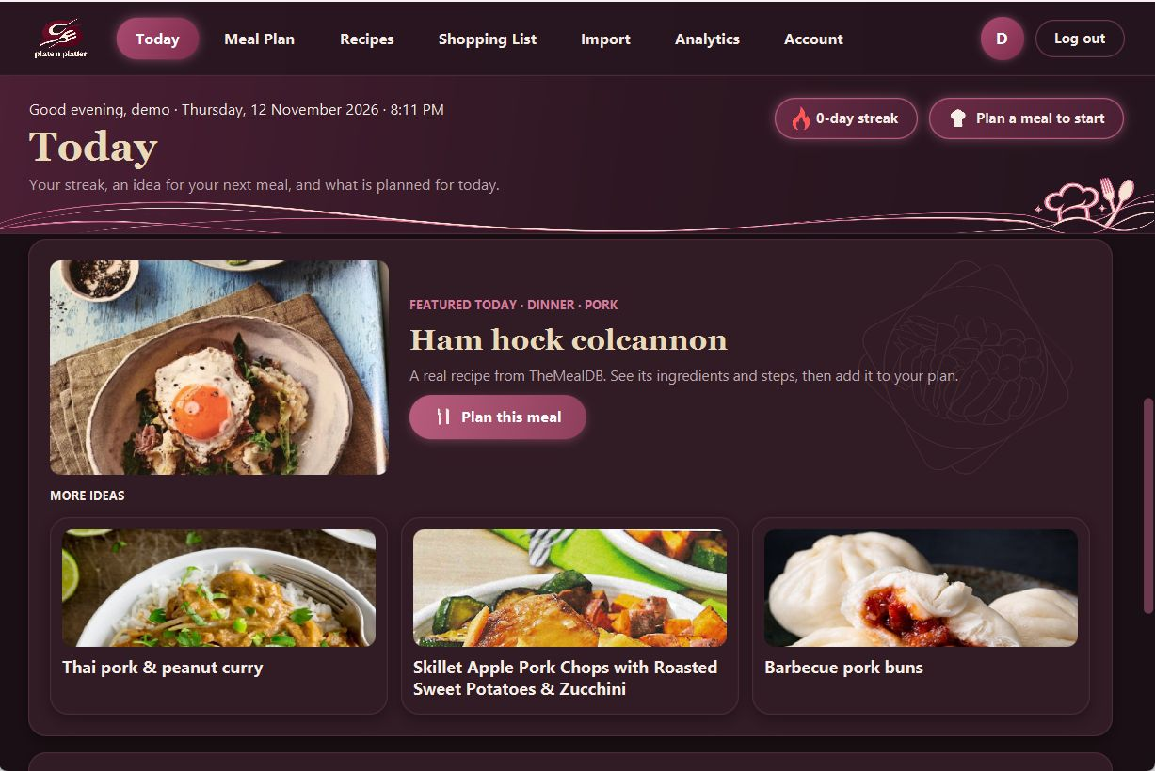
User interface: main screen
EVIDENCE: UI
Explain
Today page
The user sees the streak, a featured meal and today's meals, and adds a meal to an empty slot
Goal progress bar, Plan this meal, Add breakfast, Find a recipe, Open shopping list
Built by ui.TodayScreen inside ui.AppShell
Notes:
Show a real screenshot, not a mockup. Name the screen, what the user does here, and which handler runs.

Slide 7
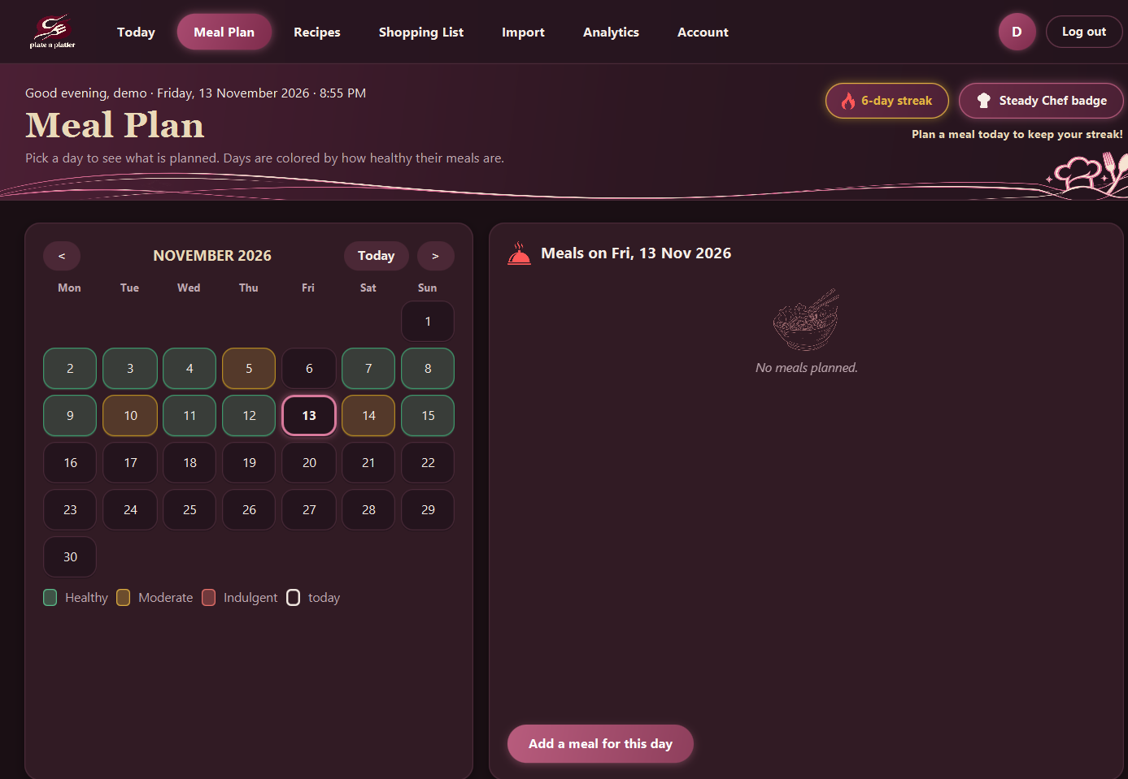
User interface: main screen
EVIDENCE: UI
Explain
Meal Plan page
The user clicks a day in the calendar to see its meals and adds a meal for that day; days are colored by Healthy Level
Calendar days, month arrows, Today, Add a meal for this day
Built by ui.MealPlanScreen inside ui.AppShell
Notes:
Show a real screenshot, not a mockup. Name the screen, what the user does here, and which handler runs.

Slide 8
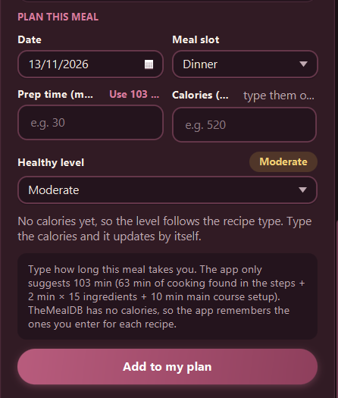
UI: second screen and controls
EVIDENCE: UI
Control | Event | Handler method
Button: Search | onAction | RecipesScreen.search()
Recipe card (VBox) | onMouseClicked | RecipesScreen.open()
TextField: Calories | text change listener | RecipesScreen.showAutoLevel()
ComboBox: Meal slot | value change listener | RecipesScreen.showAutoLevel()
Button: Add to my plan | onAction | RecipesScreen.addToPlan()
DatePicker: Date | read when adding | RecipesScreen.addToPlan()
Notes:
Requirement: at least 3 interactive controls, each wired to a working event handler. List every control in the table.

Slide 9
Where each requirement lives
ARCHITECTURE
Requirement | Class / file | Where in demo
Object-Oriented Design | model.SavedRecipe (abstract) + 3 subclasses; util.PlanStore | Recipes: prep time differs by meal type
Data Structure / Recursion | service.StatisticsService, util.ShoppingList (Map); util.CookingQueue (Queue); util.UndoStack (Stack); util.RecipeCalculator (recursion) | Shopping List groups; RecipeDemo
Automated Testing (JUnit 5) | src/test/java: 30 classes, 186 tests | mvn clean test, live
Data Model + SQLite via JDBC | schema.sql, db.DatabaseConnector, db.UserDao, db.MealPlanDao | Add a meal, restart, open the .db file
API Consumption (REST + JSON) | api.MealDbClient, api.MealData | Recipes search; Featured today
Event-Driven GUI (3+ controls) | ui.RecipesScreen, ui.MealPlanScreen, ui.ImportScreen | Search, calories box, Add, calendar days
Concurrency (background thread) | ui.CsvImportTask, ui.AppShell.runInBackground | Import 30,000 rows, click other pages
Data Mining (aggregation) | service.StatisticsService, util.StreakCalculator, util.HealthClassifier | Analytics counts; the streak
Data Visualization (chart) | ui.AnalyticsChart.buildGrouped, util.ChartMath | Analytics before and after adding a meal
Notes:
Section 3 of the project specification. Every row needs a real class or file name you can open instantly in the IDE.

Slide 10
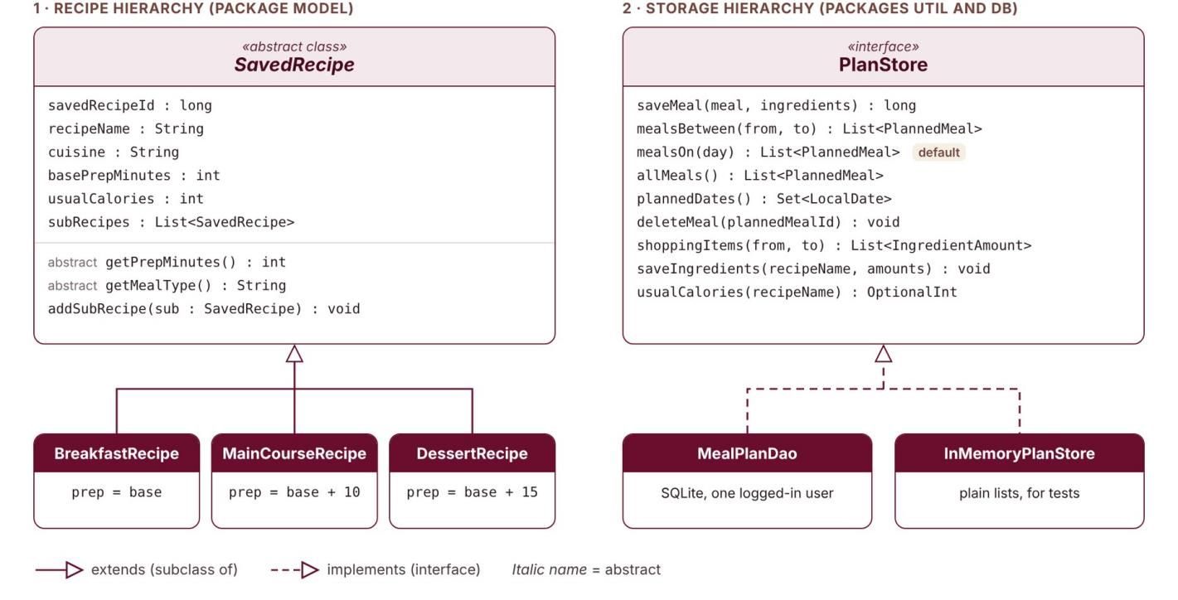
Class hierarchy
ARCHITECTURE
Point out
Abstract class: SavedRecipe (getPrepMinutes(), getMealType())
Subclasses: BreakfastRecipe, MainCourseRecipe, DessertRecipe
One job per class: SavedRecipe holds data, MealPlanDao talks to SQLite, StatisticsService counts, screens only show
Notes:
Requirement: at least one abstract class or interface with 2+ concrete subclasses, applying Single Responsibility. Be ready to open these in the IDE.

Slide 11
Polymorphism in action
ARCHITECTURE
// Adapted from RecipeDemo: a List of the base type
List<SavedRecipe> items = List.of(
new BreakfastRecipe(1, "Overnight Oats", ...),
new MainCourseRecipe(2, "Pasta Pomodoro", ...),
new DessertRecipe(3, "Chocolate Cake", ...));
for (SavedRecipe r : items) {
System.out.println(r.getMealType() + ": "
+ r.getPrepMinutes() + " min");
}
// base 10 / 20 / 30 prints 10, 30 and 45 min
Say
getPrepMinutes() is overridden
Breakfast adds 0, main course +10 min setup, dessert +15 min chilling
The loop never checks the type; each object answers for itself
Notes:
Show the line where a base-type reference calls an overridden method. Explain why this is better than if/else on type.

Slide 12
Data structure and recursion
ARCHITECTURE
Map (and Queue, Stack)
Map: StatisticsService.totals gives Map<String, Long>; ShoppingList uses an EnumMap of food group to a sorted TreeMap
A count per group; the measures per ingredient
We look values up by key. A list would search every time
Analytics bars and Shopping List groups. Also built: CookingQueue (FIFO), UndoStack (LIFO)
Recursive method
RecipeCalculator.totalPrepMinutes(SavedRecipe)
Base case: no sub-recipes, the sum is 0
Recursive case: own minutes + totalPrepMinutes of each sub-recipe
Why not a loop: recipes nest to any depth. wouldCreateCycle (also recursive) refuses a recipe that contains itself
Notes:
Requirement: a Stack, Queue or Map used purposefully, plus a genuinely recursive method (not a one-line loop in disguise).

Slide 13
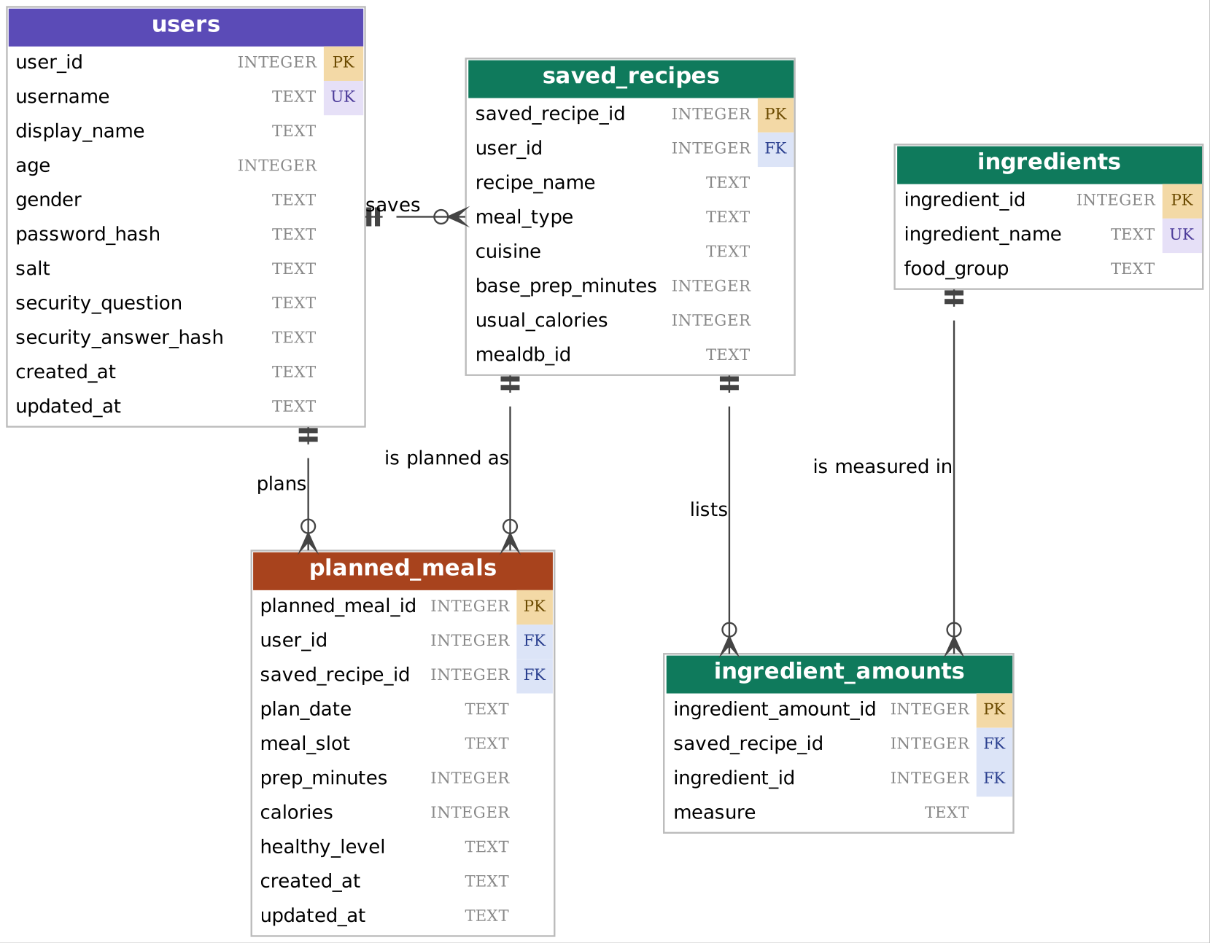
ER model and database schema
ARCHITECTURE
Point out
5 tables: users, saved_recipes, ingredients, ingredient_amounts, planned_meals
One primary key each; foreign keys link them
1 user to many planned_meals; deleting a user deletes them
Matches schema.sql, which creates the .db
Notes:
Requirement: 3+ entities, at least one relationship. The diagram must match the real .db schema; be ready to open the file.

Slide 14
JDBC and PreparedStatement
ARCHITECTURE
// db.UserDao.deleteUser (Delete in CRUD)
public synchronized boolean deleteUser(long userId)
throws SQLException {
try (PreparedStatement ps = conn.prepareStatement(
"DELETE FROM users WHERE user_id = ?")) {
ps.setLong(1, userId);
return ps.executeUpdate() == 1;
}
}
// ON DELETE CASCADE removes the user's
// planned_meals rows in the same statement.
Show
DAO classes: UserDao, MealPlanDao
Create: saveMeal, insertUser. Read: mealsBetween, findByUsername. Update: updatePassword. Delete: deleteMeal, deleteUser
Live: open plate_n_platter.db in a DB viewer and show the planned_meals rows
Notes:
No string-concatenated SQL anywhere. Show one create/read/update/delete path.

Slide 15
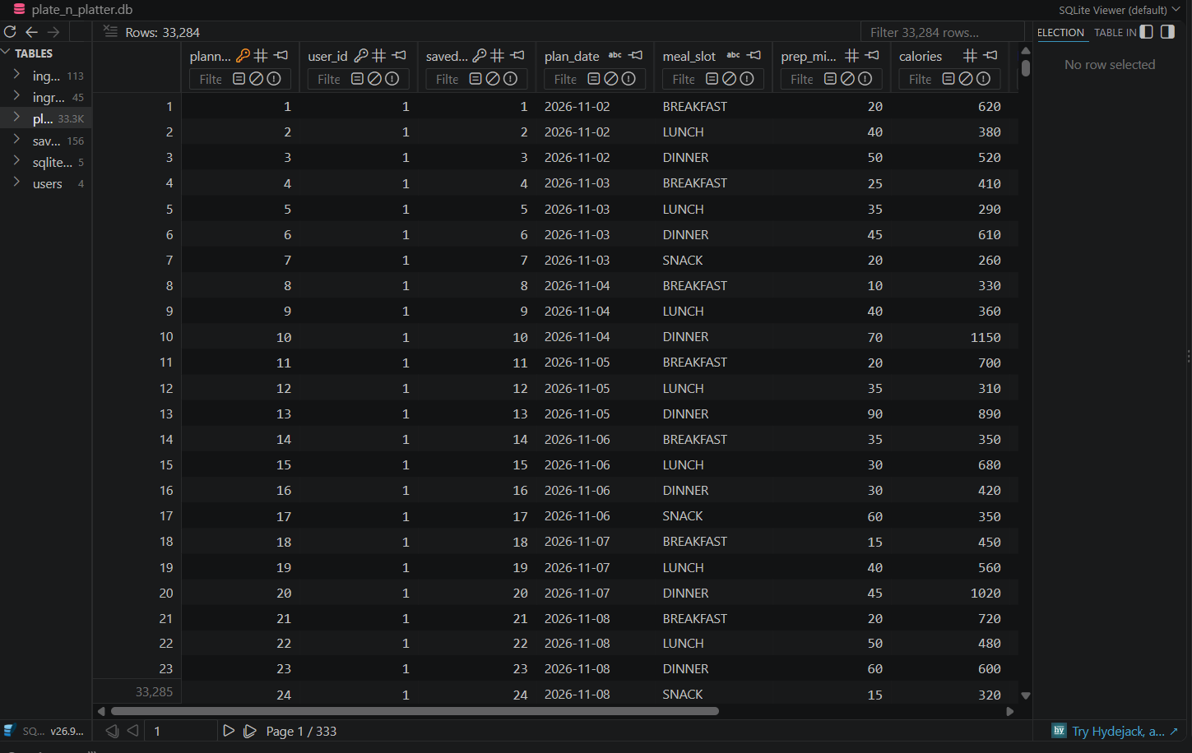
JDBC and PreparedStatement
ARCHITECTURE
Show
DAO classes: UserDao, MealPlanDao
Create: saveMeal, insertUser. Read: mealsBetween, findByUsername. Update: updatePassword. Delete: deleteMeal, deleteUser
Live: open plate_n_platter.db in a DB viewer and show the planned_meals rows
Notes:
No string-concatenated SQL anywhere. Show one create/read/update/delete path.

Slide 16
API consumption
ARCHITECTURE
Request
https://www.themealdb.com/api/json/v1/1/search.php?s=chicken (also filter.php?c= and lookup.php?i=)
JSON response
idMeal, strMeal, strCategory, strArea, strInstructions, strMealThumb, strIngredient1-20 with strMeasure1-20
Used in app
Recipe cards and photos, the recipe panel, Featured today, and the saved recipe with its ingredient amounts
When the call fails
5-second connect and 10-second response timeout. A red banner with Retry: "No internet connection" or "TheMealDB is not responding right now"
Notes:
Requirement: a real public REST call with the JSON parsed and used, not just printed. Show a log or network inspector.

Slide 17
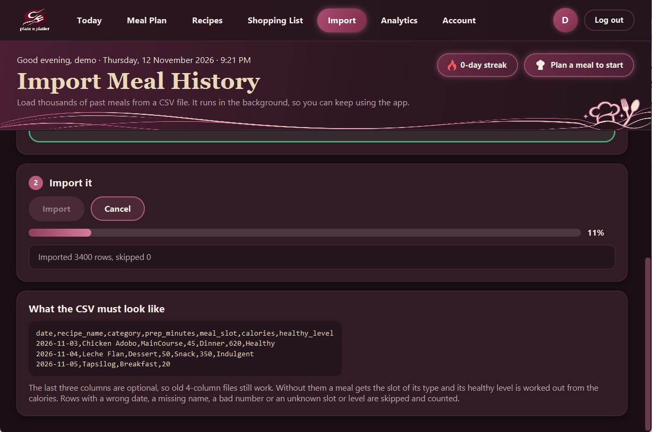
Concurrency: UI stays responsive
ARCHITECTURE
Explain
CSV import, every TheMealDB call, database reads and password hashing run off the UI thread
A JavaFX Task, started by AppShell.runInBackground on a daemon thread
setOnSucceeded runs on the UI thread and shows the result
Progress bar bound to task.progressProperty(); status line to messageProperty()
Notes:
Requirement: a long-running operation on a background thread. Graders confirm live and may read the source. Never call the API from the UI thread.

Slide 18
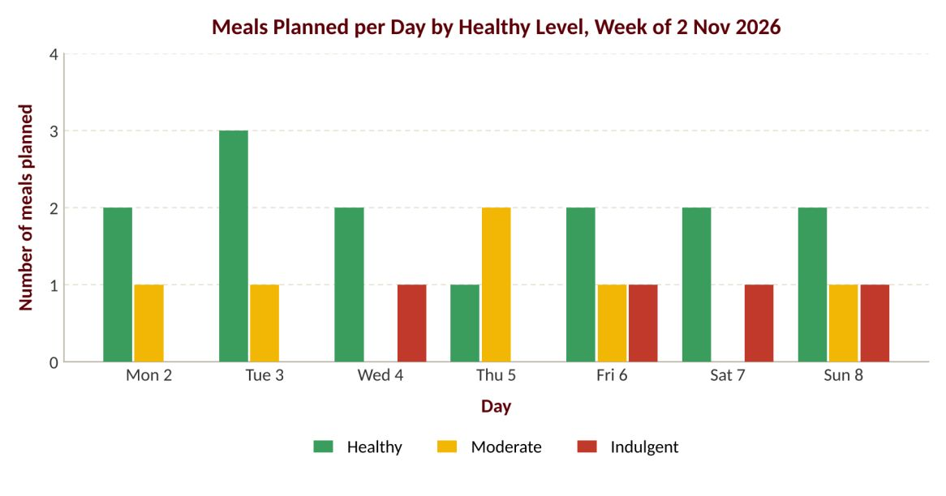
Data mining and chart
EVIDENCE: GRAPH
Explain
Mining: StatisticsService.countByDay counts meals per day by healthy level, prep tier or slot
Source: the user's own planned_meals rows
Grouped bar chart: compares a few categories over 7 days
Live: add a meal and press Refresh, that day's bar goes up by one
Notes:
Requirements: a real aggregation or frequency analysis over app data, and a labeled chart. Graders change the input and re-run: the chart must change.

Slide 19
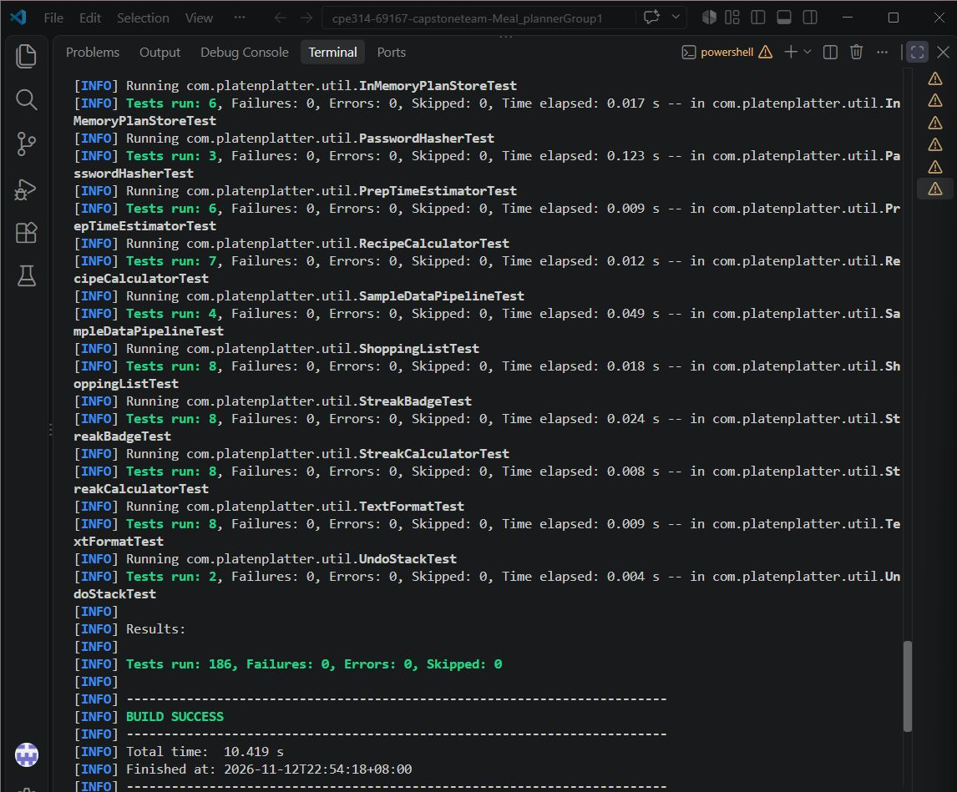
Automated tests
EVIDENCE: TESTS
Class tested | Edge case covered
StreakCalculator | No meals means no streak; two missed days reset it
CsvRecipeParser | Bad date, wrong field count, negative numbers rejected
RecipeCalculator | No sub-recipes; a recipe cannot contain itself
AuthService | Wrong password, duplicate username, blank answer refused
Notes:
Requirement: 6+ JUnit 5 tests, run live with 0 failures, and at least one edge case per tested class. Run the suite on the presentation machine.

Slide 20
Code quality and git history
EVIDENCE: CODE
Member | Commits | Lines added / removed | Main area
Kimberly Luistro | 15 | +11,855 / -10,004 | SavedRecipe, MealDbClient, AppShell, Analytics
Nesley Librea | 14 | +3,498 / -3,337 | Theme, Login, Sign up, Account, Recipes, Meal Plan
Kenneth Tamidles | 9 | +2,443 / -1,152 | schema.sql, DatabaseConnector, UserDao, AuthService
Venice Nadela | 9 | +2,747 / -1,562 | JUnit tests, known issues
Yvonne Tapan | 8 | +1,831 / -177 | HeaderBar, Today, Import, StreakCalculator
Kirk Quisagan | 6 | +2,814 / -1,368 | Enums, RecipeCalculator, CsvRecipeParser, StatisticsService
Naming: camelCase methods, PascalCase classes, UPPER_CASE constants. Packages: model, db, api, service, util, ui. Counts from git log, 12 Nov 2026.
Notes:
Run git log --author for each member beforehand. Balanced contribution and meaningful commit messages are checked.

Slide 21
Who built what
EVIDENCE: CODE
Member | Classes / files committed | Can explain
Kimberly | SavedRecipe, MealDbClient, AppShell, AnalyticsChart, CsvImportTask | A search: MealDbClient to JSON to MealData to a card
Nesley | RecipesScreen, MealPlanScreen, LoginScreen, Theme, MealPhotos | Add to my plan: card click to store.saveMeal to refresh
Kenneth | schema.sql, UserDao, MealPlanDao, AuthService, PasswordHasher | Sign up: AuthService.register to UserDao.insertUser
Venice | The 30 JUnit test classes, KNOWN_ISSUES.md | One test from arrange to assert, and the edge case it protects
Yvonne | HeaderBar, TodayScreen, ImportScreen, StreakCalculator | The streak: planned dates to the streak card and goal bar
Kirk | RecipeCalculator, CsvRecipeParser, StatisticsService, ShoppingList | The chart numbers: countByDay to the bars
Notes:
Prepares the Individual Q&A: the instructor asks each member about code they personally committed, checked against git history.

Slide 22
Design justification
DESIGN DECISIONS
Decision 1
Choice: the streak is worked out from planned_meals dates each time (StreakCalculator)
Alternative: a streaks table updated on every save
Why: a stored streak can disagree after an import or a removed meal; a derived one cannot
Cost: the dates are read again on every refresh
Decision 2
Choice: screens use the PlanStore interface; MealPlanDao is one implementation
Alternative: screens calling the DAO class directly
Why: rules and screens can be tested with InMemoryPlanStore, no database file
Cost: one more type; each new query is added in three places
Notes:
Expect 1-2 questions such as: why a Queue and not a Stack? Prepare two decisions and a rejected alternative for each.

Slide 23
Challenges and how we solved them
REFLECTION
Challenge | What we tried | How we fixed it
Importing 30,000 rows without freezing the window | Doing it on the UI thread froze the window | CsvImportTask on a background thread, progress every 50 rows, Cancel checked each row
Relied on type inference in stream collectors; Maven compiled it, but Eclipse’s compiler could not resolve the types. | Stream collectors with inferred types | Wrote the generic types out in ShoppingList
Six people editing the same files | Overlapping edits and merge conflicts | One owner per class; commit turns in a fixed order
Open: UndoStack, CookingQueue and nested recipes appear only in tests and RecipeDemo | The pages needed maps and lists, not a queue or stack | Next: an Undo button for a removed meal
Notes:
Be honest: real problems with a real fix score better than a list of things that went smoothly.

Slide 24
Lessons learned and future work
REFLECTION
What we learned
Keep rules out of the screens so they can be tested without JavaFX
A team needs one owner per class; write the test when the rule is written
Differently: agree on the database tables before building screens
If we had more time
Edit a planned meal
An Undo button for a removed meal using UndoStack
JavaFX screen tests
Notes:
Keep to 30 seconds. Name what you would do next.

Slide 25
Questions
Individual Q&A: each member explains code they committed
https://github.com/Kimonooo/cpe314-69167-capstoneteam-Meal_plannerGroup1 · Team 01
Notes:
Leave this up during individual Q&A.

