Slide 1
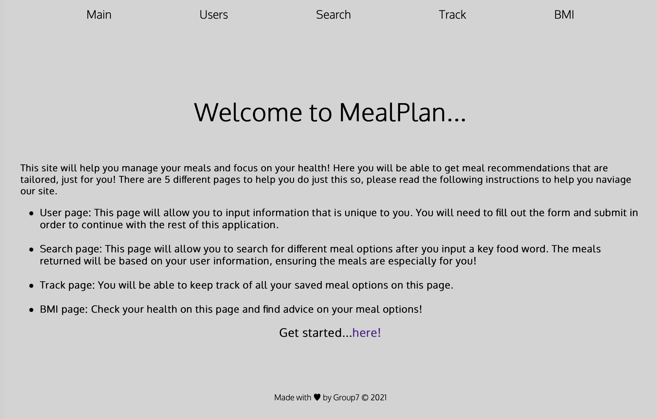
MealPlan
Contributors: Bora Kim, Charu Gera, Najma Hersi, Ola Ajibola and Whitney Ikenwe
Notes:
Introduction

Slide 2
Objectives
Monitor calorie intake
Search for recipes
Track meals
Calculate BMI
Promote healthy eating
Provide a tool for nutritionists
Notes:
Objectives of the project:

Slide 3
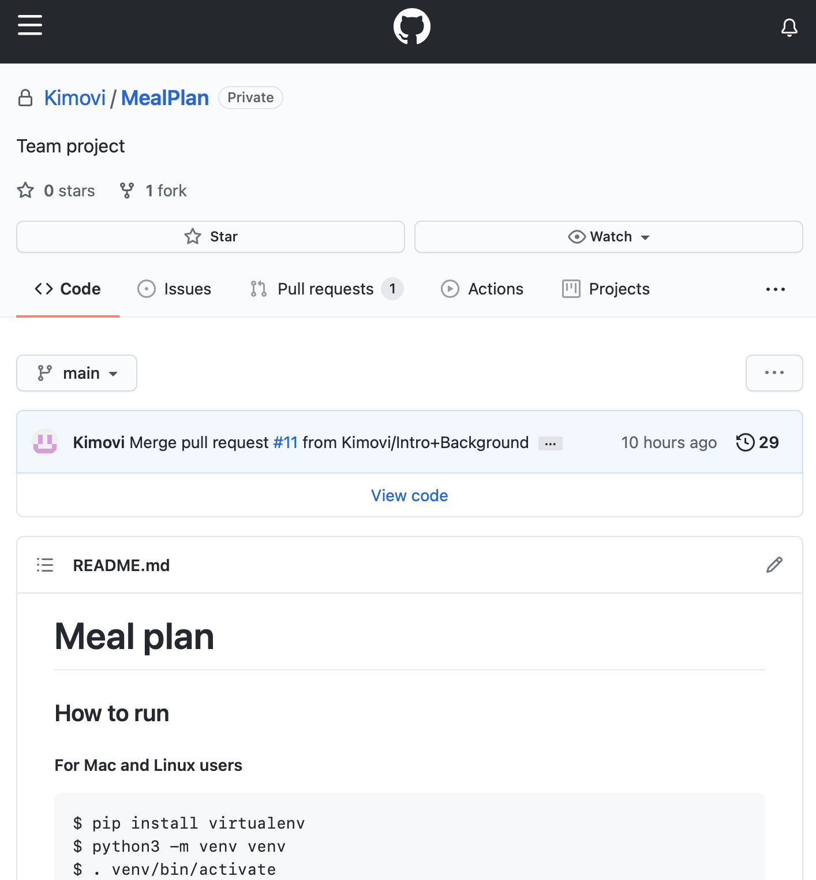
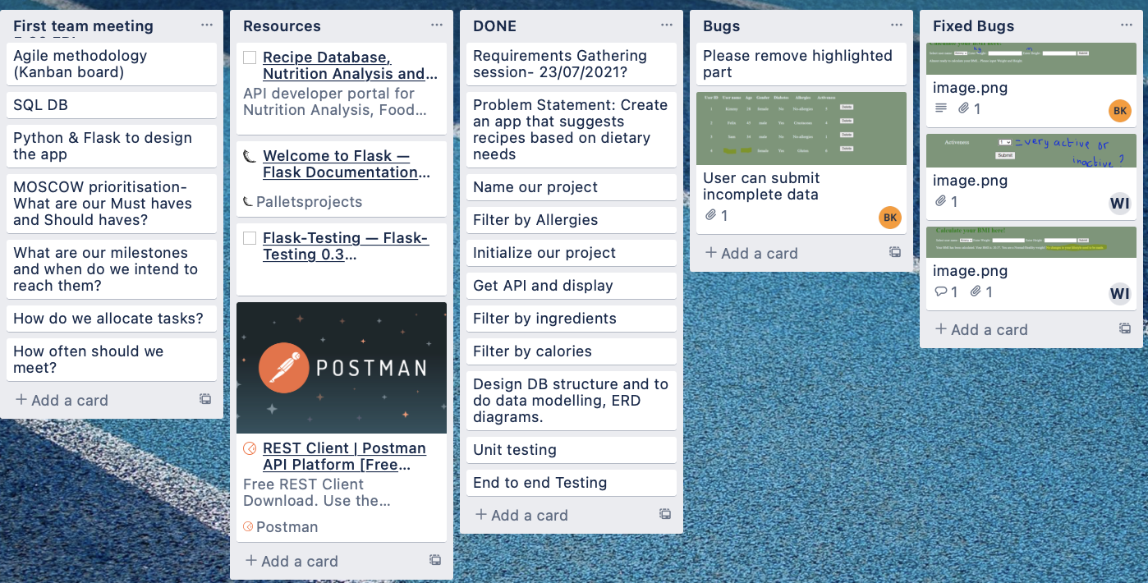

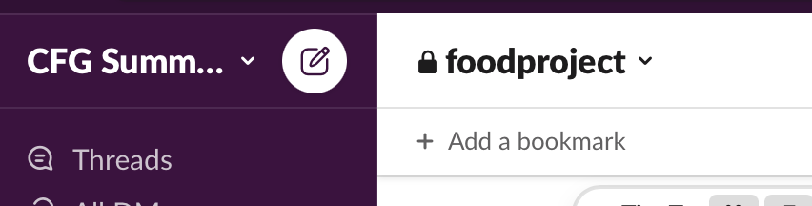
Software Development Methodology
Agile
Trello
Regular meetings
Slack group channel
GitHub
Notes:
Software development methodology

Slide 4
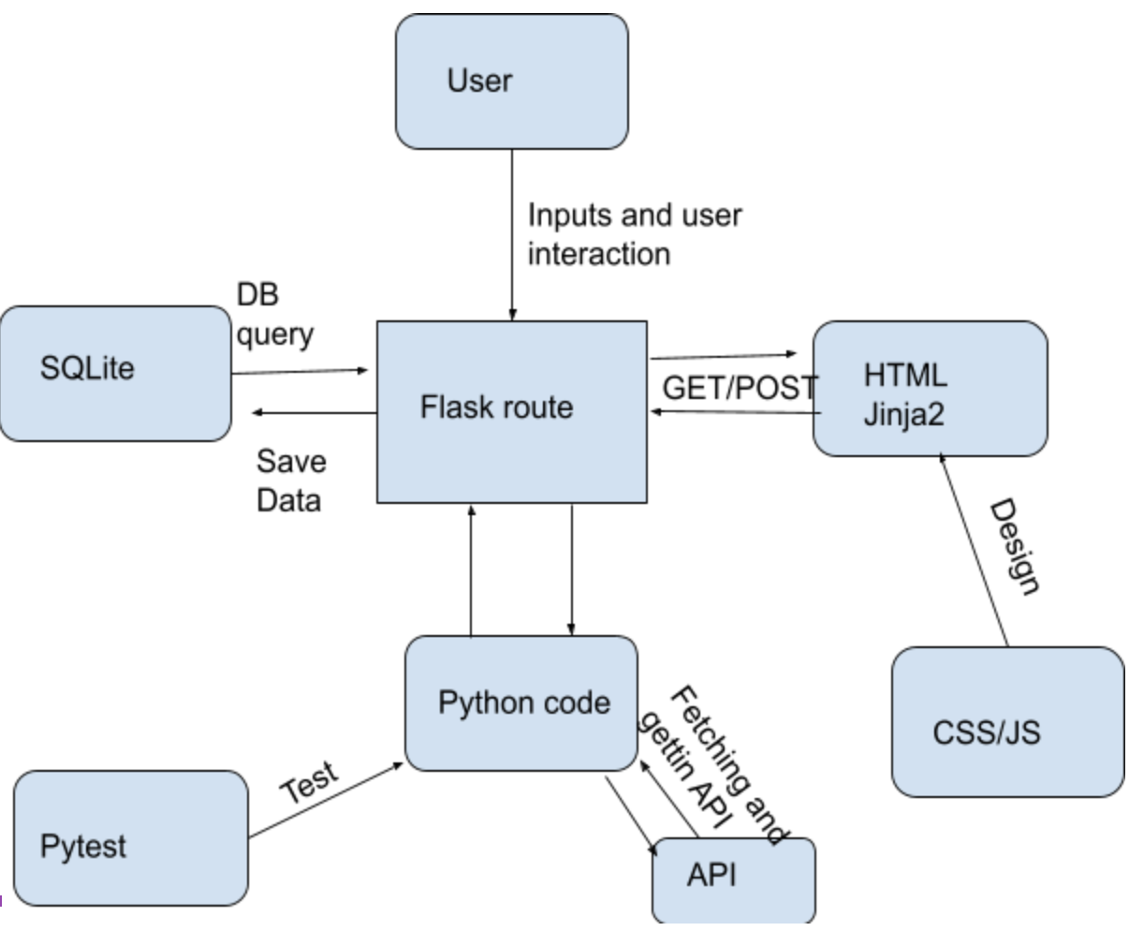
Design architecture
Notes:
Design architecture

Slide 5
Live Demo
Notes:
Demo:
Open PyCharm – show our code
Run our app

Slide 6
Any questions?
Notes:
Question time

Slide 7
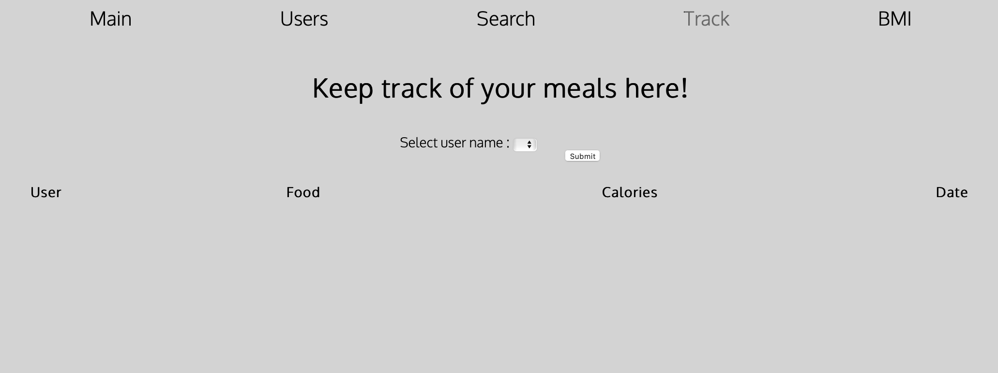
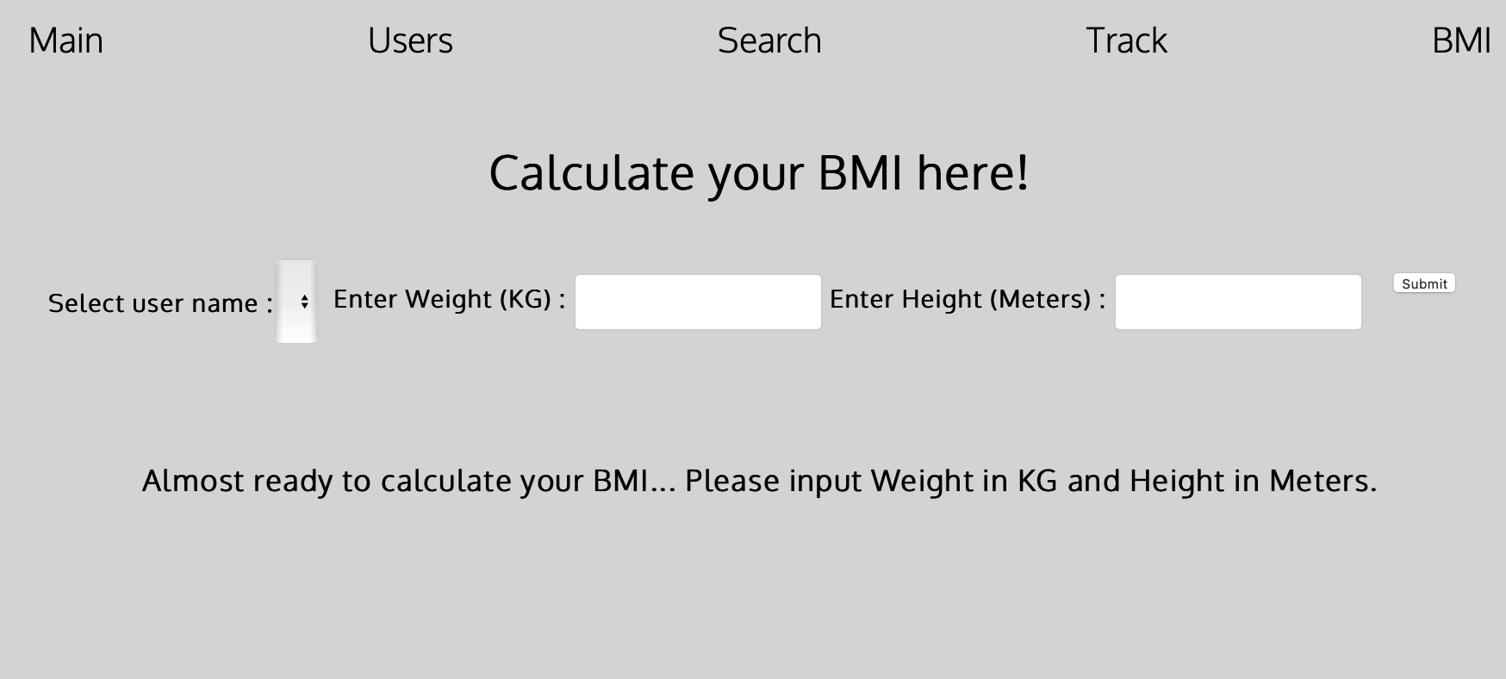
Notes:
Screenshots before the demo

Slide 8
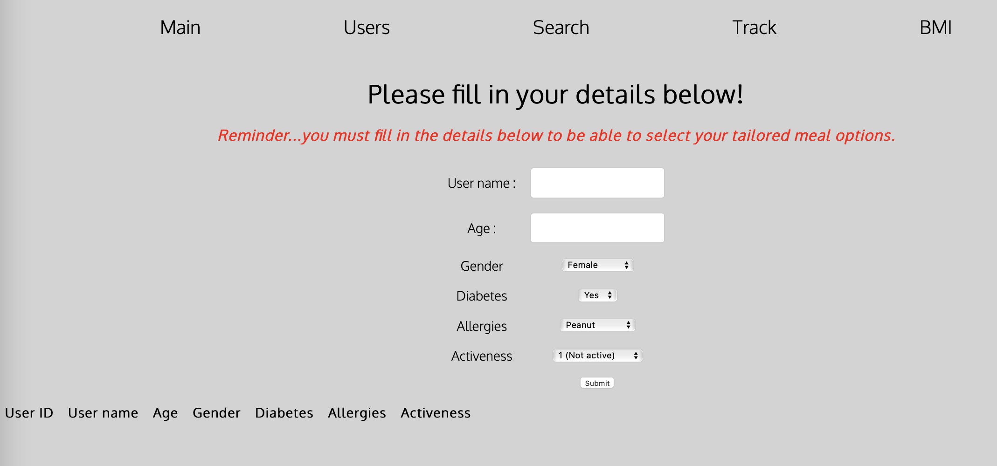
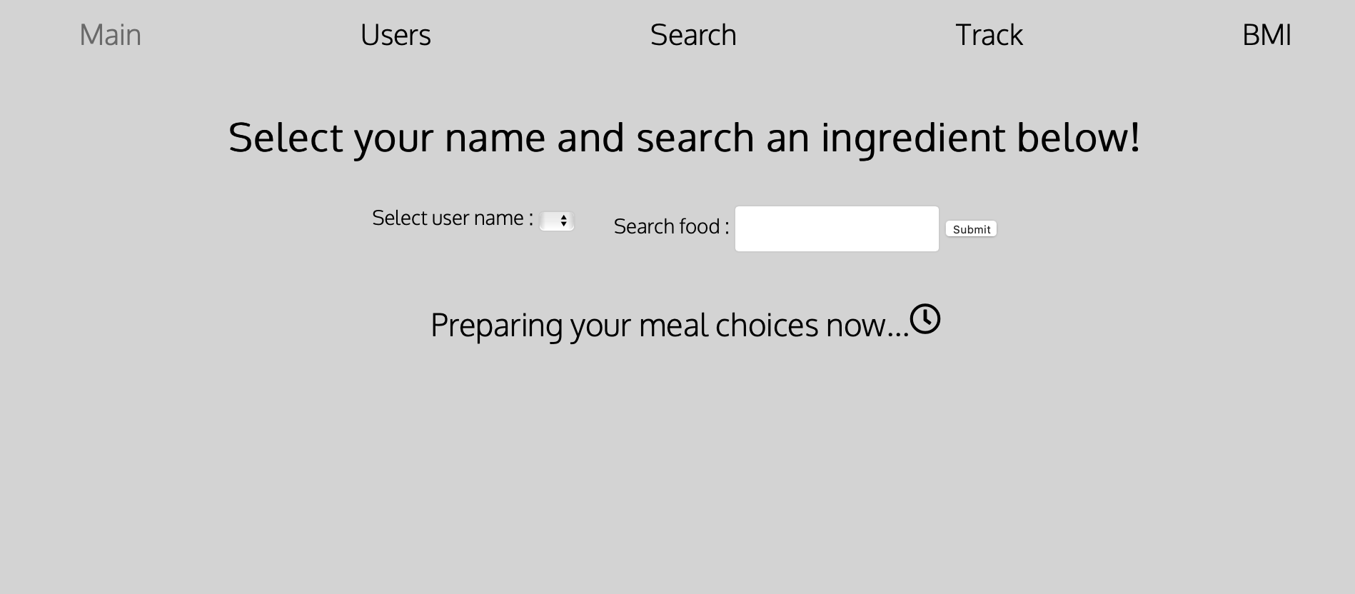
Notes:
Screenshots before the demo

Slide 9
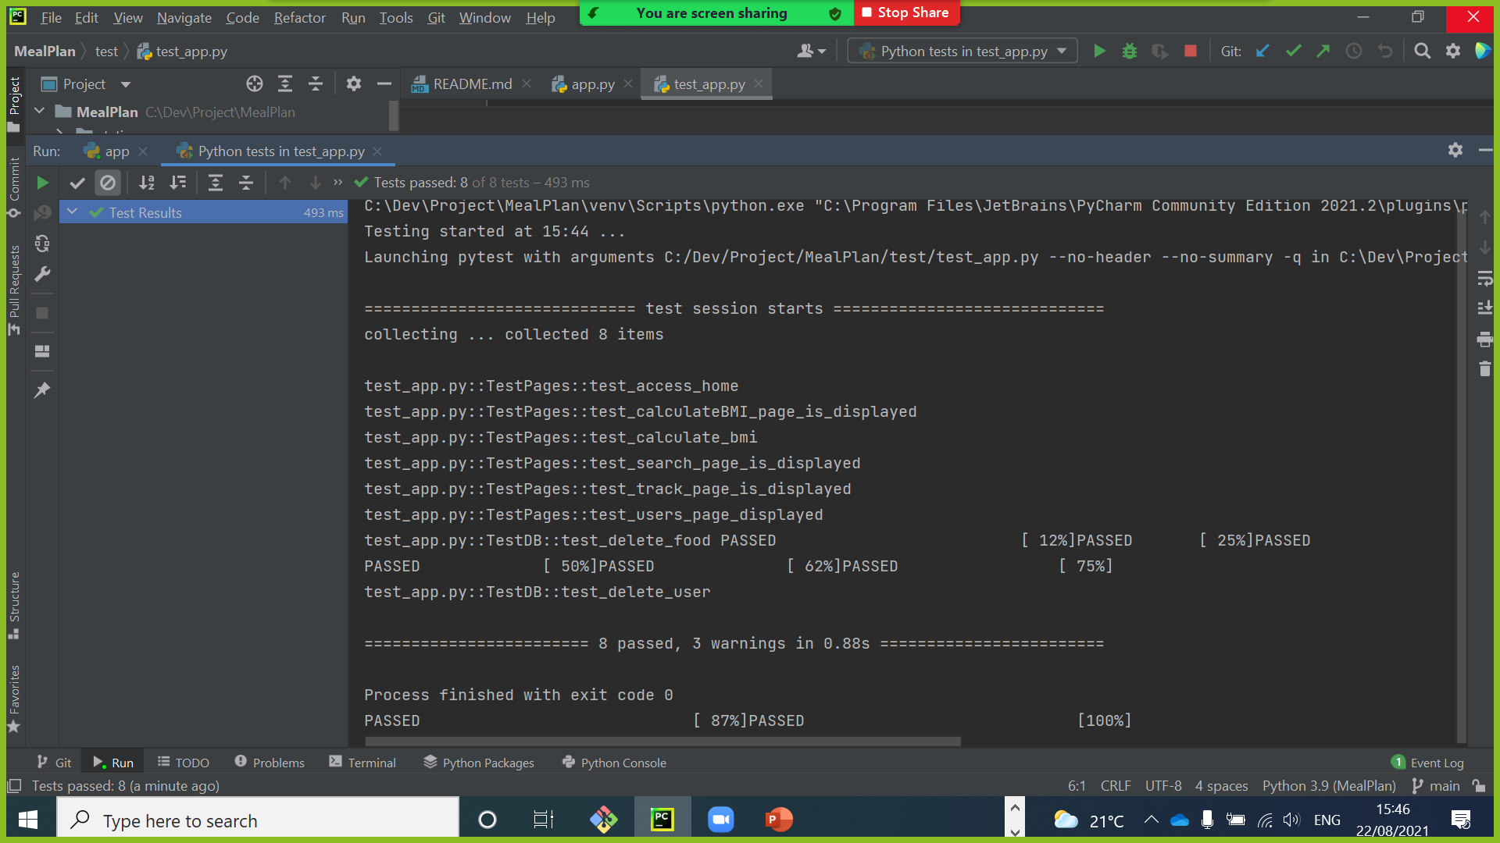
Notes:
Question time

