Slide 1
REA AWS Training
KMS (aka crypto time)

Slide 2
What is encryption
In cryptography, encryption is the process of encoding messages or information in such a way that only authorized parties can read it.
Encryption does not of itself prevent interception, but denies the message content to the interceptor.

Slide 3
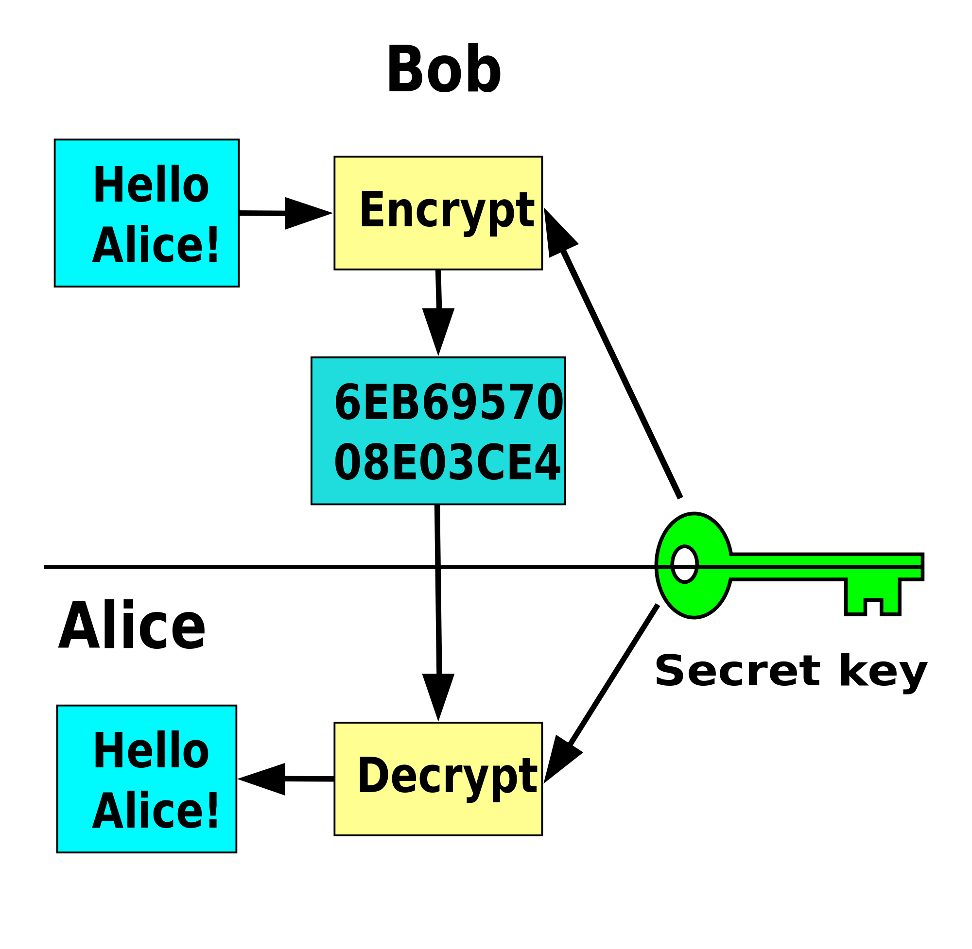
Symmetric Key
Same key to encrypt/decrypt
Fast (compared to RSA)
Two main types of cipher (block and stream)
Stream ciphers produce a constant stream of pseudo-random bits which the data is XORed with
Block ciphers work on fixed size blocks of data. Your data is cut/padded into N sized blocks and encrypted
  There are a number of block cipher modes of operation and block ciphers are more versatile than stream ciphers (for example they can provide authentication of encrypted data), however stream ciphers are often faster
  There are also some bad weaknesses in certain block cipher operation modes (Google search for “ECB Penguin”)
  Also consider if we have a repeating word input and use a fixed key block cipher, will our ciphertext reveal anything that may compromise the secrecy of the data?
Can provide authenticity guarantees in some cases (KMS does)
  (AEAD/Authenticated Encryption)
Suffers from key sharing problem
EG: AES (block [but can work like a stream in CTR mode]), RC4 (stream), Blowfish (block)

Slide 4
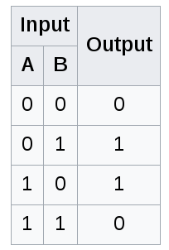
XOR (exclusive or operation)
0 == False
1 == True

Slide 5
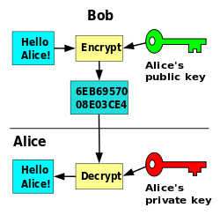
Asymmetric (Public Key)
One key to encrypt, one key to decrypt
  Keys are mathematically related
  Security based in hardness of factoring
  large prime numbers (NP-Hard)
  The discrete logarithm problem can also be used as a basis for asymmetric cryptography (research this)
Solves key sharing problem
Can be used for encryption/signatures/both
Can only encrypt a small amount of data [(key size in bits / 8) - padding]
Slow (computationally when compared to symmetric key algorithms)
EG: RSA

Slide 6
How RSA works
http://sergematovic.tripod.com/rsa1.html

Slide 7
Question
How can they be used together?
  Think about how SSL works :)

Slide 8

KMS: Key Management Service
Manages crypto keys for you (you don't need to understand cryptography well to use it securely)
  Handles key rotation/revocation
  Handles access control to keys (using “grants” and IAM)
  Provides a nice API for encrypting/decrypting
  Can encrypt up to 4K of data by itself (master key)
    Can generate data keys to encrypt more
Used by many other services (EC2, S3, RDS)
Under the IAM page in the console (make sure to set region)
  IAM → Encryption Keys

Slide 9

KMS access control for users
Key management
  Create/delete/rotate
  access management: update policies/grant/revoke
Key Use
  encrypt/decrypt/re-encrypt
  generate data key
Cross-account support

Slide 10

KMS for applications
Grants provide long-term finer-grained control
  restrict to specific principal
  optional encryption context (supplied by the client)
Application can provide Grant Token for faster access

Slide 11
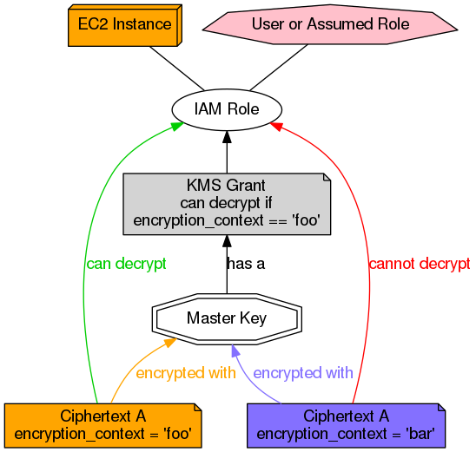
Encryption contexts and grants

Slide 12
KMS: encrypting/decrypting small data
Generate master key (with policies/grants)
  returns key ID and/or alias
Call Encrypt API with your plaintext, get back a ciphertext blob
  Blob includes key reference (you don't need to pass in the key ID when calling the Decrypt operation)
Authorized users call Decrypt API with ciphertext blob
  Returns plaintext

Slide 13
KMS: encrypting/decrypting large data
Max of 4KB per master key (explained earlier)
Generate data key
  Returns plaintext and enciphered versions of the same key
Encrypt large data with plaintext key
  Then throw away plaintext key
Store encrypted data and ciphertext of key together
Pass ciphertext of data key to Decrypt API (policy/grant controls)
  It will be decrypted by the master key
  Returns plaintext of data key
Use decrypted data key to decrypt data

Slide 14

KMS: Integration with AWS services
S3
EBS
RDS (actually using EBS underneath)
Etc.

Slide 15

KMS caveats
Keys can deleted, but only after a (minimum) 7-day cooling-off period
Don't rely on encryption context to authenticate non-AWS applications
  fine for grants against S3, for example
AWS uses default per-region key if you don't specify
Grants may not become active instantly
  use Grant Tokens to work around this

Slide 16
A Final Caveat
The master keys can never be extracted from within KMS (as they are stored in a Hardware Security Appliance).
This means if your app secures customer data with KMS you are coupling yourself to AWS.
If you want to move to another cloud you can take the ciphertexts with you, but you will not be able to decrypt them outside of AWS!
Read this to better understandhttps://docs.aws.amazon.com/kms/latest/developerguide/importing-keys.html

Slide 17
KMS hands-on
Follow the hands-on steps in …/kms/hands-on.md

