Slide 1

Amazon Web Services
Route53 Azam Rupani Systems Engineer (Residential LoB)
AWS – Route53 – Jun 2017

Slide 2
What is DNS
The Domain Name System is a hierarchical, decentralised naming system for the internet.
DNS maps names to IP addresses (and vice-versa).
Domain name resolvers determine the name servers responsible for the domain in question by a sequence of queries starting from the root.
Root servers are well known and ran by large ISPs under the supervision of ICANN.

Slide 3
Hierarchy
The root name servers are responsible for delegating authority over all top level domains (such as com, net, au) to their respective registry.
These registries are then responsible for that namespace and may delegate the duties of name registration to one or more commercial registrars (almost all do).
Depending on the domain, you can then register your own name at the second level (eg: something.com) or at a lower level (eg: something.com.au).
Authority for this domain is now yours, you must provide your own name servers (minimum of two) which will answer for the records you create (eg: test.something.com).

Slide 4
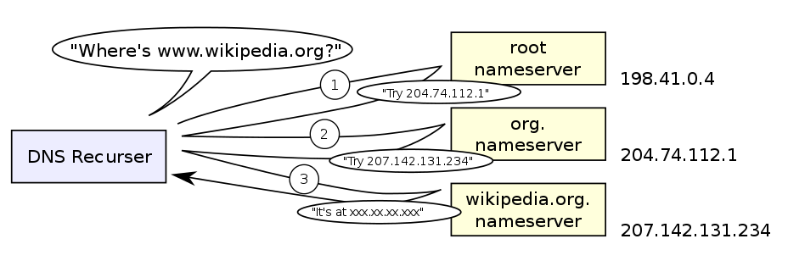
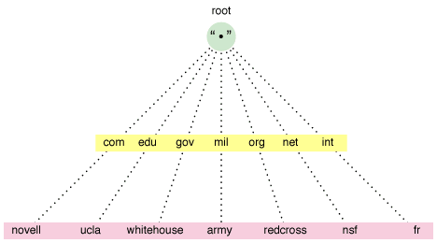
Illustration

Slide 5
Record Types (Most Common)
A – Maps name to IP address (IPv4).
AAAA – Maps name to IP address (IPv6).
CNAME – Maps a name to another name.
MX – Maps a name to the IP of a mail transfer agent.
NS – Delegates authority of a zone to a name server.
SOA – Specifies information about a zone.
TXT – Arbitrary text (often used for authentication).
PTR – Maps IP address back to Name.

Slide 6
Lookup Tools
Dig
[$] dig A +short google.com
Host
[$] host www.realestate.com.au

Slide 7
What is Route53
Public DNS (Resolvable on Internet)
Private DNS (Resolvable within VPC Only)
Domain Name Registration
Advanced Features
Health check capability (HTTP, HTTPS, TCP)
Simple, Weighted, Latency, Failover, Geolocation

Slide 8
Integration with CloudFormation
Cannot Register Domain Names
Can Manage
Addition/Deletion of Resource Records
Creation of DNS Zones
Creation of Health checks
All of our Cloud Infrastructure must be in CloudFormation

Slide 9
Route53 Console Overview & Question/Answer Time

