Slide 1

Amazon Web Services
Simple Storage Service (S3) Azam Rupani Systems Engineer (Residential LoB)
AWS - Simple Storage Service (S3) – Jun 2017

Slide 2

S3 Intro
Storage Solution
Launched - March 14, 2006
One of the secure, mature and reliable AWS services
Content is grouped and stored in:
S3 Buckets

Slide 3
S3 Intro (Cont..)
Popular and widely used service
Likes of Netflix, Dropbox, Tumblr
Example REA Use Cases are:
Property Images
Hipster Batch
Async Data Sharing between Systems
Static Websites

Slide 4
Quick Facts
Maximum File Size: 5TB
Largest Object in a Single Put: 5GB
Multipart Upload Facility Available
Object Store, not Filesystem
Buckets and their limitations:
Name constraints, account limits
Notes:
http://docs.aws.amazon.com/AmazonS3/latest/dev/BucketRestrictions.html

Slide 5




Why its so useful
Natively Integrates with other AWS Services
Lambda
CloudFormation
CloudFront
API Gateway
SNS
Notes:
The reason why its so useful is because of its tighter integration with other AWS products

Slide 6
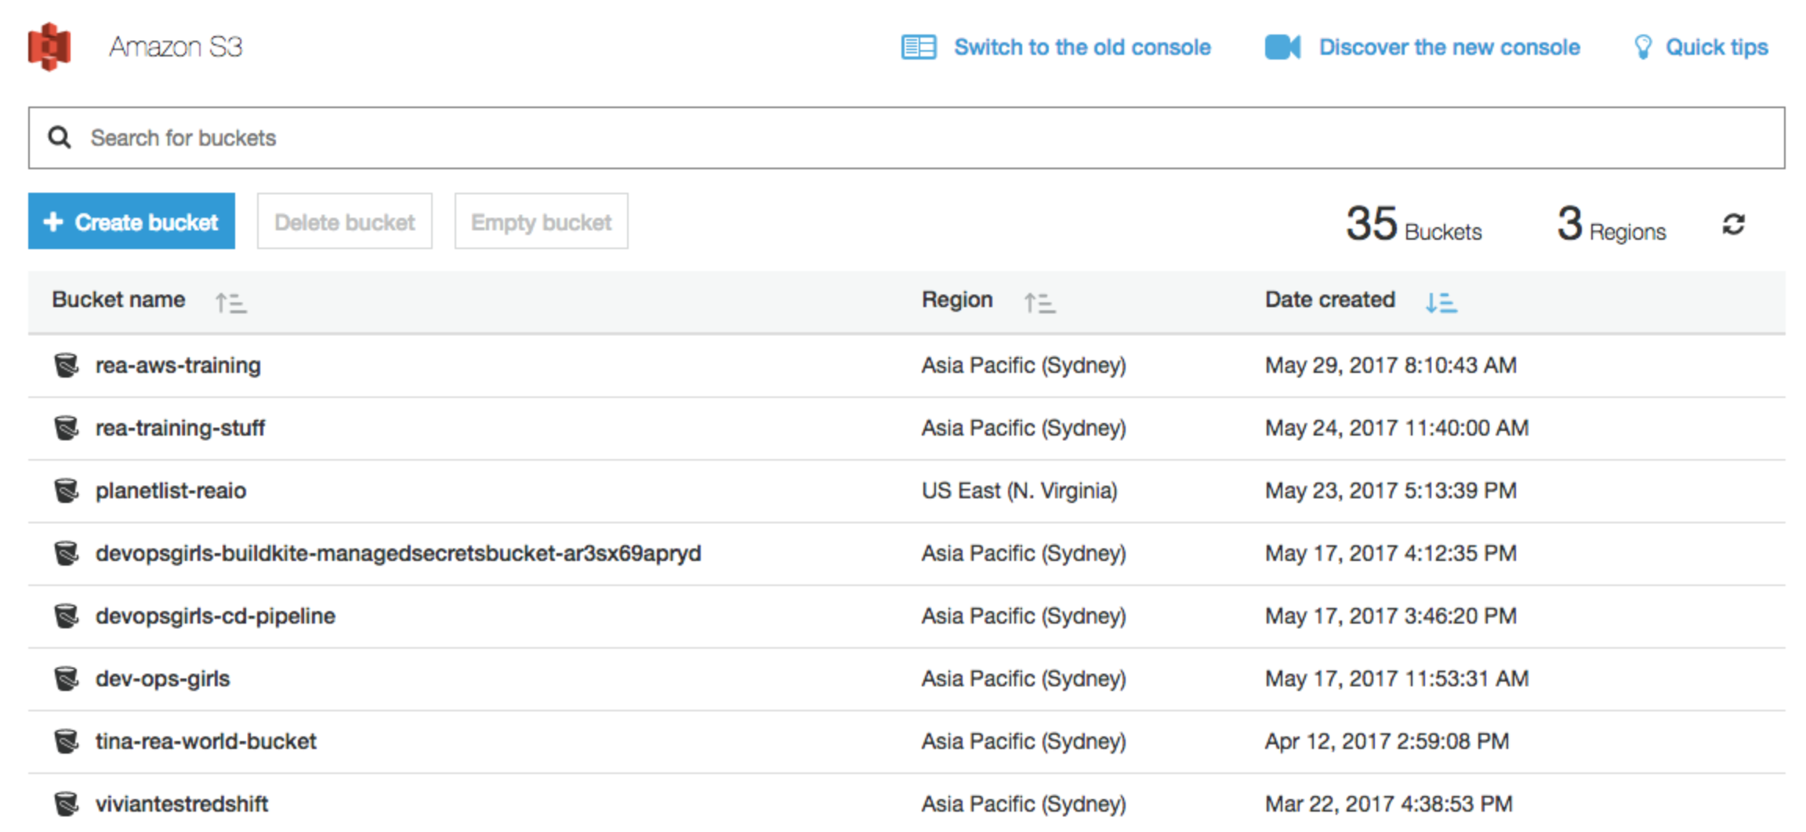
Console Sneak Peak

Slide 7
S3 Storage Classes
Storage Classes
Standard
Standard (Infrequent Access)
Reduced Redundancy
Association on Object Level
Class you choose defines cost and durability
Notes:
Choice mainly affects durability, fault tolerance and cost

Slide 8
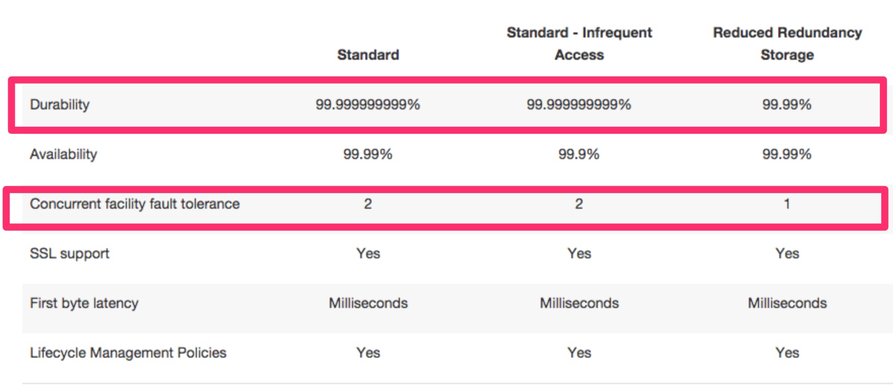
S3 Storage Classes
Notes:
Choice mainly affects durability, fault tolerance and cost

Slide 9
S3 Glacier
AWS service providing low cost storage solution for archival purpose (logs, backups)
Storage costs 80% cheaper than S3 Standard in ap-southeast-2 region
Same durability as S3 standard, but no SLAs around availability
Minimum Storage Duration: 90 days
Retrieval Costs:
Retrieval policies regulate how soon to get the data and how much it would cost

Slide 10
S3 Costs
Storage Costs
Depends on the storage class you choose
Data Transfer Out Cost
No of Requests Cost
Archival Retrieval Requests (For Glacier Only)
Prices vary by region
Notes:
https://aws.amazon.com/s3/pricing/

Slide 11
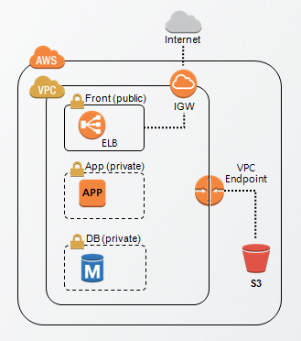
VPC Endpoints
VPC component allowing interaction with S3 without traversing the internet
Can be useful to reduce data transfer costs to/fro S3 from within AWS ecosystem.
Can apply IAM Policies to control access

Slide 12
Lifecycle Policies
Policies which can be defined to:
Automatically change object class
Transition objects to glacier
Delete objects from S3 buckets
Helps ensure S3 sanity and reduce cost

Slide 13

Security & Access Control
Leverage IAM Roles
Bucket Policies
ACLs
Legacy access control, predates IAM
Still can be used, but shouldn’t be
Versioning and MFA Delete
Notes:
https://aws.amazon.com/blogs/security/iam-policies-and-bucket-policies-and-acls-oh-my-controlling-access-to-s3-resources/

Slide 14

S3 Bucket Policy Example
{
"Version": "2012-10-17",
"Id": "S3PolicyId1",
"Statement": [
{
"Sid": "IPAllow",
"Effect": "Allow",
"Principal":{"AWS":"arn:aws:iam::1234567890:root"}
"Action": "s3:GetObject",
"Resource": "arn:aws:s3:::examplebucket/*",
"Condition": {
"IpAddress": {"aws:SourceIp": ”203.17.253.249/24”}
}
}
]
}
Notes:
https://aws.amazon.com/blogs/security/iam-policies-and-bucket-policies-and-acls-oh-my-controlling-access-to-s3-resources/

Slide 15

Versioning and MFA Delete
Versioning can be enabled on bucket-level
Multiple versions of the same object is stored
Any version is accessible and restorable to the main version
Can provide easy rollback
Additional cost
MFA Delete
Needs versioning turned on
Only person with root credentials and MFA device can permanently delete an object version
Notes:
https://aws.amazon.com/blogs/security/iam-policies-and-bucket-policies-and-acls-oh-my-controlling-access-to-s3-resources/

Slide 16

Encryption
Server Side Encryption for Data at Rest:
SSE-S3
Each Object Encrypted with its Own Key managed by AWS
SSE-C
Clients provide Encryption Keys
SSE-KMS
Integrates with and Inherits benefits from KMS, like Key Rotation
OR
If the situation demands, you can use your own keys, encrypt and upload data to S3
Note: Server-side encryption encrypts only the object data. Any object metadata is not encrypted.

Slide 17
Static Website Endpoint
S3 provides built in support at bucket-level for hosting static websites
Reliability
Durability
Cost Effectiveness
Low Maintenance Overhead
Downside
No HTTPS Support by default, use Akamai or CloudFront to work around it ☺.
Sample URLs
http://<bucket>.s3-website-<region>.amazonaws.com
http://<dns-compliant-bucketname> (If CNAME/Alias to above address exists in DNS)

Slide 18
S3 Web Console Feature Overview & Question/Answer Time

