Slide 1
REA AWS Training
Part 3
VPCs

Slide 2

Intro to VPCs
What is it? Why use it?
  VPCs the REA Way
Access Control with:
  Subnets ; Good Subnetting Patterns
  ACLs & Security Groups
  Routes (Traffic control)
Let's take a birds eye view of VPC in REA (shared account)...
Also:
  VPC Interconnectivity
  Good patterns for VPC connectivity
  CIDR 101 (?)
Notes:
Things to cover:
- What is it?
- Why have one?
- Access control within VPC
- VPCs in REA
- VPC Interconnectivity
- Good patterns for VPC Interconnectivity
- CIDR 101 (?)
## (WAIT) Birdseye view of VPC in REA….

Slide 3
















VPCs
the
REA Way
NAT ACLs
NAT subnet
Public ACLs
Public subnet
Public ACLs
Public subnet
NAT ACLs
NAT subnet
Private Subnet
Private Subnet
Templated
Resilient
Good Security Practice
Availability Zone A
Availability Zone B
Notes:
Don't freak out if you don't understand it yet!
Example VPC set up in a shared prod account:
- Captured in cfn template (see 'Resources' slide)
Why this way?
Because it's Resilient:
- we have instances in multi AZ
- ELB's to load balance traffic
- ASGs to ensure adequate service availability
Also a good Security Practice.
- @danx advocates a tiered VPC structure in his 'AWS Sec Good Practices' doc
Here's a simpler model….

Slide 4
 | IGW
 | VGW
 | PCX
VPC -Take #2:
Your own private network
Your own set of RFC1918s
VPCs only (no more ec2-classic)
Components
  Subnets
  Gateways and Peering Connections
  NACLs and Security Groups
  Routes
NAT ACLs
NAT subnet
Public ACLs
Public subnet
 | Route
 | EIP
Private Subnet
 | ASG
 | R53
 | instances
 | ELB
Availability Zone A
Notes:
Simple view of our VPC:
- VPC = our own private network, logically separated from other private networks (similar to your home network LAN)
- better alt to ec2-classic
- some of the vulns in pocket were due to ec2-classic use
- Organise VPC inhabitants using subnets
- to give different levels of access to things
- How do we reach stuff outside the VPC?
- via Gateways
- types of Gateways
- Secure VPC using NACLs and Security Groups
- Define routes to get from point A to B

Slide 5
VPC Interconnectivity
Interacting with the outside world...
IGW
VGWs – H/W & S/W VPN types
Peering Connections
Elastic IP vs “public” IP
More on role of ELB later...
 | IGW
 | VGW
 | PCX
 | ELB
 | EIP
Availability Zone A
Notes:
- How do we reach stuff outside the VPC?
IGW for Internet access
- subnet's rtb has a dest entry for IGW (pub subnet)
- instance in subnet need a EIP or Public IP
- NACL and sg rules set up to allow traffic flow
VGW for access to EQX DC
- same as above, with a dest entry for VGW in rtb
PCX for access to other (AWS) VPCs
- not recommended (more on that later)
EIP's vs Public Ips:
- EIPs are persistent, you get to keep ip

Slide 6
Subnets
Why?
  So we can apply layered access control
Good Patterns ...
Private Subnets
  NO direct internet access
  Should NOT have direct access to DC
  Should NOT have direct access to other VPCs
Public Subnets
  Should only have Public ELBs
  Maybe NAT instances ; Maybe Bastions
NAT vs Services vs Internal
How big is a subnet?
  /24s are common (254 addresses)
  Learn you some CIDR notation
NAT Subnet
Public Subnet
Private Subnet
Availability Zone A
Notes:
Why are there different subnets?
- to give different levels of access to things
- create groupings by: type of service, level of access
Private subnet (store app servers here)
- NO igw entry in rtb, so no direct access to internets
- assoc. priv instances to pub elbs
- NOT recommended to give direct access to DC/VPCs
- assoc. priv instances to int elbs in Services subnet
Public subnet
- igw entry in rtb, so accessible to internet
- public elbs (and maybe NATs and bastions) only
Others (optional):
- NAT
- Services (put an entry for vgw in rtb)
- Internal (VPC2VPC) - put entries for pcx in rtb)
Define subnet size using CIDR Notation:
Ipcalc - tool to translate CIDR notation

Slide 7
NACLs & Security Groups
(N)ACLs - Access Control for Subnets
  Use for 'coarse grain' access control (applied to ALL instances/ELBs within subnet)
  One ACL can be associated to Many subnets
  A subnet can ONLY be associated to One ACL
Security Groups – Access Control for instances/ELBs/ENIs
  Use for 'fine grain' access control (applied to ONLY associated instances)
  One SG can be associated with Many instances/ELBs/ENIs
  One instance/ELB can ONLY be associated with One SG
  Can assoc. up to 5 SGs with ENIs
N.B:
  ACL rules are stateless (explicitly define in/out bound rules)
  SG rules are stateful – return traffic automatically allowed
  eg. you have to define in/out ephemeral port access rules in NACLs, but not in SGs
Notes:
- A layered approach to security
- pattern here is 'layered security' and apply least privs at each layer
Question:

Slide 8
NACL Example
Security Group Example
Notes:
Route

Slide 9
Routes for Traffic control
How to get from A to B?
  Talk to the Router – it has route tables for all your subnets!
  1 router & 1 default route table free to each VPC; free to define your own tables.
Associate a subnet with a route table (1:1 subnet:rtb association)
What's in a route table
  Destination CIDR match–to-target lookup table
  Target can be one of: IGW/VGW, PCX, nat instance, ENI

Slide 10
Routing Example: Getting to the Internets
8.8.8.8
Private Subnet Route Table
NAT ACLs
NAT subnet
Public ACLs
Public subnet
Destination | Target
10.33.0.0/16 | local
0.0.0.0/0 | eni-781c631d / i-91620b5e
172.16.0.0/12 | vgw-98f0c085
Private Subnet
NAT Subnet Route Table
Destination | Target
10.33.0.0/16 | local
0.0.0.0/0 | igw-a8967bcd
Availability Zone A
Notes:
These examples assumes:
- NACLs and SG are configured to allow traffic
- You have a Private and NAT subnet

Slide 11
Routing Example: Getting to the EQX DC
NAT ACLs
NAT subnet
Public ACLs
Public subnet
Private Subnet Route Table
Destination | Target
10.33.0.0/16 | local
0.0.0.0/0 | eni-781c631d / i-91620b5e
172.16.0.0/12 | vgw-98f0c085
Private Subnet
What happens in the DC is beyond the scope of this module…
Availability Zone A
172.25.48.3

Slide 12
Troubleshooting Network Access Issues
Check instance's SG rules
Check NACL and RTB of instance's subnet
    Remember NACL rules are stateless!
If connecting to DC via VGW:
    Use logstash.eqx.realestate.com.au to troubleshoot firewall issues in DC
If connecting to another VPC via PCX:
    Ensure NACL, RTB and SG of other end is properly configured
Call GIA
Useful tools: ping, netcat, tcpdump, ...
Notes:
Other useful tips:
- Check RTB to ensure that there are appropriate entries for gateways and pcx
- Having access to NAT is useful when troubleshooting internet access for private subnet

Slide 13
Patterns for VPC Connectivity
Consider Pros and cons of different connection types:
Connection type | Pros | Cons
VPC Peering | Easy to setup Only involves VPC owners | Hard to Secure (it's a fat pipe) Implies trust in security standards of VPC Peer(s); region specific
Notes:
Why we should avoid creating more PCX's:
With PCX's, we are trusting the level security of the peering VPC.

Slide 14
Patterns for VPC Connectivity
Consider Pros and cons of different connection types:
Connection type | Pros | Cons
VPC Peering | Easy to setup Only involves VPC owners | Hard to Secure (it's a fat pipe) Implies trust in security standards of VPC Peer(s); region specific
VPN/Direct Connect | Direct Connect offers high bandwidth links; VPN connections not region specific | Cost/Effort to setup Direct Connect is region specific
Notes:
Why we should avoid creating more PCX's:
With PCX's, we are trusting the level security of the peering VPC.

Slide 15
Patterns for VPC Connectivity
Consider Pros and cons of different connection types:
Connection type | Pros | Cons
VPC Peering | Easy to setup Only involves VPC owners | Hard to Secure (it's a fat pipe) Implies trust in security standards of VPC Peer(s); region specific
VPN/Direct Connect | Direct Connect offers high bandwidth links; VPN connections not region specific | Cost/Effort to setup Direct Connect is region specific
SSL (over Internet) | Uses https port; no need to poke more holes in security | Application needs retooling to work with SSL connections
Notes:
Why we should avoid creating more PCX's:
With PCX's, we are trusting the level security of the peering VPC.

Slide 16
Patterns for VPC Connectivity
Consider Pros and cons of different connection types:
Connection type | Pros | Cons
VPC Peering | Easy to setup Only involves VPC owners | Hard to Secure (it's a fat pipe) Implies trust in security standards of VPC Peer(s); region specific
VPN/Direct Connect | Direct Connect offers high bandwidth links; VPN connections not region specific | Cost/Effort to setup Direct Connect is region specific
SSL (over Internet) | Uses https port; no need to poke more holes in security | Application needs retooling to work with SSL connections
Hipster Batch (asynchronous pub/sub using s3 buckets, over SSL) | Decouples processes that consumes/produces. | Application needs retooling to work asynchronously
Notes:
Why we should avoid creating more PCX's:
With PCX's, we are trusting the level security of the peering VPC.

Slide 17
VPCs
the
REA Way
NAT ACLs
NAT subnet
Public ACLs
Public subnet
Public ACLs
Public subnet
NAT ACLs
NAT subnet
Private Subnet
Private Subnet
Resilience
Drop things in
Templated
Availability Zone A
Availability Zone B
Notes:
Resilient because:
- we have instances in different availability zones
- ELB's to load balance traffic
- Autoscaling groups to ensure adequate service

Slide 18
VPC hands-on
Create VPC stack
Launch example app stacks using parameters for subnets
Poke public endpoints, try to reach private app servers
Don't delete app stacks – we'll use them in the next bit

Slide 19
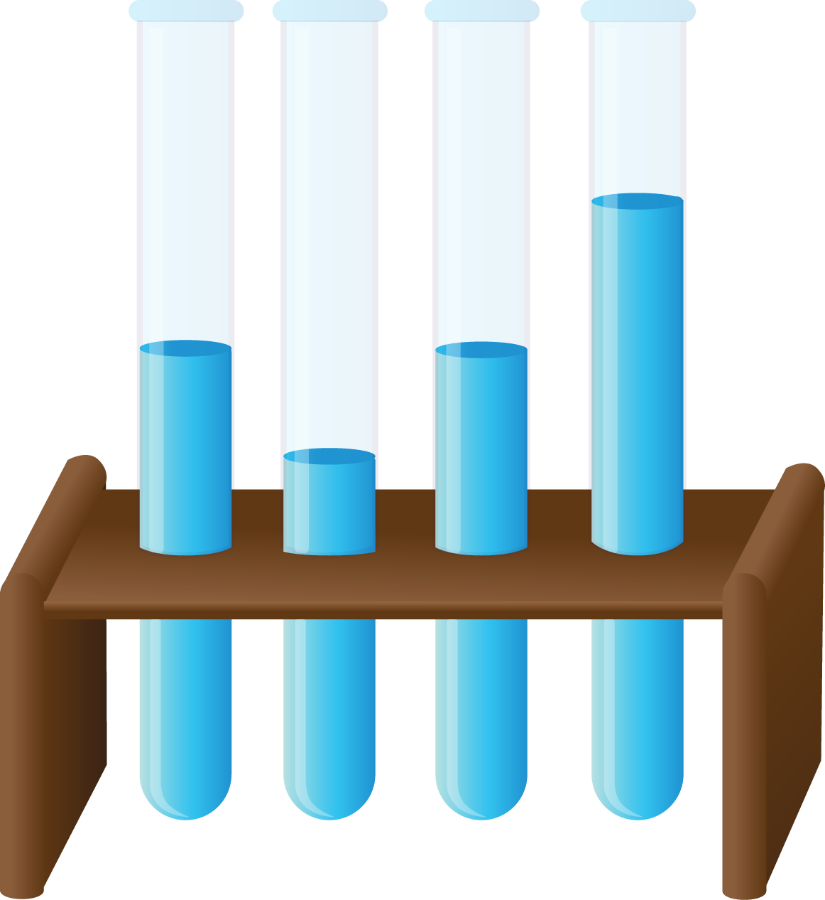
LUNCH!
LUNCHES!

