Slide 1
REA AWS Training
Application Services
SNS, SQS, Kinesis

Slide 2

Application Services: SNS
Simple Notification Service
Public Access Endpoint, Regional Service
One-to-many (broadcast)
Messages are not persisted
Messages delivered to many kinds of endpoint
  HTTP(S), SQS, email, SMS (USA only)
  Mobile push (iPhone, Android, Baidu, Windows, Amazon)
  Android devices in China with Baidu Cloud Push
  Lambda functions
  OSX VoIP/Desktop push on iOS devices

Slide 3

SNS continued
Publish message to the topic; no addressing required
Subscribers “listen”
Good for parallel processing, and decoupling services
SNS formats messages appropriately for the subscription
Scales to millions of messages/day; up to 256KB/message
AWS services use SNS: CloudFormation, CloudWatch, AutoScaling, S3, CloudTrail…
Topic policies determine who can publish,
subscription types, etc
Price: USD $0.50 per million publishes,
and $0.50 per million deliveries plus
associated data transfer

Slide 4

Application Services: SQS
Conventional Message-Queue service without ordering garuntee
Public endpoint, regional service
Many-to-one-of-many, with time limited locking
  prevent multiple readers processing a message
Messages up to 256KB
Delayed delivery possible

Slide 5

SQS continued
Excellent for decoupling components
Message lifetimes: default 4 days
Dead Letter Queue for messages that could not be delivered N times
  DLQ must be in same region as main queue
Possible to purge a queue all at once
Queue policies determine who can publish/
read/delete etc

Slide 6

Kinesis - Introduction
High-throughput, low-latency streaming framework
A gateway of a big data solution
Use cases
  website clickstreams
  financial transactions
  social media feeds
  Logs
  IoT data

Slide 7
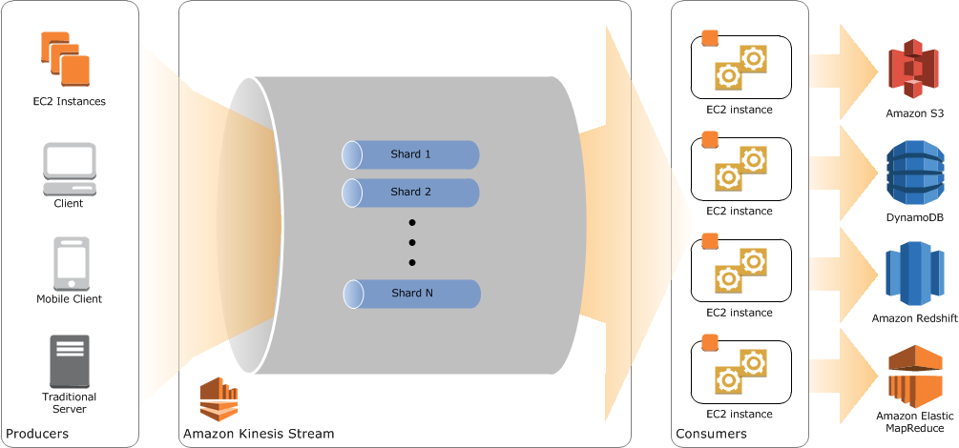
Kinesis – concepts
Use of “shards” to scale out/in with capacity demands
Each stream can scale to more than
one shards
Records are in order in
the same shard
  like a sequencial queue
Records default
persist 24 hours, Max
7 days

Slide 8
Kinesis – Applications
Amazon Kinesis Streams
  Use custom applications that process or analyze streaming data
  The KCL simplifies stream processing and provides help with fault tolerance. Developer can focus on the business logic.
Amazon Kinesis Firehose
  Pump records straight into other AWS services like S3, ElasticSearch, RedShift
Amazon Kinesis Analytics (beta)
  Use SQL to analysis Stream data

Slide 9
Kinesis – limits and pricing
Default to 25 shards in ap-southeast-2 region
Maximum size of a data blob up to 1MB (before base64)
Each shard max 5 TPS read (2MB/sec), 1000 rec/sec write (1MB/sec)
  Example: 1 stream with 4 shards = 337GB/day
Pricing per shard-hour + PUT units of 25KB each
  $0.0184 per shard-hour, $0.0195 per 1,000,000 PUTs, $0.025 per extended shard-hour

Slide 10

Application services hands on
SNS → SQS
CloudWatch → SNS
CloudFormation notification ARNs

Slide 11

BREAK
BREAK!

