Slide 1
REA AWS Training
Advanced CloudFormation

Slide 2
Advanced CloudFormation: EC2
UserData
  shell scripts
  cloud-init directives
Metadata attributes
cfn-init
cfn-hup
Wait Conditions
Custom Resources

Slide 3
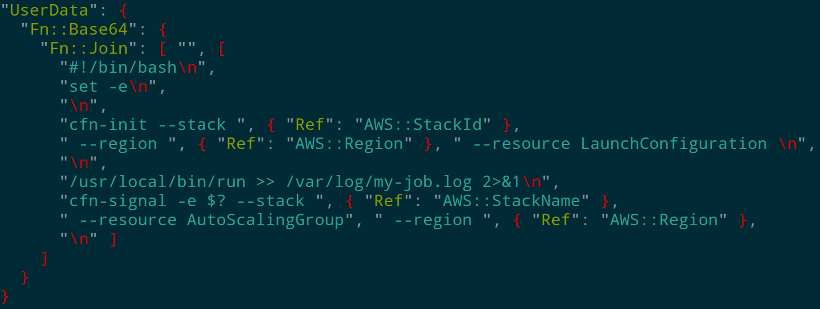
Advanced CloudFormation: UserData

Slide 4
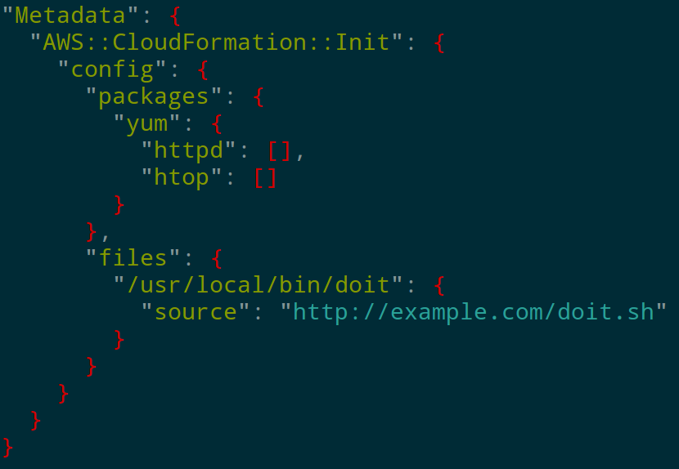
Advanced CloudFormation: Metadata

Slide 5
Advanced Cloudformation: cfn-init
Reads MetaData – AWS::Cloudformation::Init
Installs packages
Creates content on disk
Enable/Disable & Start/Stop services

Slide 6
Advanced Cloudformation: cfn-hup
Runs daemonized
Watches for stack changes
Runs hooks when changes are detected

Slide 7
Advanced Cloudformation: WaitConditions
Custom “timeouts” for stack creation
Useful when a startup process on an instance might be considered failed after “some time”
Can require more than one success to complete, useful for ASGs
cfn-signal

Slide 8
Advanced CloudFormation: Custom Resources
Allow CloudFormation to act outside of the stack
aws-cfn-bridge
Requires external listener somewhere
  Can be a Lambda function! (we will use an EC2 though)
SNS topic for communication
REA is using this now
  AWS API interaction
  DNS updates for myfun.com

Slide 9
Advanced Cloudformation hands-on
…/rea-aws-training/custom-resources/hands-on.md
Use the supplied templates to create 2 stacks, in order:
  resource-runner stack (processes custom resource messages)
    shows WaitCondition, Instance Roles, UserData, Metadata and cfn-init
  ami-lookup.json
    shows CustomResource use
Check out how things work; pretty sweet, eh?

Slide 10

That's all folks!
It's over! Go home!

